Slide 1
UNIT - IV
MULTIPLE ACCESS TECHNIQUES
FOR WIRELESS COMMUNICATIONS

Slide 2
CONTENTS
Introduction to Multiple Access Technique-MA
Frequency Division Multiple Access -FDMA
Time Division Multiple Access -TDMA
Code Division Multiple Access - CDMA
Space Division Multiple Access - SDMA

Slide 3
MULTIPLEXING
Multiplexing- a method by which multiple analog or digital signals are combined into one signal over a shared medium,
A number of signals were combined to send through a single cable. The process of multiplexing divides a communication channel into several number of logical channels, allotting each one for a different message signal or a data stream to be transferred. The device that does multiplexing, can be called as a MUX.

Slide 4
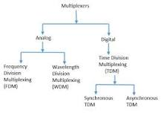
TYPES OF MULTIPLEXING
There are mainly two types of multiplexers analog and digital. If the analog signals are multiplexed, then it is called as analog multiplexing. If the digital signals are multiplexed, then it is called digital multiplexing.

Slide 5
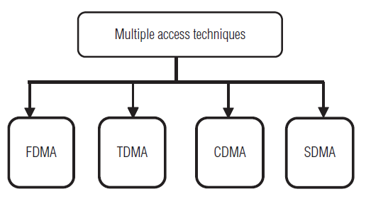
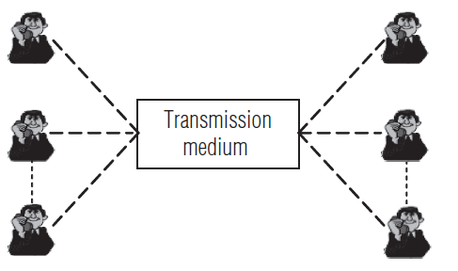

Multiple Access Techniques - Introduction
Cellular systems divide a geographic region into cells, where a mobile phone in each cell communicates with a base station.
The main objective of cellular systems design is to handle as many calls as possible (i.e., capacity) in a given bandwidth with reliability.
The success of cellular network depends on the availability of the radio frequency spectrum. The radio frequency spectrum is a finite natural resource and has greater demands placed on it every day.
This finite resource is usually defined in terms of bandwidth.

Slide 6
To allow many mobile users to share simultaneously a finite amount of radio spectrum, in a most efficient way, various technologies have been developed and the goal behind these methods is to handle as many calls as possible in a given bandwidth (i.e.,call-handling capacity). This concept is called “multiple access”.
The choice of multiple access (MA) technology is to share the available scarce bandwidth efficiently among a large number of users which could significantly enhance or lower the service quality delivered to end users.

Slide 7
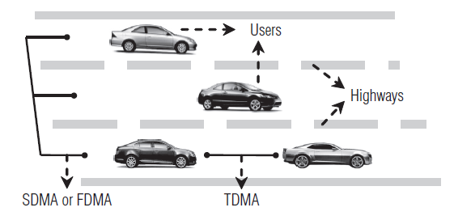
Multiple access techniques
The analogy of highway with several lanes (Figure) gives the simple example of multiple access methods such as SDMA, FDMA, and TDMA. In this figure, the medium is highway, the users are cars, and the interference is due to accidents.
SDMA – Space Division Multiple Access
FDMA – Frequency Division Multiple Access
TDMA – Time Division Multiple Access
CDMA – Code Division Multiple Access

Slide 8
What is the difference between multiple access techniques and multiplexing
Multiplexing, a method by which multiple analog or digital signals are combined into one signal over a shared medium. Multiple access, allows several terminals connected to the same transmission medium to transmit over a shared medium.

Slide 9
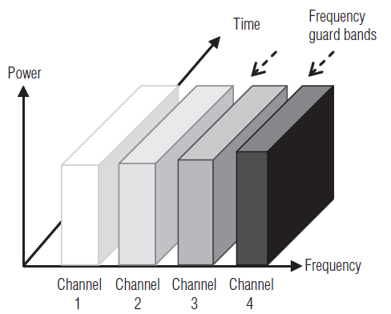
4.1 Frequency division multiple access-FDMA
The FDMA is the simplest scheme used to provide multiple access in analogue transmission. In FDMA systems, the radio frequency spectrum is divided into several frequency bands separated by a certain guard band. Each frequency band can be used simultaneously.
In this technique, the bandwidth is divided into a number of channels and distributed among users with a finite portion of bandwidth for permanent use as illustrated in Figure.
In this type of multiple access, we assign each signal a different type of frequency band (range). So, any two signals should not have same type of frequency range. Hence, there won’t be any interference between them, even if we send those signals in one channel.
In addition, we can observe from Figure is that FDMA permits only one user per channel because it allows the user to use the channel 100 percent of the time. Therefore, only the frequency “dimension” is used to define channels.
Frequency guard bands are provided between adjacent signal spectra to minimize crosstalk between adjacent channels.
In FDMA, the channel has two frequencies, namely forward channel and reverse channel.
When the FDMA technique is employed, as long as the user is engaged in “conversation,” no other user can access the same spectrum space.

Slide 10
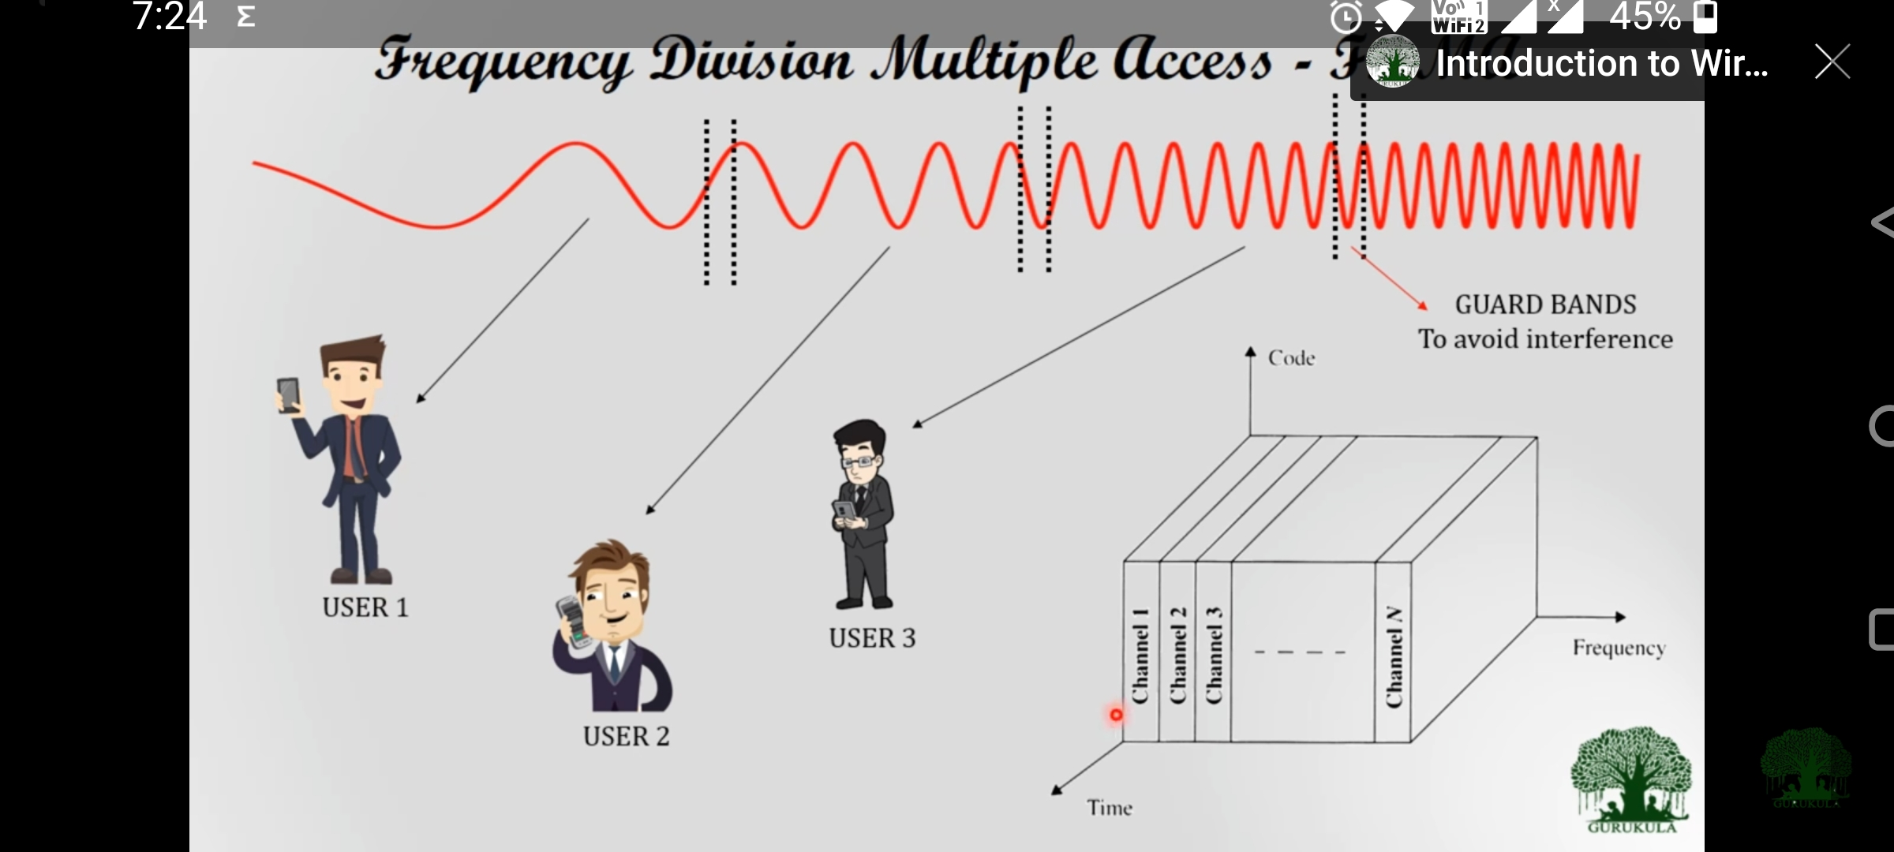

Slide 11
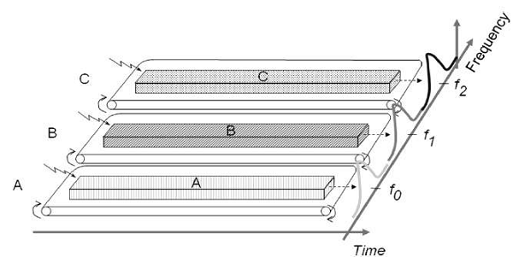
4.1 Frequency division multiple access-FDMA
One perfect example of this type of access is our radio channels. We can see that each station has been given a different frequency band in order to operate. Let’s take three stations A, B and C. We want to access them through FDMA technique. So we assigned them different frequency bands.
As shown in the figure, station A has been kept under the frequency range of 0 to 20 HZ. Similarly, stations B and C have been assigned the frequency range of 30-60 Hz and 70-90 Hz respectively. There is no interference between them.

Slide 12

Number of channels supported by FDMA system
where
  Bt is the allocated frequency spectrum
  Bg is the guard band allocated at the edge of frequency spectrum
  Bc is the channel bandwidth
  Advantages
  A continuous transmission scheme, and therefore of lower complexity than TDMA scheme, for example, synchronization requirements are not severe
  Simple to implement from a hardware standpoint, because multiple users are isolated by employing simple band pass filters – SIMPLE AND ROBUST
  Fairly efficient with a small base population and when traffic is constant
  No channel equalization required
  Capacity can be increased by reducing the information bit rate and using an efficient digital speech coding scheme

Slide 13
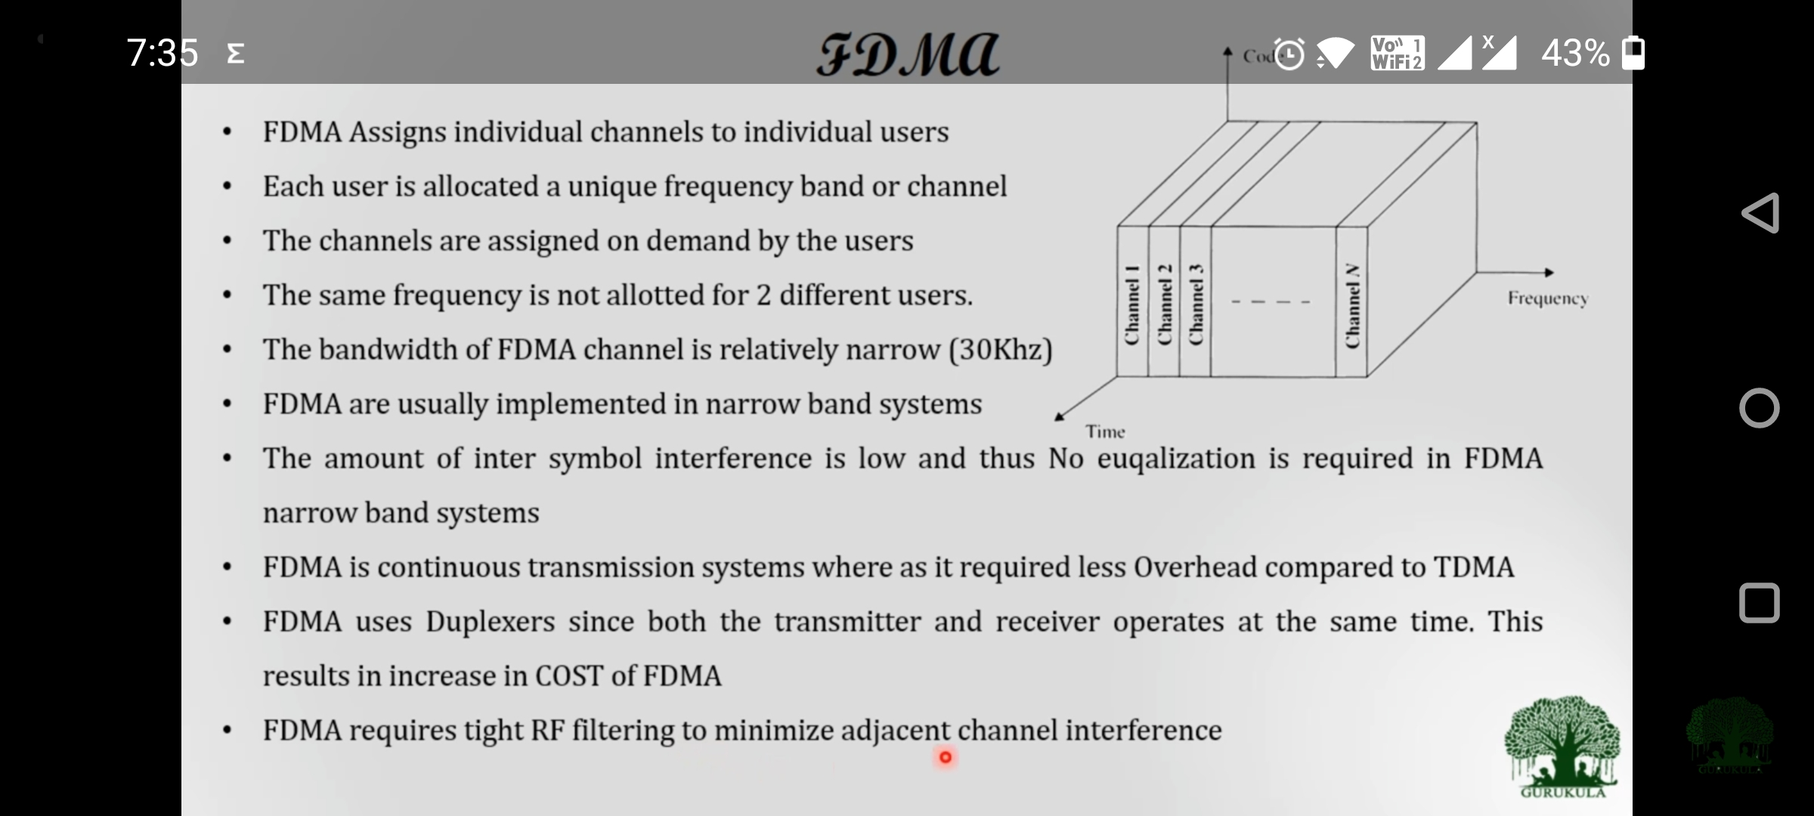

Slide 14
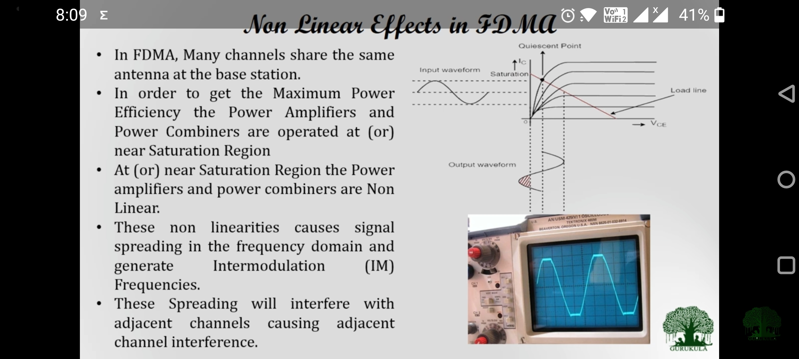

Slide 15
Disadvantages
  If an FDMA channel is not in use, then it sits idle and cannot be used by other users to increase or share the capacity. Therefore, FDMA implementation becomes inefficient use of spectrum.
  FDMA requires tight RF filtering to minimize adjacent channel interference.
  Network and spectrum planning are intensive.
  Frequency planning is time consuming.
  Even though no two users use the same frequency band at the same time, guard bands are introduced between frequency bands to minimize adjacent channel interference. Guard bands are unused frequency slots that separate neighbouring channels. This leads to a waste of bandwidth. When continuous transmission is not required, bandwidth goes wasted since it is not being utilized for a portion of the time.
  Doppler effect
Applications of FDMA
  Walkie-talkies and mobile networks for closed user groups often use FDMA.
  Another example of FDMA is AM or FM radio broadcasting, where each station has its own channel.
  Early cellular telephony mostly used FDMA analogue transmission.

Slide 16
In a FDMA system uses narrow bond of 600MHz for the users, calculate number of users can access the system with required BW of 200KHz each and if the guard band is 100hz.

Slide 17
4.2 Time division multiple access-TDMA
In digital systems, continuous transmission is not required because users do not use the allotted bandwidth all the time.
It allows several users to share the same frequency band by dividing the timescale into different time slots which are periodically allocated to each mobile user for the duration of a call.
TDMA systems have the capability to split users into time slots because they transfer digital data.
Digital 2G cellular systems that used the TDMA technology are GSM, IS-136, PDC, and DECT standard for portable phones.
TDMA systems divide the radio spectrum into time slots and each user is allowed to either transmit or receive in each time slots (i.e., different users can use the same frequency in the same cell but at different times).
In TDMA/TDD- single frame is used as a forward link for the half of the duration, and reverse link for the another half of the duration. In TDMA/FDD- two different frames are used for forward link and reverse link , but the carrier frequencies are different.
TDMA multiplexes three signals over a single channel. The current TDMA standard for cellular divides a single channel into six time slots, with each signal using two slots, providing a three to one gain in capacity over AMPS. Each caller occupies a cyclically repeating time slots.
In most of the cases, the entire system bandwidth for an interval of time is not assigned to a station. However, the frequency of the system is divided into sub-bands, and TDMA is used for the multiple access in each sub-band. Sub-bands are known as carrier frequencies. The mobile system that uses this technique is referred as the multi-carrier systems.

Slide 18
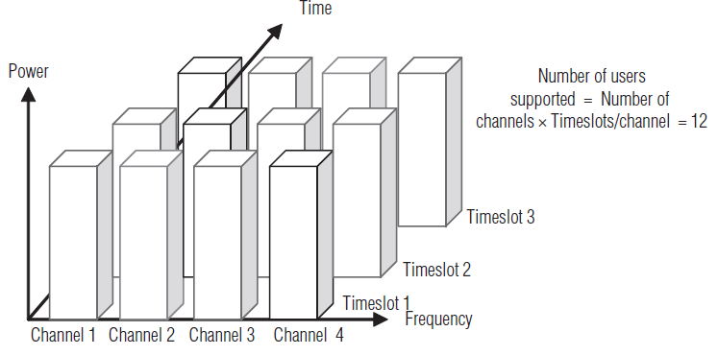
In TDMA, when the caller depresses the push-to-talk (PTT) switch, a control channel registers the radio to the closest base station. During registration, the base station assigns the user an available pair of channels, one to transmit and the other to receive.
However, unlike an FDMA system registration, a TDMA system registration also assigns an available time-slot within the channel. The user can only send or receive information at that time, regardless of the availability of other time-slots.
Information flow is not continuous for any user, but rather is sent and received in bursts.
The bursts are re-assembled at the receiving end and appear to provide continuous sound because the process is very fast.
Figure shows the principle of operation. Each row in the Figure represents a single channel and divided into three time-slots. Calls in a TDMA system start in analogue format and are sampled, transforming the call into a digital format. After the call is converted into digital format, the TDMA system places the call into an assigned time slot.
Dynamic TDMA is a TDMA variant that dynamically reserves a variable number of time slots in each frame to variable bit-rate data streams, based on the traffic demand of each data stream.
Number of users supported by the TDMA system
= Number of channels in the frequency spectrum ⋅ Time slots/channel

Slide 19
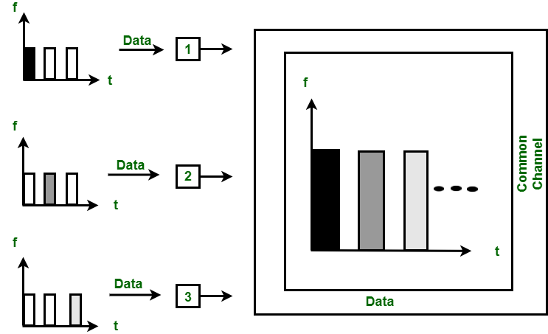

Slide 20
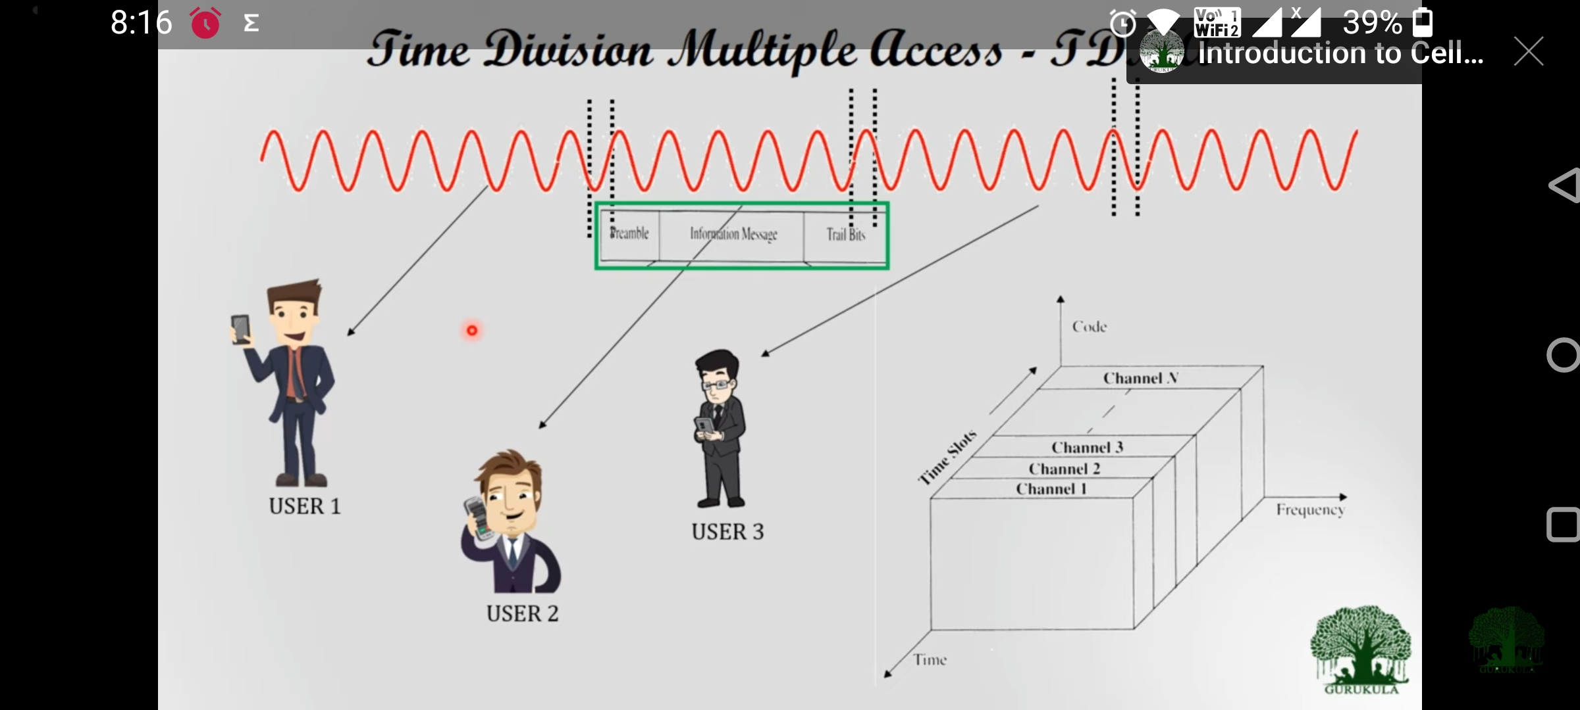

Slide 21
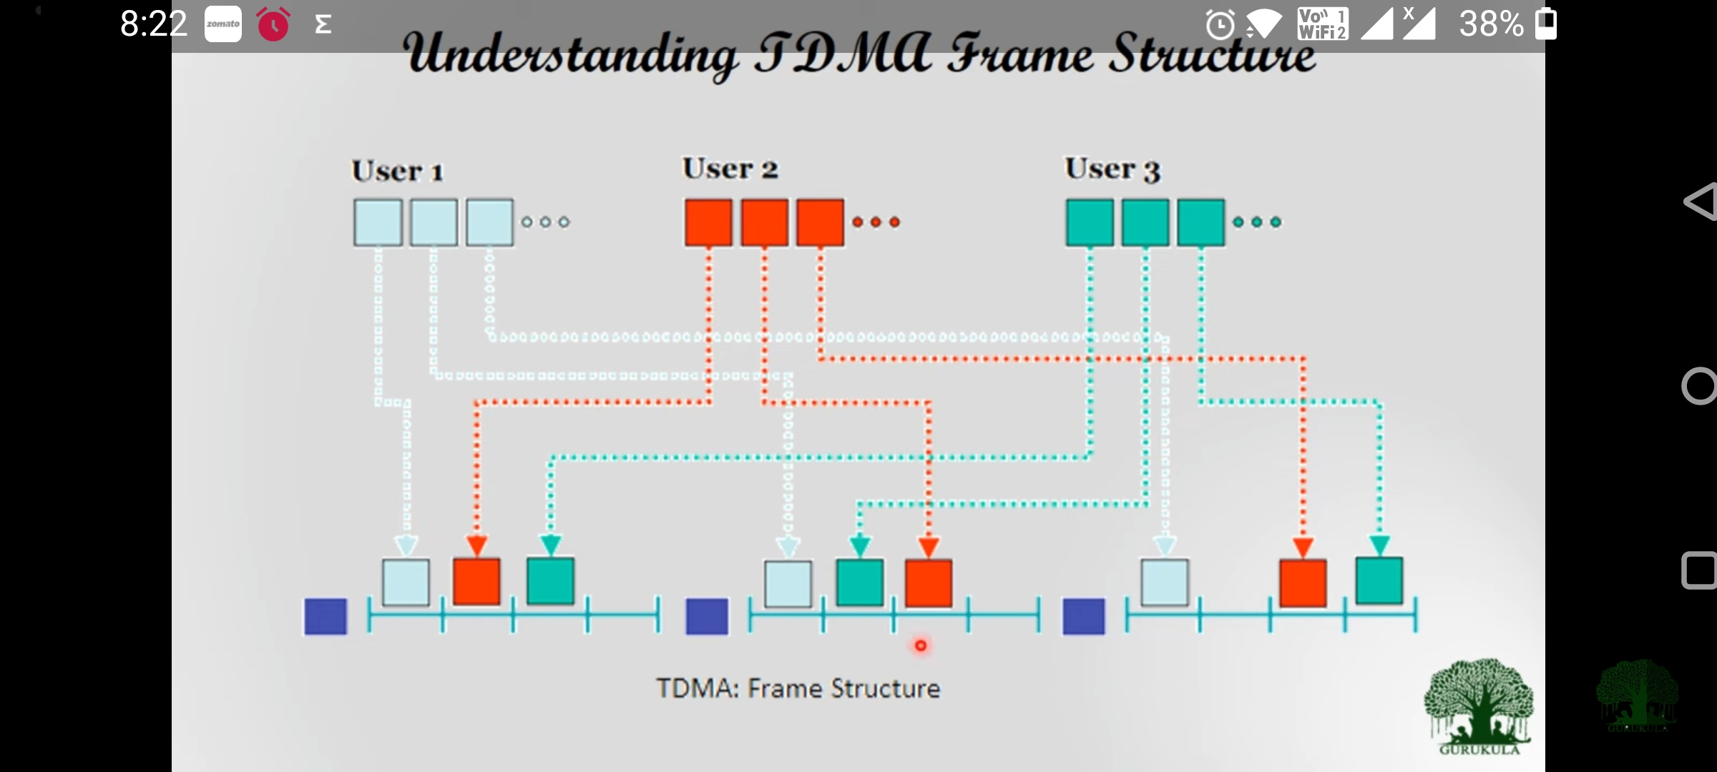

Slide 22
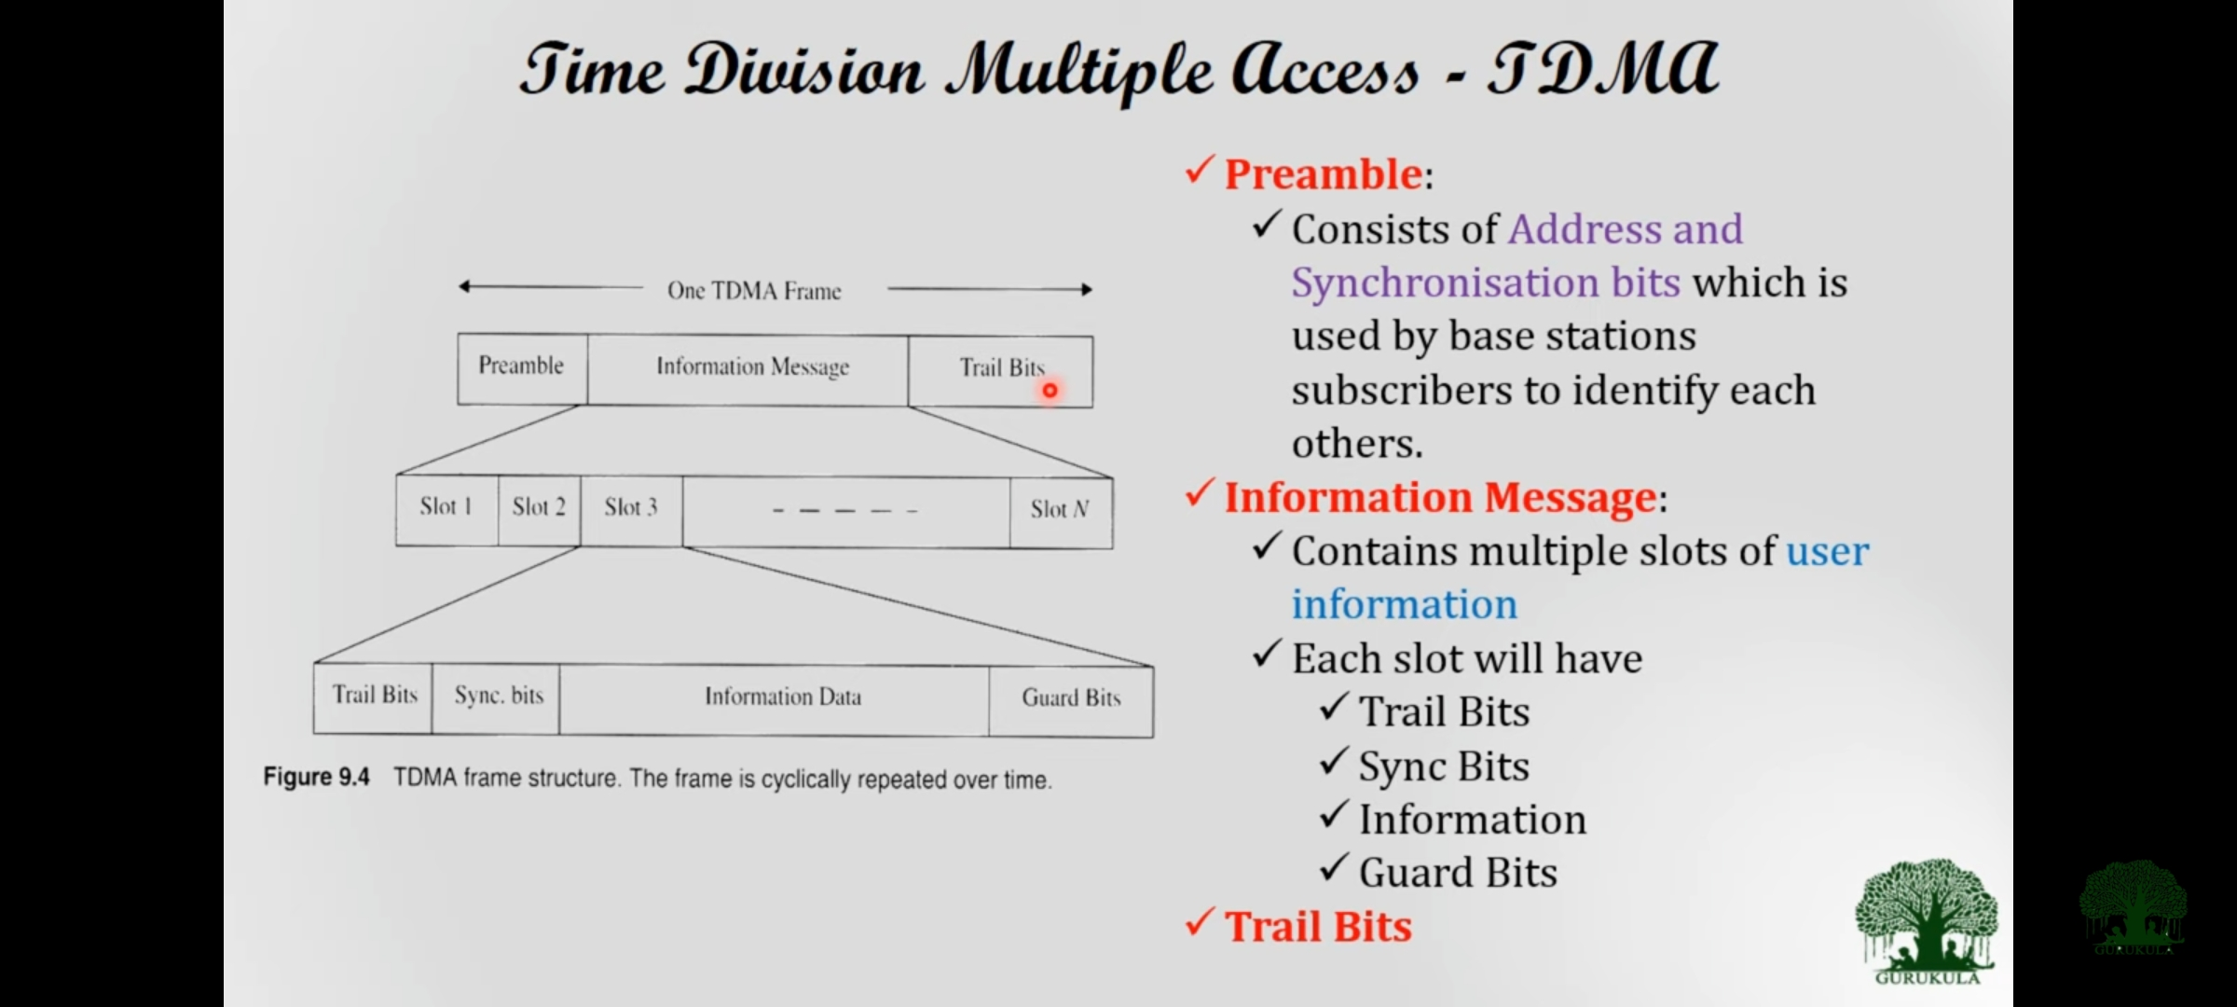

Slide 23
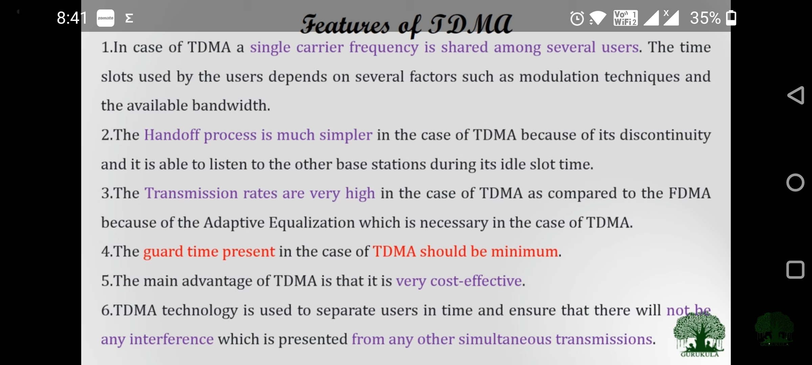

Slide 24
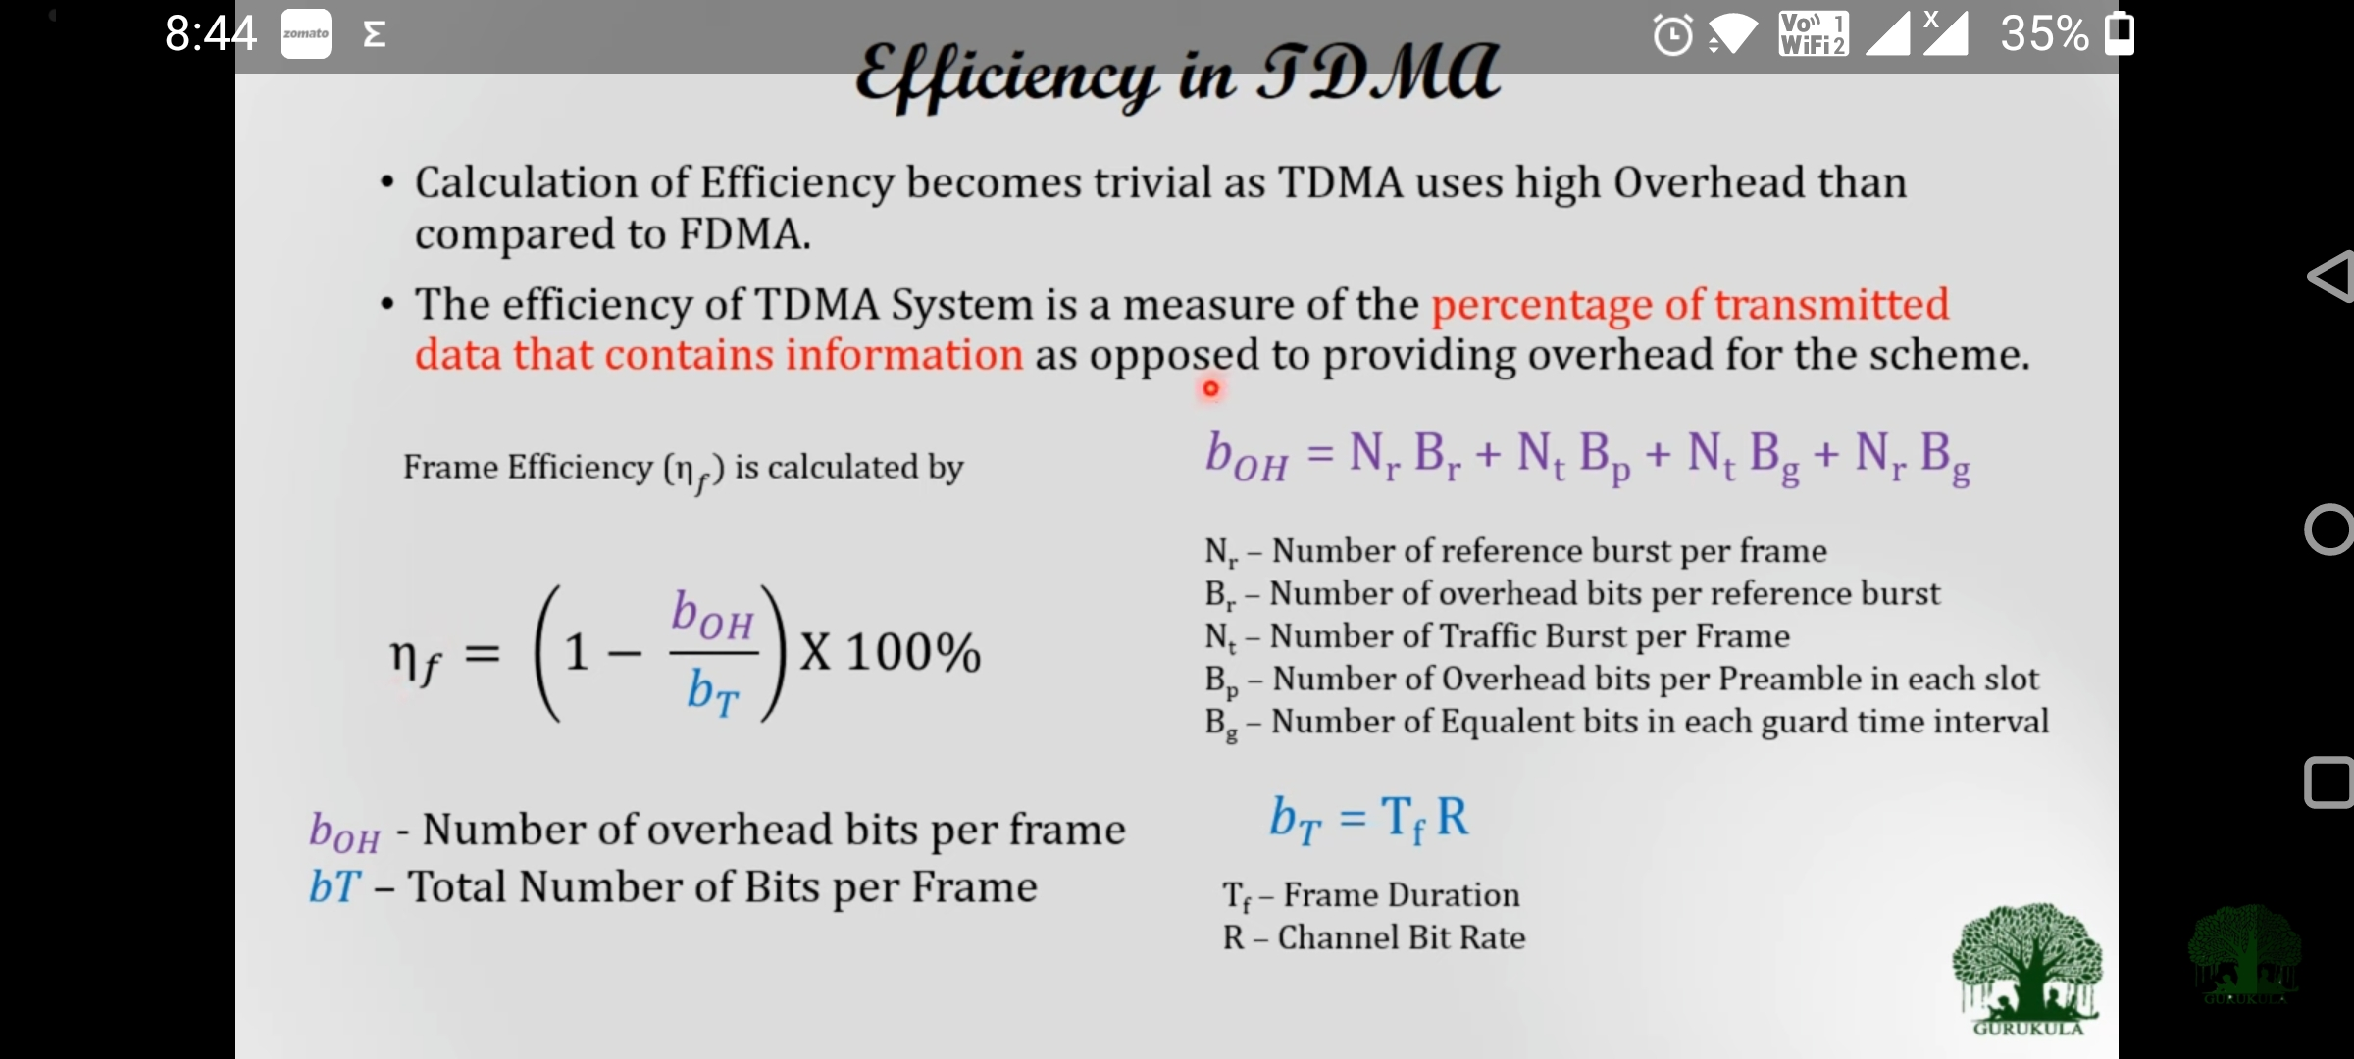

Slide 25
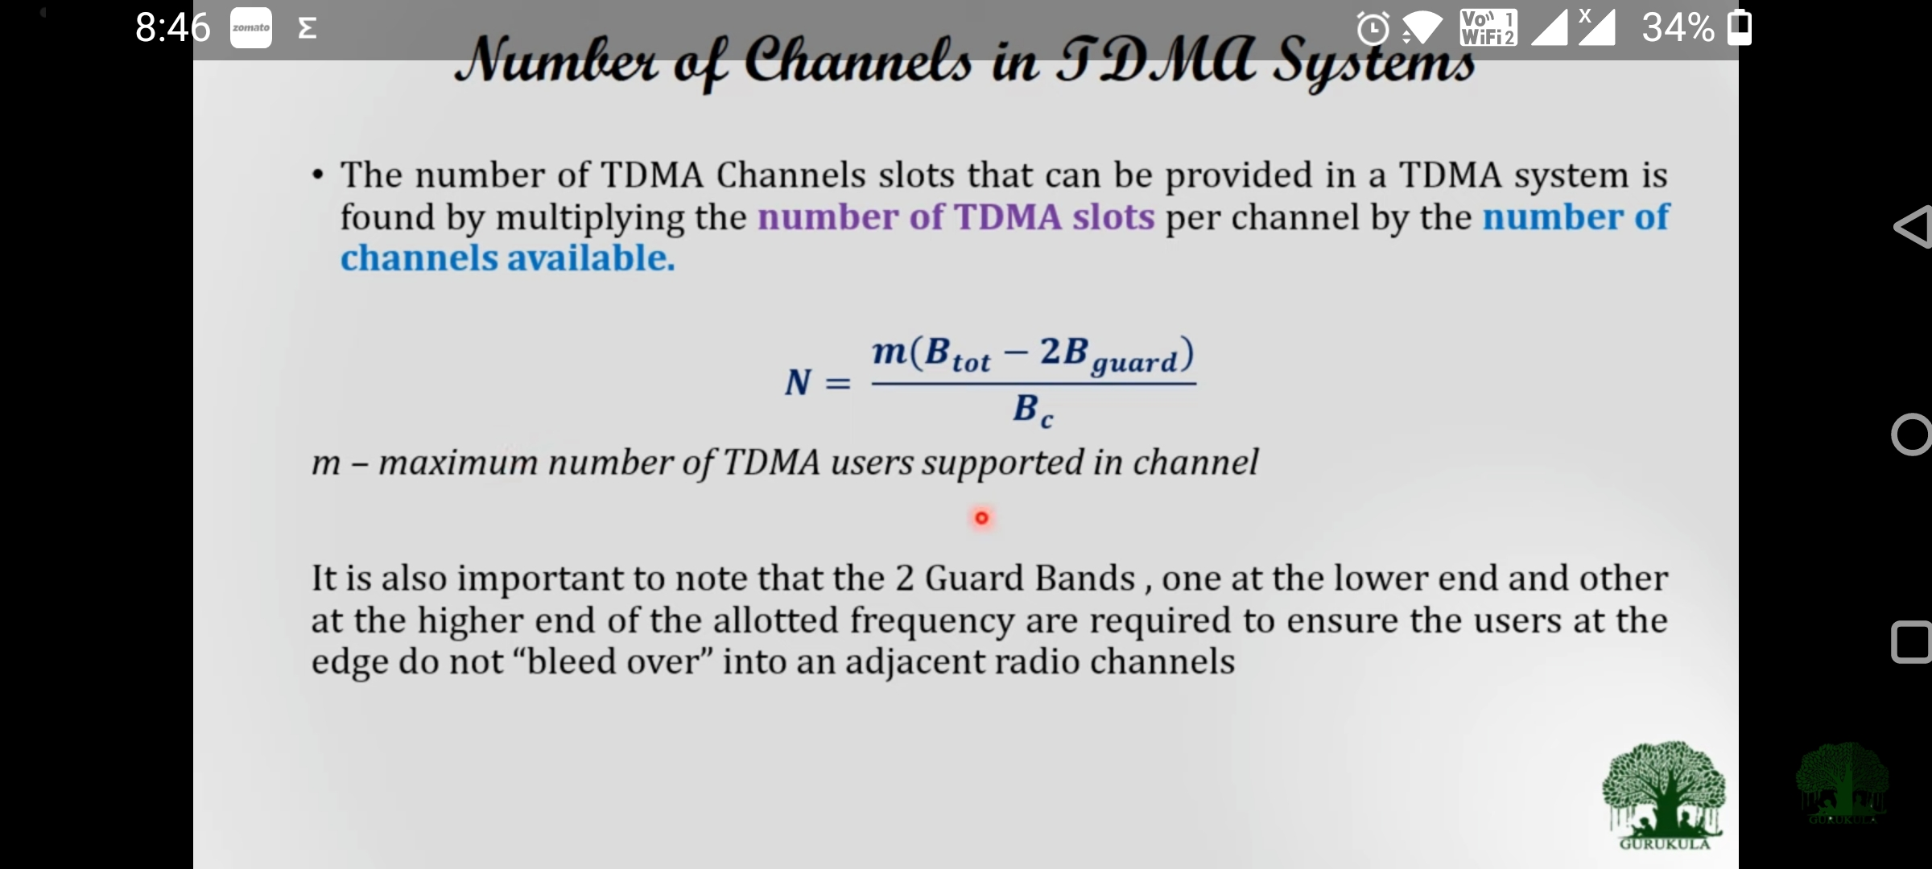

Slide 26
Advantages:
Data Transmission is in discrete bursts
  Extended battery life over FDMA and talktime
  Handoff process is simpler, since it is able to listen for other base stations during idle time slots
More efficient use of spectrum, compared to FDMA
  Will accommodate more users in the same spectrum space than an FDMA system which improves capacity in high-traffic areas, such as large metropolitan areas
  Efficient utilization of hierarchical cell structures – pico, micro, and macro cells
Since different slots are used for transmission and reception, duplexers are not required and guard band is also not required
Disadvantages:
TDMA requires synchronization. If the time slot synchronization is lost, the channels may collide with each other.
For mobiles and, particularly for handsets, TDMA on the uplink demands high-peak power in transmit mode that shortens battery life. If a TDMA interface consists of n-channels, then the transmitted powers are 10 log n times higher than in an FDMA system.
Network and spectrum planning are intensive.
Dropped calls are possible when users switch in and out of different cells.
Higher costs due to greater equipment sophistication.
Equalization is required, since transmission rates are generally very high as compared to FDMA channels.

Slide 27
1. GSM system uses 25MHz for forward link , which is broken into radio channels of 200KHz. If 8 speech channels are supportd on a single radio channel, and if no guard band is assumed , find the number of simultaneous useers that can be accommodated in GSM.

Slide 28
N= 25MHz/(200MHz)/8=1000

Slide 29
2. If a normal GSM tile slot consists of 6 tailing bitsl, 8.25 guard bits, 26 training bits, and 2 traffic bursts of 58 bit of data, find the frame efficiency.

Slide 30
A time slot has = 6+8.25+26+2*58=156.25 bits
A frame has + 8X156.25 bits= 1250 bits/frame
Number of over head bits per frame is :Boh=8[6+8.25+26]=322 bits
Efficiency = (1250-322)/1250=74.24%

Slide 31
3.If a GSM uses a frame structure , where each frame consists of 8 time slots, and each time slot contains 156.25 bits , and data is transmitted at 270.833 kbps in the channel.
Find :
Time duration of a bit
Time duration of a slot
Time duration of a frame
Ans: a. Time duration of a bit =Tb=1/270.833=3.692us
b. Time duration of slot=Tslot=156.25*Tb=0.577ms.
c. Time duration of a Frame Tf=8*Tslot=4.615ms

Slide 32
4.3 Code division multiple access-CDMA
CDMA allows transmissions to occupy the entire bandwidth at the same time without interference.
A spread-spectrum signal is a signal that has an extra modulation that expands the signal bandwidth beyond what is required by the underlying data modulation.
The most practical and dominant methods of spread-spectrum communications are direct-sequence modulation and frequency hopping of digital communications.
Spread-spectrum communication systems are useful for the following:
  1. Suppressing interference
  2. Making interception difficult
  3. Accommodating fading and multipath channels
  4. Providing a multiple-access capability
CDMA cellular technology is originally known as IS-95, which competes with GSM technology for dominance in the cellular world.
CDMA cellular systems operate in the 800 MHz and 1.9 GHz PCS bands.
QUALCOMM is the developer of the CDMA air interface used in cellular systems. Compared to GSM cellular systems, CDMA requires fewer cell towers and provides up to five times the calling capacity.
CDMA also provides more than 10 times the voice traffic of earlier analogue system (AMPS) and is the basis for 3G data transmission for GSM carriers.

Slide 33
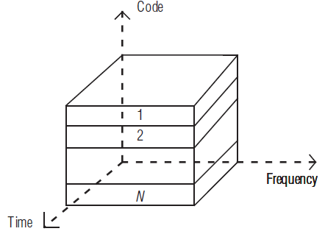
CDMA uses unique spreading codes to spread the base band data before transmission.
CDMA assigns to each user a unique code sequence that is used to code data before transmission. If a receiver knows the code sequence related to a user, it is able to decode the received data.
The codes are shared by the mobile phone and the base station. The codes are called Pseudorandom code sequences.
All the users can access the entire spectrum allocation all of the time (Figure).
A user’s unique code separates the call from all other calls.
The signal is transmitted in a channel, which is below noise level.
The receiver then uses a correlator to despread the wanted signal, which is passed through a narrowband pass filter.
Unwanted signals will not be despread and will not pass through the filter.
Codes take the form of a carefully designed one/zero sequence produced at a much higher rate than that of the base band data.
The rate of a spreading code is referred to as chip rate rather than bit rate.

Slide 34
To eliminate the noise, CDMA mobile phones and base stations use the minimum amount of power required to communicate with each other.
They use precise power control to decrease users’ transmission power.
By decreasing a user’s transmission power, the mobile phone has added battery life, increased talktime, and smaller batteries.
Advantages
Greatest spectrum efficiency: capacity increases about 8 to 10 times that of an analogue system and 4 to 5 times that of other digital systems, which makes it most useful in high traffic areas with a large number of users and limited spectrum.
CDMA improves call quality by filtering out background noise, crosstalk, and interference.
“Soft handoffs”: because of the multiple diversities in use, handoffs between cells are undetected by the user.

Slide 35
Simplified frequency planning: all users on a CDMA system use the same radio frequency spectrum.
  Engineering detailed frequency plans are not necessary.
  Frequency re-tunes for expansion are eliminated.
  Fewer cells are required for quality coverage.
Random Walsh codes enhance user privacy; a spread-spectrum advantage.
Precise power control increases talktime and battery life for mobile phones.
Disadvantages
Backwards compatibility techniques are costly.
Currently, equipment is expensive.
Difficult to optimize to maximize performance.
Low traffic areas lead to inefficient use of spectrum and equipment resources.

Slide 36
4.4. Space Division Multiple Access-SDMA
  In addition to frequency, time, and code domains, the spatial dimension can also be used for multiplexing of different data streams by transmitting the data streams over different, non-overlapping transmission channels. The use of space division multiplexing for multiple access is termed SDMA.
  SDMA enables users to share simultaneously the same bandwidth in different geographical locations.
  SDMA solves capacity problem of wireless communication systems by exploitation of the spatial dimension which makes it possible to identify the individual users, even when they are in the same time/frequency/code domains.
  SDMA can be achieved using beam forming or sectorization.
Omnidirectional antenna–based traditional cellular networks
In traditional mobile cellular network systems, the base stations have no information on the position of the mobile units within the cell, and base stations radiate the signal in all directions within the cell in order to provide radio coverage.
These results in wasting power on retransmissions when there are no mobile units to reach, in addition to causing interference for adjacent cells using the same frequency, so called co-channel cells.

Slide 37
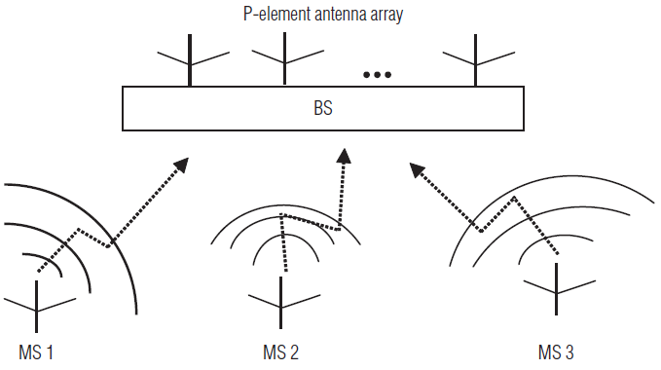
In the same way, in reception, the antenna receives signals coming from all directions including noise and interference.
These considerations have led to the development of the SDMA technique, which is based on deriving and exploiting information on the spatial position of mobile terminals.
Adaptive antenna or SDMA-based cellular network
By using adaptive antennas arrays, sometimes called smart antennas in mobile radio systems, signals can be received and sent only from and into a limited angular range, following the directional nature of multipath.
This improves coverage or link quality in noise-limited situations and enhances capacity in interference-limited situations.
The concept of SDMA is shown in Figure. Each user exploiting a single-transmitter-antenna-aided mobile station simultaneously communicates with the base station equipped with an array of receiver antennas.
SDMA concept, employing a P-element receiver antenna array for supporting three mobile users

Slide 38
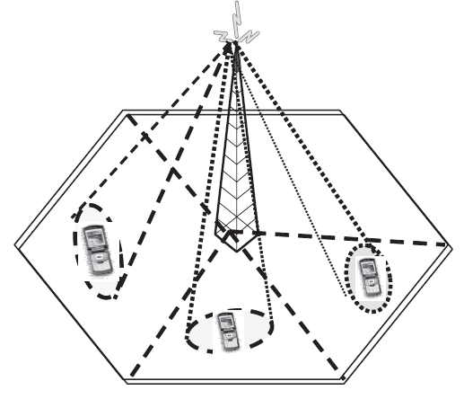
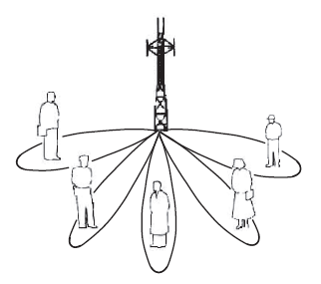
SDMA controls the radiated energy for each user in space (Figure 1) by using adaptive antenna array patterns.
These different areas covered by the antenna beam may be served by the same frequency (in a TDMA or CDMA system) or different frequencies (in an FDMA system).
Sectorized antennas may be thought of as a primitive application of SDMA
Figure 2 shows spatially filtered base station antenna serving different users by using spot beams.
Figure 2 Intra-cell SDMA
Figure 1 Multiple users belonging to the same cell use the same channel

Slide 39
Advantages
Range extension: When a system is constructed using SDMA, the number of cells required to cover a given area can be substantially reduced.
Interference suppression: Interference from other systems and from users in other cells is significantly reduced by exploiting the desired user’s unique channel impulse responses. In “noisy” areas where range is limited by interference, spatially selective transmission and reception result in range extension.
Multipath effect elimination: The copies of the desired signal that have arrived at the antenna after bouncing from objects between the signal source and the antenna can often be mitigated. In certain cases, the multipath can actually be used to reinforce the desired signal.
Capacity increase: Capacity increase can be done in two ways:
Channel reuse patterns in cellular systems can be significantly tighter because the
  average interference resulting from co-channel signals in other cells is markedly reduced(e.g., moving from a 7-cell to a 4-cell reuse pattern nearly doubles capacity).
  Separate spatial channels can be created in each cell on the same conventional channel. In other words, intracellular reuse of conventional channels is possible (Figure 2).
Compatibility: SDMA is compatible with most of the existing modulation schemes, carrier frequencies and other specifications.

Slide 40
