Slide 1
Software Project Management
Unit - II

Slide 2
Improving Team Effectiveness
Teamwork is much more important than the sum of the individuals. With software teams, a project manager needs to configure a balance of solid talent with highly skilled people in the leverage positions. Some maxims of team management include the following:
A well-managed project can succeed with a nominal engineering team.
A mismanaged project will almost never succeed, even with an expert team of engineers.

Slide 3
A well-architected system can be built by a nominal team of software builders.
A poorly architected system will flounder even with an expert team of builders.

Slide 4
Boehm five staffing principles are
The principle of top talent: Use better and fewer people
The principle of job matching: Fit the tasks to the skills and motivation of the people available.
The principle of career progression: An organization does best in the long run by helping its people to self-actualize.
The principle of team balance: Select people who will complement and harmonize with one another
The principle of phase-out: Keeping a misfit on the team doesn't benefit anyone

Slide 5
Software project managers need many leadership qualities in order to enhance team effectiveness. The following are some crucial attributes of successful software project managers that deserve much more attention:
Hiring skills. Few decisions are as important as hiring decisions. Placing the right person in the right job seems obvious but is surprisingly hard to achieve.
Customer-interface skill. Avoiding adversarial relationships among stakeholders is a prerequisite for success.

Slide 6
Decision-making skill. The jillion books written about management have failed to provide a clear definition of this attribute. We all know a good leader when we run into one, and decision-making skill seems obvious despite its intangible definition.
Team-building skill. Teamwork requires that a manager establish trust, motivate progress, exploit eccentric prima donnas, transition average people into top performers, eliminate misfits, and consolidate diverse opinions into a team direction.

Slide 7
Selling skill. Successful project managers must sell all stakeholders (including themselves) on decisions and priorities, sell candidates on job positions, sell changes to the status quo in the face of resistance, and sell achievements against objectives. In practice, selling requires continuous negotiation, compromise, and empathy

Slide 8
  IMPROVING AUTOMATION THROUGH SOFTWARE ENVIRONMENTS
The tools and environment used in the software process generally have a linear effect on the productivity of the process. Planning tools, requirements management tools, visual modeling tools, compilers, editors, debuggers, quality assurance analysis tools, test tools, and user interfaces provide crucial automation support for evolving the software engineering artifacts

Slide 9
Above all, configuration management environments provide the foundation for executing and instrument the process. At first order, the isolated impact of tools and automation generally allows improvements of 20% to 40% in effort.
However, tools and environments must be viewed as the primary delivery vehicle for process automation and improvement, so their impact can be much higher.
Automation of the design process provides payback in quality, the ability to estimate costs and schedules, and overall productivity using a smaller team.

Slide 10
Round-trip engineering describes the key capability of environments that support iterative development. As we have moved into maintaining different information repositories for the engineering artifacts, we need automation support to ensure efficient and error-free transition of data from one artifact to another.
Forward engineering is the automation of one engineering artifact from another, more abstract representation. For example, compilers and linkers have provided automated transition of source code into executable code.

Slide 11
Reverse engineering is the generation or modification of a more abstract representation from an existing artifact (for example, creating a visual design model from a source code representation).
Economic improvements associated with tools and environments. It is common for tool vendors to make rela- tively accurate individual assessments of life-cycle activities to support claims about the potential economic impact of their tools. For example, it is easy to find statements such as the following from companies in a particular tool.

Slide 12
Requirements analysis and evolution activities consume 40% of life-cycle costs.
Software design activities have an impact on more than 50% of the resources.
Coding and unit testing activities consume about 50% of software development effort and schedule.
Test activities can consume as much as 50% of a project's resources.
Configuration control and change management are critical activities that can consume as much as 25% of resources on a large-scale project.
Documentation activities can consume more than 30% of project engineering resources.
Project management, business administration, and progress assessment can consume as much as 30% of project budgets.

Slide 13
Achieving Required Quality
Software best practices are derived from the development process and technologies. Table 3-5 summarizes some dimensions of quality improvement.
Key practices that improve overall software quality include the following:
Focusing on driving requirements and critical use cases early in the life cycle, focusing on requirements completeness and traceability late in the life cycle, and focusing throughout the life cycle on a balance between requirements evolution, design evolution, and plan evolution

Slide 14
Using metrics and indicators to measure the progress and quality of an architecture as it evolves from a high-level prototype into a fully compliant product
Providing integrated life-cycle environments that support early and continuous configuration control, change management, rigorous design methods, document automation, and regression test automation
Using visual modeling and higher level languages that support architectural control, abstraction, reliable programming, reuse, and self-documentation
Early and continuous insight into performance issues through demonstration-based evaluations

Slide 15
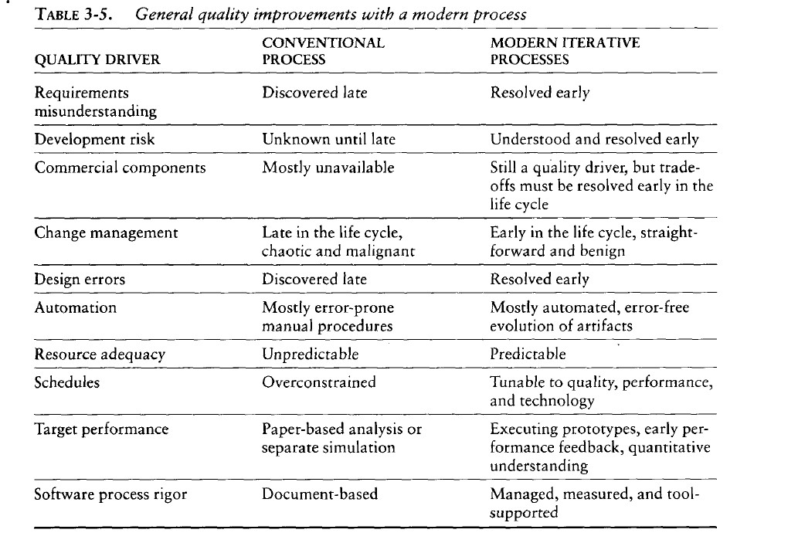

Slide 16
Conventional development processes stressed early sizing and timing estimates of computer program resource utilization. However, the typical chronology of events in performance assessment was as follows
Project inception. The proposed design was asserted to be low risk with adequate performance margin.
Initial design review. Optimistic assessments of adequate design margin were based mostly on paper analysis or rough simulation of the critical threads. In most cases, the actual application algorithms and database sizes were fairly well understood.

Slide 17
Mid-life-cycle design review. The assessments started whittling away at the margin, as early benchmarks and initial tests began exposing the optimism inherent in earlier estimates.
Integration and test. Serious performance problems were uncovered, necessitating fundamental changes in the architecture. The underlying infrastructure was usually the scapegoat, but the real culprit was immature use of the infrastructure, immature architectural solutions, or poorly understood early design trade-offs.

Slide 18
  PEER INSPECTIONS: A PRAGMATIC VIEW
Peer inspections are frequently over hyped as the key aspect of a quality system. In my experience, peer reviews are valuable as secondary mechanisms, but they are rarely significant contributors to quality compared with the following primary quality mechanisms and indicators, which should be emphasized in the management process:

Slide 19
Transitioning engineering information from one artifact set to another, thereby assessing the consistency, feasibility, understandability, and technology constraints inherent in the engineering artifacts
Major milestone demonstrations that force the artifacts to be assessed against tangible criteria in the context of relevant use cases

Slide 20
Environment tools (compilers, debuggers, analyzers, automated test suites) that ensure representation rigor, consistency, completeness, and change control
Life-cycle testing for detailed insight into critical trade-offs, acceptance criteria, and requirements compliance
Change management metrics for objective insight into multiple-perspective change trends and convergence or divergence from quality and progress goals

Slide 21
Inspections are also a good vehicle for holding authors accountable for quality products. All authors of software and documentation should have their products scrutinized as a natural by-product of the process.
Therefore, the coverage of inspections should be across all authors rather than across all components.

Slide 22
THE PRINCIPLES OF CONVENTIONAL SOFTWARE ENGINEERING
Make quality Quality must be quantified and mechanisms put into place to motivate its achievement
High-quality software is possible. Techniques that have been demonstrated to increase quality include involving the customer, prototyping, simplifying design, conducting inspections, and hiring the best people
Give products to customers early. No matter how hard you try to learn users' needs during the requirements phase, the most effective way to determine real needs is to give users a product and let them play with it

Slide 23
4.Determine the problem before writing the requirements. When faced with what they believe is a problem, most engineers rush to offer a solution. Before you try to solve a problem, be sure to explore all the alternatives and don't be blinded by the obvious solution
Evaluate design alternatives. After the requirements are agreed upon, you must examine a variety of architectures and algorithms. You certainly do not want to use” architecture" simply because it was used in the requirements specification.
Use an appropriate process model. Each project must select a process that makes ·the most sense for that project on the basis of corporate culture, willingness to take risks, application area, volatility of requirements, and the extent to which requirements are well understood.

Slide 24
Use different languages for different phases. Our industry's eternal thirst for simple solutions to complex problems has driven many to declare that the best development method is one that uses the same notation through- out the life cycle.
Minimize intellectual distance. To minimize intellectual distance, the software's structure should be as close as possible to the real-world structure
Put techniques before tools. An undisciplined software engineer with a tool becomes a dangerous, undisciplined software engineer

Slide 25
Get it right before you make it faster. It is far easier to make a working program run faster than it is to make a fast program work. Don't worry about optimization during initial coding
Inspect code. Inspecting the detailed design and code is a much better way to find errors than testing
Good management is more important than good technology. Good management motivates people to do their best, but there are no universal "right" styles of management.

Slide 26
People are the key to success. Highly skilled people with appropriate experience, talent, and training are key. 14.Follow with care. Just because everybody is doing something does not make it right for you. It may be right, but you must carefully assess its applicability to your environment.
Take responsibility. When a bridge collapses we ask, "What did the engineers do wrong?" Even when software fails, we rarely ask this. The fact is that in any engineering discipline, the best methods can be used to produce awful designs, and the most antiquated methods to produce elegant designs.

Slide 27
Understand the customer's priorities. It is possible the customer would tolerate 90% of the functionality delivered late if they could have 10% of it on time.
The more they see, the more they need. The more functionality (or performance) you provide a user, the more functionality (or performance) the user wants.
Plan to throw one away. One of the most important critical success factors is whether or not a product is entirely new. Such brand-new applications, architectures, interfaces, or algorithms rarely work the first time.

Slide 28
Design for change. The architectures, components, and specification techniques you use must accommodate change.
Design without documentation is not design. I have often heard software engineers say, "I have finished the design. All that is left is the documentation. "
Use tools, but be realistic. Software tools make their users more efficient.

Slide 29
Avoid tricks. Many programmers love to create programs with tricks constructs that perform a function correctly, but in an obscure way. Show the world how smart you are by avoiding tricky code
Encapsulate. Information-hiding is a simple, proven concept that results in software that is easier to test and much easier to maintain.
Use coupling and cohesion. Coupling and cohesion are the best ways to measure software's inherent maintainability and adaptability

Slide 30
Use the McCabe complexity measure. Although there are many metrics available to report the inherent complexity of software, none is as intuitive and easy to use as Tom McCabe's
Don't test your own software. Software developers should never be the primary testers of their own software.
Analyze causes for errors. It is far more cost-effective to reduce the effect of an error by preventing it than it is to find and fix it. One way to do this is to analyze the causes of errors as they are detected

Slide 31
Realize that software's entropy increases. Any software system that undergoes continuous change will grow in complexity and will become more and more disorganized
People and time are not interchangeable. Measuring a project solely by person-months makes little sense
Expect excellence. Your employees will do much better if you have high expectations for them.

Slide 32
  THE PRINCIPLES OF MODERN SOFTWARE MANAGEMENT
Top 10 principles of modern software management are. (The first five, which are the main themes of my definition of an iterative process, are summarized in Figure 4-1.)
    Base the process on an architecture-first approach. This requires that a demonstrable balance be achieved among the driving requirements, the architecturally significant design decisions, and the life- cycle plans before the resources are committed for full-scale development.

Slide 33
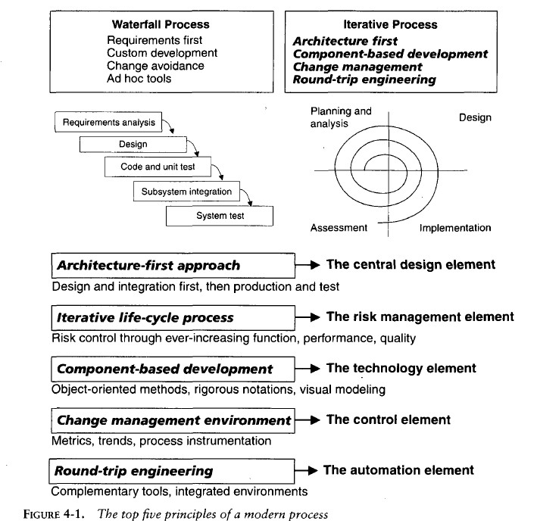

Slide 34
    Establish an iterative life-cycle process that confronts risk early. With today's sophisticated software systems, it is not possible to define the entire problem, design the entire solution, build the software, and then test the end product in sequence.
    Instead, an iterative process that refines the problem understanding, an effective solution, and an effective plan over several iterations encourages a balanced treatment of all stakeholder objectives.
    Major risks must be addressed early to increase predictability and avoid expensive downstream scrap and rework.

Slide 35
    Transition design methods to emphasize component-based development. Moving from a line-of- code mentality to a component-based mentality is necessary to reduce the amount of human-generated source code and custom development.
    Establish a change management environment. The dynamics of iterative development, Including concurrent workflows by different teams working on shared artifacts, necessitates objectively controlled baselines.

Slide 36
    Enhance change freedom through tools that support round-trip engineering. Round-trip engineering is the environment support necessary to automate and synchronizeEngineering information in different formats(such as requirements specifications, design models, source code, executable code, test cases).
    Capture design artifacts in rigorous, model-based notation. A model based approach (such as UML) supports the evolution of semantically rich graphical and textual design notations.
    Instrument the process for objective quality control and progress assessment. Life-cycle assessment of the progress and the quality of all intermediate products must be integrated into the process.

Slide 37
    Use a demonstration-based approach to assess intermediate artifacts.
    Plan intermediate releases in groups of usage scenarios with evolving levels of detail. It is essential that the software management process drive toward early and continuous demonstrations within the operational context of the system, namely its use cases.
    Establish a configurable process that is economically scalable. No single process is suitable for all software developments.

Slide 38
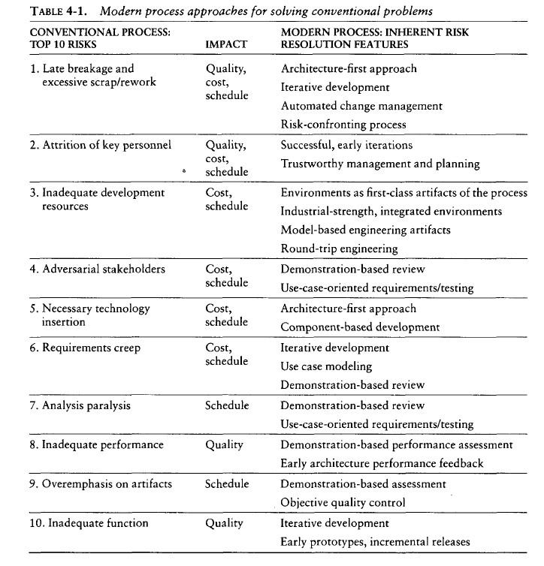

Slide 39
  TRANSITIONING TO AN ITERATIVE PROCESS
Modern software development processes have moved away from the conventional waterfall model, in which each stage of the development process is dependent on completion of the previous stage.
The economic benefits inherent in transitioning from the conventional waterfall model to an iterative development process are significant but difficult to quantify

Slide 40
As one benchmark of the expected economic impact of process improvement, consider the process exponent parameters of the COCOMO II model. (Appendix B provides more detail on the COCOMO model) This exponent can range from 1.01 (virtually no diseconomy of scale) to 1.26 (significant diseconomy of scale).
The parameters that govern the value of the process exponent are application precedentedness, process flexibility, architecture risk resolution, team cohesion, and software process maturity.

Slide 41
The following paragraphs map the process exponent parameters of CO COMO II to my top 10 principles of a modern process.
Application precedentedness. Domain experience is a critical factor in understanding how to plan and execute a software development project. For unprecedented systems, one of the key goals is to confront risks and establish early precedents, even if they are incomplete or experimental. This is one of the primary reasons that the software industry has moved to an iterative life-cycle process. Early iterations in the life cycle establish precedents from which the product, the process, and the plans can be elaborated in evolving levels of detail.

Slide 42
Process flexibility. Development of modern software is characterized by such a broad solution space and so many interrelated concerns that there is a paramount need for continuous incorporation of changes. These changes may be inherent in the problem understanding, the solution space, or the plans. Project artifacts must be supported by efficient change management commensurate with project needs. A configurable process that allows a common framework to be adapted across a range of projects is necessary to achieve a software return on investment.

Slide 43
Architecture risk resolution. Architecture-first development is a crucial theme underlying a successful iterative development process. A project team develops and stabilizes architecture before developing all the components that make up the entire suite of applications components. An architecture-first and component-based development approach forces the infrastructure, common mechanisms, and control mechanisms to be elaborated early in the life cycle and drives all component make/buy decisions into the architecture process.

Slide 44
Team cohesion. Successful teams are cohesive, and cohesive teams are successful. Successful teams and cohesive teams share common objectives and priorities. Advances in technology (such as programming languages, UML, and visual modeling) have enabled more rigorous and understandable notations for communicating software engineering information, particularly in the requirements and design artifacts that previously were ad hoc and based completely on paper exchange. These model-based formats have also enabled the round-trip engineering support needed to establish change freedom sufficient for evolving design representations.

Slide 45
Software process maturity. The Software Engineering Institute's Capability Maturity Model (CMM) is a well-accepted benchmark for software process assessment. One of key themes is that truly mature processes are enabled through an integrated environment that provides the appropriate level of automation to instrument the process for objective quality control.

