Slide 1
INSTALLING LINUX AS A SERVER
UNIT II

Slide 2
Linux and Linux Distributions:
Usually people understand Linux to be an entire package of developer tools, editors, GUIs, networking tools, and so forth. More formally, such packages are called distributions
Commercial Distributions: Red Hat, SuSE, Mandrake, and Caldera
Non Commercial Distributions: Debian, Slackware, Gentoo and Arch Linux
Linux itself is the core of the operating system: the kernel

Slide 3
The kernel is known as a nontrivial program.
It is also what puts the Linux into all those Linux distributions.
All distributions use the exact same kernel, and thus the fundamental behavior of all Linux distributions is the same
What separates one distribution from the next is the value-added tools that come with each one.

Slide 4
Defining Free Software and GNU License
Software should be free - Richard Stallman in 1980’s
Early UNIX systems did contain full source code
UNIX distributions and could be acquired only by paying large sums of money to AT&T
The Berkeley Software Distribution (BSD) maintained a free version
The greatest benefit of free software, however, comes from the users themselves: Should they need a new feature, they can add it to the program and then contribute it back to the source, so that everyone else can benefit from it.

Slide 5
GNU Public License:
The most important thing to emerge from the GNU project has been the GNU General Public License (GPL).
This license explicitly states that the software being released is free.
It is acceptable to take the software and resell it, even for a profit
In this resale, the seller must release the full source code, including any changes.
Because the resold package remains under the GPL, the package can be distributed free and resold yet again by anyone else for a profit.

Slide 6
Advantages of Free Software
Success of Free software is because of two reasons
Errors in the code itself are far more likely to be caught and quickly fixed under the watchful eyes of peers.
Under the GPL system, programmers can release code without the fear of being sued (Legal Proceedings)
Linus Torvalds released Linux in 1991 under GPL
Torvalds himself estimates that since the v.2.2.0 kernel to current Kernel (V.4.14) his contributions represent only 5 percent of the total code base.

Slide 7
Major differences between various Operating Systems
SingleUsers vs. Multiusers vs. NetworkUsers:
Windows was designed according to the “one computer, one desk, one user”
two people cannot work in parallel running.
Using Terminal Services in Windows 2000 or Windows XP allows remote use of one computer from another but is still bound by the single-user paradigm

Slide 8
The Windows .NET Server products, continue to add terminal features to enable more than one user to access the server simultaneously.
Linux borrows its philosophy from UNIX. When UNIX was originally developed at Bell Labs in the early 1970s, it ran on a PDP-7( Progarmmed Data Processor) computer that needed to be shared by an entire department.
Today, the most common implementation of a multiuser setup is to support servers— systems dedicated to running large programs for use by many clients

Slide 9
Client has a smaller workstation on the desktop, with enough power for day-to-day work, When they need to do something requiring significantly more CPU power or memory, they can run the operation on the server.
Linux, Windows 2000, and Windows .NET Server are all capable of providing services such as databases over the network.
Users of this arrangement can be called network users, since they are never actually logged in to the server but rather send requests to the server. The server does the work and then sends the results back to the user via the network.

Slide 10
Separation of GUI and Kernel
Windows developers integrated the graphical user interface (GUI) with the core operating system.
On the other hand, Linux (like UNIX in general) has kept the two elements—user interface and operating system—separate
The X Window System interface is run as a user-level application, which makes it more stable.
the GUI (which is very complex for both Windows and Linux) fails, Linux’s core does not go down with it

Slide 11
The X Window System also differs from the 2000 GUI
The most significant feature of the X Window System is its ability to transmit windows across a network and display them on another workstation’s screen.
This allows a user sitting on Host A to log in to Host B, run an application on Host B, and have all of the output routed back to Host A.
Most Linux distributions (including Red Hat) come with several window managers and include support for GNOME and KDE, both of which are available on other variants of UNIX as well

Slide 12
Which is Better??
That depends on what you are trying to do
Windows is less complex than UNIX but it lacks the X Windows feature
2000’s GUI is consistent but cannot be turned off, whereas X Windows doesn’t have to be running on a server

Slide 13
Network Neighborhood
The native mechanism for Windows users to share disks on servers or with each other is through the Network Neighborhood.
users attach to a share and have the system assign it a drive letter.
As a result, the separation between client and server is clear
The only problem is that this method of sharing data is more people-oriented than technology oriented: People have to know which servers contain which data.

Slide 14
Windows 2000 introduced a feature long available on UNIX systems: mounting
By mounting a share, Windows makes the share look as if it were just another directory located on the user’s local disk.
Microsoft’s Distributed File System (Dfs) allows a network wide join of directories that can be configured and accessed as a directory tree.
Windows .NET Server improves Dfs management features and allows a single server to host multiple Dfs trees.

Slide 15
Linux, using the Network File System (NFS), has supported the concept of mounting since its inception
This allows any directory to be “exported” for mounting on other systems
The mounted directory can be placed anywhere in the remote system’s directory tree.
A common example of mounting partitions under Linux is with mounted home directories: The user’s home directories reside on a server, and the client mounts the directories at boot time (automatically).
So /home exists on the client, but the contents of /home/username exist on the server.

Slide 16
Under Linux NFS, users never have to know server names or directory paths
DOMAINS:
For a group of Windows 2000 systems to work well together, they should exist in a domain.
This requires a Windows 2000 Server system configured as a Domain Controller (DC).
The basis of Linux’s network security model is NIS, Network Information Service
NIS is a simple text file–based database that is shared with client workstations. ach primary NIS server establishes a domain

Slide 17
Any client workstation wanting to join this domain is allowed to do so, as long as it can set its domain name.
To set the domain name, you must use the root user
The domain administrator must still add your login to the master NIS password list so that the rest of the systems in the network recognize your presence
The key difference between NIS and Windows 2000 domains is that the NIS server by itself does not perform authentication the way a DC does

Slide 18
Instead, each host looks up the login and password information from the server and compares it to the user’s entered information.
Another important difference is that NIS can be used as a general-purpose database and thus hold any kind of information that needs to be shared with the rest of the network.
The only limitation is that each NIS map can have only one key, and the database mechanism doesn’t scale well beyond about 20,000 entries
Neither Windows nor Linux requires use of domains for the base operating system to work

Slide 19
Active Directory
An active directory is a service that is provided by Microsoft that stores information about items on a network so the information can be easily made available to specific users through a logon process and network administrators.
By using an Active Directory it is possible to view an entire series of network objects from a single point and obtain an overall hierarchal view of the network.

Slide 20
Several implementations of LDAP (Lightweight Directory Access Protocol) now exist for Linux, and work is actively being done to allow NIS to tie into LDAP servers.
LDAP uses the same underlying technology that Active Directory uses in Windows 2000 and Windows .NET Server

Slide 21
Installing LINUX in Server Configuration
Before Installation:
Before getting into the actual installation phase important to evaluate two things:
The hardware the system is going to run on
The server’s ideal configuration to provide the services you need

Slide 22
Hardware
before getting started with the installation process, determine what hardware configurations would work
Each commercial vendor publishes a hardware compatibility list (HCL)
Server Design:
When a system becomes a server, its stability, availability, and performance become a significant issue

Slide 23
These three factors are usually improved through the purchase of more hardware .
The most significant design decision you must make when managing a server configuration is not technical but administrative.
You must design a server to be unfriendly to casual users. This means no cute multimedia tools, no sound card support, and no fancy web browsers
casual use of a server is strictly prohibited, not only to site users but site administrators as well

Slide 24
Another important aspect of designing a server is making sure that it has a good environment. As a system administrator, you must ensure the physical safety of your servers by keeping them in a separate room under lock and key
The server room itself should be well ventilated and kept cool. The wrong environment is an accident waiting to happen
Once the system is in a safe place, installing battery backup is also crucial.
Backup power serves two key purposes: to keep the system running during a power failure so that it may gracefully shut down, thereby avoiding file damage or loss; and to ensure that voltage spikes, drops, and other noises don’t interfere with the health of your system.

Slide 25
Dual Booting Issues
All distributions of Linux can be installed on only certain partitions of your hard disk while leaving
others alone. Typically, this means allowing Microsoft Windows to coexist with Linux.
anyone with a little experience in creating partitions can do the task. If you are having difficulty, you
may want to refer to the installation guide that comes with your distribution.

Slide 26
Methods of Installation
With the improved connectivity and speed of both local area networks and Internet connections, it is becoming an increasingly popular option to perform installations over the network rather than using a local CD-ROM.
In general, you’ll find that network installations become important once you’ve decided to deploy Linux over many machines and therefore require a fast installation procedure in which many systems can install at the same time

Slide 27
Typically, server installations aren’t well suited to automation, because each server usually has a unique task; thus, each server will have a slightly different configuration.
Because of this Servers are installed using CD-ROM. Once it is installed, you can perform Network-Based Installations easily.

Slide 28
Installing Fedora Linux
You have two ways to start the boot process: you can use a boot floppy or the CD-ROM. This installation guide assumes you will boot off the CD-ROM to start the Fedora installation procedure.
If you have an older machine not capable of booting off the CD-ROM, you will need to use a boot disk and start the procedure from there.

Slide 29
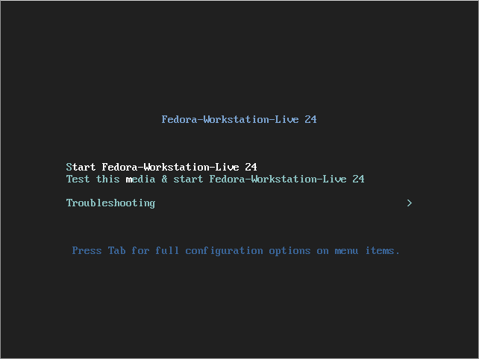
Step-By Step Procedure:
1. Insert your bootable media into a drive/port and boot from it, you should be able to see this screen below. There are two options, one you can start live Fedora 24 or test the installation media for any errors before starting Fedora 24 live.

Slide 30
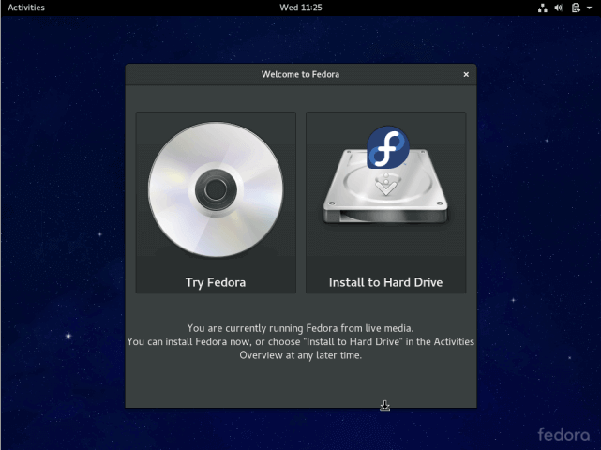
2. There are two options, one is for trying out Fedora 24 without installing it and the second is to install it to the Hard Drive, select “Install to Hard Drive”.

Slide 31
3. Next, choose the installation language and click Continue.

Slide 32
4. You will see this customization interface to configure your Keyboard layout, Time and Date, Installation disk, Network and Hostname.

Slide 33
5. Configure Keyboard Layout :Select the default Keyboard language your system will use, you can find more options by clicking on the “+” button, after selecting, click on Done.

Slide 34
6. Set Time and Date: Here, you will configure system timezone, time and date, in case your system is connected to the Internet, then time and date will be detected automatically. Setting time manually is more helpful according to your location. After that click Done.

Slide 35
Configure Installation Disk: In this step, you will configure your system partitions and filesystem types for every system partition. There are two ways to setup partitions, one is automatically and another manually.

Slide 36
In the screen below, select “Standard Partition” partitioning scheme from the drop down menu, for creating mounting points for the various partitions you will create.

Slide 37
Use the “+” button to create a new partition, let us start by creating the root (/) partition, so specify the following in the screen below:
Mount point: /
Desired Capacity: 15GB
The partition size I have selected is the purpose of this guide, you can set a capacity of your choice according to the size of your system disk. After that click on “Add mount point”.

Slide 39
Add the home partition mount point which will store system users files and home directories. Then click on “Add mount point” to proceed to the next step.
Create a swap partition, this is space on the hard disk that is allocated to hold extra data in system RAM that is not actively being used by the system in case RAM is used up. Then click on “Add mount point” to create the swap space.
Next, after creating all the necessary mount points, then click on Done button. You will see the interface below for you to effect all the changes to your disk. Click on “Accept Changes” to continue.

Slide 40
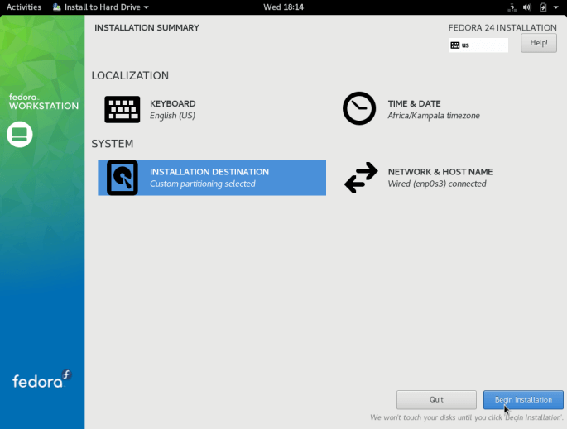
Setup Network and Hostname: From the previous step, you will see configuration screen, next, click on “Network and Hostname”. Provide the hostname you want to use for your Fedora 24, click on Done to move back to the configuration screen.
Begin the actual Fedora 24 installation of system files by clicking on “Begin Installation” from the screen below.

Slide 41
As the system files are being installed, you can setup system users.

Slide 42
To setup root user, click on “ROOT PASSWORD” and add a root password, then click Done. Move over to normal system “USER CREATION” and fill in the necessary information including giving administrator privileges to the user plus set a password for the user as in the interface below, then click Done.
Wait for the installation to finish after setting system users, when installation is complete, click Quit at the bottom right corner and reboot your system.
Remove the installation media and boot into Fedora 24.

Slide 44
GNOME And KDE
The History of X Windows:
interface they present the user should be 100 percent independent of the core operating system. As a result, Linux’s kernel is completely decoupled from its user interface.
stability that comes from having such a large program independent of the core operating system. If the GUI crashes under Windows or Mac OS, you have to reboot. Under Linux, you can kill the GUI and restart it without affecting any other services being offered by the system

Slide 45
In the mid-1980s, an OS-independent foundation for graphical user environments was created and called the X Window System. “X” (as it is commonly abbreviated) simply defines the method by which applications can communicate with the graphical hardware. Also established was a well-defined set of functions programmers could call on to perform basic window manipulation.
Note: The implementation of the X Window System used by Linux is XFree86
Control of appearance was passed off to an external program called a window manager. The window manager took care of drawing borders, using color, and making the environment pleasant to the eye; the window manager was required only to use standard calls to the X subsystem to draw on the screen

Slide 46
The window manager did not dictate how the application itself utilized the windows. This meant application programmers had the flexibility to develop a user interface most intuitive for the application.
Because the window manager was external to the X subsystem, and the X application programmers interface (API) was open, any programmer who wanted to develop a new window manager could, and many did

Slide 47
The Downside – Imp
A Windows programmer might equate programming for X to programming for the original MS Windows prior to the visual tools and MFC libraries(Microsoft Foundation Class). For example, a simple program to bring up a window, display the text “Hello World,” and then offer a button to allow the user to quit could easily be several hundred lines long under both X and MS Windows.
UNIX folks took a lesson from the Macintosh OS and MS Windows families Failure to offer a reasonably consistent user interface for both the user and the programmer that is easy to use and easy to develop for means a loss of user base.

Slide 48
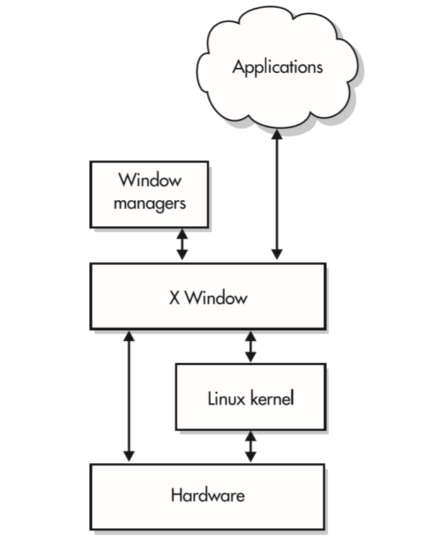
Commercial UNIX vendors tried to fix this problem with the Common Desktop Environment so that their users would get a consistent look and feel, and an improved library for X called Motif was developed, as well. For Linux, both of these developments presented a problem, because they went against the ideal of being open source

Slide 49
Enter GNOME:
With unfriendly programming environments and unfriendly user interfaces, X had the potential to one day turn into a legacy interface, This would be extremely unfortunate, because it offers a design that was better than other commercial offerings. The protocol is open, which means anyone who wants to write an X client or X server is welcome to. And, of course, one of the best features of X is that it allows applications to be run on one host but be displayed on another host.

Slide 50
In the latter 1990s, two groups came out with solutions to the problems with the X Window System: GNOME and KDE. KDE offers a new window manager and necessary libraries to make writing applications for it much easier. GNOME offers a general framework for other window managers and applications to work with it. Each has its own ideas for how things should work, but because they both work on top of the X Window System, they are not entirely incompatible.

Slide 51
Using and Customizing GNOME
GNOME (GNU Network Object Model Environment) offers a complete desktop environment and application framework to make development as well as use easier.
What makes GNOME different from KDE is how it achieves these goals?
Unlike KDE, GNOME does not provide a window manager. GNOME provides development libraries and session management— foundation features that we as users don’t see. On top of this foundation is a window manager that takes care of the general appearance of the desktop. The default window manager is Metacity in Redhat and GNOME3 in Fedora, but there are several choices available.

Slide 52
Starting theXWindow System and GNOME
If you are using Fedora Linux and have opted for its defaults, you already have GNOME installed as your default GUI. Depending on how X is configured, you may already have a graphical login prompt. In that case, logging in will automatically place you in the X Window System environment. If you have a text-based login, simply run startx in order to bring X up, like so:
[fedorauser@localhost]$ Startx

Slide 53
Opening graphical applications from the command line:
Graphical applications can be launched from a terminal window or console session by simply typing the name of the application.
[fedorauser@localhost]$ firefox
Launching Applications with Alt+F2
Most desktop environments follow the convention of using the key combination Alt+F2 for opening new applications. Pressing Alt+F2 brings up a prompt for a command to be entered into.
Commands entered into this dialog box function much as they would if entered in a terminal. Applications are known by their file name, and can accept arguments.

Slide 54
Launching applications from the Desktop Menu
Applications can also be opened from the menu system provided by the desktop environment in use. While the presentation may vary between desktop environments, the menu entries and their categories are provided by the individual application and standardized by the freedesktop.org Desktop Menu Specification1. Some desktop environments also provide search functionality in their menu system to allow quick and easy access to applications.

Slide 55
GNOME Basics
The GNOME menu, called the overview, can be accessed by either clicking the Activities button in the top left of the primary display, by moving the mouse past the top left hot corner, or by pressing the Super ( Windows ) key. The overview presents documents in addition to applications.
Selecting an item from the menu is best accomplished using the search box. Simply bring up the overview, and begin typing the name of the application you want to launch. Pressing enter will launch the highlighted application, or you can use the arrow keys or mouse to choose an alternative.

Slide 57
The overview can also be browsed. The bar on the left, called the dash, shows frequently used applications and a grid icon. Clicking on the grid icon brings up a grid in the center of the window that displays frequently used applications. The grid will display all available applications if selected using the All button at the bottom of the screen.
On the desktop:
Alt+Tab switches between applications

Slide 58
Window maximizing and tiling:
You can maximize a window by dragging it to the top edge of the screen. Alternatively, you can double-click the window title. To unmaximize, pull it down again. By dragging windows to the left and right edges of the screen you can tile them side by side.
The top bar
The top bar has the Activities button for switching to the overview, the name of the focused application (which will provide the application menu in the future), the current date, the notification icons, and the button with the user name that activates the user menu. The date in the top bar has a pop-down with the calendar available on click. The user menu has System Preferences, Log Out and Shut Down options.

Slide 59
Switching to and from the overview
Hot corner - moving the mouse pointer to the top left corner of the screen will take you to the overview or back to the desktop.
Activities button - clicking the Activities button which is in the top left corner of the screen will take you to the overview or back to the desktop.
System (Windows) key or Alt+F1 - these key combinations will take you to the overview or back to the desktop.

Slide 60
In the overview
The dash on the left side is where your favorite applications and your running applications are shown. The glow behind the application icon indicates if the application is running.
Clicking on the application icon will launch it if it is not running, and will open the last used window of that application if it is already running.
Right clicking on the application icon for a running application will display a menu with window titles for selecting one of the windows. This menu also provides options to open a new window for that application and to remove or add that application to favorites depending on its current status.

Slide 61
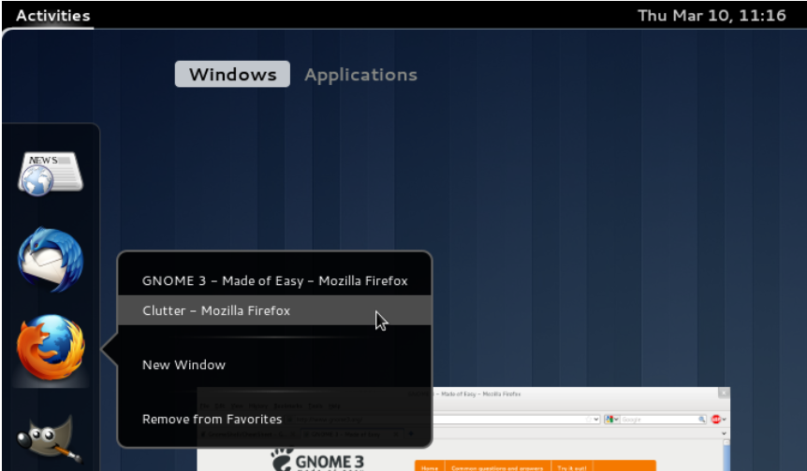
Ctrl+Clicking or middle clicking on the application icon for a running application will open a new window of that application in the current workspace.

Slide 62
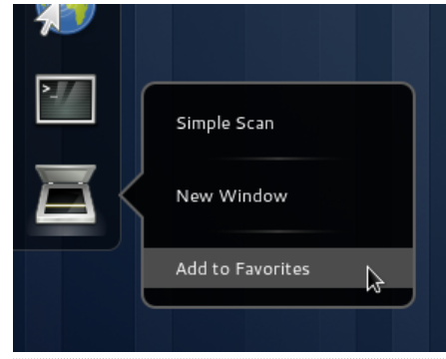
Running applications can be added to favorites with the help of the right click menu option. You can also drag an application from the application browsing pane to the favorites row to make it a favorite application.

Slide 63
Dragging an application icon within the dash moves its position. A trash can icon will appear at the bottom of the dash while dragging. If you drop the application icon on the trash can it will be removed from the dash.
KDE Desktop Environment:
KDE stands for K Desktop Environment. It is a desktop environment for Linux based operation system. You can think KDE as a GUI for Linux OS. KDE has proved Linux users to make it use as easy as they use windows. KDE provides Linux users a graphical interface to choose their own customized desktop environment.
Be default GNOME is installed with Fedora, If you want to start KDE

Slide 64
We don’t have KDE as a GUI with fedora, if you want to use KDE, then install the KDE using the following command. You must be a super user to install KDE, if not it will prompt to enter as a super user. The package installation will ask for permission, click on Y, the installation begins and it will complete after some time.
Sudo yum install @KDE-Desktop-Environment

Slide 66
Now we have both GNOME and KDE
To switch from one Desktop Environment to the other, use the following command
$ : Switchdesk
If switchdesk-gui is already installed a window will open, otherwise you need to install the switchdesk by using package installer. Or use the command switchdesk Desktop Name . Ex: switchdesk KDE
Use the following command to install switchdesk
$:Sudo yum install switchdesk-gui

Slide 67
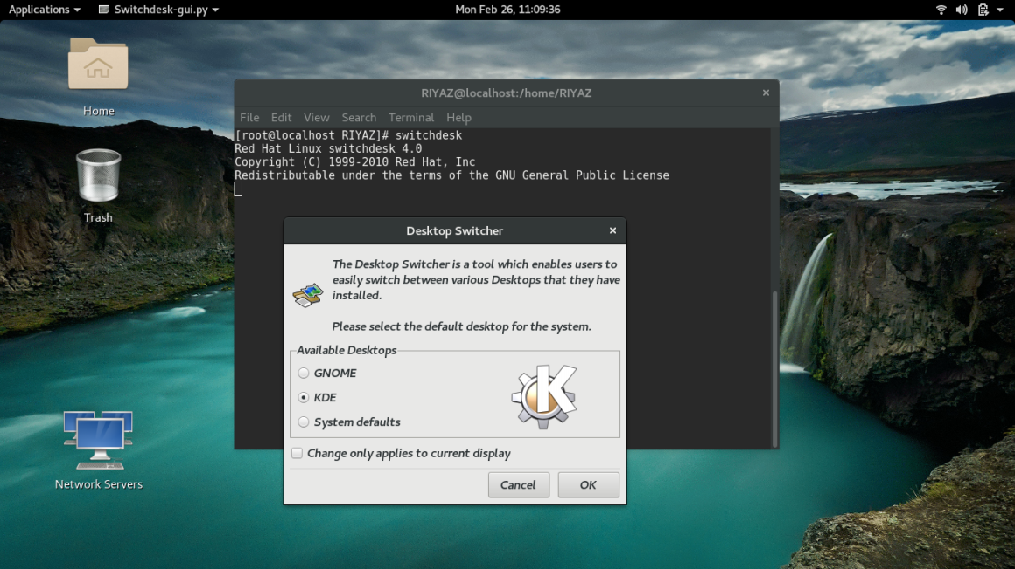
After installing the swtchdesk, use the command Switchdesk, A window will open, there you can select your default desktop environment by selectiong wither GNOME or KDE. It will affect once you restart your session

Slide 69
Now, When both the desktop environments are active, you can switch from one desktop to another using the following commands
Alt+Ctrrl+F2 – GNOME Interface
Alt+Ctrl+F3 – Console/KDE Interface
Use the following command to get back to console.
Alt+Ctrl+F3
A console window will open
Login in as a root user using the following command
[rootuser@]: root
[rootuser@]:Enter password
After login as a root user, use the following command to start the X-Window
[rootuser@]Startx

Slide 70
KDE Interface

Slide 71
The GNOME Configuration Tool:
Sometime before GNOME 3’s official release did the Gnome Tweak Tool appear in order to solve some of the early customization problems that GNOME Shell has. The purpose of the Gnome Tweak Tool is to simply provide some extra options that cannot be found anywhere elsee in GNOME Shell. In distributions that offer GNOME 3 (this excludes Ubuntu for now), you should be able to find it under the
gnome-tweak-tool You can install Gnome-tweak-tool simply by using the following command
$sudo yum install gnome-tweak-tool

Slide 73
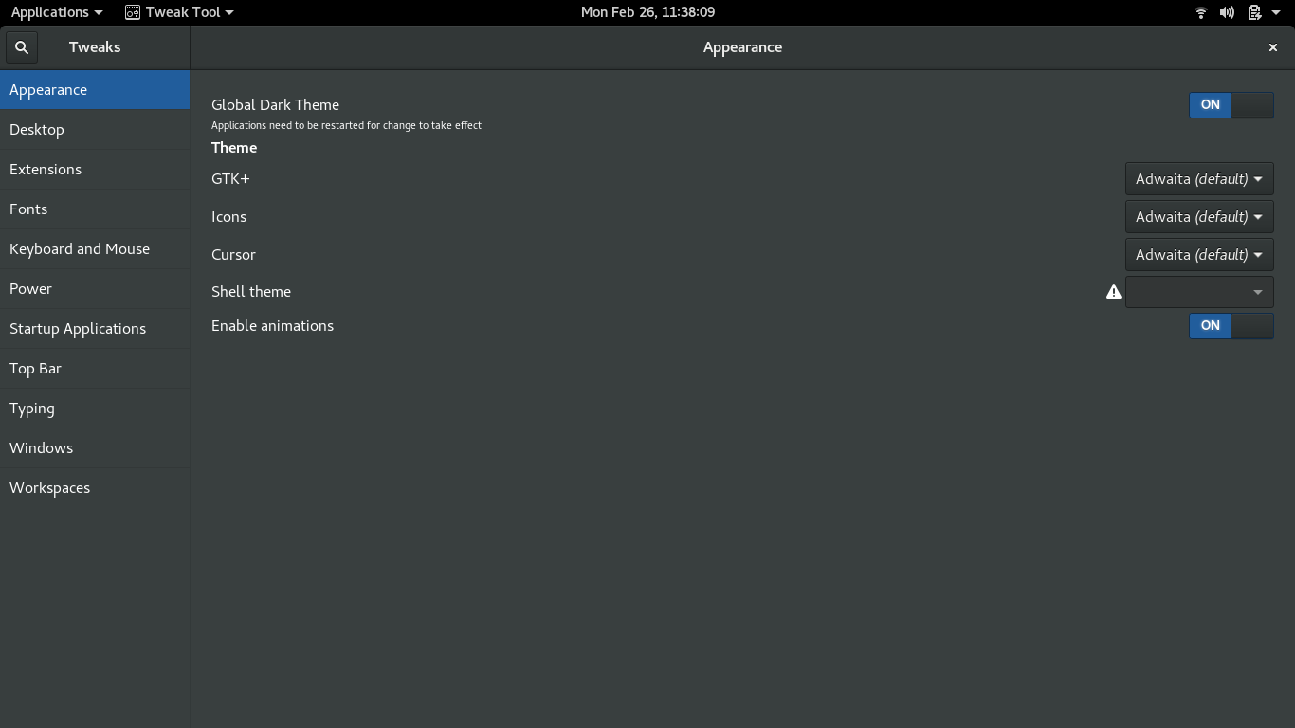
The window that greets you is fairly simple. You have categories in the left pane, and options appear on the right, where you can choose from On/Off switches or drop-down menus.
To start tweak tool, type settings or tweak tool in search and click on it. Tweak tool window will open.

Slide 74
Total 11 Categories are included in the tweak tool as listed below.
Appearance
Desktop
Extensions
Fonts
Keyboard and mouse
Power
Startup applications
Top bar
Typing
Windows
Workspaces

Slide 75
Appearance: In the Appearance you can change the theme which includes sub features lilke icons, cursor, shell theme etc..

Slide 76
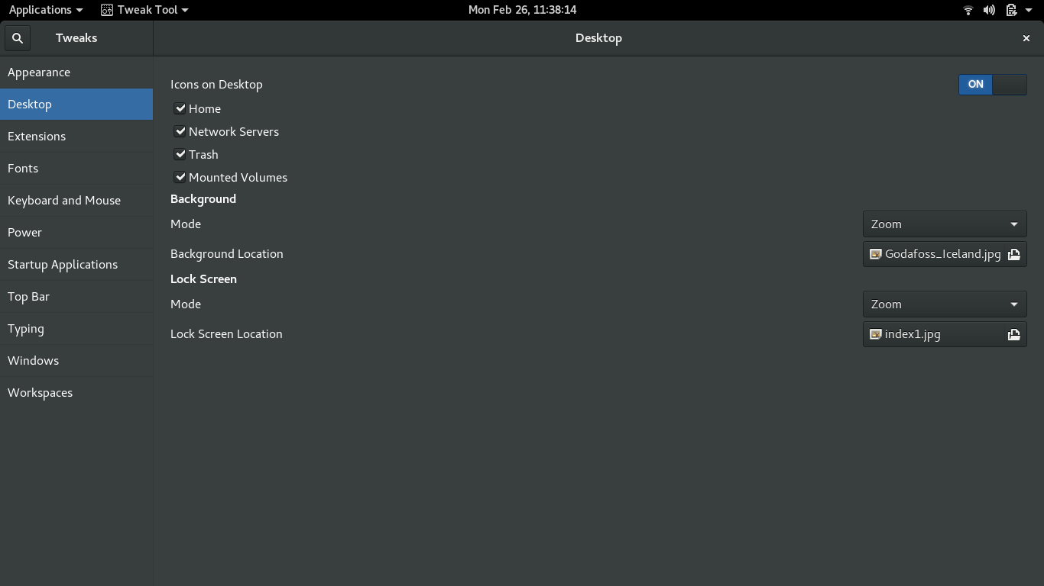
Desktop: In this tweak you can manage Icons on desktop as well as you can change the background screen and lock screen backgrounds.

Slide 77
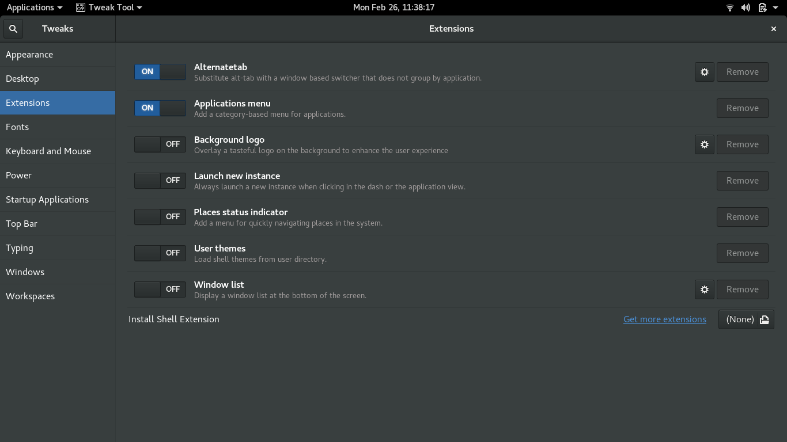
Extensions: you can switch off and switch on the required extensions in this tweak

Slide 78
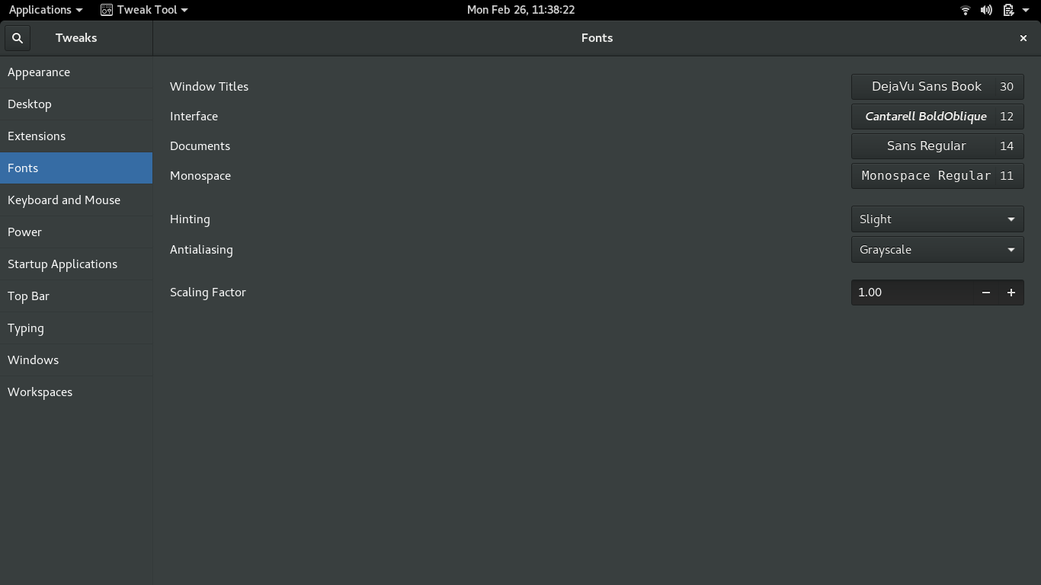
Fonts: In this tweak you can change the font styles of windows title, interface, document, and monospace. You can also change the scaling factor here.

Slide 79
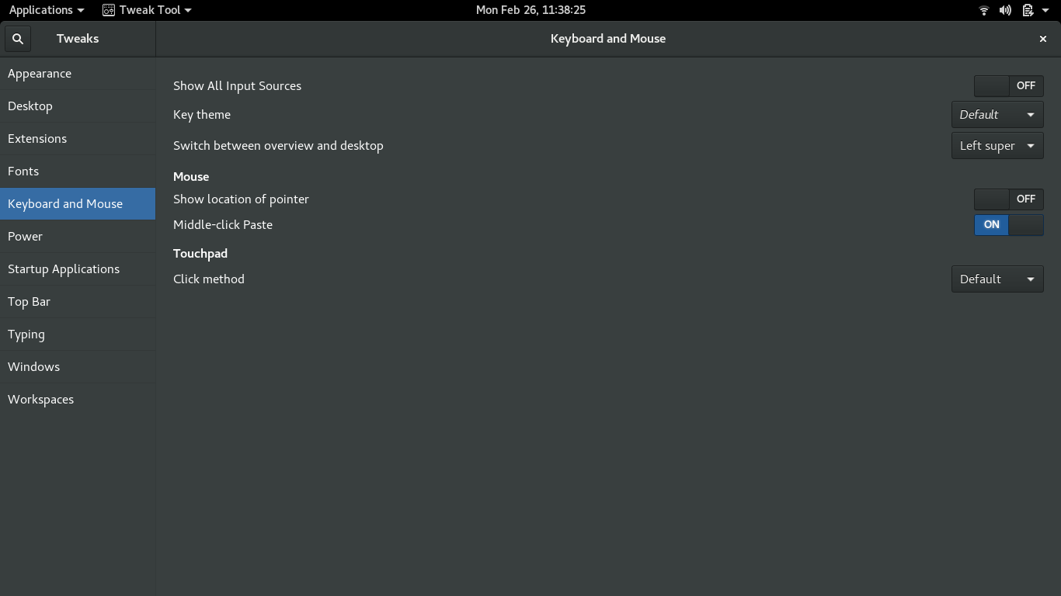
Keyboard and Mouse: in this tweak you can change the setting related to keytheme, mouse and touchpad.

Slide 80
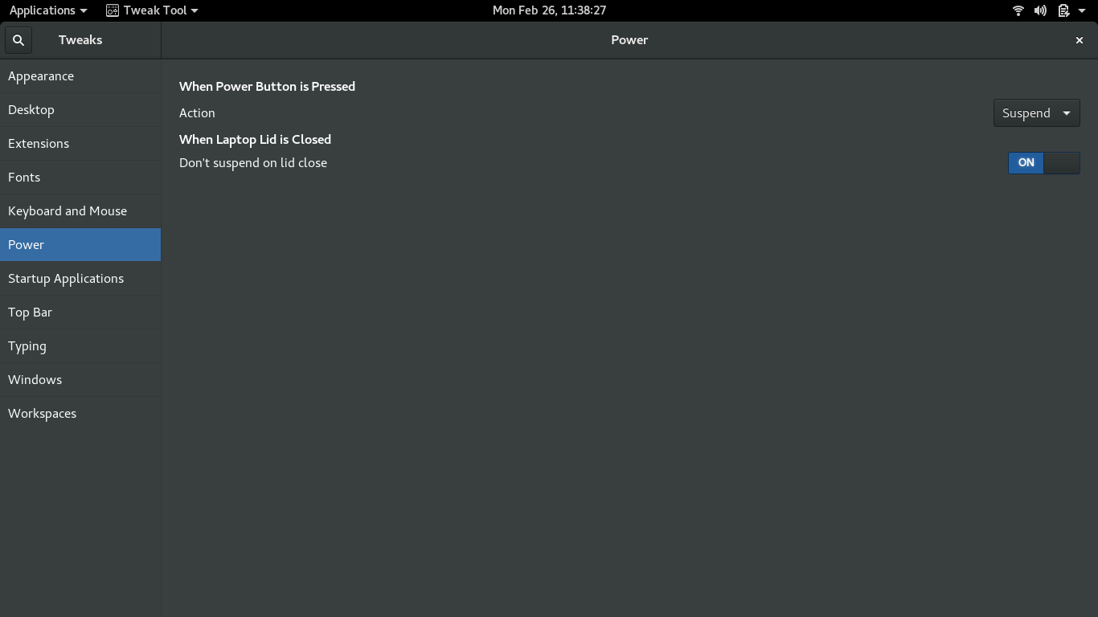
Power: You can change the action to be taken when the power button is pressed and when the system lid is closed.

Slide 81
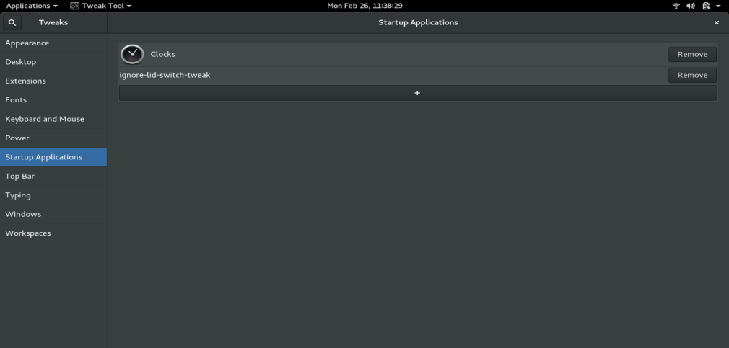
Startup Applications: You can add or remove the applications here

Slide 82
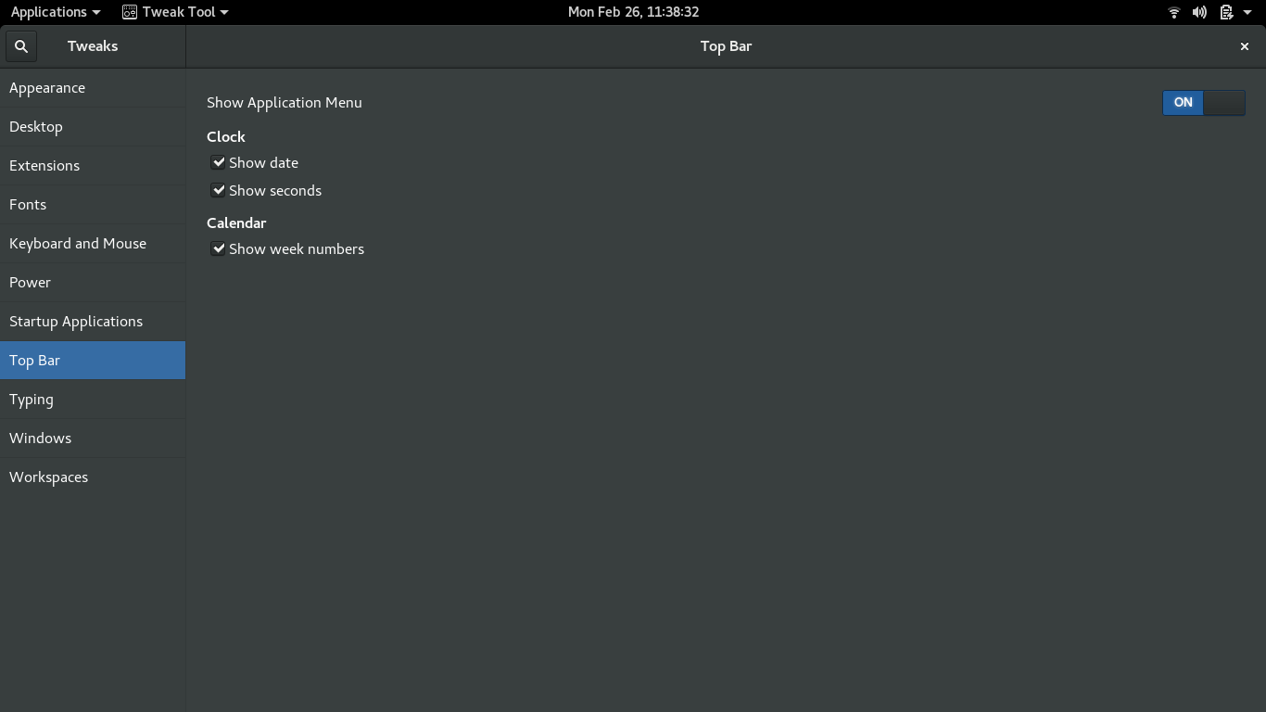
Top Bar: you can change the view of the top bar by selecting the clock and calendar options

Slide 83
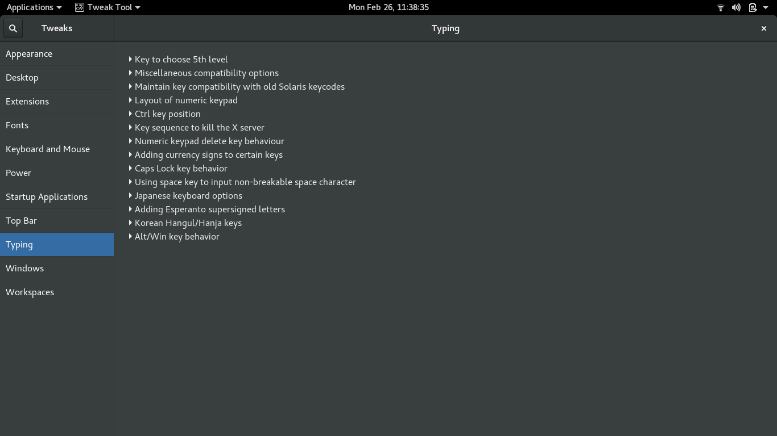
Typing: In this tweak you can change the settings related to typing

Slide 84
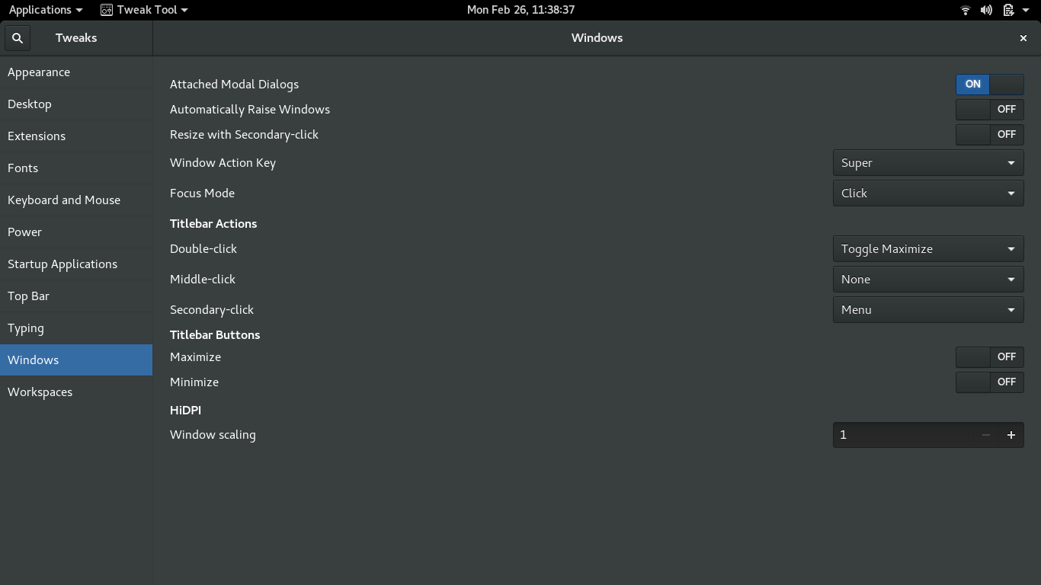
Windows: By using this tweak you can change the settings related to window key actions, titlebar actions, titlebar buttons and HiDPI.

Slide 85
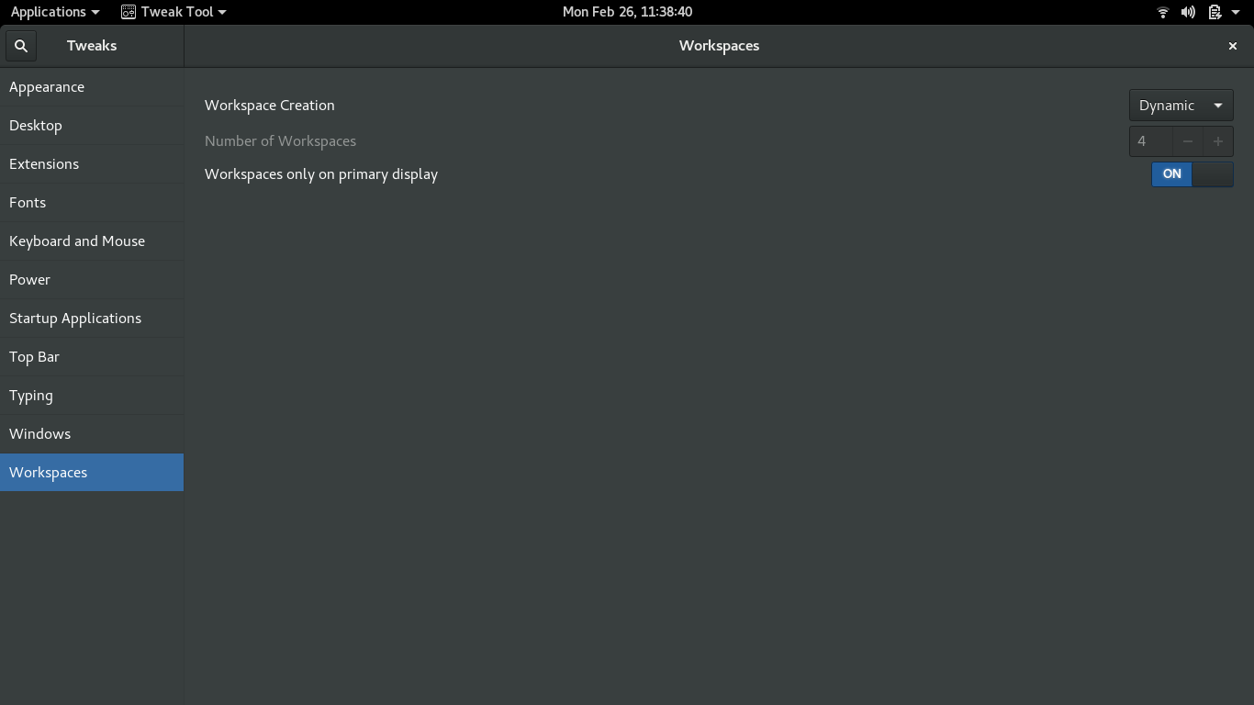
Workspaces: In this tweak you can change the workspace creation as Dynamic or Static. If it is Dynamic then the number of workspaces is fixed, when it is static you can change the number of workspaces as per the user choice. And you can also select workspace on primary display as on or off

