Slide 1
Software Project Management – Unit V
PROJECT CONTROL & PROCESS INSTRUMENTATION

Slide 2
Introduction
Software metrics are used to implement the activities and products of the software development process. Hence, the quality of the software products and the achievements in the development process can be determined using the software metrics.
Need for Software Metrics:
  Software metrics are needed for calculating the cost and schedule of a software product with
  great accuracy.
  Software metrics are required for making an accurate estimation of the progress.
  The metrics are also required for understanding the quality of the software product.

Slide 3
  Indicators
An indicator is a metric or a group of metrics that provides an understanding of the software process or software product or a software project. A software engineer assembles measures and produce metrics from which the indicators can be derived.
Two types of indicators are:
Management indicators.
Quality indicators.

Slide 4
    Management Indicators
The management indicators i.e., technical progress, financial status and staffing progress are
used to determine whether a project is on budget and on schedule. The management indicators that indicate financial status are based on earned value system.
    Quality Indicators
The quality indicators are based on the measurement of the changes occurred in software.

Slide 5
  SEVEN CORE METRICS OF SOFTWARE PROJECT
Software metrics instrument the activities and products of the software Development/integration process. Metrics values provide an important perspective for managing the process. The most useful metrics are extracted directly from the evolving artifacts.
There are seven core metrics that are used in managing a modern process.

Slide 6
Seven core metrics related to project control:
Management Indicators
Work and Progress
Budgeted cost and expenditures
Staffing and team dynamics
Quality Indicators
Change traffic and stability
Breakage and modularity
Rework and adaptability
Mean time between failures (MTBF) and maturity

Slide 7
MANAGEMENT INDICATORS
      Work And Progress
This metric measure the work performed over time. Work is the effort to be accomplished to complete a certain set of tasks. The various activities of an iterative development project can be measured by defining a planned estimate of the work in an objective measure, then tracking progress (work completed overtime) against that plan.

Slide 8
The default perspectives of this metric are:
Software architecture team: - Use cases demonstrated.
Software development team: - SLOC under baseline change management, SCOs closed Software assessment team: - SCOs opened, test hours executed and evaluation criteria meet. Software management team: - milestones completed.
The below figure shows expected progress for a typical project with three major releases

Slide 9
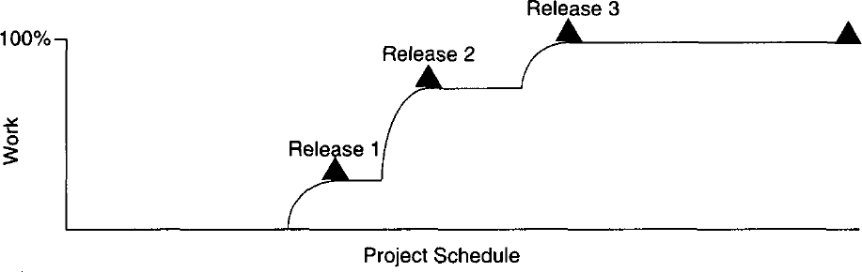

Slide 10
      Budgeted Cost And Expenditures
This metric measures cost incurred over time. Budgeted cost is the planned expenditure profile over the life cycle of the project.
To maintain management control, measuring cost expenditures over the project life cycle is always necessary. Tracking financial progress takes on an organization - specific format.
Financial performance can be measured by the use of an earned value system, which provides highly detailed cost and schedule insight.
The basic parameters of an earned value system, expressed in units of dollars, are as follows:

Slide 11
Expenditure Plan - It is the planned spending profile for a project over its planned schedule. Actual progress - It is the technical accomplishment relative to the planned progress underlying the spending profile.
Actual cost: It is the actual spending profile for a project over its actual schedule.
Earned value: It is the value that represents the planned cost of the actual progress

Slide 12
Cost variance: It is the difference between the actual cost and the earned value.
Schedule variance: It is the difference between the planned cost and the earned value. Of all parameters in an earned value system, actual progress is the most subjective
Assessment: Because most managers know exactly how much cost they have incurred and how much schedule they have used, the variability in making accurate assessments is centered in the actual progress assessment. The default perspectives of this metric are cost per month, full-time staff per month and percentage of budget expended.

Slide 13
      Staffing and Team Dynamics
These metric measures the personnel changes over time, which involves staffing additions and reductions over time. An iterative development should start with a small team until the risks in the requirements and architecture have been suitably resolved.
Depending on the overlap of iterations and other project specific circumstances, staffing can vary. Increase in staff can slow overall project progress as new people consume the productive team of existing people in coming up to speed. Low attrition of good people is a sign of success

Slide 14
The default perspectives of this metric are people per month added and people per month leaving. These three management indicators are responsible for technical progress, financial status and staffing progress.

Slide 15
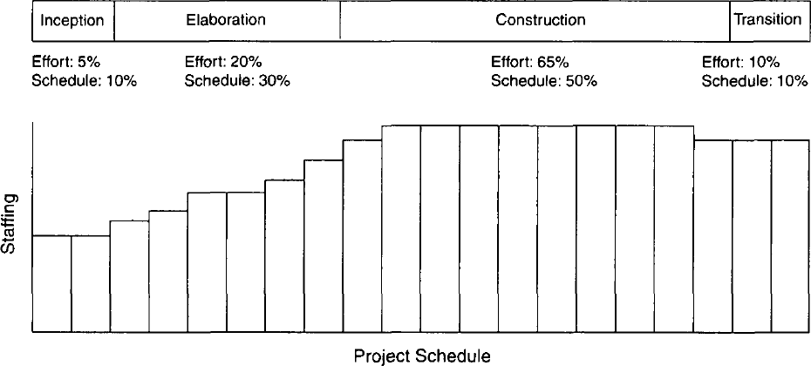

Slide 16
QUALITY INDICATORS
      Change Traffic And Stability:
This metric measures the change traffic over time. The number of software change orders opened and closed over the life cycle is called change traffic. Stability specifies the relationship between opened versus closed software change orders. This metric can be collected by change type, by release, across all releases, by term, by components, by subsystems, etc.

Slide 17
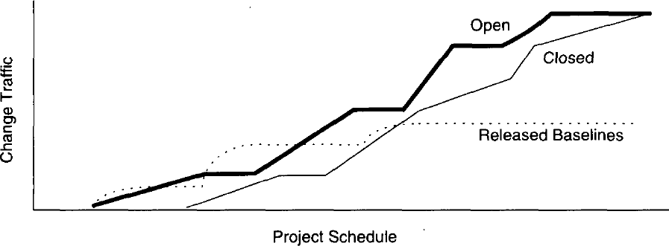

Slide 18
      Breakage And Modularity
This metric measures the average breakage per change over time. Breakage is defined as the average extent of change, which is the amount of software baseline that needs rework and measured in source lines of code, function points, components, subsystems, files or other units. Modularity is the average breakage trend over time. This metric can be collected by revoke SLOC per change, by change type, by release, by components and by subsystems.

Slide 19
      Rework and Adaptability:
This metric measures the average rework per change over time. Rework is defined as the average cost of change which is the effort to analyze, resolve and retest all changes to software baselines. Adaptability is defined as the rework trend over time.
This metric provides insight into rework measurement. All changes are not created equal. Some changes can be made in a staff- hour, while others take staff-weeks. This metric can be collected by average hours per change, by change type, by release, by components and by subsystems.

Slide 20
      MTBF And Maturity:
This metric measures defect rather over time. MTBF (Mean Time between Failures) is the average usage time between software faults. It is computed by dividing the test hours by the number of type 0 and type 1 SCOs. Maturity is defined as the MTBF trend over time.
Software errors can be categorized into two types deterministic and nondeterministic
Deterministic errors are also known as Bohr-bugs and nondeterministic errors are also called as Heisen-bugs. Bohr-bugs are a class of errors caused when the software is stimulated in a certain way such as coding errors.

Slide 21
Heisen-bugs are software faults that are coincidental with a certain probabilistic occurrence of a given situation, such as design errors. This metric can be collected by failure counts, test hours until failure, by release, by components and by subsystems. These four quality indicators are based primarily on the measurement of software change across evolving baselines of engineering data.

Slide 22
LIFE -CYCLE EXPECTATIONS
There is no mathematical or formal derivation for using seven core metrics properly. However, there were specific reasons for selecting them:
The quality indicators are derived from the evolving product rather than the artifacts.
They provide inside into the waste generated by the process. Scrap and rework metrics are a standard measurement perspective of most manufacturing processes.

Slide 23
They recognize the inherently dynamic nature of an iterative development process. Rather than focus on the value, they explicitly concentrate on the trends or changes with respect to time.
The combination of insight from the current and the current trend provides tangible indicators for management action.

Slide 24
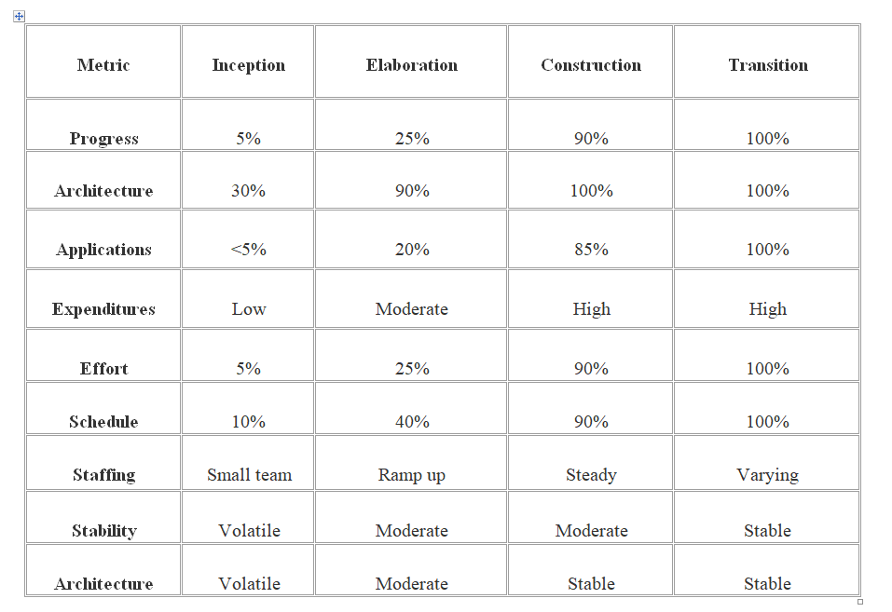

Slide 25
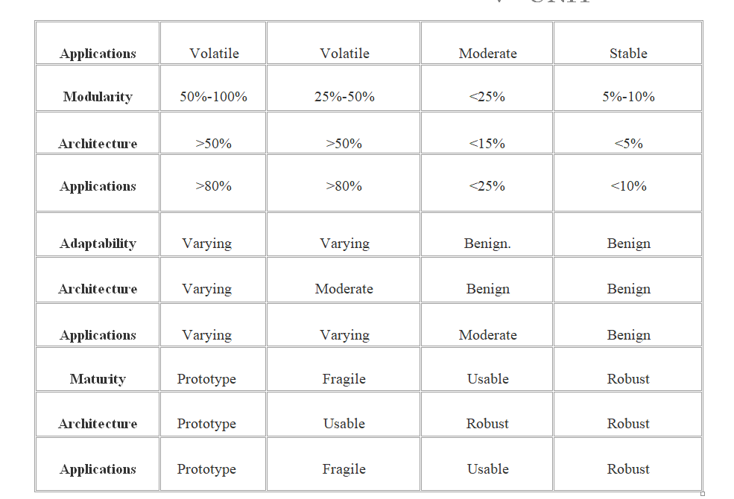

Slide 26
METRICS AUTOMATION:
Many opportunities are available to automate the project control activities of a software project. A Software Project Control Panel (SPCP) is essential for managing against a plan. This panel integrates data from multiple sources to show the current status of some aspect of the project. The panel can support standard features and provide extensive capability for detailed situation analysis. SPCP is one example of metrics automation approach that collects, organizes and reports values and trends extracted directly from the evolving engineering artifacts.

Slide 27
SPCP:
To implement a complete SPCP, the following are necessary.
Metrics primitives - trends, comparisons and progressions
A graphical user interface.
Metrics collection agents
Metrics data management server
Metrics definitions - actual metrics presentations for requirements progress, implementation progress, assessment progress, design progress and other progress dimensions.
Actors - monitor and administrator.

Slide 28
Monitor defines panel layouts, graphical objects and linkages to project data. Specific monitors called roles include software project managers, software development team leads, software architects and customers. Administrator installs the system, defines new mechanisms, graphical objects and linkages. The whole display is called a panel. Within a panel are graphical objects, which are types of layouts such as dials and bar charts for information. Each graphical object displays a metric.

Slide 29
A panel contains a number of graphical objects positioned in a particular geometric layout. A metric shown in a graphical object is labeled with the metric type, summary level and insurance name (line of code, subsystem, server1).
Metrics can be displayed in two modes – value, referring to a given point in time and graph referring to multiple and consecutive points in time.
Metrics can be displayed with or without control values. A control value is an existing expectation either absolute or relative that is used for comparison with a dynamically changing metric. Thresholds are examples of control values.

Slide 30


The basic fundamental metrics classes are trend, comparison and progress

Slide 31
The format and content of any project panel are configurable to the software project manager's preference for tracking metrics of top-level interest. The basic operation of an SPCP can be described by the following top - level use case.
Start the SPCP
Select a panel preference
Select a value or graph metric
Select to superimpose controls
Drill down to trend
Drill down to point in time.
Drill down to lower levels of information
Drill down to lower level of indicators.

Slide 32
TAILORING THE PROCESS
Process Discriminates:
In tailoring the management process to a specific domain or a project, there are two dimensions of discriminating factors:
technical complexity
management complexity

Slide 33
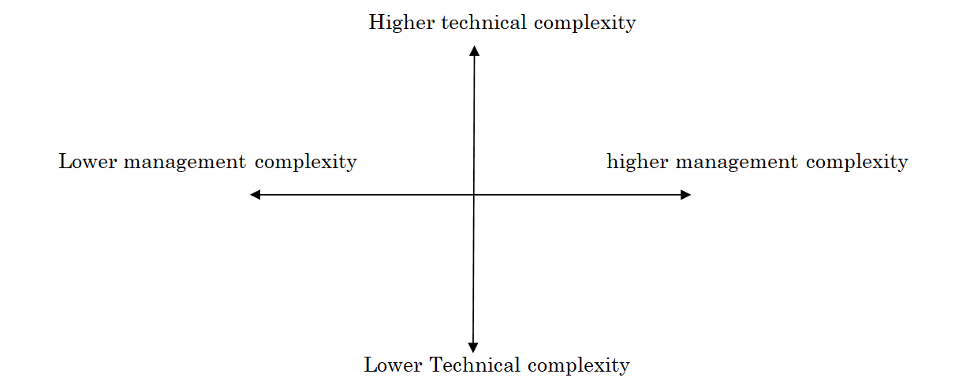

Slide 34
Management complexity considers some things like small Vs large scale, informal Vs contractual, few Vs many stakeholders and product Vs projects
Whereas technical complexity lowers order are straightforward automation, single thread, interactive performance, single platform, many precedent system, application re engineering. And higher technical complexity towards embedded, real time, distributed, fault tolerant, high performance, portable and unprecedented, architecture re engineering.

Slide 35
A process framework is not a project specific process implementation with a well defined guidelines for success.
The project processes is organized into six process parameters:
scale
stakeholders cohesion or contention
process flexibility or rigor
process maturity
architectural risk
domain experience

Slide 36
SCALE
The most important factor in tailoring a software process frame work to the specific needs of a project is the total scale of the software application.
There are many ways to measure scale, including the number of SLOC, number use cases
There is fundamentally different management approaches needed to manage a team of
1(trivial)
5(small)
25(moderate)
125(large)
625(huge) and so on

Slide 37
Trivial sized projects
There is no management overhead i.e. planning, communication, coordination, progress assessment, review, administration.
There is little need to document the intermediate artifacts
Workflow is single threaded
Performance is highly dependents on personnel skills

Slide 38
Small sized projects
Require very little management overhead
There is some need to communicate intermediate artifacts among team members
Project milestones are easily planned, informally conducted, easily changed
There are small number of individual workflows
Performance depends primarily on personnel skills

Slide 39
Moderate sized projects
Require moderate management overhead
There is a definite need to communicate the intermediate artifacts among teams
Performance is highly dependent on the skill of the key personnel, especially team lead
Large size projects
Require substantial management overhead.
There is significant expenditure in overhead workflows across all team lead.
Performance is highly dependent on the skill of the key personnel, especially subproject mangers and team lead.

Slide 40
Huge size projects
Require substantial management overhead.
Require multiple software project managers and many subproject managers.
Project milestone are formally planned and conducted and changes to milestone plans typically cause malignant re planning.
Software process maturity and domain experiences are mandatory to avoid risks and ensure synchronization of expectations across numerous stakeholders.

Slide 41
Stakeholder cohesion or contention:
The degree of cooperation and coordination among stakeholders can significantly drive the specific of how a process is defined
This process parameters range from cohesive to adversarial
A small collocated organization can be established that has a cohesive skill base and excellence day-to- day communication among team members
All these factors tend to degrade team cohesion and must be managed continuously.

Slide 42
Process flexibility or rigors
The degree of rigors, procedure and change freedom inherent in a specific projects “contract”
For every loose contracts such as building a commercial product with in a business unit of a software company management complexity is minimal
In these sorts of development process, feature set, time to market, budget and quality can all be freely traded off and changed with very little overhead

Slide 43
Process maturity
Managing a mature process is far simpler than managing immature process
Organization with a mature process typically have high level of precedent experience in developing software
Tailoring a mature organization process for a specific project is generally a straight forward task

Slide 44
Architectural risk
The degree of technical feasibility demonstrated before commitment to full scale production is an important dimension of defining a specific project process
There are many sources of architectural risk. Some of the most important and recurring sources are system performance, robustness to change and system reliability.
The degree to which these risk can be eliminated before construction begins can have dramatic ramification in the process tailoring

Slide 45
Domain experience
The development organization’s domain exp governs its ability to converge on an acceptable architecture in a minimum number of iteration
For example, an organization that has built five generations of radar control switches may be able to converge on an adequate baseline architecture for a new radar application in two or three prototyping release iteration
A skilled software organization building its first radar application may require four or five prototype releases before converging on adequate baseline.

Slide 46
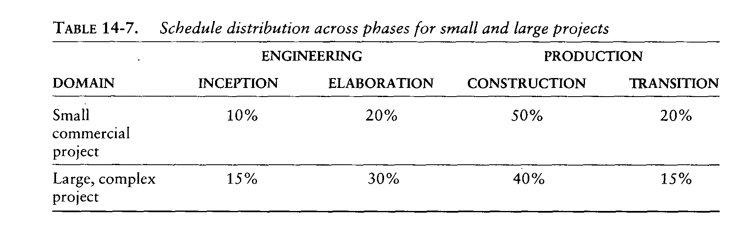

Slide 47
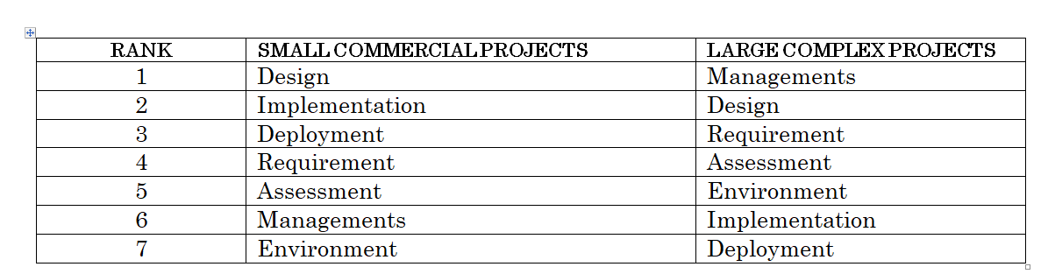

Slide 48
FUTURE SOFTWARE PROJECT MANAGEMENT
Modern project profiles
A modern process framework exploits several critical approaches for resolving these issues:
Protracted integration and late design breakage
Late risk resolution
The analysis of a requirement driven functional decomposition
Adversarial stakeholder relationship
Focus on documentation and review meetings

Slide 49
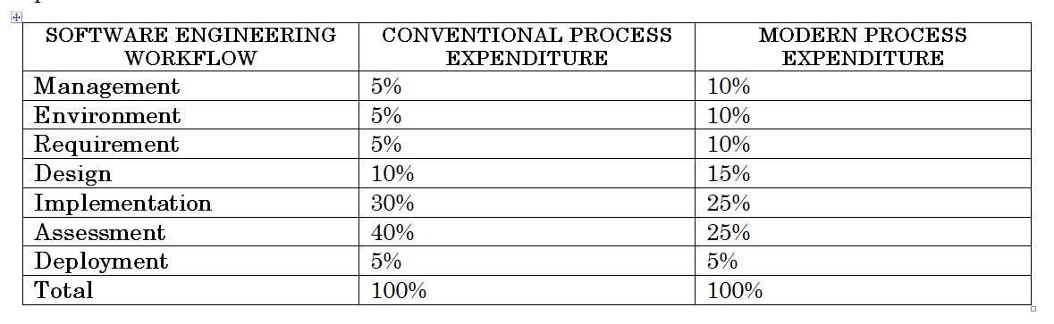
Continuous integration
Difference in workflow cost allocations between a conventional process and a modern process

Slide 50
Early risk resolution
The effect of the overall lifecycle philosophy on the 80/20 lessons learned over the past 30 years of software management experience provides a useful risk management perspective
80% of the engineering is consumed by 20% of the requirements
80% of the software cost is consumed by 20% of the components
80% of the errors are caused by 20% of the components
80% of the software scrap and rework is caused by 20% of the change
80% of the resources consumption (execution time, disk space, memory) is consumed by 20% of the components
80% of the progress is made by 20% of the people.

Slide 51
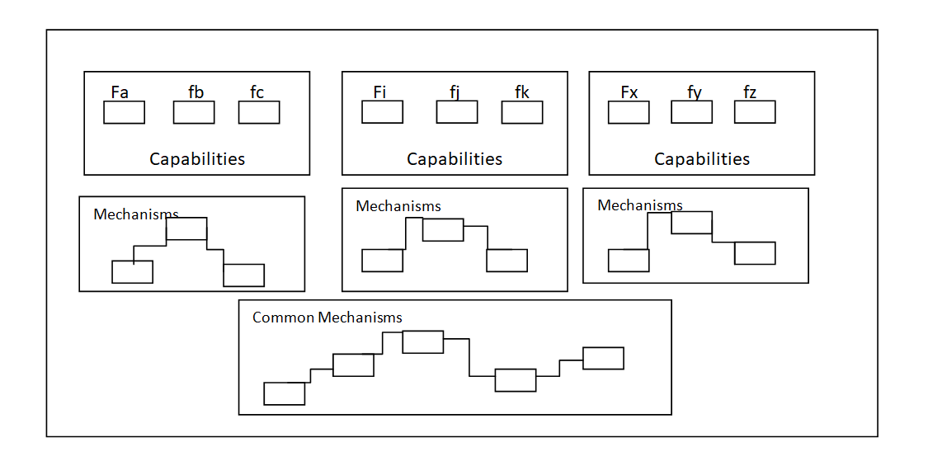
Teamwork among stakeholders

Slide 52
Top 10 software management principles
Base the process on an architecture-first approach
Establish an iterative life cycle process that confronts risk early
Transition design methods to emphasize components-based development
Establish a change management environment
Enhance change freedom through tools that support round-trip engineering.
Capture design artifacts in rigorous, model-based notation.
Instrument the process for objective quality control
Use demonstration-based approach
Plan intermediate releases in group of usage scenarios with evolving level of details
Establish a configurable process that is economically scalable

Slide 53
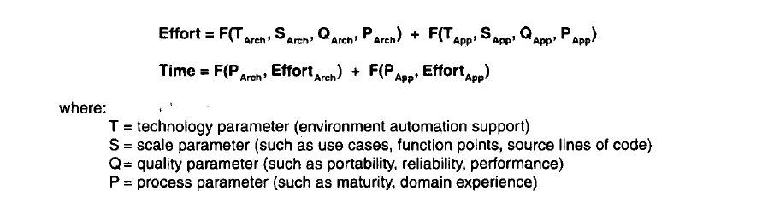
Next Generation software Economics

Slide 54
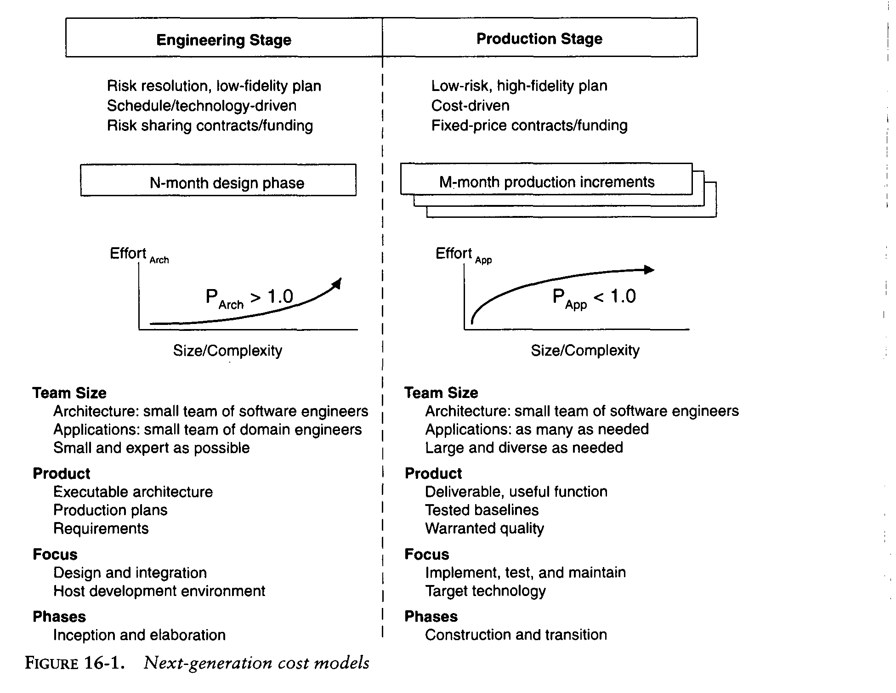

Slide 55
Modern Software Economics
Finding and fixing a software problem after delivery costs 100 times more than finding and fixing the problem in early design phases.
You can compress software development schedules 25% of nominal, but no more.
For every $1 you spend on development, you will spend $2 on maintenance.
Software development and maintenance costs are primarily a function of the number of source lines of code.
Variations among people account for the biggest differences in software productivity.

Slide 56
The overall ratio of software to hardware costs is still growing. In 1955 it was 15:85; in 1985, 85:15.
Only about 15% of software development effort is devoted to programming.
Software systems and products typically cost 3 times as much per SLOC as individual software programs. Software-system products (i.e., system of systems) cost 9 times as much.
Walkthroughs catch 60% of the errors
80% of the contribution comes from 20% of the contributors.

Slide 57
Modern Process Transitions
Culture Shifts
Lower level and mid level Mangers are performers
Requirements and Design are fluid and tangible
Ambitious demonstration are encourage
Good and Bad project Performance is much more obvious earlier in the life
Early increments will be immature
Artifacts are less important early, more important later

Slide 58
Real issues are surfaced and resolved systematically
Quality assurance is everyone’s job, not a separate discipline
Performance issues arise early in the life cycle.
Investments in automation are necessary
Good software organization should be more profitable

