Slide 1
Unit - II
Process Concept, Multithreaded Programming, Process Scheduling, Inter-process Communication

Slide 2
Part-I
Process Concept
Process scheduling
Operations on processes
Inter-process communication
Communication in client server systems.

Slide 3
The Process
A process is basically a program in execution. The execution of a process must progress in a sequential fashion.
A process is basically a program in execution. The execution of a process must progress in a sequential fashion.
When a program is loaded into the memory and it becomes a process, it can be divided into four sections ─ stack, heap, text and data. The following image shows a simplified layout of a process inside main memory

Slide 4
Fig. Process in Memory

Slide 5
Stack: The process Stack contains the temporary data such as method/function parameters, return address and local variables.
Heap : This is dynamically allocated memory to a process during its run time.
Text: This includes the current activity represented by the value of Program Counter and the contents of the processor's registers
Data: This section contains the global and static variables.

Slide 6
Process State
As a process executes, it changes state. The state of a process is defined in part by the current activity of that process. A process may be in one of the following states:
New. The process is being created
Running. Instructions are being executed.
Waiting. The process is waiting for some event to occur
Ready. The process is waiting to be assigned to a processor
Terminated. The process has finished execution

Slide 7
Fig. Process States

Slide 8
Process Control Block
Each process is represented in the operating system by a process control block (PCB)—also called a task control block
It contains many pieces of information associated with a specific process, including these: Process State, Program Counter, CPU Registers, CPU- Scheduling Information, Memory Management Information, Accounting Information and I/O Status Information

Slide 9
Fig. Process Control Block

Slide 10
Process State: The current state of the process i.e., whether it is ready, running, waiting, or whatever.
Program Counter : The counter indicates the address of the next instruction to be executed for this process
CPU Registers: The registers vary in number and type, depending on the computer architecture need to be stored for execution for running state.
CPU Scheduling Information: Process priority and other scheduling information which is required to schedule the process.

Slide 11
Fig. Diagram showing CPU switch from process to process

Slide 12
Threads
A process is a program that performs a single thread of execution.
For example, when a process is running a word-processor program, a single thread of instructions is being executed. This single thread of control allows the process to perform only one task at a time. The user cannot simultaneously type in characters and run the spell checker within the same process
for example. Most modern operating systems have extended the process concept to allow a process to have multiple threads of execution and thus to perform more than one task at a time

Slide 13
Memory Management Information: This information may include such items as the value of the base and limit registers and the page tables, or the segment tables, depending on the memory system used by the operating system
Accounting Information : This information includes the amount of CPU and real time used, time limits, account numbers, job or process numbers, and so on
I/O Status Information : This information includes the list of I/O devices allocated to the process, a list of open files, and so on.

Slide 14
Process Scheduling
The objective of multiprogramming is to have some process running at all times, to maximize CPU utilization.
The objective of time sharing is to switch the CPU among processes so frequently that users can interact with each program while it is running.
To meet these objectives, the process scheduler selects an available process for program execution on the CPU. For a single-processor system, there will never be more than one running process. If there are more processes, the rest will have to wait until the CPU is free and can be rescheduled

Slide 15
Scheduling Queues
The Operating System maintains the following important process scheduling queues
Job queue − This queue keeps all the processes in the system.
Ready queue − This queue keeps a set of all processes residing in main memory, ready and waiting to execute. A new process is always put in this queue.
Device queues − The processes which are blocked due to unavailability of an I/O device constitute this queue.

Slide 16
Fig. queuing Diagram Representation of Process Scheduling

Slide 17
A common representation of process scheduling is a queueing diagram
Each rectangular box represents a queue. Two types of queues are present: the ready queue and a set of device queues. The circles represent the resources that serve the queues, and the arrows indicate the flow of processes in the system.
A new process is initially put in the ready queue. It waits there until it is selected for execution, or dispatched
Once the process is allocated the CPU and is executing, one of several events could occur

Slide 18
The process could issue an I/O request and then be placed in an I/O queue.
The process could create a new child process and wait for the child’s termination.
The process could be removed forcibly from the CPU, as a result of an interrupt, and be put back in the ready queue.
In the first two cases, the process eventually switches from the waiting state to the ready state and is then put back in the ready queue. A process continues this cycle until it terminates, at which time it is removed from all queues and has its PCB and resources deallocated

Slide 19
Schedulers
Schedulers are special system software which handle process scheduling in various ways. Their main task is to select the jobs to be submitted into the system and to decide which process to run. Schedulers are of three types
Long-Term Scheduler
Short-Term Scheduler
Medium-Term Scheduler

Slide 20
Long Term Scheduler
It is also called a job scheduler. A long-term scheduler determines which programs are admitted to the system for processing.
It selects processes from the queue and loads them into memory for execution. Process loads into the memory for CPU scheduling.
The primary objective of the job scheduler is to provide a balanced mix of jobs, such as I/O bound and processor bound. It also controls the degree of multiprogramming.
If the degree of multiprogramming is stable, then the average rate of process creation must be equal to the average departure rate of processes leaving the system.

Slide 21
Short Term Scheduler
It is also called as CPU scheduler. Its main objective is to increase system performance in accordance with the chosen set of criteria. It is the change of ready state to running state of the process.
CPU scheduler selects a process among the processes that are ready to execute and allocates CPU to one of them.
Short-term schedulers, also known as dispatchers, make the decision of which process to execute next. Short-term schedulers are faster than long-term schedulers.

Slide 22
Medium Term Scheduler
Some operating systems, such as time-sharing systems, may introduce an additional, intermediate level of scheduling called medium-term scheduler
The key idea behind a medium-term scheduler is that sometimes it can be advantageous to remove a process from memory and thus reduce the degree of multiprogramming. Later, the process can be reintroduced into memory, and its execution can be continued where it left off. This scheme is called swapping.
The process is swapped out, and is later swapped in, by the medium-term scheduler

Slide 23
Fig. Addition of medium-term scheduling to the queueing diagram

Slide 24
Context Switch
A context switch is the mechanism to store and restore the state or context of a CPU in Process Control block so that a process execution can be resumed from the same point at a later time.
Context switching is an essential part of a multitasking operating system features.
When the scheduler switches the CPU from executing one process to execute another, the state from the current running process is stored into the process control block.
After this, the state for the process to run next is loaded from its own PCB and used to set the PC, registers, etc. At that point, the second process can start executing.

Slide 25
Operations on Process
Process Creation
A process may create several new processes, via a create-process system call, during the course of execution.
The creating process is called a parent process, and the new processes are called the children of that process. Each of these new processes may in turn create other processes, forming a tree of processes.
Most operating systems identify processes according to a unique process identifier (or pid), which is typically an integer number.
The pid provides a unique value for each process in the system, and it can be used as an index to access various attributes of a process within the kernel

Slide 26
Fig. A Tree of Processes on typical Linux System

Slide 27
A typical process tree for the Linux operating system, showing the name of each process and its pid.
The init process serves as the root parent process for all user processes
When a process creates a new process, two possibilities exist in terms of execution:
The parent continues to execute concurrently with its children.
The parent waits until some or all of its children have terminated

Slide 28
There are also two possibilities in terms of the address space of the new process:
1. The child process is a duplicate of the parent process (it has the same program and data as the parent).
2. The child process has a new program loaded into it
A new process is created by the fork() system call. The new process consists of a copy of the address space of the original process. This mechanism allows the parent process to communicate easily with its child process

Slide 29
Both processes (the parent and the child) continue execution at the instruction after the fork(), with one difference:
The return code for the fork() is zero for the new (child) process, whereas the (nonzero) process identifier of the child is returned to the parent.
the exec() system call is used after a fork() system call by one of the two processes to replace the process's memory space with a new program starts its execution

Slide 30
Fig. Process Creation using Fork System Call

Slide 31
Process Termination
A process terminates when it finishes executing its final statement and asks the operating system to delete it by using the exit () system call.
At that point, the process may return a status value (typically an integer) to its parent process (via the wait() system call).
All the resources of the process—including physical and virtual memory, open files, and I/O buffers—are deallocated by the operating system.
Termination can occur in other circumstances as well. A process can cause the termination of another process via an appropriate system call

Slide 32
A parent may terminate the execution of one of its children for a variety of reasons, such as these:
The child has exceeded its usage of some of the resources that it has been allocated.
The task assigned to the child is no longer required.
The parent is exiting, and the operating system does not allow a child to continue if its parent terminates.

Slide 33
Inter-process Communication
Processes executing concurrently in the operating system may be either independent processes or cooperating processes.
A process is independent if it cannot affect or be affected by the other processes executing in the system
Any process that does not share data with any other process is independent.
A process is cooperating if it can affect or be affected by the other processes executing in the system.

Slide 34
There are several reasons for providing an environment that allows process cooperation:
Information sharing. Since several users may be interested in the same piece of information (for instance, a shared file), we must provide an environment to allow concurrent access to such information
Computation speedup. If we want a particular task to run faster, we must break it into subtasks, each of which will be executing in parallel with the others. Notice that such a speedup can be achieved only if the computer has multiple processing elements (such as CPUs or I/O channels).

Slide 35
Modularity. We may want to construct the system in a modular fashion, dividing the system functions into separate processes or threads.
Convenience. Even an individual user may work on many tasks at the same time. For instance, a user may be editing, printing, and compiling in parallel.
Cooperating processes require an interprocess communication (IPC) mechanism that will allow them to exchange data and information.
There are two fundamental models of inter-process communication:

Slide 36
(1) shared memory and
(2) message passing.
In the shared-memory model, a region of memory that is shared by cooperating processes is established.
Processes can exchange information by reading and writing data to the shared region.
In the message passing model, communication takes place by means of messages exchanged between the cooperating processes.

Slide 37
Message passing is useful for exchanging smaller amounts of data, because no conflicts need be avoided.
Message passing is also easier to implement than is shared memory for inter computer communication.
Shared memory allows maximum speed and convenience of communication, as it can be done at memory speeds when within a computer.
Shared memory is faster than message passing, as message-passing systems are typically implemented using system calls and thus require the more time consuming task of kernel intervention.

Slide 38
Fig. Communication Models : A. Message Passing B. Shared Memory

Slide 39
Shared-Memory Systems Inter process communication using shared memory requires communicating processes to establish a region of shared memory.
Typically, a shared-memory region resides in the address space of the process creating the shared-memory segment. Other processes that wish to communicate using this shared-memory segment must attach it to their address space.
The operating system tries to prevent one process from accessing another process's memory. Shared memory requires that two or more processes agree to remove this restriction.
They can then exchange information by reading and writing data in the shared areas

Slide 40
Message-Passing Systems The scheme requires that these processes share a region of memory and that the code for accessing and manipulating the shared memory be written explicitly by the application programmer.
Another way to achieve the same effect is for the operating system to provide the means for cooperating processes to communicate with each other via a message-passing facility
Message passing provides a mechanism to allow processes to communicate and to synchronize their actions without sharing the same address space and is particularly useful in a distributed environment, where the communicating processes may reside on different computers connected by a network.

Slide 41
A message-passing facility provides at least two operations:
send(message) and receive(message).
Messages sent by a process can be of either fixed or variable size.
If only fixed sized messages can be sent, the system-level implementation is straightforward. This restriction, however, makes the task of programming more difficult.
Conversely, variable-sized messages require a more complex system-level implementation, but the programming task becomes simpler. This is a common kind of tradeoff seen throughout operating system design

Slide 42
Naming
Processes that want to communicate must have a way to refer to each other.
They can use either direct or indirect communication.
Under direct communication, each process that wants to communicate must explicitly name the recipient or sender of the communication.
In this scheme, the send() and receive() primitives are defined as:

Slide 43
send(P, message)—Send a message to process P
receive (Q, message)—Receive a message from process Q
A communication link in this scheme has the following properties:
A link is established automatically between every pair of processes that want to communicate. The processes need to know only each other's identity to communicate.
A link is associated with exactly two processes.
Between each pair of processes, there exists exactly one link

Slide 44
The disadvantage in both of these schemes (symmetric and asymmetric) is the limited modularity of the resulting process definitions. Changing the identifier of a process may necessitate examining all other process definitions.

Slide 45
Synchronization
Communication between processes takes place through calls to send() and receive () primitives. There are different design options for implementing each primitive.
Message passing may be either blocking or nonblocking— also known as synchronous and asynchronous.
Blocking send- The sending process is blocked until the message is received by the receiving process or by the mailbox.
Nonblocking send- The sending process sends the message and resumes operation

Slide 46
Blocking receive- The receiver blocks until a message is available.
Nonblocking receive- The receiver retrieves either a valid message or a null.
Buffering Whether communication is direct or indirect, messages exchanged by communicating processes reside in a temporary queue. Basically, such queues can be implemented in threeways:
Zero capacity- The queue has a maximum length of zero; thus, the link cannot have any messages waiting in it. In this case, the sender must block until the recipient receives the message.

Slide 47
Bounded capacity- The queue has finite length n; thus, at most n messages can reside in it. If the queue is not full when a new message is sent, the message is placed in the queue (either the message is copied or a pointer to the message is kept), and the sender can continue execution without waiting. The links capacity is finite, however. If the link is full, the sender must block until space is available in the queue.
Unbounded capacity- The queues length is potentially infinite; thus, any number of messages can wait in it. The sender never blocks

Slide 48
Case Studies
Examples of IPC Systems :
POSIX Shared Memory
Windows XP

Slide 49
Communication in Client Server Systems
Client/Server communication involves two components, namely a client and a server. They are usually multiple clients in communication with a single server. The clients send requests to the server and the server responds to the client requests.
There are three main methods to client/server communication
Sockets
Remote Procedure Calls
PIPES

Slide 50
Sockets
Sockets facilitate communication between two processes on the same machine or different machines. They are used in a client/server framework and consist of the IP address and port number.
Many application protocols use sockets for data connection and data transfer between a client and a server.
Socket communication is quite low-level as sockets only transfer an unstructured byte stream across processes. The structure on the byte stream is imposed by the client and server applications.

Slide 51
Fig. Communication using sockets

Slide 52
When a client process initiates a request for a connection, it is assigned a port by its host computer. This port has some arbitrary number greater than 1024.
For example, if a client on host X with IP address 146.86.5.20 wishes to establish a connection with a web server (which is listening on port 80) at address 161.25.19.8, host X may be assigned port 1625.
The connection will consist of a pair of sockets: (146.86.5.20:1625) on host X and (161.25.19.8:80) on the web server

Slide 53
Remote Procedure Calls
These are interprocess communication techniques that are used for client-server based applications. A remote procedure call is also known as a subroutine call or a function call.
A client has a request that the RPC translates and sends to the server.
This request may be a procedure or a function call to a remote server. When the server receives the request, it sends the required response back to the client

Slide 54
Pipes
These are interprocess communication methods that contain two end points. Data is entered from one end of the pipe by a process and consumed from the other end by the other process.
The two different types of pipes are ordinary pipes and named pipes.
Ordinary pipes allow two processes to communicate in standard producer– consumer fashion: the producer writes to one end of the pipe (the write-end) and the consumer reads from the other end (the read-end).
Ordinary pipes only allow one way communication. For two way communication, two pipes are required.
Ordinary pipes have a parent child relationship between the processes as the pipes can only be accessed by processes that created or inherited them.

Slide 55
Fig. File Descriptors for Ordinary PIPE

Slide 56
Named pipes provide a much more powerful communication tool.
Communication can be bidirectional, and no parent–child relationship is required. Once a named pipe is established, several processes can use it for communication.
These pipes exist even after the processes using them have terminated. They need to be explicitly deleted when not required anymore.

Slide 57
Part-II
Multithreaded Programming: Multithreading models, Thread libraries, Threading issues, Examples

Slide 58
Threads
A thread is a basic unit of CPU utilization; it comprises a thread ID, a program counter, a register set, and a stack.
It shares with other threads belonging to the same process its code section, data section, and other operating-system resources, such as open files and signals.
A traditional (or heavyweight) process has a single thread of control. If a process has multiple threads of control, it can perform more than one task at a time

Slide 60
Overview
A word processor may have a thread for displaying graphics, another thread for responding to keystrokes from the user, and a third thread for performing spelling and grammar checking in the background
In certain situations, a single application may be required to perform several similar tasks. For example, a web server accepts client requests for web pages, images, sound, and so forth.
A busy web server may have several (perhaps thousands) of clients concurrently accessing it. If the web server ran as a traditional single-threaded process, it would be able to service only one client at a time. The amount of time that a client might have to wait for its request to be serviced could be enormous.

Slide 61
One solution is to have the server run as a single process that accepts requests.
When the server receives a request, it creates a separate process to service that request. Threads also play a vital role in remote procedure call (RPC) systems.
Finally, many operating system kernels are now multithreaded; several threads operate in the kernel, and each thread performs a specific task,such as managing devices or interrupt handling.

Slide 62
Fig. Multi threaded server architecture

Slide 63
Benefits of Multithreaded Programming
Responsiveness: Multithreading an interactive application may allow a program to continue running even if part of it is blocked or is performing a lengthy operation, thereby increasing responsiveness to the user.
Resource sharing. Processes can only share resources through techniques such as shared memory and message passing. Such techniques must be explicitly arranged by the programmer.
Economy. Allocating memory and resources for process creation is costly. Because threads share the resources of the process to which they belong, it is more economical to create and context-switch threads

Slide 64
Fig: Concurrent execution on a single-core system
Scalability. The benefits of multithreading can be even greater in a multiprocessor architecture, where threads may be running in parallel on different processing cores. A single-threaded process can run on only one processor, regardless how many are available. We explore this issue further in the following section

Slide 65
Multicore programming
A more recent, similar trend in system design is to place multiple computing cores on a single chip. Each core appears as a separate processor to the operating system
Whether the cores appear across CPU chips or within CPU chips, we call these systems multicore or multiprocessor systems
Multithreaded programming provides a mechanism for more efficient use of these multiple computing cores and improved concurrency

Slide 66
Fig. Parallel execution on a multicore system

Slide 67
Types of Parallelism
There are two types of parallelism: data parallelism and task parallelism. Data parallelism focuses on distributing subsets of the same data across multiple computing cores and performing the same operation on each core.
Task parallelism involves distributing not data but tasks (threads) across multiple computing cores. Each thread is performing a unique operation. Different threads may be operating on the same data, or they may be operating on different data

Slide 68
Multithreading Models
Multi threading-It is a process of multiple threads executes at same time.
Many operating systems support kernel thread and user thread in a combined way.
Many to One Model
The many to one model maps many of the user threads to a single kernel thread. This model is quite efficient as the user space manages the thread management.
A disadvantage of the many to one model is that a thread blocking system call blocks the entire process. Also, multiple threads cannot run in parallel as only one thread can access the kernel at a time.

Slide 69
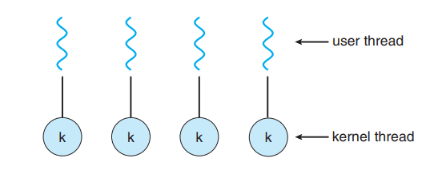
Many to one Model
One to One Model

Slide 70
One to One Model: The one to one model maps each of the user threads to a kernel thread. This means that many threads can run in parallel on multiprocessors and other threads can run when one thread makes a blocking system call.
A disadvantage of the one to one model is that the creation of a user thread requires a corresponding kernel thread. Since a lot of kernel threads burden the system, there is restriction on the number of threads in the system.

Slide 71
Many to Many Model:The many to many model maps many of the user threads to a equal number or lesser kernel threads. The number of kernel threads depends on the application or machine.
The many to many does not have the disadvantages of the one to one model or the many to one model. There can be as many user threads as required and their corresponding kernel threads can run in parallel on a multiprocessor.

Slide 72
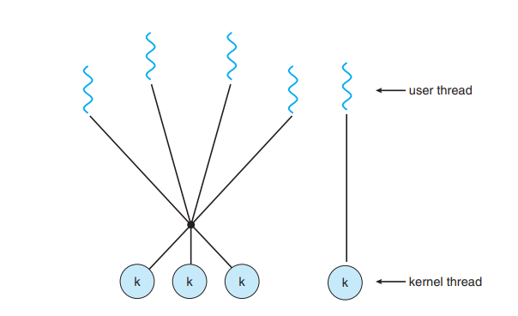
Many to Many Model
Two Level Model

Slide 73
One variation on the many-to-many model still multiplexes many userlevel threads to a smaller or equal number of kernel threads but also allows a user-level thread to be bound to a kernel thread. This variation is sometimes referred to as the two-level model

Slide 74
Thread Libraries
A thread library provides the programmer with an API (Application program interface) for creating and managing thread.
Ways of implementing thread library
There are two primary ways of implementing thread library, which are as follows −
The first approach is to provide a library entirely in user space with kernel support. All code and data structures for the library exist in a local function call in user space and not in a system call.

Slide 75
The second approach is to implement a kernel level library supported directly by the operating system. In this case the code and data structures for the library exist in kernel space.
Invoking a function in the application program interface for the library typically results in a system call to the kernel.
The main thread libraries which are used are given below
POSIX threads − Pthreads refers to the POSIX standard (IEEE 1003.1c) defining an API for thread creation and synchronization. This is a specification for thread behavior, not an implementation
Pthreads, the threads extension of the POSIX standard, may be provided as either a user level or a kernel level library.

Slide 76
WIN 32 thread − The windows thread library is a kernel level library available on windows systems.
JAVA thread − The JAVA thread API allows threads to be created and managed directly as JAVA programs.

Slide 77
Threading Issues
Semantics of fork() and exec() system calls
Thread cancellation
Signal handling
Thread pools
The fork() and exec() system calls:
The fork() is used to create a duplicate process. The meaning of the fork() and exec() system calls change in a multithreaded program
If one thread in a program which calls fork(), does the new process duplicate all threads, or is the new process single-threaded?

Slide 78
If we take, some UNIX systems have chosen to have two versions of fork(), one that duplicates all threads and another that duplicates only the thread that invoked the fork() system call.
If a thread calls the exec() system call, the program specified in the parameter to exec() will replace the entire process which includes all threads

Slide 79
Signal Handling: Generally, signal is used in UNIX systems to notify a process that a particular event has occurred. A signal received either synchronously or asynchronously, based on the source of and the reason for the event being signalled.
All signals, whether synchronous or asynchronous, follow the same pattern as given below −
A signal is generated by the occurrence of a particular event.
The signal is delivered to a process.
Once delivered, the signal must be handled.

Slide 80
Cancellation:Thread cancellation is the task of terminating a thread before it has completed.
A target thread is a thread that is to be cancelled, cancellation of target thread may occur in two different scenarios −
Asynchronous cancellation − One thread immediately terminates the target thread.
Deferred cancellation − The target thread periodically checks whether it should terminate, allowing it an opportunity to terminate itself in an ordinary fashion.

Slide 81
Thread Polls:Multithreading in a web server, whenever the server receives a request it creates a separate thread to service the request
Some of the problems that arise in creating a thread are as follows :
The amount of time required to create the thread prior to serving the request together with the fact that this thread will be discarded once it has completed its work.
If all concurrent requests are allowed to be serviced in a new thread, there is no bound on the number of threads concurrently active in the system

Slide 82
Unlimited thread could exhaust system resources like CPU time or memory.
A thread pool is to create a number of threads at process start-up and place them into a pool, where they sit and wait for work.

Slide 83
Operating System Examples
Windows Threads:Windows implements the Windows API, which is the primary API for the family of Microsoft operating systems
A Windows application runs as a separate process, and each process may contain one or more threads
Windows uses the one-to-one mapping
The general components of a thread include:A thread ID, A register set, A user stack and A private storage area

Slide 84
The register set, stacks, and private storage area are known as the context of the thread.
The primary data structures of a thread include:
ETHREAD—executive thread block
KTHREAD—kernel thread block
TEB—thread environment block
The key components of the ETHREAD include a pointer to the process to which the thread belongs and the address of the routine in which the thread starts control
The KTHREAD includes scheduling and synchronization information for the thread
the TEB contains the thread identifier, a user-mode stack, and an array for thread-local storage

Slide 85
Fig. Data Structures of a windows thread

Slide 86
Linux Threads:Linux provides the fork() system call with the traditional functionality of duplicating a process
Linux also provides the ability to create threads using the clone() system call
Linux does not distinguish between processes and threads. In fact, Linux uses the term task —rather than process or thread— when referring to a flow of control within a program
When clone() is invoked, it is passed a set of flags that determine how much sharing is to take place between the parent and child tasks

Slide 87
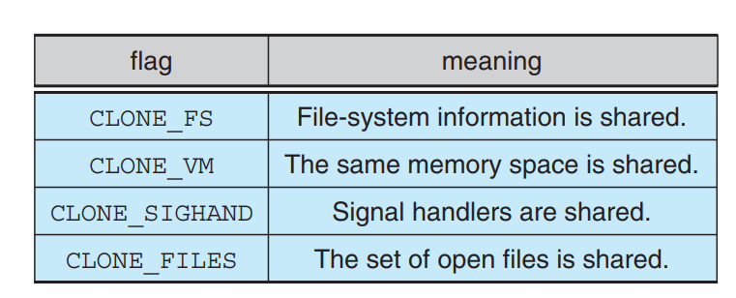
For example, suppose that clone() is passed the flags CLONE FS, CLONE VM, CLONE SIGHAND, and CLONE FILES. The parent and child tasks will then share the same file-system information

Slide 88
Using clone() in this fashion is equivalent to creating a thread
since the parent task shares most of its resources with its child task
However, if none of these flags is set when clone() is invoked, no sharing takes place, resulting in functionality similar to that provided by the fork() system call

Slide 89
Part-III
Process Scheduling: Basic concepts, Scheduling criteria, Scheduling algorithms, Multiple processor scheduling, Thread scheduling, Examples

Slide 90
In a single-processor system, only one process can run at a time. Others must wait until the CPU is free and can be resched
The objective of multiprogramming is to have some process running at all times, to maximize CPU utilization.
Several processes are kept in memory at one time when one process has to wait, the operating system takes the CPU away from that process and gives the CPU to another process. This pattern continues

Slide 91
CPU –I/O Burst Cycle
process execution consists of a cycle of CPU execution and I/O wait. Processes alternate between these two states.
Process execution begins with a CPU burst. That is followed by an I/O burst, which is followed by another CPU burst, then anotherI/O burst, and so on.
Eventually, the final CPU burst ends with a system request to terminate execution.
An I/O-bound program typically has many short CPU bursts. A CPU-bound program might have a few long CPU bursts

Slide 92
Fig. Alternating sequence of CPU and I/O bursts.

Slide 93
CPU Scheduler
Selects from among the processes in memory that are ready to execute, and allocates the CPU to one of them
CPU scheduling decisions may take place when a process:
When a process switches from the running state to the waiting state
When a process switches from the running state to the ready state
When a process switches from the waiting state to the ready state
When a process terminates

Slide 94
When scheduling takes place only under circumstances 1 and 4, we say that the scheduling scheme is nonpreemptive or cooperative. Otherwise, it is preemptive
Preemptive Scheduling: The resources (mainly CPU cycles) are allocated to the process for a limited amount of time and then taken away, and the process is again placed back in the ready queue if that process still has CPU burst time remaining. That process stays in the ready queue till it gets its next chance to execute.

Slide 95
Non Preemptive Scheduling: In this scheduling, once the resources (CPU cycles) are allocated to a process, the process holds the CPU till it gets terminated or reaches a waiting state.
In the case of non-preemptive scheduling does not interrupt a process running CPU in the middle of the execution.
Instead, it waits till the process completes its CPU burst time, and then it can allocate the CPU to another process.

Slide 96
Scheduling Criteria
CPU utilization. We want to keep the CPU as busy as possible. CPU utilization can range from 0 to 100 percent. In a real system, it should range from 40 percent (for a lightly loaded system) to 90 percent (for a heavily loaded system).
Throughput: number of processes that are completed per time unit, called throughput
Turnaround Time: The interval from the time of submission of a process to the time of completion is the turnaround time. Turnaround time is the sum of the periods spent waiting to get into memory, waiting in the ready queue, executing on the CPU, and doing I/O.

Slide 97
Waiting Time: Waiting time is the sum of the periods spent waiting in the ready queue.
Response Time:the time from the submission of a request until the first response is produced. This measure, called response time, is the time it takes to start responding, not the time it takes to output the response

Slide 98
Scheduling Algorithms
First Come First Served Scheduling:
Jobs are executed on first come, first serve basis.
It is a non-preemptive scheduling algorithm.
Easy to understand and implement.
Its implementation is based on FIFO queue.
Poor in performance as average wait time is high.

Slide 99
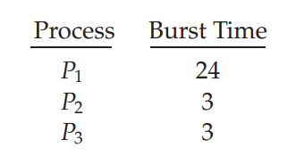
Example: If the processes arrive in the order P1, P2, P3, and are served in FCFS order, we get the result shown in the following Gantt chart, which is a bar chart that illustrates a particular schedule, including the start and finish times of each of the participating processes:

Slide 100
The waiting time is 0 milliseconds for process P1, 24 milliseconds for process P2, and 27 milliseconds for process P3. Thus, the average waiting time is (0 + 24 + 27)/3 = 17 milliseconds. If the processes arrive in the order P2, P3, P1, however, the results will be as shown in the following Gantt chart:
The average waiting time is now (6 + 0 + 3)/3 = 3 milliseconds

Slide 101
There is a convoy effect as all the other processes wait for the one big process to get off the CPU. This effect results in lower CPU and device utilization than might be possible if the shorter processes were allowed to go first.
The FCFS algorithm is thus particularly troublesome for time-sharing systems, where it is important that each user get a share of the CPU at regular intervals

Slide 102
Shortest Job First Scheduling
This is also known as shortest job first, or SJF
This is a non-preemptive, pre-emptive scheduling algorithm.
Best approach to minimize waiting time.
Easy to implement in Batch systems where required CPU time is known in advance.
Impossible to implement in interactive systems where required CPU time is not known.
The processer should know in advance how much time process will take.

Slide 103
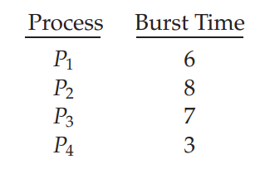
The waiting time is 3 milliseconds for process P1, 16 milliseconds for process P2, 9 milliseconds for process P3, and 0 milliseconds for process P4. Thus, the average waiting time is (3 + 16 + 9 + 0)/4 = 7 milliseconds.

Slide 104
The SJF algorithm can be either preemptive or nonpreemptive. The choice arises when a new process arrives at the ready queue while a previous process is still executing.
The next CPU burst of the newly arrived process may be shorter than what is left of the currently executing process.
A preemptive SJF algorithm will preempt the currently executing process, whereas a nonpreemptive SJF algorithm will allow the currently running process to finish its CPU burst. Preemptive SJF scheduling is sometimes called shortest-remaining-time-first scheduling

Slide 105
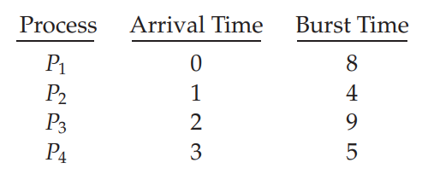
As an example, consider the following four processes, with the length of the CPU burst given in milliseconds:
If the processes arrive at the ready queue at the times shown and need the indicated burst times, then the resulting preemptive SJF schedule is as depicted in the following Gantt chart:

Slide 106
Process P1 is started at time 0, since it is the only process in the queue. Process P2 arrives at time 1. The remaining time for process P1 (7 milliseconds) is larger than the time required by process P2 (4 milliseconds), so process P1 is preempted, and process P2 is scheduled. The average waiting time for this example is [(10 − 1) + (1 − 1) + (17 − 2) + (5 − 3)]/4 = 26/4 = 6.5 milliseconds. Nonpreemptive SJF scheduling would result in an average waiting time of 7.75 milliseconds.

Slide 107
Priority Scheduling Algorithm
The SJF algorithm is a special case of the general priority-scheduling algorithm. A priority is associated with each process, and the CPU is allocated to the process with the highest priority. Equal-priority processes are scheduled in FCFS order
The larger the CPU burst, the lower the priority, and vice versa
Priorities are generally indicated by some fixed range of numbers, such as 0 to 7 or 0 to 4,095.
we assume that low numbers represent high priority.

Slide 108
As an example, consider the following set of processes, assumed to have arrived at time 0 in the order P1, P2, ···, P5, with the length of the CPU burst given in milliseconds:
The average waiting time is 8.2 milliseconds.

Slide 109
Priority scheduling can be either preemptive or nonpreemptive. When a process arrives at the ready queue, its priority is compared with the priority of the currently running process.
A preemptive priority scheduling algorithm will preempt the CPU if the priority of the newly arrived process is higher than the priority of the currently running process. A nonpreemptive priority scheduling algorithm will simply put the new process at the head of the ready queue.
A major problem with priority scheduling algorithms is indefinite blocking, or starvation. A process that is ready to run but waiting for the CPU can be considered blocked

Slide 110
A solution to the problem of indefinite blockage of low-priority processes is aging.
Aging involves gradually increasing the priority of processes that wait in the system for a long time
For example, if priorities range from 127 (low) to 0 (high), we could increase the priority of a waiting process by 1 every 15 minutes. Eventually, even a process with an initial priority of 127 would have the highest priority in the system and would be executed. In fact, it would take no more than 32 hours for a priority-127 process to age to a priority-0 process.

Slide 111
Round-Robin Scheduling
The round-robin (RR) scheduling algorithm is designed especially for time-sharing systems.
It is similar to FCFS scheduling, but preemption is added to enable the system to switch between processes. A small unit of time, called a time quantum or time slice, is defined
Once a process is executed for a given time period, it is preempted and other process executes for a given time period.
Context switching is used to save states of preempted processes

Slide 112
If we use a time quantum of 4 milliseconds, then process P1 gets the first 4 milliseconds. Since it requires another 20 milliseconds, it is preempted after the first time quantum, and the CPU is given to the next process in the queue, process P2. Process P2 does not need 4 milliseconds, so it quits before its time quantum expires. The CPU is then given to the next process, process P3. Once each process has received 1 time quantum, the CPU is returned to process P1 for an additional time quantum.

Slide 113
P1 waits for 6 milliseconds (10 - 4), P2 waits for 4 milliseconds, and P3 waits for 7 milliseconds. Thus, the average waiting time is 17/3 = 5.66 milliseconds.
In the RR scheduling algorithm, no process is allocated the CPU for more than 1 time quantum in a row (unless it is the only runnable process).
if the time quantum is extremely large, the RR policy is the same as the FCFS policy. In contrast, if the time quantum is extremely small (say, 1 millisecond), the RR approach can result in a large number of context switches

Slide 114
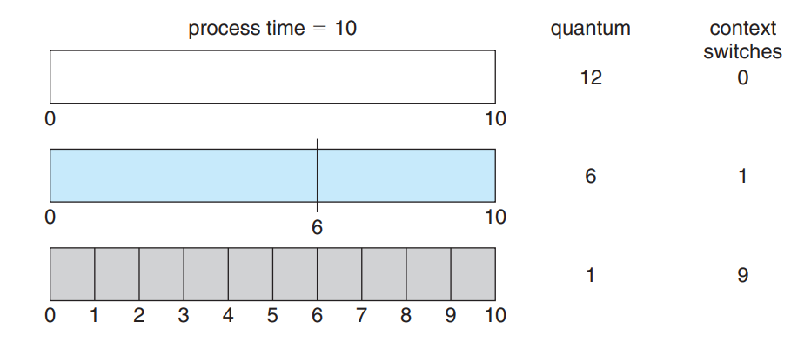
Fig. smaller time quantum increases context switches

Slide 115
Multilevel Queue Scheduling
Another class of scheduling algorithms has been created for situations in which processes are easily classified into different groups.
common division is made between foreground (interactive) processes and background (batch) processes.
These two classes have different scheduling needs. For this kind of situation Multilevel Queue Scheduling is used.
A multilevel queue scheduling algorithm partitions the ready queue into several separate queues

Slide 116
The processes are permanently assigned to one queue, generally based on some property of the process, such as memory size, process priority, or process type
Each queue has its own scheduling algorithm.
For example, separate queues might be used for foreground and background processes. The foreground queue might be scheduled by an RR algorithm, while the background queue is scheduled by an FCFS algorithm
example of a multilevel queue scheduling algorithm with five queues, listed below in order of priority

Slide 117
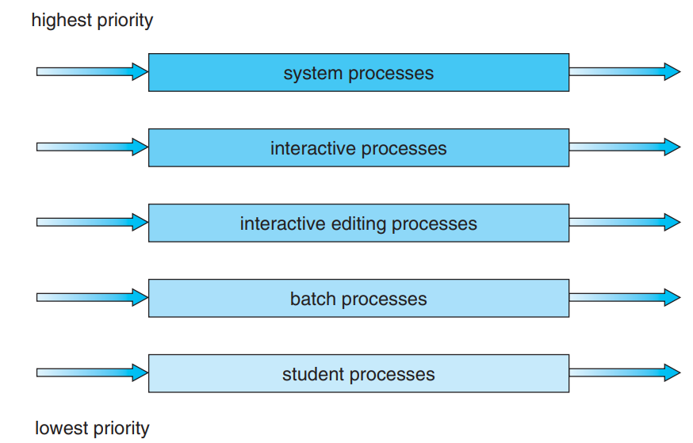
Fig. Multilevel queue scheduling

Slide 118
Each queue has absolute priority over lower-priority queues. No process in the batch queue, for example, could run unless the queues for system processes, interactive processes, and interactive editing processes were all empty.
If an interactive editing process entered the ready queue while a batch process was running, the batch process would be preempted
Another possibility is to time-slice among the queues. Here, each queue gets a certain portion of the CPU time, which it can then schedule among its various processes.

Slide 119
Multilevel Feedback Queue Scheduling
The multilevel feedback queue scheduling algorithm allows a process to move between queues.
The idea is to separate processes according to the characteristics of their CPU bursts. If a process uses too much CPU time, it will be moved to a lower-priority queue
This scheme leaves I/O-bound and interactive processes in the higher-priority queues.
In addition, a process that waits too long in a lower-priority queue may be moved to a higher-priority queue. This form of aging prevents starvation.

Slide 120
For example, consider a multilevel feedback queue scheduler with three queues, numbered from 0 to 2
The scheduler first executes all processes in queue 0 Only when queue 0 is empty will it execute processes in queue 1. Similarly, processes in queue 2 will be executed only if queues 0 and 1 are empty.
A process that arrives for queue 1 will preempt a process in queue 2. A process in queue 1 will in turn be preempted by a process arriving for queue 0.

Slide 121
Fig. Multilevel Feedback Queues

Slide 122
A multilevel feedback queue scheduler is defined by the following parameters:
The number of queues
The scheduling algorithm for each queue
The method used to determine when to upgrade a process to a higher priority queue
The method used to determine when to demote a process to a lower priority queue
The method used to determine which queue a process will enter when that process needs service

Slide 123
Thread Scheduling
Contention ScopThe word contention here refers to the competition or fight among the User level threads to access the kernel resources.
Thus, this control defines the extent to which contention takes place. It is defined by the application developer using the thread library. Depending upon the extent of contention it is classified as Process Contention Scope and System Contention Scope. e:

Slide 124
Process Contention Scope (PCS):The contention takes place among threads within a same process. The thread library schedules the high-prioritized PCS thread to access the resources via available LWPs
System Contention Scope (SCS):The contention takes place among all threads in the system. In this case, every SCS thread is associated to each LWP by the thread library and are scheduled by the system scheduler to access the kernel resources

Slide 125
Pthread Scheduling: Pthreads identifies the following contention scope values
PTHREAD_SCOPE_PROCESS schedules threads using PCS scheduling.
PTHREAD_SCOPE_SYSTEM schedules threads using SCS scheduling
The Pthread IPC provides two functions for getting—and setting—the contention scope policy
pthread attr setscope(pthread attr t *attr, int scope)
pthread attr getscope(pthread attr t *attr, int *scope)

Slide 126
Multiprocessor Scheduling
In multiple-processor scheduling multiple CPU’s are available and hence Load Sharing becomes possible. However multiple processor scheduling is more complex as compared to single processor scheduling
Approaches to Multiple-Processor Scheduling
One approach is when all the scheduling decisions and I/O processing are handled by a single processor which is called the Master Server and the other processors executes only the user code. This is simple and reduces the need of data sharing. This entire scenario is called Asymmetric Multiprocessing

Slide 127
A second approach uses Symmetric Multiprocessing where each processor is self scheduling.
All processes may be in a common ready queue or each processor may have its own private queue for ready processes.
The scheduling proceeds further by having the scheduler for each processor examine the ready queue and select a process to execute.

Slide 128
Process Affinity
When a process runs on a specific processor there are certain effects on the cache memory. The data most recently accessed by the process populate the cache for the processor and as a result successive memory access by the process are often satisfied in the cache memory.
Now if the process migrates to another processor, the contents of the cache memory must be invalidated for the first processor and the cache for the second processor must be repopulated

Slide 129
Because of the high cost of invalidating and repopulating caches, most of the SMP(symmetric multiprocessing) systems try to avoid migration of processes from one processor to another and try to keep a process running on the same processor. This is known as PROCESSOR AFFINITY.
There are two types of process affinity
Soft Affinity
Hard Affinity

Slide 130
Soft Affinity – When an operating system has a policy of attempting to keep a process running on the same processor but not guaranteeing it will do so, this situation is called soft affinity.
Hard Affinity – Hard Affinity allows a process to specify a subset of processors on which it may run. Some systems such as Linux implements soft affinity but also provide some system calls like sched_setaffinity() that supports hard affinity.

Slide 131
Load Balancing
On SMP systems, it is important to keep the workload balanced among all processors to fully utilize the benefits of having more than one processor.
Otherwise, one or more processors may sit idle while other processors have high workloads, along with lists of processes awaiting the CPU.
Load balancing attempts to keep the workload evenly distributed across all processors in an SMP system. It is important to note that load balancing is typically necessary only on systems where each processor has its own private queue of eligible processes to execute

Slide 132
On systems with a common run queue, load balancing is often unnecessary, because once a processor becomes idle, it immediately extracts a runnable process from the common run queue.
There are two general approaches to load balancing: push migration and pull migration
Push Migration – In push migration a task routinely checks the load on each processor and if it finds an imbalance then it evenly distributes load on each processors by moving the processes from overloaded to idle or less busy processors.

Slide 133
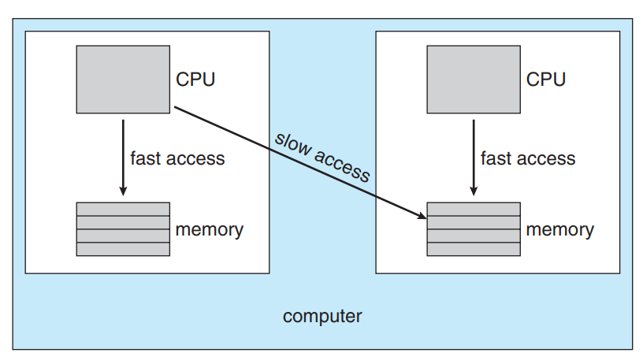
Pull Migration – Pull Migration occurs when an idle processor pulls a waiting task from a busy processor for its execution.
Fig. Non Uniform Memory Access (NUMA) and CPU Scheduling

Slide 134
Part - IV
Inter-process Communication: Race conditions, Critical Regions, Mutual exclusion with busy waiting, Sleep and wakeup, Semaphores, Mutexes, Monitors, Message passing, Barriers, Classical IPC Problems - Dining philosophers problem, Readers and writers problem.

Slide 135
Race Condition
The situation where several processes access and manipulate the same data concurrently and the outcome of the execution depends on the particular order in which the access takes place, is called a race condition
We can easily synchronize the processes to prevent the race condition. To prevent the race condition, we need to ensure that only one process can access the shared data at a time

Slide 136
Critical Region
Mutual Exclusion:
mutual exclusion, that is, some way of making sure that if one process is using a shared variable or file, the other processes will be excluded from doing the same thing.
sometimes a process has to access shared memory or files, or do other critical things that can lead to races. That part of the program where the shared memory is accessed is called the critical region or critical section

Slide 137
Critical Region
Use critical regions to provide mutual exclusion and help fix race conditions
Four conditions to provide mutual exclusion
No two processes simultaneously in critical region 
No assumptions made about speeds or numbers of CPUs 
No process running outside its critical region may block another process 
No process must wait forever to enter its critical region

Slide 138
Time

Slide 139
Mutual Exclusion with Busy Waiting
Disabling Interrupt: Once a process enters the critical section, it disables all interrupts
With interrupts turned off the CPU will not be switched to another process. The process finishes its job in the critical section
Unattractive – unwise to give user process the power to turn off interrupts. If the process never turned it on again, it might cause the end of the system

Slide 140
Lock Variable:
Software solution
There is a single shared variable (lock), initially 0.
If lock = 0, the process sets it to 1 and enters the critical section.
If lock = 1, the process will wait until it becomes 0. -- busy waiting
Unfortunately, it has the race condition
Suppose that one process reads the lock and sees that it is 0. Before it can set the lock to 1, another process is scheduled, runs, and sets the lock to 1. When the first process runs again, it will also set the lock to 1, and two processes will be in their critical regions at the sametime

Slide 141
Strict Alternation:

Slide 142
These code fragments offer a solution to the mutual exclusion problem.
Assume the variable turn is initially set to zero.
Process 0 is allowed to run. It finds that turn is zero and is allowed to enter its critical region. If process 1 tries to run, it will also find that turn is zero and will have to wait (the while statement) until turn becomes equal to 1.
When process 0 exits its critical region it sets turn to 1, which allows process 1 to enter its critical region.
If process 0 tries to enter its critical region again it will be blocked as turn is no longer zero.

Slide 143
However, there is one major flaw in this approach. Consider this sequence of events.
Process 0 runs, enters its critical section and exits; setting turn to 1. Process 0 is now in its non-critical section. Assume this non-critical procedure takes a long time.
Process 1, which is a much faster process, now runs and once it has left its critical section turn is set to zero.
Process 1 executes its non-critical section very quickly and returns to the top of the procedure.
The situation is now that process 0 is in its non-critical section and process 1 is waiting for turn to be set to zero. In fact, there is no reason why process 1 cannot enter its critical region as process 0 is not in its critical region.

Slide 144
What we can see here is violation of one of the conditions that we listed above (number 3). That is, a process, not in its critical section, is blocking another process. If you work through a few iterations of this solution you will see that the processes must enter their critical sections in turn; thus this solution is called strict alternation.

Slide 145
Peterson’s Solution
By combining the idea of taking turns with the idea of lock variables and warning variables, a Dutch mathematician, T. Dekker, was the first one to devise a software solution to the mutual exclusion problem that does not require strict alternation.
In 1981, G. L. Peterson discovered a much simpler way to achieve mutual exclusion

Slide 147
A process that is about to enter its critical region has to call enter_region. At the end of its critical region it calls leave_region.
Initially, both processes are not in their critical region and the array interested has all (both in the above example) its elements set to false
Assume that process 0 calls enter_region. The variable other is set to one (the other process number) and it indicates its interest by setting the relevant element of interested. Next it sets the turn variable, before coming across the while loop. In this instance, the process will be allowed to enter its critical region, as process 1 is not interested in running.

Slide 148
Now process 1 could call enter_region. It will be forced to wait as the other process (0) is still interested. Process 1 will only be allowed to continue when interested[0] is set to false which can only come about from process 0 calling leave_region.
If we ever arrive at the situation where both processes call enter region at the same time, one of the processes will set the turn variable, but it will be immediately overwritten.
Assume that process 0 sets turn to zero and then process 1 immediately sets it to 1. Under these conditions process 0 will be allowed to enter its critical region and process 1 will be forced to wait.

Slide 149
TSL – Test and Set Lock
If we are given assistance by the instruction set of the processor we can implement a solution to the mutual exclusion problem.
The instruction we require is called test and set lock (TSL). This instructions reads the contents of a memory location, stores it in a register and then stores a non-zero value at the address.
This operation is guaranteed to be indivisible. That is, no other process can access that memory location until the TSL instruction has finished.

Slide 151
Assume, again, two processes.
Process 0 calls enter_region. The tsl instruction copies the flag to a register and sets it to a non-zero value. The flag is now compared to zero (cmp - compare) and if found to be non-zero (jnz - jump if non-zero) the routine loops back to the top. Only when process 1 has set the flag to zero (or under initial conditions), by calling leave_region, will process 0 be allowed to continue.

Slide 152
Sleep and Wakeup
Both Peterson’s solution and the solutions using TSL both have the defect of requiring busy waiting
That is, if the process is not allowed to enter its critical section it sits in a tight lop waiting for a condition to be met. This is obviously wasteful in terms of CPU usage.
It can also have, not so obvious disadvantages

Slide 153
Consider a computer with two processes, H, with high priority, and L, with low priority. The scheduling rules are such that H is run whenever it is in ready state.
At a certain moment, with L in its critical region, H becomes ready to run (e.g., an I/O operation completes). H now begins busy waiting, but since L is never scheduled while H is running, L never gets the chance to leave its critical region, so H loops forever.
This situation is sometimes referred to as the priority inversion problem.

Slide 154
To implement a sleep and wakeup system we need access to two system calls (SLEEP and WAKEUP). These can be implemented in a number of ways. One method is for SLEEP to simply block the calling process and for WAKEUP to have one parameter; that is the process it has to wakeup
An alternative is for both calls to have one parameter, this being a memory address which is used to match the SLEEP and WAKEUP calls.

