Slide 1
Linux Environment system

Slide 2
Unit I
INTRODUCTION TO LINUX OPERATING SYSTEM: Introduction and Types of Operating Systems, Linux Operating System, Features, Architecture Of Linux OS and Shell Interface,
Linux System Calls, Linux Shared Memory Management,
Device and Disk Management in Linux, Swap space and its management. File System and Directory Structure in Linux. Multi- Processing, load sharing and Multi-Threading in Linux, Types of Users in Linux, Capabilities of Super Users and equivalents.

Slide 3
Introduction to Linux Operating System
Linux is a Unix-like computer operating system assembled under the model of free and open source software development and distribution
Linux was originally developed as a free operating system for Intel x86-based personal computers
90% of today's 500 fastest supercomputers run some variant of Linux
Linux also runs on embedded systems

Slide 4
Linux advantages
Low cost
Stability
Performance
Network Friendliness
Flexibility
Compatibility
Choice
Fast and easy installation
Full use of hard disk
Security
Open source

Slide 5
Low cost: You don’t need to spend time and money to obtain licenses since Linux and much of its software come with the GNU General Public License. You can start to work immediately without worrying that your software may stop working anytime because the free trial version expires.
Additionally, there are large repositories from which you canfreely download high quality software for almost any task you can think of.

Slide 6
Stability: Linux doesn’t need to be rebooted periodically to maintain performance levels. Itdoesn’t freeze up or slow down over time due to memory leaks and such. Continuous up-times of hundreds of days (up to a year or more) are not uncommon.

Slide 7
Performance: Linux provides persistent high performance on workstations and onnetworks. It can handle unusually large numbers of users simultaneously, and can make oldcomputers sufficiently responsive to be useful again

Slide 8
Network friendliness: Linux was developed by a group of programmers over the Internet and has therefore strong support for network functionality;
client and server systems can be easily set up onany computer running Linux. It can perform tasks such as network backups faster and more reliably than alternative systems.

Slide 9
Flexibility: Linux can be used for high performance server applications, desktop applications, and embedded systems. You can save disk space by only installing the components needed for a particular use.
You can restrict the use of specific computers by installing for example only selected office applications instead of the whole suite.
Compatibility: It runs all common Unix software packages and can process all common file formats.

Slide 10
Choice: The large number of Linux distributions gives you a choice. Each distribution is developed and supported by a different organization. You can pick the one you like best; the core functionalities are the same; most software runs on most distributions
Fast and easy installation: Most Linux distributions come with user-friendly installation and setup programs.
Popular Linux distributions come with tools that make installation of additional software very user friendly as well.

Slide 11
Full use of hard disk: Linux continues work well even when the hard disk is almost full.
Multitasking: Linux is designed to do many things at the same time; e.g., a large printing job in the background won’t slow down your other work.
Security: Linux is one of the most secure operating systems. “Walls” and flexible file access permission systems prevent access by unwanted visitors or viruses. Linux users have to option to select and safely download software, free of charge, from online repositories containing thousands of high quality packages.

Slide 12
Open Source: If you develop software that requires knowledge or modification of the operating system code, Linux’s source code is at your fingertips. Most Linux applications are Open Source as well.

Slide 13
Linux Distribution (Operating System) Names
A few popular names:
1.Redhat Enterprise Linux
2.Fedora Linux
3.Debian Linux
4.Suse Enterprise Linux
5.Ubuntu Linux

Slide 14
Common Things Between Linux & UNIX
Both share many common applications such as:
GUI, file, and windows managers (KDE, Gnome)
Shells (ksh, csh, bash)
Various office applications such as OpenOffice.org
Development tools (perl, php, python, GNU c/c++ compilers)
Posix interface

Slide 15
Types of Operating System
Batch operating system
The users of a batch operating system do not interact with the computer directly. Each user prepares his job on an off-line device like punch cards and submits it to the computer operator.
To speed up processing, jobs with similar needs are batched together and run as a group. The programmers leave their programs with the operator and the operator then sorts the programs with similar requirements into batches.
The problems with Batch Systems are as follows −
Lack of interaction between the user and the job.
CPU is often idle, because the speed of the mechanical I/O devices is slower than the CPU.
Difficult to provide the desired priority.

Slide 16
Time-sharing operating systems
Time-sharing is a technique which enables many people, located at various terminals, to use a particular computer system at the same time.
Time-sharing or multitasking is a logical extension of multiprogramming.
Processor's time which is shared among multiple users simultaneously is termed as time-sharing.
Multiple jobs are executed by the CPU by switching between them, but the switches occur so frequently.
Thus, the user can receive an immediate response. The operating system uses CPU scheduling and multiprogramming to provide each user with a small portion of a time.
Computer systems that were designed primarily as batch systems have been modified to time-sharing systems.

Slide 17
Advantages of Timesharing operating systems are as follows −
Provides the advantage of quick response.
Avoids duplication of software.
Reduces CPU idle time.
Disadvantages of Time-sharing operating systems are as follows −
Problem of reliability.
Question of security and integrity of user programs and data.
Problem of data communication.

Slide 18
Distributed operating System
Distributed systems use multiple central processors to serve multiple real-time applications and multiple users. Data processing jobs are distributed among the processors accordingly.
The processors communicate with one another through various communication lines (such as high-speed buses or telephone lines). These are referred as loosely coupled systems or distributed systems. Processors in a distributed system may vary in size and function. These processors are referred as sites, nodes, computers, and so on.

Slide 19
The advantages of distributed systems are as follows
With resource sharing facility, a user at one site may be able to use the resources available at another.
Speedup the exchange of data with one another via electronic mail.
If one site fails in a distributed system, the remaining sites can potentially continue operating.
Better service to the customers.
Reduction of the load on the host computer.
Reduction of delays in data processing

Slide 20
Network operating System
A Network Operating System runs on a server and provides the server the capability to manage data, users, groups, security, applications, and other networking functions. The primary purpose of the network operating system is to allow shared file and printer access among multiple computers in a network, typically a local area network (LAN), a private network or to other networks.
Examples of network operating systems include Microsoft Windows Server 2003, Microsoft Windows Server 2008, UNIX, Linux, Mac OS X, Novell NetWare, and BSD.

Slide 21
The advantages of network operating systems are as follows
Centralized servers are highly stable.
Security is server managed.
Upgrades to new technologies and hardware can be easily integrated into the system.
Remote access to servers is possible from different locations and types of systems.
The disadvantages of network operating systems are as follows −
High cost of buying and running a server.
Dependency on a central location for most operations.
Regular maintenance and updates are required.

Slide 22
Real Time operating System
A real-time system is defined as a data processing system in which the time interval required to process and respond to inputs is so small that it controls the environment.
The time taken by the system to respond to an input and display of required updated information is termed as the response time. So in this method, the response time is very less as compared to online processing.
There are two types of real-time operating systems.

Slide 23
Hard real-time systems
Hard real-time systems guarantee that critical tasks complete on time. In hard real-time systems, secondary storage is limited or missing and the data is stored in ROM. In these systems, virtual memory is almost never found.
Soft real-time systems
Soft real-time systems are less restrictive. A critical real-time task gets priority over other tasks and retains the priority until it completes. Soft real-time systems have limited utility than hard real-time systems. For example, multimedia, virtual reality, Advanced Scientific Projects like undersea exploration and planetary rovers, etc

Slide 24
Examples of Real-Time Operating Systems are: Scientific experiments, medical imaging systems, industrial control systems, weapon systems, robots, air traffic control systems, etc.

Slide 25
Linux Operating System, Features, Architecture Of Linux OS
Linux is one of popular version of UNIX operating System. It is open source as its source code is freely available. It is free to use. Linux was designed considering UNIX compatibility. Its functionality list is quite similar to that of UNIX
Components of Linux System
Kernel
System Library
System Utility

Slide 26
Kernel − Kernel is the core part of Linux. It is responsible for all major activities of this operating system. It consists of various modules and it interacts directly with the underlying hardware. Kernel provides the required abstraction to hide low level hardware details to system or application programs.
System Library − System libraries are special functions or programs using which application programs or system utilities accesses Kernel's features. These libraries implement most of the functionalities of the operating system and do not requires kernel module's code access rights.
System Utility − System Utility programs are responsible to do specialized, individual level tasks.

Slide 27
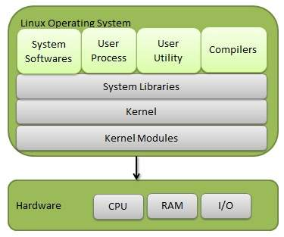

Slide 28
Kernel Mode vs User Mode
Kernel component code executes in a special privileged mode called kernel mode with full access to all resources of the computer. This code represents a single process, executes in single address space and do not require any context switch and hence is very efficient and fast. Kernel runs each processes and provides system services to processes, provides protected access to hardware to processes.

Slide 29
Support code which is not required to run in kernel mode is in System Library.
User programs and other system programs works in User Mode which has no access to system hardware and kernel code.
User programs/ utilities use System libraries to access Kernel functions to get system's low level tasks.

Slide 30
Basic Features
Portable - Portability means softwares can works on different types of hardwares in same way. Linux kernel and application programs supports their installation on any kind of hardware platform.
Open Source - Linux source code is freely available and it is community based development project. Multiple teams works in collaboration to enhance the capability of Linux operating system and it is continuously evolving.
Multi-User - Linux is a multiuser system means multiple users can access system resources like memory/ ram/ application programs at same time.
Multiprogramming - Linux is a multiprogramming system means multiple applications can run at same time.

Slide 31
Hierarchical File System - Linux provides a standard file structure in which system files/ user files are arranged
Shell - Linux provides a special interpreter program which can be used to execute commands of the operating system. It can be used to do various types of operations, call application programs etc.
Security - Linux provides user security using authentication features like password protection/ controlled access to specific files/ encryption of data.

Slide 32
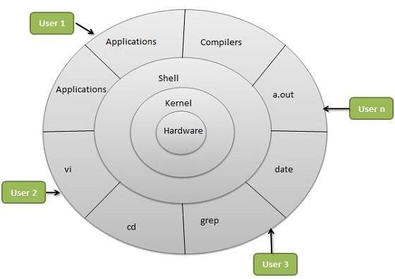
Architecture

Slide 33
The architecture of a Linux System consists of the following layers
Hardware layer − Hardware consists of all peripheral devices RAM/HDD/CPU Etc..
Kernel − It is the core component of Operating System, interacts directly with hardware, provides low level services to upper layer components.
Shell − An interface to kernel, hiding complexity of kernel's functions from users. The shell takes commands from the user and executes kernel's functions.
Utilities − Utility programs that provide the user most of the functionalities of an operating systems.

Slide 34
LINUX Shell Interface
A User Interface is a program that lets you interact with the computer.
User interfaces have been classified in different ways. A Graphical User Interface allows a user to use graphics, icons, menus, and windows to interact with the computer
A Command Driven or Command Line interface offers a prompt (the command line) at which the user enters commands

Slide 35
Shells:
The typical user interface on a Unix or Linux system is called a shell. This shell is the first thing a user interacts with when he or she connects to a system via a telnet or secure connection.
The shell takes the user's commands and changes them into instructions for the operating system to execute. Several shells have been developed for Unix, and these shells are generally consistent across different varieties and distributions of Unix.

Slide 36
The Bourne Shell
The Bourne shell (sh), written by Steve Bourne at AT&T Bell Labs, is the original UNIX shell. It is the preferred shell for shell programming because of its compactness and speed.
A Bourne shell drawback is that it lacks features for interactive use, such as the ability to recall previous commands (history). The Bourne shell also lacks built-in arithmetic and logical expression handling.

Slide 37
The Bourne shell is the Solaris OS default shell. It is the standard shell for Solaris system administration scripts. For the Bourne shell the:
Command full-path name is /bin/sh and /sbin/sh.
Non-root user default prompt is $.
Root user default prompt is #.

Slide 38
The C Shell:
The C shell (csh):
Is a UNIX enhancement written by Bill Joy at the University of California at Berkeley.
Incorporated features for interactive use, such as aliases and command history.
Includes convenient programming features, such as built-in arithmetic and a C-like expression syntax.

Slide 39
For the C shell the:
Command full-path name is /bin/csh.
Non-root user default prompt is hostname %.
Root user default prompt is hostname #.

Slide 40
The Korn Shell:
Was written by David Korn at AT&T Bell Labs
Is a superset of the Bourne shell.
Supports everything in the Bourne shell.
Has interactive features comparable to those in the C shell.
Includes convenient programming features like built-in arithmetic and C-like arrays, functions, and string-manipulation facilities.
Is faster than the C shell.
Runs scripts written for the Bourne shell.

Slide 41
For Korn Shell
Command full-path name is /bin/ksh.
Non-root user default prompt is $.
Root user default prompt is #.

Slide 42
The GNU Bourne-Shell Again:BASH
Is compatible to the Bourne shell.
Incorporates useful features from the Korn and C shells.
Has arrow keys that are automatically mapped for command recall and editing.
Command full-path name is /bin/bash.
Default prompt for a non-root user is bash-x.xx$. (Where x.xx indicates the shell version number. For example, bash-3.50$)
Root user default prompt is bash-x.xx#. (Where x.xx indicates the shell version number. For example, bash-3.50$#)

Slide 43
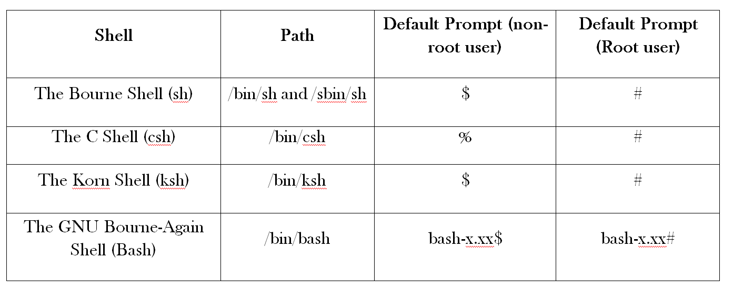
comparison of the all 4 shells and their properties

Slide 44
IV. LINUX System Calls:
The operating system is responsible for
Process Management (starting, running, stopping processes)
File Management(creating, opening, closing, reading, writing, renaming files)
Memory Management (allocating, deallocating memory)
Other stuff (timing, scheduling, network management)

Slide 45
An application program makes a system call to get the operating system to perform a service for it, like reading from a file.
System calls (often shorted to syscalls) are function invocations made from user space—your text editor, favorite game, and so on—into the kernel (the core internals of the system) in order to request some service or resource from the operating system. System calls range from the familiar, such as read( ) and write( )Etc..

Slide 46
Invoking a System Call:
It is not possible to directly link user-space applications with kernel space. For reasons of security and reliability, user-space applications must not be allowed to directly execute kernel code or manipulate kernel data.
Instead, the kernel must provide a mechanism by which a user-space application can "signal" the kernel that it wishes to invoke a system call
The application can then trap into the kernel through this well-defined mechanism, and execute only code that the kernel allows it to execute. The exact mechanism varies from architecture to architecture.
The application tells the kernel which system call to execute and with what parameters via machine registers. System calls are denoted by number, starting at 0.

Slide 47
File system
The file is the most basic and fundamental abstraction in Linux. In order to be accessed, a file must first be opened. Files can be opened for reading, writing, or both.
An open file is referenced via a unique descriptor, a mapping from the metadata associated with the open file back to the specific file itself. Inside the Linux kernel, this descriptor is handled by an integer (of the C type int) called the file descriptor, abbreviated fd. File descriptors are shared with user space, and are used directly by user programs to access files.
A large part of Linux system programming consists of opening, manipulating, closing, and otherwise using file descriptors. Few Examples are Given below

Slide 48
LINUX Shared Memory Management
In computer science, shared memory is memory that may be simultaneously accessed by multiple programs with an intent to provide communication among them or avoid redundant copies. Shared memory is an efficient means of passing data between programs. Depending on context, programs may run on a single processor or on multiple separate processors.
Using memory for communication inside a single program, e.g. among its multiple threads, is also referred to as shared memory.

Slide 49
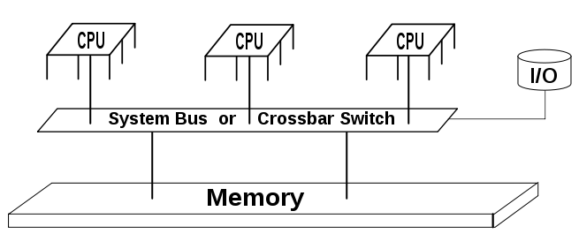

Slide 50
As its name implies, shared memory makes a segment of memory accessible to more than one process. Special system calls, or requests to the UNIX kernel, allocate and free the memory and set permissions; common read and write operations put and get data from the region.
Shared memory is not drawn from a process's own memory; that memory is always private. Instead, shared memory is allocated from the system's free memory pool and is annexed by each process that wants access. Annexation is called mapping, where the shared segment of memory is assigned local addresses in each process' own address space. Figure 1, Figure 2, Figure 3, and Figure 4 depict the process:

Slide 51
1. Assume two processes, A and B, are running on the same system, as shown in Figure 1, and have been specifically coded to coordinate and share information via shared memory. A and B have disproportionate sizes in the figure to emphasize that the applications need not be identical.
Figure 1. Two processes running on a host, executing different code

Slide 52
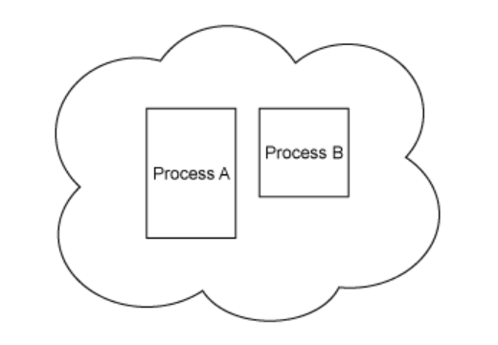

Slide 53
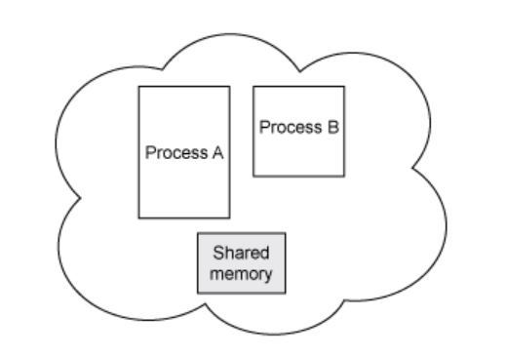
2. In Figure 2, process A requests a segment of shared memory. Process A initializes the memory segment, preparing it for use. The process also names the segment so that other processes can find it. Typically, a segment name is not dynamically assigned; instead, it is well known, such as a constant in a header file, and easily referenced from other code.

Slide 54
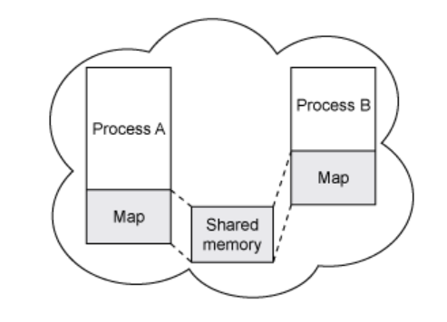
3. Process A annexes, or maps, the shared memory segment into its own address space. Process B finds the segment via its named pipe and also maps the segment into its address space. This is shown in Figure 3. Both processes are enlarged by the size of the shared memory segment.

Slide 55
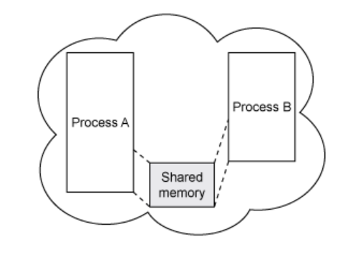
4. Finally, in Figure 4, processes A and B can read and write from the shared memory segment freely. The shared memory is treated the same as local process memory. read() and write() operate as normal.
Figure 4. Two or more processes can now share data via common memory

Slide 56
Much of the work shown in these figures is captured in the UNIX shared memory API.
In fact, there are two variants of the shared memory API: the POSIX API and the older (but no less effective) System V API. Because POSIX is the ratified standard likely found on UNIX and Linux® and derivations of those systems using this version.
Additionally, the POSIX API uses simple file descriptors for read and write and so should seem much more familiar.
POSIX provides five entry points to create, map, synchronize, and undo shared memory segments:

Slide 57
Shared Memory
Shared memory allows one or more processes to communicate via memory that appears in all of their virtual address spaces.
The pages of the virtual memory is referenced by page table entries in each of the sharing processes' page tables. It does not have to be at the same address in all of the processes' virtual memory. As with all System V IPC objects, access to shared memory areas is controlled via keys and access rights checking.
Once the memory is being shared, there are no checks on how the processes use it. They must rely on other mechanisms, for example System V semaphores, to synchronize access to the memory

Slide 58
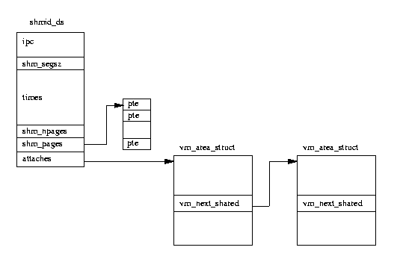

Slide 59
Shared memory system calls:
shm_open() creates and opens a new, or opens an existing, POSIX shared memory object. A POSIX shared memory object is in effect a handle which can be used by unrelated processes to mmap(2) the same region of shared memory.
Syntax: int shm_open(const char *name, int oflag, mode_t mode);

Slide 60
The shm_unlink() function performs the converse operation, removing an object previously created by shm_open().
Syntax: int shm_unlink(const char *name);

Slide 61
munmap() creates a new mapping in the virtual address space of the calling process. The starting address for the new mapping is specified in addr. The length argument specifies the length of the mapping.
Syntax: void *mmap(void *addr, size_t lengthint " prot ", int " flags , int fd, off_t offset); int munmap(void *addr, size_t length);

Slide 62
Logging out
To log out of your ssh session, and so your server, at any time, type:
$ exit
If you are logged in as the super user having used the su command, remember that you may need to type this twice.

