Slide 1
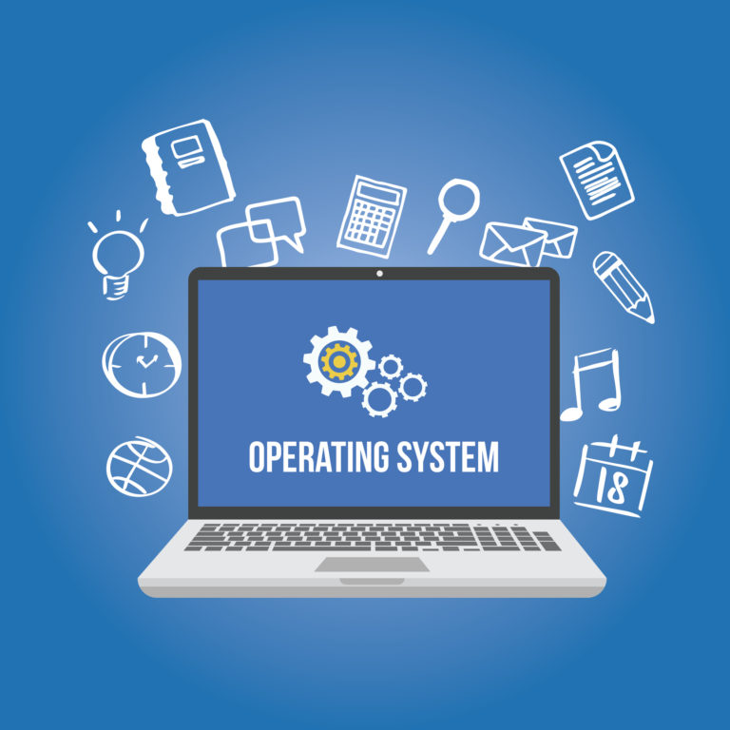
Operating systems
Unit - I

Slide 2
What is an Operating System?
A program that acts as an intermediary between a user of a computer and the computer hardware Operating system goals:
Execute user programs and make solving user problems easier
Make the computer system convenient to use
Use the computer hardware in an efficient manner

Slide 3
Operating System Definition
OS is a resource allocator
Manages all resources
Decides between conflicting requests for efficient and fair resource use
OS is a control program
Controls execution of programs to prevent errors and improper use of the computer No universally accepted definition
Everything a vendor ships when you order an operating system” is good approximation But varies wildly
“The one program running at all times on the computer” is the kernel. Everything else is either a system program (ships with the operating system) or an application program

Slide 4
Computer System Structure
Computer system can be divided into four components
Hardware – provides basic computing resources CPU, memory, I/O devices
Operating system - Controls and coordinates use of hardware among various applications and user
Application programs – define the ways in which the system resources are used to solve the computing problems of the users
problems of the users Word processors, compilers, web browsers, database systems, video games Users People, machines, other computers

Slide 5
Four Components of a Computer System

Slide 6
Computer architecture means construction/design of a computer. A computer system may be organized in different ways. Some computer systems have single processor and others have multiprocessors. So based on the processors used in computer systems, they are categorized into the following systems.
1. Single-processor system
2. Multiprocessor system
3. Clustered Systems:

Slide 7
Single Processor Systems
Some computers use only one processor such as microcomputers (or personal computers PCs). On a single-processor system, there is only one CPU that performs all the activities in the computer system.
A system that has only one general-purpose CPU, is considered as single- processor system.

Slide 8
Multiprocessor Systems:
In multiprocessor system, two or more processors work together. In this system, multiple programs (more than one program) are executed on different processors at the same time. T
his type of processing is known as multiprocessing. Some operating systems have features of multiprocessing.
UNIX is an example of multiprocessing operating system. Some versions of Microsoft Windows also support multiprocessing.

Slide 9
Multiprocessor system is also known as parallel system. Mostly the processors of multiprocessor system share the common system bus, clock, memory and peripheral devices. This system is very fast in data processing.
Types of Multiprocessor Systems: The multiprocessor systems are further divided into two types;
(i). Asymmetric multiprocessing system
(ii). Symmetric multiprocessing system

Slide 10
Asymmetric Multiprocessing System(AMS):
The multiprocessing system, in which each processor is assigned a specific task, is known as Asymmetric Multiprocessing System.
For example, one processor is dedicated for handling user's requests, one processor is dedicated for running application program, and one processor is dedicated for running image processing and so on. In this system, one processor works as master processor, while other processors work as slave processors.
The master processor controls the operations of system. It also schedules and distributes tasks among the slave processors. The slave processors perform the predefined tasks.

Slide 11
Symmetric Multiprocessing System(SMP):
The multiprocessing system, in which multiple processors work together on the same task, is known as Symmetric Multiprocessing System.
In this system, each processor can perform all types of tasks. All processors are treated equally and no master-slave relationship exists between the processors.

Slide 12
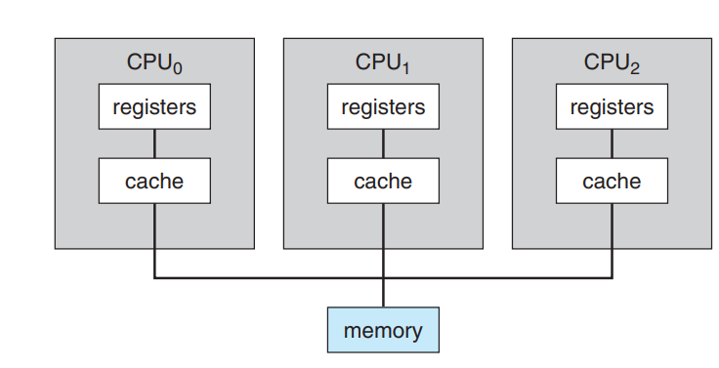
Symmetric Multiprocessing Architecture

Slide 13
For example, different processors in the system can communicate with each other. Similarly, an I/O can be processed on any processor. However, I/O must be controlled to ensure that the data reaches the appropriate processor.
Because all the processors share the same memory, so the input data given to the processors and their results must be separately controlled. Today all modern operating systems including Windows and Linux provide support for SMP.

Slide 14
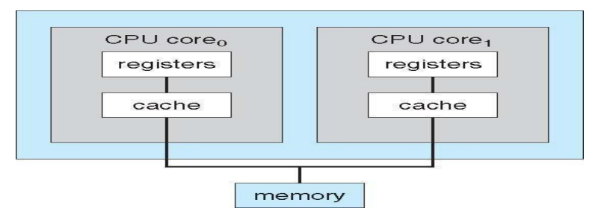
Dual core design with two cores placed on same chip
A recent trend in CPU design is to include multiple computing cores on a single chip. Such multiprocessor systems are termed multicore. They can be more efficient than multiple chips with single cores because on-chip communication is faster than between-chip communication

Slide 15
Computer Startup
bootstrap program is loaded at power-up or reboot
Typically stored in ROM or EPROM, generally known as firmware
Initializes all aspects of system
Loads operating system kernel and starts execution

Slide 16
Computer System Organization
Computer-system operation
One or more CPUs, device controllers connect through common bus providing access to shared memory
Concurrent execution of CPUs and devices competing for memory cycles

Slide 17
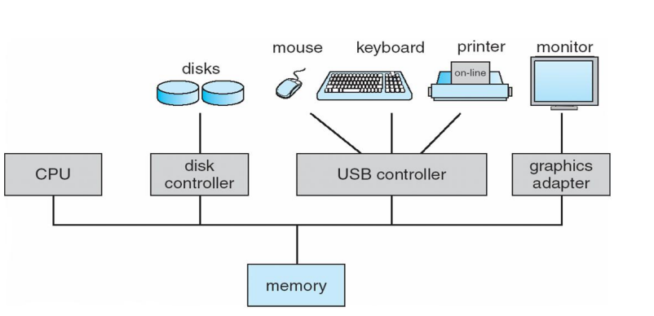
A Modern Computer System

Slide 18
I/O devices and the CPU can execute concurrently
Each device controller is in charge of a particular device type
Each device controller has a local buffer
CPU moves data from/to main memory to/from local buffers
I/O is from the device to local buffer of controller
Device controller informs CPU that it has finished its operation by causing An interrupt

Slide 19
Functions of Operating Systems
1. Booting Booting is a process of starting the computer operating system starts the computer to work. It checks the computer and makes it ready to work.
2. Memory Management It is also an important function of operating system. The memory cannot be managed without operating system. Different programs and data execute in memory at one time. if there is no operating system, the programs may mix with each other. The system will not work properly.

Slide 20
3. Loading and Execution A program is loaded in the memory before it can be executed. Operating system provides the facility to load programs in memory easily and then execute it.
4. Data security Data is an important part of computer system. The operating system protects the data stored on the computer from illegal use, modification or deletion.
5. Disk Management Operating system manages the disk space. It manages the stored files and folders in a proper way

Slide 21
6. Process Management CPU can perform one task at one time. if there are many tasks, operating system decides which task should get the CPU.
7. Device Controlling operating system also controls all devices attached to computer. The hardware devices are controlled with the help of small software called device drivers.
8. Providing interface It is used in order that user interface acts with a computer mutually. User interface controls how you input data and instruction and how information is displayed on screen. The operating system offers two types of the interface to the user:

Slide 22
1. Graphical-line interface: It interacts with of visual environment to communicate with the computer. It uses windows, icons, menus and other graphical objects to issues commands.
2. Command-line interface:it provides an interface to communicate with the computer by typing commands.

Slide 23
Operating System operations
modern operating systems are interrupt driven. If there are no processes to execute, no I/O devices to service, and no users to whom to respond, an operating system will sit quietly, waiting for something to happen.
Events are almost always signaled by the occurrence of an interrupt or a trap.
A trap (or an exception) is a software-generated interrupt caused either by an error, or by a specific request from a user program that an operating-system service be performed

Slide 24
For each type of interrupt, separate segments of code in the operating system determine what action should be taken. An interrupt service routine is provided to deal with the interrupt.
Since the operating system and the users share the hardware and software resources of the computer system, we need to make sure that an error in a user program could cause problems only for the one program running

Slide 25
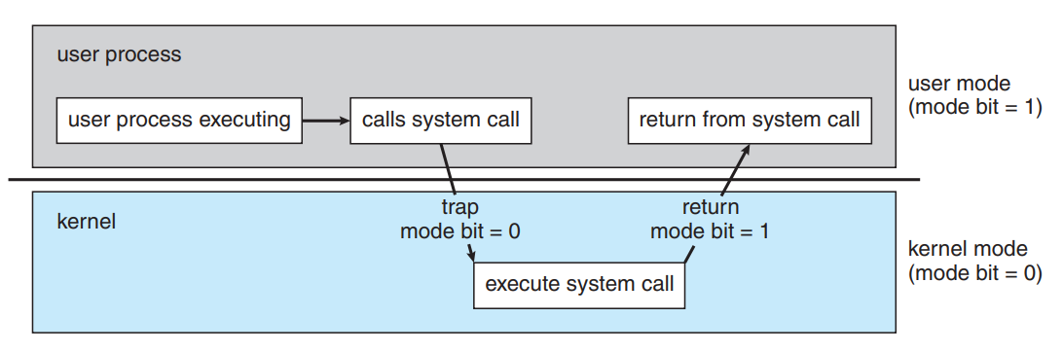
Dual-Mode and Multimode Operation:
There are two modes of operation in the operating system to make sure it works correctly. These are user mode and kernel mode.
A diagram that illustrates the transition from user mode to kernel mode and back again is as follows

Slide 26
The following are the modes
User Mode:The system is in user mode when the operating system is running a user application such as handling a text editor. The transition from user mode to kernel mode occurs when the application requests the help of operating system or an interrupt or a system call occurs.
The mode bit is set to 1 in the user mode. It is changed from 1 to 0 when switching from user mode to kernel mode.

Slide 27
Kernel Mode
The system starts in kernel mode when it boots and after the operating system is loaded, it executes applications in user mode. There are some privileged instructions that can only be executed in kernel mode. These are interrupt instructions, input output management etc. If the privileged instructions are executed in user mode, it is illegal and a trap is generated.
The mode bit is set to 0 in the kernel mode. It is changed from 0 to 1 when switching from kernel mode to user mode.

Slide 28
Multimode
The concept of modes of operation in operating system can be extended beyond the dual mode. This is known as the multimode system. In those cases the more than 1 bit is used by the CPU to set and handle the mode.
An example of the multimode system can be described by the systems that support virtualisation. These CPU’s have a separate mode that specifies when the virtual machine manager (VMM) and the virtualisation management software is in control of the system.
For these systems, the virtual mode has more privileges than user mode but less than kernel mode.

Slide 29
Computing Environments
Personal Computing Environment
Mobile Computing
Distributed Computing Environment
Client Server Computing Environment
Peer-to-Peer Computing
Virtualization
Cloud Computing
Real Time Embeded System

Slide 30
What is Computing Environment
While solving a problem, a computer uses multiple devices. During which the devices can be arranged in a number of ways to work together towards the solution. As a result, the devices and components constitute a computing environment

Slide 31
Personal Computing
A Personal Computing Environment includes a single machine. Moreover, it incorporates complete programs on a computer and performs it.
For example, machines like laptops, mobiles, printers, etc are a part of the Personal Computing Environment. As a result, this type of computing environment is for single users to run tasks at home or offices.

Slide 32
Mobile Computing
Mobile Computing refers to the type of environment that runs tasks on smartphones and tablets. Hence, it is computing on portable and lightweight devices.
Although, compared to other devices, mobile systems lack screen size, memory capacity, and other traditional functionalities. However, it does provide remote access to multiple services.
Today, mobile computing environments consist of multiple functions. Hence, it offers services as good as any other traditional device. Moreover, the two main operating systems that dominate this market are Apple iOS and Google Android.

Slide 33
Distributed Computing
A distributed computing environment contains multiple nodes that are physically separate but linked together using the network.
All the nodes in this system communicate with each other and handle processes in tandem. Each of these nodes contains a small part of the distributed operating system software.

Slide 34
Client Server Computing
Client-Server Computing is a type of environment that incorporates two machines. Therefore, it includes a client machine and a server machine. Sometimes, the same machine serves as the client and the server.
Subsequently, a client requests a resource or service and a server provides the same. Moreover, a server provides a resource or service to multiple clients simultaneously. Hence, the communication takes place using a computer network.

Slide 35
Categorization of Client-Server Computing Environment is into two types:
Computer Server: It provides the interface to the clients. Hence, it helps communicate requests to execute tasks.
Meanwhile, the server performs the task and responds with the outcome.
File-Server: The environment provides a file-system interface. Therefore, allowing clients to create, update, read, and delete files.

Slide 36
Peer to Peer Computing
Peer-to-Peer Computing is a type of environment similar to a Distributed type of Computing Environment. That is to say, there are no differences between clients and servers in this type of computing environment.
P2P provides an advantage over traditional client-server environments. That is to say, it provides services using several nodes throughout the network

Slide 37
Cloud Computing
The computing is moved away from individual computer systems to a cloud of computers in cloud computing environment. The cloud users only see the service being provided and not the internal details of how the service is provided.
This is done by pooling all the computer resources and then managing them using a software.

Slide 38
Real Time Embeded Systems
Embedded computers are the most prevalent form of computers in existence. These devices are found everywhere, from car engines and manufacturing robots to DVDs and microwave ovens.
Real time systems are those systems that work within strict time constraints and provide a worst case time estimate for critical situations. Embedded systems provide a specific function in a much larger system. When there is an embedded component in a real time system, it is known as a real time embedded system.

Slide 39
Open-Source Operating Systems
Open-source operating systems are those available in source-code format rather than as compiled binary code.
Linux is the most famous opensource operating system, while Microsoft Windows is a well-known example of the opposite closed-source approach.
Apple’s Mac OS X and iOS operating systems comprise a hybrid approach. They contain an open-source kernel named Darwin yet include proprietary, closed-source components as well

Slide 40
With the source code in hand, a student can modify the operating system and then compile and run the code to try out those changesThere are many benefits to open-source operating systems, including a community of interested (and usually unpaid) programmers who contribute to the code by helping to debug it, analyze it, provide support, and suggest changes.

Slide 41
History
Computer and software companies eventually sought to limit the use of their software to authorized computers and paying customers.
Releasing only the binary files compiled from the source code, rather than the source code itself, helped them to achieve this goal, as well as protecting their code and their ideas from their competitors
Another issue involved copyrighted material.

Slide 42
Operating systems and other programs can limit the ability to play back movies and music or display electronic books to authorized computers.
Such copy protection or digital rights management (DRM) would not be effective if the source code that implemented these limits were published
Richard Stallman in 1983 started the GNU project to create a free, open-source, UNIXcompatible operating system.

Slide 43
In 1985, he published the GNU Manifesto, which argues that all software should be free and open-sourced. He also formed the Free Software Foundation (FSF) with the goal of encouraging the free exchange of software source code and the free use of that software. Rather than copyright its software
The GNU General Public License (GPL) codifies copylefting and is a common license under which free software is released. Fundamentally, GPL requires that the source code be distributed with any binaries and that any changes made to the source code be released under the same GPL license.
GNU's not Unix

Slide 44
Linux
As an example of an open-source operating system, consider GNU/Linux
In 1991, a student in Finland, Linus Torvalds, released a rudimentary UNIX-like kernel using the GNU compilers and tools and invited contributions worldwide.
The resulting GNU/Linux operating system has spawned hundreds of unique distributions, or custom builds, of the system

Slide 45
Major distributions include RedHat, SUSE, Fedora, Debian, Slackware, and Ubuntu.
Distributions vary in function, utility, installed applications, hardware support, user interface, and purpose. For example, RedHat Enterprise Linux is geared to large commercial use
PCLinuxOS is a LiveCD—an operating system that can be booted and run from a CD-ROM without being installed on a system’s hard disk.

Slide 46
One variant of PCLinuxOS—called “PCLinuxOS Supergamer DVD”—is a LiveDVD that includes graphics drivers and games. A gamer can run it on any compatible system simply by booting from the DVD. When the gamer is finished, a reboot of the system resets it to its installed operating system.

Slide 47
BSD Linux
It started in 1978 as a derivative of AT&T’s UNIX. Releases from the University of California at Berkeley (UCB) came in source and binary form, but they were not opensource because a license from AT&T was required.
BSD UNIX’s development was slowed by a lawsuit by AT&T, but eventually a fully functional, open-source version, 4.4BSD-lite, was released in 1994

Slide 48
Just as with Linux, there are many distributions of BSD UNIX, including FreeBSD, NetBSD, OpenBSD, and DragonflyBSD
Darwin, the core kernel component of Mac OS X, is based on BSD UNIX and is open-sourced as well.
Every Mac OS X release has its opensource components posted at that site. The name of the package that contains the kernel begins with “xnu.”

Slide 49
Solaris
Solaris is the commercial UNIX-based operating system of Sun Microsystems. Originally, Sun’s SunOS operating system was based on BSD UNIX. Sun moved to AT&T’s System V UNIX as its base in 1991
In 2005, Sun open-sourced most of the Solaris code as the OpenSolaris project. The purchase of Sun by Oracle in 2009, however, left the state of this project unclear. The source code as it was in 2005 is still available via a source code browser and for download at http://src.opensolaris.org/source

Slide 50
Open Source Systems as Learning Tools
The free software movement is driving legions of programmers to create thousands of open-source projects, including operating systems.
Sites like http://freshmeat.net/ and http://distrowatch.com/
provide portals to many of these projects.
The advantages of free software and open sourcing are likely to increase the number and quality of open-source projects, leading to an increase in the number of individuals and companies that use these projects

Slide 51
PART-II
System Structures: Operating System Services, User and Operating-System Interface, systems calls, Types of System Calls, system programs, Operating system Design and Implementation, Operating system structure, Operating system debugging, System Boot

Slide 52
Operating System Services
An operating system provides an environment for the execution of programs. It provides certain services to programs and to the users of those programs.
These operating system services are provided for the convenience of the programmer, to make the programming task easier
The Figure shows one view of the various operating-system services and how they interrelate.

Slide 53
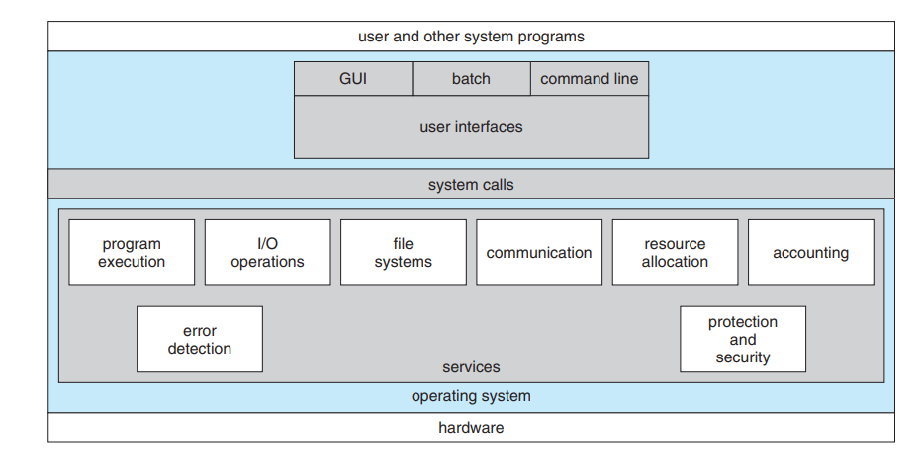

Slide 54
User Interface : An interface is required to communicate with the user.
Interface can take several forms
command-line interface (CLI), which uses text commands and a method for entering them (say, a keyboard for typing in commands in a specific format with specific options).
batch interface, in which commands and directives to control those commands are entered into files, and those files are executed

Slide 55
graphical user interface (GUI) the interface is a window system with a pointing device to direct I/O, choose from menus, and make selections and a keyboard to enter text. Some systems provide two or all three of these variations.
Program Execution : The system must be able to load a program into memory and to run that program. The program must be able to end its execution, either normally or abnormally (indicating error).

Slide 56
I/O operations : . A running program may require I/O, which may involve a file or an I/O device. For efficiency and protection, users usually cannot control I/O devices directly. Therefore, the operating system must provide a means to do I/O
File System Manipulation : A program is read and then written in the form of directories and files. These files can be stored on the storage disk for the long term. The OS allows the users to create and delete files, duplicate these files, and search files and their information or properties.
It also does permission management for these files i.e., allowing or denying access to these files or directories based on the file ownership.

Slide 57
Error detection: Errors may occur in any of the resources like CPU, I/O devices, or memory hardware. The OS keeps a lookout for such errors, corrects errors when they occur, and makes sure that the system works uninterruptedly.
Another set of operating system functions exists not for helping the user but rather for ensuring the efficient operation of the system itself. Systems with multiple users can gain efficiency by sharing the computer resources among the users

Slide 58
Resource allocation : When there are multiple users or multiple jobs running at the same time, resources must be allocated to each of them.
The operating system manages many different types of resources. Some (such as CPU cycles, main memory, and file storage) may have special allocation code, whereas others (such as I/O devices) may have much more general request and release code.

Slide 59
Accounting: We want to keep track of which users use how much and what kinds of computer resources.
This record keeping may be used for accounting (so that users can be billed) or simply for accumulating usage statistics. Usage statistics may be a valuable tool for researchers who wish to reconfigure the system to improve computing services.

Slide 60
Protection and security : This is to ensure the safety of the system. Thus, user authentication is required to access a system. It is also necessary to protect a process from another when multiple processes are running on a system at the same time.
The OS controls the access to the resources, protects the I/O devices from invalid access, and provides authentication through passwords.

Slide 61
User and Operating-System Interface
Two important interfaces:
1)Command Interpreter: which allows users to directly enter commands
2)GUI: allows users to interface with the operating system via a graphical user interface

Slide 62
Command Interpreters
If a computer system is having multiple command interpreters, they are called as “ Shells”. For example, on UNIX and Linux systems, a user may choose among several different shells, including the Bourne shell, C shell, Bourne-Again shell, Korn shell, and others.
Figure below shows the Bourne shell command interpreter being used on Solaris 10

Slide 63
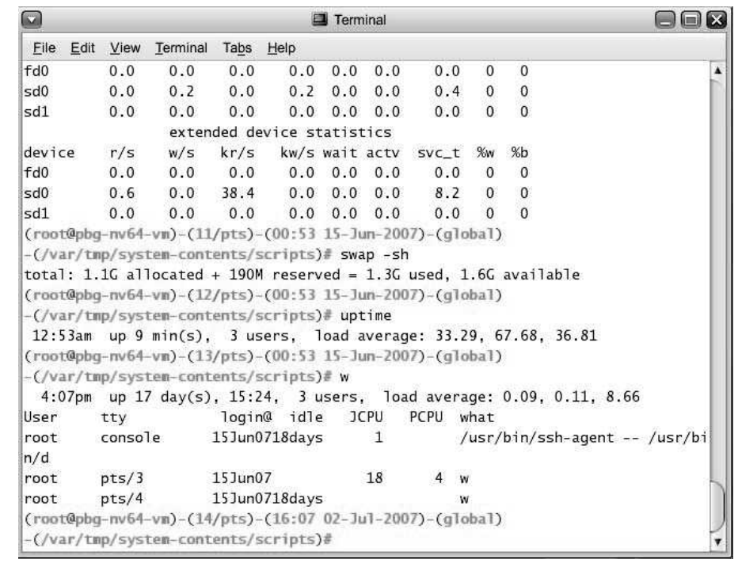

Slide 64
The main function of the command interpreter is to get and execute the user-specified commands. Many of the commands given at this level manipulate files: create, delete, list, print, copy, execute, and so on. These commands can be implemented in two general ways
1st Approach:
In this approach, the command interpreter itself contains the code to execute the command. For example, a command to delete a file may cause the command interpreter to jump to a section of its code that sets up the parameters and makes the appropriate system call.

Slide 65
2nd Approach:
In this case, the command interpreter does not understand the command in any way; it merely uses the command to identify a file to be loaded into memory and executed. Thus, the UNIX command to delete a file
                rm file.txt
would search for a file called rm, load the file into memory, and execute it with the parameter file.txt. The function associated with the rm command would be defined completely by the code in the file rm.

Slide 66
Graphical User Interfaces :
A second strategy for interfacing with the operating system is through a user friendly graphical user interface, or GUI. Here, rather than entering commands directly via a command-line interface, users employ a mouse-based window and- menu system characterized by a desktop metaphor.
The user moves the mouse to position its pointer on images, or icons, on the screen (the desktop) that represent programs, files, directories, and system functions. Depending on the mouse pointer’s location, clicking a button on the mouse can invoke a program, select a file or directory—known as a folder—or pull down a menu that contains commands.

Slide 67
Mobile systems, smartphones and handheld tablet computers typically use a touchscreen interface. Here, users interact by making gestures on the touchscreen—for example, pressing and swiping fingers across the screen. Figure below illustrates the touchscreen of the Apple iPad.

Slide 68
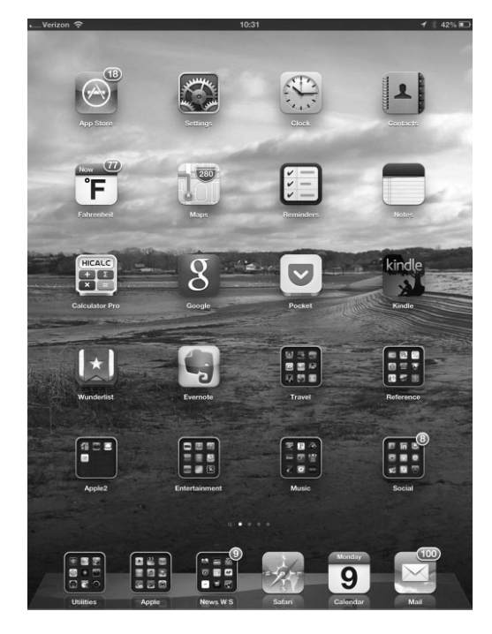

Slide 69
System Calls
System calls provide an interface to the services made available by an operating system. These calls are generally available as routines written in C and C++, although certain low-level tasks (for example, tasks where hardware must be accessed directly) may have to be written using assembly-language instructions.
Let’s first use an example to illustrate how system calls are used: writing a simple program to read data from one file and copy them to another file.

Slide 70
The first input that the program will need is the names of the two files: the input file and the output file. One approach is for the program to ask the user for the names. In an interactive system, this approach will require a sequence of system calls, first to write a prompting message on the screen and then to read from the keyboard the characters that define the two files.
Once the two file names have been obtained, the program must open the input file and create the output file. Each of these operations requires another system call. Possible error conditions for each operation can require additional system calls. When the program tries to open the input file, for example, it may find that there is no file of that name or that the file is protected against access.

Slide 71
In these cases, the program should print a message on the console (another sequence of system calls) and then terminate abnormally (another system call). If the input file exists, then we must create a new output file. We may find that there is already an output file with the same name.
This situation may cause the program to abort (a system call), or we may delete the existing file (another system call) and create a new one (yet another system call). Another option, in an interactive system, is to ask the user (via a sequence of system calls to output the prompting message and to read the response from the terminal) whether to replace the existing file or to abort the program.

Slide 72
When both files are set up, we enter a loop that reads from the input file (a system call) and writes to the output file (another system call). Each read and write must return status information regarding various possible error conditions.
On input, the program may find that the end of the file has been reached or that there was a hardware failure in the read (such as a parity error). The write operation may encounter various errors, depending on the output device (for example, no more disk space).

Slide 73
Finally, after the entire file is copied, the program may close both files (another system call), write a message to the console or window (more system calls), and finally terminate normally (the final system call). This system-call sequence is shown below.

Slide 74
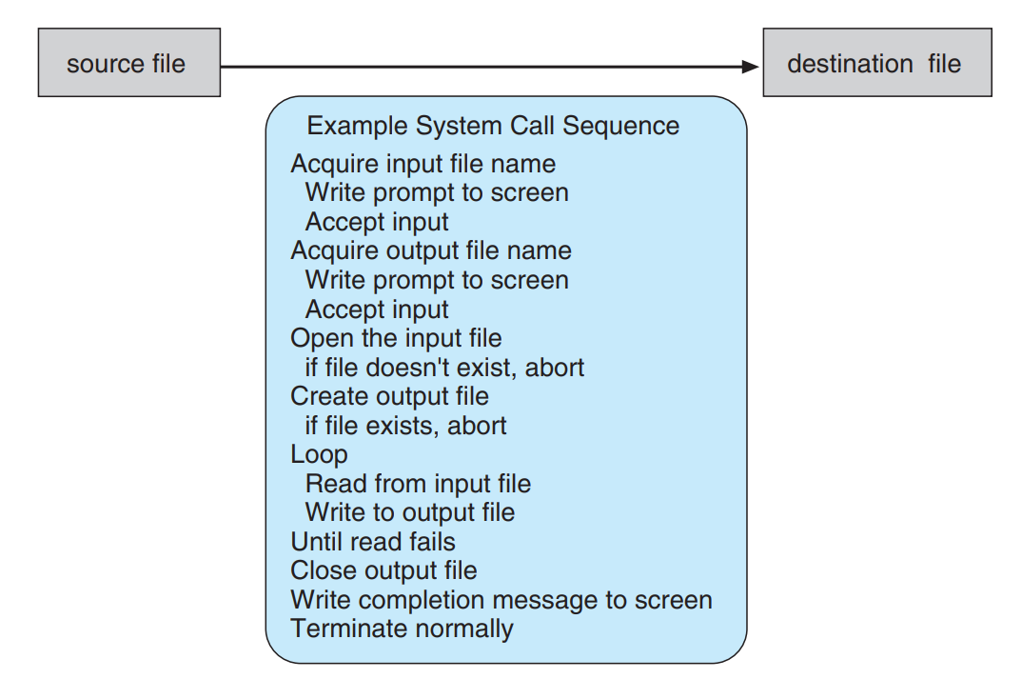

Slide 75
For most programming languages, the run-time support system provides a systemcall interface that serves as the link to system calls made available by the operating system.
The system-call interface intercepts function calls in the API and invokes the necessary system calls within the operating system. Typically, a number is associated with each system call, and the system-call interface maintains a table indexed according to these numbers

Slide 76
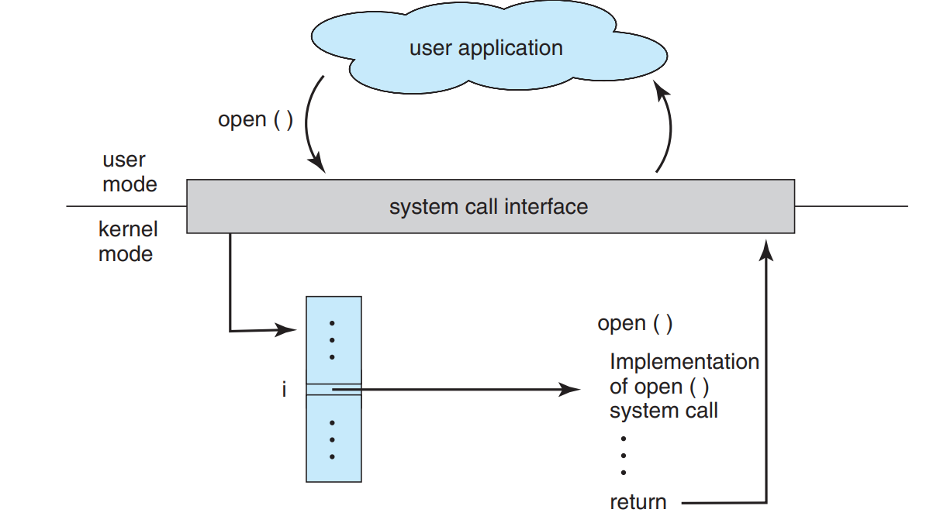
Handling of user application invoking open() system call

Slide 77
The system call interface then invokes the intended system call in the operating-system kernel and returns the status of the system call and any return values
Three general methods are used to pass parameters to the operating system. The simplest approach is to pass the parameters in registers.
In some cases, however, there may be more parameters than registers. In these cases, the parameters are generally stored in a block, or table, in memory, and the address of the block is passed as a parameter in a register

Slide 78
Parameters also can be placed, or pushed, onto the stack by the program and popped off the stack by the operating system. Some operating systems prefer the block or stack method because those approaches do not limit the number or length of parameters being passed

Slide 79
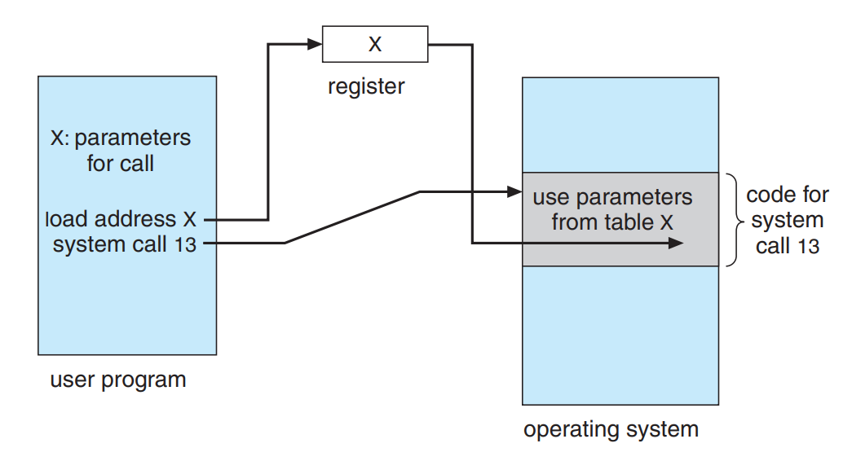
Passing parameters as a table

Slide 80
Types of system calls
System calls can be grouped roughly into six major categories:
process control
file manipulation
device manipulation
information maintenance
communications, and
protection.

Slide 81
System Programs

Slide 82
System Programming can be defined as the act of building Systems Softwares using System Programming Languages.
According to Computer Hierarchy, one which comes at last is Hardware. Then it is Operating System, System Programs, and finally Application Programs
System programs, also known as system utilities, provide a convenient environment for program development and execution.

Slide 83
They can be divided into these categories
File management. These programs create, delete, copy, rename, print, dump, list, and generally manipulate files and directories
Status information Some programs simply ask the system for the date, time, amount of available memory or disk space, number of users, or similar status information.
Others are more complex, providing detailed performance, logging, and debugging information.

Slide 84
these programs format and print the output to the terminal or other output devices or files or display it in a window of the GUI. Some systems also support a registry, which is used to store and retrieve configuration information
File modification. Several text editors may be available to create and modify the content of files stored on disk or other storage devices. There may also be special commands to search contents of files or perform transformations of the text

Slide 85
Programming-language support. Compilers, assemblers, debuggers, and interpreters for common programming languages are often provided with the operating system or available as a separate download.
Program loading and execution. Once a program is assembled or compiled, it must be loaded into memory to be executed. The system may provide absolute loaders, relocatable loaders, linkage editors, and overlay loaders.

Slide 86
Communications. These programs provide the mechanism for creating virtual connections among processes, users, and computer systems. They allow users to send messages to one another’s screens, to browse Web pages, to send e-mail messages, to log in remotely, or to transfer files from one machine to another.
Background services. All general-purpose systems have methods for launching certain system-program processes at boot time. Some of these processes terminate after completing their tasks, while others continue to run until the system is halted. Constantly running system-program processes are known as services, subsystems, or daemons.

Slide 87
Operating-System Design and Implementation
There are many problems that can occur while designing and implementing an operating system. There are, of course, no complete solutions to such problems, but there are approaches that have proved successful.
Operating System Design Goals
It is quite complicated to define all the goals and specifications of the operating system while designing it.The design changes depending on the type of the operating system i.e if it is batch system, time shared system, single user system, multi user system, distributed system etc.

Slide 88
There are basically two types of goals while designing an operating system. These are
User Goals: The operating system should be convenient, easy to use, reliable, safe and fast according to the users. However, these specifications are not very useful as there is no set method to achieve these goals.
System Goals:The operating system should be easy to design, implement and maintain. These are specifications required by those who create, maintain and operate the operating system. But there is not specific method to achieve these goals as well.

Slide 89
Operating System Mechanisms and Policies
There is no specific way to design an operating system as it is a highly creative task. However, there are general software principles that are applicable to all operating systems
A subtle difference between mechanism and policy is that mechanism shows how to do something and policy shows what to do.
Policies may change over time and this would lead to changes in mechanism. So, it is better to have a general mechanism that would require few changes even when a policy change occurs.

Slide 90
Operating System Implementation
The operating system needs to be implemented after it is designed. Earlier they were written in assembly language but now higher level languages are used. The first system not written in assembly language was the Master Control Program (MCP) for Burroughs Computers.
Advantages of Higher Level Language
There are multiple advantages to implementing an operating system using a higher level language such as: the code is written more fast, it is compact and also easier to debug and understand. Also, the operating system can be easily moved from one hardware to another if it is written in a high level language.

Slide 91
Disadvantages of Higher Level Language
Using high level language for implementing an operating system leads to a loss in speed and increase in storage requirements.
However in modern systems only a small amount of code is needed for high performance, such as the CPU scheduler and memory manager.
Also, the bottleneck routines in the system can be replaced by assembly language equivalents if required

Slide 92
Operating-System Structure
For efficient performance and implementation an OS should be partitioned into separate subsystems, each with carefully defined tasks, inputs, outputs, and performance characteristics. These subsystems can then be arranged in various architectural configurations
Simple Structure
Monolithic Structure
Layered Approach
Micro kernels
Modules
Hybrid Systems

Slide 93
Simple Structure
Many operating systems do not have well-defined structures. Frequently, such systems started as small, simple, and limited systems and then grew beyond their original scope
MS-DOS was originally designed and implemented by a few people who had no idea that it would become so popular.
It was written to provide the most functionality in the least space, so it was not carefully divided into modules
has no distinction between user and kernel modes, allowing all programs direct access to the underlying hardware

Slide 94
MS-DOS was also limited by the hardware of its era. Because the Intel 8088 for which it was written provides no dual mode and no hardware protection, the designers of MS-DOS had no choice but to leave the base hardware accessible.

Slide 95
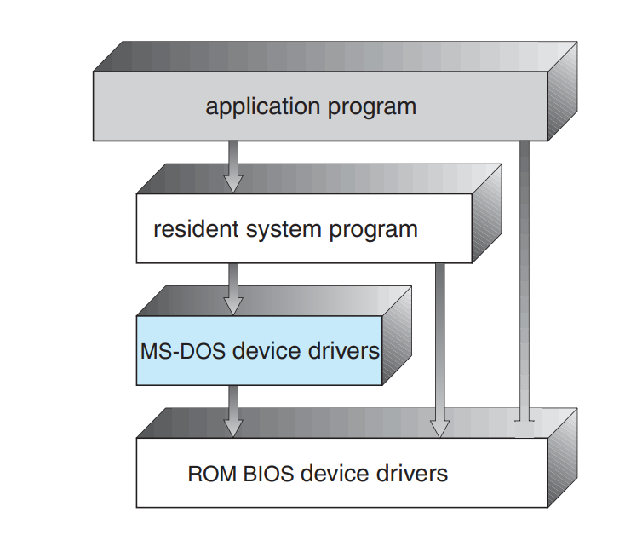

Slide 96
Monolithic Structure
Another example of limited structuring is the original UNIX operating system. Like MS-DOS, UNIX initially was limited by hardware functionality. It consists of two separable parts: the kernel and the system programs.
We can view the traditional UNIX operating system as being layered to some extent
This monolithic structure was difficult to implement and maintain

Slide 97
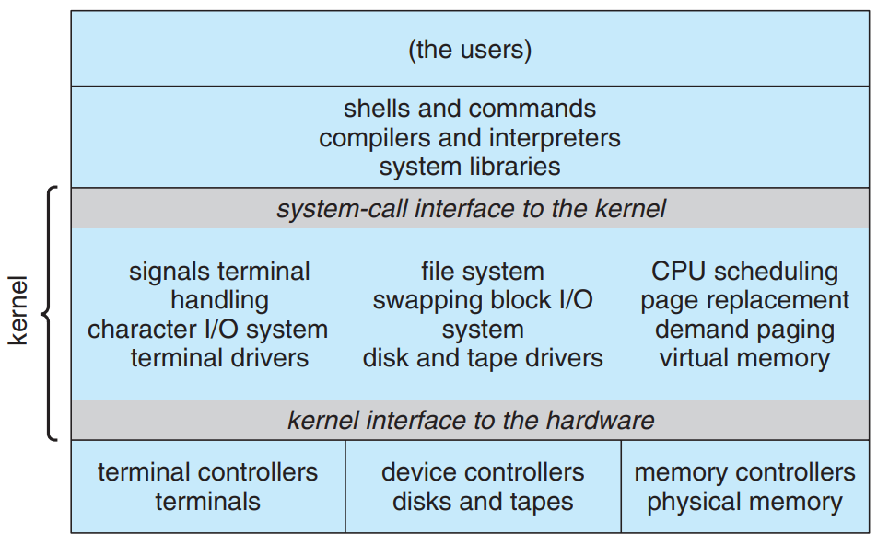

Slide 98
Layered Approach
Another approach is to break the OS into a number of smaller layers, each of which rests on the layer below it, and relies solely on the services provided by the next lower layer.
This approach allows each layer to be developed and debugged independently, with the assumption that all lower layers have already been debugged and are trusted to deliver proper services.
The problem is deciding what order in which to place the layers, as no layer can call upon the services of any higher layer

Slide 99
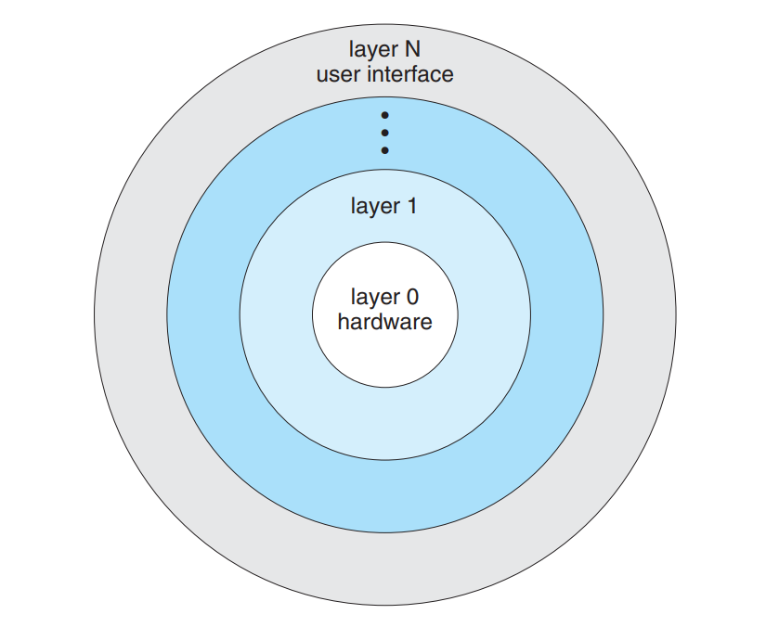
Layered approaches can also be less efficient, as a request for service from a higher layer has to filter through all lower layers before it reaches the HW, possibly with significant processing at each step.

Slide 100
Microkernels
The basic idea behind micro kernels is to remove all non-essential services from the kernel, and implement them as system applications instead, thereby making the kernel as small and efficient as possible.
Most microkernels provide basic process and memory management, and message passing between other services, and not much more.
Security and protection can be enhanced, as most services are performed in user mode, not kernel mode.
System expansion can also be easier, because it only involves adding more system applications, not rebuilding a new kernel.

Slide 101
Mach was the first and most widely known microkernel, and now forms a major component of Mac OSX.
Windows NT was originally microkernel, but suffered from performance problems relative to Windows 95. NT 4.0 improved performance by moving more services into the kernel, and now XP is back to being more monolithic.
Another microkernel example is QNX, a real-time OS for embedded systems.

Slide 102
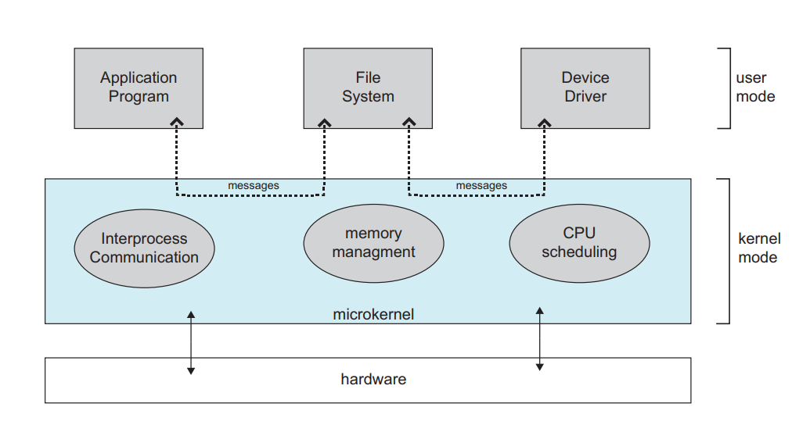

Slide 103
Modules
Modern OS development is object-oriented, with a relatively small core kernel and a set of modules which can be linked in dynamically. See for example the Solaris structure, as shown in Figure below.
Modules are similar to layers in that each subsystem has clearly defined tasks and interfaces, but any module is free to contact any other module, eliminating the problems of going through multiple intermediary layers, as well as the chicken-and-egg problems.
The kernel is relatively small in this architecture, similar to microkernels, but the kernel does not have to implement message passing since modules are free to contact each other directly.

Slide 104
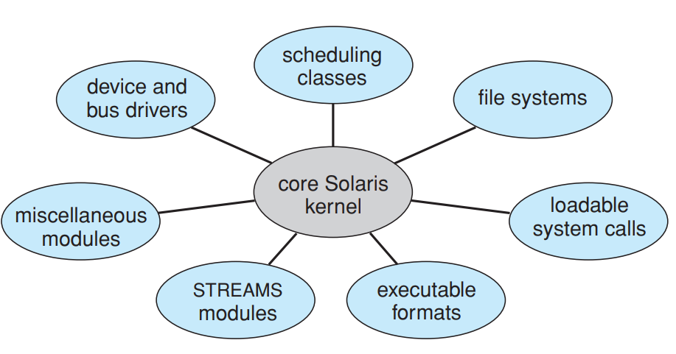

Slide 105
Hybrid Systems
Most Operating Systems today do not strictly adhere to one architecture, but are hybrids of several.
three hybrid systems:
the Apple Mac OS X operating system
and the two most prominent mobile operating systems—iOS and Android.

Slide 106
Mac OS X
The Apple Mac OS X operating system uses a hybrid structure.
The top layers include the Aqua user interface and a set of application environments and services
Notably, the Cocoa environment specifies an API for the Objective-C programming language, which is used for writing Mac OS X applications.
Below these layers is the kernel environment, which consists primarily of the Mach microkernel and the BSD UNIX kernel.

Slide 107
Mach provides memory management; support for remote procedure calls (RPCs) and interprocess communication (IPC) facilities, including message passing; and thread scheduling.
The BSD component provides a BSD command-line interface, support for networking and file systems, and an implementation of POSIX APIs, including Pthreads.
In addition to Mach and BSD, the kernel environment provides an I/O kit for development of device drivers and dynamically loadable modules

Slide 108
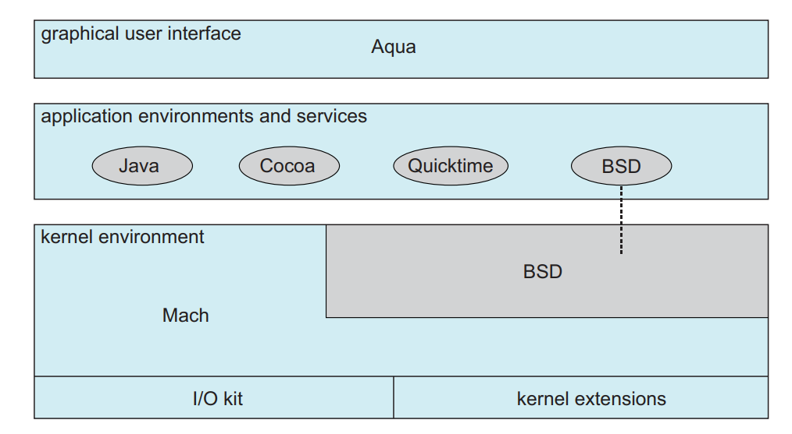
Fig: Mac OS X Structure

Slide 109
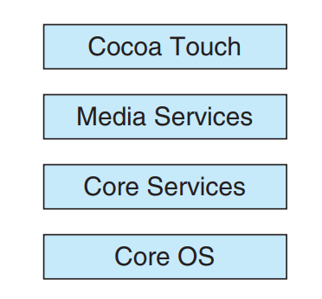
The core services layer provides a variety of features, including support for cloud computing and databases. The bottom layer represents the core operating system, which is based on the kernel environment
Architecture of APPLE IOS

Slide 110
Android
The Android operating system was designed by the Open Handset Alliance and was developed for Android smartphones and tablet computers.
Android runs on a variety of mobile platforms and is open-sourced, partly explaining its rapid rise in popularity.
Android is similar to iOS in that it is a layered stack of software that provides a rich set of frameworks for developing mobile applications. At the bottom of this software stack is the Linux kernel, although it has been modified by Google and is currently outside the normal distribution of Linux releases

Slide 111
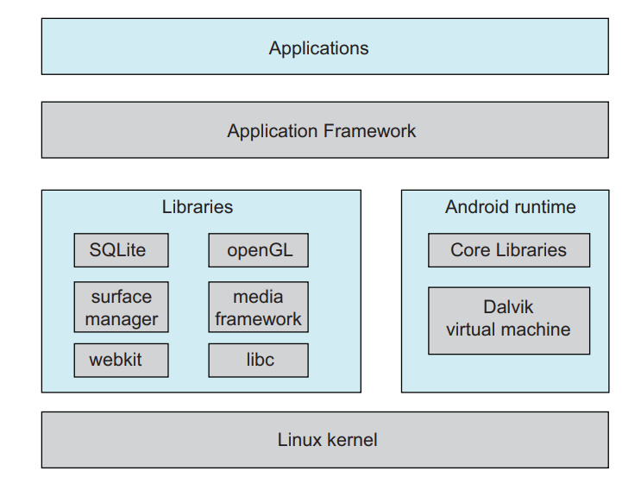

Slide 112
Operating System Debugging
debugging is the activity of finding and fixing errors in a system, both in hardware and in software.
Performance problems are considered bugs, so debugging can also include performance tuning, which seeks to improve performance by removing processing bottlenecks

Slide 113
Failure Analysis
If a process fails, most operating systems write the error information to a log file to alert system operators or users that the problem occurred.
The operating system can also take a core dump—a capture of the memory of the process— and store it in a file for later analysis.
Debugging user-level process code is a challenge. Operating-system kernel debugging is even more complex because of the size and complexity of the kernel, its control of the hardware, and the lack of user-level debugging tools

Slide 114
A failure in the kernel is called a crash. When a crash occurs, error information is saved to a log file, and the memory state is saved to a crash dump.
Consider that a kernel failure in the file-system code would make it risky for the kernel to try to save its state to a file on the file system before rebooting
A common technique is to save the kernel’s memory state to a section of disk set aside for this purpose that contains no file system

Slide 115
If the kernel detects an unrecoverable error, it writes the entire contents of memory, or at least the kernel-owned parts of the system memory, to the disk area.
When the system reboots, a process runs to gather the data from that area and write it to a crash dump file within a file system for analysis

Slide 116
  Kernighan’s Law
“Debugging is twice as hard as writing the code in the first place. Therefore, if you write the code as cleverly as possible, you are, by definition, not smart enough to debug it.”

Slide 117
Performance Tuning
performance tuning seeks to improve performance by removing processing bottlenecks.
To identify bottlenecks, we must be able to monitor system performance.
Thus, the operating system must have some means of computing and displaying measures of system behavior.
the operating system does this by producing trace listings of system behavior

Slide 118
One approach is for the system to record important events into log files, which can then be analyzed by other tools.
These traces can also be used to evaluate how a proposed new system would perform under the same workload
Traces also can help people to find errors in operating-system behavior.
Another approach is to provide utilities that will report system status upon demand, such as the unix "top" command

Slide 119
The Windows Task Manager is a similar tool for Windows systems. The task manager includes information for current applications as well as processes, CPU and memory usage, and networking statistics.

Slide 120
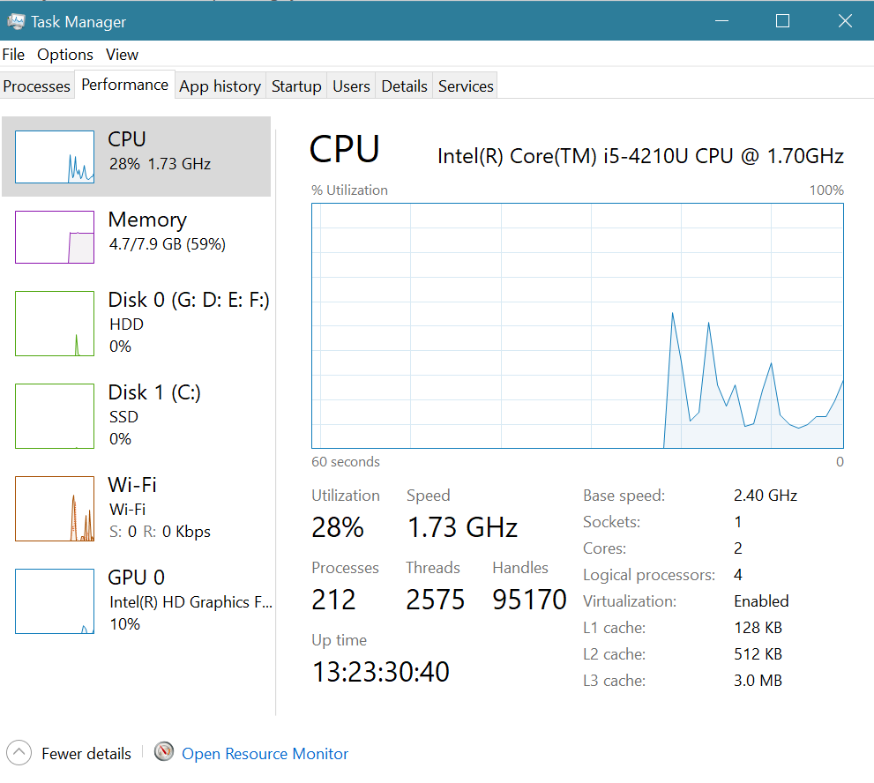

Slide 121
DTrace
DTrace is a special facility for tracing a running OS, developed for Solaris 10.
DTrace adds "probes" directly into the OS code, which can be queried by "probe consumers".
Probes are removed when not in use, so the DTrace facility has zero impact on the system when not being used, and a proportional impact in use.
Consider, for example, the trace of an ioctl system call as shown in Figure

Slide 122
In computing, ioctl is a system call for device-specific input/output operations and other operations which cannot be expressed by regular system calls
Example: It takes a parameter specifying a request code; the effect of a call depends completely on the request code. Request codes are often device-specific. For instance, a CD-ROM device driver which can instruct a physical device to eject a disc would provide an ioctl request code to do so

Slide 123
Probe code is restricted to be "safe", ( e.g. no loops allowed ), and to use a minimum of system resources.
When a probe fires, enabling control blocks, ECBs, are performed, each having the structure of an if-then block
When a consumer terminates, the ECBs associated with that consumer are removed. When no more ECBs remain interested in a particular probe, then that probe is also removed.
Use of DTrace is restricted, due to the direct access to ( and ability to change ) critical kernel data structures.
Because DTrace is open-source, it is being adopted by several UNIX distributions. Others are busy producing similar utilities.

Slide 124
System Boot
The procedure of starting a computer by loading the kernel is known as booting the system.
On most computer systems, a small piece of code known as the bootstrap program or bootstrap loader locates the kernel, loads it into main memory, and starts its execution
Some computer systems, such as PCs, use a two-step process in which a simple bootstrap loader fetches a more complex boot program from disk, which in turn loads the kernel

Slide 125
When a CPU receives a reset event—for instance, when it is powered up or rebooted—the instruction register is loaded with a predefined memory location, and execution starts there.
At that location is the initial bootstrap program. This program is in the form of read-only memory (ROM), because the RAM is in an unknown state at system startup. ROM is convenient because it needs no initialization and cannot easily be infected by a computer virus

Slide 126
The bootstrap program can perform a variety of tasks. Usually, one task is to run diagnostics to determine the state of the machine. If the diagnostics pass, the program can continue with the booting steps.
It can also initialize all aspects of the system, from CPU registers to device controllers and the contents of main memory. Sooner or later, it starts the operating system

Slide 127
Some systems—such as cellular phones, tablets, and game consoles—store the entire operating system in ROM. Storing the operating system in ROM is suitable for small operating systems, simple supporting hardware, and rugged operation.
A problem with this approach is that changing the bootstrap code requires changing the ROM hardware chips. Some systems resolve this problem by using erasable programmable read-only memory (EPROM), which is readonly except when explicitly given a command. All forms of ROM is also known as firmware

Slide 128
For large operating systems (including most general-purpose operating systems like Windows, Mac OS X, and UNIX) or for systems that change frequently, the bootstrap loader is stored in firmware, and the operating system is on disk.
In this case, the bootstrap runs diagnostics and has a bit of code that can read a single block at a fixed location (say block zero) from disk into memory and execute the code from that boot block.

Slide 129
The program stored in the boot block may be sophisticated enough to load the entire operating system into memory and .
GRUB is an example of an open-source bootstrap program for Linux systems. All of the disk-bound bootstrap, and the operating system itself, can be easily changed by writing new versions to disk.
A disk that has a boot partition is called a boot disk or system disk.

Slide 130
Now that the full bootstrap program has been loaded, it can traverse the file system to find the operating system kernel, load it into memory, and start its execution. It is only at this point that the system is said to be running.

