Slide 1
Linux Environment system

Slide 2
Unit I
Device and Disk Management in Linux, Swap space and its management. File System and Directory Structure in Linux. Multi- Processing, load sharing and Multi-Threading in Linux, Types of Users in Linux, Capabilities of Super Users and equivalents.

Slide 3
Device and Disk Management
Device files
Device files are also known as device special files. Device files are employed to provide the operating system and users an interface to the devices that they represent. All Linux device files are located in the /dev directory, which is an integral part of the root (/) filesystem because these device files must be available to the operating system during the boot process.

Slide 4
One of the most important things to remember about these device files is that they are most definitely not device drivers. They are more accurately described as portals to the device drivers. Data is passed from an application or the operating system to the device file which then passes it to the device driver which then sends it to the physical device. The reverse data path is also used, from the physical device through the device driver, the device file, and then to an application or another device.

Slide 5
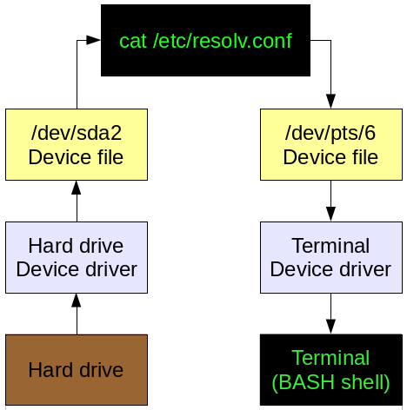

Slide 6
Disk management: fdisk stands (for “fixed disk or format disk“) is an most commonly used command-line based disk manipulation utility for a Linux/Unix systems.
With the help of fdisk command you can view, create, resize, delete, change, copy and move partitions on a hard drive using its own user friendly text based menu driven interface.

Slide 7
This tool is very useful in terms of creating space for new partitions, organising space for new drives, re-organising an old drives and copying or moving data to new disks. It allows you to create a maximum of four new primary partition and number of logical (extended) partitions, based on size of the hard disk you have in your system.

Slide 8
View all Disk Partitions in Linux
The following basic command list all existing disk partition on your system.
The ‘-l‘ argument stand for (listing all partitions) is used with fdisk command to view all available partitions on Linux. The partitions are displayed by their device’s names. For example: /dev/sda, /dev/sdb or /dev/sdc.

Slide 9
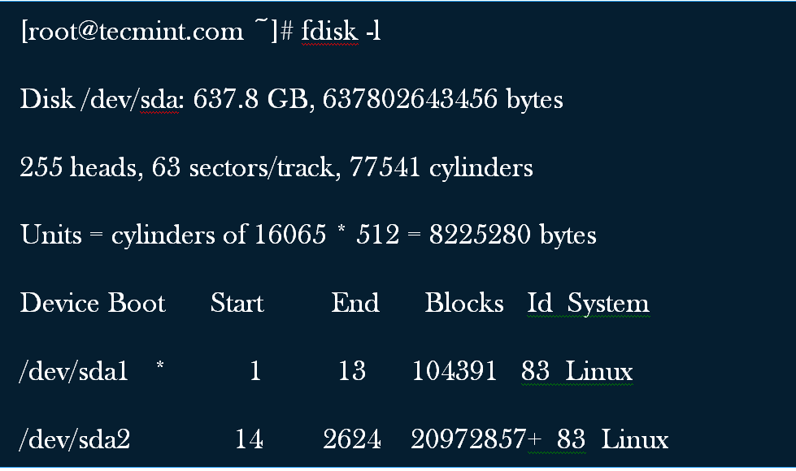

Slide 10
View Specific Disk Partition in Linux
To view all partitions of specific hard disk use the option ‘-l‘ with device name.
For example, the following command will display all disk partitions of device /dev/sda. If you’ve different device names, simple write device name as /dev/sdb or /dev/sdc.

Slide 11
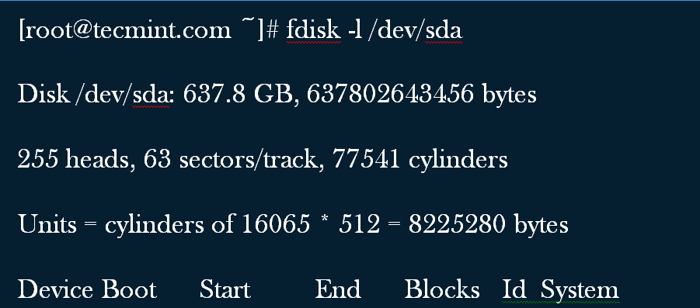
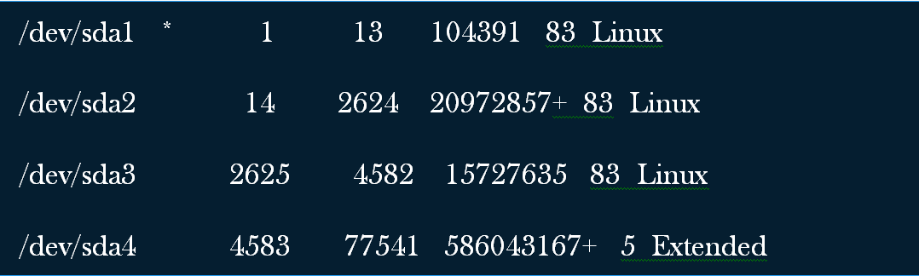

Slide 12
.Check all Available fdisk Commands
If you would like to view all commands which are available for fdisk. Simply use the following command by mentioning the hard disk name such as /dev/sda as shown below. The following command will give you output similar to below.

Slide 13
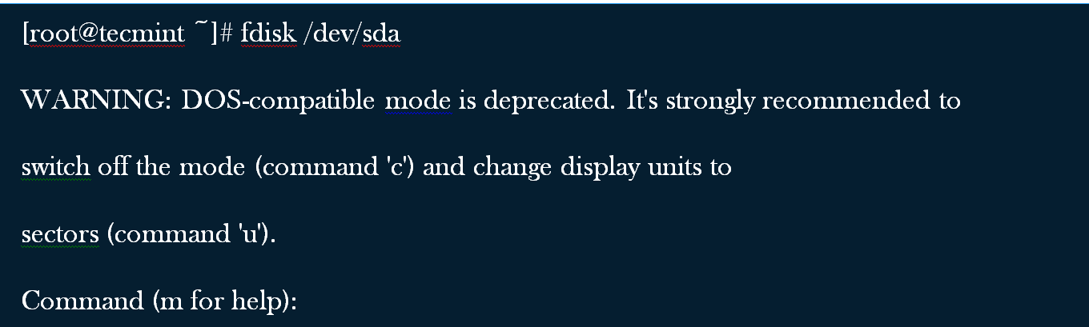

Slide 14
Type ‘m‘ to see the list of all available commands of fdisk which can be operated on /dev/sda hard disk. After, I enter ‘m‘ on the screen, you will see the all available options for fdisk that you can be used on the /dev/sda device

Slide 15
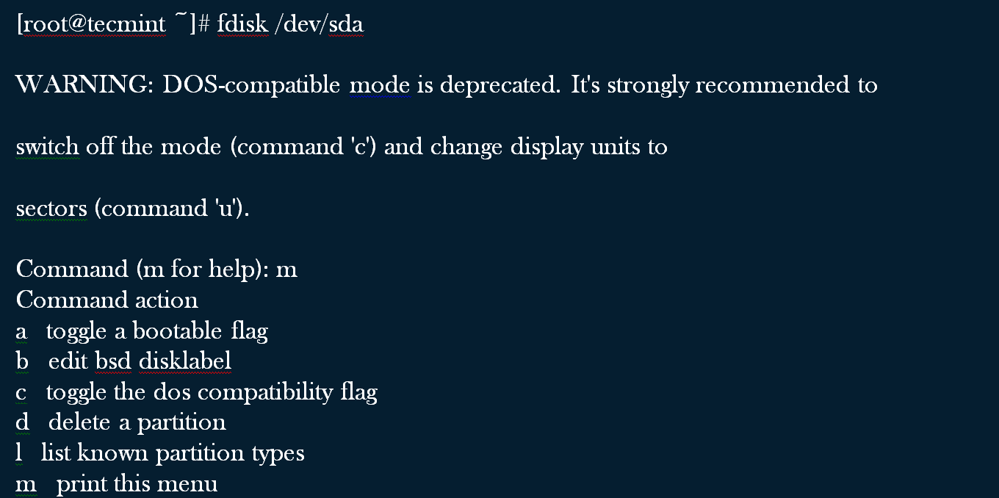

Slide 16
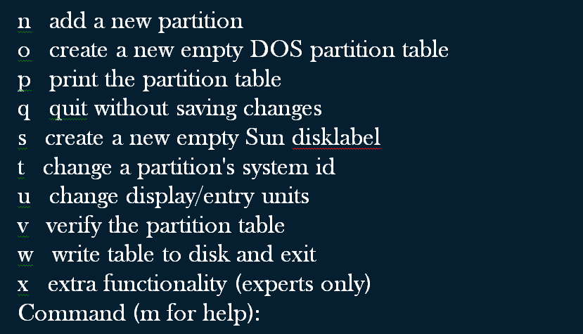

Slide 17
Print all Partition Table in Linux
To print all partition table of hard disk, you must be on command mode of specific hard disk say /dev/sda.
[root@tecmint ~]# fdisk /dev/sda
From the command mode, enter ‘p‘ instead of ‘m‘ as we did earlier. If enter ‘p‘, it will print the specific /dev/sda partition table.

Slide 18
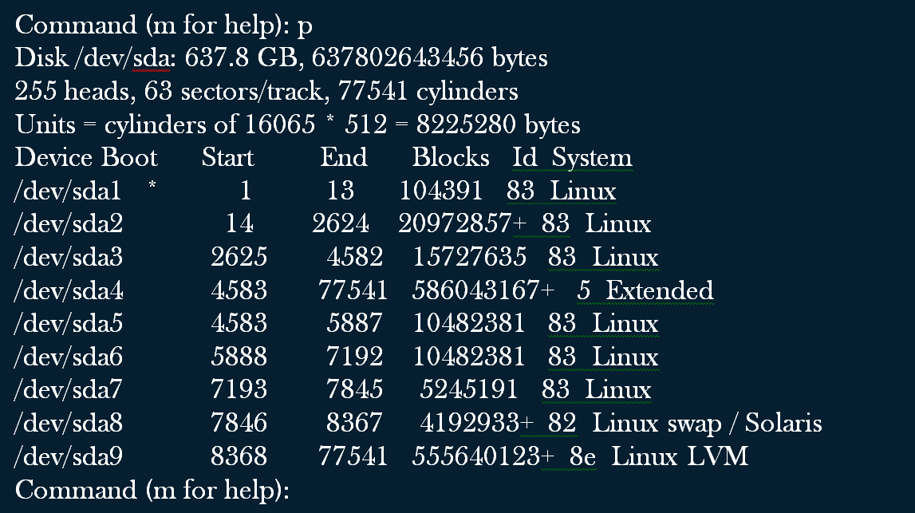

Slide 19
How to Delete a Partition in Linux
If you would like to delete a specific partition (i.e /dev/sda9) from the specific hard disk such as /dev/sda. You must be in fdisk command mode to do this.
[root@tecmint ~]# fdisk /dev/sda
Next, enter ‘d‘ to delete any given partition name from the system. As I enter ‘d‘, it will prompt me to enter partition number that I want to delete from /dev/sda hard disk.

Slide 20
Suppose I enter number ‘4‘ here, then it will delete partition number ‘4‘ (i.e. /dev/sda4) disk and shows free space in partition table. Enter ‘w‘ to write table to disk and exit after making new alterations to partition table. The new changes would only take place after next reboot of system. This can be easily understood from the below output.

Slide 21
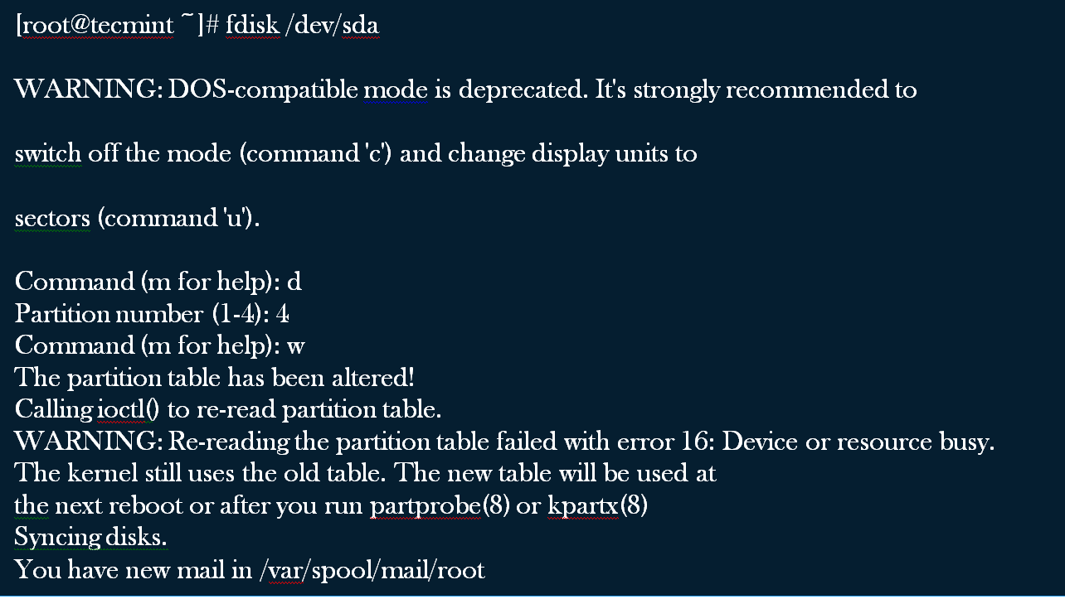

Slide 22
How to Create a New Partition in Linux
If you’ve free space left on one of your device say /dev/sda and would like to create a new partition under it. Then you must be in fdisk command mode of /dev/sda. Type the following command to enter into command mode of specific hard disk.
[root@tecmint ~]# fdisk /dev/sda
After entering in command mode, now press “n” command to create a new partition under /dev/sda with specific size. This can be demonstrated with the help of following given output

Slide 23
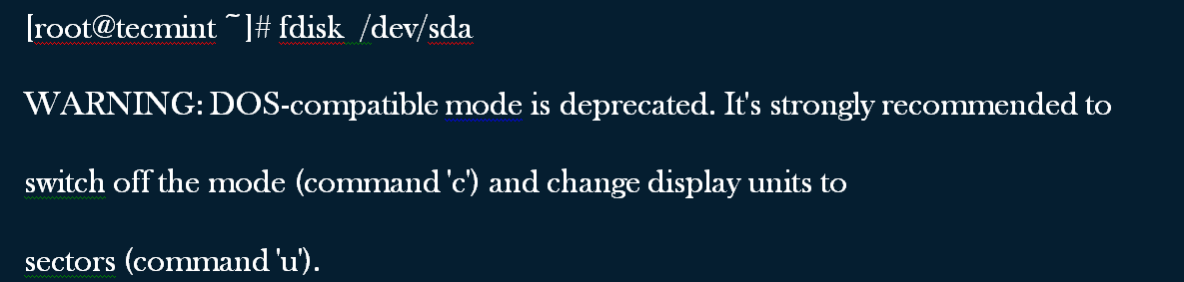
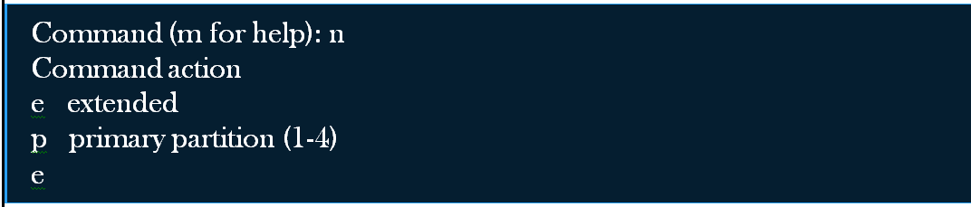

Slide 24
While creating a new partition, it will ask you two options ‘extended‘ or ‘primary‘ partition creation. Press ‘e‘ for extended partition and ‘p‘ for primary partition. Then it will ask you to enter following two inputs.
First cylinder number of the partition to be create.
Last cylinder number of the partition to be created (Last cylinder, +cylinders or +size).

Slide 25
You can enter the size of cylinder by adding “+5000M” in last cylinder. Here, ‘+‘ means addition and 5000Mmeans size of new partition (i.e 5000MB).
Please keep in mind that after creating a new partition, you should run ‘w‘ command to alter and save new changes to partition table and finally reboot your system to verify newly created partition.

Slide 26
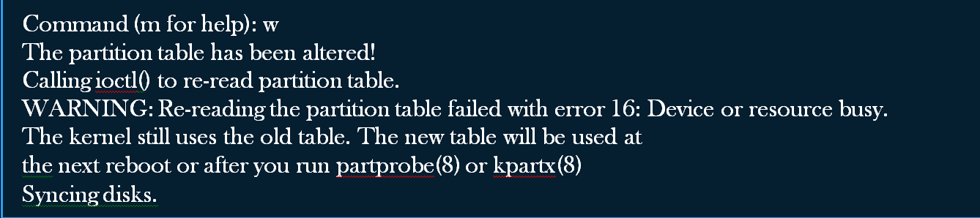

Slide 27
How to Format a Partition in Linux
After the new partition is created, don’t skip to format the newly created partition using ‘mkfs‘ command. Type the following command in the terminal to format a partition. Here /dev/sda4 is my newly created partition.
[root@tecmint ~]# mkfs.ext4 /dev/sda4

Slide 28
How to Check Size of a Partition in Linux
After formatting new partition, check the size of that partition using flag ‘s‘ (displays size in blocks) with fdisk command. This way you can check size of any specific device.
[root@tecmint ~]# fdisk -s /dev/sda2
5194304

Slide 29
How to Fix Partition Table Order
If you’ve deleted a logical partition and again recreated it, you might notice ‘partition out of order‘ problem or error message like ‘Partition table entries are not in disk order‘.
For example, when three logical partitions such as (sda4, sda5 and sda6) are deleted, and new partition created, you might expect the new partition name would be sda4. But, the system would create it as sda5. This happens because of, after the partition are deleted, sda7 partition had been moved as sda4 and free space shift to the end.

Slide 30
To fix such partition order problems, and assign sda4 to the newly created partition, issue the ‘x‘ to enter an extra functionality section and then enter ‘f‘ expert command to fix the order of partition table as shown below.

Slide 31
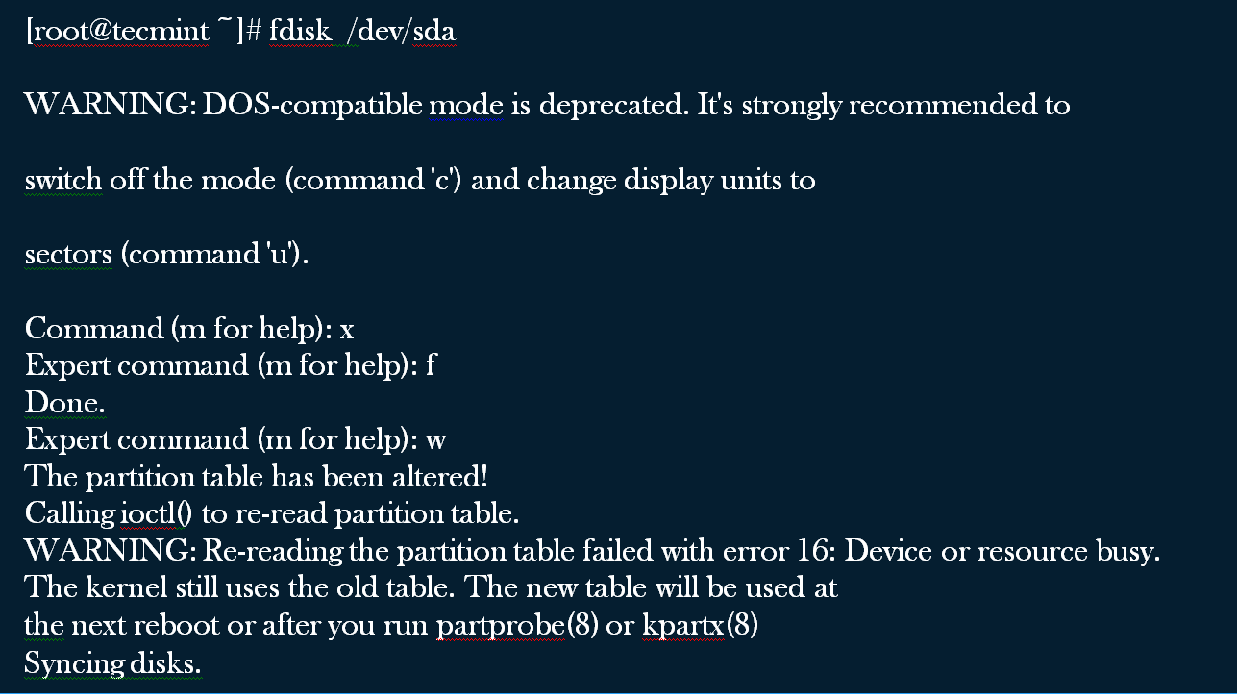
After, running ‘f‘ command, don’t forget to run ‘w‘ command to save and
exit from fdisk command mode. Once it fixed partition table order,
you will no longer get error messages

Slide 32
SWAP SPACE AND ITS MANAGEMENT
Linux divides its physical RAM (random access memory) into chucks of memory called pages. Swapping is the process whereby a page of memory is copied to the preconfigured space on the hard disk, called swap space, to free up that page of memory. The combined sizes of the physical memory and the swap space is the amount of virtual memory available.

Slide 33
Swapping is necessary for two important reasons. First, when the system requires more memory than is physically available, the kernel swaps out less used pages and gives memory to the current application (process) that needs the memory immediately.
Second, a significant number of the pages used by an application during its startup phase may only be used for initialization and then never used again. The system can swap out those pages and free the memory for other applications or even for the disk cache.

Slide 34

Linux has two forms of swap space: the swap partition and the swap file. The swap partition is an independent section of the hard disk used solely for swapping; no other files can reside there. The swap file is a special file in the filesystem that resides amongst your system and data files.
To see what swap space you have, use the command swapon -s. The output will look something like this:

Slide 35
NOTE: 'Priority' tells Linux which swap space to use first.
One great thing about the Linux swapping subsystem is that if you mount two (or more) swap spaces (preferably on two different devices) with the same priority, Linux will interleave its swapping activity between them, which can greatly increase swapping performance.
To add an extra swap partition to your system, you first need to prepare it. Step one is to ensure that the partition is marked as a swap partition and step two is to make the swap filesystem. To check that the partition is marked for swap, run as root:

Slide 36
fdisk -l /dev/hdb
Replace /dev/hdb with the device of the hard disk on your system with the swap partition on it. You should see output that looks like this:

Slide 37
If the partition isn't marked as swap you will need to alter it by running fdisk and using the 't' menu option.
Once a partition is marked as swap, you need to prepare it using the mkswap (make swap) command as root:
mkswap /dev/hdb1
If you see no errors, your swap space is ready to use. To activate it immediately, type:
swapon /dev/hdb1

Slide 38
You can verify that it is being used by running swapon -s.
To check that your swap space is being automatically mounted without having to reboot, you can run the swapoff -a command (which turns off all swap spaces) and then swapon -a (which mounts all swap spaces listed in the /etc/fstab file) and then check it with swapon -s.

Slide 39
Swap file :
As well as the swap partition, Linux also supports a swap file that you can create, prepare, and mount in a fashion similar to that of a swap partition. The advantage of swap files is that you don't need to find an empty partition or repartition a disk to add additional swap space.
To create a swap file, use the dd command to create an empty file. To create a 1GB file, type:

Slide 40
dd if=/dev/zero of=/swapfile bs=1024 count=1048576
/swapfile is the name of the swap file, and the count of 1048576 is the size in kilobytes (i.e. 1GB).
Prepare the swap file using mkswap just as you would a partition, but this time use the name of the swap file:
mkswap /swapfile
And similarly, mount it using the swapon command: swapon /swapfile.
The /etc/fstab entry for a swap file would look like this:
/swapfile none swap sw 0 0

Slide 41
File System and Directory Structure in linux
All users including the superuser have their own home directories where all private data, like documents, bookmarks, or e-mail, are stored. System directories holding central configuration files or executable files can only be modified by the superuser.
A file manager provides a graphical and more intuitive way to handle these tasks. Learn more about the file managers of GNOME and KDE in GNOME User Guide and KDE User Guide. Whatever method you choose: the following sections provide you with some basic knowledge of the file system and provide an overview of the default directory structure in Linux.

Slide 42
In Linux, all files and directories are located in a tree-like structure. The topmost directory is referred to as the file system root or just / (not to be confused with the root user). The counterpart of / in a Windows system would probably be C:\. All other directories in Linux can be accessed from the root directory and are arranged in a hierarchical structure.

Slide 43
Specifying Paths : As opposed to Windows, Linux does not use backslashes to separate the components of a pathname, it uses slashes instead. For example, the private data of users in Windows may be stored under C:\My Documents\Letters, whereas in Linux it would be stored under /home/username/Letters.
Partitions, Drives/Devices and Directories :Linux does not use drive letters as Windows does. From the mere appearance of a pathname in Linux you can not tell whether you are addressing a partition, a drive/device, a network device or an “ordinary” directory.

Slide 44
Mounting and Unmounting : Another crucial difference between Windows/DOS and Linux is the concept of mounting and unmounting partitions, drives or directories. Windows detects partitions and drives during the boot process and assigns a drive letter to them. In Linux however, partitions or devices are usually not visible in the directory tree unless they are mounted, that means integrated into the file system at a specific location in the directory tree.

Slide 45
During the installation of your system, you can define partitions to be mounted automatically when the system is started. Removable devices are usually also detected and mounted automatically by your system the desktop environments such as KDE or GNOME will inform you about the appearance of a new device.

Slide 46
Case-Sensitivity : Linux distinguishes between uppercase and lowercase letters in the file system. For example, whether you name file test.txt, TeST.txt or Test.txt make a difference in Linux. This also holds true for directories: You cannot access a directory named Letters by the name letters.

Slide 47
File Extensions : As opposed to Windows, files in Linux may have a file extension, such as .txt, but do not need to have one. When you start working with the shell this sometimes makes it difficult for beginners to differentiate between files and folders, depending on the command you use to list the contents of a directory.

Slide 48
Hidden Files :Similar to Windows, Linux also distinguishes between “normal” files and hidden files which are often configuration files that you usually do not want to access or see as a normal user. In Linux, hidden files are indicated by a dot in front (for example, .hiddenfile).
File System Permissions : Because Linux is a multiuser system, every file in a Linux file system belongs to a user and a group. Only the owner of a file or directory (or, of course, root) can grant other users access permission to it. Linux basically distinguishes between three different types of access permissions: write permission, read permission and execute permission.

Slide 49
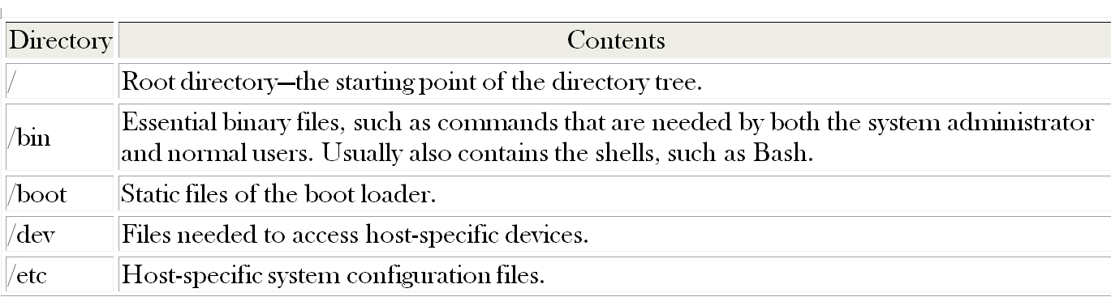
The Directory Structure
The following table provides a short overview of the most important higher-level directories you find on a Linux system. Find more detailed information about the directories and important subdirectories in the following list.

Slide 50
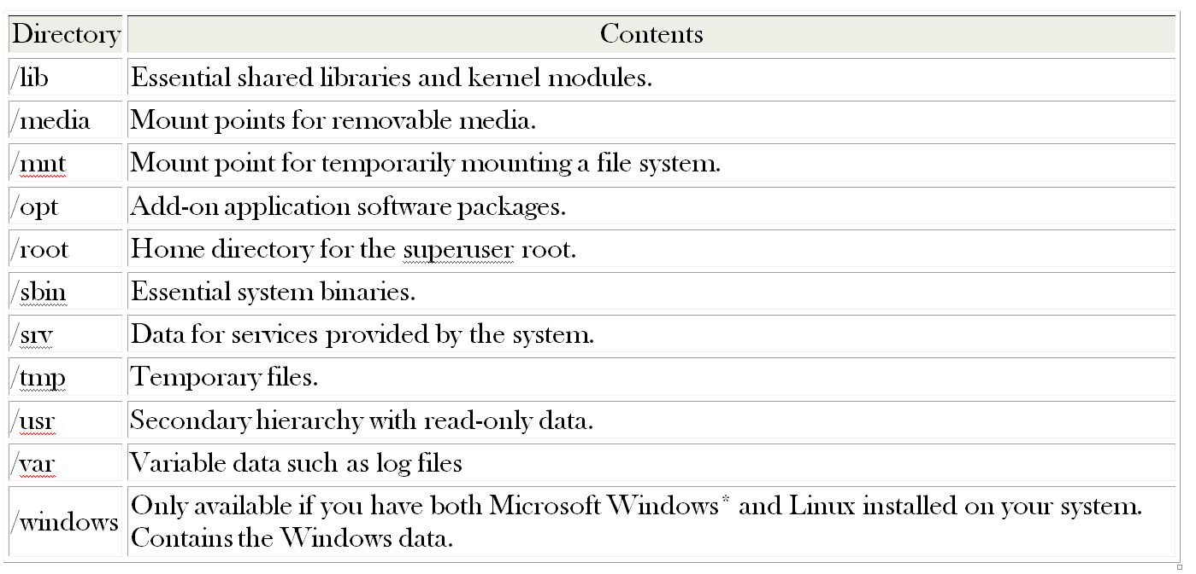

Slide 51
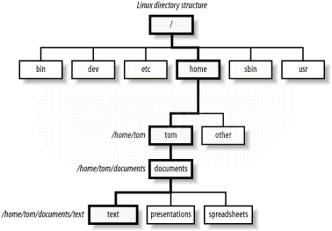
eXAMPLE

Slide 52
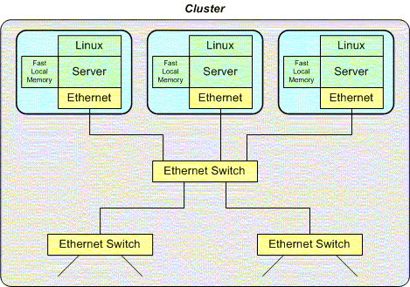
MULTIPROCESSING:
A multiprocessing system consists of a number of processors communicating via a bus or a network. There are two types of multiprocessing systems: loosely coupled and tightly coupled.

Slide 53
Loosely coupled systems consist of processors that operate stand-alone. Each processor has its own bus, memory, and I/O subsystem, and communicates with other processors through the network medium. Loosely coupled systems can be either homogeneous or heterogeneous.

Slide 54
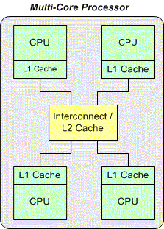
Tightly Couples Multiprocessing Architecture

Slide 55
Tightly coupled systems consist of processors that share the memory, bus, devices, and sometimes cache. Tightly coupled systems run a single instance of the operating system. Tightly coupled systems can be classified into symmetric and asymmetric systems. Asymmetric systems are configured so that each processor is assigned a specific task. Asymmetric systems have a single "master" processor that controls all others.

Slide 56
Symmetric systems treat all processors the same way—processes have equal access to all system resources. In the symmetric model, all tasks are spread equally across all processors.
Symmetric systems are subdivided into further classes consisting of dedicated and shared cache systems. Symmetrical Multiprocessing (SMP) systems have become very popular and have become the default choice for many large servers.

Slide 57
LOAD SHARING AND MULTI THREADING IN LINUX
Thread is an execution unit which consists of its own program counter, a stack, and a set of registers. Threads are also known as Lightweight processes. Threads are popular way to improve application through parallelism. The CPU switches rapidly back and forth among the threads giving illusion that the threads are running in parallel.
As each thread has its own independent resource for process execution, multpile processes can be executed parallely by increasing number of threads.

Slide 58
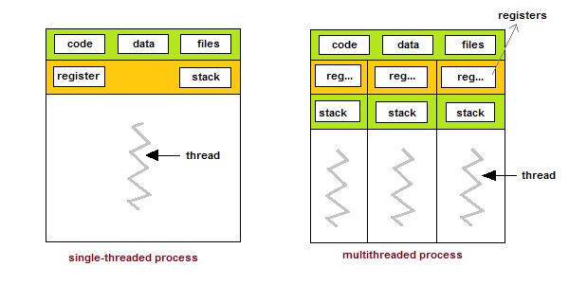

Slide 59
Types of Thread:
There are two types of threads :
User Threads
User Threads
User threads, are above the kernel and without kernel support. These are the threads that application programmers use in their programs.
Kernel threads are supported within the kernel of the OS itself. All modern OSs support kernel level threads, allowing the kernel to perform multiple simultaneous tasks and/or to service multiple kernel system calls simultaneously.

Slide 60
Multithreading Models:
The user threads must be mapped to kernel threads, by one of the following strategies.
Many-To-One Model
One-To-One Model
Many-To-Many Model

Slide 61
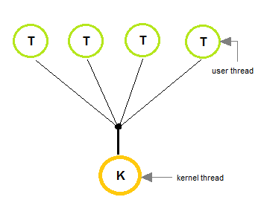
Many-To-One Model
In the many-to-one model, many user-level threads are all mapped onto a single kernel thread.
Thread management is handled by the thread library in user space, which is efficient in nature.

Slide 62
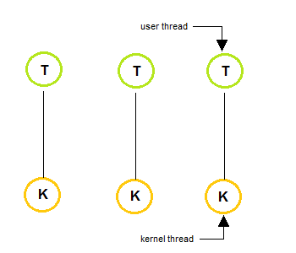
The one-to-one model creates a separate kernel thread to handle each and every user thread.
Most implementations of this model place a limit on how many threads can be created.
Linux and Windows from 95 to XP implement the one-to-one model for threads.

Slide 63
Many-To-Many Model
The many-to-many model multiplexes any number of user threads onto an equal or smaller number of kernel threads, combining the best features of the one-to-one and many-to-one models.
Users can create any number of the threads.
Blocking the kernel system calls does not block the entire process.
Processes can be split across multiple processors.

Slide 64
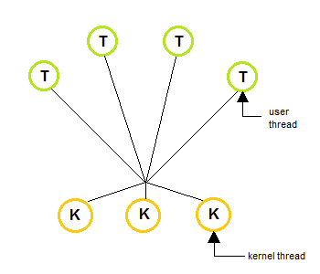

Slide 65
Thread Libraries
Thread libraries provides programmers with API for creating and managing of threads.
Thread libraries may be implemented either in user space or in kernel space. The user space involves API functions implemented solely within user space, with no kernel support. The kernel space involves system calls, and requires a kernel with thread library support.

Slide 66
There are three types of thread :
POSIX Pitheads, may be provided as either a user or kernel library, as an extension to the POSIX standard.
Win32 threads, are provided as a kernel-level library on Windows systems.
Java threads - Since Java generally runs on a Java Virtual Machine, the implementation of threads is based upon whatever OS and hardware the JVM is running on, i.e. either Pitheads or Win32 threads depending on the system

Slide 67
Benefits of Multithreading
Responsiveness
Resource sharing, hence allowing better utilization of resources.
Economy. Creating and managing threads becomes easier.
Scalability. One thread runs on one CPU. In Multithreaded processes, threads can be distributed over a series of processors to scale.
Context Switching is smooth. Context switching refers to the procedure followed by CPU to change from one task to another.

Slide 68
Multithreading Issues
Thread Cancellation: Thread cancellation means terminating a thread before it has finished working. There can be two approaches for this, one is Asynchronous cancellation, which terminates the target thread immediately. The other is Deferred cancellation allows the target thread to periodically check if it should be cancelled.
Signal Handling: Signals are used in UNIX systems to notify a process that a particular event has occurred. Now in when a Multithreaded process receives a signal, to which thread it must be delivered? It can be delivered to all, or a single thread.

Slide 69
fork() System Call: fork() is a system call executed in the kernel through which a process creates a copy of itself. Now the problem in Multithreaded process is, if one thread forks, will the entire process be copied or not?
Security Issues because of extensive sharing of resources between multiple threads.
There are many other issues that you might face in a multithreaded process, but there are appropriate solutions available for them.

Slide 70
TYPES OF USERS IN LINUX:
User :From the beginning, Linux has been designed as a multiuser system: Any number of users can simultaneously work on one machine. These users can connect to the system via different terminals or network connections. Usually users need to log in to the system before starting a session. Personal information and individual desktop configuration are stored separately for any user.

Slide 71
Distinct User Roles
Among the users working on a machine, Linux distinguishes between different kinds of user roles: you can log in to a Linux machine as “normal” user or as superuser (administrator), traditionally called root in Linux and group users.
The superuser has privileges which authorize him to access all parts of the system and to execute administrative tasks: He has the unrestricted capacity to make changes to the system and has unlimited access to all files. If you are logged in as a normal user you lack these privileges. User and root can of course be the same physical person but acting in different roles.

Slide 72
The root user account is always created on your Linux system by default — during installation you are therefore requested to specify a password for root. Which other users can log in to your system depends on the method of authentication you choose during installation.
For your daily work, you usually log in to your system as normal user. Performing some administrative tasks or running certain programs such as require root permissions. You can easily switch from your normal account to root and back to your normal user account after accomplishing the administrative task.

Slide 73
If you are working with a graphical user interface you are usually prompted to enter the root password when necessary. Closing the application which required root permissions results in withdrawal of the root privileges: you automatically switch back to your normal user account.

Slide 74
Groups
Every user in a Linux system belongs at least to one group. A group, in this case, can be defined as a set of connected users with certain collective privileges. Groups are usually defined according to functional roles or the data and resources the members of the group need to access.
When a new user account is created on your system, the user is usually assigned to a default, primary group. The system administrator can change this primary group or assign the user to an additional group, if necessary

Slide 75
Managing Users and Groups
There are four main user administration files −
/etc/passwd − Keeps the user account and password information. This file holds the majority of information about accounts on the Unix system.
/etc/shadow − Holds the encrypted password of the corresponding account. Not all the systems support this file.
/etc/group − This file contains the group information for each account.
/etc/gshadow − This file contains secure group account information.

Slide 76
To add a user
Syntax : sudo adduser username
Ex: $: sudo adduser ramu
$ sudo vim /etc/passwd or
$ cat /etc/ passwd ( to display the existing users)

Slide 77
To delete a user:
Syntax : sudo userdel username
Ex: $: sudo userdel ramu
$ sudo vim /etc/passwd or $ cat /etc/ passwd ( to display the existing users)

Slide 78
To create a user group:
Syntax : sudo addgroup groupname
Ex: $: sudo addgroup srec
$ sudo vim /etc/ group or $ cat /etc/ group ( to display the existing groups, group users)
To delete a user group:
Syntax : sudo groupdel groupname
Ex: $: sudo groupdel srec
$ sudo vim /etc/group or $ cat /etc/ group ( to display the existing groups)

Slide 79
To add a user to group:
Syntax : sudo adduser –G username groupname
Ex: $: sudo adduser ramu srec
$ sudo vim /etc/group or $ cat /etc/ group ( to display the existing groups, group users)
To delete a user from group:
Syntax : sudo deluser username groupname
Ex: $: sudo deluser ramu srec
$ sudo vim /etc/group or $ cat /etc/ group ( to display the existing groups, group users)

Slide 80
FILE PERMISSIONS
In linux, different users has different file permissions. To know the file permissions of various users, the following command can be used.
$ ls –l file1.txt
-rwxr-xr-x . 2 srec srec 4096 jan 10:05 downloads
To change permissions, we can use chmod command.
$ sudo chmod desired file permissions file name.
File permissions can be

Slide 81
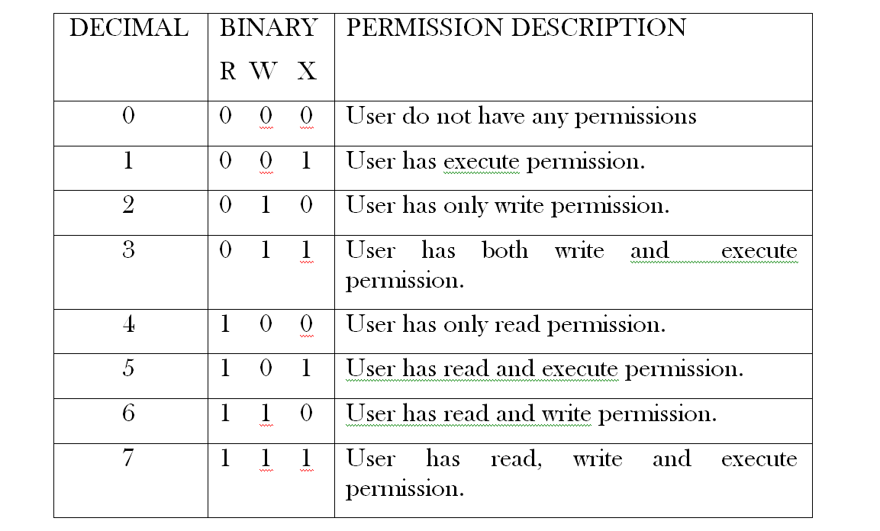

Slide 82
Example: $ chmod 777 file1.txt , it sets every user ( owner, group, others ) can have all the three permissions.
$ ls –l file1.txt
-rwxrwxrwx . 2 srec srec 4096 jan 10:05 downloads.

Slide 83
CAPABILITIES OF SUPER USER
The Linux super user, or root user, is a special user that has tremendous power, with the ability to access and modify all files on the operating system. This is necessary at times, but there is a potential for accidental errors to cause a great deal of destruction, so you have to be careful. Fot the times when the super user’s power is necessary, we’ll look at safer ways to be the super user on your Linux dedicated server.
Super User and Sudo

Slide 84
A really important feature of Linux is privileges. It’s part of the security, and controls which users can access, manipulate or even be aware of what files. Logged in with the user account we’ve created will allow safe usage of the operating system, but there are times when the privileges of the root, or super user are required.
There are two ways to access super user privileges. The first is with the su command.
$ su –

Slide 85
If you enter this command, and note the hyphen, then you will be prompted for the root user’s password. Enter it correctly, and you will be logged in as the super user. You can then perform what tasks you need to, but with care! When you’ve finished, log out immediately using the exit command.
The second way to get super user privileges is to use sudo. This is a method by which a regular user can gain a temporary privilege boost. It takes a little setting up, but once done it is probably safer than the su command method.

Slide 86
First, log in to your server. Then, log in as root using the su command. Then, enter the following.
$ vi sudo
This will open up a text file that contains information for sudo. A little way down the file you’ll see the following text.
# User privilege specification
root ALL=(ALL) ALL

Slide 87
You need to add yourself to the file in order to get your privileges. To do this, you need to do a little editing. Use the arrow keys to move the cursor to this line, then press i on the keyboard. You’re now editing the file, so enter the following line:
YourUserName ALL=(ALL) ALL
Of course substitute your user name for YourUserName, then press escape, and type ZZ (capital Z twice). This will save the file, and that’s it. If you’ve done it right, you can now use sudo. To test this, log out as the root user (type exit, hit return), then try the following.

Slide 88
$ ls /root
You should receive an error message telling you that permission is denied. So, try it with sudo.
$ sudo ls /root
Now you will be asked for a password. Enter your own password at this point (not the root password) and hey presto, you’ll be presented with a listing of the root user’s directory. So, any time that you wish to do something that requires root user privileges, remember that you can use the sudo command, saving you from logging in as the root user.

Slide 89
Logging out
To log out of your ssh session, and so your server, at any time, type:
$ exit
If you are logged in as the super user having used the su command, remember that you may need to type this twice.

