Slide 1
SOFTWARE PROJECT MANAGEMENT
Unit - I

Slide 2
What Is Software Project Management? Software project management refers to the branch of project management dedicated to the planning, scheduling, resource allocation, execution, tracking and delivery of software and web projects.

Slide 3
Course Objectives
The main goal of software development projects is to create a software system with a predetermined functionality and quality in a given time frame and with given costs.
For achieving this goal, models are required for determining target values and for continuously controlling these values. This course focuses on principles, techniques, methods & tools for model-based management of software projects, assurance of product quality and process adherence (quality assurance), as well as experience-based creation & improvement of models (process management).

Slide 4
The goals of the course can be characterized as follows:
Understanding the specific roles within a software organization as related to project and process management .
Describe the principles, techniques, methods & tools for model-based management of software projects, assurance of product quality and process adherence (quality assurance), as well as experience-based creation & improvement of models (process management)

Slide 5
Understanding the basic infrastructure competences (e.g., process modeling and measurement)
Understanding the basic steps of project planning, project management, quality assurance, and process management and their relationships

Slide 6
Unit I
Conventional Software Management: The waterfall model, conventional software Management performance. Evolution of Software Economics: Software Economics, pragmatic software cost estimation

Slide 7
Conventional software management
Conventional software management practices are sound in theory, but practice is still tied to archaic (outdated) technology and techniques.
Conventional software economics provides a benchmark of performance for conventional software management principles

Slide 8
The best thing about software is its flexibility: It can be programmed to do almost anything.
The worst thing about software is also its flexibility: The "almost anything" characteristic has made it difficult to plan, monitors, and control software development.
Three important analyses of the state of the software engineering industry are

Slide 9
  Software development is still highly unpredictable. Only about 10% of software projects are delivered successfully within initial budget and schedule estimates.
  Management discipline is more of a discriminator in success or failure than are technology advances.
  The level of software scrap and rework is indicative of an immature process.
  All three analyses reached the same general conclusion: The success rate for software projects is very low. The three analyses provide a good introduction to the magnitude of the software problem and the current norms for conventional software management performance.

Slide 10
  THE WATERFALL MODEL
Most software engineering texts present the waterfall model as the source of the "conventional" software process.
In Theory It provides an insightful and concise summary of conventional software management three main primary points are
There are two essential steps common to the development of computer programs: analysis and Coding.

Slide 11
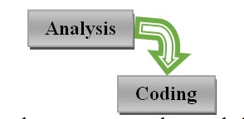
Waterfall Model part 1: The two basic steps to building a program.

Slide 12
In order to manage and control all of the intellectual freedom associated with software development, one must introduce several other "overhead" steps, including system requirements definition, software requirements definition, program design, and testing.
These steps supplement the analysis and coding steps. Below Figure illustrates the resulting project profile and the basic steps in developing a large-scale progra

Slide 13
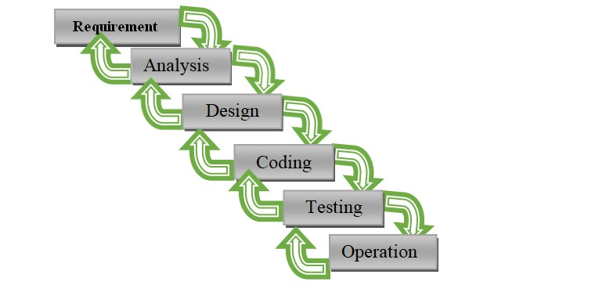

Slide 14
      The basic framework described in the waterfall model is risky and invites failure. The testing phase that occurs at the end of the development cycle is the first event for which timing, storage, input/output transfers, etc., are experienced as distinguished from analyzed.
      The resulting design changes are likely to be so disruptive that the software requirements upon which the design is based are likely violated. Either the requirements must be modified or a substantial design change is warranted.

Slide 15
Five necessary improvements for waterfall model are
Program design comes first
Document the design
Do it twice
Plan, control, and monitor testing
Involve the customer

Slide 16
1.Program design comes first
Insert a preliminary program design phase between the software requirements generation phase and the analysis phase.
By this technique, the program designer assures that the software will not fail because of storage, timing, and data flux (continuous change)
As analysis proceeds in the succeeding phase, the program designer must impose on the analyst the storage, timing, and operational constraints in such a way that he senses the consequences

Slide 17
If the total resources to be applied are insufficient or if in an early stage of developmen) operational design is wrong, it will be recognized at this early stage and the iteration with requirements and preliminary design can be redone before final design, coding, and test commences

Slide 18
The following steps are required:
Begin the design process with program designers, not analysts or programmers.
Design, define, and allocate the data processing modes even at the risk of being wrong. Allocate processing functions, design the database, allocate execution time, define interfaces and processing modes with the operating system, describe input and output processing, and define preliminary operating procedures.
Write an overview document that is understandable, informative, and current so that every worker on the project can gain an elemental understanding of the system

Slide 19
2. Document the design
amount of documentation required on most software programs is quite a lot
Why do we need so much documentation?
Each designer must communicate with interfacing designers, managers, and possibly customers
During early phases, the documentation is the design
The real monetary value of documentation is to support later modifications by a separate test team, a separate maintenance team, and operations personnel who are not software literate.

Slide 20
3. Do it Twice
If a computer program is being developed for the first time, arrange matters so that the version finally delivered to the customer for operational deployment is actually the second version in sofar as critical design/operations are concerned
Note that this is simply the entire process done in miniature, to a time scale that is relatively small with respect to the overall effort
In the first version, the team must have a special broad competence where they can quickly sense trouble spots in the design, model them, model alternatives, forget the straightforward aspects of the design that aren't worth studying at this early point, and, finally, arrive at an error-free program.

Slide 21
4. Plan, control, and monitor testing
Without question, the biggest user of project resources-manpower, computer time, and/or management judgment-is the test phase. This is the phase of greatest risk in terms of cost and schedule
It occurs at the latest point in the schedule, when backup alternatives are least available, if at all.
The previous three recommendations were all aimed at uncovering and solving problems before entering the test phase.

Slide 22
However, even after doing these things, there is still a test phase and there are still important things to be done, including.
(1) employ a team of test specialists who were not responsible for the original design
(2) employ visual inspections to spot the obvious errors like dropped minus signs, missing factors of two, jumps to wrong addresses (do not use the computer to detect this kind of thing, it is too expensive);
(3) test every logic path; (4) employ the final checkout on the target computer

Slide 23
5. Involve the customer
It is important to involve the customer in a formal way so that he has committed himself at earlier points before final delivery.
There are three points following requirements definition where the insight, judgment, and commitment of the customer can bolster the development effort.
These include a "preliminary software review" following the preliminary program design step, a sequence of "critical software design reviews" during program design, and a "final software acceptance review".

Slide 24
In Practice
Some software projects still practice the conventional software management approach
It is useful to summarize the characteristics of the conventional process as it has typically been applied, which is not necessarily as it was intended
Projects destined for trouble frequently exhibit the following symptoms:

Slide 25
Protracted integration and late design breakage.
Late risk resolution.
Requirements-driven functional decomposition.
Adversarial (conflict or opposition) stakeholder relationships.
Focus on documents and review meetings.

Slide 26
Protracted Integration and Late Design Breakage
For a typical development project that used a waterfall model management process, Following Figure illustrates development progress versus time. Progress is defined as percent coded, that is, demonstrable in its target form.

Slide 27
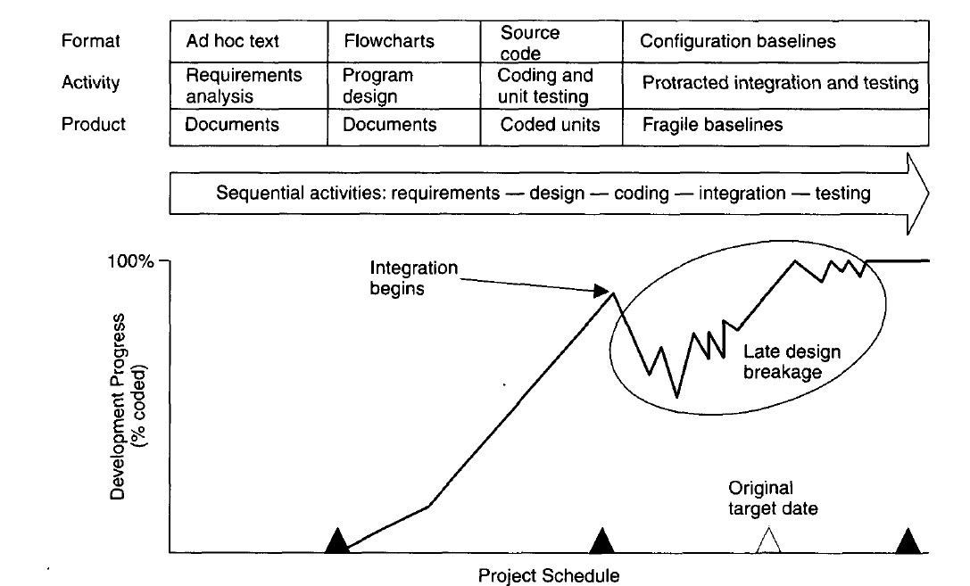

Slide 28
The following sequence was common:
Early success via paper designs and thorough (often too thorough) briefings.
Commitment to code late in the life cycle.
Integration nightmares (unpleasant experience) due to unforeseen implementation issues and interface ambiguities.
Heavy budget and schedule pressure to get the system working.
Late shoe-homing of no optimal fixes, with no time for redesign.
A very fragile, unmentionable product delivered late.

Slide 29
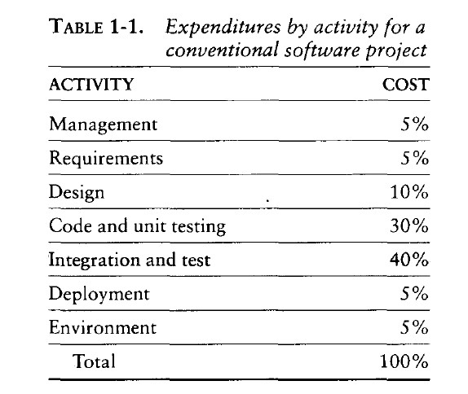
In the conventional model, the entire system was designed on paper, then implemented all at once, then integrated. Table 1-1 provides a typical profile of cost expenditures across the spectrum of software activities.

Slide 30
Late risk resolution
A serious issue associated with the waterfall lifecycle was the lack of early risk resolution. Following Figure illustrates a typical risk profile for conventional waterfall model projects.
It includes four distinct periods of risk exposure, where risk is defined as the probability of missing a cost, schedule, feature, or quality goal.
Early in the life cycle, as the requirements were being specified, the actual risk exposure was highly unpredictable.

Slide 31
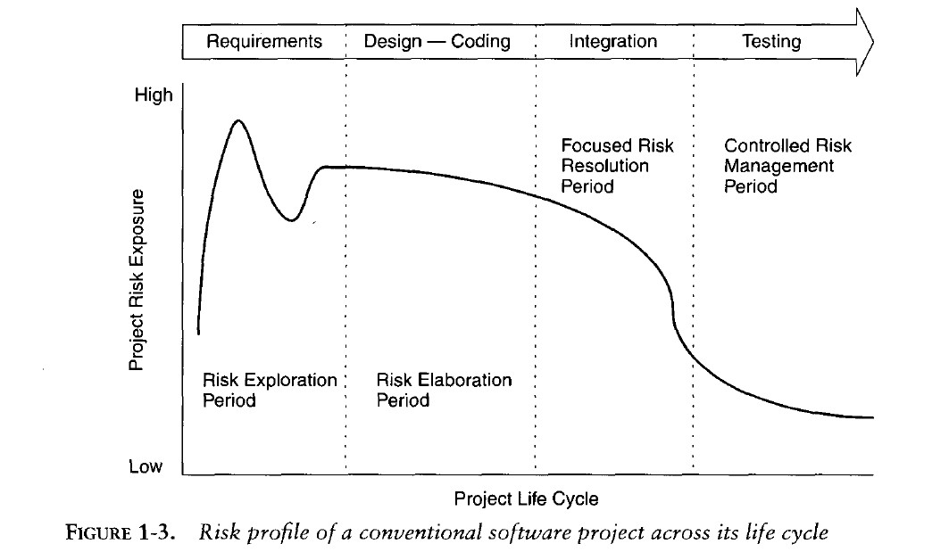

Slide 32
Requirements-Driven Functional Decomposition
This approach depends on specifying requirements com- pletely and unambiguously before other development activities begin.
It naively treats all requirements as equally important, and depends on those requirements remaining constant over the software development life cycle.
These conditions rarely occur in the real world. Specification of requirements is a difficult and important part of the software development process.

Slide 33
Another property of the conventional approach is that the requirements were typically specified in a functional manner.
Built into the classic waterfall process was the fundamental assumption that the software itself was decomposed into functions; requirements were then allocated to the resulting components.
This decomposition was often very different from a decomposition based on object-oriented design and the use of existing components

Slide 34
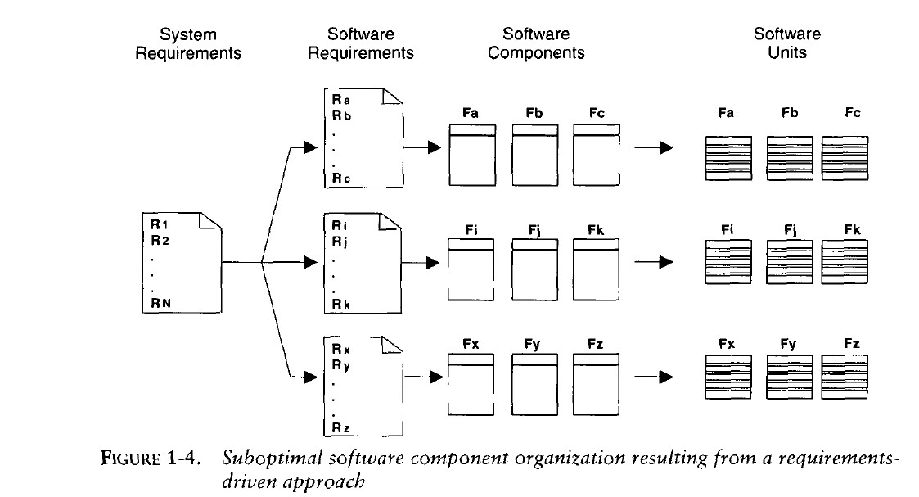

Slide 35
Adversarial Stakeholder Relationships:
The conventional process tended to result in adversarial stakeholder relationships, in large part because of the difficulties of requirements specification and the exchange of information solely through paper documents that captured engineering information in ad hoc formats.
The following sequence of events was typical for most contractual software efforts:

Slide 36
The contractor prepared a draft contract-deliverable document that captured an intermediate artifact and delivered it to the customer for approval
The customer was expected to provide comments (typically within 15 to 30 days).
The contractor incorporated these comments and submitted (typically within 15 to 30 days) a final version for approval.

Slide 37
Focus on Documents and Review Meetings:
The conventional process focused on producing various documents that attempted to describe the software product, with insufficient focus on producing tangible increments of the products themselves.
Contractors were driven to produce literally tons of paper to meet milestones and demonstrate progress to stakeholders, rather than spend their energy on tasks that would reduce risk and produce quality software.

Slide 38
Typically, presenters and the audience reviewed the simple things that they understood rather than the complex and important issues. Most design reviews therefore resulted in low engineering value and high cost in terms of the effort and schedule involved in their preparation and conduct. They presented merely a facade of progress.
Table 1-2 summarizes the results of a typical design review.

Slide 39
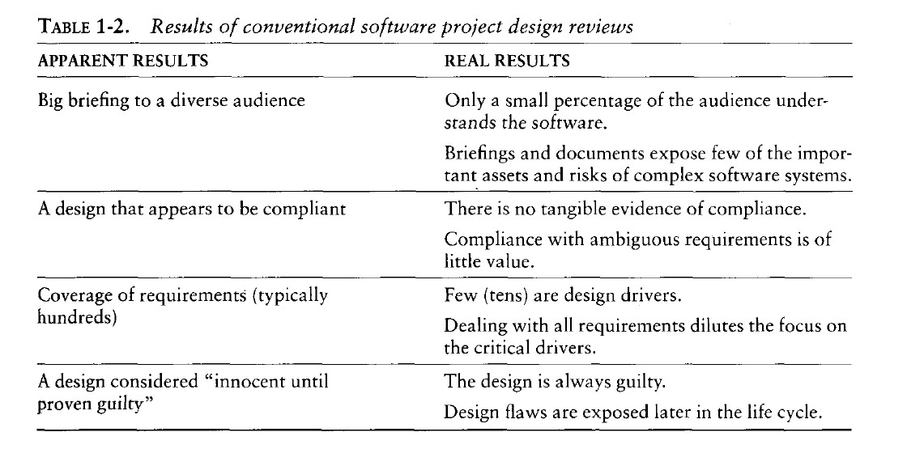

Slide 40
  CONVENTIONAL SOFTWARE MANAGEMENT PERFORMANCE
Barry Boehm's "Industrial Software Metrics Top 10 List” is a good, objective characterization of the state of software development.
Finding and fixing a software problem after delivery costs 100 times more than finding and fixing the problem in early design phases.
You can compress software development schedules 25% of nominal, but no more.
For every $1 you spend on development, you will spend $2 on maintenance.

Slide 41
Software development and maintenance costs are primarily a function of the number of source lines of code.
Variations among people account for the biggest differences in software productivity.
The overall ratio of software to hardware costs is still growing. In 1955 it was 15:85; in 1985, 85:15.
Only about 15% of software development effort is devoted to programming.

Slide 42
Software systems and products typically cost 3 times as much per SLOC as individual software programs. Software-system products (i.e., system of systems) cost 9 times as much.
Walkthroughs catch 60% of the errors
80% of the contribution comes from 20% of the contributors.

Slide 43
Evolution of Software Economics
  SOFTWARE ECONOMICS
Most software cost models can be abstracted into a function of five basic parameters: size, process, personnel, environment, and required quality.
    The size of the end product (in human-generated components), which is typically quantified in terms of the number of source instructions or the number of function points required to develop the required functionality
    The process used to produce the end product, in particular the ability of the process to avoid non- value-adding activities (rework, bureaucratic delays, communications overhead)

Slide 44
    The capabilities of software engineering personnel, and particularly their experience with the computer science issues and the applications domain issues of the project
    The environment, which is made up of the tools and techniques available to support efficient software development and to automate the process
    The required quality of the product, including its features, performance, reliability, and adaptability

Slide 45
    The relationships among these parameters and the estimated cost can be written as follows:
Effort = (Personnel) (Environment) (Quality) ( Sizeprocess)
One important aspect of software economics (as represented within today's software cost models) is that the relationship between effort and size exhibits a diseconomy of scale.
Contrary to most manufacturing processes, the more software you build, the more expensive it is per unit item.

Slide 46
Figure 2-1 shows three generations of basic technology advancement in tools, components, and processes. The required levels of quality and personnel are assumed to be constant. The ordinate of the graph refers to software unit costs (pick your favorite: per SLOC, per function point, per component) realized by an organization.

Slide 47
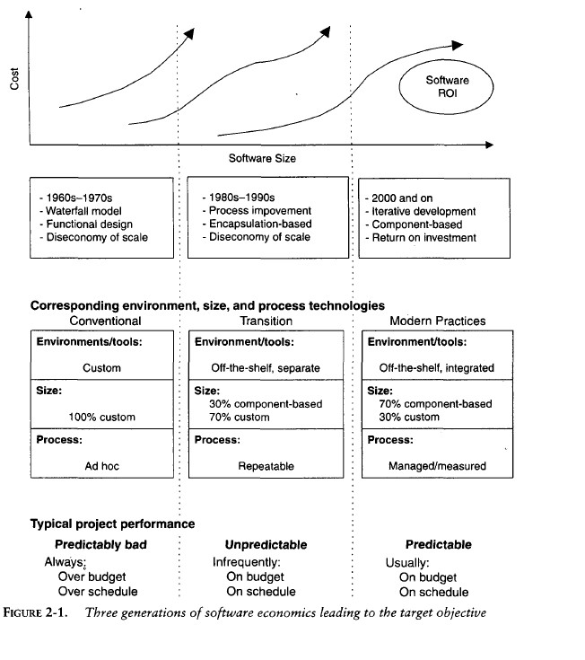

Slide 48
The three generations of software development are defined as follows:
Conventional: 1960s and 1970s, craftsmanship. Organizations used custom tools, custom processes, and virtually all custom components built in primitive languages. Project performance was highly predictable in that cost, schedule, and quality objectives were almost always underachieved.

Slide 49
Transition: 1980s and 1990s, software engineering. Organize: solution used more-repeatable processes and off- the-shelf tools, and mostly (>70%) custom components built in higher level languages. Some of the components (<30%) were available as commercial products, including the operating system, database management system, networking, and graphical user interface.

Slide 50
Modern practices: 2000 and later, software production. This book's philosophy is rooted in the use of managed and measured processes, integrated automation environments, and mostly (70%) off-the-shelf components. Perhaps as few as 30% of the components need to be custom built
Technologies for environment automation, size reduction, and process improvement are not independent of one another

Slide 51
In each new era, the key is complementary growth in all technologies. For example, the process advances could not be used successfully without new component technologies and increased tool automation.
Organizations are achieving better economies of scale in successive technology eras-with very large projects (systems of systems), long-lived products, and lines of business comprising multiple similar projects. Figure 2-2 provides an overview of how a return on investment (ROI) profile can be achieved in subsequent efforts across life cycles of various domains.

Slide 52
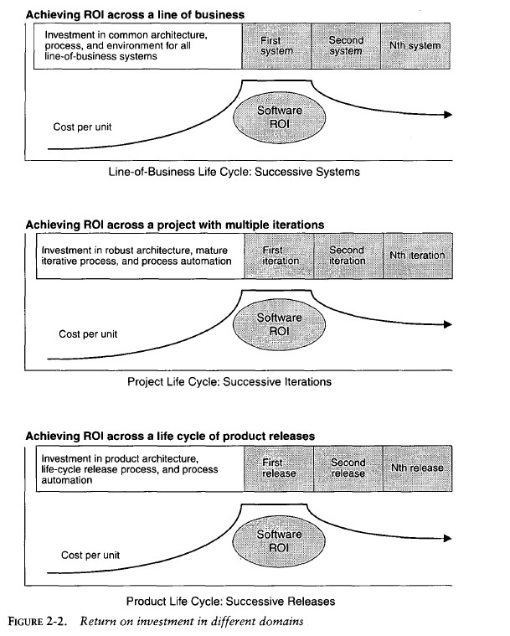

Slide 53
  PRAGMATIC SOFTWARE COST ESTIMATION
One critical problem in software cost estimation is a lack of well-documented case studies of projects that used an iterative development approach.
Software industry has inconsistently defined metrics or atomic units of measure, the data from actual projects are highly suspect in terms of consistency and comparability.
It is hard enough to collect a homogeneous set of project data within one organization

Slide 54
it is extremely difficult to homog- enize data across different organizations with different processes, languages, domains, and so on.
There have been many debates among developers and vendors of software cost estimation models and tools.
Three topics of these debates are of particular interest here: They are

Slide 55
    Which cost estimation model to use?
    Whether to measure software size in source lines of code or function points.
    What constitutes a good estimate?
There are several popular cost estimation models (such as COCOMO, CHECKPOINT, ESTIMACS, Knowledge Plan, Price-S, ProQMS, SEER, SLIM, SOFTCOST, and SPQR/20), CO COMO is also one of the
most open and well-documented cost estimation models. The general accuracy of conventional cost models (such as COCOMO) has been described as "within 20% of actual, 70% of the time."

Slide 56
Most real-world use of cost models is bottom-up (substantiating a target cost) rather than top-down (estimating the "should" cost).
Figure 2-3 illustrates the predominant practice: The software project manager defines the target cost of the software, and then manipulates the parameters and sizing until the target cost can be justified.

Slide 57
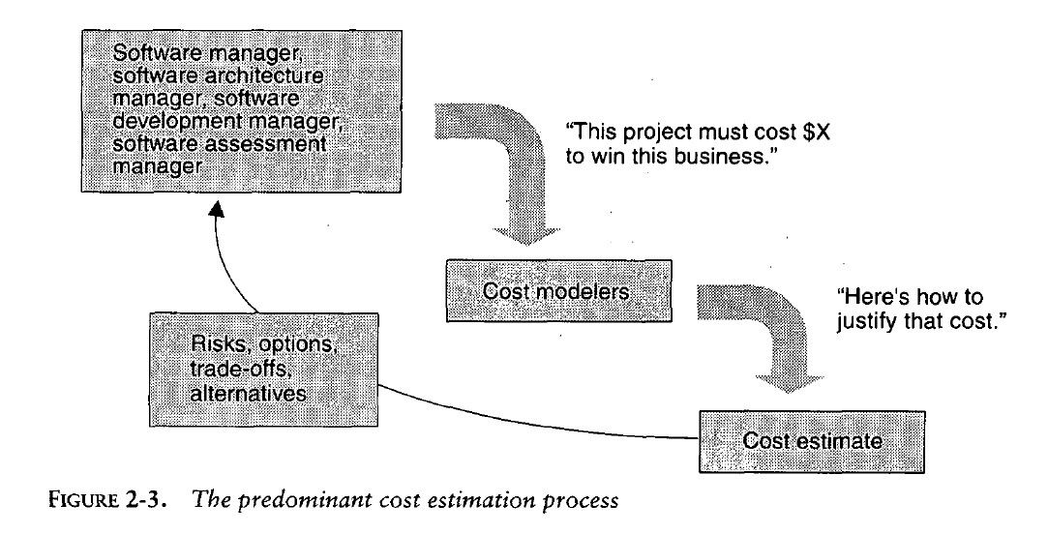

Slide 58
The process described in Figure 2-3 is not all bad. In fact, it is absolutely necessary to analyze the cost risks and understand the sensitivities and trade-offs objectively.
It forces the software project manager to examine the risks associated with achieving the target costs and to discuss this information with other stakeholders.
A good software cost estimate has the following attributes:

Slide 59
It is conceived and supported by the project manager, architecture team, development team, and test team accountable for performing the work.
It is accepted by all stakeholders as ambitious but realizable.
It is based on a well-defined software cost model with a credible basis.
It is based on a database of relevant project experience that includes similar processes, similar technologies, similar environments, similar quality requirements, and similar people.
It is defined in enough detail so that its key risk areas are understood and the probability of success is objectively assessed.

