Slide 1
Signals & Classification
Unit-1
Part-A
Mallikarjuna Rao. Y
Assistant Professor & HOD
Electronics & Communication Engineering
Santhiram Engineering College, Nandyal, A.P
Email: hod.ece@srecnandyal.edu.in

Slide 2
Signal - Definition

Slide 3
Continuous-time signals

Slide 4
Discrete-time Signals
Sample number

Slide 5
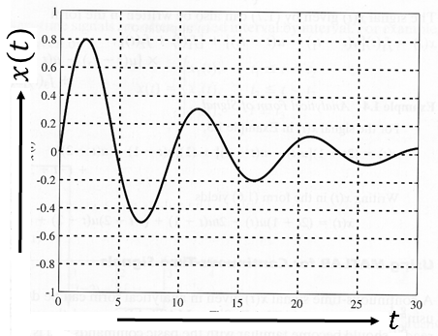
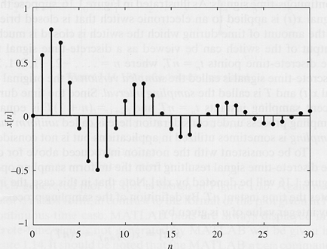
Examples: CT vs. DT signals

Slide 6
Sampling
Discrete-time signals are often obtained by sampling continuous-time signals.
.
.

Slide 7
Classification of Signals
Deterministic & Non deterministic signals
Periodic & Non periodic signals
Even & Odd signals
Energy & Power signals

Slide 8
Deterministic signal
Behavior of these signals is predictable w.r.t time
There is no uncertainty with respect to its value at any time.
These signals can be expressed mathematically.
For example $x(t) = sin⁡(3t)$ is deterministic signal.

Slide 9
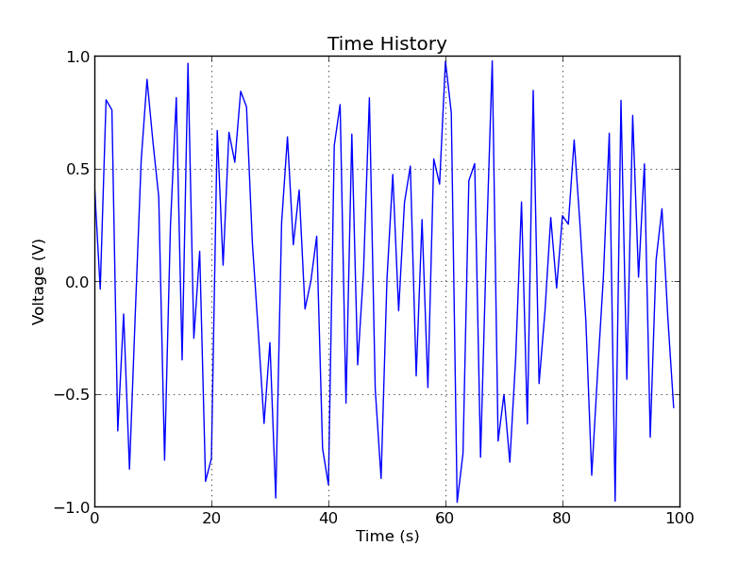
Non deterministic signals
They are also called random signals.
Behavior of these signals is random i.e. not predictable w.r.t time.
There is an uncertainty with respect to its value at any time.
These signals can’t be expressed mathematically.
For example Thermal Noise generated is non deterministic signal.

Slide 10
Periodic signal
A continuous time signal $x(t)$ is said to be periodic if it obeys
$x\left(t+T\right)=x\left(t\right)$ for any value of $T$.
The minimum value of $T$for which the equation holds $x\left(t+T\right)=x\left(t\right)$is called fundamental time period. It is denoted as $T_{0}.$
Example: $x\left(t\right)=A cos ω t$
Here the angular frequency is $ω$ , then $T=\frac{2π}{ω}$
The signal is periodic if $x\left(t+T\right)=x(t)$
$x\left(t+T\right)=A\cos{ω\left(t+T\right)=A\cos{[ω(t+\frac{2π}{ω}}})]$
$=A\cos{(ωt+2π}$)
$$=A\cos{ωt=x(t)}$$
So, The given signal is periodic.
A signal is said to be non periodic, if it is not periodic signal.

Slide 11
Problems – Periodicity- Fundamental time period-C.T signal

Slide 12
Problems – Periodicity- Fundamental time period-C.T signal

Slide 13
Periodicity for discrete time signals

Slide 14
Problems – Periodicity- D.T signal
$x\left[n\right]=\cos{5πn}$
Here $ω=5π$
$x\left[n+N\right]=\cos{5π[n+N]}$
$=\cos{[5πn+5πN]}$
The above signal is periodic if $5πN$is multiples of 2$π$
$i.e. 5πN=2πm$
$N=\frac{2π}{5π}m=\frac{2}{5}m$
$N$ becomes integer for values of $m=5, 10,15….$
$N=2, 4, 6…..$for values of $m=5,10,15…$
So, the given signal is periodic with fundamental period $N_{0}=2$

Slide 15
Problems – Periodicity- D.T signal
$x\left[n\right]=\cos{5n}$
Here $ω=5$
$x\left[n+N\right]=\cos{5[n+N]}$
$=\cos{[5n+5N]}$
The above signal is periodic if $5N$is multiples of 2$π$
$i.e. 5N=2πm$
$N=\frac{2π}{5}m ∴N$ never becomes integer for any values of integer $m$
So, the given signal is non periodic.

Slide 16
Problems – Periodicity- D.T signal
Consider a signal $x\left[n\right]=\cos{\frac{2π}{3}n+\cos{\frac{3π}{4}n}}$
Let $x\left[n\right]=x_{1}\left[n\right]+x_{2}\left[n\right]$, here $x_{1}\left[n\right]=\cos{\frac{2π}{3}n}$ and $x_{2}\left[n\right]=\cos{\frac{3π}{4}n}$
First determine $x_{1}\left[n\right] and x_{2}\left[n\right]$ are periodic individually.
$x_{1}\left[n\right]=\cos{\frac{2π}{3}n}$ , here $ω_{1}=\frac{2π}{3}$ and $N_{1}=\left(\frac{2π}{ω_{1}}\right)m=\left(\frac{2π}{\frac{2π}{3}}\right)m=3 m$
Where $m=1,2,3, …$ Therefore $N_{1}=3,6,9,….$
Secondly, determine $x_{2}\left[n\right]$ is periodic or not
$x_{2}\left[n\right]=\cos{\frac{3π}{4}n}$ , here $ω_{2}=\frac{3π}{4}$and $N_{2}=\left(\frac{2π}{ω_{2}}\right)m=\left(\frac{2π}{\frac{3π}{4}}\right)m=(\frac{8}{3}) m$
For $m=3,6,9, …$ only the $N_{2}$becomes integer. Therefore $N_{2}=8,16,24….$
So, both $x_{1}\left[n\right] and x_{2}\left[n\right]$ are periodic. Then , $x\left[n\right]$ is periodic.
The Fundamental period is $\left(N\right)=$LCM ($N_{1}$, $N_{2}$)$=24$

Slide 17
Sum of periodic Signals

Slide 18
Sum of periodic Signals

Slide 19
Sum of periodic Signals – may not always be periodic!

Slide 20
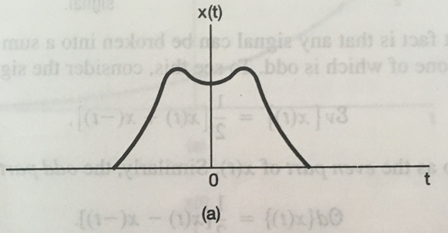
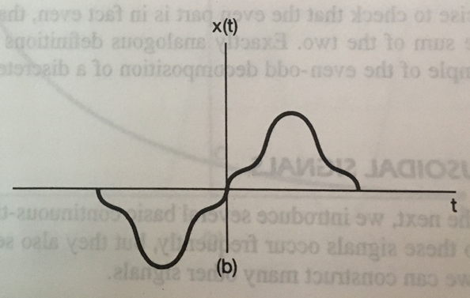
Even and Odd Signals

Slide 21
Even and Odd parts of functions

Slide 22
Even and odd signal- Problems
Determine the following signals are even or odd
$x\left(t\right)=\sin{t}$ 2. $x\left(t\right)=\cos{t}$ 3. $x\left(t\right)=\sin{t}+cos t,$
Solution to problem 1 :Given $x\left(t\right)=sin t$
Then to find even or odd first determine $x\left(−t\right),$
$$x\left(−t\right)=sin\left(− t\right)$$
= $−\sin{t}$
= $−x(t)$
The given signal is odd signal
Solution to problem 2 :Given $x\left(t\right)=cos t$
Then to find even or odd first determine $x\left(−t\right),$
$$x\left(−t\right)=cos\left(− t\right)$$
= $\cos{t}$
= $x(t)$
The given signal is even signal

Slide 23
Even and odd signal- Problems
Solution to problem 3 :Given $x\left(t\right)=cos t+sin t$
Then to find even or odd first determine $x\left(−t\right),$
$$x\left(−t\right)=cos\left(− t\right)+\sin{(−t)}$$
= $\cos{t−\sin{t}}$
$≠$ $x(t)$
$≠−x(t)$
The given signal is neither even & nor odd signal

Slide 24
Energy Signal
A Signal is said to be energy signal if its total energy is finite and total average power is zero. I.e., $0<E< ∞$, $P_{av}=0$
For Continuous time signal$, x(t)$
Total Energy $E=\int_{−∞}^{∞}{{\left|x(t)\right|}^{2}dt}$
Total average power $P_{av}=\lim_{T→∞}\frac{1}{T}{\int_{−T/2}^{T/2}{{\left|x(t)\right|}^{2}dt}}$
For Discrete time signal$, x[n]$
Total Energy $E=\sum_{n=−∞}^{n=∞}{{\left|x[n]\right|}^{2}}$
Total average power $P_{av}=\lim_{N→∞}\frac{1}{2N+1}\sum_{n=−N}^{n=N}{{\left|x[n]\right|}^{2}}$
For power signal, $0<P_{av}< ∞$, $E=∞$

Slide 26
Problem 2:
$x(t)=e^{j(\frac{π}{2}t+\frac{π}{8})}$
Total energy $E =\int_{−∞}^{∞}{{\left|x(t)\right|}^{2}dt}$
$=$ $\int_{−∞}^{∞}{{\left|e^{j(\frac{π}{2}t+\frac{π}{8})}\right|}^{2}dt}$
$=$ $\int_{−∞}^{∞}{1 dt}=∞$
Total a$verage power (P_{av})=\lim_{T→∞}\frac{1}{T}{\int_{−T/2}^{T/2}{{\left|x(t)\right|}^{2}dt}}$
$=$ $\lim_{T→∞}\frac{1}{T}{\int_{−T/2}^{T/2}{{\left|e^{j(\frac{π}{2}t+\frac{π}{8})}\right|}^{2}dt}}$
$=\lim_{T→∞}\frac{1}{T}{\int_{−T/2}^{T/2}{1 dt}}=\lim_{T→∞}\frac{1}{T}{[T]}=1$
The given signal is power signal.

