Slide 1
DIGITAL IMAGE PROCESSING UNIT-V Image Compression
Presented By
Dr Y Mallikarjuna Rao
ECE department.
Santhiram Engineering College

Slide 2
Image Compression
Image files may be too big for network transmission, even at low resolutions.
Use more sophisticated data representation or discard information to reduce data size.
Effectiveness of compression will depend on actual image data.
For any compression scheme, there will always be some data for which 'compressed' version is actually bigger than the original.

Slide 3
Redundancy
Compression algorithms are developed by taking advantage of the redundancy that is inherent in image data
Four primary types of redundancy that can be found in images are:
Data redundancy
Coding redundancy
Interpixel redundancy
Psychovisual redundancy

Slide 4
Data Redundancy
Let n₁ and n₂ denote the number of information carrying units in two data sets that represent the same information
The relative redundancy R_{D} is define as :
where C_{R}, commonly called the compression ratio, is

Slide 5
Coding redundancy
Occurs when the data used to represent the image is not utilized in an optimal manner
Interpixel redundancy
Occurs because adjacent pixels tend to be highly correlated, in most images the brightness levels do not change rapidly, but change gradually

Slide 6
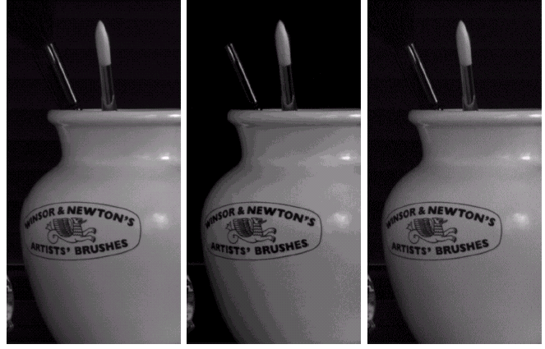
Psycho-visual Redundancy
The human visual system is more
sensitive to edges
Middle Picture:
Uniform quantization from 256 to
16 gray levels
C_{R}= 2
Right picture:
Improved gray level quantization
(IGS)
C_{R}= 2

Slide 7
Compression Model
The source encoder is responsible for removing redundancy
(coding, inter-pixel, psycho-visual)
The channel encoder ensures robustness against channel noise

Slide 8
Compression Types
Error-Free Compression (Loss-less)
Lossy Compression

Slide 9
Error-Free Compression
Some applications require no error in compression (medical, business documents, etc..)
C_{R}=2 to 10 can be expected.
Make use of coding redundancy and inter-pixel redundancy.
Ex: Huffman codes, LZW, Arithmetic coding, 1D and 2D run-length encoding, Loss-less Predictive Coding, and Bit-Plane Coding.

Slide 10
Bit-Plane Coding
An effective technique to reduce inter pixel redundancy is to process each bit plane individually
The image is decomposed into a series of binary images.
Each binary image is compressed using one of well known binary compression techniques.

Slide 11
Huffman Coding
The most popular technique for removing coding
redundancy is due to Huffman (1952)
Huffman Coding yields the smallest number of code
symbols per source symbol
The resulting code is optimal

Slide 12
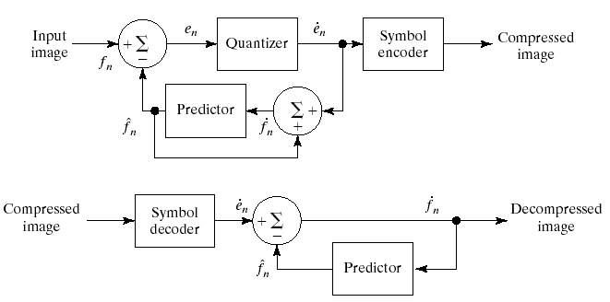
Lossy Compression
Quantizer

Slide 13
Transform Coding
A reversible linear transform (such as Fourier Transform) is used to map the image into a set of transform coefficients
These coefficients are then quantized and coded.
The goal of transform coding is to decorrelate pixels and pack as much information into small number of transform coefficients.
Compression is achieved during quantization not during the transform step

Slide 14
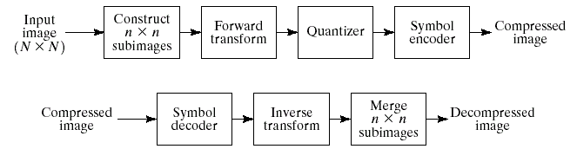
Transform Coding

Slide 15
Discrete Cosine Transform
One of the most frequently used transformations for image compression is the DCT.
for u=0
for u=1, 2, …, N-1

Slide 16
The JPEG Standard
JPEG is an image compression standard which was accepted as an international standard in 1992.
Developed by the Joint Photographic Expert Group of the ISO/IEC
For coding and compression of color/gray scale images
Yields acceptable compression in the 10:1 range

Slide 17
The Image compression Standard
JPEG is the one of the Image compression standard.
Image data usually changes slowly across an image, especially within an 8x8 block
Therefore images contain much redundancy
Experiments indicate that humans are not very sensitive to the high frequency data images
Therefore we can remove much of this data using transform coding

Slide 18
JPEG Encoding Overview

Slide 19
DCT on Image Blocks
The image is divided up into 8x8 blocks
2D DCT is performed on each block
The DCT is performed independently for each block
This is why, when a high degree of compression is requested, JPEG gives a “blocky” image result

Slide 20
Quantization
Quantization in JPEG aims at reducing the total number of bits in the compressed image
Divide each entry in the frequency space block by an integer, then round
Use a quantization matrix Q(u, v)

Slide 21
Quantization
Use larger entries in Q for the higher spatial frequencies
These are entries to the lower right part of the matrix
The following slide shows the default Q(u, v) values for luminance and chrominance
Based on psychophysical studies intended to maximize compression ratios while minimizing perceptual distortion
Since after division the entries are smaller, we can use fewer bits to encode them

Slide 22
Original and DCT coded block

Slide 23
Quantized and Reconstructed Blocks

Slide 24
After IDCT and Difference from Original

Slide 25
Same steps on a less homogeneous block

Slide 26
IDCT and Difference

Slide 27
Preparation for Entropy Coding
We have seen two main steps in JPEG coding: DCT and quantization
The remaining steps all lead up to entropy coding of the quantized DCT coefficients
These additional data compression steps are lossless
Most of the lossiness is in the quantization step

Slide 28
Run-Length Coding
We now do run-length coding
The AC and DC components are treated differently
Since after quantization we have many 0 AC components, RLC is a good idea
Note that most of the zero components are towards the lower right corner (high spatial frequencies)
To take advantage of this, use zigzag scanning to create a 64-vector

Slide 29
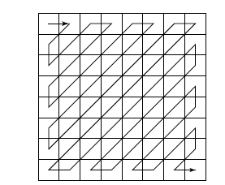
Zigzag Scan in JPEG

Slide 30
Run-Length Coding
Now the RLC step replaces values in a 64-vector (previously an 8x8 block) by a pair (RUNLENGTH, VALUE), where RUNLENGTH is the number of zeroes in the run and VALUE is the next non-zero value
From the first example we have (32, 6, -1, -1, 0, -1, 0, 0, 0, -1, 0, 0, 1, 0, 0, …, 0)
This becomes (0,6) (0,-1)(1,-1)(3,-1)(2,1)(0,0) - Note that DC coefficient is ignored

Slide 31
Coding of DC Coefficients
Now we handle the DC coefficients
1 DC per block
DC coefficients may vary greatly over the whole image, but slowly from one block to its neighbor (once again, zigzag order)
So apply Differential Pulse Code Modulation (DPCM) for the DC coefficients
If the first five DC coefficients are 150, 155, 149, 152, 144, we come up with DPCM code- 150, 5, -6, 3, -8

Slide 32
Entropy Coding
Now we apply entropy coding to the RLC coded AC coefficients and the DPCM coded DC coefficients
The baseline entropy coding method uses Huffman coding on images with 8-bit components
DPCM-coded DC coefficients are represented by a pair of symbols (SIZE, AMPLITUDE)
SIZE = number of bits to represent coefficient
AMPLITUDE = the actual bits

Slide 33
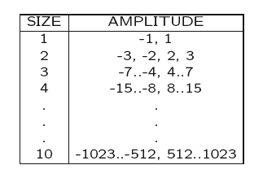
Entropy Coding
The size category for the different possible amplitudes is shown below
DPCM values might require more than 8 bits and might be negative

Slide 34
Entropy Coding
One’s complement is used for negative numbers
Codes 150, 5, -6, 3, -8 become
(8, 10010110), (3, 101), (2, 11), (4, 0111)
Now the SIZE is Huffman coded
Expect lots of small SIZEs
AMPLITUDE is not Huffman coded
Pretty uniform distribution expected, so probably not worth while

Slide 35
Huffman Coding for AC Coefficients
AC coefficients have been RL coded and represented by symbol pairs (RUNLENGTH, VALUE)
VALUE is really a (SIZE, AMPLITUDE) pair
RUNLENGTH and SIZE are each 4-bit values stored in a single byte - Symbol1
For runs greater than 15, special code (15, 0) is used
Symbol2 is the AMPLITUDE
Symbol1 is run-length coded, Symbol 2 is not

Slide 36
JPEG Modes
JPEG supports several different modes
Sequential Mode
Progressive Mode
Hierarchical Mode
Lossless Mode

