Slide 1
Classification of systems
Unit-1
Mallikarjuna Rao. Y
AssociateProfessor & HOD
Electronics & Communication Engineering
Santhiram Engineering College, Nandyal, A.P
Email: hod.ece@srecnandyal.edu.in

Slide 2
Contents
Classification of systems
Linear systems or Non linear systems
Time invariant systems or time variant
Static systems or dynamic systems
Causal systems or non causal systems
Invertible systems or non invertible systems
Stable systems or unstable systems

Slide 3

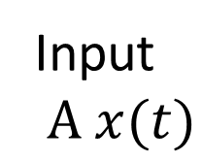
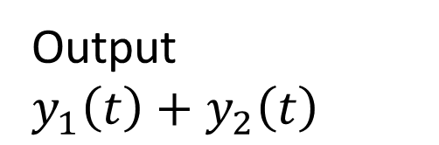
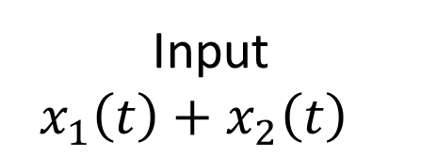
Linear systems and Non linear systems
A system is said to be linear system if it obeys both homogeneity property and additivity property.
Homogeneity property:
If input is scaled by some constant then output should also scaled by same constant.
Additivity property:
The total response of the system is sum of individual response.
A system which is not linear is called Non linear system
Input
$$A x(t)$$
System
Output $A y(t)$
Input
$x_{1}\left(t\right)+$$x_{2}\left(t\right)$
System
Output
$y_{1}\left(t\right)+$$y_{2}\left(t\right)$

Slide 4
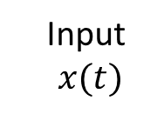

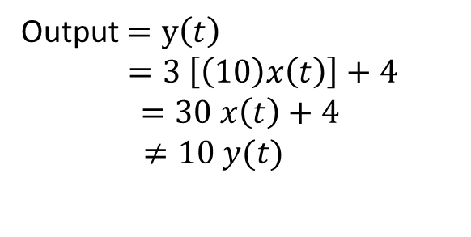
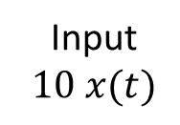
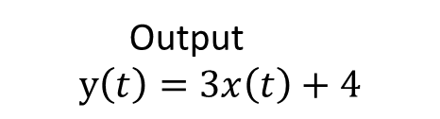
Linear systems- Problem-1
Find the given system is linear or not whose input and output relation is given as $y\left(t\right)=3x\left(t\right)+4$?
Given equation is $y\left(t\right)=3x\left(t\right)+4$
Step1: Check for homogeneity:
If input is scaled by input by a constant 10, then
The above system doesn’t follow the homogeneity property. So, the given system is non linear.
Input
$$x(t)$$
System
Output
$$y\left(t\right)=3x\left(t\right)+4$$
Output $=y\left(t\right)$
$=3 \left[\left(10\right)x\left(t\right)\right]+4$
$$=30 x\left(t\right)+4$$
$≠10 y(t)$
Input
$$10 x(t)$$
System

Slide 5
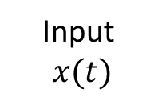


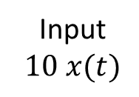
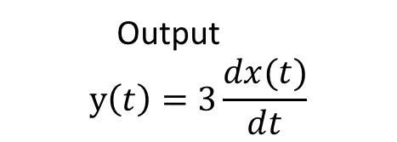
Linear systems- Problem-2
Find the given system is linear or not whose input and output relation is given as $y\left(t\right)=3\frac{dx(t)}{dt}$
Given equation is $y\left(t\right)=3\frac{dx(t)}{dt}$
Step1: Check for homogeneity:
If input is scaled by input by a constant 10, then
The above system obeys the homogeneity property. Then check for additivity property.
Input
$$x(t)$$
System
Output
$$y\left(t\right)=3\frac{dx(t)}{dt}$$
Output $=y\left(t\right)$
$= \left[3\frac{d 10 x(t)}{dt}\right]$
$$=30\frac{dx(t)}{dt}$$
$=10 y(t)$
Input
$$10 x(t)$$
System

Slide 6



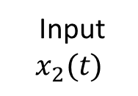
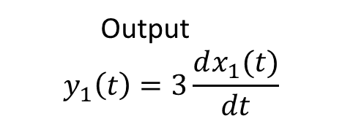
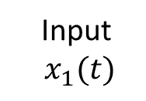
Linear systems- Problem-2 (Contd.)
Step2: Check for Additivity Property:
If
and
The system obeys both homogeneity and additivity properties. So, the system is Linear system.
Input
$$x_{1}(t)$$
System
Output
$$y_{1}\left(t\right)=3\frac{dx_{1}(t)}{dt}$$
Input
$$x_{2}(t)$$
System
Output
$$y_{2}\left(t\right)=3\frac{dx_{2}(t)}{dt}$$
Input
$$x_{1}\left(t\right)+ x_{2}\left(t\right)$$
System
Output
$$y\left(t\right)=3[\frac{d{[x}_{1}\left(t\right)+ x_{2}\left(t\right)]}{dt}]$$
$$y\left(t\right)=3\frac{dx_{1}\left(t\right)}{dt}+3\frac{dx_{2}\left(t\right)}{dt}$$
$$y\left(t\right)=y_{1}\left(t\right)+y_{2}\left(t\right)$$

Slide 7
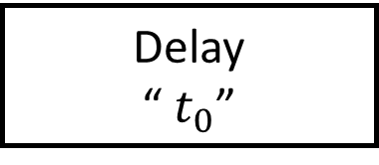
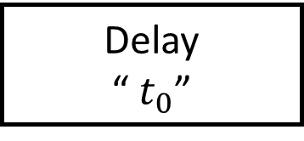


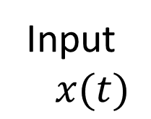


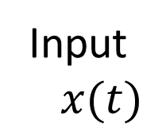
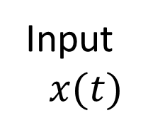
Time invariant systems
A system is said to be linear system if shift in input results identical shift in output.
$$x(t−t_{0})$$
$$y(t)$$
A system is said to be Time variant system if it is not time invariant.
Input
$$x(t)$$
System
Output $y(t)$
Input
$$x(t)$$
Delay
“ $t_{0}$”
Output $y(t−t_{0})$
System
Input
$$x(t)$$
Delay
“ $t_{0}$”
Output $y(t−t_{0})$
System

Slide 8
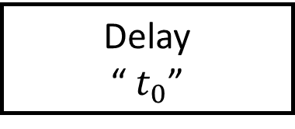



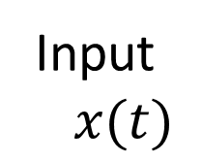

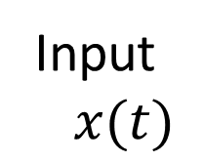
Time invariant system – problem-1
Determine the system $y\left(t\right)= e^{x(t)}$ is time invariant or not?
$$x(t−t_{0})$$
$$y\left(t\right)=e^{x(t)}$$
The above system is time invariant system.
Output
$$=e^{x(t−t_{0}) }$$
Input
$$x(t)$$
Delay
“ $t_{0}$”
System
Output
$=$$e^{x(t−t_{0}) }$
Input
$$x(t)$$
System
Delay
“ $t_{0}$”

Slide 9
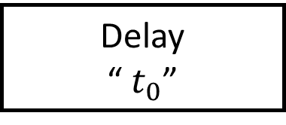



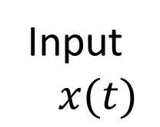

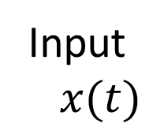
Time invariant system – problem-2
Determine the system $y\left(t\right)=t \frac{d x(t)}{dt}$is time invariant or not?
$$x(t−t_{0})$$
$$y\left(t\right)=t \frac{d x(t)}{dt}$$
The above system is time variant system.
Output
$$=t\frac{d x(t−t_{0})}{dt}$$
Input
$$x(t)$$
Delay
“ $t_{0}$”
System
Output
$$=(t−t_{0})\frac{d x(t−t_{0})}{dt}$$
Input
$$x(t)$$
System
Delay
“ $t_{0}$”

Slide 10
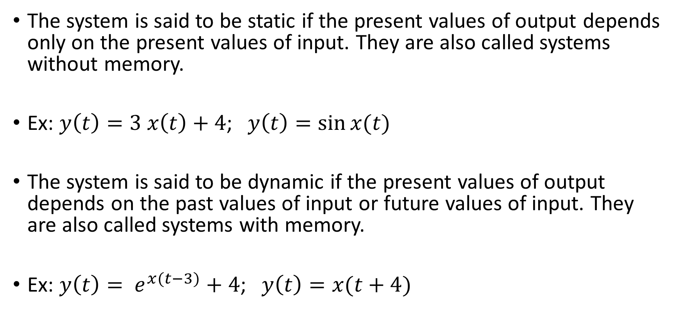
Static or dynamic systems
The system is said to be static if the present values of output depends only on the present values of input. They are also called systems without memory.
Ex: $y\left(t\right)=3 x\left(t\right)+4$; $y\left(t\right)=\sin{x(t)}$
The system is said to be dynamic if the present values of output depends on the past values of input or future values of input. They are also called systems with memory.
Ex: $y\left(t\right)= e^{x(t−3)}+4$; $y\left(t\right)=x(t+4)$

Slide 11
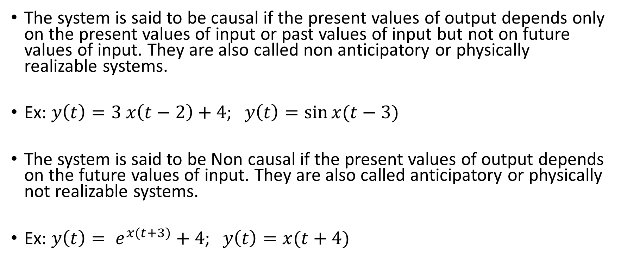
Causal or Non causal systems
The system is said to be causal if the present values of output depends only on the present values of input or past values of input but not on future values of input. They are also called non anticipatory or physically realizable systems.
Ex: $y\left(t\right)=3 x\left(t−2\right)+4$; $y\left(t\right)=\sin{x(t−3)}$
The system is said to be Non causal if the present values of output depends on the future values of input. They are also called anticipatory or physically not realizable systems.
Ex: $y\left(t\right)= e^{x(t+3)}+4$; $y\left(t\right)=x(t+4)$

Slide 12
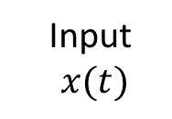
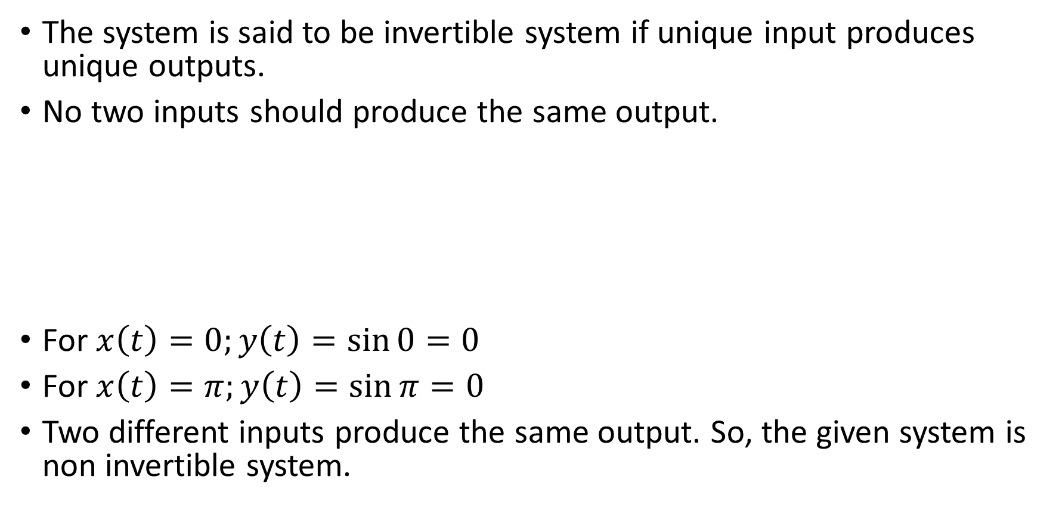
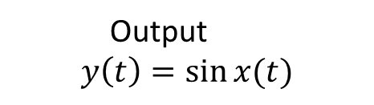
Invertible systems
The system is said to be invertible system if unique input produces unique outputs.
No two inputs should produce the same output.
For $x\left(t\right)=0;y\left(t\right)=\sin{0}=0$
For $x\left(t\right)=π;y\left(t\right)=\sin{π}=0$
Two different inputs produce the same output. So, the given system is non invertible system.
Input
$$x(t)$$
System
Output
$$y\left(t\right)=\sin{x(t)}$$

Slide 13


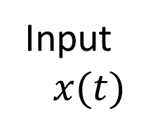



Identity systems
A cascade connection of invertible and inverse system results identity system
EX:
Output
$$=x(t)$$
Input
$$x(t)$$
Invertible
System
Inverse System
Output
$$=x(t)$$
Input
$$x(t)$$
Delay
$$′t_{0}′$$
advance
$$′t_{0}′$$

Slide 14



Stable or Unstable systems
The system is said to be stable if it produce a bounded output for a bounded input (BIBO criteria)
A signal $x\left(t\right)$ is said to bounded if $\left|x(t)\right|≤C<∞$
Ex: $y\left(t\right)=e^{x(t)}$
The system is said to be unstable if it produce unbounded output for a bounded input.
Ex: $y\left(t\right)=te^{x(t)}$
Input
$$\left|x(t)\right|<∞$$
System
Output
$$\left|y(t)\right|<∞$$

