Slide 1
DIGITAL COMMUNICATION Unit-IV: Pass Band Transmission
Dr.Y. Mallikarjuna Rao _{M.Tech, Ph.D}
Assistant Professor & HOD
Electronics & Communication Engineering
Santhiram Engineering College, Nandyal, A.P
Email: hod.ece@srecnandyal.edu.in

Slide 2
Syllabus
Passband transmission model
Generation and detection of binary phase shift keying (BPSK)
Quadrature shift keying (QPSK)
Binary Frequency shift keying (BFSK)
M-ary PSK
M-ary quadrature amplitude modulation (M-ary QAM)
Generation and detection of non-coherent BFSK
DPSK - analysis of probability of error
Comparison of power bandwidth requirements for all the above schemes

Slide 3
Passband transmission model
In digital passband transmission, the incoming data stream is modulated onto a carrier with fixed frequency and then transmitted over a band-pass channel.
Passband digital transmission allows more efficient use of the allocated RF bandwidth, and flexibility in accommodating different baseband signal formats.
Example Mobile Telephone Systems GSM: GMSK modulation is used (a variation of FSK) IS-54: π/4-DQPSK modulation is used (a variation of PSK)
The modulation process making the transmission possible involves switching (keying) the amplitude, frequency, or phase of a sinusoidal carrier in accordance with the incoming data. There are three basic signaling schemes: Amplitude-shift keying (ASK) Frequency-shift keying (FSK) Phase-shift keying (PSK)

Slide 4
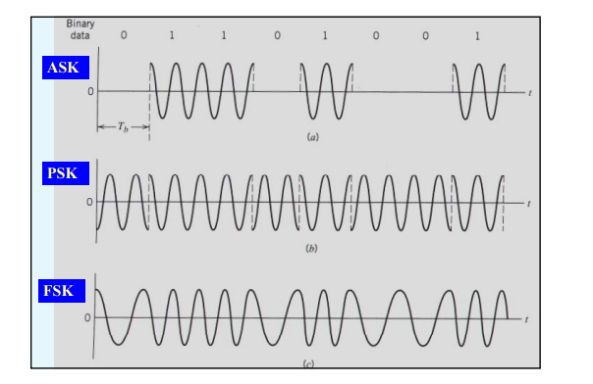
Unlike ASK signals, both PSK and FSK signals have a constant envelope.
PSK and FSK are preferred to ASK signals for passband data transmission over nonlinear channel (amplitude nonlinearities) such as micorwave link and satellite channels.

Slide 5
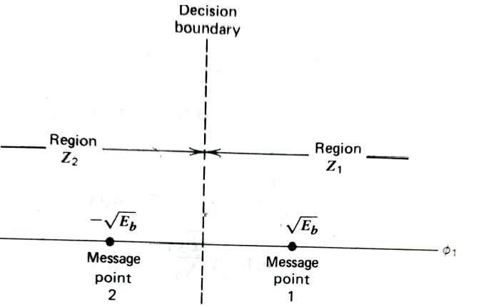
Generation and detection of binary phase shift keying (BPSK)
In coherent binary PSK system pair of signals s₁(t) and s₂(t) used to represent symbol 1 and 0 respectively are defined by
$$s_{1}(t)=\sqrt{\frac{2E_{b}}{T_{b}}}\cos{(}2πf_{c}t) \\ s_{2}(t)=\sqrt{\frac{2E_{b}}{T_{b}}}\cos{(}2πf_{c}t+π)=−\sqrt{\frac{2E_{b}}{T_{b}}}\cos{(}2πf_{c}t) \\ onebasisfunctionofunitenergy \\ Φ_{1}(t)=\sqrt{\frac{2}{T_{b}}}\cos{(}2πf_{c}t)0≤t≤T_{b} \\ then \\ s_{1}(t)=\sqrt{E_{b}}Φ_{1}(t)0≤t≤T_{b} \\ s_{2}(t)=\sqrt{E_{b}}Φ_{2}(t)0≤t≤T_{b}$$
Figure: signal space diagram for coherent BPSK

Slide 6
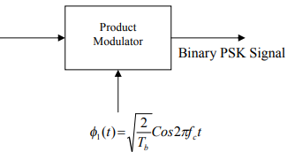

Slide 7
$$AcoherentbinaryPSKishavingsignalspaceis \\ one−\dim{e}nsionali.eN=1, \\ withtwomessagepo\operatorname{int}{s}M=2. \\ Thecoordinatesofthemessagepo\operatorname{int}{s}equal \\ s_{11}=\int_{0}^{T_{b}}{s_{1}(t)Φ_{1}(t)dt} \\ =+\sqrt{E_{b}} \\ s_{21}=\int_{0}^{T_{b}}{s_{2}(t)Φ_{1}(t)dt} \\ =−\sqrt{E_{b}} \\ 1.Thesetofpo\operatorname{int}{s}closesttothemessagepo\operatorname{int}{}at+\sqrt{E_{b}} \\ 2.Thesetofpo\operatorname{int}{s}closesttothemessagepo\operatorname{int}{}at−\sqrt{E_{b}}$$

Slide 8
The decision region associated with symbol 1 or signal s₁(t) is

Slide 9
$$puttingz=\frac{1}{N_{0}}(x_{1}+\sqrt{E_{b}}) \\ P_{e}(0)=\frac{1}{\sqrt{πN_{0}}}\int_{\sqrt{E_{b}/N_{0}}}^{∞}{\exp{(}−z^{2}})dz \\ theaverageprobabilityofsymbolerrorfor \\ coherentBPSKis \\ P_{e}=\frac{1}{2}erfc(\sqrt{\frac{E_{b}}{N_{0}}})$$

Slide 10
Quadrature shift keying (QPSK)

Slide 11
Based on representation,we have some observations
1. There are only two orthonormal basis functions φ₁ (t) and φ₂ (t) contained in the expansion of s_{i} (t). The appropriate forms for φ₁ (t) and φ₂(t) are defined by
$$Φ_{1}(t)=\sqrt{\frac{2}{T_{}}}\cos{(}2πf_{c}t)0≤t≤T_{} \\ Φ_{2}(t)=\sqrt{\frac{2}{T_{}}}\sin{(}2πf_{c}t)0≤t≤T_{}$$
2. There are four message points and the associated signal vectors are defined by
$$s_{i}=\left[{}_{−\sqrt{E}\sin\left((2i−1)\frac{π}{4}\right)}^{\sqrt{E}\cos\left((2i−1)\frac{π}{4}\right)}\right]i=1,2,3,4$$

Slide 12
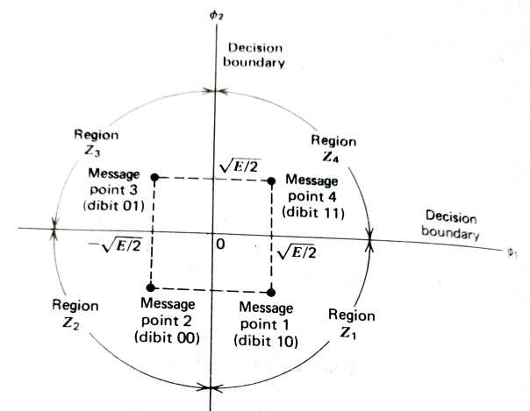
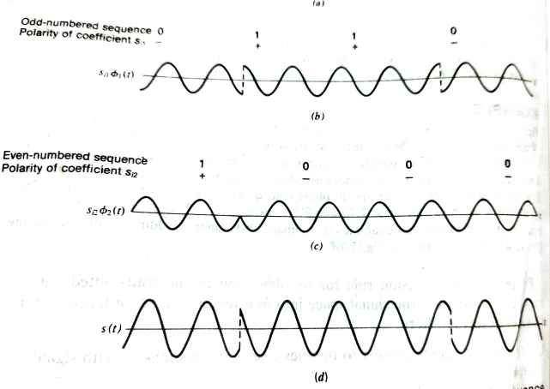
Figure: signal space diagram
Figure: a) input binary sequence
b)odd numbered of input sequence
c)even numbered of input sequence

Slide 13
Figure: illustrating the region of correct decision and the region of erroneous decisions that the signal s₄ (t) was transmitted

Slide 14
To realize the decision rule for the detection of transmitted signal data sequence, we partition the signal space into four regions as
1. The set of point closest to the message point associated with signal vector to s_{1.}
2. The set of point closest to the message point associated with signal vector to s_{2.}
3. The set of point closest to the message point associated with signal vector to s_{3.}
4. The set of point closest to the message point associated with signal vector to s_{4.}
The received signal x(t) is defined by
x(t)=s_{i} (t) + w(t) 0<t<T, i=1,2,3,4
The observation vector x of a cohrent QPSK receiver has two elements x₁ and x₂ are defined by

Slide 17
Binary Frequency shift keying (BFSK)
In coherent binary FSK system symbol 1 and 0 are distinguished from each other by transmitting one of two sinusoidal waves that differ in frequency by a fixed amount. A pair of sinusoidal waves is described by

Slide 18
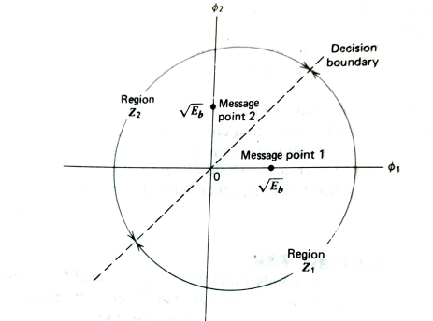
Figure: signal space diagram for coherent BFSK

Slide 19
Coherent FSK system is characterized by having a signal space that is two dimensional N=2 with two message points i.e M=2 as

Slide 20
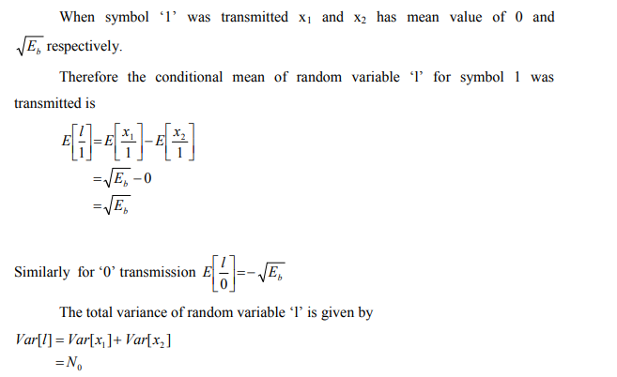

Slide 21
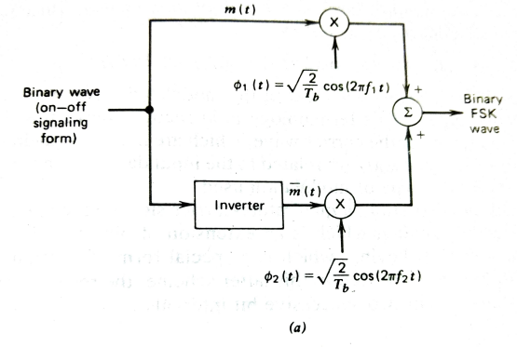
Figure: a) FSK transmitter b) FSK Receiver

Slide 22
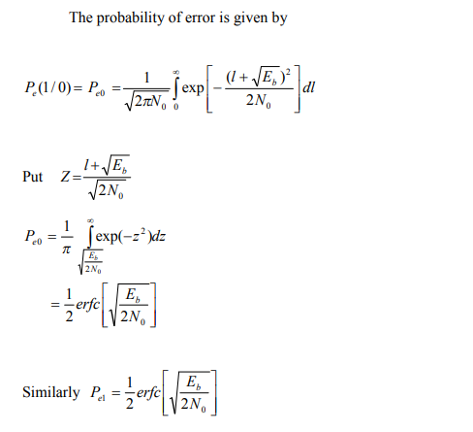
The corresponding value of the conditional probability density function function of the random variable L equals

Slide 23
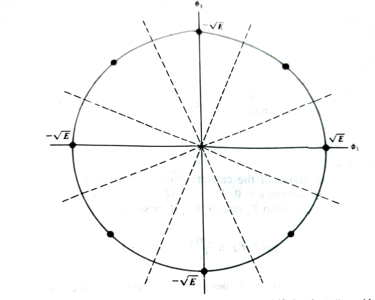
M-ary PSK
In M-ary PSK the phase of the carrier takes on one of M possible values namely ϴ_{i} =2iπ/M,where i=0,1,…M-1
During each signalling interval of duration T, one of the M possible signals
Figure: signal constellation for octaphase shift keyingi.e M=8

Slide 27
Figure: Receiver for coherent M-ary PSK

Slide 29
M-ary quadrature amplitude modulation (M-ary QAM)
In M-ary QAM inphase and quadrature components are independent ,the general form of M-ary QAM is defined by the transmitted signal by

Slide 30
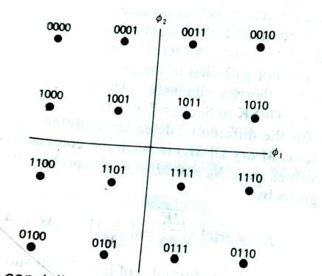
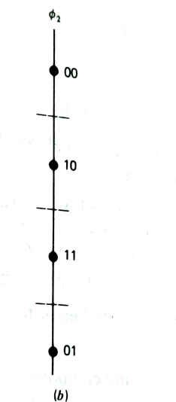
Figure: signal constellation for M-ary QAM for M-16
Figure: a) decomposition of signal constellation of M-ary QAM for M=16 into two signal space diagrams a) inphase component b) quadrature component

Slide 31
The coordinates of the ith message points are

Slide 32
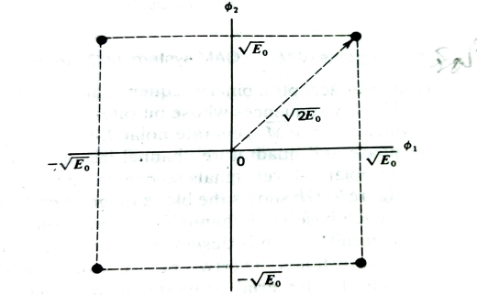
Figure : signal constellationof M-ary for M=4

Slide 33
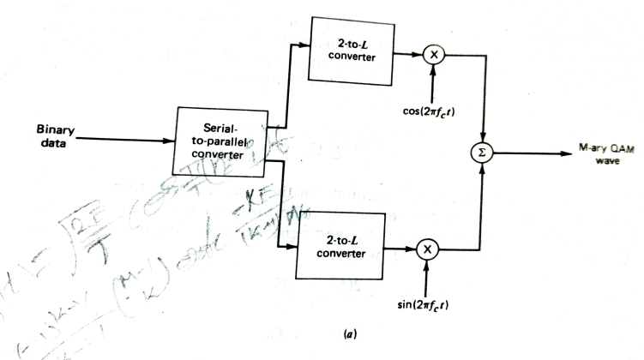
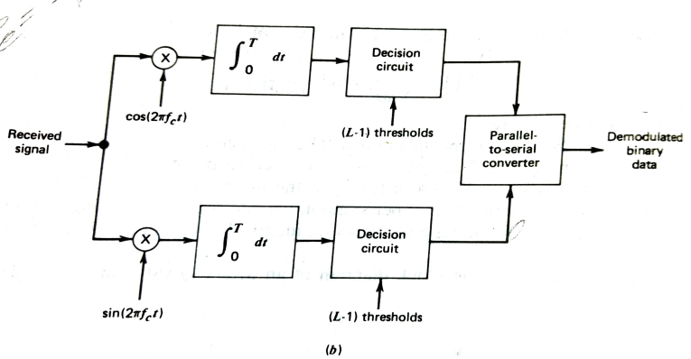
Figure a) : M-ary QAM transmitter
Figure b) : M-ary QAM receiver

Slide 34
Generation and detection of non-coherent BFSK
In BFSK transmitted signal is given by

Slide 35
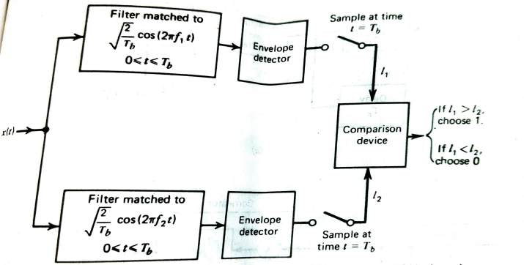
Figure: non coherent receiver for detection of BFSK signals

Slide 36
DPSK
In DPSK the transmitted of 1 leaves the carrier phase unchanged and so we define s₁ (t) as
In DPSK the transmitted of 1 leaves the carrier phase unchanged and so we define s₁ (t) as

Slide 38
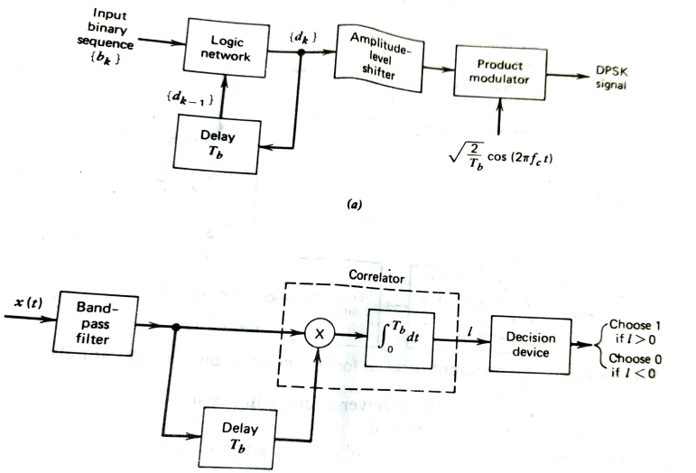
Figure: a) DPSK transmitter b) DPSK receiver

Slide 39
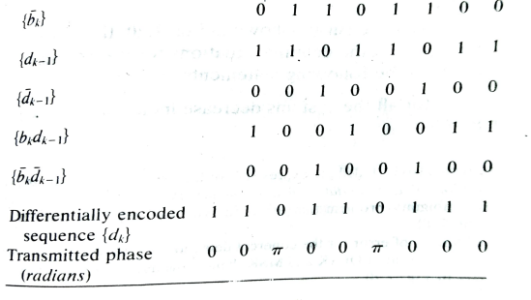
The differential encoding process at the transmitter input starts with an arbitary first bit serving as reference and thereafter the differentially encoded sequence is generated as
Table: Illustrating the generation of DPSK signal
If b_{k} input is 1 0 0 1 0 0 1 1

Slide 40
Comparison of power bandwidth requirements for all the above schemes

Slide 41
