Slide 1
Graph matrices and Applications Motivational Overview, Matrix of Graph, Relations, Power of a Matrix, Node reduction Algorithm,Building Tools
By: S.Md.Farooq

Slide 2
Overview:
The pictorial representation of the behaviour of the system is known as graph. The graph should be thoroughly traced to perform path coverage, path sensitization etc..
The pictorial representation have many advantages but they equally have disadvantages. The problems with pictorial graphs are:
Tracing of path is not easy
While tracing some paths may be missed, or some may be marked twice
The generation of test cases would also be difficult for pictorial graphs.

Slide 3
Solution:
The solution would be representation of the pictorial graphs in the form of Matrices.
And these matrix and matrix operations are used for tracing the paths.
These operations and methods are also not very simple but they are more mechanical and they are not dependent on “ ability to see “ the path.

Slide 4
Graph matrices
The pictorial graphs are represented using another notation known as Graph Matrices.
Each and every node of a graph is represented by a single row and a single column of a matrix which is known as Graph Matrix.
Building of Tools: in building test tools it should be consider that how a user or tool builder would go for finding the properties of all paths. The properties of graph matrices should be considered while building the tool for testing.

Slide 5
Basic algorithms
The graph theory contains basic tool kit that contains three algorithms.
Matrix Multiplication: this algorithm is used to get the path expression from one node to other node
Partitioning Algorithm: it is used for converting loop graphs to loop free graphs
Matrix Determinant: to find the path expression from any node to any other node.

Slide 6
Applicaitons of graph matrices
There are many uses of matrices in day to day life. Matrices are used in almost all the fields such as engineering, physics, computer science. Some other applications in detail are
Matrices used with encryption
Geologists make use of matrices for seismic surveys
Matrices are used to calculate GDP’s in economics
Used in computer Animation

Slide 7
Matrices are used with computing in architecture.
Math reports are recorded using matrices in engineering
Text mining and automated thesaurus compilation makes use of document term metrices.
Matrix of Graph:
The pictorial graphs are represented using another notation known as Graph Matrices. Each and every node of a graph is represented by a single row and a single column of a matrix which is known as Graph Matrix.

Slide 8
principles
1. The size of the matrix (i.e., the number of rows and columns) equals the number of nodes.
2. There is a place to put every possible direct connection or link between any node and any other node.
3. The entry at a row and column intersection is the link weight of the link (if any) that connects the two nodes in that direction.
4. A connection from node i to node j does not imply a connection from node j to node i.
5. If there are several links between two nodes, then the entry is a sum; the “+” sign denotes parallel links as usual.

Slide 9
Some graphs and their metrices

Slide 11
Simple weight
The simplest weight to represent whether the connection exist or does not exist between two nodes in the binary weights i.e., it is represented as “1” if link exists otherwise it is represented as “0”.
The arithmetic rules are:
1+1=1 1*1=1
1+0=1 1*0=0
0+0=0 0*0=0
A matrix defined like this is called connection matrix. i.e., represented a matrix with 0’s and 1’s

Slide 12
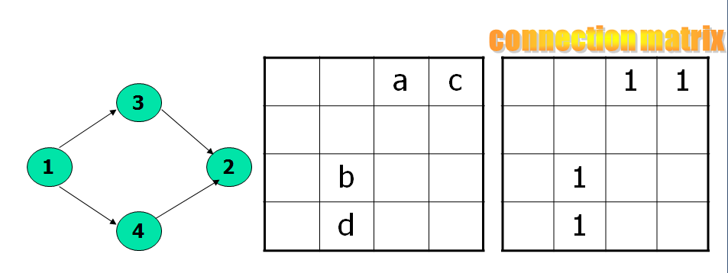
Connection matrix
The connection matrix is obtained by replacing each entry with 1 if there is a link and 0 if there isn’t.
As usual we don’t write down 0 entries to reduce the clutter.

Slide 13
Connection matrix contd..
Each row of a matrix denotes the outlinks of the node corresponding to that row.
Each column denotes the inlinks corresponding to that node
The different nodes such as branch node, junction node, loop node in connection graph can be identified.

Slide 14
Branch Node: If the row contains two or more 1’s then it is a branch node. The number of decisions at a particular node can be calculated by using “n-1” formula
Junction node: if the column contains two or more 1’s then it is a junction node
If there is an entry “1” in the diagonal of corresponding node then that node is a loop node.

Slide 15
Cyclomatic complexity
The cyclomatic complexity obtained by subtracting 1 from the total number of entries in each row and ignoring rows with no entries, we obtain the equivalent number of decisions for each row. Adding these values and then adding 1 to the sum yields the graph’s cyclomatic complexity.

Slide 16
Further notations
To simplify the notation of the matrix, the entry or element of the matrix which corresponds to the row i and column j is denoted as k_{ij.} The self loop is denoted as k_{ii}
Relations:A relation is a property that exists between two objects of interest.
If “a” and “b” are any things connected by relation R so it is said that “a” has relation R to “b”. Represented as a R b

Slide 17
Diff kinds of relations
There are different kinds of relations such as
If it is said a R b then it means a “is connected to “ b.
If given a>=b then R here means “ greater than or equal”
If it is given as a aCb then the relation here is “a subset of”
If the data object in the program is defined and used then the relation between the nodes would be “du”

Slide 18
Properties of relations-Transitive relation
A relation is transitive if aRb and bRc implies aRc.
Most relations used in testing are transitive.
Examples of transitive relations include: is connected to, is greater than or equal to, is less than or equal to, is a relative of, is faster than, is slower than, takes more time than, is a subset of, includes, shadows, is the boss of.

Slide 19
Reflexive relation
A relation R is reflexive if, for every a, aRa.
A reflexive relation is equivalent to a self loop at every node.
Examples of reflexive relations include: equals, is acquainted with, is a relative of.
Examples of irreflexive relations include: not equals, is a friend of, is on top of, is under.
a=a // Reflexive
a ≠a // irreflexive

Slide 20
Symmetric relations
A relation R is symmetric if for every a and b, aRb implies bRa.
A symmetric relation mean that if there is a link from a to b then there is also a link from b to a.
A graph whose relations are not symmetric are called directed graph.
A graph over a symmetric relation is called an undirected graph.
The matrix of an undirected graph is symmetric (a_{ij}=a_{ji}) for all i,j)
Examples: equal, is brother of, is similar to etc..

Slide 21
Antisymmetric relations
A relation R is antisymmetric if for every a and b, if aRb and bRa, then a=b, or they are the same elements.
Examples of antisymmetric relations: is greater than or equal to, is a subset of, time.
Examples of non antisymmetric relations: is connected to, can be reached from, is greater than, is a relative of, is a friend of

Slide 22
Equivalance relations
An equivalence relation is a relation that satisfies the reflexive, transitive and symmetric properties.
If a set of objects satisfy an equivalence relation we say that they form an “Equivalence class” over that relation.

Slide 23
Partial ordering relations
A partial ordering relation satisfies the reflexive, transitive, and anti symmetric properties.
Partial ordering graphs: have several important properties:
they are loop-free, there is at least one maximum element, there is at least one minimum element, and if you reverse all the arrows, the resulting graph is also partly ordered.

Slide 24
Power of a matrix
There exists a direct relation between the pair of nodes.
But the relation between only two nodes is not important. It is also important to know the relation of two nodes with the intermediate nodes between them. This is nothing but indirect relation between nodes.
The indirect relation between nodes is obtained by squaring the matrix with appropriate weight arithmetic.

Slide 25
Power of matrix contd..
The square of the matrix represents all path segments that are of two links weight.
The third power represents all path segments three links long.
The kth power of matrix will give the paths of k link weights
If the matrix is of order nxn i.e., ‘n’ nodes there could be no path of length greater than (n-1). So the maximum power of matrix would be (n-1).
Let A be a matrix whose entries are a_{ij}. The set of all paths between any node i and any other node j, via all possible intermediate nodes, is given by

Slide 27
1. Consider the relation between every node and its neighbor.
2. Extend that relation by considering each neighbor as an intermediate node.
3. Extend further by considering each neighbor’s neighbor as an intermediate node.
4. Continue until the longest possible non repeating path has been established.
5. Do this for every pair of nodes in the graph.

Slide 28
Matrix powers and products
Power of matrices: the graph is an array of node representation and their relationship. The entry at the intersection of a row and a column is a weight of the link that links two nodes.
Given a matrix whose entries are aij, the square of that matrix is obtained by replacing every entry with
n
a_{ij}=Σ a_{ik} a_{kj}
_{k=1}

Slide 29
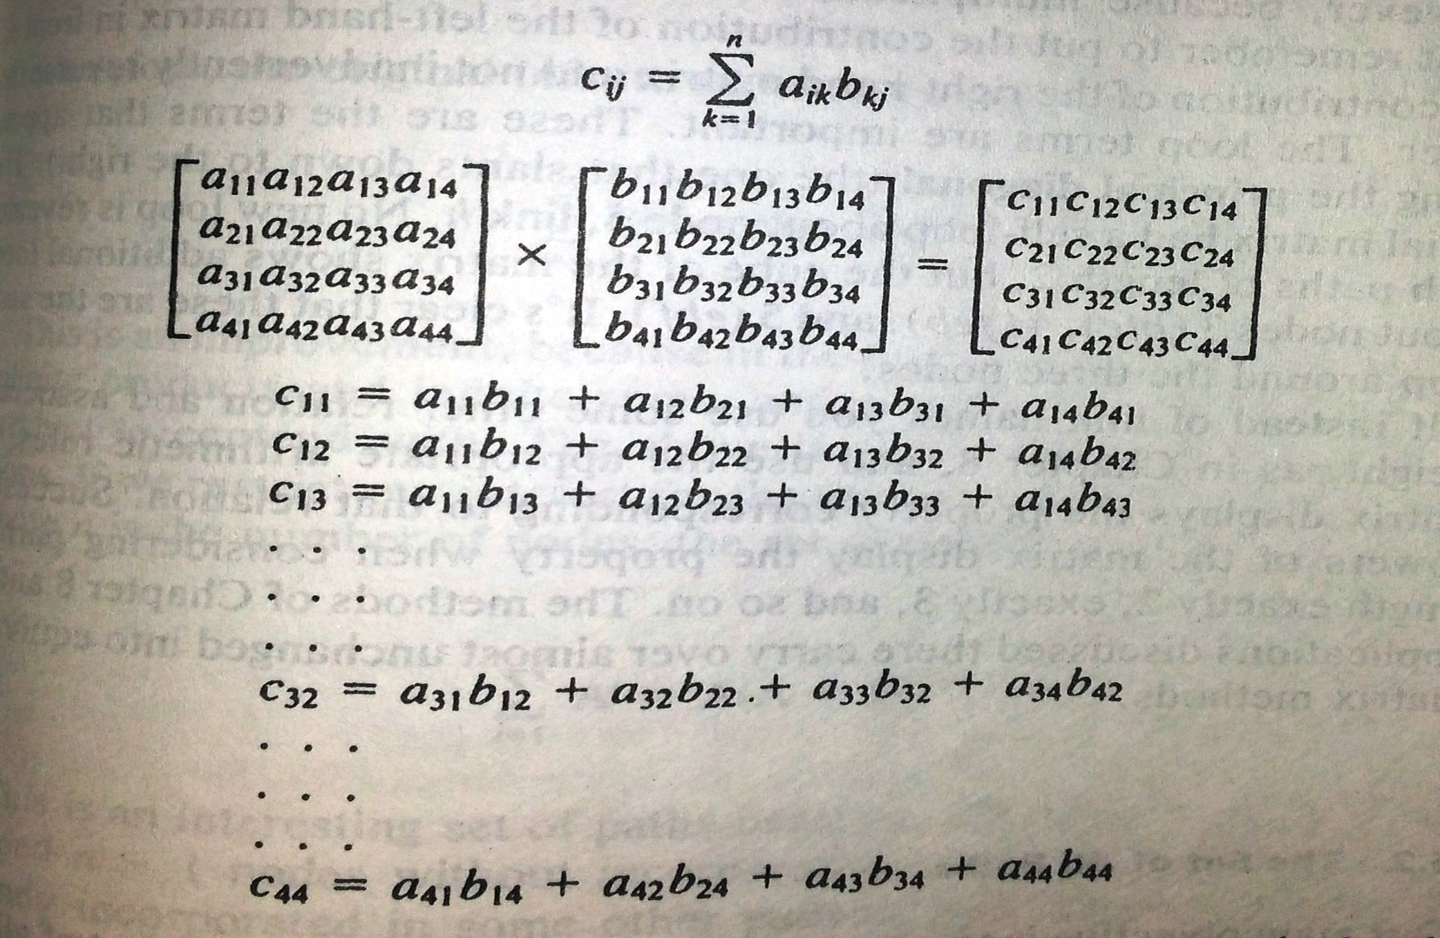
Given two matrices A and B, with entries a_{ik} and b_{kj} respectively. Their product is a new matrix C, whose entries are c_{ij} where

Slide 30
The indexes of the product ex.C32, the row of the first matrix and the column of the second matrix that will be combined to yield the entry for that product in the product matrix.
The C32 is obtained by combining, element by element, the entries in the third row of the A matrix with the corresponding elements in the second column of the B matrix.

Slide 31
d
1
a
3
b
4
c
2
f
e
h
g
5
 |  | a
 | d |  | b
 | c |  |  | f
 | g | e |  | h

Slide 33
A²A=AA², that is the matrix multiplication is associative, if the underlying relation arithmetic is associative.
Loop terms are important. These are the terms that appear along the principal diagonal

Slide 34
Set of all paths
The main goal here is to find the set of all paths using matrix operations. The set of all paths include all the possible paths from every node to every other node. It can be easily expressed in matrix form or in terms of matrix operation.

Slide 35
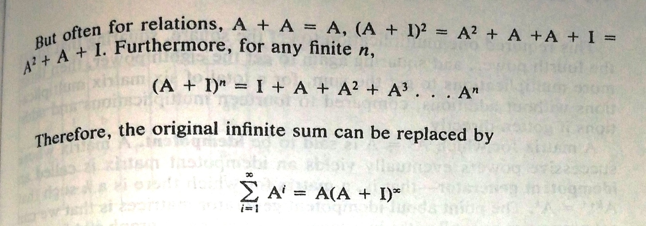
If it is considered as n X n matrix then the above expression can be considered as

Slide 36
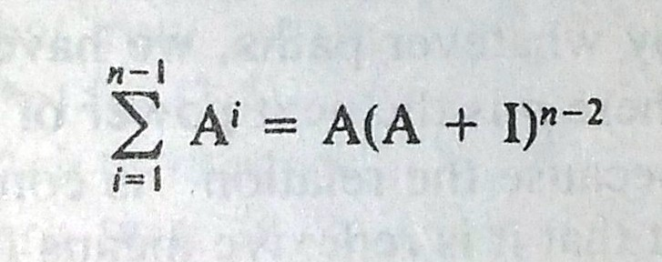
If it is restricted of paths of length n-1 then
The following algorithm can be considered as effective to find the set of paths
Express n-2 as a binary number
Take successive squares of (A+I), leading to (A+I)2, (A+I)4, (A+I)8, and son on..
Keep only those binary powers of (A+I) that correspond to a 1 value in the binary representation of n-2.
The set of all paths of length n-1 or less is obtained as the product of the matrices you go in step 3 with original matrix

Slide 37
Loops
Loops: The collection of terms that can make the matrix to repeat infinite number of times is known as loop.
In a matrix, the loop terms are nothing but the entries at the principal diagonal
The loops can be removed by multipying the path expression of the corresponding row entries at which loop occurs

Slide 38
d
1
a
3
b
4
c
2
f
e
h
g
5
 |  | a
 | d |  | b
 | c |  |  | f
 | g | e |  | h

Slide 39
The self loop at node 5 can be removed by multiplying the weight on loop with the weights of paths emerging from it.
Now, after removing the self loop that paths of the graph nownode 5 to 3 is eh* and node 5 to node 2 is gh*
After removing self loop at node 5 adding I to the matrix then we get

Slide 40
Graph matrix of X+I
1 |  | a
 | 1
 | d | 1 | b
 | c |  | 1 | f
 | gh* | eh* |  | 1

Slide 41
The power if the loop must be obtained in order to find the presence of any other loop
Now (X+I)²
1 | ad | ab
 | 1
 | d+bc | 1 | b | bf
 | C+fh*g | Gh*e | 1 | f
 | H*g+h*ed | H*e | H*eb | 1

Slide 42
The second power doesnot show any loop. So the third power should be calculated.

