Slide 1

TELETRAFFIC THEORY &LARGE SIGNAL PATH LOSS
Dr.Y.Mallikarjuna Rao M.Tech., Ph.D
Professor & Head of ECE
Santhiram Engineering College
hod.ece@srecnandyal.edu.in

Slide 2

SYLLABUS
1.INTRODUCTION
TELETRAFFIC THEORY
1.1INTRODUCTION TO TELE-TRAFFIC THEORY
1.2 CELLULAR TRAFFIC MODELLING & BLOCKING PROBABILITY
2. LARGE SCALE PATH LOSS
  2.1 INTRODUCTION TO WIRELESS PROPOGATION MODELS
  2.2 GROUND REFLECTION MODELS
  2.3 OKUMURA MODEL
  2.4 HATA MODEL
  2.5 LINK BUDGET ANALYSIS
  2.6 LOG NORMAL SHADOWING
3G &4G STANDARDS Dr.Y.Mallikarjuna Rao 07-02-2023 02/33

Slide 3
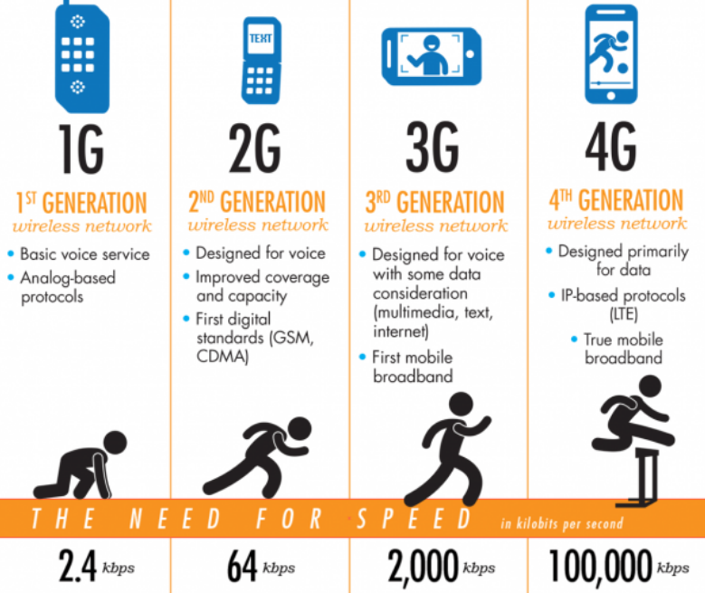
INTRODUCTION TO 3G &4G STANDARDS
Modern telecommunications now seem very different as a result of the remarkable breakthroughs in wireless communications in recent decades. Wireless communication has come a long way since its early days, when it was only available to a small number of users. Today, the majority of people on the planet can access it. In terms of connectivity and communication, this has ushered in a completely new era.
As a result, the rich high-data-rate wireless ecosystem, which essentially consists of the third and fourth generations of development in radio communications, has been supported by successive generations of wireless standards.3G and 4G are shorthand for these terms. The key wireless standards for each iteration of the wireless revolution are described in detail below.
3G &4G STANDARDS Dr.Y.Mallikarjuna Rao 07-02-2023 03/33

Slide 4
INTRODUCTION
2G WIRELESS STANDARDS
GENERATION | STANDARD | Data Rate
2G | GSM | 10 kbps
2G | IS-95 (CDMA) | 10 kbps
2.5 G | GPRS | 50kbps
2.5G | EDGE | 200kbps
GSM : Global System for Mobile
CDMA: code division for multiple access
GPRS: General Packet Radio Service
EDGE: enhanced data for GSM evolution
AIM:
The main goal of the 2G family of wireless standards was to give mobile cellular device customers a basic method of wireless voice communication.
ENHANCEMENT:
Furthermore, compared to 1G systems, which were analogue in nature, these devices were the first set of entirely digital wireless communication equipment. In an effort to converge the mobile communication infrastructure around the world, the dominant 2G standard, GSM, was first suggested with the goal of producing a multi-country joint standard.
3G &4G STANDARDS Dr.Y.Mallikarjuna Rao 07-02-2023 04/33

Slide 5
INTRODUCTION:
3G WIRELESS STANDARDS
Due to CDMA's superior features compared to other access technologies like Time Division for Multiple Access (TDMA) and Frequency Division for Multiple Access (FDMA), the third generation, or 3G wireless standards, were first proposed around the year 2000. (FDMA). Additionally, 3G standards—which use spectral bandwidth typically greater than 5 MHz—are referred to as wideband wireless technology.
WCDMA: wideband code division for multiple access
UMTS: Universal Mobile Telecommunications System
CDMA 2000: code division for multiple access
HSDPA: High-Speed Downlink Packet Access
HSUPA: High Speed Uplink Packet Access
GENERATION | STANDARD | Data Rate
3G | WCDMA/UMTS | 384 kbps
3G | CDMA 2000 | 384 kbps
3.5G | HSDPA/HSUPA | 5–30 mbps
3.5G | 1xEVDO-Rev. A,B | 5–30 mbps
3G &4G STANDARDS Dr.Y.Mallikarjuna Rao 07-02-2023 05/33

Slide 6
INTRODUCTION:
4G WIRELESS STANDARDS
GENERATION | STANDARD | Data Rate
4G | LTE | 100–200 Mbps
4G | WiMAX | 100 Mbps
4G | LTE Advanced | > 1 Gbps
LTE: Long-Term Evolution
Wi-MAX: Worldwide Interoperability for Microwave Access
LTE: Long-Term Evolution
The OFDM technology is the foundation for the set of 4G wireless standards OFDM. It is the name of the multiple access technique based on MIMO, another ground-breaking innovation used in 4G wireless systems, is essentially the use of multiple antennas at the transmitter and receiver in such systems. Thus, these revolutionary developments enable data rates greater than 100 Mbps for 4G wireless systems.
Four Modern Wireless Communication System Principles.The Third Generation Partnership Project (3GPP) standardization group created the Long-Term Evolution (LTE) and LTE Advanced standards, whereas the WiMAX forum is responsible for the Worldwide Interoperability for Microwave Access (WiMAX) standard. At the moment, 4G devices
3G &4G STANDARDS Dr.Y.Mallikarjuna Rao 07-02-2023 06/33

Slide 7
INTRODUCTION
OVERVIEW ON THE STANDARDS
GENERATION | STANDARD | APPLICATION
2.0–2.75G | 10–100 kbps | Voice, Low Rate Data
3.0–3.5G | 300 kbps - 30 mbps | Voice, Data, Video Calling, Video Conferencing
4G | 100–200 Mbps | Online Gaming, HDTV
The table above shows that in addition to the newer services provided in the current generation, each generation also offers all the services of the generations before it.
Applications for streaming television (HDTV) over 4G networks typically need a data throughput of 10 Mbps per stream.
3G &4G STANDARDS Dr.Y.Mallikarjuna Rao 07-02-2023 07/33

Slide 8
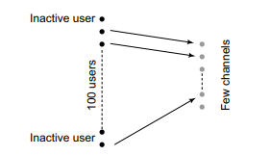
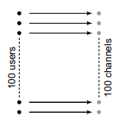
TELETRAFFIC THEORY
To cater for or meet the needs of a large number of users with a constrained number of channels, cellular networks apply the interconnection principle.
From the below figure Consider a cellular system with 100 supported users and 100 available channels
practically, only a few channels are necessary to meet the demands of users as they are random in nature. This random nature for the demand or the demand to place a call is exploited by the PRINCIPLE OF STATISTICAL MULTIPLEXING.
FIG:SCHEMATIC SHOWING TELETRAFFIC SYSTEM WITH N = 100 CHANNELS AND N = 100 USERS
FIG: SCHEMATIC SHOWING TELETRAFFIC SYSTEM WITH 100 USERS AND MUCH FEWER CHANNELS
Tele-traffic Theory Dr.Y.Mallikarjuna Rao 07-02-2023 08/33

Slide 9
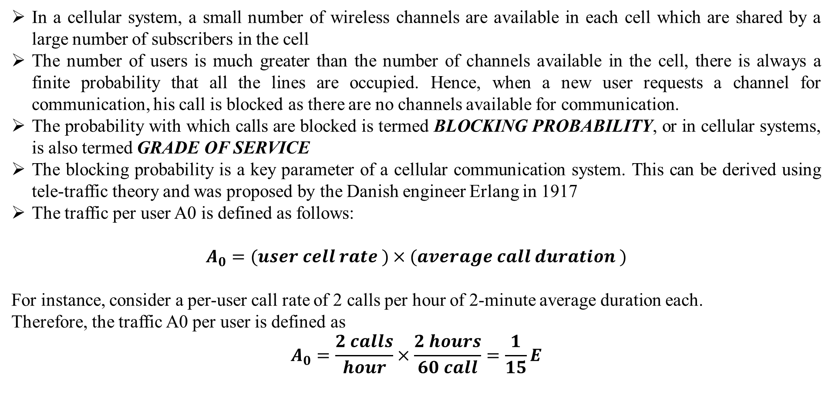
TELETRAFFIC THEORY
In a cellular system, a small number of wireless channels are available in each cell which are shared by a large number of subscribers in the cell
The number of users is much greater than the number of channels available in the cell, there is always a finite probability that all the lines are occupied. Hence, when a new user requests a channel for communication, his call is blocked as there are no channels available for communication.
The probability with which calls are blocked is termed BLOCKING PROBABILITY, or in cellular systems, is also termed GRADE OF SERVICE
The blocking probability is a key parameter of a cellular communication system. This can be derived using tele-traffic theory and was proposed by the Danish engineer Erlang in 1917
The traffic per user A0 is defined as follows:
$$A_{0}=(user cell rate )×(average call duration )$$
For instance, consider a per-user call rate of 2 calls per hour of 2-minute average duration each.
Therefore, the traffic A0 per user is defined as
$$A_{0}=\frac{2 calls}{hour}×\frac{2 hours}{60 call}=\frac{1}{15}E$$
Tele-traffic Theory Dr.Y.Mallikarjuna Rao 07-02-2023 09/33

Slide 10
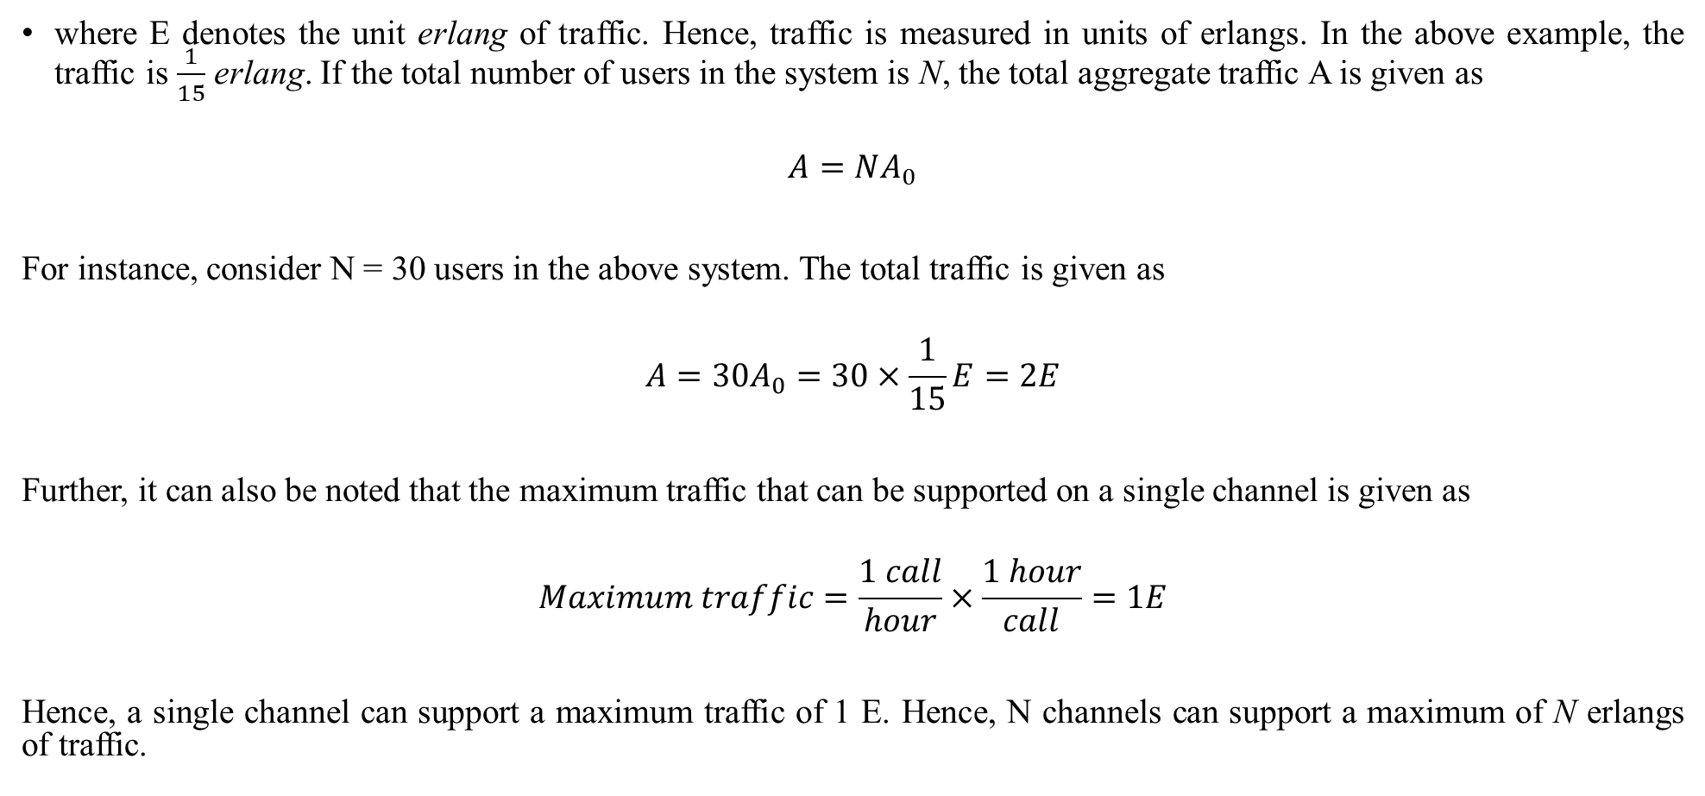
TELETRAFFIC THEORY
where E denotes the unit erlang of traffic. Hence, traffic is measured in units of erlangs. In the above example, the traffic is $\frac{1}{15}$ erlang. If the total number of users in the system is N, the total aggregate traffic A is given as
$$A=NA_{0}$$
For instance, consider N = 30 users in the above system. The total traffic is given as
$$A=30A_{0}=30×\frac{1}{15}E=2E$$
Further, it can also be noted that the maximum traffic that can be supported on a single channel is given as
$$Maximum traffic=\frac{1 call}{hour}×\frac{1 hour}{call}=1E$$
Hence, a single channel can support a maximum traffic of 1 E. Hence, N channels can support a maximum of N erlangs of traffic.
Tele-traffic Theory Dr.Y.Mallikarjuna Rao 07-02-2023 10/33

Slide 11
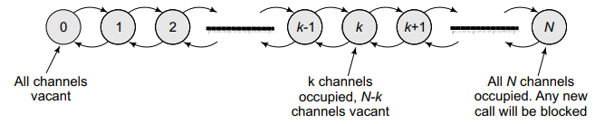
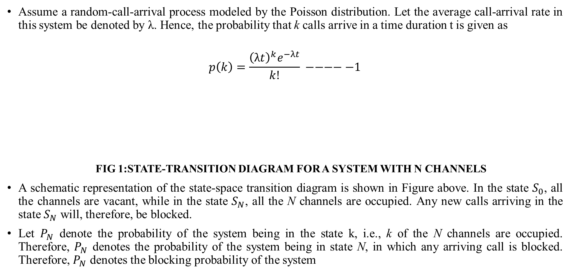
TELETRAFFIC THEORY
Assume a random-call-arrival process modeled by the Poisson distribution. Let the average call-arrival rate in this system be denoted by λ. Hence, the probability that k calls arrive in a time duration t is given as
$$p\left(k\right)=\frac{{\left(λt\right)}^{k}e^{−λt}}{k!} −−−−−1$$
FIG 1:STATE-TRANSITION DIAGRAM FOR A SYSTEM WITH N CHANNELS
A schematic representation of the state-space transition diagram is shown in Figure above. In the state $S_{0}$, all the channels are vacant, while in the state $S_{N}$, all the N channels are occupied. Any new calls arriving in the state $S_{N}$ will, therefore, be blocked.
Let $P_{N}$ denote the probability of the system being in the state k, i.e., k of the N channels are occupied. Therefore, $P_{N}$ denotes the probability of the system being in state N, in which any arriving call is blocked. Therefore, $P_{N}$ denotes the blocking probability of the system
Tele-traffic Theory Dr.Y.Mallikarjuna Rao 07-02-2023 11/33

Slide 12
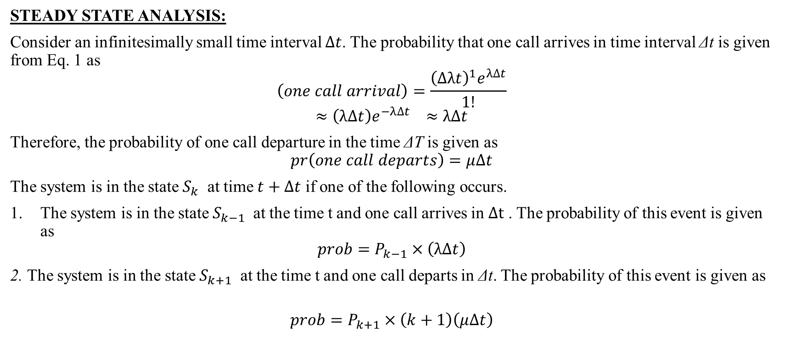
TELETRAFFIC THEORY
STEADY STATE ANALYSIS:
Consider an infinitesimally small time interval $∆t$. The probability that one call arrives in time interval Δt is given from Eq. 1 as
$$\left(one call arrival\right)=\frac{{\left(∆λt\right)}^{1}e^{λ∆t}}{1!}$$
$$≈\left(λ∆t\right)e^{−λ∆t} ≈λ∆t$$
Therefore, the probability of one call departure in the time ΔT is given as
$$pr\left(one call departs\right)=μ∆t$$
The system is in the state $S_{k}$ at time $t+∆t$ if one of the following occurs.
The system is in the state $S_{k−1}$ at the time t and one call arrives in $∆t$ . The probability of this event is given as
$$prob=P_{k−1}×\left(λ∆t\right)$$
2. The system is in the state $S_{k+1}$ at the time t and one call departs in Δt. The probability of this event is given as
$$prob=P_{k+1}×\left(k+1\right)\left(μ∆t\right)$$
Tele-traffic Theory Dr.Y.Mallikarjuna Rao 07-02-2023 12/33

Slide 13
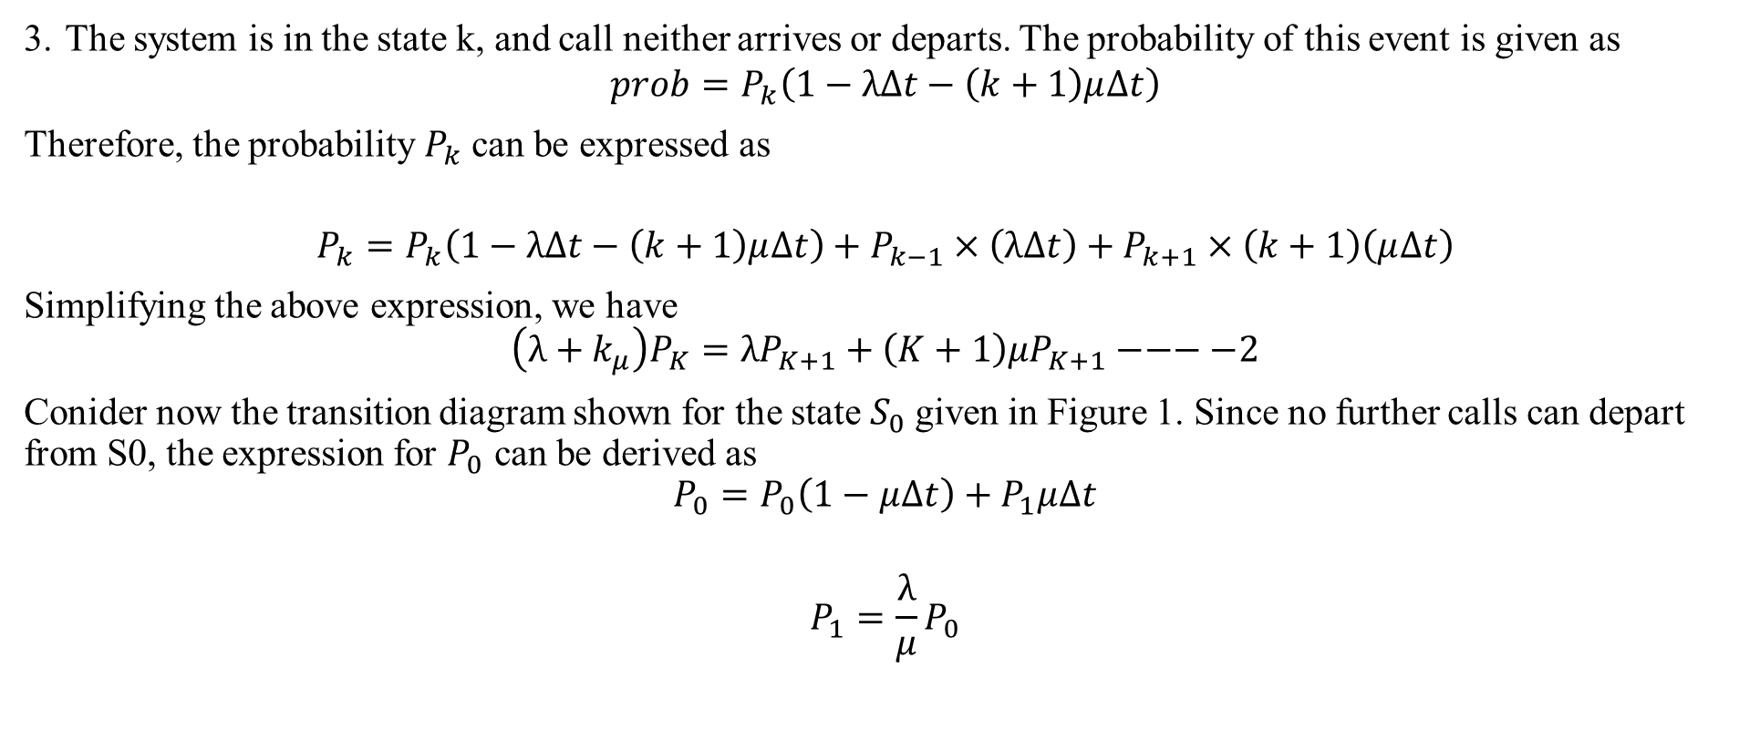
TELETRAFFIC THEORY
3. The system is in the state k, and call neither arrives or departs. The probability of this event is given as
$$prob=P_{k}\left(1−λ∆t−\left(k+1\right)μ∆t\right)$$
Therefore, the probability $P_{k}$ can be expressed as
$$P_{k}=P_{k}\left(1−λ∆t−\left(k+1\right)μ∆t\right)+P_{k−1}×\left(λ∆t\right)+P_{k+1}×\left(k+1\right)\left(μ∆t\right)$$
Simplifying the above expression, we have
$$\left(λ+k_{μ}\right)P_{K}={λP}_{K+1}+\left(K+1\right){μP}_{K+1}−−−−2$$
Conider now the transition diagram shown for the state $S_{0}$given in Figure 1. Since no further calls can depart from S0, the expression for $P_{0}$ can be derived as
$$P_{0}=P_{0}\left(1−μ∆t\right)+P_{1}μ∆t$$
$$P_{1}=\frac{λ}{μ}P_{0}$$
Tele-traffic Theory Dr.Y.Mallikarjuna Rao 07-02-2023 13/33

Slide 14

TELETRAFFIC THEORY
Substituting $k=1$ in Eq 2. above we have
$$\left(λ+μ\right)P_{1}={λP}_{0}+{2μP}_{2}$$
$$\left(λ+μ\right)\frac{λ}{μ}P_{0}={λP}_{0}+{2μP}_{2}$$
$$\frac{λ^{2}}{μ}P_{0}=2μP_{2}=\frac{1}{2}{\left(\frac{λ}{μ}\right)}^{2}$$
Proceeding similarly, it can be shown that
$$\sum{k=0^{N}=1}$$
$$\sum_{k=0}^{N}{\frac{1}{k!}}{\left(\frac{λ}{μ}\right)}^{k}P_{0}=1 ⇒P_{0}=\frac{1}{\sum_{k=0}^{N}{\frac{1}{k!}{\left(\frac{λ}{μ}\right)}^{k}}}$$
Tele-traffic Theory Dr.Y.Mallikarjuna Rao 07-02-2023 14/33

Slide 15
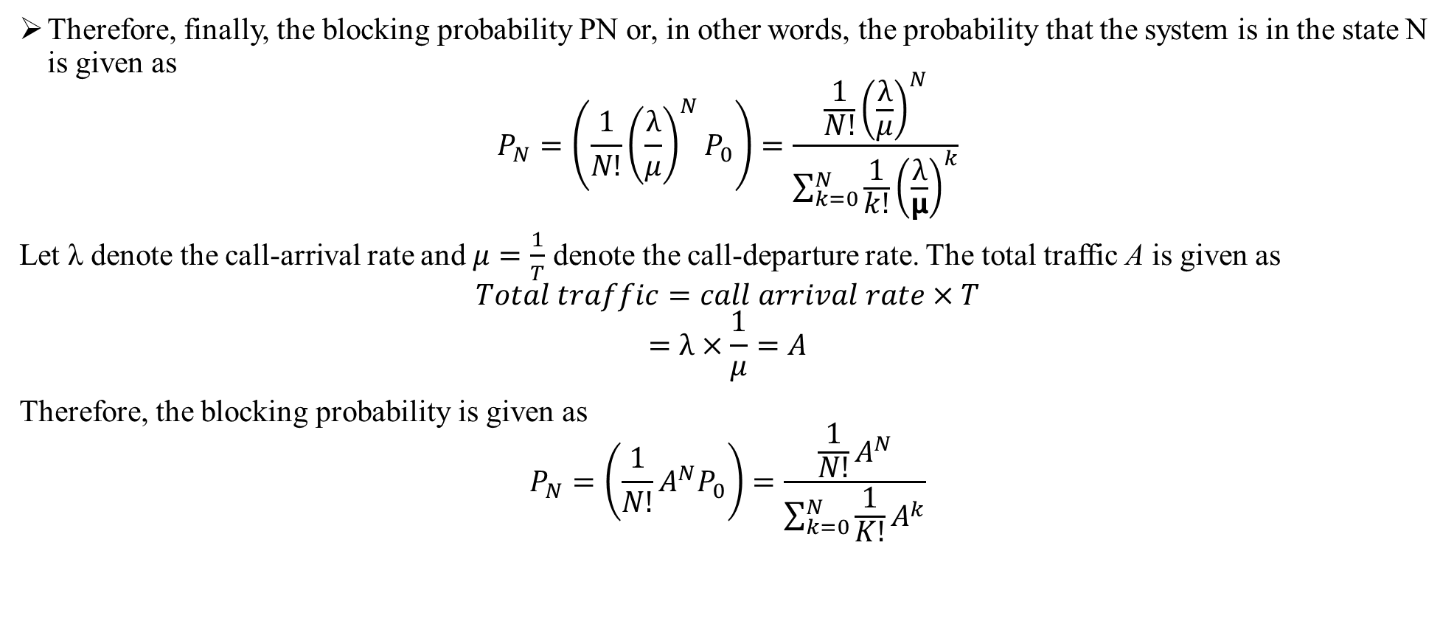
TELETRAFFIC THEORY
Therefore, finally, the blocking probability PN or, in other words, the probability that the system is in the state N is given as
$$P_{N}=\left(\frac{1}{N!}{\left(\frac{λ}{μ}\right)}^{N}P_{0}\right)=\frac{\frac{1}{N!}{\left(\frac{λ}{μ}\right)}^{N}}{\sum_{k=0}^{N}{\frac{1}{k!}{\left(\frac{λ}{μ}\right)}^{k}}}$$
Let λ denote the call-arrival rate and $μ=\frac{1}{T}$ denote the call-departure rate. The total traffic A is given as
$$Total traffic=call arrival rate×T$$
$$=λ×\frac{1}{μ}=A$$
Therefore, the blocking probability is given as
$$P_{N}=\left(\frac{1}{N!}A^{N}P_{0}\right)=\frac{\frac{1}{N!}A^{N}}{\sum_{k=0}^{N}{\frac{1}{K!}A^{k}}}$$
Tele-traffic Theory Dr.Y.Mallikarjuna Rao 07-02-2023 15/33

Slide 16
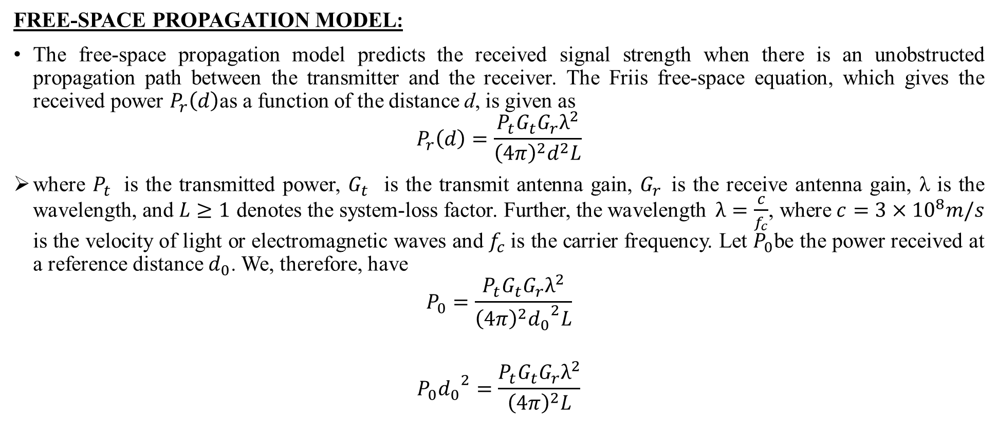
LARGE SCALE PATH LOSS
FREE-SPACE PROPAGATION MODEL:
The free-space propagation model predicts the received signal strength when there is an unobstructed propagation path between the transmitter and the receiver. The Friis free-space equation, which gives the received power $P_{r}\left(d\right)$as a function of the distance d, is given as
$$P_{r}\left(d\right)=\frac{P_{t}G_{t}G_{r}λ^{2}}{{\left(4π\right)}^{2}d^{2}L}$$
where $P_{t}$ is the transmitted power, $G_{t}$ is the transmit antenna gain, $G_{r}$is the receive antenna gain, λ is the wavelength, and $L≥1$ denotes the system-loss factor. Further, the wavelength$λ=\frac{c}{f_{c}}$, where $c=3×{10}^{8}m/s$ is the velocity of light or electromagnetic waves and $f_{c}$is the carrier frequency. Let $P_{0}$be the power received at a reference distance $d_{0}$. We, therefore, have
$$P_{0}=\frac{P_{t}G_{t}G_{r}λ^{2}}{{\left(4π\right)}^{2}{d_{0}}^{2}L}$$
$$P_{0}{d_{0}}^{2}=\frac{P_{t}G_{t}G_{r}λ^{2}}{{\left(4π\right)}^{2}L}$$
Large scale path loss Dr.Y.Mallikarjuna Rao 07-02-2023 16/33

Slide 17
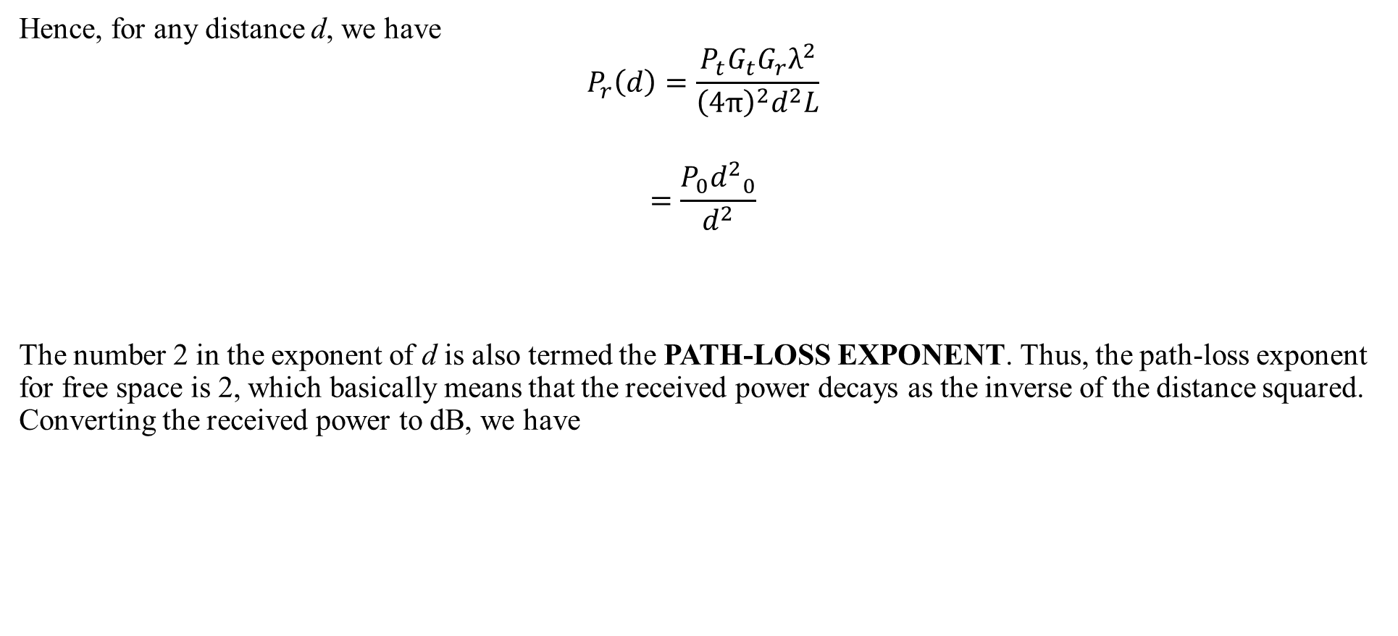
LARGE SCALE PATH LOSS
Hence, for any distance d, we have
$$P_{r}\left(d\right)=\frac{P_{t}G_{t}G_{r}λ^{2}}{{\left(4π\right)}^{2}d^{2}L}$$
$$=\frac{P_{0}{d^{2}}_{0}}{d^{2}}$$
The number 2 in the exponent of d is also termed the PATH-LOSS EXPONENT. Thus, the path-loss exponent for free space is 2, which basically means that the received power decays as the inverse of the distance squared. Converting the received power to dB, we have
Large scale path loss Dr.Y.Mallikarjuna Rao 07-02-2023 17/33

Slide 18

LARGE SCALE PATH LOSS
$$P^{dB}=10\log_{10}{P}=10 \log_{10}\left(\frac{P_{0}{d^{2}}_{0}}{d^{2}}\right)$$
$$=10 \log_{10}{P_{0}}+20\log_{10}\left(\frac{d}{d_{0}}\right)$$
$$=10 \log_{10}{P_{0}}−2×10\log_{10}\left(\frac{d_{0}}{d}\right)$$
$$=10\log_{10}{P_{0}−n×10\log_{10}\left(\frac{d_{0}}{d}\right)}$$
where n = 2 is the path-loss exponent for free-space propagation.
Large scale path loss Dr.Y.Mallikarjuna Rao 07-02-2023 18/33

Slide 19
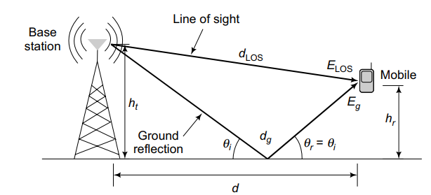
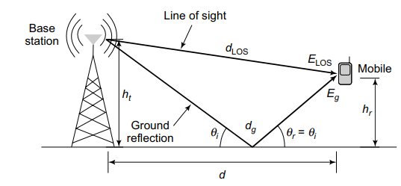

LARGE SCALE PATH LOSS
GROUND-REFLECTIONMODEL:
Consider the ground-reflection model shown in below Figure. The total received signal $E_{TOt }$is given as
$E_{Tot}=E_{Los}+E_{g}$----------1
Where $E_{Loss }\&E_{g}$ are the received line-of-sight and ground-reflection components, The component $E_{LOS}$ can be expressed as
$${ E}_{LoS}=\frac{E_{0}d_{0}e^{j2πf_{c}\left(t−\frac{d_{Los}}{c}\right)}}{d_{Los}}$$
FIGURE1 : GROUND-REFLECTION MODEL
FIGURE 2 LINE-OF-SIGHT DISTANCE DLOS IN GROUND-REFLECTION MODEL
Large scale path loss Dr.Y.Mallikarjuna Rao 07-02-2023 19/33

Slide 20
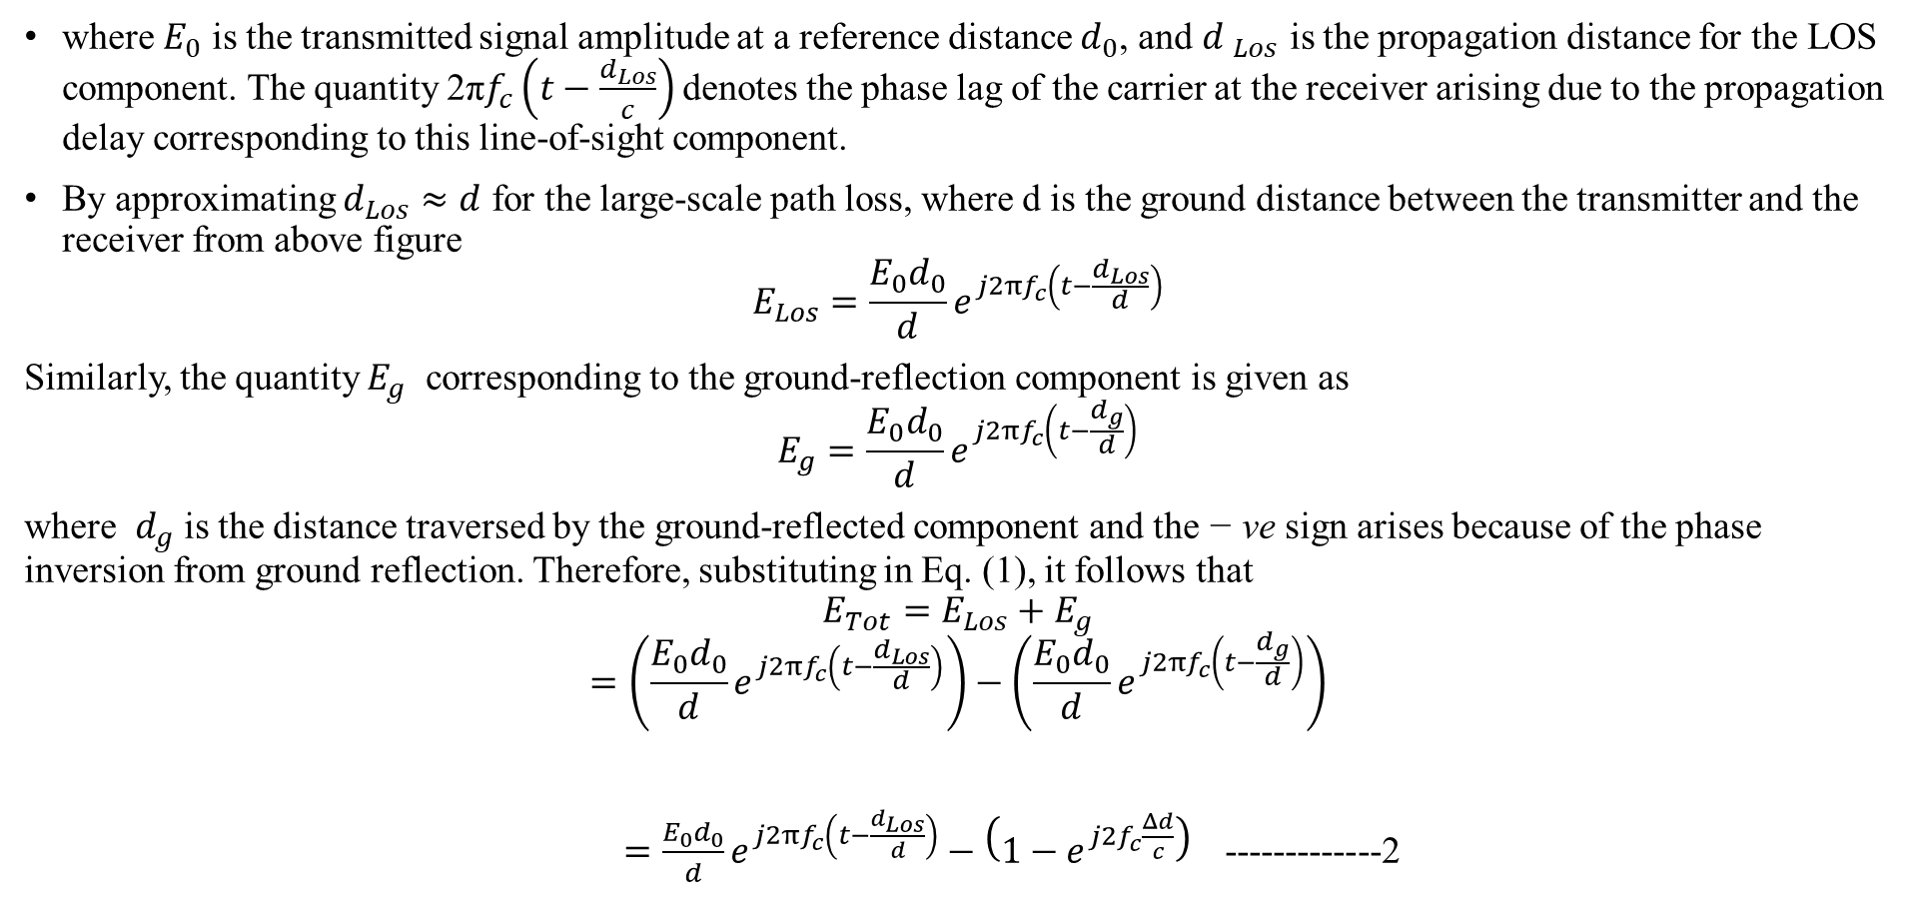
LARGE SCALE PATH LOSS
where $E_{0}$ is the transmitted signal amplitude at a reference distance $d_{0}$, and ${d }_{Los}$ is the propagation distance for the LOS component. The quantity 2π$f_{c}\left(t−\frac{d_{Los}}{c}\right)$ denotes the phase lag of the carrier at the receiver arising due to the propagation delay corresponding to this line-of-sight component.
By approximating $d_{Los}≈d$ for the large-scale path loss, where d is the ground distance between the transmitter and the receiver from above figure
$$E_{Los}=\frac{E_{0}d_{0}}{d}e^{j2{πf}_{c}\left(t−\frac{d_{Los}}{d}\right)}$$
Similarly, the quantity $E_{g}$ corresponding to the ground-reflection component is given as
$$E_{g}=\frac{E_{0}d_{0}}{d}e^{j2{πf}_{c}\left(t−\frac{d_{g}}{d}\right)}$$
where $d_{g}$ is the distance traversed by the ground-reflected component and the − ve sign arises because of the phase inversion from ground reflection. Therefore, substituting in Eq. (1), it follows that
$$E_{Tot}=E_{Los}+E_{g}$$
$$=\left(\frac{E_{0}d_{0}}{d}e^{j2{πf}_{c}\left(t−\frac{d_{Los}}{d}\right)}\right)−\left(\frac{E_{0}d_{0}}{d}e^{j2{πf}_{c}\left(t−\frac{d_{g}}{d}\right)}\right)$$
$=\frac{E_{0}d_{0}}{d}e^{j2{πf}_{c}\left(t−\frac{d_{Los}}{d}\right)}−\left(1−e^{j2f_{c}\frac{Δd}{c}}\right)$-------------2
Large scale path loss Dr.Y.Mallikarjuna Rao 07-02-2023 20/33

Slide 21
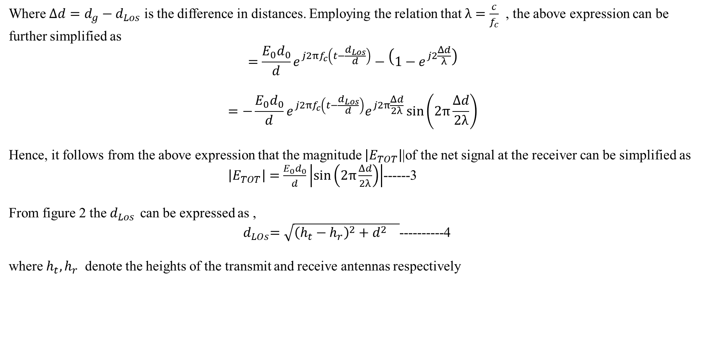
LARGE SCALE PATH LOSS
Where $Δd=d_{g}−d_{Los}$ is the difference in distances. Employing the relation that $λ=\frac{c}{f_{c}}$ , the above expression can be further simplified as
$$=\frac{E_{0}d_{0}}{d}e^{j2{πf}_{c}\left(t−\frac{d_{Los}}{d}\right)}−\left(1−e^{j2\frac{Δd}{λ}}\right)$$
$$=−\frac{E_{0}d_{0}}{d}e^{j2{πf}_{c}\left(t−\frac{d_{Los}}{d}\right)}e^{j2π\frac{Δd}{2λ}}\sin\left(2π\frac{Δd}{2λ}\right)$$
Hence, it follows from the above expression that the magnitude $\left|E_{TOT}\right|$|of the net signal at the receiver can be simplified as
$\left|E_{TOT}\right|=\frac{E_{0}d_{0}}{d}\left|\sin\left(2π\frac{Δd}{2λ}\right)\right|$------3
From figure 2 the $d_{Los }$can be expressed as ,
${ d}_{LOs}=\sqrt{{\left(h_{t}−h_{r}\right)}^{2}+d^{2} }$----------4
where $h_{t}{,h}_{r}$ denote the heights of the transmit and receive antennas respectively
Large scale path loss Dr.Y.Mallikarjuna Rao 07-02-2023 21/33

Slide 22
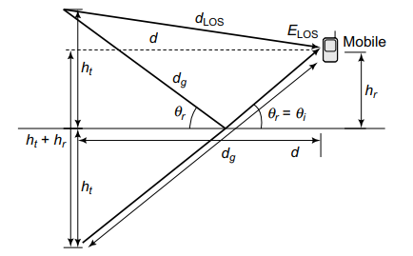
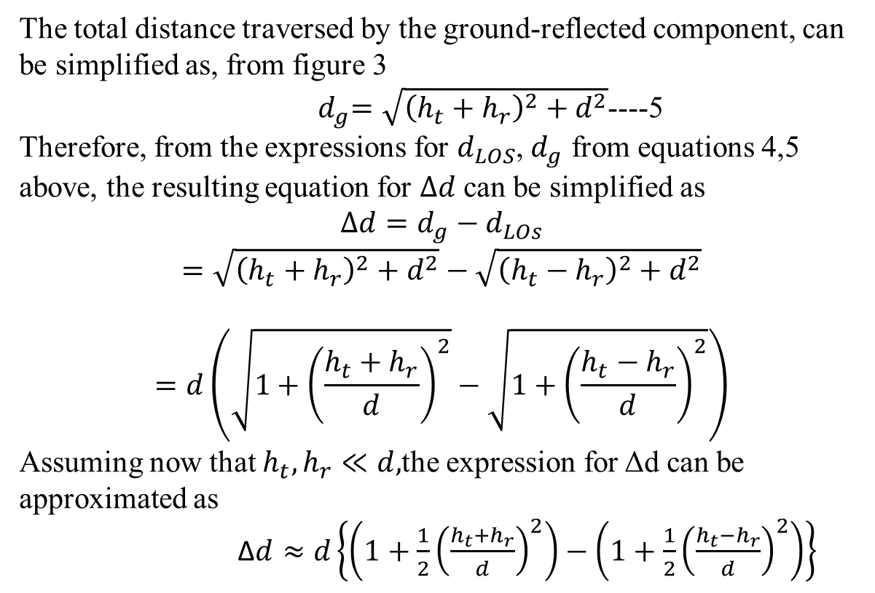

LARGE SCALE PATH LOSS
The total distance traversed by the ground-reflected component, can be simplified as, from figure 3
${ d}_{g}=\sqrt{{\left(h_{t}+h_{r}\right)}^{2}+d^{2}}$----5
Therefore, from the expressions for $d_{LOS}$, $d_{g}$ from equations 4,5 above, the resulting equation for $Δd$ can be simplified as
$$Δd=d_{g}−d_{LOs}$$
$$=\sqrt{{\left(h_{t}+h_{r}\right)}^{2}+d^{2}}−\sqrt{{\left(h_{t}−h_{r}\right)}^{2}+d^{2}}$$
$$=d\left(\sqrt{1+{\left(\frac{h_{t}+h_{r}}{d}\right)}^{2}}−\sqrt{1+{\left(\frac{h_{t}−h_{r}}{d}\right)}^{2}}\right)$$
Assuming now that $h_{t},h_{r}≪d,$the expression for Δd can be approximated as
Δ$d≈d\left\{\left(1+\frac{1}{2}{\left(\frac{h_{t}+h_{r}}{d}\right)}^{2}\right)−\left(1+\frac{1}{2}{\left(\frac{h_{t}−h_{r}}{d}\right)}^{2}\right)\right\}$
FIGURE 3 GROUND-REFLECTION DISTANCE $d_{g}$ IN GROUND-REFLECTION MODEL
Large scale path loss Dr.Y.Mallikarjuna Rao 07-02-2023 22/33

Slide 23

LARGE SCALE PATH LOSS
Δ$d=d\left(\frac{1}{2}\frac{4h_{t}h_{r}}{d^{2}}\right)$
$=\frac{2h_{t}h_{r}}{d}$ --------6
Substituting the above expression for $Δd$ in Eq. (8.4) yields
$$\left|E_{Tot}\right|=\frac{2E_{0}d_{0}}{d}\sin\left(2π\frac{Δd}{2λ}\right)$$
$$≈\frac{2E_{0}d_{0}}{d}2π\frac{Δd}{2λ}$$
$$=\frac{2E_{0}d_{0}}{d}\frac{2π}{2λ}\frac{2h_{t}h_{r}}{d}$$
$$\frac{4πE_{0}d_{0}h_{t}h_{r}}{d^{2}}α\frac{1}{d^{2}}$$
Large scale path loss Dr.Y.Mallikarjuna Rao 07-02-2023 23/33

Slide 24

LARGE SCALE PATH LOSS
Thus, we have
$$p_{TOt}∝\frac{1}{d^{4}}$$
Therefore, considering the dB power level $P^{dB}=10\log_{10}P_{TOt}$, we have
$$P^{dB}={\overline{P}}^{dB}−40\log_{10}\left(\frac{d}{\overline{d}}\right)$$
where $\overline{P}$is the received power at a reference distance $\overline{d}$. Thus, the path-loss exponent can vary depending on the scenario and, therefore, the received power decays as $\frac{1}{d^{n}}$ , where n = 2 for free space,
Large scale path loss Dr.Y.Mallikarjuna Rao 07-02-2023 24/33

Slide 25
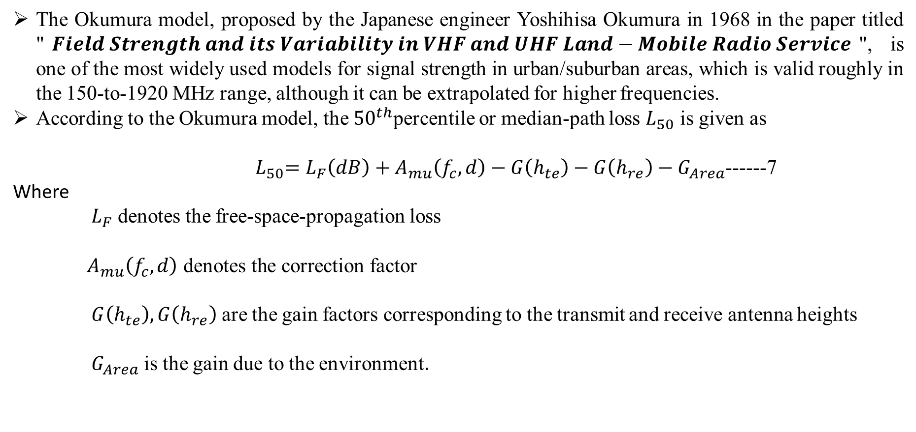
LARGE SCALE PATH LOSS
OKUMURA MODEL:
The Okumura model, proposed by the Japanese engineer Yoshihisa Okumura in 1968 in the paper titled "$Field Strength and its Variability in VHF and UHF Land−Mobile Radio Service$", is one of the most widely used models for signal strength in urban/suburban areas, which is valid roughly in the 150-to-1920 MHz range, although it can be extrapolated for higher frequencies.
According to the Okumura model, the ${50}^{th}$percentile or median-path loss $L_{50}$ is given as
${ L}_{50}=L_{F}\left(dB\right)+A_{mu}\left(f_{c},d\right)−G\left(h_{te}\right)−G\left(h_{re}\right)−G_{Area}$------7
Where
$L_{F}$ denotes the free-space-propagation loss
$A_{mu}\left(f_{c},d\right) \text{denotes} \text{the} \text{correction} \text{factor}$
$G\left(h_{te}\right),G\left(h_{re}\right)$ are the gain factors corresponding to the transmit and receive antenna heights
$G_{Area}$ is the gain due to the environment.
Large scale path loss Dr.Y.Mallikarjuna Rao 07-02-2023 25/33

Slide 26
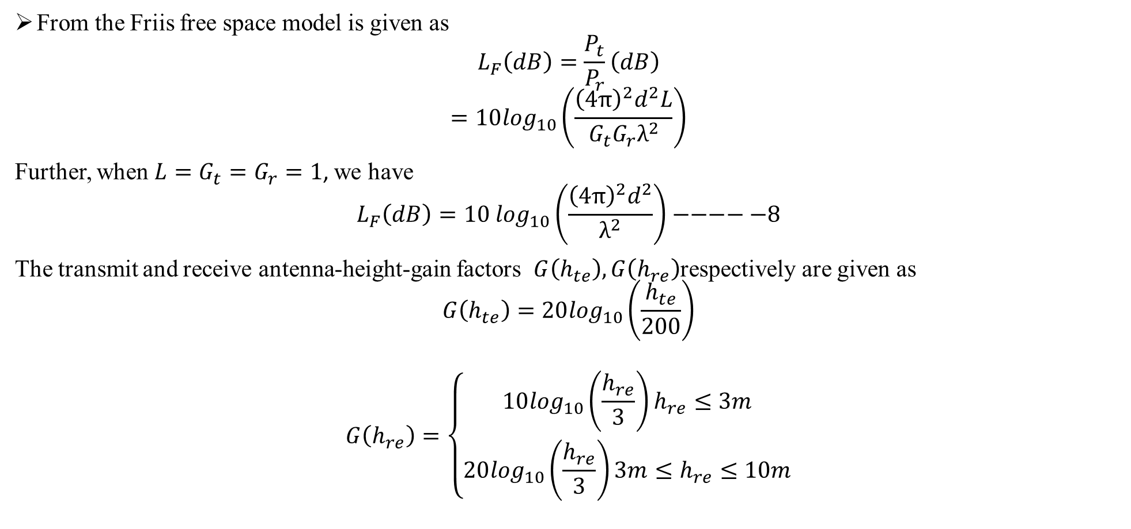
LARGE SCALE PATH LOSS
From the Friis free space model is given as
$$L_{F}\left(dB\right)=\frac{P_{t}}{P_{r}}\left(dB\right)$$
$$=10\log_{10}\left(\frac{{\left(4π\right)}^{2}d^{2}L}{G_{t}G_{r}λ^{2}}\right)$$
Further, when$L=G_{t}=G_{r}=1$, we have
$$L_{F}\left(dB\right)={10 log}_{10}\left(\frac{{\left(4π\right)}^{2}d^{2}}{λ^{2}}\right)−−−−−8$$
The transmit and receive antenna-height-gain factors $G\left(h_{te}\right),G\left(h_{re}\right)$respectively are given as
$$G\left(h_{te}\right)=20\log_{10}\left(\frac{h_{te}}{200}\right)$$
$$G\left(h_{re}\right)=\left\{\begin{aligned}10\log_{10}\left(\frac{h_{re}}{3}\right)h_{re}≤3m \\ 20\log_{10}\left(\frac{h_{re}}{3}\right)3m≤h_{re}≤10m\end{aligned}\right.$$
Large scale path loss Dr.Y.Mallikarjuna Rao 07-02-2023 26/33

Slide 27
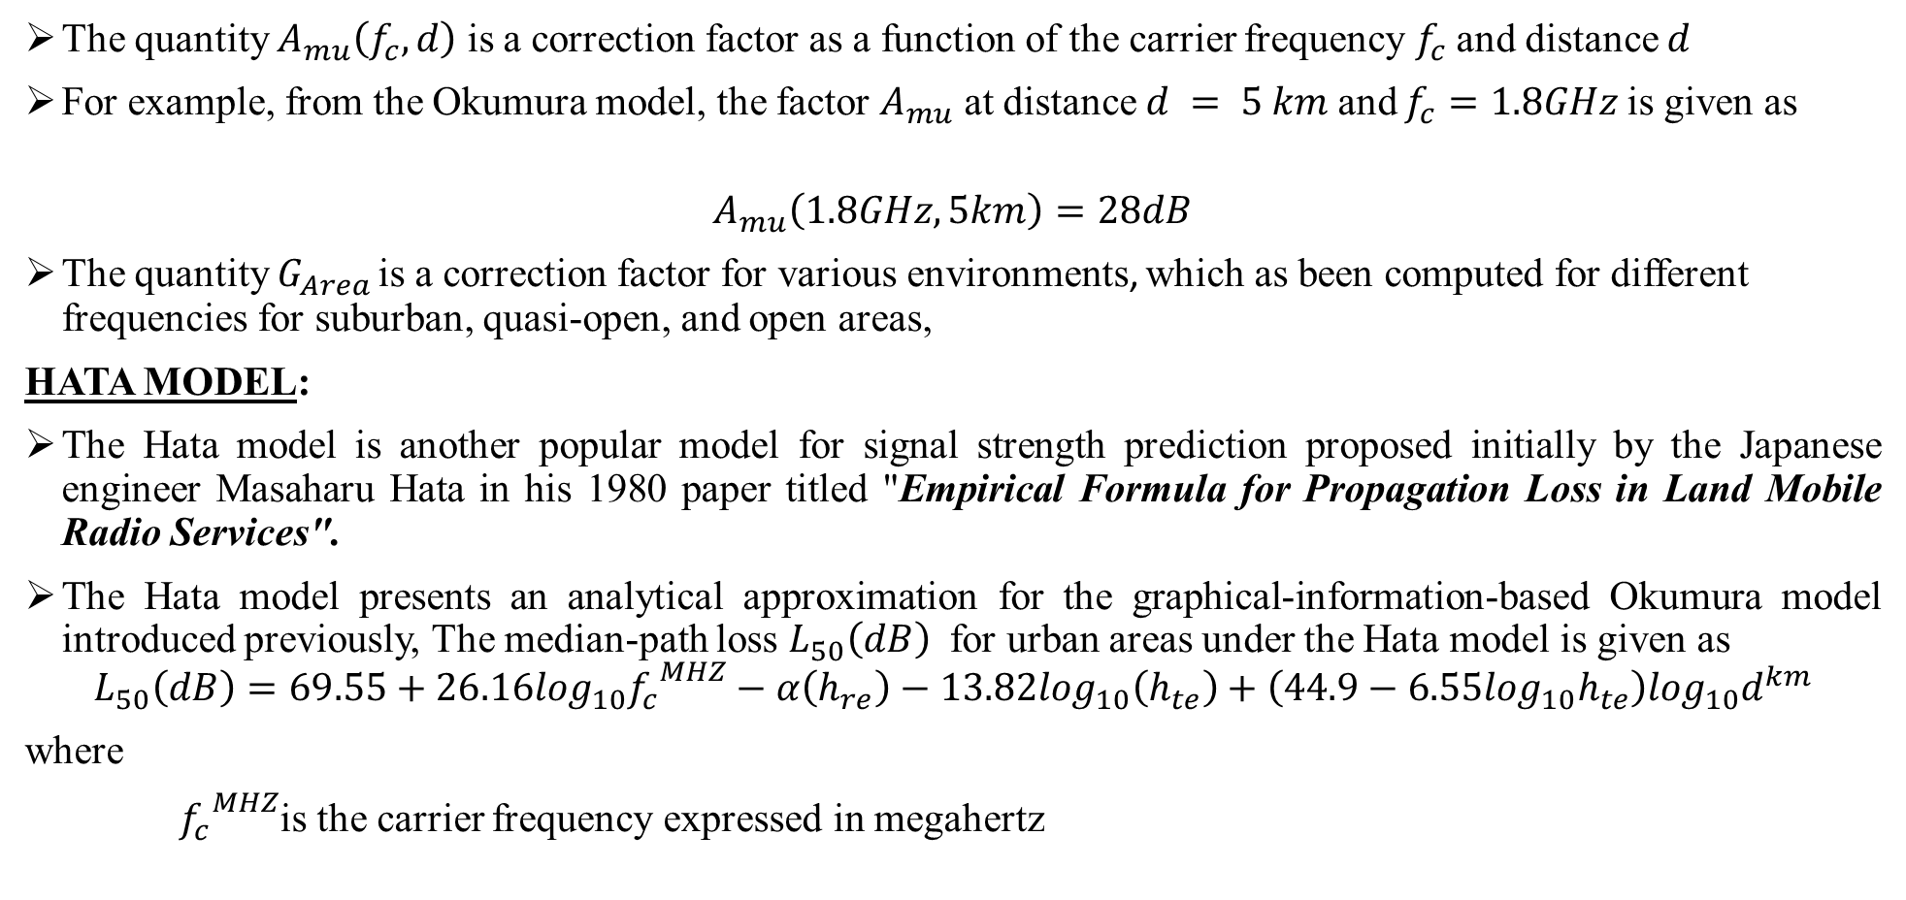
LARGE SCALE PATH LOSS
The quantity $A_{mu}\left(f_{c},d\right)$ is a correction factor as a function of the carrier frequency $f_{c}$and distance $d$
For example, from the Okumura model, the factor $A_{mu}$ at distance $d = 5 km$and $f_{c}=1.8GHz$is given as
$$A_{mu}\left(1.8GHz,5km\right)=28dB$$
The quantity $G_{Area }$is a correction factor for various environments, which as been computed for different frequencies for suburban, quasi-open, and open areas,
HATA MODEL:
The Hata model is another popular model for signal strength prediction proposed initially by the Japanese engineer Masaharu Hata in his 1980 paper titled "Empirical Formula for Propagation Loss in Land Mobile Radio Services".
The Hata model presents an analytical approximation for the graphical-information-based Okumura model introduced previously, The median-path loss $L_{50}\left(dB\right)$ for urban areas under the Hata model is given as
$$L_{50}\left(dB\right)=69.55+26.16\log_{10}{f_{c}}^{MHZ}−α\left(h_{re}\right)−13.82\log_{10}\left(h_{te}\right)+\left(44.9−6.55\log_{10}h_{te}\right)\log_{10}d^{km}$$
where
${f_{c}}^{MHZ}$is the carrier frequency expressed in megahertz
Large scale path loss Dr.Y.Mallikarjuna Rao 07-02-2023 27/33

Slide 28
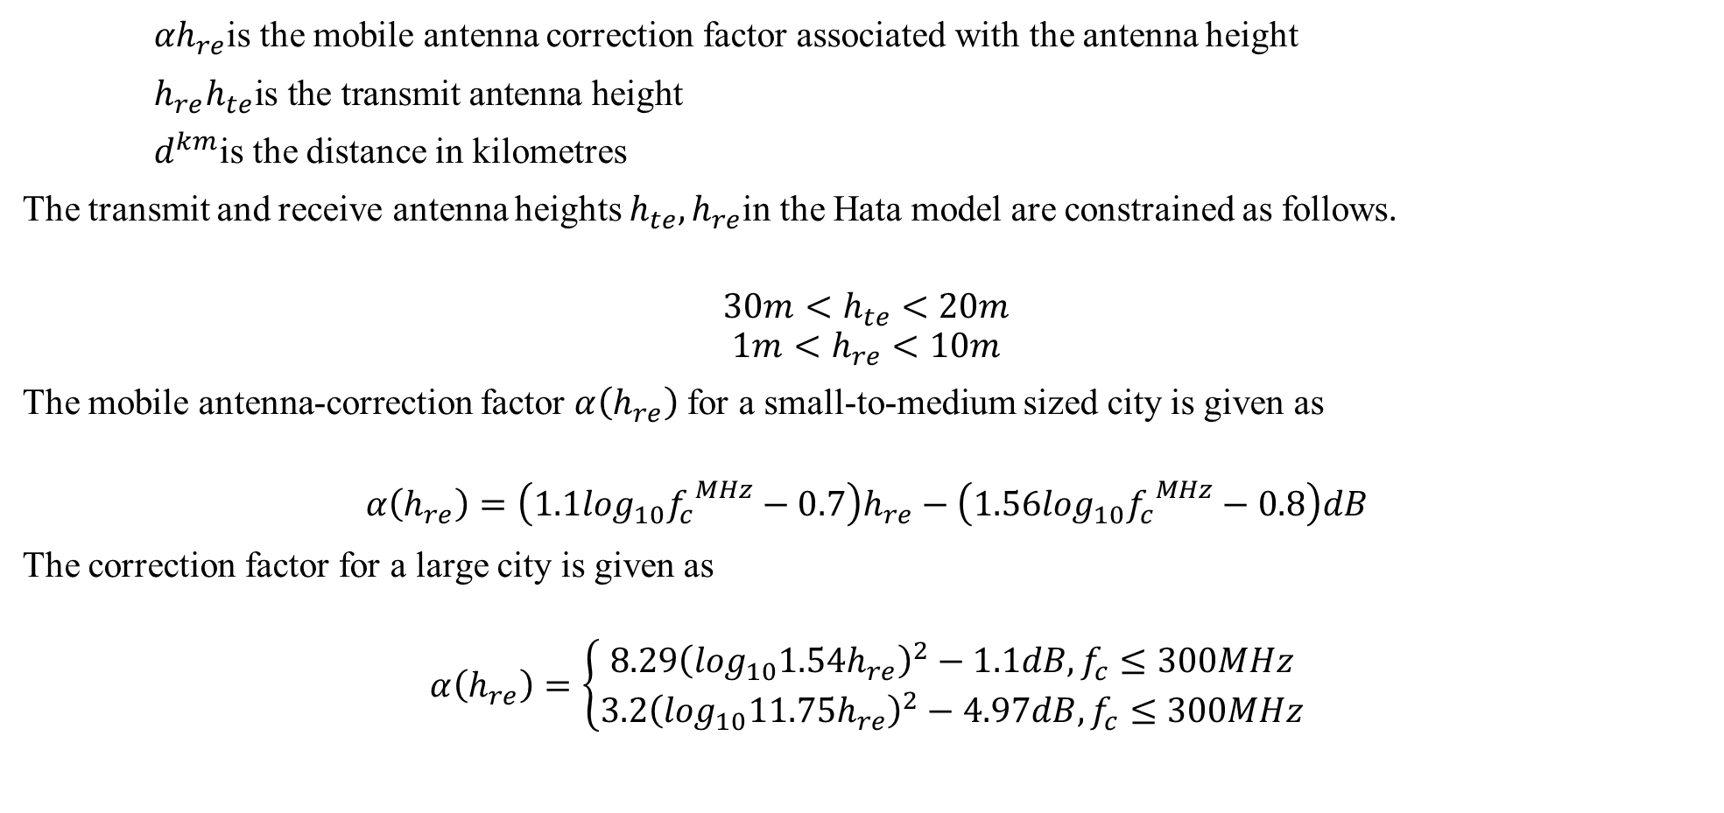
LARGE SCALE PATH LOSS
${αh}_{re}$is the mobile antenna correction factor associated with the antenna height
$h_{re}h_{te}\text{is} \text{the} \text{transmit} \text{antenna} \text{height}$
$d^{km}$is the distance in kilometres
The transmit and receive antenna heights $h_{te},h_{re}$in the Hata model are constrained as follows.
$$30m<h_{te}<20m$$
$$1m<h_{re}<10m$$
The mobile antenna-correction factor $α\left(h_{re}\right)$ for a small-to-medium sized city is given as
$$α\left(h_{re}\right)=\left(1.1\log_{10}{f_{c}}^{MHz}−0.7\right)h_{re}−\left(1.56\log_{10}{f_{c}}^{MHz}−0.8\right)dB$$
The correction factor for a large city is given as
$$α\left(h_{re}\right)=\left\{\begin{aligned}8.29{\left(\log_{10}1.54h_{re}\right)}^{2}−1.1dB,f_{c}≤300MHz \\ 3.2{\left(\log_{10}11.75h_{re}\right)}^{2}−4.97dB,f_{c}≤300MHz\end{aligned}\right.$$
Large scale path loss Dr.Y.Mallikarjuna Rao 07-02-2023 28/33

Slide 29
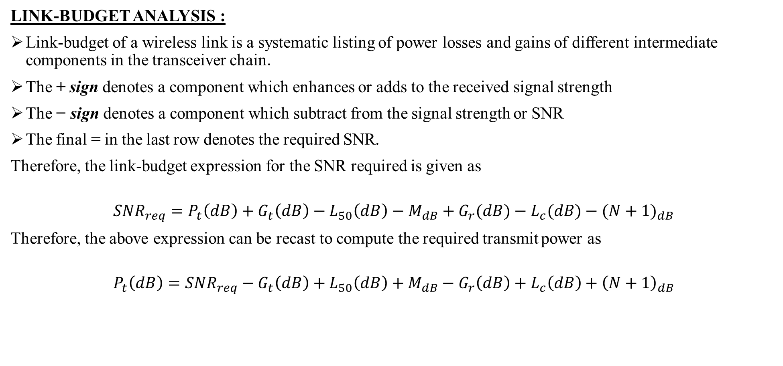
LARGE SCALE PATH LOSS
LINK-BUDGET ANALYSIS :
Link-budget of a wireless link is a systematic listing of power losses and gains of different intermediate components in the transceiver chain.
The + sign denotes a component which enhances or adds to the received signal strength
The − sign denotes a component which subtract from the signal strength or SNR
The final = in the last row denotes the required SNR.
Therefore, the link-budget expression for the SNR required is given as
$${SNR}_{req}=P_{t}\left(dB\right)+G_{t}\left(dB\right)−L_{50}\left(dB\right)−M_{dB}+G_{r}(dB)−L_{c}(dB)−{(N+1)}_{dB}$$
Therefore, the above expression can be recast to compute the required transmit power as
$$P_{t}\left(dB\right)={SNR}_{req}−G_{t}\left(dB\right)+L_{50}\left(dB\right)+M_{dB}−G_{r}\left(dB\right)+L_{c}\left(dB\right)+{\left(N+1\right)}_{dB}$$
Large scale path loss Dr.Y.Mallikarjuna Rao 07-02-2023 29/33

Slide 30
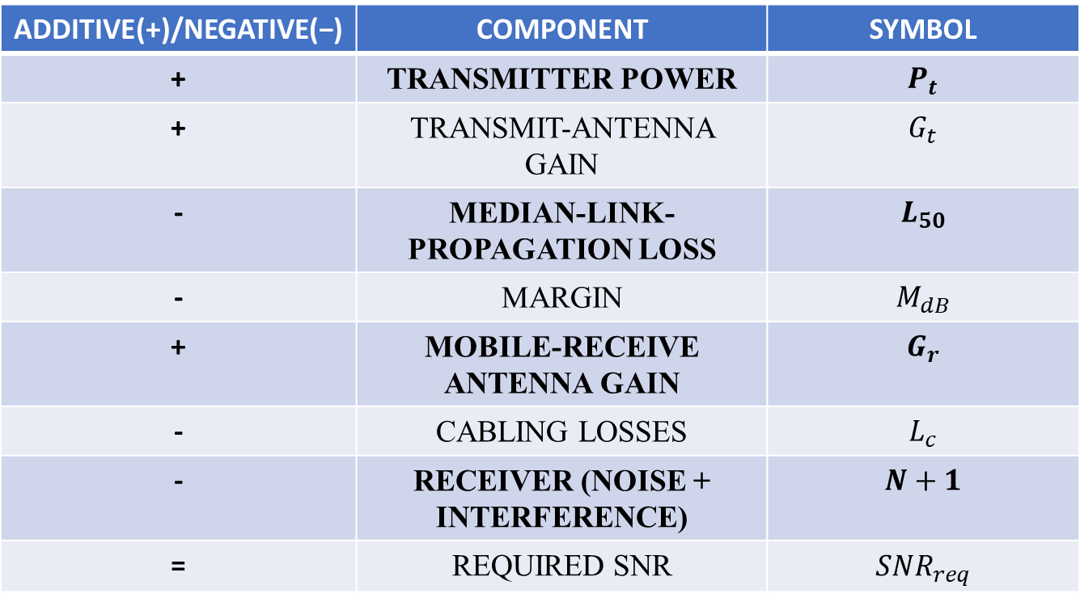
LARGE SCALE PATH LOSS
COMPONENTS OF A TYPICAL WIRELESS-LINK BUDGET:
ADDITIVE(+)/NEGATIVE(−) | COMPONENT | SYMBOL
+ | TRANSMITTER POWER | $$P_{t}$$
+ | TRANSMIT-ANTENNA GAIN | $$G_{t}$$
- | MEDIAN-LINK-PROPAGATION LOSS | $$L_{50}$$
- | MARGIN | $$M_{dB}$$
+ | MOBILE-RECEIVE ANTENNA GAIN | $$G_{r}$$
- | CABLING LOSSES | $$L_{c}$$
- | RECEIVER (NOISE + INTERFERENCE) | $$N+1$$
= | REQUIRED SNR | $${SNR}_{req}$$
Large scale path loss Dr.Y.Mallikarjuna Rao 07-02-2023 30/33

Slide 31
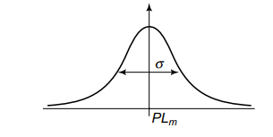

LARGE SCALE PATH LOSS
Let us consider an example, users can be shadowed by large objects such as walls or buildings. Thus, the net received signal strength is basically a random variable with the mean predicted by the path loss.
The random dB deviation about the mean signal strength can be modelled as a Gaussian${ RV X}_{σ}\sim 𝓝\left(0,σ^{2}\right)$ . This is shown schematically in Figure 4,
LOG-NORMAL SHADOWING:
FIGURE 4: PROBABILITY DENSITY FUNCTIONOF LOG-NORMAL SHADOWING
Large scale path loss Dr.Y.Mallikarjuna Rao 07-02-2023 31/33

Slide 32
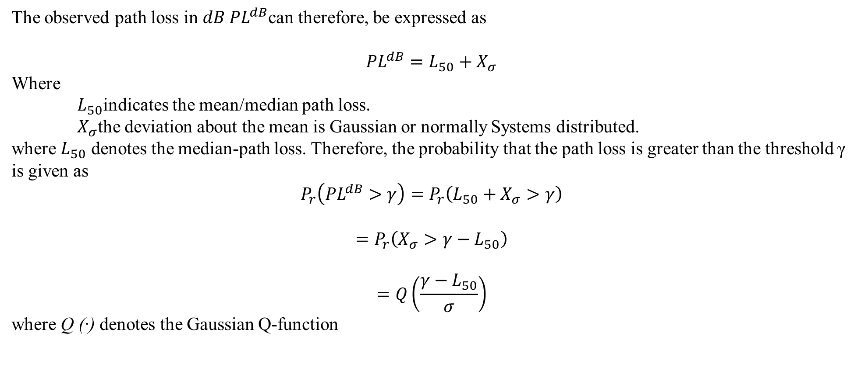
LARGE SCALE PATH LOSS
The observed path loss in $dB {PL}^{dB}$can therefore, be expressed as
$${PL}^{dB}=L_{50}+X_{σ}$$
Where
$L_{50}$indicates the mean/median path loss.
$X_{σ}$the deviation about the mean is Gaussian or normally Systems distributed.
where $L_{50}$ denotes the median-path loss. Therefore, the probability that the path loss is greater than the threshold γ is given as
$$P_{r}\left({PL}^{dB}>γ\right)=P_{r}\left(L_{50}+X_{σ}>γ\right)$$
$$=P_{r}\left(X_{σ}>γ−L_{50}\right)$$
$$=Q\left(\frac{γ−L_{50}}{σ}\right)$$
where Q (·) denotes the Gaussian Q-function
Large scale path loss Dr.Y.Mallikarjuna Rao 07-02-2023 32/33

Slide 33
End of Presentation
Thank you all
Dr.Y.Mallikarjuna Rao 07-02-2023 33/33

