Slide 1

CODE DIVISION MULTIPLE ACCESS (CDMA)
Dr.Y.Mallikarjuna Rao M.Tech., Ph.D
Professor & Head of ECE
Santhiram Engineering College
hod.ece@srecnandyal.edu.in

Slide 2

Outline of the Presentation
3.1 Introduction to CDMA
Spread spectrum and LFSR
3.2 Generation and Properties of PN sequences
Correlation of PN Sequences and Jammer margin
CDMA advantages and RAKE receiver
Multiuser CDMA downlink
Multi user CDMA uplink and asynchronous CDMA
CDMA near-Far problem
Code Division Multiple Access Dr.Y.Mallikarjuna Rao 14-03-2023

Slide 3
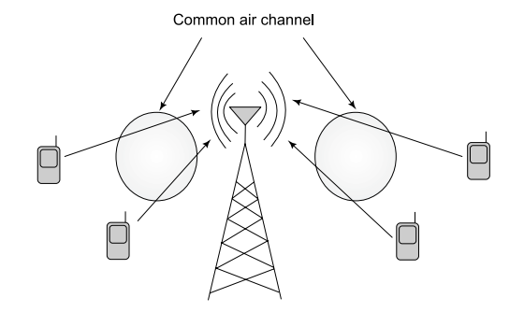
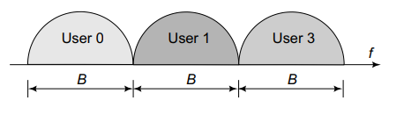
3.1 INTRODUCTION
CDMA stands for Code Division for Multiple Access and is considered a path-breaking wireless technology due to its several superior properties which was first employed in the 2nd generation IS-95 cellular standard, which was predominantly used in North America, under the brand name CDMA-ONE. It also forms the basis for several advanced 3rd Generation i.e., 3G cellular standards such as Wideband CDMA (WCDMA), High-Speed Downlink Packet Access (HSDPA), High Speed Uplink Packet Access (HSUPA), CDMA 2000, and 1x Evolution Data Optimized (1xEV-DO).
Figure 5.2 Frequency division for multiple access
Figure 1: Multiple access for wireless cellular networks
Code Division Multiple Access Dr.Y.Mallikarjuna Rao 14-03-2023 01/35

Slide 4
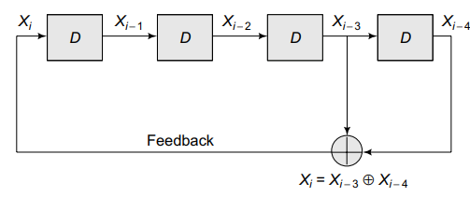


CODE DIVISION MULTIPLE ACCESS (CDMA)
Consider the code $c_{2}=\left[1,−1,1,−1\right]$. Observe that the code looks like a random sequence of $+1,−1$ or a pseudo-noise (PN) sequence. This is so termed since it only resembles a noise sequence, but is not actually a noise sequence. One method to generate such long spreading codes based on PN sequences for a significantly large N is through the employment of a Linear Feedback Shift Register (LFSR) is described.
Consider the shift register architecture shown in Figure3: where the element D represents delays. Thus, the digital circuit therein contains D = 4 delay elements or shift registers. The input on the left is denoted by $X_{i}$, and the outputs of the different delays are$X_{i−1},X_{i−2},X_{i−3},X_{i−4}$ also denote the final output of the system. Also observe that the $xor X_{i−4}⨁X_{i−3}$ is fed back as X_{i} which is the input to the first shift register. Thus, the governing equation of the circuit is an linear equation
$$X_{i}=X_{i−3}⨁X_{i−4}$$
The above equation implies a linear relation, with feedback and uses delay elements or shift registers, such a circuit is also termed a Linear Feedback Shift Register (LFSR) architecture.
Figure 3: Linear feedback shift register
Code Division Multiple Access Dr.Y.Mallikarjuna Rao 14-03-2023 02/35

Slide 5
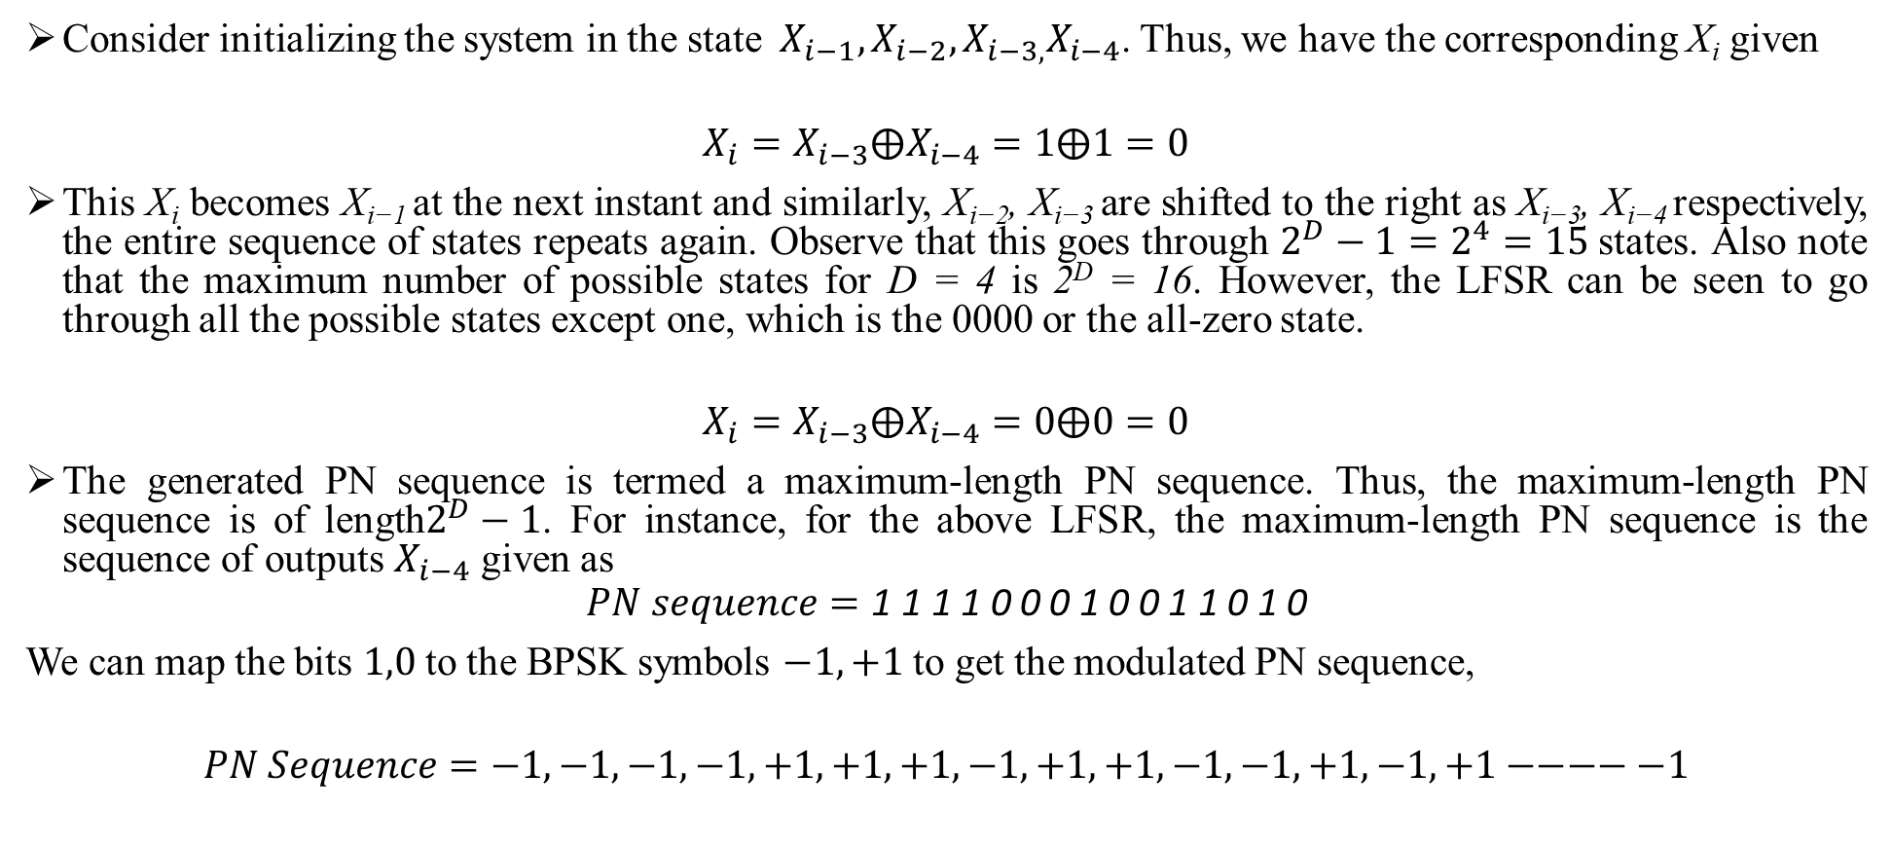
CODE DIVISION MULTIPLE ACCESS (CDMA)
Consider initializing the system in the state$X_{i−1},X_{i−2},X_{i−3,}X_{i−4}$. Thus, we have the corresponding X_{i} given
$$X_{i}=X_{i−3}⨁X_{i−4}=1⨁1=0$$
This X_{i} becomes X_{i−1} at the next instant and similarly, X_{i−2}, X_{i−3} are shifted to the right as X_{i−3}, X_{i−4} respectively, the entire sequence of states repeats again. Observe that this goes through $2^{D}−1=2^{4}=15$states. Also note that the maximum number of possible states for D = 4 is 2^{D} = 16. However, the LFSR can be seen to go through all the possible states except one, which is the 0000 or the all-zero state.
$$X_{i}=X_{i−3}⨁X_{i−4}=0⨁0=0$$
The generated PN sequence is termed a maximum-length PN sequence. Thus, the maximum-length PN sequence is of length$2^{D}−1$. For instance, for the above LFSR, the maximum-length PN sequence is the sequence of outputs $X_{i−4}$ given as
$$PN sequence=\text{1 1 1 1 0 0 0 1 0 0 1 1 0 1 0}$$
We can map the bits $1,0$to the BPSK symbols $−1,+1$to get the modulated PN sequence,
$$PN Sequence=−1,−1,−1,−1,+1,+1,+1,−1,+1,+1,−1,−1,+1,−1,+1−−−−−1$$
Code Division Multiple Access Dr.Y.Mallikarjuna Rao 14-03-2023 03/35

Slide 6
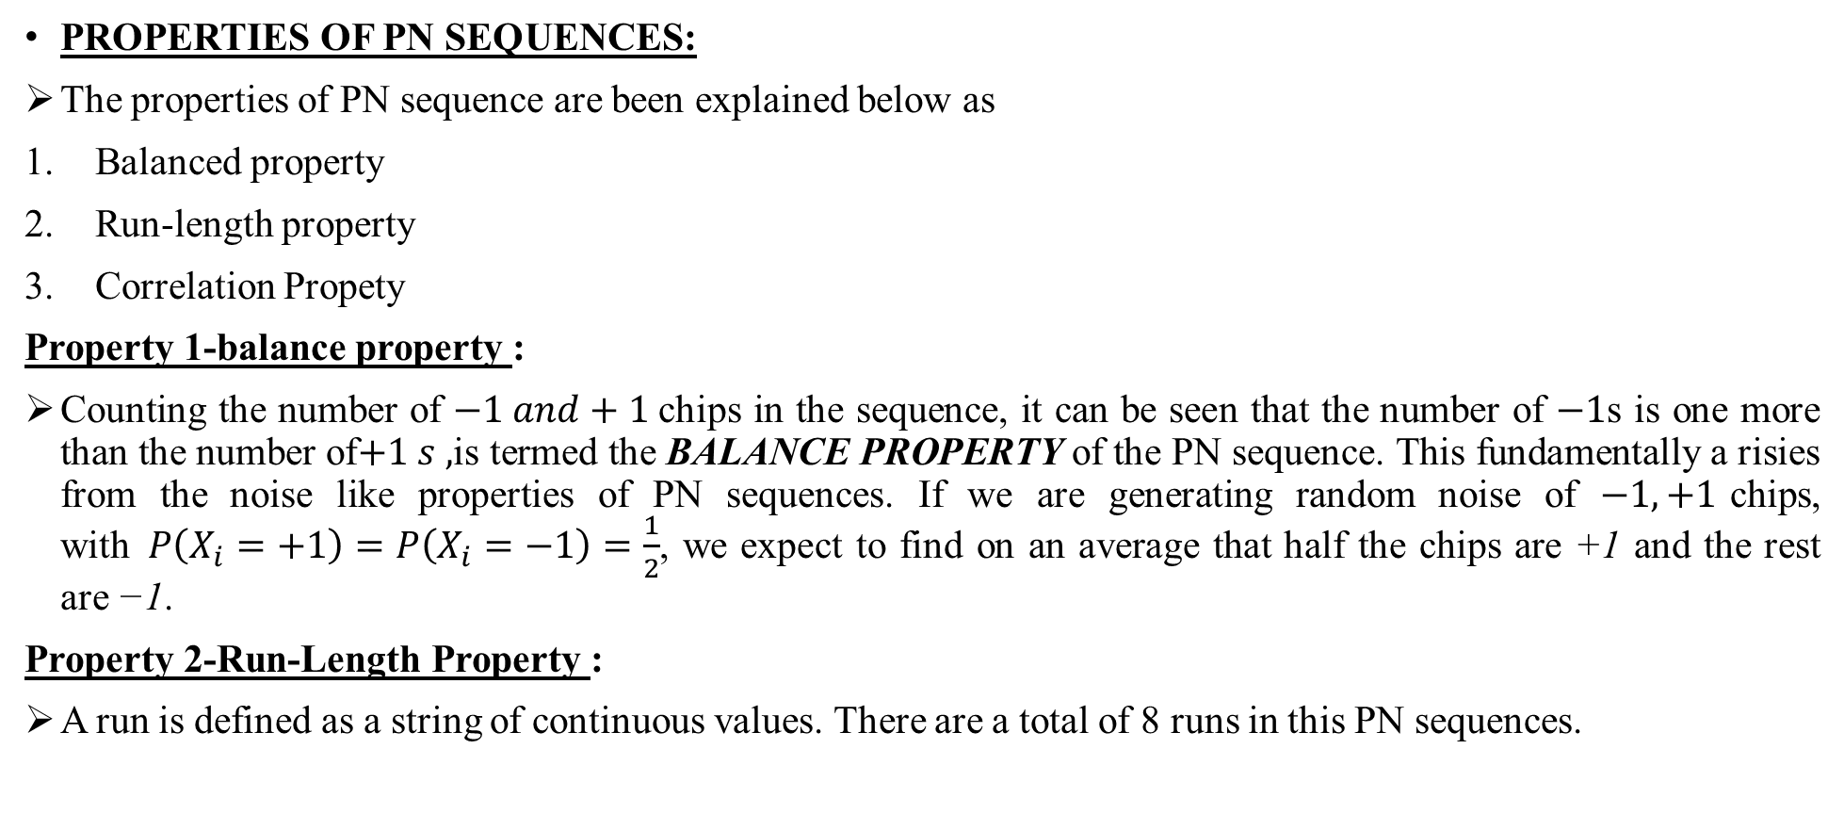
CODE DIVISION MULTIPLE ACCESS (CDMA)
PROPERTIES OF PN SEQUENCES:
The properties of PN sequence are been explained below as
Balanced property
Run-length property
Correlation Propety
Property 1-balance property :
Counting the number of $−1 and+1$chips in the sequence, it can be seen that the number of $−1$s is one more than the number of$+1 s ,$is termed the BALANCE PROPERTY of the PN sequence. This fundamentally a risies from the noise like properties of PN sequences. If we are generating random noise of $−1,+1$chips, with$P\left(X_{i}=+1\right)=P\left(X_{i}=−1\right)=\frac{1}{2}$, we expect to find on an average that half the chips are +1 and the rest are −1.
Property 2-Run-Length Property :
A run is defined as a string of continuous values. There are a total of 8 runs in this PN sequences.
Code Division Multiple Access Dr.Y.Mallikarjuna Rao 14-03-2023 04/35

Slide 7
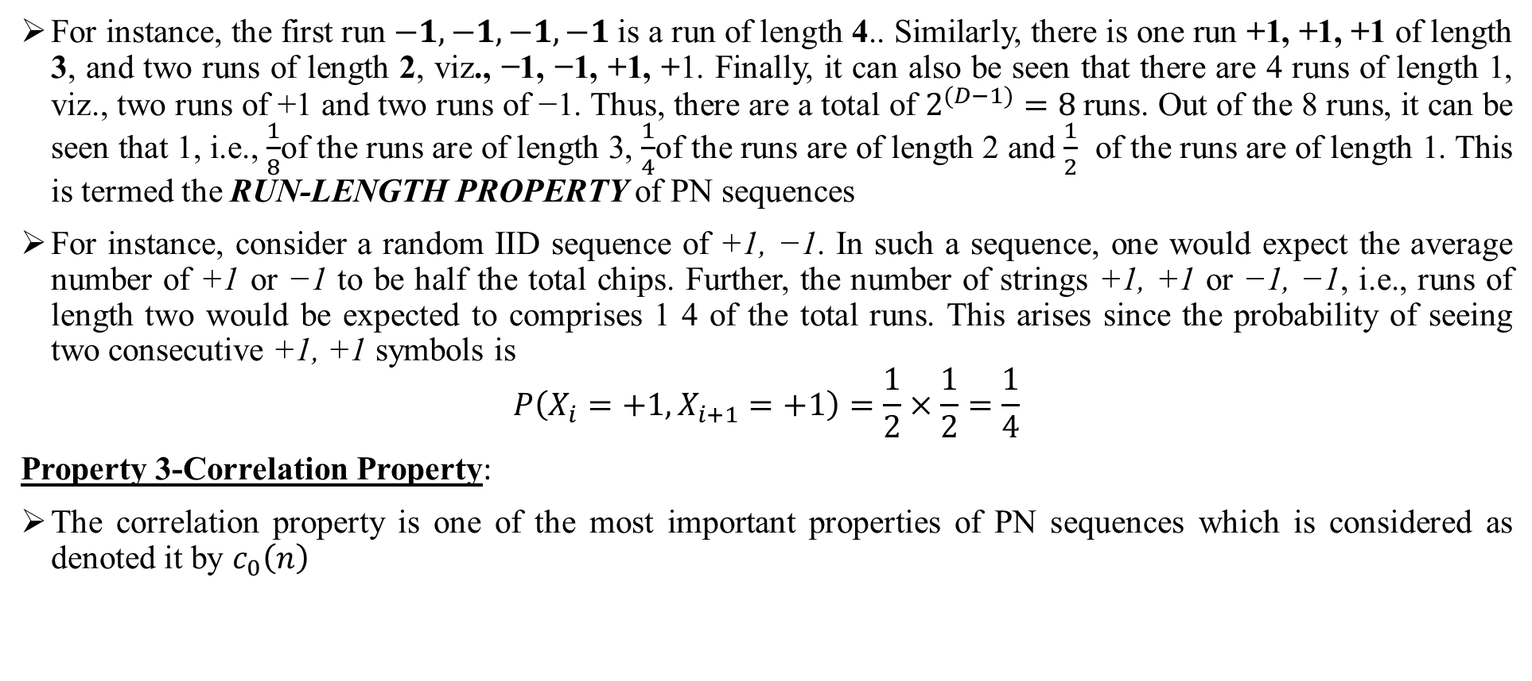
CODE DIVISION MULTIPLE ACCESS (CDMA)
For instance, the first run $−1, −1, −1, −1$is a run of length 4.. Similarly, there is one run +1, +1, +1 of length 3, and two runs of length 2, viz., −1, −1, +1, +1. Finally, it can also be seen that there are 4 runs of length 1, viz., two runs of +1 and two runs of −1. Thus, there are a total of $2^{(D−1)}=8$runs. Out of the 8 runs, it can be seen that 1, i.e., $\frac{1}{8}$of the runs are of length 3, $\frac{1}{4}$of the runs are of length 2 and $\frac{1}{2}$ of the runs are of length 1. This is termed the RUN-LENGTH PROPERTY of PN sequences
For instance, consider a random IID sequence of +1, −1. In such a sequence, one would expect the average number of +1 or −1 to be half the total chips. Further, the number of strings +1, +1 or −1, −1, i.e., runs of length two would be expected to comprises 1 4 of the total runs. This arises since the probability of seeing two consecutive +1, +1 symbols is
$$P\left(X_{i}=+1,X_{i+1}=+1\right)=\frac{1}{2}×\frac{1}{2}=\frac{1}{4}$$
Property 3-Correlation Property:
The correlation property is one of the most important properties of PN sequences which is considered as denoted it by $c_{0}\left(n\right)$
Code Division Multiple Access Dr.Y.Mallikarjuna Rao 14-03-2023 05/35

Slide 8
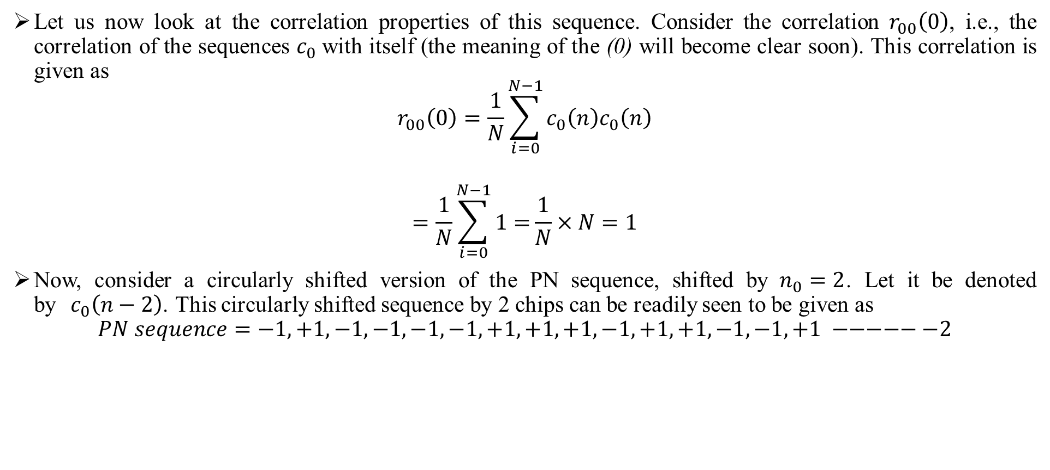
CODE DIVISION MULTIPLE ACCESS (CDMA)
Let us now look at the correlation properties of this sequence. Consider the correlation$r_{00}\left(0\right)$, i.e., the correlation of the sequences $c_{0}$with itself (the meaning of the (0) will become clear soon). This correlation is given as
$$r_{00}\left(0\right)=\frac{1}{N}\sum_{i=0}^{N−1}{c_{0}\left(n\right)c_{0}\left(n\right)}$$
$$=\frac{1}{N}\sum_{i=0}^{N−1}{1=}\frac{1}{N}×N=1$$
Now, consider a circularly shifted version of the PN sequence, shifted by$n_{0}=2$. Let it be denoted by${ c}_{0}\left(n−2\right)$. This circularly shifted sequence by 2 chips can be readily seen to be given as
$$PN sequence=−1,+1,−1,−1,−1,−1,+1,+1,+1,−1,+1,+1,−1,−1,+1 −−−−−−2$$
Code Division Multiple Access Dr.Y.Mallikarjuna Rao 14-03-2023 06/35

Slide 9
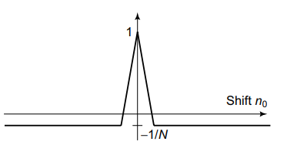
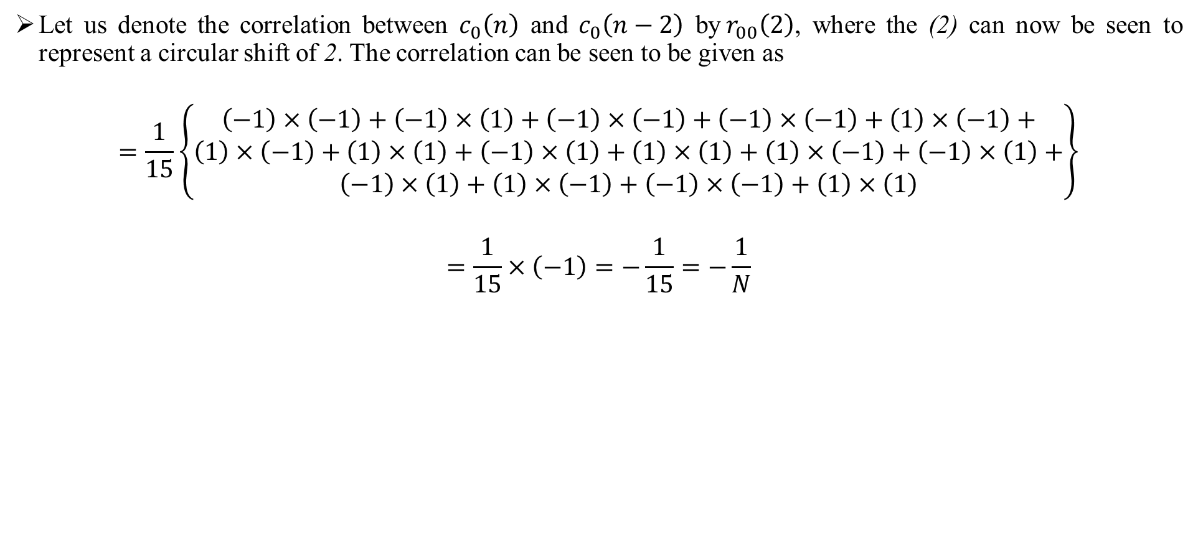
CODE DIVISION MULTIPLE ACCESS (CDMA)
Let us denote the correlation between $c_{0}\left(n\right)$ and $c_{0}\left(n−2\right)$ by$r_{00}\left(2\right)$, where the (2) can now be seen to represent a circular shift of 2. The correlation can be seen to be given as
$$=\frac{1}{15}\left\{\begin{aligned}\left(−1\right)×\left(−1\right)+\left(−1\right)×\left(1\right)+\left(−1\right)×\left(−1\right)+\left(−1\right)×\left(−1\right)+\left(1\right)×\left(−1\right)+ \\ \left(1\right)×\left(−1\right)+\left(1\right)×\left(1\right)+\left(−1\right)×\left(1\right)+\left(1\right)×\left(1\right)+\left(1\right)×\left(−1\right)+\left(−1\right)×\left(1\right)+ \\ \left(−1\right)×\left(1\right)+\left(1\right)×\left(−1\right)+\left(−1\right)×\left(−1\right)+\left(1\right)×\left(1\right)\end{aligned}\right\}$$
$$=\frac{1}{15}×\left(−1\right)=−\frac{1}{15}=−\frac{1}{N}$$
Figure 4: Autocorrelation of PN sequence
Code Division Multiple Access Dr.Y.Mallikarjuna Rao 14-03-2023 07/35

Slide 10
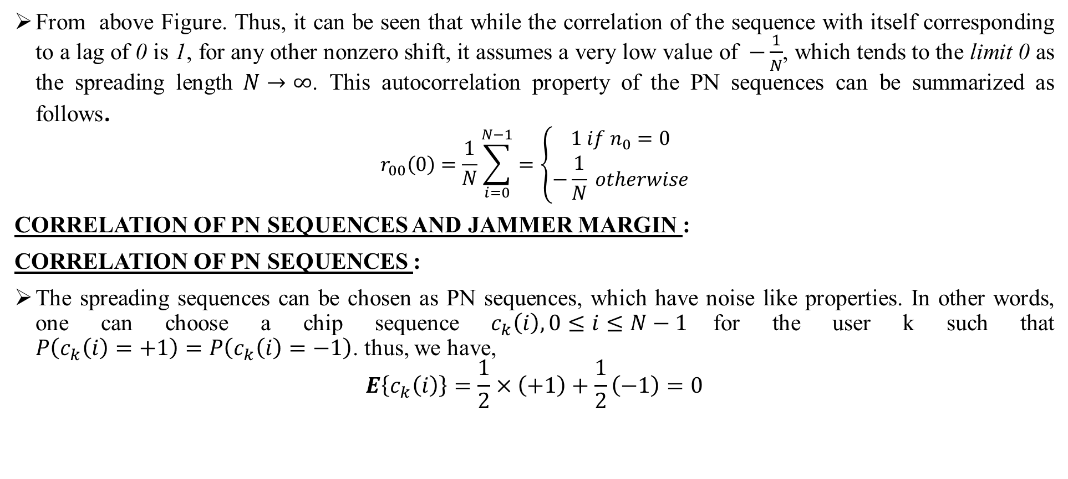
CODE DIVISION MULTIPLE ACCESS (CDMA)
From above Figure. Thus, it can be seen that while the correlation of the sequence with itself corresponding to a lag of 0 is 1, for any other nonzero shift, it assumes a very low value of$−\frac{1}{N}$, which tends to the limit 0 as the spreading length$N→∞$. This autocorrelation property of the PN sequences can be summarized as follows.
$$r_{00}\left(0\right)=\frac{1}{N}\sum_{i=0}^{N−1}{=\left\{\begin{aligned}1 if n_{0}=0 \\ −\frac{1}{N} otherwise\end{aligned}\right.}$$
CORRELATION OF PN SEQUENCES AND JAMMER MARGIN :
CORRELATION OF PN SEQUENCES :
The spreading sequences can be chosen as PN sequences, which have noise like properties. In other words, one can choose a chip sequence $c_{k}\left(i\right),0≤i≤N−1$for the user k such that $P\left(c_{k}\left(i\right)=+1\right)=P\left(c_{k}\left(i\right)=−1\right)$. thus, we have,
$$E\left\{c_{k}\left(i\right)\right\}=\frac{1}{2}×\left(+1\right)+\frac{1}{2}\left(−1\right)=0$$
Code Division Multiple Access Dr.Y.Mallikarjuna Rao 14-03-2023 08/35

Slide 11
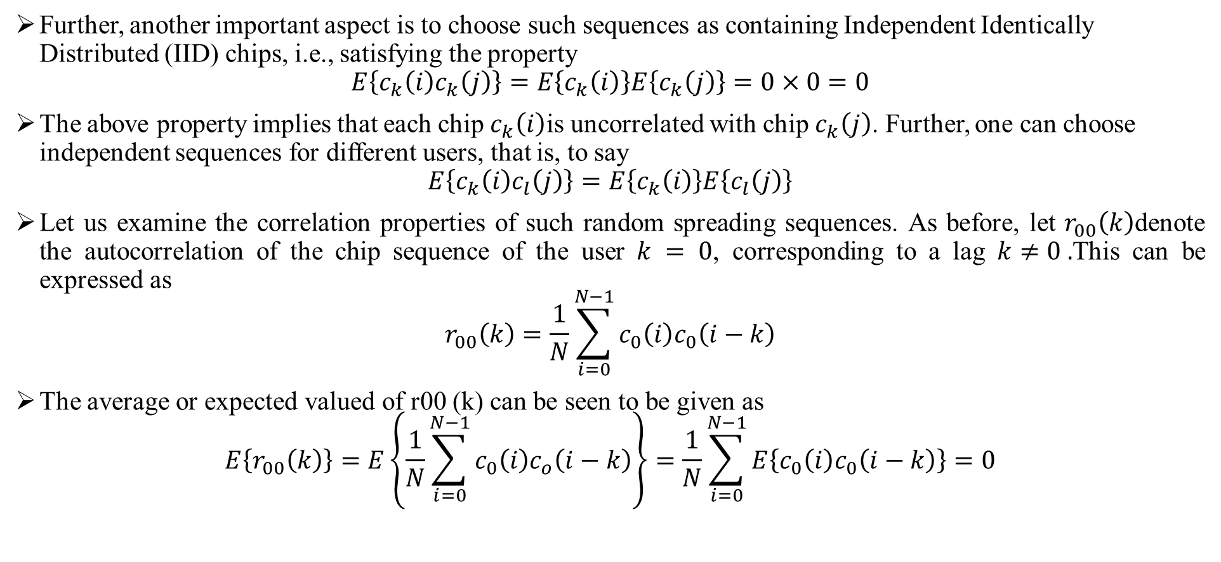
CODE DIVISION MULTIPLE ACCESS (CDMA)
Further, another important aspect is to choose such sequences as containing Independent Identically Distributed (IID) chips, i.e., satisfying the property
$$E\left\{c_{k}\left(i\right)c_{k}\left(j\right)\right\}=E\left\{c_{k}\left(i\right)\right\}E\left\{c_{k}\left(j\right)\right\}=0×0=0$$
The above property implies that each chip $c_{k}\left(i\right)$is uncorrelated with chip $c_{k}\left(j\right)$. Further, one can choose independent sequences for different users, that is, to say
$$E\left\{c_{k}\left(i\right)c_{l}\left(j\right)\right\}=E\left\{c_{k}\left(i\right)\right\}E\left\{c_{l}\left(j\right)\right\}$$
Let us examine the correlation properties of such random spreading sequences. As before, let $r_{00}\left(k\right)$denote the autocorrelation of the chip sequence of the user $k = 0$, corresponding to a lag $k≠0 .$This can be expressed as
$$r_{00}\left(k\right)=\frac{1}{N}\sum_{i=0}^{N−1}{c_{0}\left(i\right)c_{0}\left(i−k\right)}$$
The average or expected valued of r00 (k) can be seen to be given as
$$E\left\{r_{00}\left(k\right)\right\}=E\left\{\frac{1}{N}\sum_{i=0}^{N−1}{c_{0}\left(i\right)c_{o}\left(i−k\right)}\right\}=\frac{1}{N}\sum_{i=0}^{N−1}{E\left\{c_{0}\left(i\right)c_{0}\left(i−k\right)\right\}}=0$$
Code Division Multiple Access Dr.Y.Mallikarjuna Rao 14-03-2023 09/35

Slide 12
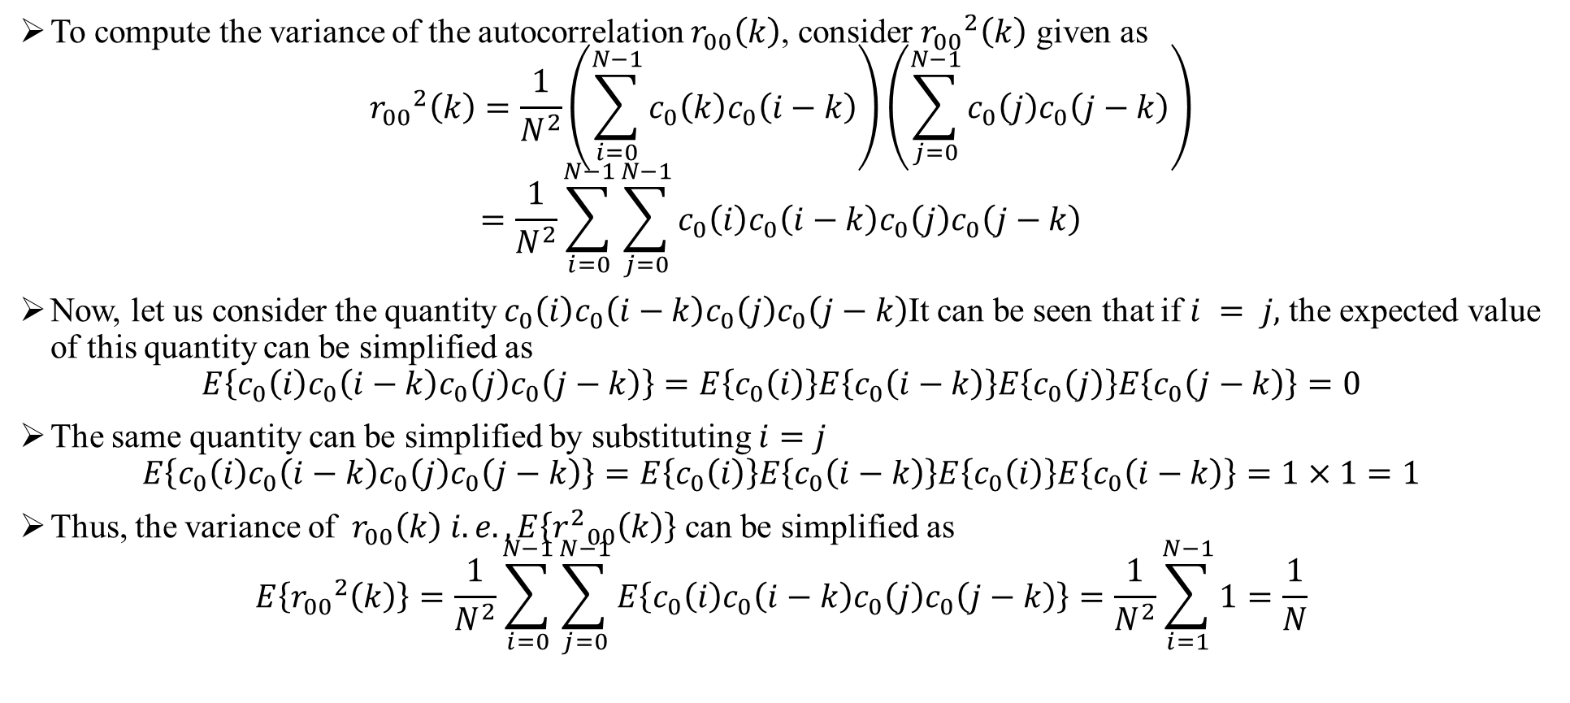
CODE DIVISION MULTIPLE ACCESS (CDMA)
To compute the variance of the autocorrelation $r_{00}\left(k\right)$, consider ${r_{00}}^{2}\left(k\right)$ given as
$${r_{00}}^{2}\left(k\right)=\frac{1}{N^{2}}\left(\sum_{i=0}^{N−1}{c_{0}\left(k\right)c_{0}\left(i−k\right)}\right)\left(\sum_{j=0}^{N−1}{c_{0}\left(j\right)c_{0}\left(j−k\right)}\right)$$
$$=\frac{1}{N^{2}}\sum_{i=0}^{N−1}{\sum_{j=0}^{N−1}{c_{0}\left(i\right)c_{0}\left(i−k\right)c_{0}\left(j\right)c_{0}\left(j−k\right)}}$$
Now, let us consider the quantity $c_{0}\left(i\right)c_{0}\left(i−k\right)c_{0}\left(j\right)c_{0}\left(j−k\right)$It can be seen that if $i = j,$ the expected value of this quantity can be simplified as
$$E\left\{c_{0}\left(i\right)c_{0}\left(i−k\right)c_{0}\left(j\right)c_{0}\left(j−k\right)\right\}=E\left\{c_{0}\left(i\right)\right\}E\left\{c_{0}\left(i−k\right)\right\}E\left\{c_{0}\left(j\right)\right\}E\left\{c_{0}\left(j−k\right)\right\}=0$$
The same quantity can be simplified by substituting $i=j$
$$E\left\{c_{0}\left(i\right)c_{0}\left(i−k\right)c_{0}\left(j\right)c_{0}\left(j−k\right)\right\}=E\left\{c_{0}\left(i\right)\right\}E\left\{c_{0}\left(i−k\right)\right\}E\left\{c_{0}\left(i\right)\right\}E\left\{c_{0}\left(i−k\right)\right\}=1×1=1$$
Thus, the variance of $r_{00}\left(k\right) i.e.,E\left\{{r^{2}}_{00}\left(k\right)\right\}$ can be simplified as
$$E\left\{{r_{00}}^{2}\left(k\right)\right\}=\frac{1}{N^{2}}\sum_{i=0}^{N−1}{\sum_{j=0}^{N−1}{E\left\{c_{0}\left(i\right)c_{0}\left(i−k\right)c_{0}\left(j\right)c_{0}\left(j−k\right)\right\}}}=\frac{1}{N^{2}}\sum_{i=1}^{N−1}{1}=\frac{1}{N}$$
Code Division Multiple Access Dr.Y.Mallikarjuna Rao 14-03-2023 10/35

Slide 13
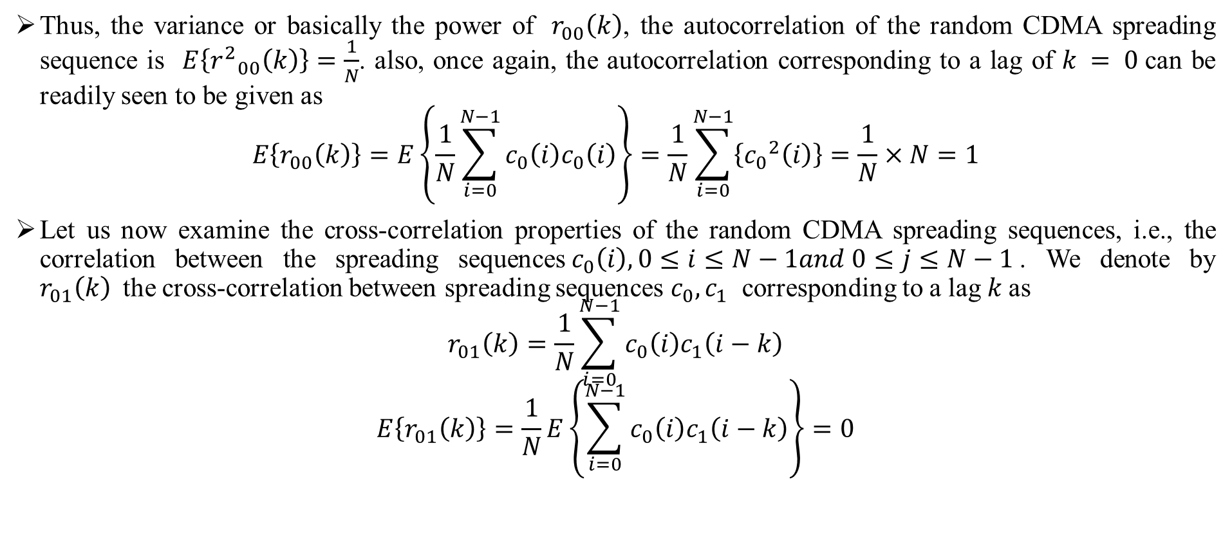
CODE DIVISION MULTIPLE ACCESS (CDMA)
Thus, the variance or basically the power of${ r}_{00}\left(k\right)$, the autocorrelation of the random CDMA spreading sequence is$E\left\{{r^{2}}_{00}\left(k\right)\right\}=\frac{1}{N}$. also, once again, the autocorrelation corresponding to a lag of $k = 0$can be readily seen to be given as
$$E\left\{r_{00}\left(k\right)\right\}=E\left\{\frac{1}{N}\sum_{i=0}^{N−1}{c_{0}\left(i\right)c_{0}\left(i\right)}\right\}=\frac{1}{N}\sum_{i=0}^{N−1}{\left\{{c_{0}}^{2}\left(i\right)\right\}}=\frac{1}{N}×N=1$$
Let us now examine the cross-correlation properties of the random CDMA spreading sequences, i.e., the correlation between the spreading sequences$c_{0}\left(i\right),0≤i≤N−1and 0≤j≤N−1$. We denote by $r_{01}\left(k\right)$the cross-correlation between spreading sequences $c_{0},c_{1}$ corresponding to a lag$k$as
$$r_{01}\left(k\right)=\frac{1}{N}\sum_{i=0}^{N−1}{c_{0}\left(i\right)c_{1}\left(i−k\right)}$$
$$E\left\{r_{01}\left(k\right)\right\}=\frac{1}{N}E\left\{\sum_{i=0}^{N−1}{c_{0}\left(i\right)c_{1}\left(i−k\right)}\right\}=0$$
Code Division Multiple Access Dr.Y.Mallikarjuna Rao 14-03-2023 11/35

Slide 14
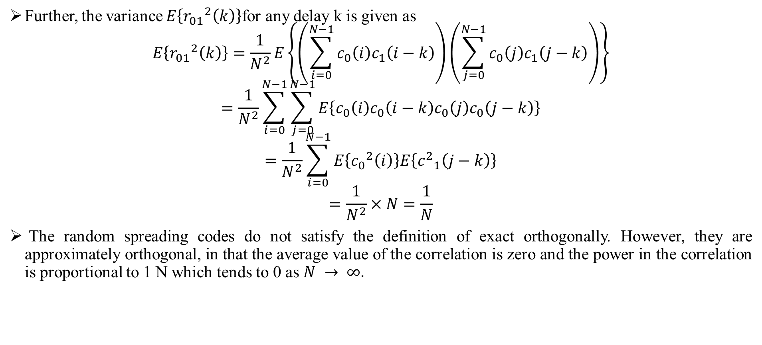
CODE DIVISION MULTIPLE ACCESS (CDMA)
Further, the variance $E\left\{{r_{01}}^{2}\left(k\right)\right\}$for any delay k is given as
$$E\left\{{r_{01}}^{2}\left(k\right)\right\}=\frac{1}{N^{2}}E\left\{\left(\sum_{i=0}^{N−1}{c_{0}\left(i\right)c_{1}\left(i−k\right)}\right)\left(\sum_{j=0}^{N−1}{c_{0}\left(j\right)c_{1}\left(j−k\right)}\right)\right\}$$
$$=\frac{1}{N^{2}}\sum_{i=0}^{N−1}{\sum_{j=0}^{N−1}{E\left\{c_{0}\left(i\right)c_{0}\left(i−k\right)c_{0}\left(j\right)c_{0}\left(j−k\right)\right\}}}$$
$$=\frac{1}{N^{2}}\sum_{i=0}^{N−1}{E\left\{{c_{0}}^{2}\left(i\right)\right\}E\left\{{c^{2}}_{1}\left(j−k\right)\right\}}$$
$$=\frac{1}{N^{2}}×N=\frac{1}{N}$$
The random spreading codes do not satisfy the definition of exact orthogonally. However, they are approximately orthogonal, in that the average value of the correlation is zero and the power in the correlation is proportional to 1 N which tends to 0 as $N → ∞.$
Code Division Multiple Access Dr.Y.Mallikarjuna Rao 14-03-2023 12/35

Slide 15
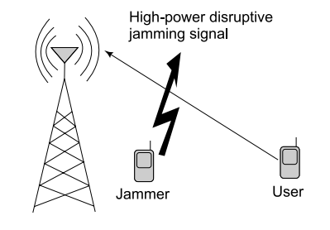

CODE DIVISION MULTIPLE ACCESS (CDMA)
JAMMEER MARGIN:
An important advantage of CDMA over conventional cellular systems is jammer suppression. A jammer is basically a malicious user in a communication network who transmits with a very high power to cause interference, thus leading to disruption of communication links. This is shown schematically in figure 5.
The effect of jammer suppression in a CDMA system can be understood as follows. Consider a communication system in which the signal $X\left(n\right)$ of the power $P$ is received in the presence of additive white Gaussian noise $w (n)$ of power ${σ_{w}}^{2}$. The baseband system model for this communication system can be expressed as
$$y\left(n\right)=x\left(n\right)+w\left(n\right)$$
Hence, the SNR at the receiver is$SNR=\frac{p}{{σ_{w}}^{2}}$. However, in the presence of a jamming signal $x_{j}\left(n\right)$of power $P_{j}$, the received signal $y\left(n\right)$is
$$y\left(n\right)=x\left(n\right)+x_{j}\left(n\right)+w\left(n\right)$$
Figure 5 :Disruption by jammer in wireless communication
Code Division Multiple Access Dr.Y.Mallikarjuna Rao 14-03-2023 13/35

Slide 16
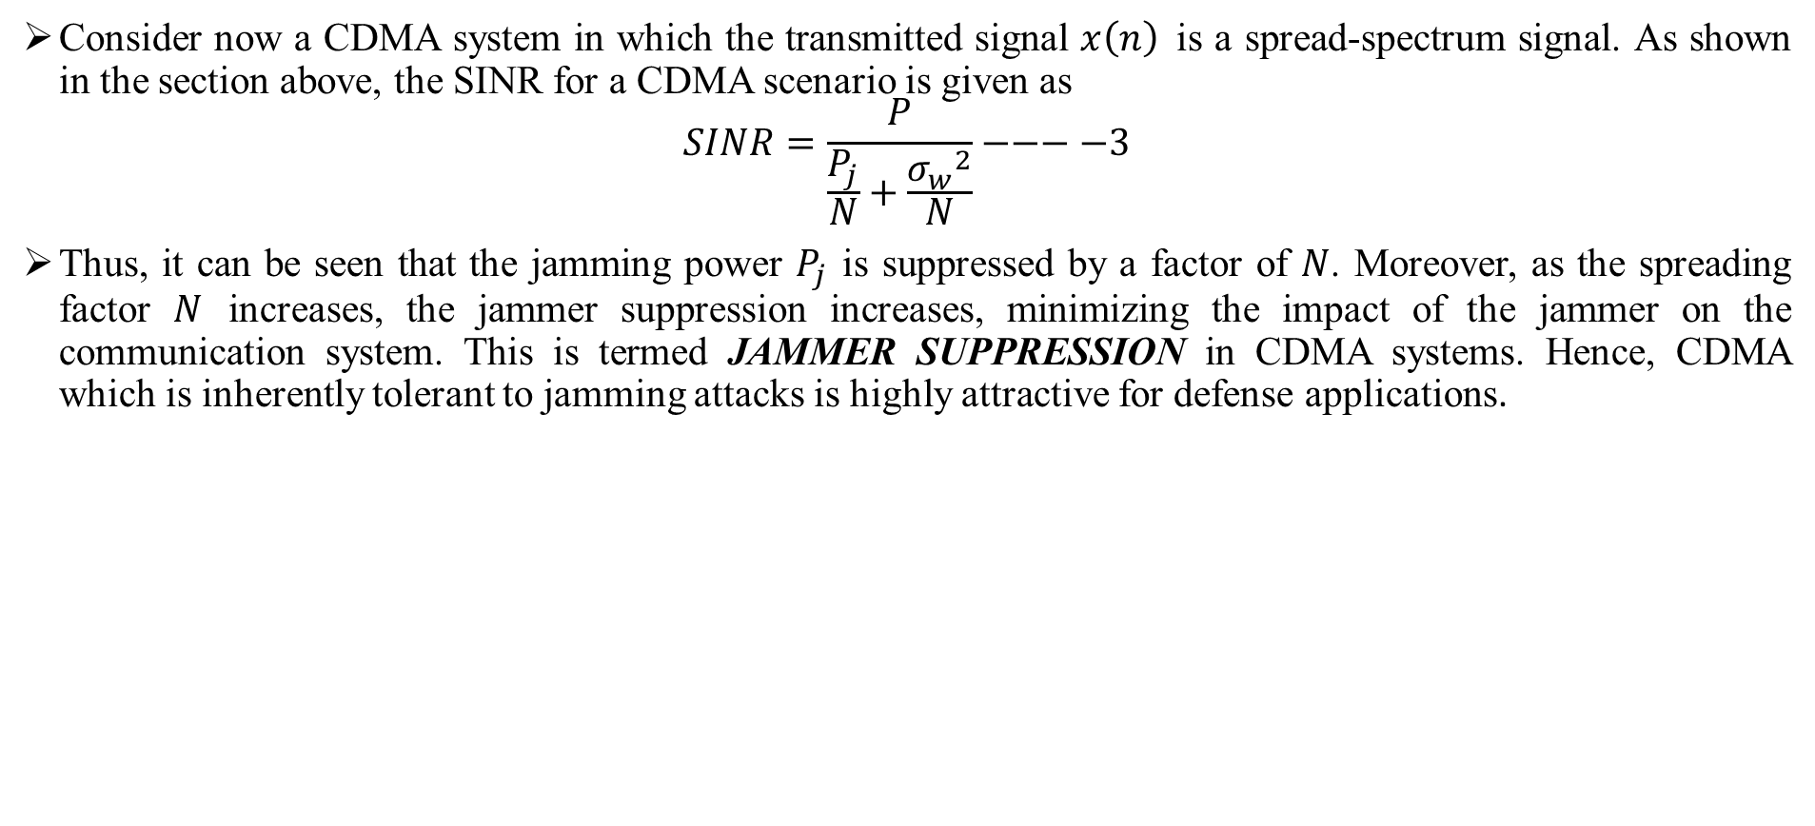
CODE DIVISION MULTIPLE ACCESS (CDMA)
Consider now a CDMA system in which the transmitted signal $x\left(n\right)$is a spread-spectrum signal. As shown in the section above, the SINR for a CDMA scenario is given as
$$SINR=\frac{P}{\frac{P_{j}}{N}+\frac{{σ_{w}}^{2}}{N}}−−−−3$$
Thus, it can be seen that the jamming power $P_{j}$ is suppressed by a factor of $N$. Moreover, as the spreading factor $N$ increases, the jammer suppression increases, minimizing the impact of the jammer on the communication system. This is termed JAMMER SUPPRESSION in CDMA systems. Hence, CDMA which is inherently tolerant to jamming attacks is highly attractive for defense applications.
Code Division Multiple Access Dr.Y.Mallikarjuna Rao 14-03-2023 14/35

Slide 17
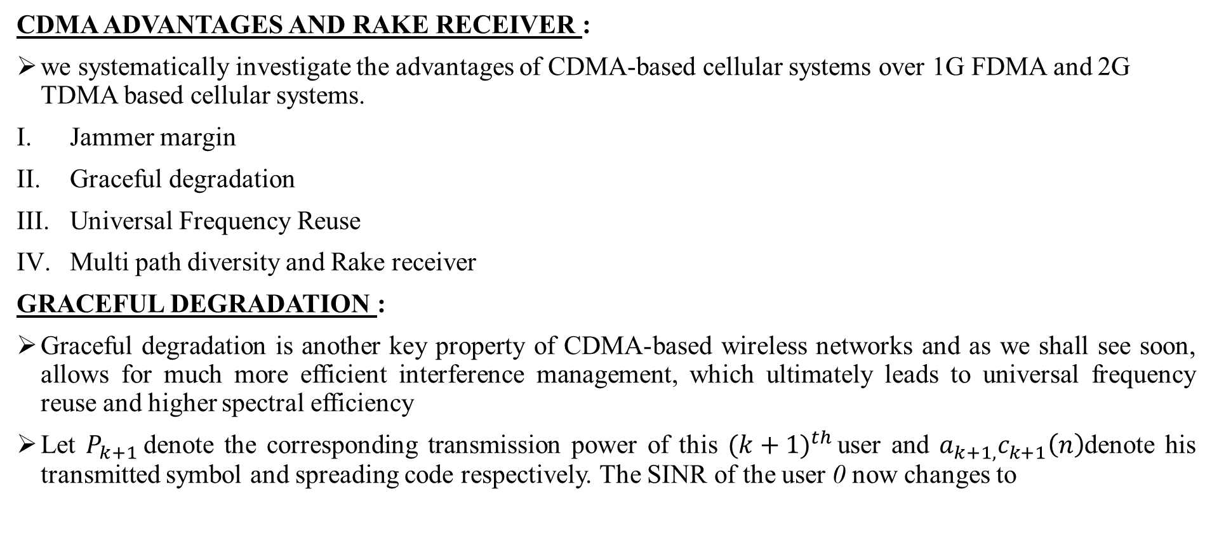
CODE DIVISION MULTIPLE ACCESS (CDMA)
CDMA ADVANTAGES AND RAKE RECEIVER :
we systematically investigate the advantages of CDMA-based cellular systems over 1G FDMA and 2G TDMA based cellular systems.
Jammer margin
Graceful degradation
Universal Frequency Reuse
Multi path diversity and Rake receiver
GRACEFUL DEGRADATION :
Graceful degradation is another key property of CDMA-based wireless networks and as we shall see soon, allows for much more efficient interference management, which ultimately leads to universal frequency reuse and higher spectral efficiency
Let $P_{k+1}$denote the corresponding transmission power of this ${(k+1)}^{th }$user and $a_{k+1,}c_{k+1}\left(n\right)$denote his transmitted symbol and spreading code respectively. The SINR of the user 0 now changes to
Code Division Multiple Access Dr.Y.Mallikarjuna Rao 14-03-2023 15/35

Slide 18
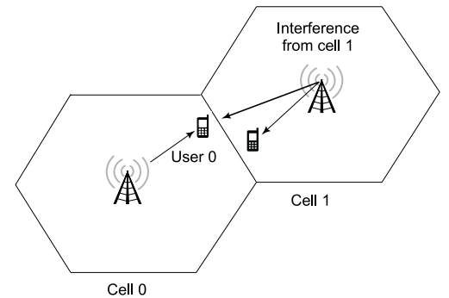
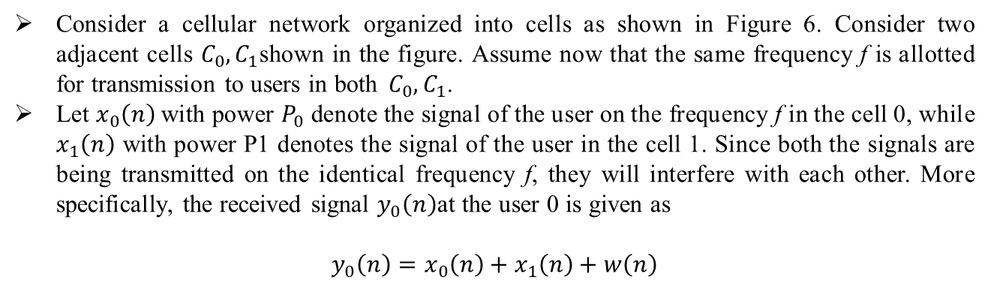

CODE DIVISION MULTIPLE ACCESS (CDMA)
$$SINR=\frac{p_{0}}{\frac{P_{1}}{N}+\frac{P_{2}}{N}+…+\frac{P_{K}}{N}+\frac{P_{K+1}}{N}+\frac{{σ_{n}}^{2}}{N}}=N×\frac{P_{0}}{\sum_{K=0}^{k+1}{P_{K}+{σ^{2}}_{n}}}$$
Further, in general, at any user i = (K + 1), the additional interference due to the introduction of this new user is PK+1 N . Therefore, the addition of the new user K + 1 does not adversely affect any single user. Rather, the additional interference caused by this new user is shared amongst all the existing users in the system leading to interference distribution. This sharing of the interference by all the existing users leads to a graceful degradation of the SINR at each user. This is termed the graceful degradation property of CDMA systems.
UNIVERSAL FREQUENCY REUSE:
Consider a cellular network organized into cells as shown in Figure 6. Consider two adjacent cells $C_{0},C_{1}$shown in the figure. Assume now that the same frequency f is allotted for transmission to users in both${ C}_{0},C_{1}$.
Let $x_{0}\left(n\right)$with power $P_{0}$denote the signal of the user on the frequency f in the cell 0, while $x_{1}\left(n\right)$ with power P1 denotes the signal of the user in the cell 1. Since both the signals are being transmitted on the identical frequency f, they will interfere with each other. More specifically, the received signal $y_{0}\left(n\right)$at the user 0 is given as
$$y_{0}\left(n\right)=x_{0}\left(n\right)+x_{1}\left(n\right)+w\left(n\right)$$
Figure 6: Intercell interference for the user 0 on the cell edge
Code Division Multiple Access Dr.Y.Mallikarjuna Rao 14-03-2023 16/35

Slide 19
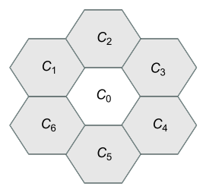
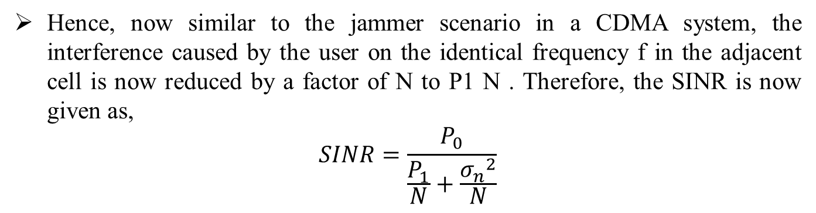

CODE DIVISION MULTIPLE ACCESS (CDMA)
For instance, as can be seen from the hexagonal-lattice based cellular structure in Figure 7, each hexagonal cell has 6 neighbours. Hence, to avoid adjacent cell interference, any of the frequencies allocated to $C_{0}$cannot be allocated to its neighbors $C_{0}.C_{1}…C_{6}.$This holds true for all the cells in the network. Hence, only 1 7 of the total available frequency bands can be allocated to each cell. This factor $\frac{1}{7}$is termed the frequency-reuse factor of the cellular network.
Thus, since only a fraction of the frequencies are used in the cell, the total spectral efficiency is proportional to the frequency-reuse factor, resulting in a rate which is $\frac{1}{7}$ compared to that of using all the available bandwidth, since the capacity is linearly related to bandwidth.
Hence, now similar to the jammer scenario in a CDMA system, the interference caused by the user on the identical frequency f in the adjacent cell is now reduced by a factor of N to P1 N . Therefore, the SINR is now given as,
$$SINR=\frac{P_{0}}{\frac{P_{1}}{N}+\frac{{σ_{n}}^{2}}{N}}$$
Figure 6: Grid or lattice of hexagonal cells
Code Division Multiple Access Dr.Y.Mallikarjuna Rao 14-03-2023 17/35

Slide 20
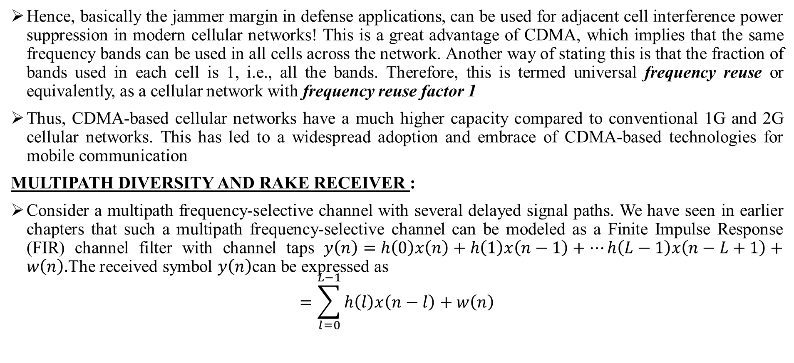
CODE DIVISION MULTIPLE ACCESS (CDMA)
Hence, basically the jammer margin in defense applications, can be used for adjacent cell interference power suppression in modern cellular networks! This is a great advantage of CDMA, which implies that the same frequency bands can be used in all cells across the network. Another way of stating this is that the fraction of bands used in each cell is 1, i.e., all the bands. Therefore, this is termed universal frequency reuse or equivalently, as a cellular network with frequency reuse factor 1
Thus, CDMA-based cellular networks have a much higher capacity compared to conventional 1G and 2G cellular networks. This has led to a widespread adoption and embrace of CDMA-based technologies for mobile communication
MULTIPATH DIVERSITY AND RAKE RECEIVER :
Consider a multipath frequency-selective channel with several delayed signal paths. We have seen in earlier chapters that such a multipath frequency-selective channel can be modeled as a Finite Impulse Response (FIR) channel filter with channel taps $y\left(n\right)=h\left(0\right)x\left(n\right)+h\left(1\right)x\left(n−1\right)+…h\left(L−1\right)x\left(n−L+1\right)+w\left(n\right).$The received symbol $y\left(n\right)$can be expressed as
$$=\sum_{l=0}^{L−1}{h\left(l\right)x\left(n−l\right)+w\left(n\right)}$$
Code Division Multiple Access Dr.Y.Mallikarjuna Rao 14-03-2023 18/35

Slide 21
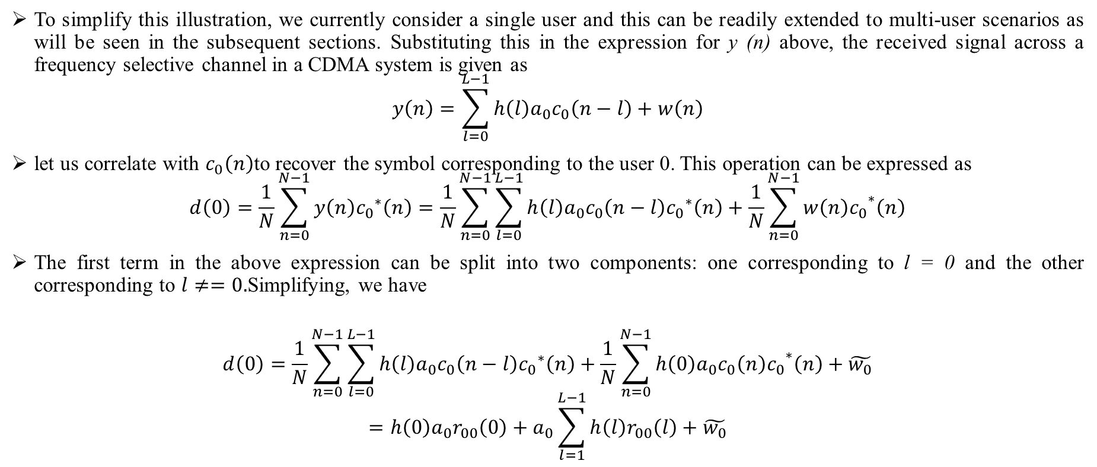
CODE DIVISION MULTIPLE ACCESS (CDMA)
To simplify this illustration, we currently consider a single user and this can be readily extended to multi-user scenarios as will be seen in the subsequent sections. Substituting this in the expression for y (n) above, the received signal across a frequency selective channel in a CDMA system is given as
$$y\left(n\right)=\sum_{l=0}^{L−1}{h\left(l\right)a_{0}c_{0}\left(n−l\right)+w\left(n\right)}$$
let us correlate with $c_{0}\left(n\right)$to recover the symbol corresponding to the user 0. This operation can be expressed as
$$d\left(0\right)=\frac{1}{N}\sum_{n=0}^{N−1}{y\left(n\right){c_{0}}_{}^{∗}\left(n\right)}=\frac{1}{N}\sum_{n=0}^{N−1}{\sum_{l=0}^{L−1}{h\left(l\right)a_{0}c_{0}\left(n−l\right){c_{0}}_{}^{∗}\left(n\right)+\frac{1}{N}\sum_{n=0}^{N−1}{{{w\left(n\right)c}_{0}}_{}^{∗}\left(n\right)}}}$$
The first term in the above expression can be split into two components: one corresponding to l = 0 and the other corresponding to $l≠=0.$Simplifying, we have
$$d\left(0\right)=\frac{1}{N}\sum_{n=0}^{N−1}{\sum_{l=0}^{L−1}{h\left(l\right)a_{0}c_{0}\left(n−l\right){c_{0}}_{}^{∗}\left(n\right)+\frac{1}{N}\sum_{n=0}^{N−1}{{{h\left(0\right)a_{0}c_{0}\left(n\right)c}_{0}}_{}^{∗}\left(n\right)}}}+\tilde{w_{0}}$$
$$=h\left(0\right)a_{0}r_{00}\left(0\right)+a_{0}\sum_{l=1}^{L−1}{h\left(l\right)r_{00}\left(l\right)+\tilde{w_{0}}}$$
Code Division Multiple Access Dr.Y.Mallikarjuna Rao 14-03-2023 19/35

Slide 22
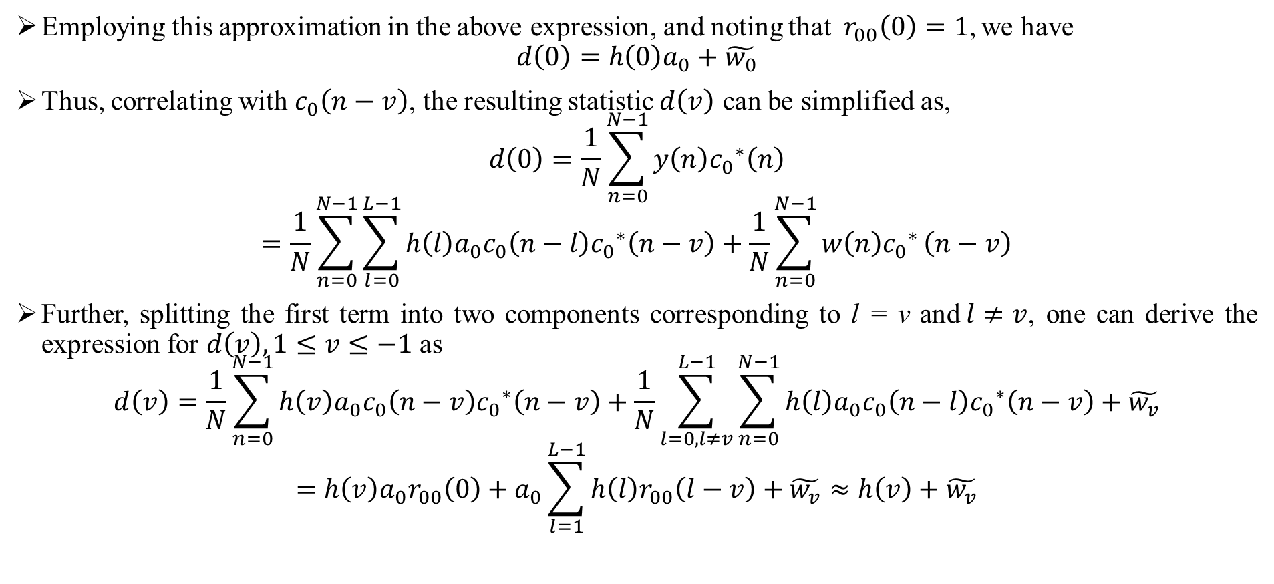
CODE DIVISION MULTIPLE ACCESS (CDMA)
Employing this approximation in the above expression, and noting that$r_{00}\left(0\right)=1$, we have
$$d\left(0\right)=h\left(0\right)a_{0}+\tilde{w_{0}}$$
Thus, correlating with $c_{0}\left(n−v\right)$, the resulting statistic $d\left(v\right)$ can be simplified as,
$$d\left(0\right)=\frac{1}{N}\sum_{n=0}^{N−1}{y\left(n\right){c_{0}}_{}^{∗}\left(n\right)}$$
$$=\frac{1}{N}\sum_{n=0}^{N−1}{\sum_{l=0}^{L−1}{h\left(l\right)a_{0}c_{0}\left(n−l\right){c_{0}}_{}^{∗}\left(n−v\right)+\frac{1}{N}\sum_{n=0}^{N−1}{w\left(n\right){c_{0}}_{}^{∗}}}}\left(n−v\right)$$
Further, splitting the first term into two components corresponding to l = v and$l≠v$, one can derive the expression for $d\left(v\right),1≤v≤−1$as
$$d\left(v\right)=\frac{1}{N}\sum_{n=0}^{N−1}{h\left(v\right)a_{0}c_{0}\left(n−v\right){c_{0}}_{}^{∗}\left(n−v\right)}+\frac{1}{N}\sum_{l=0,l≠v}^{L−1}{\sum_{n=0}^{N−1}{h\left(l\right)a_{0}c_{0}\left(n−l\right){c_{0}}_{}^{∗}\left(n−v\right)+\tilde{w_{v}}}}$$
$$=h\left(v\right)a_{0}r_{00}\left(0\right)+a_{0}\sum_{l=1}^{L−1}{h\left(l\right)r_{00}\left(l−v\right)+\tilde{w_{v}}}≈h\left(v\right)+\tilde{w_{v}}$$
Code Division Multiple Access Dr.Y.Mallikarjuna Rao 14-03-2023 20/35

Slide 23
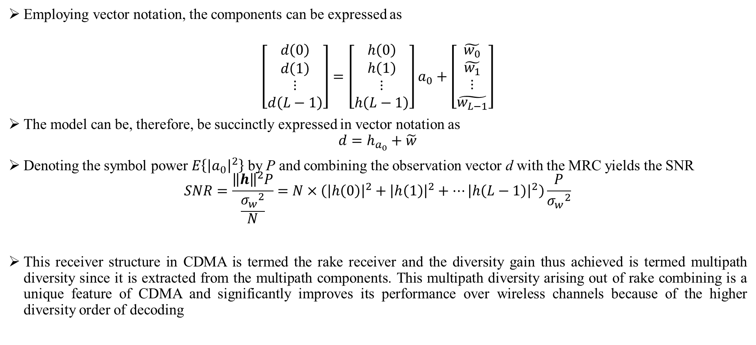
CODE DIVISION MULTIPLE ACCESS (CDMA)
Employing vector notation, the components can be expressed as
$$\left[\begin{matrix}d\left(0\right) \\ \begin{matrix}d\left(1\right) \\ \begin{matrix}⋮ \\ d\left(L−1\right)\end{matrix}\end{matrix}\end{matrix}\right]=\left[\begin{matrix}h\left(0\right) \\ \begin{matrix}h\left(1\right) \\ ⋮ \\ h\left(L−1\right)\end{matrix}\end{matrix}\right]a_{0}+\left[\begin{matrix}\tilde{w_{0}} \\ \tilde{w_{1}} \\ \begin{matrix}⋮ \\ \tilde{w_{L−1}}\end{matrix}\end{matrix}\right]$$
The model can be, therefore, be succinctly expressed in vector notation as
$$d=h_{a_{0}}+\tilde{w}$$
Denoting the symbol power $E\left\{{\left|a_{0}\right|}^{2}\right\}$ by P and combining the observation vector d with the MRC yields the SNR
$$SNR=\frac{{\left\|h\right\|}^{2}P}{\frac{{σ_{w}}_{}^{2}}{N}}=N×\left({\left|h\left(0\right)\right|}^{2}+{\left|h\left(1\right)\right|}^{2}+…{\left|h\left(L−1\right)\right|}^{2}\right)\frac{P}{{σ_{w}}_{}^{2}}$$
This receiver structure in CDMA is termed the rake receiver and the diversity gain thus achieved is termed multipath diversity since it is extracted from the multipath components. This multipath diversity arising out of rake combining is a unique feature of CDMA and significantly improves its performance over wireless channels because of the higher diversity order of decoding
Code Division Multiple Access Dr.Y.Mallikarjuna Rao 14-03-2023 21/35

Slide 24
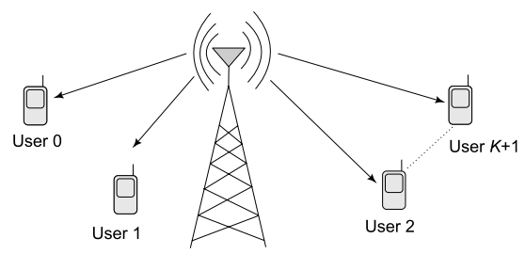

CODE DIVISION MULTIPLE ACCESS (CDMA)
MULTIPLE USERS CDMA DOWNLINK SCENARIO :
Consider the downlink scenario schematically from Figure 7, where the CDMA base station is transmitting to K + 1 users indexed 0, 1, . . . , K. Let the information symbols transmitted to the K + 1 users be$a_{0},a_{1},…,a_{k+1}$. Let $c_{0}\left(n\right),c_{1}\left(n\right)…,c_{k+1}\left(n\right)$ be the spreading codes corresponding to the K + 1 users. Thus, the individual transmit signal $x_{k}\left(m\right)$, $0≤k≤K$is formed by $x_{k}\left(m\right)=a_{k}c_{k}\left(m\right)$.The composite signal corresponding to all the users is obtained by adding the individual signals corresponding to the K + 1 users,
$$x\left(n\right)=x_{0}\left(n\right)+x_{1}\left(n\right)+…x_{k}\left(n\right)$$
$$=\sum_{k=0}^{K}{x_{k}\left(n\right)=\sum_{k=0}^{K}{a_{k}c_{k}\left(n\right)}}$$
Thus, the inter-symbol-interference-affected received symbol $y_{0}\left(n\right)$ at the user 0 corresponding to time instant n is given as
$$y\left(n\right)=h_{0}\left(n\right)x\left(n\right)+h_{0}\left(1\right)x\left(n−1\right)+…+h_{0}\left(L−1\right)x\left(n−L+1\right)+w\left(n\right)$$
$$=\sum_{l=0}^{L−1}{h_{0}\left(l\right)x\left(n−l\right)+w\left(n\right)−−−−−4}$$
Figure 7: CDMA downlink scenario
Code Division Multiple Access Dr.Y.Mallikarjuna Rao 14-03-2023 22/35

Slide 25
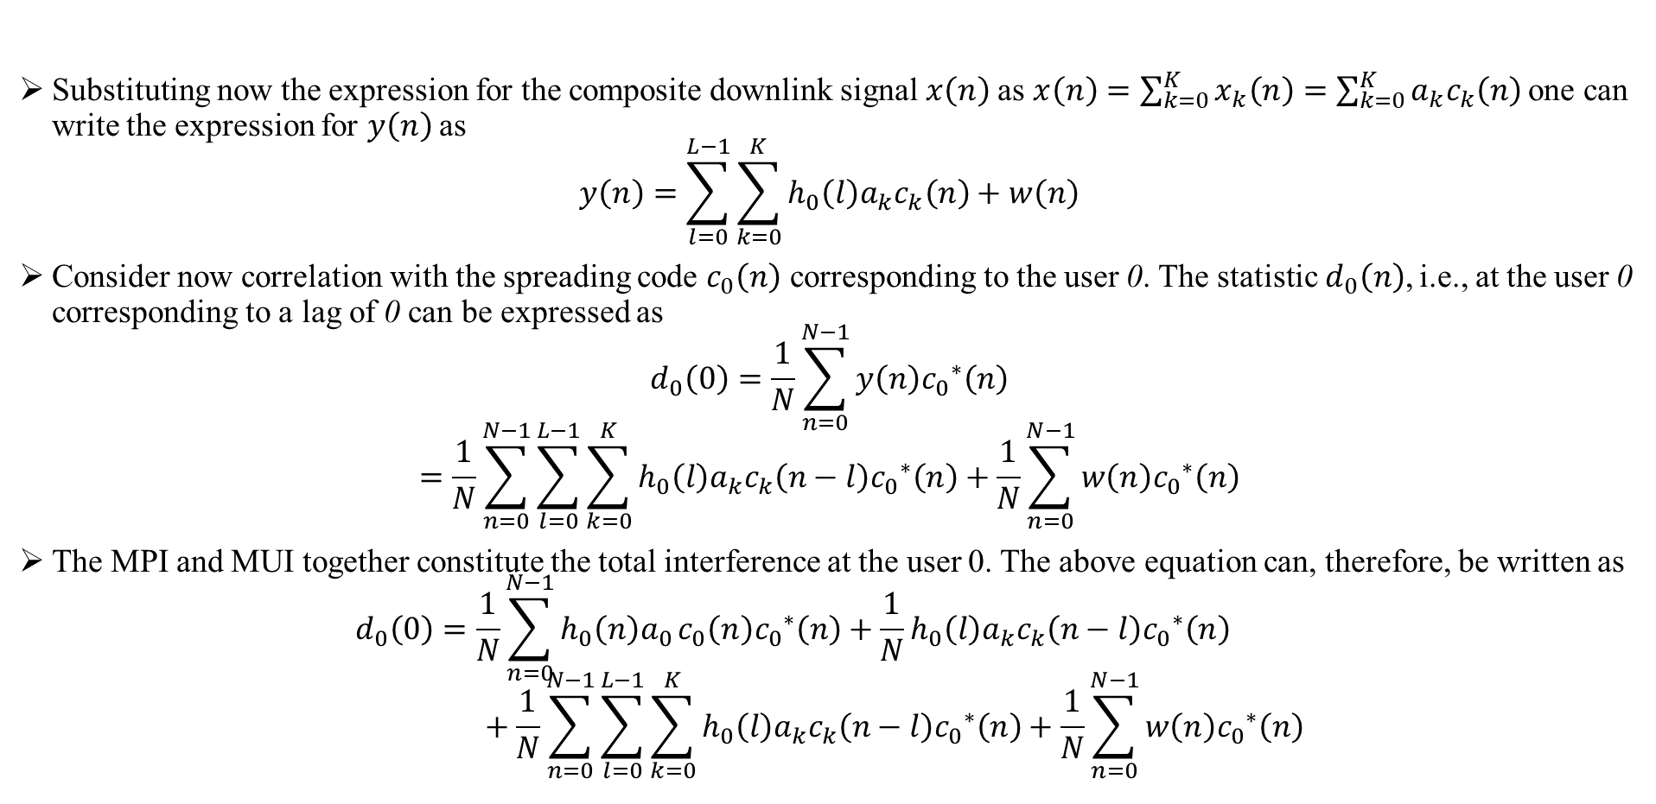
CODE DIVISION MULTIPLE ACCESS (CDMA)
Substituting now the expression for the composite downlink signal $x\left(n\right)$as $x\left(n\right)=\sum_{k=0}^{K}{x_{k}\left(n\right)=\sum_{k=0}^{K}{a_{k}c_{k}\left(n\right)} }$one can write the expression for $y\left(n\right)$as
$$y\left(n\right)=\sum_{l=0}^{L−1}{\sum_{k=0}^{K}{h_{0}\left(l\right)a_{k}c_{k}\left(n\right)+w\left(n\right)}}$$
Consider now correlation with the spreading code $c_{0}\left(n\right)$ corresponding to the user 0. The statistic$d_{0}\left(n\right)$, i.e., at the user 0 corresponding to a lag of 0 can be expressed as
$$d_{0}\left(0\right)=\frac{1}{N}\sum_{n=0}^{N−1}{y\left(n\right){c_{0}}_{}^{∗}\left(n\right)}$$
$$=\frac{1}{N}\sum_{n=0}^{N−1}{\sum_{l=0}^{L−1}{\sum_{k=0}^{K}{h_{0}\left(l\right)a_{k}c_{k}\left(n−l\right){c_{0}}_{}^{∗}\left(n\right)+\frac{1}{N}\sum_{n=0}^{N−1}{w\left(n\right){c_{0}}_{}^{∗}\left(n\right)}}}}$$
The MPI and MUI together constitute the total interference at the user 0. The above equation can, therefore, be written as
$$d_{0}\left(0\right)=\frac{1}{N}\sum_{n=0}^{N−1}{h_{0}\left(n\right)a_{0}}c_{0}\left(n\right){c_{0}}_{}^{∗}\left(n\right)+\frac{1}{N}h_{0}\left(l\right)a_{k}c_{k}\left(n−l\right){c_{0}}_{}^{∗}\left(n\right)+\frac{1}{N}\sum_{n=0}^{N−1}{\sum_{l=0}^{L−1}{\sum_{k=0}^{K}{h_{0}\left(l\right)a_{k}c_{k}\left(n−l\right){c_{0}}_{}^{∗}\left(n\right)+\frac{1}{N}\sum_{n=0}^{N−1}{w\left(n\right){c_{0}}_{}^{∗}\left(n\right)}}}}$$
Code Division Multiple Access Dr.Y.Mallikarjuna Rao 14-03-2023 23/35

Slide 26
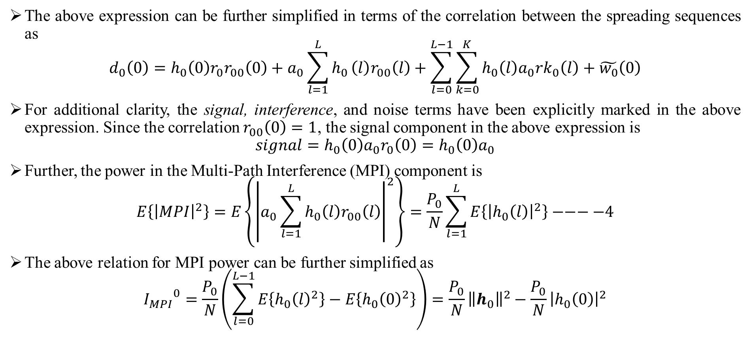
CODE DIVISION MULTIPLE ACCESS (CDMA)
The above expression can be further simplified in terms of the correlation between the spreading sequences as
$$d_{0}\left(0\right)=h_{0}\left(0\right)r_{0}r_{00}\left(0\right)+a_{0}\sum_{l=1}^{L}{h_{0}}\left(l\right)r_{00}\left(l\right)+\sum_{l=0}^{L−1}{\sum_{k=0}^{K}{h_{0}\left(l\right)a_{0}rk_{0}\left(l\right)+\tilde{w_{0}}\left(0\right)}}$$
For additional clarity, the signal, interference, and noise terms have been explicitly marked in the above expression. Since the correlation $r_{00}\left(0\right)=1$, the signal component in the above expression is
$$signal=h_{0}\left(0\right)a_{0}r_{0}\left(0\right)=h_{0}\left(0\right)a_{0}$$
Further, the power in the Multi-Path Interference (MPI) component is
$$E\left\{{\left|MPI\right|}^{2}\right\}=E\left\{{\left|a_{0}\sum_{l=1}^{L}{h_{0}\left(l\right)r_{00}\left(l\right)}\right|}^{2}\right\}=\frac{P_{0}}{N}\sum_{l=1}^{L}{E\left\{{\left|h_{0}\left(l\right)\right|}^{2}\right\}−−−−4}$$
The above relation for MPI power can be further simplified as
$${I_{MPI}}^{0}=\frac{P_{0}}{N}\left(\sum_{l=0}^{L−1}{E\left\{{h_{0}\left(l\right)}^{2}\right\}−E\left\{{h_{0}\left(0\right)}^{2}\right\}}\right)=\frac{P_{0}}{N}{\left\|h_{0}\right\|}^{2}−\frac{P_{0}}{N}{\left|h_{0}\left(0\right)\right|}^{2}$$
Code Division Multiple Access Dr.Y.Mallikarjuna Rao 14-03-2023 24/35

Slide 27
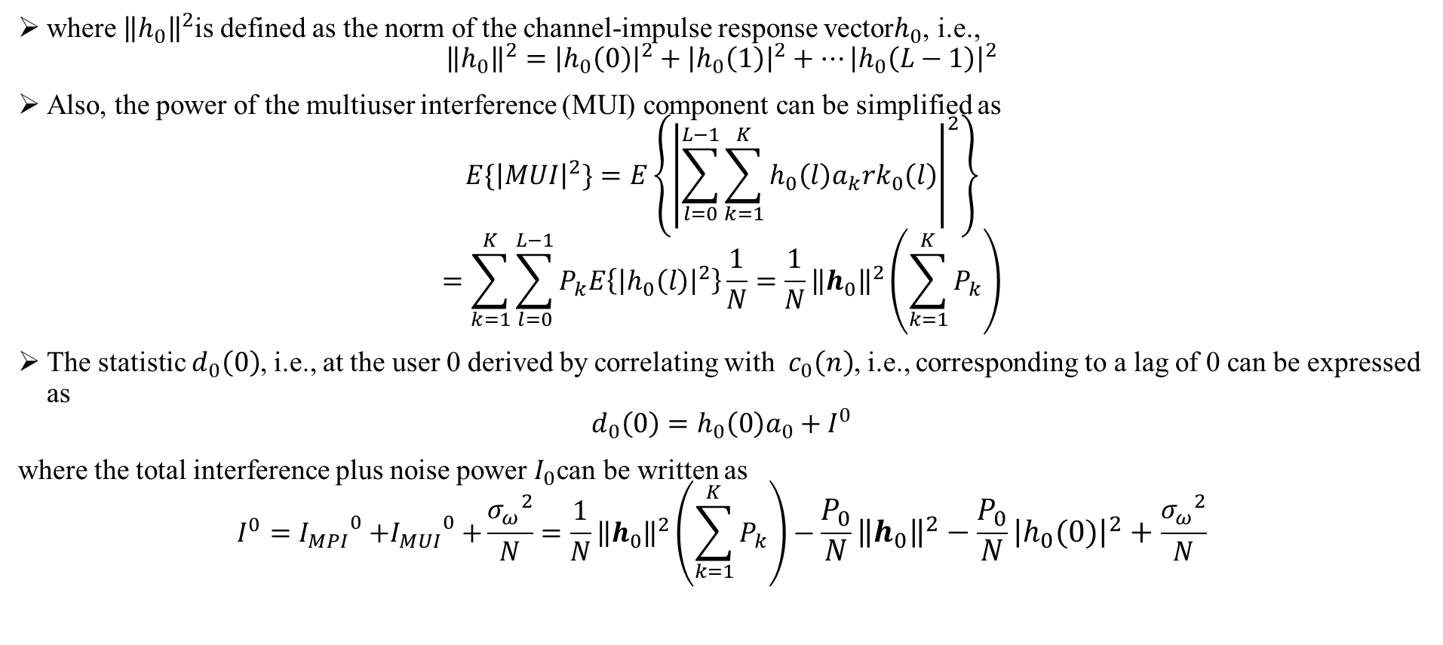
CODE DIVISION MULTIPLE ACCESS (CDMA)
where ${\left\|h_{0}\right\|}^{2}$is defined as the norm of the channel-impulse response vector$h_{0}$, i.e.,
$${\left\|h_{0}\right\|}^{2}={\left|h_{0}\left(0\right)\right|}^{2}+{\left|h_{0}\left(1\right)\right|}^{2}+…{\left|h_{0}\left(L−1\right)\right|}^{2}$$
Also, the power of the multiuser interference (MUI) component can be simplified as
$$E\{{\left|MUI\right|}^{2}\}=E\left\{{\left|\sum_{l=0}^{L−1}{\sum_{k=1}^{K}{h_{0}\left(l\right)a_{k}rk_{0}\left(l\right)}}\right|}^{2}\right\}$$
$$=\sum_{k=1}^{K}{\sum_{l=0}^{L−1}{P_{k}E\left\{{\left|h_{0}\left(l\right)\right|}^{2}\right\}\frac{1}{N}}}=\frac{1}{N}{\left\|h_{0}\right\|}^{2}\left(\sum_{k=1}^{K}{P_{k}}\right)$$
The statistic $d_{0}\left(0\right)$, i.e., at the user 0 derived by correlating with$c_{0}\left(n\right)$, i.e., corresponding to a lag of 0 can be expressed as
$$d_{0}\left(0\right)=h_{0}\left(0\right)a_{0}+I^{0}$$
where the total interference plus noise power $I_{0}$can be written as
$$I^{0}={I_{MPI}}_{}^{0}{+I_{MUI}}_{}^{0}+\frac{{σ_{ω}}_{}^{2}}{N}=\frac{1}{N}{\left\|h_{0}\right\|}^{2}\left(\sum_{k=1}^{K}{P_{k}}\right)−\frac{P_{0}}{N}{\left\|h_{0}\right\|}^{2}−\frac{P_{0}}{N}{\left|h_{0}\left(0\right)\right|}^{2}+\frac{{σ_{ω}}_{}^{2}}{N}$$
Code Division Multiple Access Dr.Y.Mallikarjuna Rao 14-03-2023 25/35

Slide 28
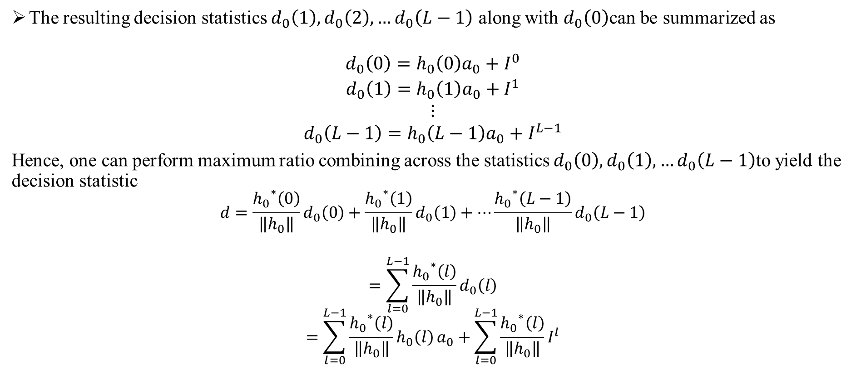
CODE DIVISION MULTIPLE ACCESS (CDMA)
The resulting decision statistics $d_{0}\left(1\right),d_{0}\left(2\right),…d_{0}\left(L−1\right)$ along with $d_{0}\left(0\right)$can be summarized as
$$\begin{matrix}d_{0}\left(0\right)=h_{0}\left(0\right)a_{0}+I^{0} \\ d_{0}\left(1\right)=h_{0}\left(1\right)a_{0}+I^{1} \\ \begin{matrix}⋮ \\ d_{0}\left(L−1\right)=h_{0}\left(L−1\right)a_{0}+I^{L−1}\end{matrix}\end{matrix}$$
Hence, one can perform maximum ratio combining across the statistics $d_{0}\left(0\right),d_{0}\left(1\right),…d_{0}\left(L−1\right)$to yield the decision statistic
$$d=\frac{{h_{0}}_{}^{∗}\left(0\right)}{\left\|h_{0}\right\|}d_{0}\left(0\right)+\frac{{h_{0}}_{}^{∗}\left(1\right)}{\left\|h_{0}\right\|}d_{0}\left(1\right)+…\frac{{h_{0}}_{}^{∗}\left(L−1\right)}{\left\|h_{0}\right\|}d_{0}\left(L−1\right)$$
$$=\sum_{l=0}^{L−1}{\frac{{h_{0}}_{}^{∗}\left(l\right)}{\left\|h_{0}\right\|}d_{0}\left(l\right)}$$
$$=\sum_{l=0}^{L−1}{\frac{{h_{0}}_{}^{∗}\left(l\right)}{\left\|h_{0}\right\|}h_{0}\left(l\right)}a_{0}+\sum_{l=0}^{L−1}{\frac{{h_{0}}_{}^{∗}\left(l\right)}{\left\|h_{0}\right\|}}I^{l}$$
Code Division Multiple Access Dr.Y.Mallikarjuna Rao 14-03-2023 26/35

Slide 29
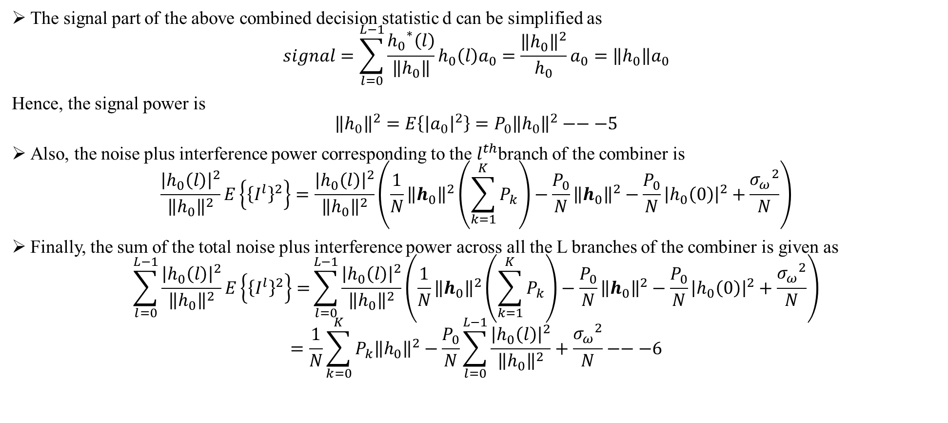
CODE DIVISION MULTIPLE ACCESS (CDMA)
The signal part of the above combined decision statistic d can be simplified as
$$signal=\sum_{l=0}^{L−1}{\frac{{h_{0}}_{}^{∗}\left(l\right)}{\left\|h_{0}\right\|}h_{0}\left(l\right)a_{0}=\frac{{\left\|h_{0}\right\|}^{2}}{h_{0}}}a_{0}=\left\|h_{0}\right\|a_{0}$$
Hence, the signal power is
$${\left\|h_{0}\right\|}^{2}=E\left\{{\left|a_{0}\right|}^{2}\right\}=P_{0}{\left\|h_{0}\right\|}^{2}−−−5$$
Also, the noise plus interference power corresponding to the $l^{th}$branch of the combiner is
$$\frac{{\left|h_{0}\left(l\right)\right|}^{2}}{{\left\|h_{0}\right\|}^{2}}E\left\{{\left\{I^{l}\right\}}^{2}\right\}=\frac{{\left|h_{0}\left(l\right)\right|}^{2}}{{\left\|h_{0}\right\|}^{2}}\left(\frac{1}{N}{\left\|h_{0}\right\|}^{2}\left(\sum_{k=1}^{K}{P_{k}}\right)−\frac{P_{0}}{N}{\left\|h_{0}\right\|}^{2}−\frac{P_{0}}{N}{\left|h_{0}\left(0\right)\right|}^{2}+\frac{{σ_{ω}}_{}^{2}}{N}\right)$$
Finally, the sum of the total noise plus interference power across all the L branches of the combiner is given as
$$\sum_{l=0}^{L−1}{\frac{{\left|h_{0}\left(l\right)\right|}^{2}}{{\left\|h_{0}\right\|}^{2}}E\left\{{\left\{I^{l}\right\}}^{2}\right\}=}\sum_{l=0}^{L−1}{\frac{{\left|h_{0}\left(l\right)\right|}^{2}}{{\left\|h_{0}\right\|}^{2}}\left(\frac{1}{N}{\left\|h_{0}\right\|}^{2}\left(\sum_{k=1}^{K}{P_{k}}\right)−\frac{P_{0}}{N}{\left\|h_{0}\right\|}^{2}−\frac{P_{0}}{N}{\left|h_{0}\left(0\right)\right|}^{2}+\frac{{σ_{ω}}_{}^{2}}{N}\right)}$$
$$=\frac{1}{N}\sum_{k=0}^{K}{P_{k}{\left\|h_{0}\right\|}^{2}−\frac{P_{0}}{N}\sum_{l=0}^{L−1}{\frac{{\left|h_{0}\left(l\right)\right|}^{2}}{{\left\|h_{0}\right\|}^{2}}}}+\frac{{σ_{ω}}_{}^{2}}{N}−−−6$$
Code Division Multiple Access Dr.Y.Mallikarjuna Rao 14-03-2023 27/35

Slide 30
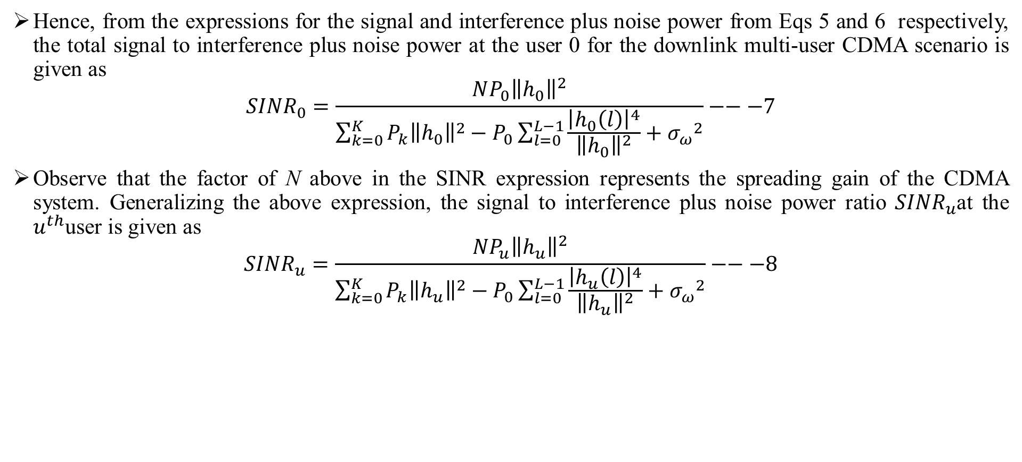
CODE DIVISION MULTIPLE ACCESS (CDMA)
Hence, from the expressions for the signal and interference plus noise power from Eqs 5 and 6 respectively, the total signal to interference plus noise power at the user 0 for the downlink multi-user CDMA scenario is given as
$${SINR}_{0}=\frac{NP_{0}{\left\|h_{0}\right\|}^{2}}{\sum_{k=0}^{K}{P_{k}{\left\|h_{0}\right\|}^{2}−P_{0}\sum_{l=0}^{L−1}{\frac{{\left|h_{0}\left(l\right)\right|}^{4}}{{\left\|h_{0}\right\|}^{2}}+{σ_{ω}}^{2}}}}−−−7$$
Observe that the factor of N above in the SINR expression represents the spreading gain of the CDMA system. Generalizing the above expression, the signal to interference plus noise power ratio ${SINR}_{u}$at the $u^{th}$user is given as
$${SINR}_{u}=\frac{NP_{u}{\left\|h_{u}\right\|}^{2}}{\sum_{k=0}^{K}{P_{k}{\left\|h_{u}\right\|}^{2}−P_{0}\sum_{l=0}^{L−1}{\frac{{\left|h_{u}\left(l\right)\right|}^{4}}{{\left\|h_{u}\right\|}^{2}}+{σ_{ω}}^{2}}}}−−−8$$
Code Division Multiple Access Dr.Y.Mallikarjuna Rao 14-03-2023 28/35

Slide 31
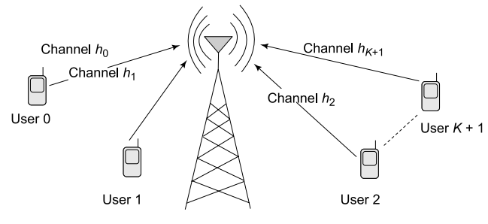

CODE DIVISION MULTIPLE ACCESS (CDMA)
MULTIPLE USERS CDMA UPLINK SCENARIO :
We now consider a CDMA uplink scenario with K + 1 users. Similar to the downlink multi-user scenario, let$a_{0},a_{1}…a_{k}$denote the information symbols and $c_{0}\left(n\right),c_{1}\left(n\right),…c_{K}\left(n\right)$ denote the spreading codes corresponding to the K + 1 users respectively.
Hence, the spread signal transmitted by each user $x_{K}\left(m\right)$ can be expressed as $x_{k}\left(m\right)=a_{k}c_{k}\left(m\right).$However, there is a key difference here with respect to the downlink scenario. Unlike the composite signal which is transmitted by the base station in the downlink scenario, each mobile user transmits his individual signal from the transmitter
Thus, the composite signal in the uplink scenario is formed by superposition at the receiver
To understand this better, consider the frequency-selective channel$h_{k}\left(0\right),h_{k}\left(1\right),…h_{k}\left(L−1\right)$between the $k^{th}$user and the base station. Thus, the received signal component $y_{k}\left(n\right)$of the user k at the base station is given as
$$y_{k}\left(n\right)=h_{k}\left(0\right)x_{k}\left(n\right)+h_{k}\left(1\right)x_{k}\left(n−1\right)+…h_{k}\left(L−1\right)x_{k}\left(n−L+1\right)$$
$$=\sum_{l=0}^{L−1}{h_{k}\left(l\right)a_{k}c_{k}\left(l\right)}$$
Figure 8: CDMA uplink scenario
Code Division Multiple Access Dr.Y.Mallikarjuna Rao 14-03-2023 29/35

Slide 32
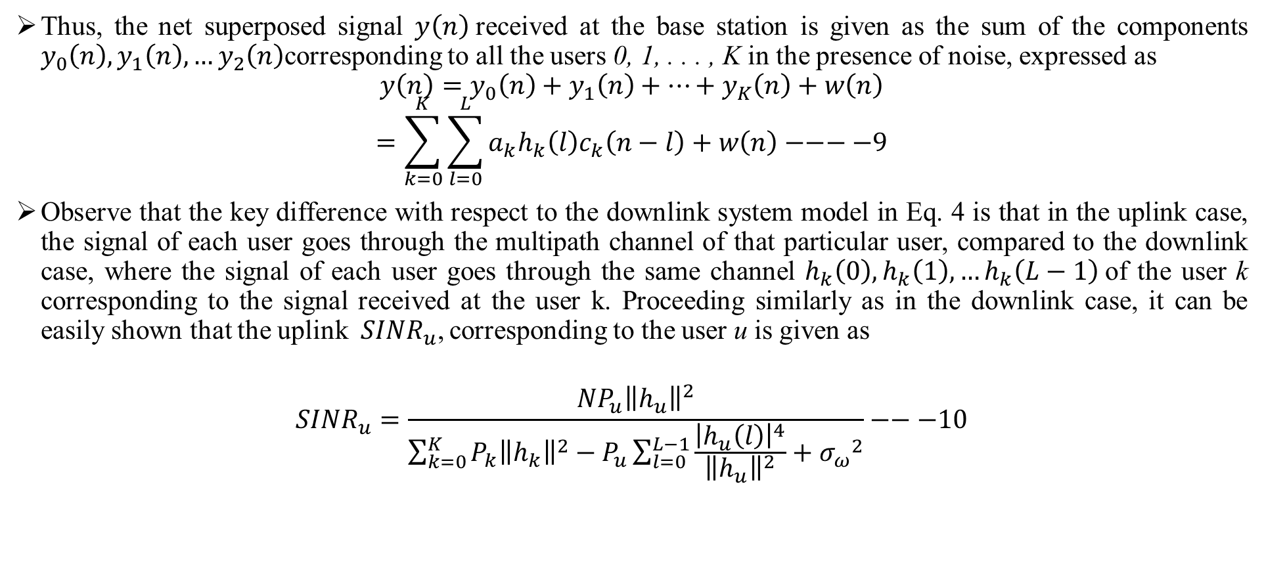
CODE DIVISION MULTIPLE ACCESS (CDMA)
Thus, the net superposed signal $y\left(n\right)$received at the base station is given as the sum of the components $y_{0}\left(n\right),y_{1}\left(n\right),…y_{2}\left(n\right)$corresponding to all the users 0, 1, . . . , K in the presence of noise, expressed as
$$y\left(n\right)=y_{0}\left(n\right)+y_{1}\left(n\right)+…+y_{K}\left(n\right)+w\left(n\right)$$
$$=\sum_{k=0}^{K}{\sum_{l=0}^{L}{a_{k}h_{k}\left(l\right)c_{k}\left(n−l\right)+w\left(n\right)−−−−9}}$$
Observe that the key difference with respect to the downlink system model in Eq. 4 is that in the uplink case, the signal of each user goes through the multipath channel of that particular user, compared to the downlink case, where the signal of each user goes through the same channel $h_{k}\left(0\right),h_{k}\left(1\right),…h_{k}\left(L−1\right)$of the user k corresponding to the signal received at the user k. Proceeding similarly as in the downlink case, it can be easily shown that the uplink${ SINR}_{u}$, corresponding to the user u is given as
$${SINR}_{u}=\frac{NP_{u}{\left\|h_{u}\right\|}^{2}}{\sum_{k=0}^{K}{P_{k}{\left\|h_{k}\right\|}^{2}−P_{u}\sum_{l=0}^{L−1}{\frac{{\left|h_{u}\left(l\right)\right|}^{4}}{{\left\|h_{u}\right\|}^{2}}+{σ_{ω}}^{2}}}}−−−10$$
Code Division Multiple Access Dr.Y.Mallikarjuna Rao 14-03-2023 30/35

Slide 33
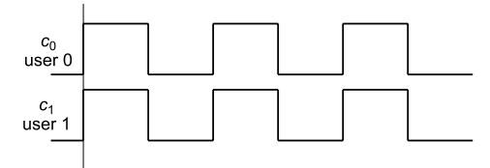
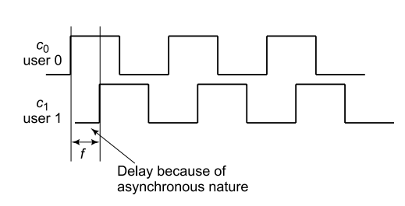

CODE DIVISION MULTIPLE ACCESS (CDMA)
ASYNCHRONOUS CDM :
we have implicitly assumed that the CDMA spreading sequences are aligned or synchronized as shown in Figure 5.14. However, frequently, the spreading sequences at the base station in an uplink scenario are not aligned. This is due to the fact that difference users are at different distances from the base station. Hence, the resulting propagation delays are different, leading to loss of synchronization at the receiver.
One of the unique advantages of CDMA is the ability of asynchronous operation. The SINR corresponding to asynchronous operation in CDMA scenarios can be derived as follows.
From fig 10 the asynchronous correlation ${r_{01}}_{}^{a}$can be expressed as a linear combination of the two synchronous correlations $r_{01}\left(0\right),r_{01}\left(−1\right)$as
$${r_{01}}_{}^{a}=\left(1−f\right)r_{01}\left(0\right)+{fr}_{01}\left(−1\right)$$
Figure 9:Synchronous CDMA code sequences
Figure 10:Asynchronous CDMA code sequences
Code Division Multiple Access Dr.Y.Mallikarjuna Rao 14-03-2023 31/35

Slide 34
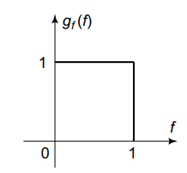
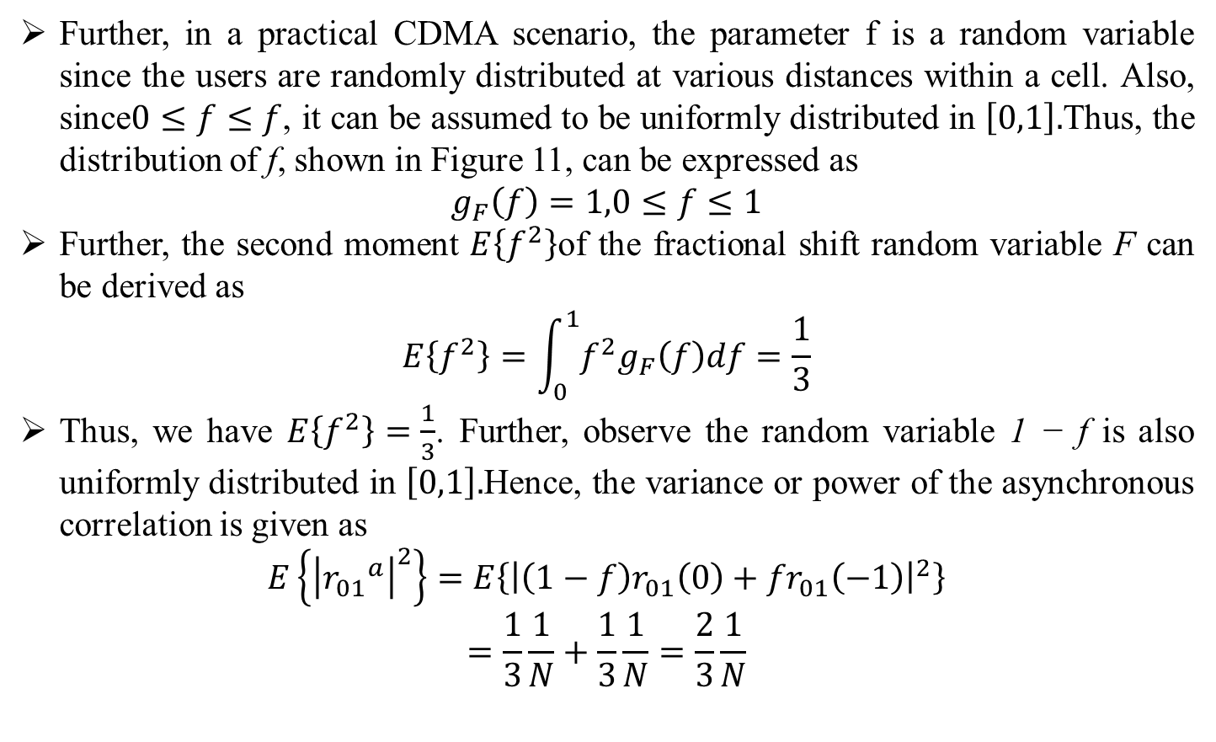
CODE DIVISION MULTIPLE ACCESS (CDMA)
Further, in a practical CDMA scenario, the parameter f is a random variable since the users are randomly distributed at various distances within a cell. Also, since$0≤f≤f$, it can be assumed to be uniformly distributed in $\left[0,1\right].$Thus, the distribution of f, shown in Figure 11, can be expressed as
$$g_{F}\left(f\right)=1,0≤f≤1$$
Further, the second moment $E\left\{f^{2}\right\}$of the fractional shift random variable F can be derived as
$$E\left\{f^{2}\right\}=\int_{0}^{1}{f^{2}g_{F}\left(f\right)df}=\frac{1}{3}$$
Thus, we have $E\left\{f^{2}\right\}=\frac{1}{3}$. Further, observe the random variable 1 − f is also uniformly distributed in $\left[0,1\right].$Hence, the variance or power of the asynchronous correlation is given as
$$E\left\{{\left|{r_{01}}_{}^{a}\right|}^{2}\right\}=E\left\{{\left|\left(1−f\right)r_{01}\left(0\right)+{fr}_{01}\left(−1\right)\right|}^{2}\right\}$$
$$=\frac{1}{3}\frac{1}{N}+\frac{1}{3}\frac{1}{N}=\frac{2}{3}\frac{1}{N}$$
Figure 11: Uniform distribution of fractional shift f
Code Division Multiple Access Dr.Y.Mallikarjuna Rao 14-03-2023 32/35

Slide 35
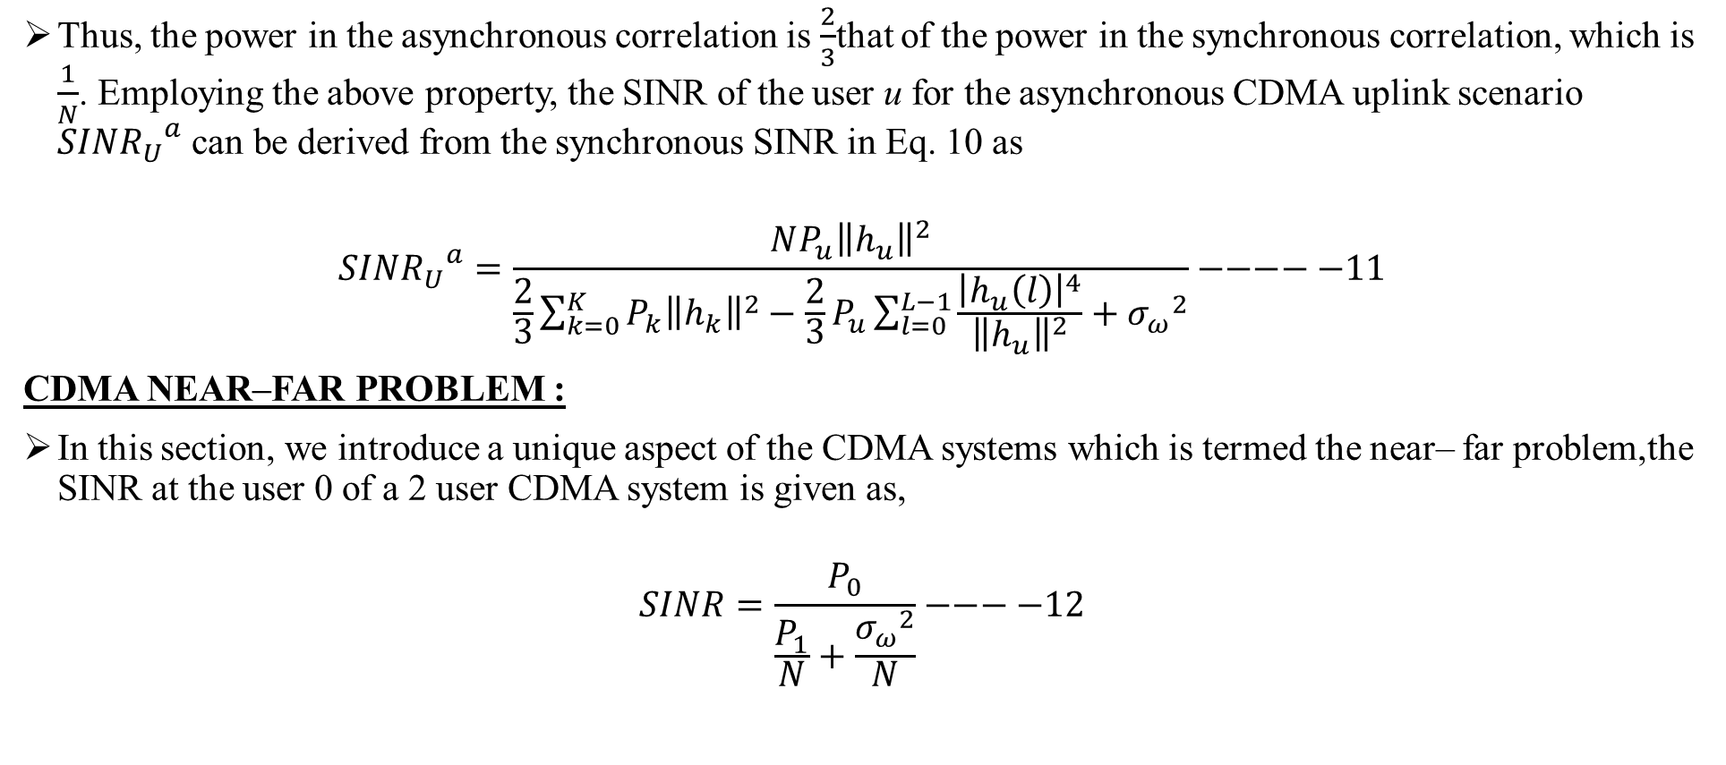
CODE DIVISION MULTIPLE ACCESS (CDMA)
Thus, the power in the asynchronous correlation is $\frac{2}{3}$that of the power in the synchronous correlation, which is $\frac{1}{N}$. Employing the above property, the SINR of the user u for the asynchronous CDMA uplink scenario ${{SINR}_{U}}_{}^{a}$ can be derived from the synchronous SINR in Eq. 10 as
$${{SINR}_{U}}_{}^{a}=\frac{NP_{u}{\left\|h_{u}\right\|}^{2}}{\frac{2}{3}\sum_{k=0}^{K}{P_{k}{\left\|h_{k}\right\|}^{2}−{\frac{2}{3}P}_{u}\sum_{l=0}^{L−1}{\frac{{\left|h_{u}\left(l\right)\right|}^{4}}{{\left\|h_{u}\right\|}^{2}}+{σ_{ω}}^{2}}}}−−−−−11$$
CDMA NEAR–FAR PROBLEM :
In this section, we introduce a unique aspect of the CDMA systems which is termed the near– far problem,the SINR at the user 0 of a 2 user CDMA system is given as,
$$SINR=\frac{P_{0}}{\frac{P_{1}}{N}+\frac{{σ_{ω}}_{}^{2}}{N}}−−−−12$$
Code Division Multiple Access Dr.Y.Mallikarjuna Rao 14-03-2023 33/35

Slide 36
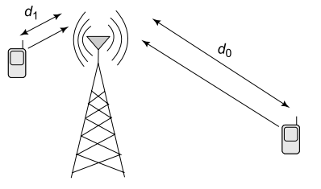
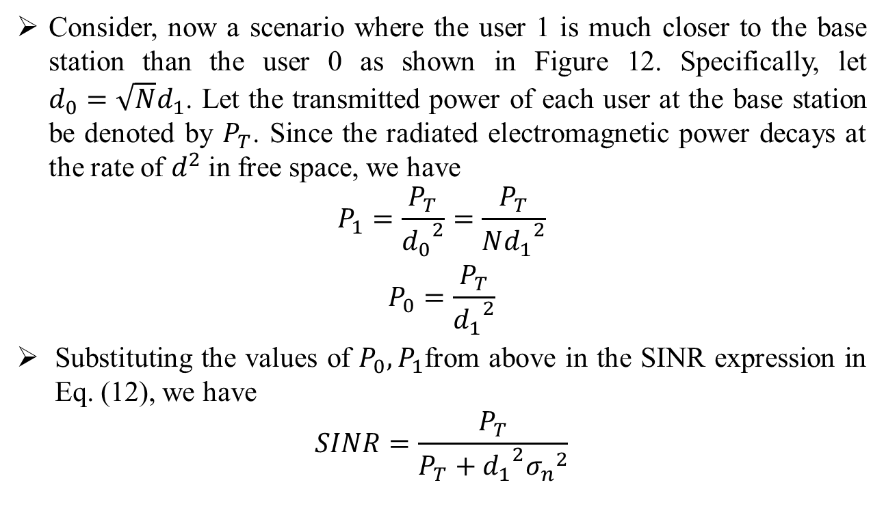
CODE DIVISION MULTIPLE ACCESS (CDMA)
Consider, now a scenario where the user 1 is much closer to the base station than the user 0 as shown in Figure 12. Specifically, let $d_{0}=\sqrt{N}d_{1}$. Let the transmitted power of each user at the base station be denoted by $P_{T}$. Since the radiated electromagnetic power decays at the rate of $d^{2}$in free space, we have
$$P_{1}=\frac{P_{T}}{{d_{0}}_{}^{2}}=\frac{P_{T}}{N{d_{1}}_{}^{2}}$$
$$P_{0}=\frac{P_{T}}{{d_{1}}_{}^{2}}$$
Substituting the values of $P_{0},P_{1}$from above in the SINR expression in Eq. (12), we have
$$SINR=\frac{P_{T}}{P_{T}+{d_{1}}_{}^{2}{σ_{n}}_{}^{2}}$$
Figure 12: Near-far problem in CDMA networks
Code Division Multiple Access Dr.Y.Mallikarjuna Rao 14-03-2023 34/35

Slide 37
CODE DIVISION MULTIPLE ACCESS (CDMA)
Thus, the above expression yields the surprising result that both the signal and interference power at the user 0 are of the same magnitude and the effect of the spreading gain N is lost. This phenomenon arises because the user 1, who is closer to the base station, drowns out the power of the user 0, i.e., there is heavy interference at the user 0. This is the near–far problem in CDMA systems.
To avoid this near–far problem, the power that is transmitted to the different users has to be regulated in CDMA systems, i.e., lower power has to be transmitted to users closer to the base station such as the user 1, while transmitting at a higher power to users farther away such as the user 0,which is termed as power control in CDMA systems.
Code Division Multiple Access Dr.Y.Mallikarjuna Rao 14-03-2023 35/35

Slide 38
End of Presentation
Thank you all
A Presentation to NAAC Peer Team Dr.Y.Mallikarjuna Rao 14-03-2023

