Slide 1
Software Project Management
Unit III

Slide 2
ARTIFACTS OF THE PROCESS
  The Artifact Sets
To make the development of a complete software system manageable, distinct collections of information are organized into artifact sets. Artifact represents cohesive information that typically is developed and reviewed as a single entity.
Life-cycle software artifacts are organized into five distinct sets that are roughly partitioned by the underlying language of the set: management (ad hoc textual formats), requirements (organized text and models of the problem space), design (models of the solution space), implementation (human-readable programming language and associated source files), and deployment (machine-process able languages and associated files).

Slide 3
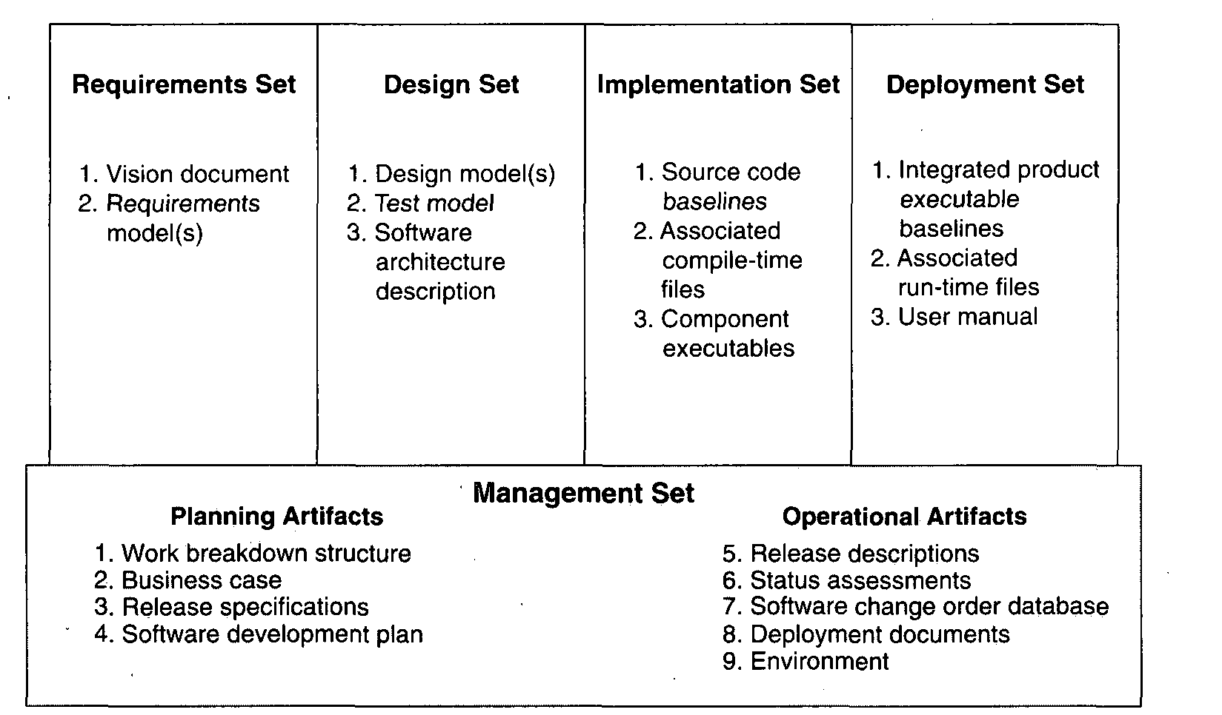

Slide 4
    THE MANAGEMENT SET
The management set captures the artifacts associated with process planning and execution. These artifacts use ad hoc notations, including text, graphics, or whatever representation is required to capture the "contracts" among project personnel (project management, architects, developers, testers, marketers, administrators), among stakeholders (funding authority, user, software project manager, organization manager, regulatory agency), and between project personnel and stakeholders

Slide 5
. Specific artifacts included in this set are the work breakdown structure (activity breakdown and financial tracking mechanism), the business case (cost, schedule, profit expectations), the release specifications (scope, plan, objectives for release baselines), the software development plan (project process instance), the release descriptions (results of release baselines), the status assessments (periodic snapshots of project progress), the software change orders (descriptions of discrete baseline changes), the deployment documents (cutover plan, training course, sales rollout kit), and the environment (hardware and software tools, process automation, & documentation).

Slide 6
Management set artifacts are evaluated, assessed, and measured through a combination of the following:
Relevant stakeholder review
Analysis of changes between the current version of the artifact and previous versions
Major milestone demonstrations of the balance among all artifacts and, in particular, the accuracy of the business case and vision artifacts

Slide 7
    THE ENGINEERING SETS
The engineering sets consist of the requirements set, the design set, the implementation set, and the deployment set.
Requirements Set
      Analysis of consistency with the release specifications of the management set
      Analysis of consistency between the vision and the requirements models
      Mapping against the design, implementation, and deployment sets to evaluate the consistency and completeness and the semantic balance between information in the different sets

Slide 8
      Analysis of changes between the current version of requirements artifacts and previous versions (scrap, rework, and defect elimination trends)
      Subjective review of other dimensions of quality
Design Set
UML notation is used to engineer the design models for the solution. The design set contains varying levels of abstraction that represent the components of the solution space (their identities, attributes, static relationships, dynamic interactions). The design set is evaluated, assessed, and measured through a combination of the following:

Slide 9
      Analysis of the internal consistency and quality of the design model
      Analysis of consistency with the requirements models
      Translation into implementation and deployment sets and notations (for example, traceability, source code generation, compilation, linking) to evaluate the consistency and completeness and the semantic balance between information in the sets
      Analysis of changes between the current version of the design model and previous versions (scrap, rework, and defect elimination trends)
      Subjective review of other dimensions of quality

Slide 10
Implementation Set
The implementation set includes source code (programming language notations) that represents the tangible implementations of components (their form, interface, and dependency relationships)
Implementation sets are human-readable formats that are evaluated, assessed, and measured through a
Combination of the following:
      Analysis of consistency with the design models
      Translation into deployment set notations (for example, compilation and linking) to evaluate the consistency and completeness among artifact sets

Slide 11
      Assessment of component source or executable files against relevant evaluation criteria through inspection, analysis, demonstration, or testing
      Execution of stand-alone component test cases that automatically compare expected results with actual results
      Analysis of changes between the current version of the implementation set and previous versions (scrap, rework, and defect elimination trends)
      Subjective review of other dimensions of quality

Slide 12
Deployment Set
The deployment set includes user deliverables and machine language notations, executable software, and the
build scripts, installation scripts, and executable target specific data necessary to use the product in its target environment. Deployment sets are evaluated, assessed, and measured through a combination of the following:

Slide 13
      Testing against the usage scenarios and quality attributes defined in the requirements set to evaluate the consistency and completeness and the~ semantic balance between information in the two sets
      Testing the partitioning, replication, and allocation strategies in mapping components of the implementation set to physical resources of the deployment system (platform type, number, network topology)

Slide 14
      Testing against the defined usage scenarios in the user manual such as installation, user-oriented dynamic reconfiguration, mainstream usage, and anomaly management
      Analysis of changes between the current version of the deployment set and previous versions (defect elimination trends, performance changes)
      Subjective review of other dimensions of quality
Each artifact set is the predominant development focus of one phase of the life cycle; the other sets take on check and balance roles.

Slide 15
As illustrated in Figure 6-2, each phase has a predominant focus: Requirements are the focus of the inception phase; design, the elaboration phase; implementation, the construction phase; and deployment, the transition phase. The management artifacts also evolve, but at a fairly constant level across the life cycle.
Most of today's software development tools map closely to one of the five artifact sets.

Slide 16
Management: scheduling, workflow, defect tracking, change management, documentation, spreadsheet, resource management, and presentation tools
Requirements: requirements management tools
Design: visual modeling tools
Implementation: compiler/debugger tools, code analysis tools, test coverage analysis tools, and test management tools
Deployment: test coverage and test automation tools, network management tools, commercial components (operating systems, GUIs, RDBMS, networks, middleware), and installation tools.

Slide 17
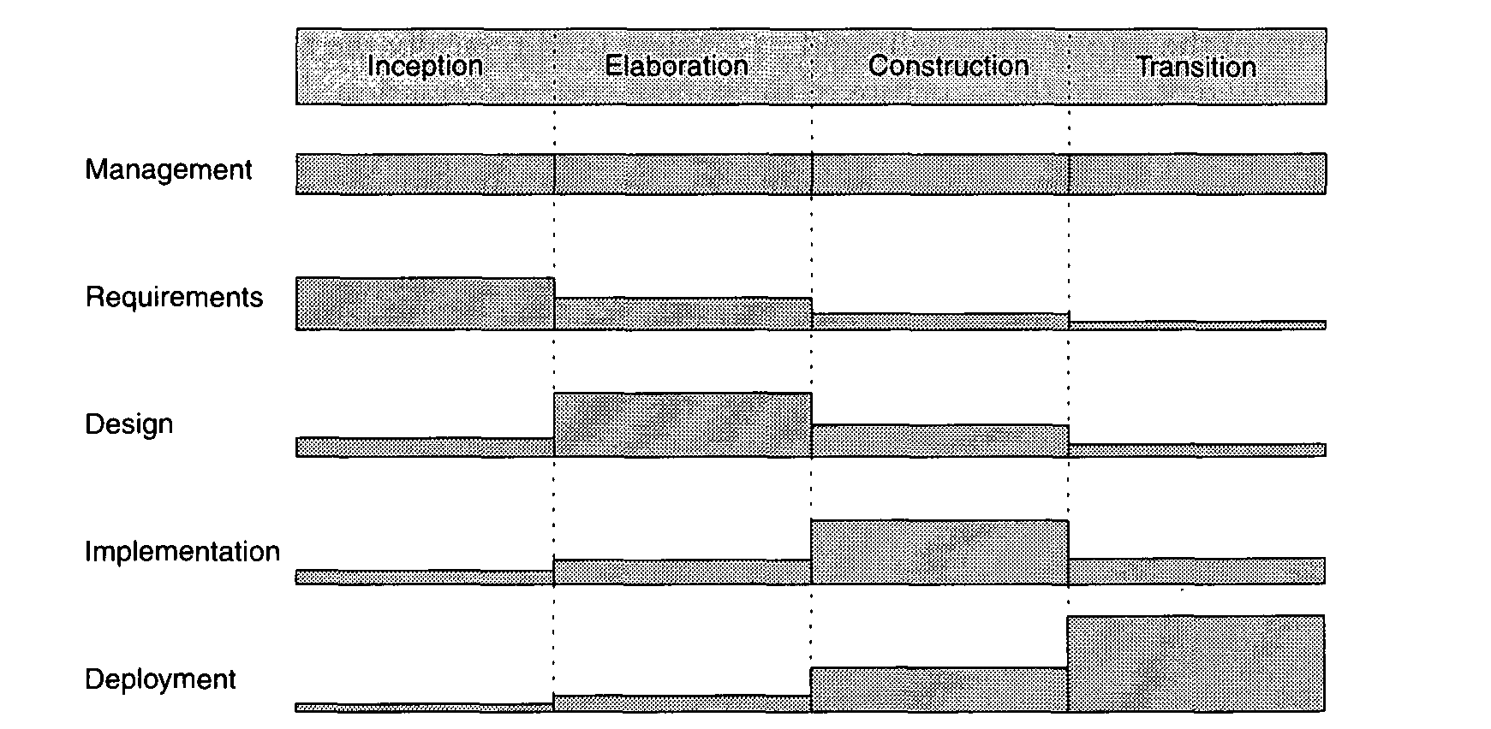

Slide 18
IMPLEMENTATION SET VERSUS DEPLOYMENT SET
The separation of the implementation set (source code) from the deployment set (executable code) is important because there are very different concerns with each set.
The structure of the information delivered to the user (and typically the test organization) is very different from the structure of the source code information. Engineering decisions that have an impact on the quality of the deployment set but are relatively incomprehensible in the design and implementation sets include the following

Slide 19
      Dynamically reconfigurable parameters (buffer sizes, color palettes, number of servers, number of simultaneous clients, data files, run-time parameters)
      Effects of compiler/link optimizations (such as space optimization versus speed optimization)
      Performance under certain allocation strategies (centralized versus distributed, primary and shadow threads, dynamic load balancing, hot backup versus checkpoint/rollback)
      Virtual machine constraints (file descriptors, garbage collection, heap size, maximum record size, disk file rotations)
      Process-level concurrency issues (deadlock and race conditions)
      Platform-specific differences in performance or behavior

Slide 20
3. ARTIFACT EVOLUTION OVER THE LIFE CYCLE
Each state of development represents a certain amount of precision in the final system description. Early in the life cycle, precision is low and the representation is generally high. Eventually, the precision of representation is high and everything is specified in full detail. Each phase of development focuses on a particular artifact set. At the end of each phase, the overall system state will have progressed on all sets, as illustrated in Figure 6-3.

Slide 21
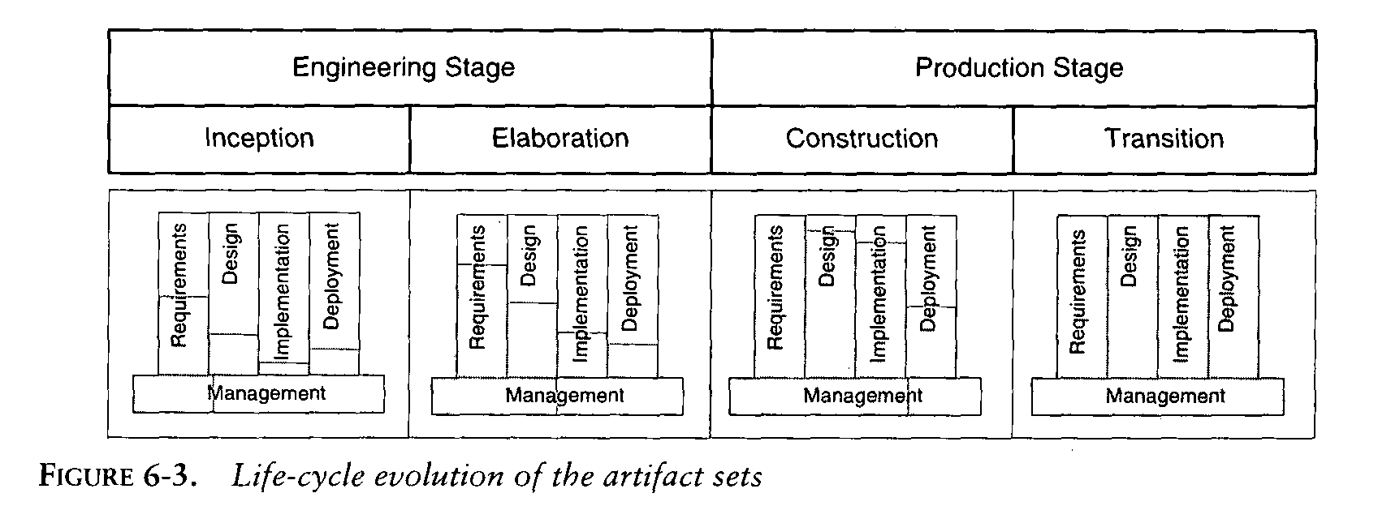

Slide 22
The inception phase focuses mainly on critical requirements usually with a secondary focus on an initial deployment view. During the elaboration phase, there is much greater depth in requirements, much more breadth in the design set, and further work on implementation and deployment issues.
The main focus of the construction phase is design and implementation. The main focus of the transition phase is on achieving consistency and completeness of the deployment set in the context of the other sets.

Slide 23
4.TEST ARTIFACTS
      The test artifacts must be developed concurrently with the product from inception through deployment. Thus, testing is a full-life-cycle activity, not a late life-cycle activity.
      The test artifacts are communicated, engineered, and developed within the same artifact sets as the developed product.
      The test artifacts are implemented in programmable and repeatable formats (as software programs).
      The test artifacts are documented in the same way that the product is documented.
      Developers of the test artifacts use the same tools, techniques, and training as the software engineers developing the product.

Slide 24
Test artifact subsets are highly project-specific; the following example clarifies the relationship between test artifacts and the other artifact sets. Consider a project to perform seismic data processing for the purpose of oil exploration. This system has three fundamental subsystems:
(1) a sensor subsystem that captures raw seismic data in real time and delivers these data to
(2) a technical operations subsystem that converts raw data into an organized database and manages queries to this database from
(3) a display subsystem that allows workstation operators to examine seismic data in human-readable form. Such a system would result in the following test artifacts:

Slide 25
      Management set. The release specifications and release descriptions capture the objectives, evaluation criteria, and results of an intermediate milestone. These artifacts are the test plans and test results negotiated among internal project teams. The software change orders capture test results (defects, testability changes, requirements ambiguities, enhancements) and the closure criteria associated with making a discrete change to a baseline.
      Requirements set. The system-level use cases capture the operational concept for the system and the acceptance test case descriptions, including the expected behavior of the system and its quality attributes. The entire requirement set is a test artifact because it is the basis of all assessment activities across the life cycle.

Slide 26
    Design set. A test model for non deliverable components needed to test the product baselines is captured in the design set. These components include such design set artifacts as a seismic event simulation for creating realistic sensor data; a "virtual operator" that can support unattended, after- hours test cases; specific instrumentation suites for early demonstration of resource usage; transaction rates or response times; and use case test drivers and component stand-alone test drivers.

Slide 27
Implementation set. Self-documenting source code representations for test components and test drivers provide the equivalent of test procedures and test scripts. These source files may also include human-readable data files representing certain statically defined data sets that are explicit test source files. Output files from test drivers provide the equivalent of test reports.
Deployment set. Executable versions of test components, test drivers, and data files are provided.

Slide 28
  MANAGEMENT ARTIFACTS
The management set includes several artifacts that capture intermediate results and ancillary information necessary to document the product/process legacy, maintain the product, improve the product, and improve the process.
Work Breakdown Structure
  Work breakdown structure (WBS) is the vehicle for budgeting and collecting costs. To monitor and control a project's financial performance, the software project man1ger must have insight into project costs and how they are expended. The structure of cost accountability is a serious project planning constraint.

Slide 29
Business Case
  The business case artifact provides all the information necessary to determine whether the project is worth investing in. It details the expected revenue, expected cost, technical and management plans, and backup data necessary to demonstrate the risks and realism of the plans. The main purpose is to transform the vision into economic terms so that an organization can make an accurate ROI assessment. The financial forecasts are evolutionary, updated with more accurate forecasts as the life cycle progresses. Figure 6-4 provides a default outline for a business case.

Slide 30
Release Specifications
  The scope, plan, and objective evaluation criteria for each baseline release are derived from the vision statement as well as many other sources (make/buy analyses, risk management concerns, architectural considerations, shots in the dark, implementation constraints, quality thresholds). These artifacts are intended to evolve along with the process, achieving greater fidelity as the life cycle progresses and requirements understanding matures. Figure 6-6 provides a default outline for a release specification

Slide 31
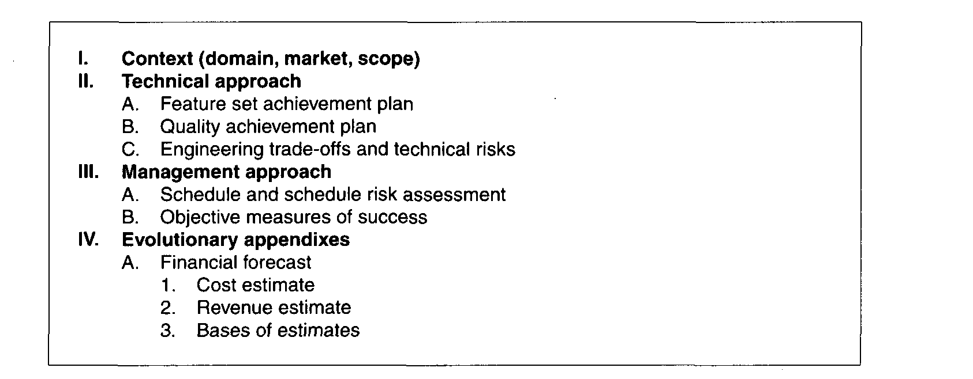

Slide 32
Software Development Plan
The software development plan (SDP) elaborates the process framework into a fully detailed plan. Two indications of a useful SDP are periodic updating (it is not stagnant shelfware) and understanding and acceptance by managers and practitioners alike. Figure 6-5 provides a default outline for a software development plan.

Slide 33
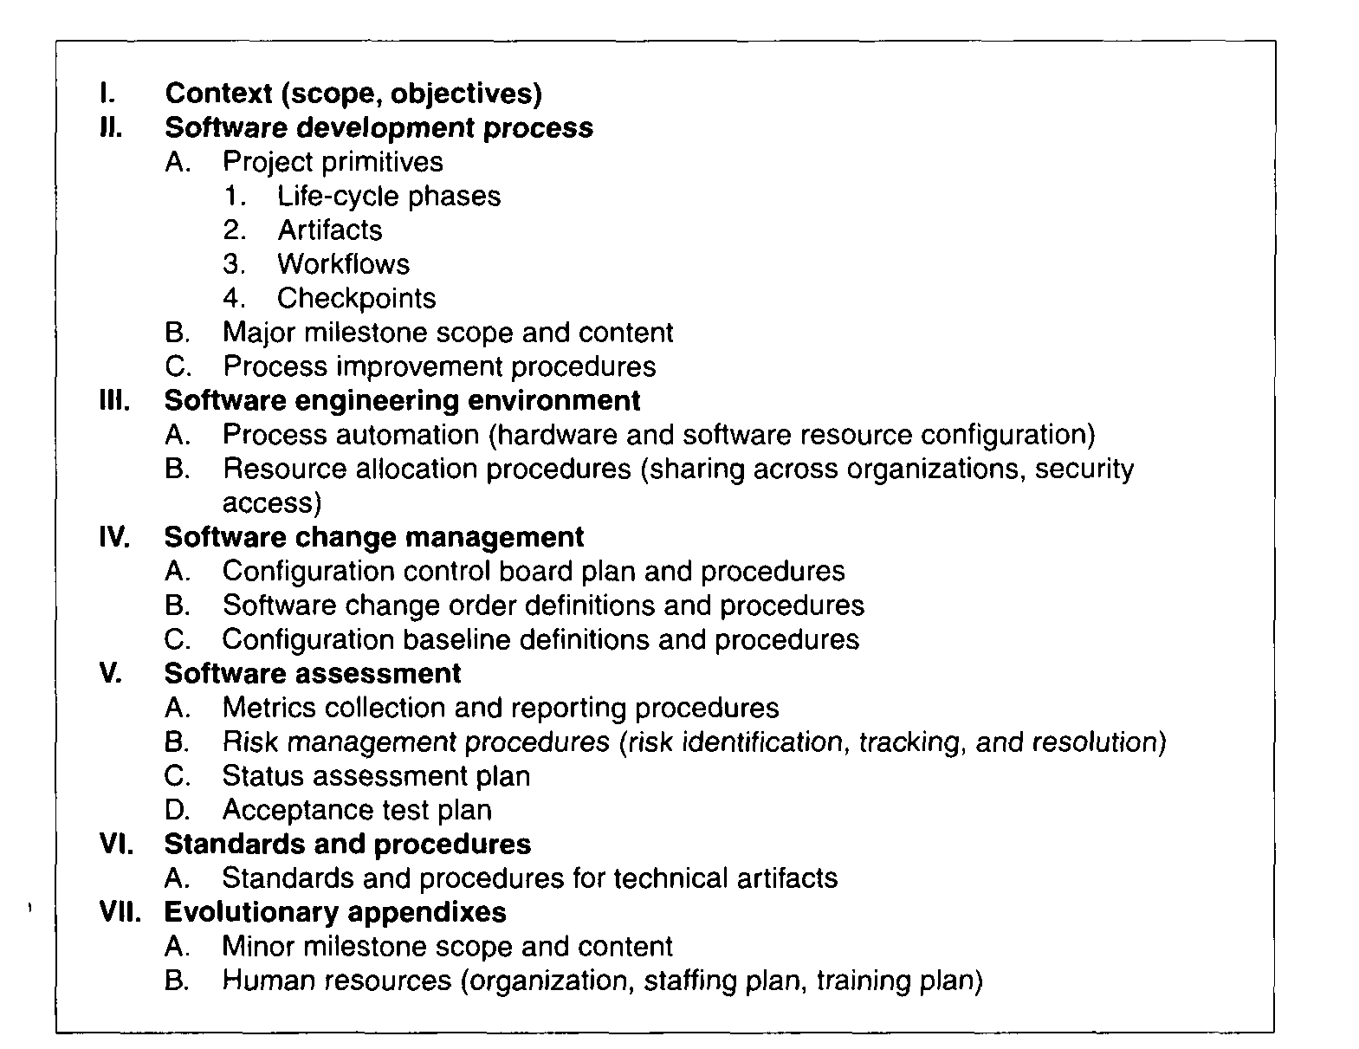

Slide 34
Release Descriptions
Release description documents describe the results of each release, including performance against each of the evaluation criteria in the corresponding release specification. Release baselines should be accompanied by a release description document that describes the evaluation criteria for that configuration baseline and provides substantiation (through demonstration, testing, inspection, or analysis) that each criterion has been addressed in an acceptable manner. Figure 6-7 provides a default outline for a release description.

Slide 35
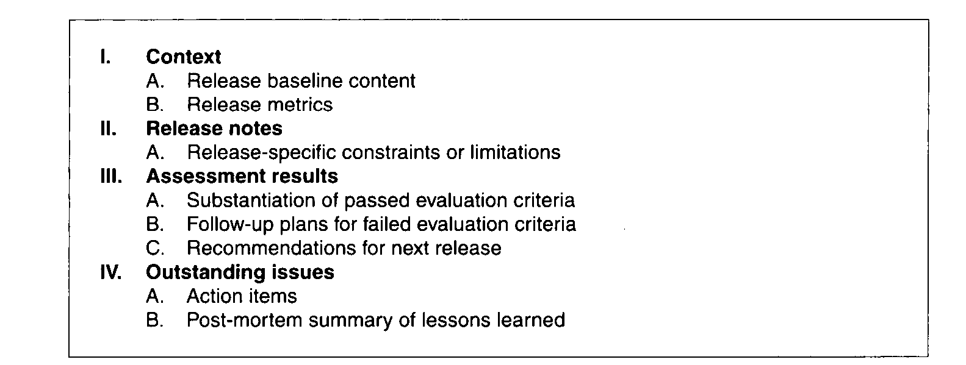

Slide 36
Status Assessments
Status assessments provide periodic snapshots of project health and status, including the software project manager's risk assessment, quality indicators, and management indicators.
Typical status assessments should include a review of resources, personnel staffing, financial data (cost and revenue), top 10 risks, technical progress (metrics snapshots), major milestone plans and results, total project or product scope & action items

Slide 37
Software Change Order Database
Managing change is one of the fundamental primitives of an iterative development process. With greater change freedom, a project can iterate more productively. This flexibility increases the content, quality, and number of iterations that a project can achieve within a given schedule. Change freedom has been achieved in practice through automation, and today's iterative development environments carry the burden of change management. Organizational processes that depend on manual change management techniques have encountered major inefficiencies.

Slide 38
Deployment
A deployment document can take many forms. Depending on the project, it could include several document subsets for transitioning the product into operational status. In big contractual efforts in which the system is delivered to a separate maintenance organization, deployment artifacts may include computer system operations manuals, software installation manuals, plans and procedures for cutover (from a legacy system), site surveys, and so forth. For commercial software products, deployment artifacts may include marketing plans, sales rollout kits, and training courses.

Slide 39
Environment
An important emphasis of a modern approach is to define the development and maintenance environment as a first-class artifact of the process. A robust, integrated development environment must support automation of the development process. This environment should include requirements management, visual modeling, document automation, host and target programming tools, automated regression testing, and continuous and integrated change management, and feature and defect tracking

Slide 40
Management Artifact Sequences
In each phase of the life cycle, new artifacts are produced and previously developed artifacts are updated to incorporate lessons learned and to capture further depth and breadth of the solution. Figure 6-8 identifies a typical sequence of artifacts across the life-cycle phases

Slide 41
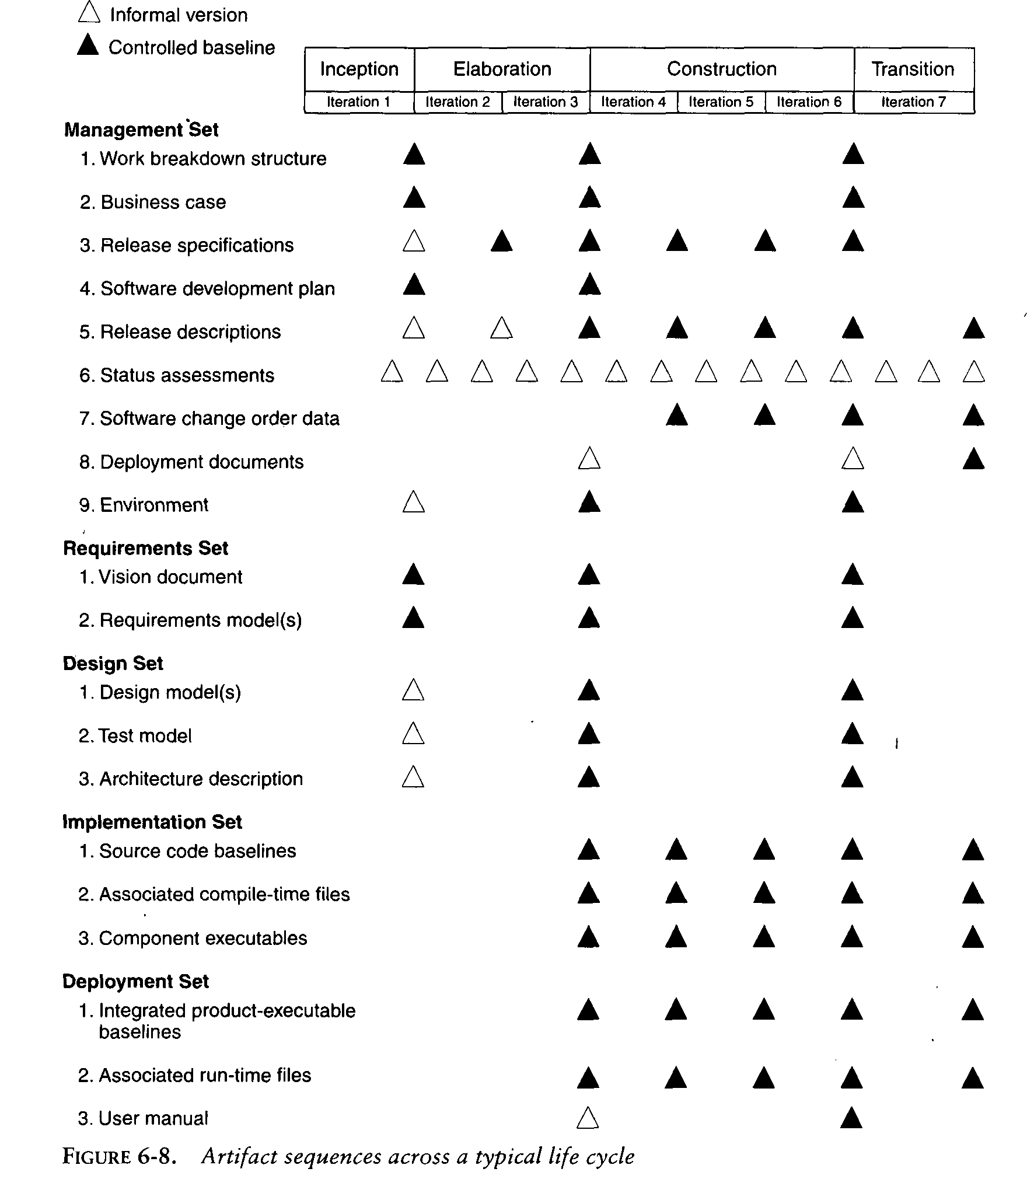

Slide 42
  ENGINEERING ARTIFACTS
Most of the engineering artifacts are captured in rigorous engineering notations such as UML, programming languages, or executable machine codes. Three engineering artifacts are explicitly intended for more general review, and they deserve further elaboration.

Slide 43
Vision Document
  The vision document provides a complete vision for the software system under development and. supports the contract between the funding authority and the development organization. A project vision is meant to be changeable as understanding evolves of the requirements, architecture, plans, and technology. A good vision document should change slowly. Figure 6-9 provides a default outline for a vision document.

Slide 44
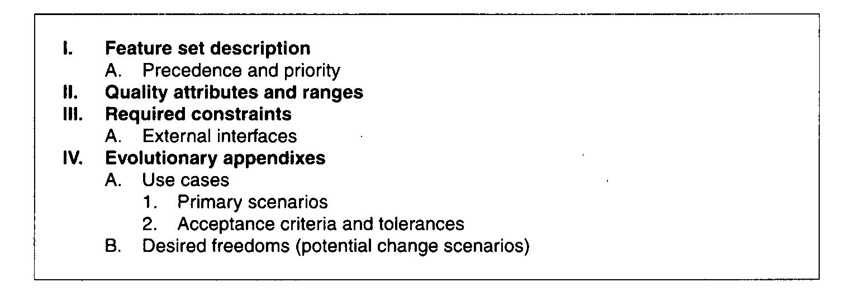

Slide 45
Architecture Description
  The architecture description provides an organized view of the software architecture under development. It is extracted largely from the design model and includes views of the design, implementation, and deployment sets sufficient to understand how the operational concept of the requirements set will be achieved. The breadth of the architecture description will vary from project to project depending on many factors. Figure provides a default outline for an architecture description.

Slide 46
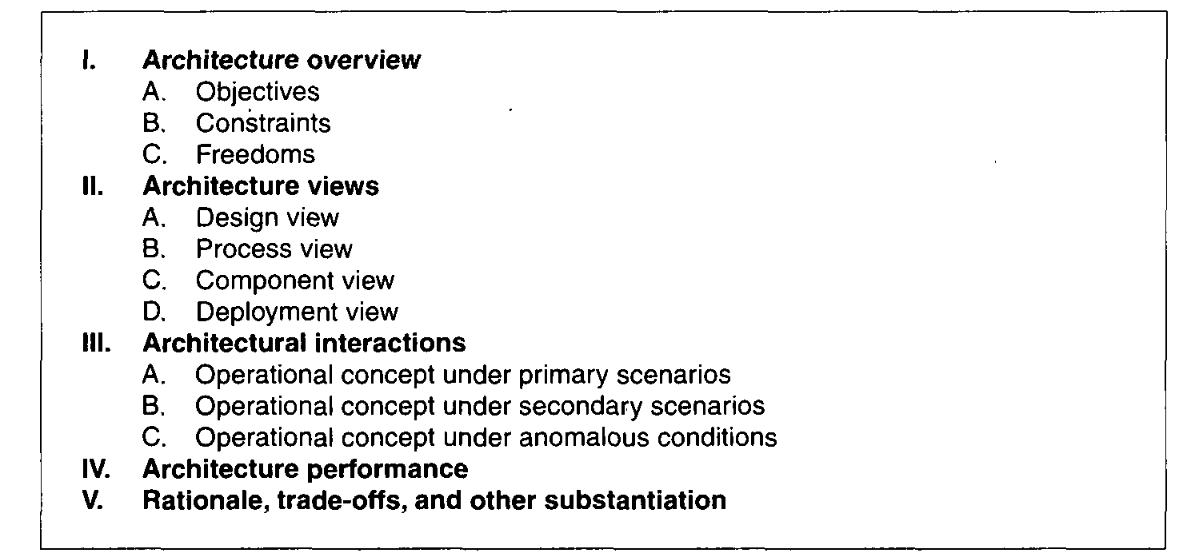

Slide 47
Software User Manual
  The software user manual provides the user with the reference documentation necessary to support the delivered software. Although content is highly variable across application domains, the user manual should include installation procedures, usage procedures and guidance, operational constraints, and a user interface description, at a minimum
  For software products with a user interface, this manual should be developed early in the life cycle because it is a necessary mechanism for communicating and stabilizing an important subset of requirements

Slide 48
  For software products with a user interface, this manual should be developed early in the life cycle because it is a necessary mechanism for communicating and stabilizing an important subset of requirements.
  The user manual should be written by members of the test team, who are more likely to understand the user's perspective than the development team

Slide 49
  PRAGMATIC ARTIFACTS
People want to review information but don't understand the language of the artifact. Many interested reviewers of a particular artifact will resist having to learn the engineering language in which the artifact is written. It is not uncommon to find people (such as veteran software managers, veteran quality assurance specialists, or an auditing authority from a regulatory agency) who react as follows: "I'm not going to learn UML, but I want to review the design of this software, so give me a separate description such as some flowcharts and text that I can understand

Slide 50
People want to review the information but don't have access to the tools. It is not very common for the development organization to be fully tooled; it is extremely rare that the/other stakeholders have any capability to review the engineering artifacts on-line. Consequently, organizations are forced to exchange paper documents. Standardized formats (such as UML, spreadsheets, Visual Basic, C++, and Ada 95), visualization tools, and the Web are rapidly making it economically feasible for all stakeholders to exchange information electronically.

Slide 51
Human-readable engineering artifacts should use rigorous notations that are complete, consistent, and used in a self-documenting manner. Properly spelled English words should be used for all identifiers and descriptions. Acronyms and abbreviations should be used only where they are well accepted jargon in the context of the component's usage. Readability should be emphasized and the use of proper English words should be required in all engineering artifacts. This practice enables understandable representations, browse able formats (paperless review), more-rigorous notations, and reduced error rates.

Slide 52
Useful documentation is self-defining: It is documentation that gets used.
Paper is tangible; electronic artifacts are too easy to change. On-line and Web-based artifacts can be changed easily and are viewed with more skepticism because of their inherent volatility.

Slide 53
MODEL BASED SOFTWARE ARCHITECTURE
ARCHITECTURE: A MANAGEMENT PERSPECTIVE
The most critical technical product of a software project is its architecture: the infrastructure, control, and data interfaces that permit software components to cooperate as a system and software designers to cooperate efficiently as a team. When the communications media include multiple languages and intergroup literacy varies, the communications problem can become extremely complex and even unsolvable. If a software development team is to be successful, the inter project communications, as captured in the software architecture, must be both accurate and precise

Slide 54
From a management perspective, there are three different aspects of architecture.
    An architecture (the intangible design concept) is the design of a software system this includes all engineering necessary to specify a complete bill of materials.
    An architecture baseline (the tangible artifacts) is a slice of information across the engineering artifact sets sufficient to satisfy all stakeholders that the vision (function and quality) can be achieved within the parameters of the business case (cost, profit, time, technology, and people).

Slide 55
    An architecture description (a human-readable representation of an architecture, which is one of the components of an architecture baseline) is an organized subset of information extracted from the design set model(s). The architecture description communicates how the intangible concept is realized in the tangible artifacts.
The number of views and the level of detail in each view can vary widely.

Slide 56
The importance of software architecture and its close linkage with modern software development processes can be summarized as follows:
Achieving stable software architecture represents a significant project milestone at which the critical make/buy decisions should have been resolved.
Architecture representations provide a basis for balancing the trade-offs between the problem space (requirements and constraints) and the solution space (the operational product).
The architecture and process encapsulate many of the important (high-payoff or high-risk) communications among individuals, teams, organizations, and stakeholders

Slide 57
Poor architectures and immature processes are often given as reasons for project failures.
A mature process, an understanding of the primary requirements, and a demonstrable architecture are important prerequisites for predictable planning.
Architecture development and process definition are the intellectual steps that map the problem to a solution without violating the constraints; they require human innovation and cannot be automated.

Slide 58
  ARCHITECTURE: A TECHNICAL PERSPECTIVE
An architecture framework is defined in terms of views that are abstractions of the UML models in the design set. The design model includes the full breadth and depth of information.
An architecture view is an abstraction of the design model; it contains only the architecturally significant information. Most real-world systems require four views: design, process, component, and deployment. The purposes of these views are as follows:

Slide 59
Design: describes architecturally significant structures and functions of the design model
Process: describes concurrency and control thread relationships among the design, component, and deployment views
Component: describes the structure of the implementation set
Deployment: describes the structure of the deployment set

Slide 60
Figure 7-1 summarizes the artifacts of the design set, including the architecture views and architecture description. The requirements model addresses the behavior of the system as seen by its end users, analysts, and testers. This view is modeled statically using use case and class diagrams, and dynamically using sequence, collaboration, state chart, and activity diagrams.

Slide 61
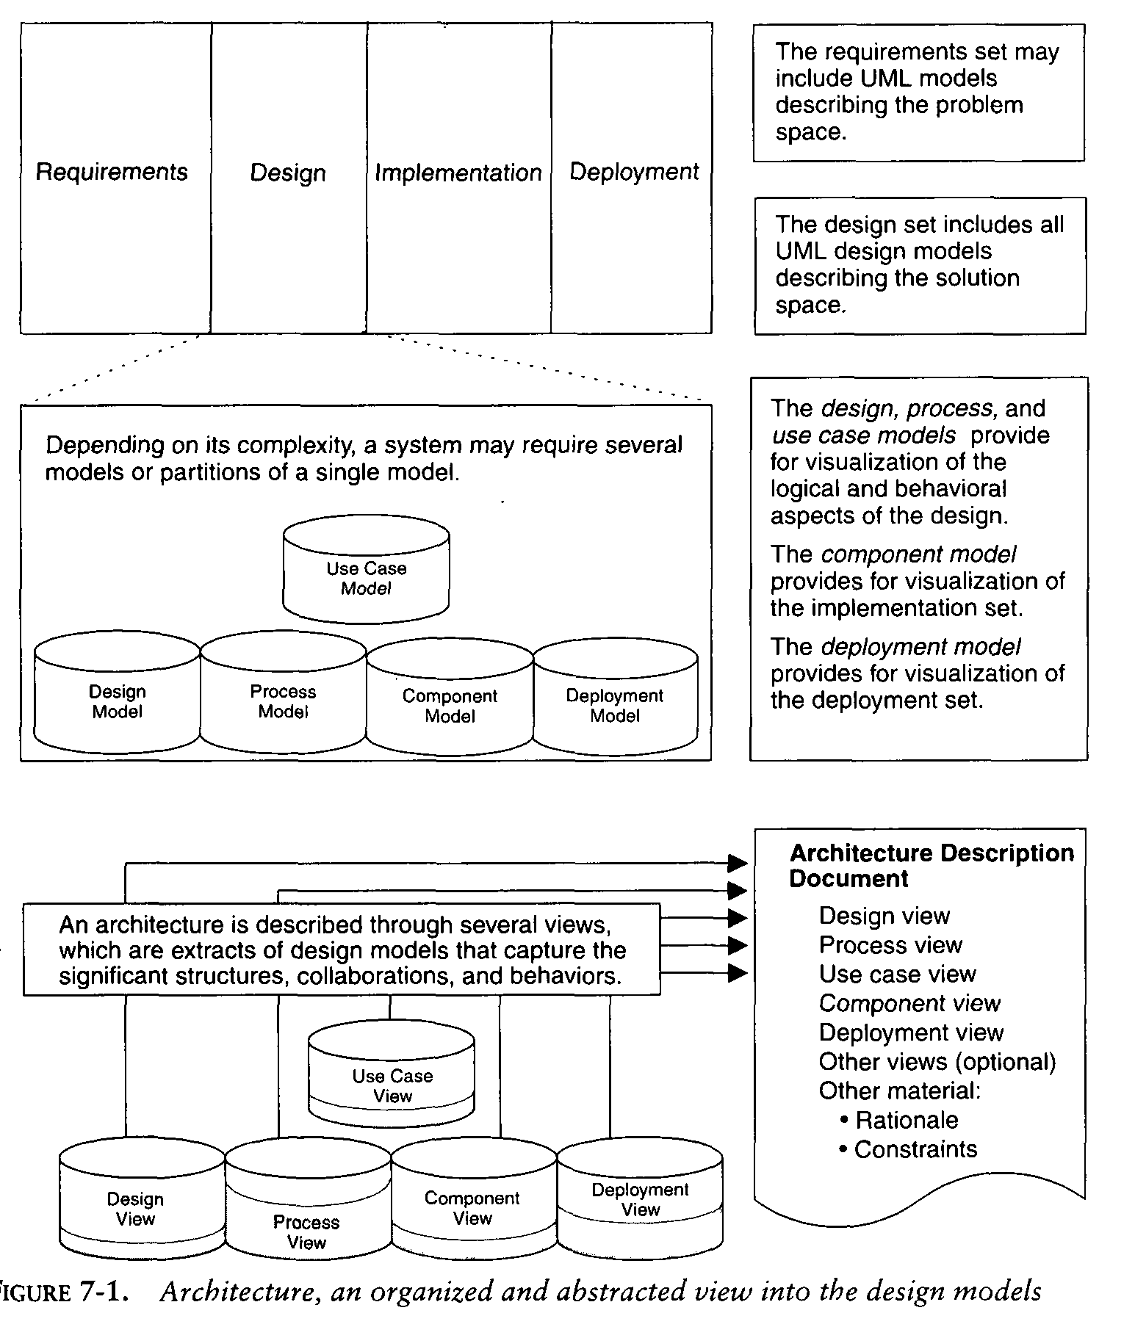

Slide 62
The use case view describes how the system's critical (architecturally significant) use cases are realized by elements of the design model. It is modeled statically using use case diagrams, and dynamically using any of the UML behavioral diagrams.
The design view describes the architecturally significant elements of the design model. This view, an
abstraction of the design model, addresses the basic structure and functionality of the solution. It is modeled statically using class and object diagrams, and dynamically using any of the UML behavioral diagrams.

Slide 63
The process view addresses the run-time collaboration issues involved in executing the architecture on a distributed deployment model, including the logical software network topology (allocation to processes and threads of control), inter process communication, and state management. This view is modeled statically using deployment diagrams, and dynamically using any of the UML behavioral diagrams.
The component view describes the architecturally significant elements of the implementation set. This view, an abstraction of the design model, addresses the software source code realization of the system from the perspective of the project's integrators and developers, especially with regard to releases and configuration management. It is modeled statically using component diagrams, and dynamically using any of the UML behavioral diagrams

Slide 64
The deployment view addresses the executable realization of the system, including the allocation of logical processes in the distribution view (the logical software topology) to physical resources of the deployment network (the physical system topology). It is modeled statically using deployment dia- grams, and dynamically using any of the UML behavioral diagrams.

Slide 65
Generally, an architecture baseline should include the following:
Requirements: critical use cases, system-level quality objectives, and priority relationships among features and qualities
• Design: names, attributes, structures, behaviors, groupings, and relationships of significant classes and components
• Implementation: source component inventory and bill of materials (number, name, purpose, cost) of all primitive components
• Deployment: executable components sufficient to demonstrate the critical use cases and the risk associated with achieving the system qualities

