Slide 1
GOOD MORNING
Finite State Machines
By :
Dr.M.V.SUBRAMANYAM
PRINCIPAL
SANTHIRAM ENGINEERING COLLGE, NANDYAL

Slide 2
Combinational and Sequential Circuit
Digital logic systems can be classified in two ways: combinational or sequential.
Combinational circuits can be completely described by the truth table.
Sequential systems contain state stored in memory elements internal to the system. Their behavior depends both on the set of inputs supplied and on the contents of the internal memory, or state of the system. Thus, a sequential system cannot be described with a truth table. Instead, a sequential system is described as a finite-state machine (or often just state machine).

Slide 3
Finite State Machines
A finite state machine has a set of states and two functions called the next-state function and the output function
The set of states correspond to all the possible combinations of the internal storage
If there are n bits of storage, there are 2^{n} possible states
The next state function is a combinational logic function that given the inputs and the current state, determines the next state of the system
Dr.M.V.SUBRAMANYAM

Slide 4
Finite State Machines
The output function produces a set of outputs from the current state and the inputs
There are two types of finite state machines
In a Moore machine, the output only depends on the current state
While in a Mealy machine, the output depends both the current state and the current input
We are only going to deal with the Moore machine.
These two types are equivalent in capabilities

Slide 5
Implementing an FSM
Outputs
Implement
transition
functions
Inputs
Current state
Next state
D
Q

Slide 6
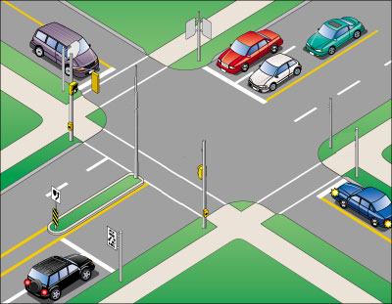
Intelligent Traffic Controller
We want to use a finite state machine to control the traffic lights at an intersection of a north-south route and an east-west route
We consider only the green and red lights
We want the lights to change no faster than 30 seconds in each direction
So we use a 0.033 Hz clock

Slide 7
Intelligent Traffic Controller
There are two output signals
NSlite: When the signal is asserted, the light on the north-south route is green; otherwise, it should be red
EWlite: When the signal is asserted, the light on the east-west route is green; otherwise, it should be red

Slide 8
Intelligent Traffic Controller
There are two inputs
NScar: Indicates that there is at least one car that is over the detectors placed in the roadbed in the north-south road
EWcar: Indicates that there is at least one car that is over the detectors placed in the roadbed in the east-west road

Slide 9
Finite state machines
SANTHIRAM ENGINEERING COLLEGE
Presented By
Dr. M. V. Subramanyam
Professor & Principal

Slide 10
Overview
Finite state machine
Types of FSM
Melay
Moore
Comparison
Example
Dr. M.V. Subramanyam|ECE|SREC
Digital electronics

Slide 11
definition
State diagram: The state diagram or state graph is a pictorial representation of the relationships between the present state, the input, the next state, and the output of a sequential circuit. The state diagram is a pictorial representation of the behavior of a sequential circuit.
Dr. M.V. Subramanyam|ECE|SREC
Digital electronics

Slide 12
Synthesis of sequential circuits
The synchronous or clocked sequential circuits are represented by two models.
1. Melay circuit: In this model, the output depends on both present state of the flip flop and the inputs.
2. Moore circuit: in this model, the output depends only on the present state of the flip flops
Dr. M.V. Subramanyam|ECE|SREC
Digital electronics

Slide 13
Continue…
The relation between the present state S(t), present input X(t), and next state s(t+1) can be given as
S(t+1)= f{S(t),X(t)}
The value of output Z(t) can be given as
Z(t)= g{S(t),X(t)} for mealy model
Z(t)= G{S(t)} for Moore model
Dr. M.V. Subramanyam|ECE|SREC
Digital electronics

Slide 14
Comparison between the Moore machine and
mealy machine
Dr. M.V. Subramanyam|ECE|SREC
Digital electronics

Slide 15
Melay model
Dr. M.V. Subramanyam|ECE|SREC
Digital electronics

Slide 16
Example
Convert the state diagram into logic circuit:
Dr. M.V. Subramanyam|ECE|SREC
Digital electronics

Slide 17
Continue…
In the above state diagram the output depends up on the present state of the flip-flop and input, it is referred as the Melay machine.
Now draw the state table and follow the sequential circuit design steps.
Dr. M.V. Subramanyam|ECE|SREC
Digital electronics

Slide 18
Continue…
.
Dr. M.V. Subramanyam|ECE|SREC
Digital electronics

Slide 19
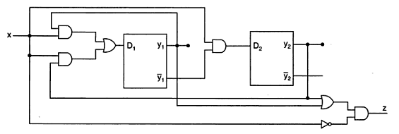
Logic diagram
Dr. M.V. Subramanyam|ECE|SREC
Digital electronics

Slide 20
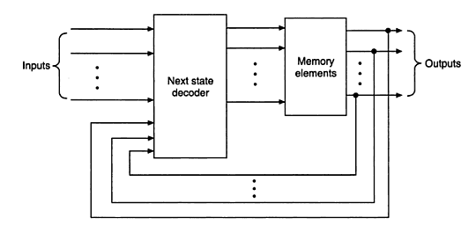
Moore machine
Dr. M.V. Subramanyam|ECE|SREC
Digital electronics

Slide 21
example
Convert the state diagram into logic circuit:
Dr. M.V. Subramanyam|ECE|SREC
Digital electronics

Slide 22
Continue…
In the above state diagram the output depends up only on the present state of the flip-flop, it is referred as the Moore machine.
Now draw the state table and follow the sequential circuit design steps.
Dr. M.V. Subramanyam|ECE|SREC
Digital electronics

Slide 23
Continue...
.
Dr. M.V. Subramanyam|ECE|SREC
Digital electronics

Slide 24
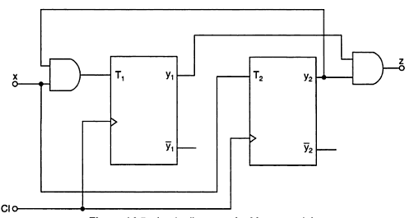
Logic diagram
Dr. M.V. Subramanyam|ECE|SREC
Digital electronics

Slide 25
Dr. M.V. Subramanyam|ECE|SREC
Digital electronics

