Slide 1
CONTINUOUS TIME FOURIER TRANSFORM
SIGNALS & SYSTEMS
UNIT/ CHAPTER-2
Dr.Y. Mallikarjuna Rao M.Tech., Ph.D
Professor & HOD
Electronics & Communication Engineering
Santhiram Engineering College, Nandyal, A.P
Email: hod.ece@srecnandyal.edu.in

Slide 2
CONTENTS
Continuous time Fourier transform (CTFT)
CTFT of some standard signals
CTFT properties
Inverse Fourier transform
Sampling theorem for low pass signals
Fourier Transform Dr.Y.Mallikarjuna Rao SREC, Nandyal 01/34

Slide 3
CONTINUOUS TIME FOURIER TRANSFORM (CTFT)
Let $x (t)$ be any aperiodic signal , then
the Fourier transform of $x(t)$ is
$X(j⍵)=\int_{−∞}^{∞}{x\left(t\right) e^{−jωt}dt}$ ----(1)
The inverse Fourier transform of x(j$ω) is$
$x(t) = \frac{1}{ 2π}\int_{−∞}^{∞}{X(jω)e^{jωt }dω}$ ----(2)
The first equation is called analysis equation and second one is synthesis equation.
Now , Fourier transform pair can be written as
$$x\left(t\right)\underset{↔}{F.T}X\left(jω\right)$$
Fourier Transform Dr.Y.Mallikarjuna Rao SREC, Nandyal 02/34

Slide 4
FOURIER TRANSFORM OF $e^{at}$ $u(−t)$
The fourier transform of $e^{at}$ $u(−t)$is
=$\int_{−∞}^{∞}{e^{at}}$ $u(−t) e^{−jωt}$ $dt$
=$\int_{−∞}^{0}{e^{at}}e^{−jωt}dt$
=$\int_{−∞}^{0}{e^{(a−jω)t}}dt$
= $\frac{1−0}{a−jω}$
= $\frac{1}{a−jω}$
$$X(jω)=\frac{1}{a−jω}$$
Fourier Transform Dr.Y.Mallikarjuna Rao SREC, Nandyal 01/34

Slide 5
FOURIER TRANSFORM OF $e^{at}$ $u(−t)$ (CONTD.)
The $X(jω) is a complex number,it can be expressed as$
$X(jω)=\left|X(jω)\right|{ e}^{jθ(ω)}$
$X(jω)= \frac{1}{a−jω}$ x $\frac{a+jω}{a+jω}$ = $\frac{a+jω}{a^{2}+ω^{2}}$
$=\frac{a}{a^{2}+ω^{2}}$ + $j\frac{ω}{a^{2}+ω^{2}}$
Now, the magnitude of$X(jω)$ is $\left|X(jω)\right|$= $\frac{1}{\sqrt{a^{2}+ω^{2}}}$
The phase angle of $X(jω)$ is $θ\left(ω\right)= \tan^{−1}{[\frac{\frac{ω}{a^{2}+ω^{2}} }{\frac{a}{a^{2}+ω^{2}}}]}$
${=tan}^{−1}\left(\frac{ω}{a}\right)$
Fourier Transform Dr.Y.Mallikarjuna Rao SREC, Nandyal 01/34

Slide 6
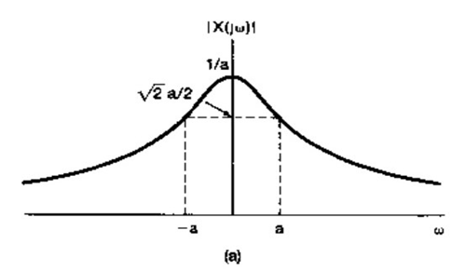
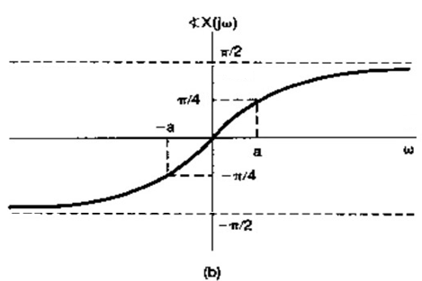
FOURIER TRANSFORM OF $e^{at}$ $u(−t)$ (CONTD.)
The Magnitude spectrum is
At $ω=−∞ ;\left|X\left(jω\right)\right|=0$
$ω= 0 ; \left|X(jω)\right|=\frac{1}{a}$
$ω= ∞ ;\left|X(jω)\right|=0$
The Phase spectrum can be drawn as
At $ω=−∞ ; θ\left(ω\right)=−{90}^{°}$
$ω= 0 ; θ\left(ω\right)=0^{°}$
$ω= ∞ ;$ $θ\left(ω\right)={90}^{°}$
Note:
1. Magnitude spectrum is even function of $ω$.
2. Phase spectrum is odd function of $ω$
Fourier Transform Dr.Y.Mallikarjuna Rao SREC, Nandyal 01/34

Slide 7
Find the Fourier transform of $e^{−at}$ $u(t)$
FOURIER TRANSFORM OF $e^{−at}$ $u(t)$
The fourier transform of $x(t)$
=$\int_{−∞}^{∞}{x(t)}$ $e^{−jωt}dt=$ $X(jω)$
Then the Fourier transform of $e^{−at}$ $u(t)$is =$\int_{−∞}^{∞}{e^{−at} u\left(t\right)}e^{−jωt}dt$ $=\int_{0}^{∞}{e^{−at}}$ $e^{−jωt}dt$
$=\int_{0}^{∞}{e^{−\left(a+jω\right)t}}$ $dt$
$=\frac{0−1}{−(a+jω)}$
$$X(jω)=\frac{1}{a+jω}$$
$∴$ $x(t)$ $\underset{↔}{F.T}X(jω)$
and $e^{−at}$ $u(t)\underset{↔}{F.T}\frac{1}{a+jω}$
Fourier Transform Dr.Y.Mallikarjuna Rao SREC, Nandyal 01/34

Slide 8
FOURIER TRANSFORM OF $e^{−at}$ $u(t)$ (CONTD.)
We Know, $e^{−at }u(t)↔\underset{↔}{F.T}$ $\frac{1}{a+jω}$
Since $X(jω)=\frac{1}{a+jω}$ is a complex number, $X(jω)$can be expressed as
$$X\left(jω\right)=\left|X(jω)\right|{ e}^{jθ(ω)}$$
Where $\left|X(jω)\right|=$Magnitude of $X(jω)$
$θ\left(ω\right)=$ Phase angle of $X(jω)$
$\left|X(jω)\right|$ = $\frac{1}{\sqrt{a^{2}+ω^{2}}}$ ;
$θ\left(ω\right)=−\tan^{−1}({\frac{ω}{a})}$
Fourier Transform Dr.Y.Mallikarjuna Rao SREC, Nandyal 01/34

Slide 9
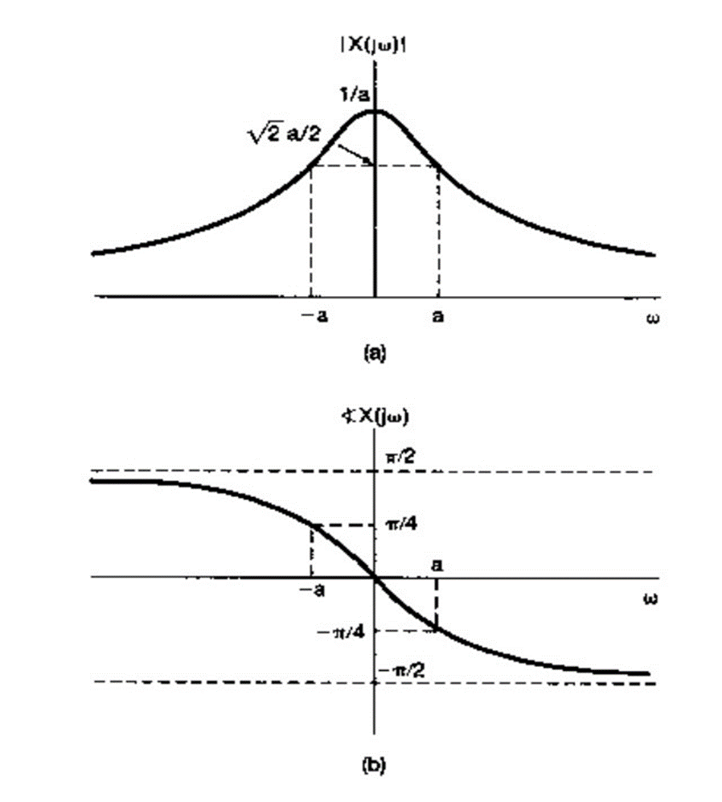
FOURIER TRANSFORM OF $e^{−at}$ $u(t)$ (CONTD.)
Magnitude spectrum $\left|X(jω)\right|=\frac{1}{\sqrt{a^{2}+ω^{2}}}$
At $ω=−∞ ;\left|X\left(jω\right)\right|=0$
$ω= 0 ; \left|X(jω)\right|=\frac{1}{a}$
$ω= ∞ ;\left|X(jω)\right|=0$
$∴$Magnitude is an even function
i.e;$\left|X(−jω)\right|$= $\left|X(jω)\right|$
Phase spectrum:-
$θ\left(ω\right)=−\tan^{−1}\left(\frac{ω}{a}\right)$
At $ω=−∞ ; θ\left(ω\right)={90}^{°}$
$ω= 0 ; θ\left(ω\right)=0^{°}$
$ω= ∞ ;$ $θ\left(ω\right)=−{90}^{°}$
Fourier Transform Dr.Y.Mallikarjuna Rao SREC, Nandyal 01/34

Slide 10
Find the Fourier transform of a Rectangular function
FOURIER TRANSFORM OF $A$ $Rect$ $\left(\frac{t}{τ}\right)$
Given $x(t)$= $A$ $Rect$ $\left(\frac{t}{τ}\right)$
$x(t)$ = $A Rect$ $\left(\frac{t}{τ}\right)=A ;$ for $\frac{−τ}{2}$ $≤ τ≤\frac{τ}{2}$
$=0;$ else where
The Fourier transform of $A Rect \left(\frac{τ}{2}\right)$ is
$=\int_{−∞}^{∞}{A }Rect \left(\frac{t}{τ}\right)$ $e^{−jωt}$ $dt$
$=\int_{\frac{−τ}{2}}^{\frac{τ}{2}}{A}$ $e^{−jωt}dt$ $= A \int_{\frac{−τ}{2}}^{\frac{τ}{2}}{e^{−jωt}}$ $dt=A\left[\frac{e^{\frac{−jωt}{2}}−e^{\frac{jωt}{2}}}{−jω}\right]$
=$A\left[\frac{e^{\frac{+jωt}{2}}−e^{\frac{−jωt}{2}}}{jω}\right] =\frac{2A}{ω}\left[\frac{e^{\frac{jωt}{2}}−e^{\frac{−jωt}{2}}}{2j}\right]=\frac{2A}{ω}\left[\sin\left(\frac{ωτ}{2}\right)\right]=\frac{τ}{2}2A\left[\frac{\sin\left(\frac{ωτ}{2}\right)}{\frac{ωτ}{2}}\right]$
$X(jω)=Aτ sa \left(\frac{ωτ}{2}\right)$ ; $∴A Rect$ $\left(\frac{t}{τ}\right)\underset{↔}{F.T}Aτ sa \left(\frac{ωτ}{2}\right)$
Fourier Transform Dr.Y.Mallikarjuna Rao SREC, Nandyal 01/34

Slide 11
MAGNITUDE SPECTRUM OF RECTANGULAR SIGNAL
Fourier Transform Dr.Y.Mallikarjuna Rao SREC, Nandyal 01/34

Slide 12
FOURIER TRANSFORM OF $e^{−a\left|t\right|}$
Given $x\left(t\right)=e^{−a\left|t\right|}$
$=e^{−at }$for $t>0$
$=e^{at}$ for $t<0$
$∴$ The Fourier transform of $e^{−a\left|t\right|}$ is
$=\int_{−∞}^{∞}{e^{−a\left|t\right|}} e^{−jωt}dt$
$=\int_{−∞}^{0}{e^{at}}$ $e^{−jωt}$ $dt$ + $\int_{0}^{∞}{e^{−at }}$ $e^{−jωt}$ $dt$
$=\frac{1}{a−jω}+\frac{1}{a+jω}$
$e^{−a\left|t\right|}\underset{↔}{F.T}\frac{1}{a−jω}+\frac{1}{a+jω}$
$X\left(jω\right)=\frac{2ω}{a^{2}+ω^{2}}$
$e^{−a\left|t\right|}\underset{↔}{F.T}\frac{2a}{a^{2}+ω^{2} }$
Fourier Transform Dr.Y.Mallikarjuna Rao SREC, Nandyal 01/34

Slide 13
FOURIER TRANSFORM OF SIGNUM FUNCTION
Sol:- s$gn \left(t\right)=\left\{\begin{aligned}\text{= 1 ; }t>0 \\ \text{= 0 ; }t=0 \\ \text{= −1 ;}t<0\end{aligned}\right.$ The above function in not absolutely integrable so consider the function $e^{−a\left|t\right|} sgn⁡(t)$ and substitute the limit $a→0$ $\log_{a→0}{e^{−a\left|t\right|}}\operatorname{sgn}\left(t\right)=sgn⁡(t)$
Fourier Transform Dr.Y.Mallikarjuna Rao SREC, Nandyal 01/34

Slide 14
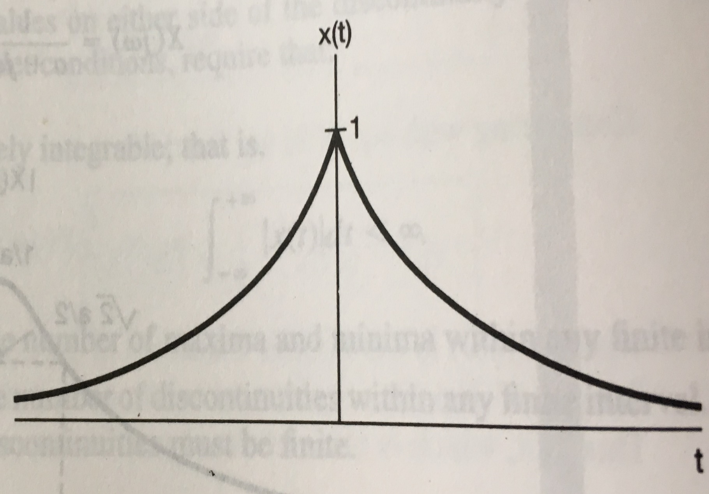
FOURIER TRANSFORM OF SIGNUM FUNCTION (CONTD.)
$X(jω)=$ $\lim_{a→0}{\int_{−∞}^{∞}{e^{−a\left|t\right|}}}$ sgn(t) $e^{−iωt}$ $dt$
$=\lim_{a→0}$ $\left[−\int_{−∞}^{∞}{e^{at}e^{−iωt} dt}+\int_{0}^{∞}{e^{−at}e^{−iωt} dt}\right]$ ${=lim}_{a→0}$ $\left[−\left(\frac{1}{a−jω}\right)+\frac{1}{(a+jω)}\right]$ ${=lim}_{a→0}$ $\frac{−2jω}{a^{2}+ω^{2}}$ $=\frac{−2j}{ω}=\frac{2j^{3}}{j^{4} ω}=\frac{2}{jω}$ $∴sgn(t)$ $\underset{↔}{F.T}$ $\frac{2}{j^{ω}}$
Fourier Transform Dr.Y.Mallikarjuna Rao SREC, Nandyal 01/34

Slide 15
We know $x\left(t\right)=u\left(t\right)=\frac{1}{2}$ + $\frac{1}{2} sgn (t)$ Apply Fourier transform on both sides $X(jω)$ = $\frac{1}{2}$ $F(1)$ + $\frac{1}{2}$ $F [sgn(t)]$ = $\frac{1}{2}$[2$πδ(ω)$] +$\frac{1}{2}$ [$\frac{2}{j^{ω}}$] $X(jω)$ = $πδ(ω)$ +$\frac{1}{j^{ω}}$ $∴u(t)$ $\underset{↔}{F.T }$ $πδ(ω)$ +$\frac{1}{j^{ω}}$
FOURIER TRANSFORM OF UNIT STEP FUNCTION
Fourier Transform Dr.Y.Mallikarjuna Rao SREC, Nandyal 01/34

Slide 16
FOURIER TRANSFORM OF $e^{at}$ $u(−t)$ (CONTD.)
Sol:- The inverse Fourier transform of $δ\left(ω\right)$ is
= $\frac{1}{2π}$ $\int_{−∞}^{∞}{δ(ω)}$ $e^{jωt}$ $dω$
[from sampling property of $δ$(t), i.e, $x\left(t\right)δ\left(t\right)=x\left(0\right)δ\left(t\right)$]
$=\frac{1}{2π}$ $\int_{−∞}^{∞}{δ\left(ω\right)}$ $e^{0}$ $dω$
$=\frac{1}{2π}$ $\int_{−∞}^{∞}{δ\left(ω\right)}$ $dω$
$=\frac{1}{2π}$
$\frac{1}{2π}$ $\underset{↔}{F.T}$ $δ\left(ω\right)$ ; Multiply on both sides by $2π$
$∴$ 1 $\underset{↔}{F.T}$ 2$π$ $δ\left(ω\right)$
Fourier Transform Dr.Y.Mallikarjuna Rao SREC, Nandyal 01/34

Slide 17
INVERSE FOURIER TRANSFORM OF $δ(ω−ω_{0)}$
Inverse Fourier transform of $δ(ω−ω_{0)}$
$=\frac{1}{2π}$ $\int_{−∞}^{∞}{δ(ω−ω_{0)}}$ $e^{jωt}$ $dω$
$=\frac{1}{2π}$ $\int_{−∞}^{∞}{δ(ω−ω_{0)}}$ $e^{jω_{0}t}dω$
$=\frac{e^{jω_{0}t}}{2π}$ $\int_{−∞}^{∞}{δ(ω−ω_{0)}}$ $dω$
$=\frac{e^{jω_{0}t}}{2π}$
$\frac{e^{jω_{0}t}}{2π}$ $\underset{↔}{F.T}δ(ω−ω_{0)}$
${∴e}^{jω_{0}t}$ $\underset{↔}{F.T}$ 2$π δ(ω−ω_{0)}$
Similarly, $e^{jω_{0}t}$ $\underset{↔}{F.T}$ 2$π δ(ω−ω_{0)}$
Fourier Transform Dr.Y.Mallikarjuna Rao SREC, Nandyal 01/34

Slide 18
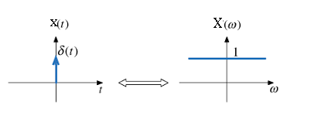
FOURIER TRANSFORM OF $δ(t)$
The Fourier transform of $δ(t)=\int_{−∞}^{∞}{δ(t)}$ $e^{−jωt}$ $dt$
$=\int_{−∞}^{∞}{δ\left(t\right).}e^{0}$.$dt=$ $\int_{−∞}^{∞}{δ\left(t\right).}$ $dt=1$
$δ(t)\underset{↔}{F.T}$1
Fourier Transform Dr.Y.Mallikarjuna Rao SREC, Nandyal 01/34

Slide 19
FOURIER TRANSFORM OF sin$ω_{0}$t
We know $sin⁡ω_{0}$t = $\frac{e^{−jω_{0}t}−e^{jω_{0}t}}{2j}$
$F[sin⁡ω_{0}$t ] = $\frac{1}{2j}$[$F(e^{jω_{0}t}$)- $F(e^{−jω_{0}t}$)]
= $\frac{1}{2j}\left[2πδ\left(ω−ω_{0}\right)−2πδ(ω+ω_{0})\right]$
= $\frac{π}{j}\left[πδ\left(ω−ω_{0}\right)−2πδ(ω+ω_{0})\right]$
$∴F[sinω_{0}$t ] $\underset{↔}{F.T}$ $\frac{π}{j}\left[δ\left(ω−ω_{0}\right)−δ(ω+ω_{0})\right]$
Fourier Transform Dr.Y.Mallikarjuna Rao SREC, Nandyal 01/34

Slide 20
FOURIER TRANSFORM OF cos$ω_{0}t$
$\cos{{ ω}_{0}t}$ $=\frac{e^{jω_{0}t}+e^{−jω_{0}t}}{2}$
$F [\cos{{ ω}_{0}t}$] $=F\left[\frac{e^{jω_{0}t}+e^{−jω_{0}t}}{2}\right]$
$= F\left[\frac{e^{jω_{0}t}}{2}\right]+F\left[\frac{e^{−jω_{0}t}}{2}\right]$
$=$ $\frac{ 1}{ 2}F\left[\frac{e^{jω_{0}t}}{2}\right]+\frac{ 1}{ 2}F\left[\frac{e^{−jω_{0}t}}{2}\right]$
$=\frac{1}{2}$ [2$π$ $δ(ω−ω_{0 }$)$+\frac{1}{2}$ [2$π$ $δ(ω+ω_{0 }$)]
$=$ $π \left[δ\left(ω−ω_{0 }\right)+δ(ω+ω_{0 }\text{) }\right]$
[$\cos{{ ω}_{0}t}$ ] $\underset{↔}{F.T}π \left[δ\left(ω−ω_{0 }\right)+δ(ω+ω_{0 }\text{) }\right]$
Fourier Transform Dr.Y.Mallikarjuna Rao SREC, Nandyal 01/34

Slide 21
DIRICHLET’S CONDITIONS
All the signals does not have Fourier transform Ex: $e^{at }u(t)$ does not have Fourier transform. The signals which satisfy the Dirichlet's conditions do have the Fourier transform. 1). The signal $x(t)$ must be absolutely integrable i.e. $\int_{∞}^{−∞}{x(t}$) $dt$ <$∞$ 2). The signal x(t) must have finite number of maxima and minima over any finite time period 3). The signal x(t) must have finite number of discontinuities over finite time duration and each of the discontinuity should be also finite. *Dirichlet’s conditions are sufficient conditions.
Fourier Transform Dr.Y.Mallikarjuna Rao SREC, Nandyal 01/34

Slide 22
PROPERTIES OF FOURIER TRANSFORM :
1. Linearity
If ${ x}_{1}(t) \underset{↔}{F.T}$ $X_{1}$(j$ω)$
and ${ x}_{2}(t) \underset{↔}{F.T}$ $X_{2}$(j$ω)$
then A$x_{1}(t)$+B $x_{2}(t)\underset{↔}{F.T}$ A $X_{1}$(j$ω)$ +${ X}_{2}$(j$ω)$
Proof:-
The Fourier Transform of ${ x}_{1}(t)$ is
= $\int_{−∞}^{∞}{x_{1}(t)} e^{−jωt}$ $dt$
= $X_{1}$(j$ω)$
The Fourier transform of $A$ $x_{1}(t) is$
Fourier Transform Dr.Y.Mallikarjuna Rao SREC, Nandyal 01/34

Slide 23
PROPERTIES OF FOURIER TRANSFORM (CONTD.)
= $\int_{−∞}^{∞}{Ax_{1}(t)} e^{−jωt}$ $dt$
= $A$ $\int_{−∞}^{∞}{x_{1}(t)} e^{−jωt}$ $dt$
= $A$ $X_{1}$(j$ω)$
The Fourier Transform of $B$ $x_{2}(t)$ is
$=\int_{−∞}^{∞}{Bx_{2}(t)} e^{−jωt}$ $dt$ $=B\int_{−∞}^{∞}{x_{2}(t)} e^{−jωt}$ $dt$
$=B$ $X_{2}(jω)$ A$x_{1}(t)\underset{↔}{F.T}$ $A$ $X(jω)$ B $x_{2}(t)\underset{↔}{F.T}$ $B{ X}_{2}(jω)$
Fourier Transform Dr.Y.Mallikarjuna Rao SREC, Nandyal 01/34

Slide 24
PROPERTIES OF FOURIER TRANSFORM (CONTD.)
Then the Fourier Transform of ${A x}_{1}\left(t\right)+Bx_{2}(t)$ =$\int_{−∞}^{∞}{\left[\text{A}x_{1}\left(t\right)+\text{B} x_{2}(t) \right]}$ $e^{−jωt}$ $dt$
=$\int_{−∞}^{∞}{Ax_{1}}(t) e^{−jωt}$ $dt$ + $\int_{−∞}^{∞}{Bx_{2}}(t) e^{−jωt}$ $dt$ =$A\int_{−∞}^{∞}{x_{1}}(t) e^{−jωt}$ $dt$ + $B\int_{−∞}^{∞}{x_{2}}(t) e^{−jωt}$ $dt$ = $A{ X}_{1}(jω)$+$B{ X}_{2}(jω)$ $∴{A x}_{1}\left(t\right)+B x_{2}(t)\underset{↔}{F.T}$ $A X_{1}(jω)$+$B{ X}_{2}(jω)$
Fourier Transform Dr.Y.Mallikarjuna Rao SREC, Nandyal 01/34

Slide 25
If $x\left(t\right)$ $\underset{↔}{F.T }$ $X(jω)$ then $x$($t$-$t_{0})$ $\underset{↔}{F.T} X(jω)e^{−jωt_{0}}$ Sol:- Then Fourier transform of $x \left(t\right)$ is $=\int_{−∞}^{∞}{x\left(t\right)}$ $e^{−jωt}$ $dt$ $=X(jω)$ The Fourier transform of $x$($t$-$t_{0})$ is $=\int_{−∞}^{∞}{x\left(t\text{−}t_{0}\right)}$ $e^{−jωt}$ $dt$ Let $t\text{−}t_{0}=τ$ $\frac{dt}{dτ}=1$ $⇒$ $dτ=$ $dt$
PROPERTIES OF FOURIER TRANSFORM (CONTD.)
2.Time shift property
Fourier Transform Dr.Y.Mallikarjuna Rao SREC, Nandyal 01/34

Slide 26
Time shift property (contd)
PROPERTIES OF FOURIER TRANSFORM (CONTD.)
When $\left\{\begin{aligned}t=∞ ; τ=∞ \\ t=−∞ ;τ=−∞\end{aligned}\right.$ $∴\int_{−∞}^{∞}{x(τ)e^{−jω(τ+t_{0})}}$ $dτ$ = $\int_{−∞}^{∞}{x(τ)}$ $e^{−jωτ}$ .${ e}^{−jωt_{0}}$ $dτ={ e}^{−jωt_{0}}$ $\int_{−∞}^{∞}{x(τ)}$ $e^{−jωτ}$ $dt$ = ${ e}^{−jωt_{0}}X(jω)$ $∴$ $x\left(t\text{−}t_{0}\right)$ $\underset{↔}{F.T }$ $e^{−jωt_{0}}$ $X (jω)$ Similarly,$∴$ $x\left(t\text{+}t_{0}\right)$ $\underset{↔}{F.T }$ $e^{jωt_{0}}$ $X (jω)$
Note:
1. Shift in time domain $is$equivalent to $X(jω)$ is multiplied with $e^{±jωt_{0}}.$
Fourier Transform Dr.Y.Mallikarjuna Rao SREC, Nandyal 01/34

Slide 27
PROPERTIES OF FOURIER TRANSFORM (CONTD.)
Frequency Shift Property
If $x(t)\underset{↔}{F.T }$ $X(jω)$ Then $x(t)$ $e^{−jω_{0}t}$ $\underset{↔}{F.T}$ ?
The Fourier Transform of $x(t)$is
=$\int_{−∞}^{∞}{x\left(t\right) }e^{−jωt} dt$
=$X(jω)$
The Fourier transform of $e^{−jω_{0}t}$ $x(t)$is
= $\int_{−∞}^{∞}{x\left(t\right)}$ $e^{−jω_{0}t}$ $e^{−jωt}$ $dt$
=$\int_{−∞}^{∞}{x\left(t\right)}e^{−j(ω+ω_{0})t}$ $dt$
= $\int_{−∞}^{∞}{x\left(t\right)}e^{−j(ω+ω_{0})t}$ $dt$ = $X \left[j(ω+ω_{0}\right]$
Or simply = $X$($ω+ω_{0}$)
Fourier Transform Dr.Y.Mallikarjuna Rao SREC, Nandyal 01/34

Slide 28
3.Frequency shift property:- (Contd.)
PROPERTIES OF FOURIER TRANSFORM (CONTD.)
$∴$ $e^{−jω_{0}t}x(t)\underset{↔}{F.T}X$($ω+ω_{0}$)
Similarly, $e^{jω_{0}t}x(t) \underset{↔}{F.T}$ $X[$($ω−ω_{0}$)]
Note:
1. A signal multiplied with $e^{±jω_{0}t}$ in time domain is equivalent to shift in frequency ($ω∓ω_{0}$) occurs.
Fourier Transform Dr.Y.Mallikarjuna Rao SREC, Nandyal 01/34

Slide 29
4. Time scaling property:-
PROPERTIES OF FOURIER TRANSFORM (CONTD.)
If $x(t)$ $\underset{↔}{F.T}$ $X$(j$ω$) Then $x(at)$ $\underset{↔}{F.T}$ ?
Then Fourier transform of $x(t)$ is $=\int_{−∞}^{∞}{x(t)}$ $e^{−jωt} dt$
$=$ $X$(j$ω$)
Then the Fourier transform of $x(at)$ is $=$ $\int_{−∞}^{∞}{x(at)}$ $e^{−jωt} dt$
Let $at=τ$ $⇒t= \frac{τ}{a}$ $a\frac{dt}{dτ}=1⇒dt=\frac{1}{a}dτ$
When $t=−∞ ; τ=−∞$ $t=+∞ ; τ=+∞$
Fourier Transform Dr.Y.Mallikarjuna Rao SREC, Nandyal 01/34

Slide 30
4. Time scaling property(contd.)
PROPERTIES OF FOURIER TRANSFORM (CONTD.)
$=\int_{−∞}^{∞}{x\left(τ\right)e^{−jω\frac{τ}{a}}}$ $\frac{1}{a}$ $dτ$ $=\frac{1}{a}\int_{−∞}^{∞}{x\left(τ\right)e^{−j\frac{ω}{a}τ}}$ $dτ=\frac{1}{a}$ $X\left(\frac{jω}{a}\right)=\frac{1}{a}X\left(\frac{ω}{a}\right)$
$x\left(at\right)\underset{↔}{F.T}$ $\frac{1}{a}$ $X\left(\frac{ω}{a}\right)$
If ‘a’ is Negative $x\left(−at\right)\underset{↔}{F.T}$ $\frac{1}{a}$ $X\left(\frac{ω}{a}\right)$
$∴$ $x\left(at\right)\underset{↔}{F.T}$ $\frac{1}{\left|a\right|}$ $X\left(\frac{ω}{a}\right)$
Note: Expansion in time domain is equivalent to compression in frequency domain and
vice versa.
Fourier Transform Dr.Y.Mallikarjuna Rao SREC, Nandyal 01/34

Slide 31
5. Time Reversal Property:-
PROPERTIES OF FOURIER TRANSFORM (CONTD.)
The Fourier transform of x(t) is $= \int_{−∞}^{∞}{x(t)}$ $e^{−jωt} dt=X(jω)$
The Fourier Transform of x$(−t)$is
$=$ $\int_{−∞}^{∞}{x(−t)}$ $e^{−jωt} dt$ Let $–t=τ$ when $t=−∞ ; τ=∞$ $dt=−d τ$ $t=∞ ; τ=−∞$
$∴X(jω)=$ $\int_{∞}^{−∞}{x(τ)}$ $e^{−j(−ω)t} (−dt)$
$=$ -$\int_{−∞}^{∞}{x(τ)}$ $e^{−j(−ω)t} (−dt)$
Fourier Transform Dr.Y.Mallikarjuna Rao SREC, Nandyal 01/34

Slide 32
5. Time Reversal Property:-(Contd.)
PROPERTIES OF FOURIER TRANSFORM (CONTD.)
$=\int_{−∞}^{∞}{x(τ)}$ $e^{−j(−ω)t} (−dt)$
$=$ x(-j$ω)$ or simply
$=$ x(- $ω$)
$X(t) \underset{↔}{F.T}$X(j$ω)$
Then $x(−t)$ $\underset{↔}{F.T}$ $X$(-j$ω)$
Fourier Transform Dr.Y.Mallikarjuna Rao SREC, Nandyal 01/34

Slide 33
6. Time Differentiation Property:-
Fourier transform of $e^{at}$ $u(−t)$ (Contd.)
If$x(t) \underset{↔}{F.T}X(jω)$
Then $\frac{dx(t)}{dt}$ $\underset{↔}{F.T}$ ?
Sol:- we know that
$X$(j$ω)$ = $\int_{−∞}^{∞}{x\left(t\right) e^{−jωt}}$ $dt$
and $x(t)$= $\frac{1}{2π}$ $\int_{−∞}^{∞}{X\left(jω\right) e^{−jωt}}$ $dω$
Fourier Transform Dr.Y.Mallikarjuna Rao SREC, Nandyal 01/34

Slide 34
6. Time Differentiation Property:-(Contd.)
Fourier transform of $e^{at}$ $u(−t)$ (Contd.)
If we differentiate the above equation
$\frac{dx(t)}{dt}$ = $\frac{1}{2π}$ $\int_{−∞}^{∞}{X\left(jω\right) {\frac{d}{dt} (e}^{jωt})}$ $dω$
= $\frac{1}{2π}$ $\int_{−∞}^{∞}{X\left(jω\right)(jω)}$ $e^{jωt}$ $dω$
$∴ \frac{dx(t)}{dt}$ $\underset{↔}{F.T}\left(jω\right)X\left(jω\right)$
Similarly
$\frac{d^{n} x(t)}{dt^{n}}$ $\underset{↔}{F.T }$ (${jω)}^{n }$ X(j$ω$)
Fourier Transform Dr.Y.Mallikarjuna Rao SREC, Nandyal 01/34

Slide 35
7. Differentiation in Frequency Domain:-
Fourier transform of $e^{at}$ $u(−t)$ (Contd.)
If $x\left(t\right) \underset{↔}{F.T}$ X(j$ω$)
Then $t$ $x\left(t\right) \underset{↔}{F.T}$ -j$\frac{d\text{x}\text{(}\text{j}ω\text{) }}{dω}$
Sol:- We know , by definition
$X$(j$ω$) = $\int_{−∞}^{∞}{x\left(t\right) e^{−jωt}}$ $dt$
Differentiate above equation w.r.t ‘$ω^{′}$
$\frac{d\text{x}\text{(}\text{j}ω\text{) }}{dω}=$ $\int_{−∞}^{∞}{x\left(t\right)}$ $\frac{d\left(e^{−jωt}\right) }{dω}$ $dt$
= $\int_{−∞}^{∞}{x\left(t\right)} \left(−jt\right)$ $e^{−jωt}$ $dt$
Fourier Transform Dr.Y.Mallikarjuna Rao SREC, Nandyal 01/34

Slide 36
7. Differentiation in Frequency Domain:-(Contd.)
Fourier transform of $e^{at}$ $u(−t)$ (Contd.)
$∴ X(t)\underset{↔}{F.T}$ X(j$ω)$
$−jt$ $x(t)\underset{↔}{F.T}$ $\frac{d\text{x}\text{(}\text{j}ω\text{) }}{dω}$ or
$t x\left(t\right)\underset{↔}{F.T}$ j $\frac{d\text{x}\text{(}\text{j}ω\text{) }}{dω}$
Similarly
${(−jt)}^{n}$ $x(t)$ $\underset{↔}{F.T}$ $\frac{d^{n} X(jω)}{dω^{n}}$
Fourier Transform Dr.Y.Mallikarjuna Rao SREC, Nandyal 01/34

Slide 37
8.Complex conjugate symmetry:-
Fourier transform of $e^{at}$ $u(−t)$ (Contd.)
If $x\left(t\right) \underset{↔}{F.T}$ X(j$ω)$
Then $x^{∗}$ $(t)$ $\underset{↔}{F.T}X^{∗}\text{(−}\text{j}ω)$
Proof:- $X^{∗}\text{(}\text{j}ω)$ $=$ $\left[\int_{−∞}^{∞}{x\left(t\right)e^{−jωt} dt}\right]$
$=\int_{−∞}^{∞}{X^{∗}\left(t\right){ e}^{jωt} dt}$
Now replace ‘$ω^{′}$ by –’$ω^{′},$then
$$X^{∗}\text{(−}\text{j}ω) = \int_{−∞}^{∞}{x^{∗}\left(t\right){ e}^{−jωt} dt}$$
$x^{∗}\left(t\right)\underset{↔}{F.T}$ $X^{∗}\text{(−}\text{j}ω)$
Fourier Transform Dr.Y.Mallikarjuna Rao SREC, Nandyal 01/34
Continuous Wave Modulation Dr.Y.Mallikarjuna Rao SREC, Nandyal 02/34

Slide 38
9.Duality Property:-
Fourier transform of $e^{at}$ $u(−t)$ (Contd.)
If$x(t)↔$ $X(jω)$
$X(t) ↔$ $2πx$(-$ω$)
Proof:- we know$x(t)$ $=\frac{1}{2π}$ $\int_{−∞}^{∞}{X\left(jω\right)e^{−jωt}}$ $dω$
Then $2πx(t) = \int_{−∞}^{∞}{X\left(jω\right)e^{jωt}}$ $dω$
Replace $t$ with $−t$in above equation
$2π$ $x(−t)$ $= \int_{−∞}^{∞}{X\left(jω\right)e^{−jωt}}$ $dω$
interchange ‘$ω$’ and ‘$t$’
$2π$ $x(−ω)$ $= \int_{−∞}^{∞}{X\left(jt\right)e^{−jωt}}$ $dt$
$X(t)$ $\underset{↔}{F.T}2πx$(-$ω$)
Fourier Transform Dr.Y.Mallikarjuna Rao SREC, Nandyal 01/34

Slide 39
Duality Property- Problem-1
Fourier transform of $e^{at}$ $u(−t)$ (Contd.)
* Find the Fourier transform for $\frac{1}{a+jt}$
Sol:- $X(jω)$ = $\int_{−∞}^{∞}{\left[\frac{1}{a+jt}\right]}$ $e^{−jωt}$ $dt$
It is difficult to integrate
then we use the Relation
$e^{−at }u(t)$ $\underset{↔}{F.T}$ $\frac{1}{a+jω}$
We know duality property
$X(t)$ $\underset{↔}{F.T}$ 2$π x(−ω$)
$\frac{1}{a+jt}\underset{↔}{F.T}$ 2$π$ $e^{−a(−ω)}$ $u (− ω)$
Fourier Transform Dr.Y.Mallikarjuna Rao SREC, Nandyal 01/34

Slide 40
Duality Property- Problem-2
Fourier transform of $e^{at}$ $u(−t)$ (Contd.)
Find the Fourier transform for $\frac{2}{1+t^{2}}$
Sol:- $e^{−a\left|t\right|}$ $\underset{↔}{F.T}$ $\frac{2ω}{ω^{2}+a^{2}}$
Sol:- $X(jω)$ = $\int_{−∞}^{∞}{\left[\frac{2}{1+t^{2}}\right]}$ $e^{−jωt}$ $dt$
It is difficult to integrate
then we use the Relation
$e^{−a\left|t\right| }u(t)$ $\underset{↔}{F.T}$ $\frac{2a}{a+ω^{2}}$
We know duality property
$X(t)$ $\underset{↔}{F.T}$ 2$π x(−ω$)
$\frac{2}{1+t^{2}}$ $\underset{↔}{F.T}$ 2$π e^{−\left|ω\right|}$
Fourier Transform Dr.Y.Mallikarjuna Rao SREC, Nandyal 01/34

Slide 41
Duality Property- Problem-3
Fourier transform of $e^{at}$ $u(−t)$ (Contd.)
Find the Fourier Transform of $\frac{2}{jt}$
Sol:- We Know $Sgn(t)$ $\underset{↔}{F.T}$ $\frac{2}{j^{ω}}$
$x(t)$ $\underset{↔}{F.T}$ X(j$ω)$
According to Duality Property
$X(t)$ $\underset{↔}{F.T}$ 2$π x$(-$ω)$
$∴$ $\frac{2}{jt}$ $\underset{↔}{F.T}$ 2$π sgn$(-$ω)$
Fourier Transform Dr.Y.Mallikarjuna Rao SREC, Nandyal 01/34

Slide 42
10. Multiplication Property:-
Fourier transform of $e^{at}$ $u(−t)$ (Contd.)
If $x_{1}(t) \underset{↔}{F.T}$ $X_{1}$($jω)$
and $x_{2}(t) \underset{↔}{F.T}$ $X_{2}$($jω)$
then $x_{1}(t) x_{2}(t) \underset{↔}{F.T}$ ?
Sol:- By Definition
$x_{1}(t) =$ $\frac{1}{2π}$ $\int_{−∞}^{∞}{X_{1}\text{(}jω) e^{jωt}}$ $dω$
$x_{2}(t) =$ $\frac{1}{2π}$ $\int_{−∞}^{∞}{X_{2}\text{(}jω) e^{jωt}}$ $dω$
The Fourier Transform of $x\left(t\right)$ is
$=$ $\int_{−∞}^{∞}{x\left(t\right)}$ $e^{jωt}$ $dt$
$=$ $X (jω)$
Fourier Transform Dr.Y.Mallikarjuna Rao SREC, Nandyal 01/34

Slide 43
10. Multiplication Property:-(Contd.)
Fourier transform of $e^{at}$ $u(−t)$ (Contd.)
The Fourier Transform of $x_{1}(t) x_{2}(t)$is
= $\int_{−∞}^{∞}{x_{1}\text{(}\text{t}\text{) }x_{2}\text{(}\text{t}\text{)}}$ $e^{−jωt}$ $dt$
= $\int_{−∞}^{∞}{\left[\frac{1}{2π} \int_{−∞}^{∞}{X_{1}\left(k\right)e^{jωt}} dk\right]}$ $x_{2}(t) e^{−jωt}$ $dt$
= $\frac{1}{2π }$ $\int_{−∞}^{∞}{X(k)\left[\int_{−∞}^{∞}{x_{2} e^{−j(ω−k)t}} dt\right]}$ $dk$
= $\frac{1}{2π }$ $\int_{−∞}^{∞}{X_{1}(k) }X$ ($ω−k) dk$
= $\frac{1}{2π }$ $X_{1}\left(ω\right)∗X\left(ω\right)$
$∴$ $x_{1}$(t) $x_{2}$(t) $\underset{↔}{F.T}$ $\frac{1}{2π }$ $X_{1}(ω)∗ X_{2}(ω)$
Note:- Multiplication in time domain is equivalent to convolution in frequency domain and vice – versa
Fourier Transform Dr.Y.Mallikarjuna Rao SREC, Nandyal 01/34

Slide 44
11. Convolution Property:-
Fourier transform of $e^{at}$ $u(−t)$ (Contd.)
If $x_{1}(t)$ $\underset{↔}{F.T}$ $X_{1}(jω)$ and
$x_{2}(t)$ $\underset{↔}{F.T}$ $X_{2}(jω)$ then
$x_{1}$(t) $∗x_{2}$(t) $\underset{↔}{F.T}$ ?
By definition of convolution
$x_{1}$(t) $∗x_{2}$(t) $= \int_{−∞}^{∞}{x_{1}(τ) }x_{2}$ (t$−τ) dτ$
The Fourier transform of $x(t)$ is
$=$ $\int_{−∞}^{∞}{x(t) }e^{−jωt}$ $dt$
$=X$(j$ω)$
The Fourier transform of $x_{1}$(t) $∗x_{2}$(t) is
$=\int_{−∞}^{∞}{\left[x_{1}\text{(}\text{t}\text{) }∗x_{2}\text{(}\text{t}\text{)}\right]} e^{−jωt}$ $dt$
Fourier Transform Dr.Y.Mallikarjuna Rao SREC, Nandyal 01/34

Slide 45
11. Convolution Property (Contd.)
Fourier transform of $e^{at}$ $u(−t)$ (Contd.)
$= \int_{−∞}^{∞}{\left[ \int_{−∞}^{∞}{x_{1}\left(τ\right) x_{2}(t−τ)} dτ\right]}$ $e^{−jωt}$ $dt$
$=\int_{−∞}^{∞}{x_{1}\left(τ\right)\left[ \int_{−∞}^{∞}{ x_{2}(t−τ)}e^{−jωt} dt\right]dτ}$
$=$ $\int_{−∞}^{∞}{x_{1}\left(τ\right)\left[X_{2}\text{(}\text{j}ω\text{)}e^{−jωτ} \right]dτ}$
$=$ $X_{2}\text{(}\text{j}ω\text{)}$ $\int_{−∞}^{∞}{x_{1}(τ) }e^{−jωτ}$ $dτ$
$=$ ${X_{2}\text{(}\text{j}ω\text{) }X}_{1}\text{(}\text{j}ω\text{)}$
$∴ x_{1}$(t) $∗x_{2}$(t) $\underset{↔}{F.T }$ ${X\text{(}\text{j}ω\text{) }X}_{1}\text{(}\text{j}ω\text{)}$
Note:- Convolution in time domain is equivalent to multiplication in frequency domain and vice –versa.
Fourier Transform Dr.Y.Mallikarjuna Rao SREC, Nandyal 01/34

Slide 46
12.Integration Property:-
Fourier transform of $e^{at}$ $u(−t)$ (Contd.)
If $x\left(t\right)\underset{↔}{F.T} X(jω)$
Then $\int_{−∞}^{∞}{x\left(τ\right)dτ \underset{↔}{F.T}}$ ?
Sol & Proof:- Let x(t) $∗u(t)$ = $\int_{−∞}^{∞}{x\left(τ\right)} u(t−$ $τ$) $d τ$
$=u(t−$ $τ$) = 1 for $t−$ $τ$ $≥0$ $or$ $t≥ τ or$ $τ$ $≤$ t
$= 0$for $τ$ $>0$
$∴ \int_{−∞}^{∞}{x(}$ τ) $u(t−$ $τ$) $d τ$ = $\int_{−∞}^{∞}{x(}$ τ) $d τ$
Fourier transform of $\int_{−∞}^{t}{x(}$ τ) $d τ$ =F. T of $\left[x\left(t\right)∗u (t)\right]$
$F\left[x\left(t\right)∗u (t)\right]=X(jω$) $\left[π δ\left(ω\right)+ \frac{1}{j^{ω}}\right]$
= $\frac{x(jω\text{)}}{j^{ω}}$ + $π δ\left(ω\right) X(jω$)
$F\left[x\left(t\right)∗u (t)\right]$= $\frac{x(jω\text{)}}{j^{ω}}$ + $π δ\left(ω\right) X(0)$
$\int_{−∞}^{∞}{x\left(τ\right)dτ \underset{↔}{F.T}} \frac{x(jω\text{)}}{j^{ω}}$ + $π δ\left(ω\right) X(0)$
Fourier Transform Dr.Y.Mallikarjuna Rao SREC, Nandyal 01/34

Slide 47
13. Parseval’s Relation:-
Fourier transform of $e^{at}$ $u(−t)$ (Contd.)
We know, $x\left(t\right)$ $\underset{↔}{F.T} X\left(jω\right)$
The energy of a signal is $\int_{−∞}^{∞}{{\left|x(t)\right|}^{2 } }dt$ = $\int_{−∞}^{∞}{x\left(t\right) }$ $x^{∗}$ (t) $dt$
= $\int_{−∞}^{∞}{x\left(t\right) }\left[\frac{1}{2π}\int_{−∞}^{∞}{X^{∗} \left(jω\right) e^{−jωt} dω}\right]$
= $\frac{1}{2π}\int_{−∞}^{∞}{X^{∗} \left(jω\right)\left[\int_{−∞}^{∞}{x\left(t\right)e^{−jωt }}dt \right] }dω$
= $\frac{1}{2π}\int_{−∞}^{∞}{X^{∗} \left(jω\right) }X$(j$ω$) $dω=\frac{1}{2π}\int_{−∞}^{∞}{{\left|X\text{(}\text{j}ω\text{)}\right|}^{2} }dω$
The energy of a signal is $\int_{−∞}^{∞}{{\left|x(t)\right|}^{2 } }dt$ = $\frac{1}{2π}\int_{−∞}^{∞}{ }{\left|X(jω)\right|}^{2}dω$
Note: The above relation is called Parseval’s relation.
Fourier Transform Dr.Y.Mallikarjuna Rao SREC, Nandyal 01/34

Slide 48
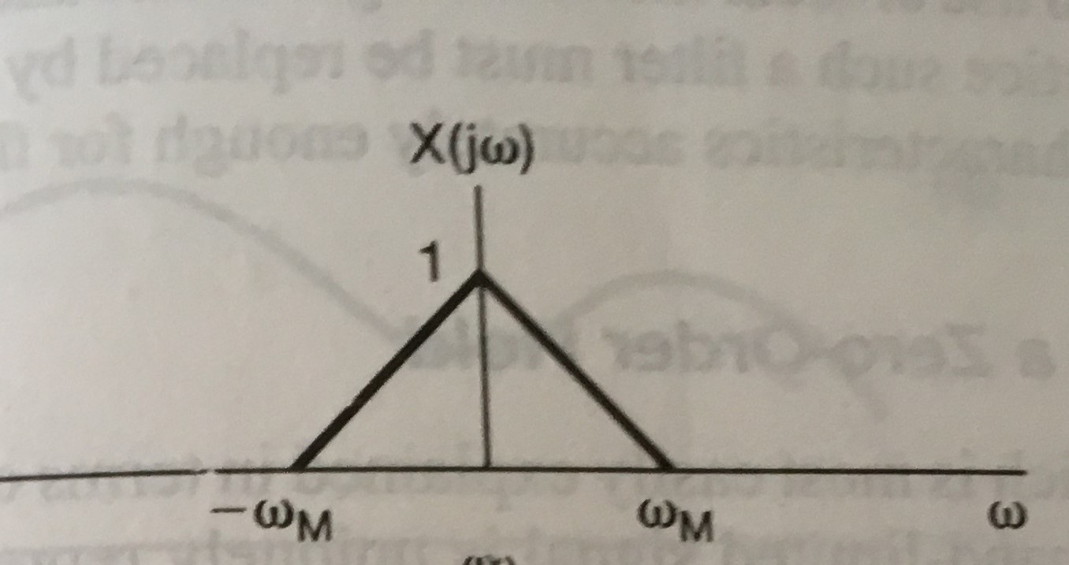
Fourier transform of $e^{at}$ $u(−t)$ (Contd.)
Sampling Theorem:-
Sampling is a process of converting a continuous time signal to discrete time.
Statement:-
A Strictly band limited signal which has maximum frequency ‘$ω^{′}$ can be represented & recovered by its samples taken at a rate ‘$ω_{s}≥2ω$’.
Proof:-
Consider any arbitrary signal $x(t)$whose Fourier transform is $X(jω)$
Fourier Transform Dr.Y.Mallikarjuna Rao SREC, Nandyal 01/34

Slide 49
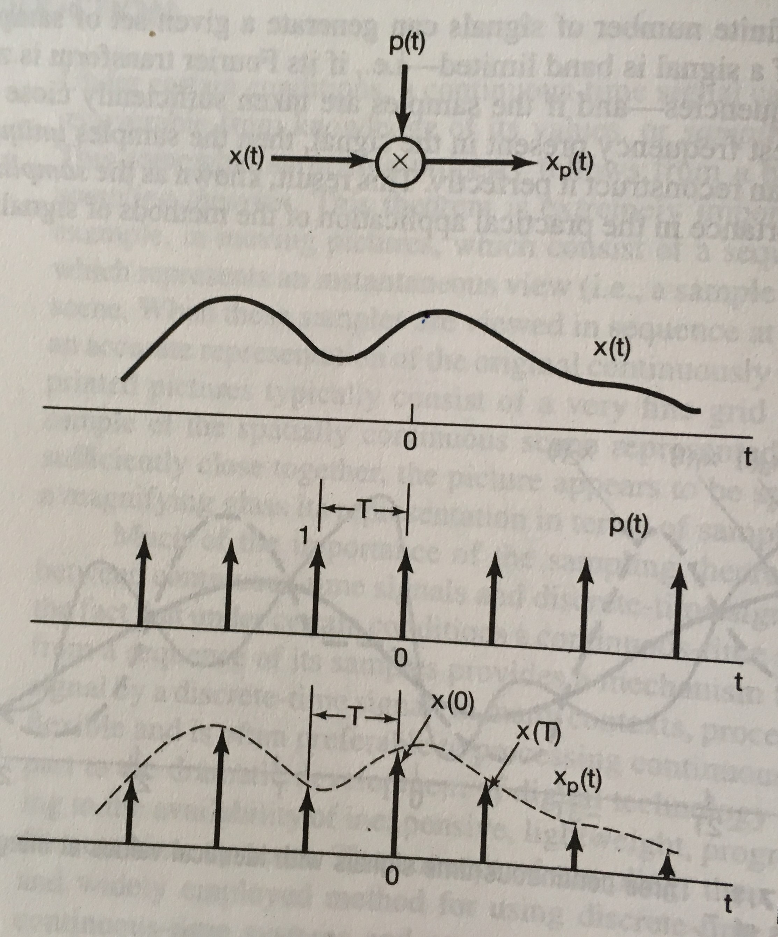
Fourier transform of $e^{at}$ $u(−t)$ (Contd.)
Discrete time signal is obtained by multiplying $x(t)$ with impulse train with a period ‘$T_{S}$’.
Where $x(t) =$ Continuous time signal
$P(t)=$Periodic impulse train
$x_{p}(t)$ $=discrete time signal$
Fourier Transform Dr.Y.Mallikarjuna Rao SREC, Nandyal 01/34

Slide 50
Fourier transform of $e^{at}$ $u(−t)$ (Contd.)
$p(t)$can be expressed as complex exponentials using Fourier Series
$p(t)$ = $\sum_{n=−∞}^{−∞}{δ(t−nT_{S}}$) = $\sum_{n=−∞}^{∞}{c_{n }}e^{−jnωt}$
For $P(t)$; Period = $T_{S}$ ; $ω$ =$\frac{2π}{T_{S}}$ ;
$∴$ $c_{n }$= $\frac{1}{T_{S}}$ $\int_{\frac{{−T}_{s}}{2}}^{\frac{T_{s}}{2}}{p(t)}$ $e^{−jnωt}$ $dt$
= $\frac{1}{T_{S}}$ $\int_{\frac{{−T}_{s}}{2}}^{\frac{T_{s}}{2}}{δ(t)}$ $e^{−jnωt}$ $dt$
= $\frac{1}{T_{S}}$ $\int_{\frac{{−T}_{s}}{2}}^{\frac{T_{s}}{2}}{δ(t)}$ $dt$
$∴ c_{n }$= $\frac{1}{T_{S}}$
$∴ p\left(t\right)=$ $\sum_{n=−∞}^{∞}{\left(\frac{1}{T_{S}}\right)}$ $e^{−jnt}\frac{2π}{T_{s}}$ $t$
$\sum_{n=−∞}^{∞}{\left(\frac{1}{T_{S}}\right)}$ $e^{−jnω_{s}t}$
$∴\frac{2π}{T_{s}}$ = 2$π f_{s}$ = $ω_{s}$
$∴ p\left(t\right)$= $\frac{1}{T_{S}}$ $\sum_{n=−∞}^{∞}{e^{jnω_{s}t}}$
The Fourier transform of $p(t)$is $p(ω)$
$p(ω)$= $\frac{1}{T_{S}}$ $\sum_{n=−∞}^{∞}{2πδ(ω−nω_{s}}$)
Using the relation $e^{−jnω_{0}t}$ $\underset{↔}{F.T}$ $2πδ(ω−$ $ω_{0}$)
Fourier Transform Dr.Y.Mallikarjuna Rao SREC, Nandyal 01/34

Slide 51
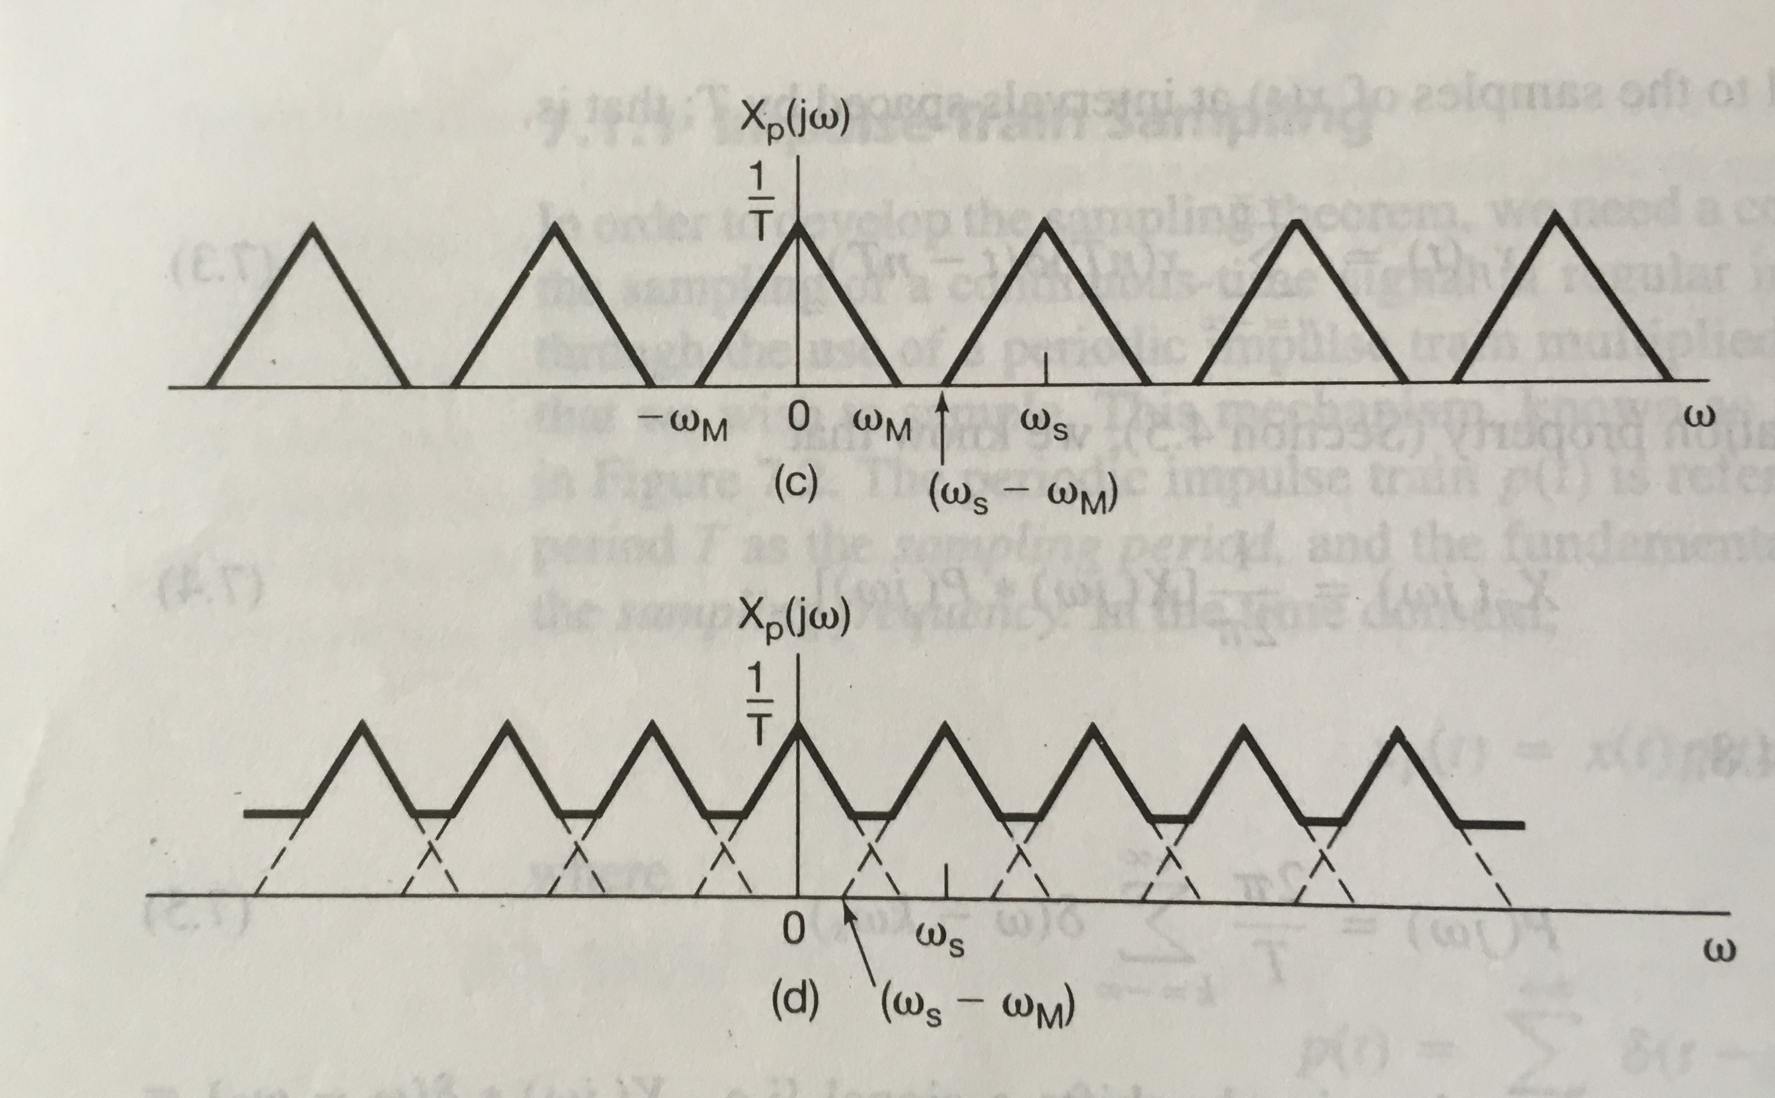
Fourier transform of $e^{at}$ $u(−t)$ (Contd.)
Fourier Transform Dr.Y.Mallikarjuna Rao SREC, Nandyal 01/34

Slide 52
Fourier transform of $e^{at}$ $u(−t)$ (Contd.)
Now, $x_{p}(t) = x(t). P(t)$
$X_{p}(ω)$= $\frac{1}{2π}$ $\left[x\left(ω\right) ∗p(ω)\right]$
=$\frac{1}{2π}$ $\left[x\left(ω\right)∗ \frac{2π}{T_{S}} \sum_{n=−∞}^{∞}{δ(ω−nω_{s}}\right]$
= $\frac{1}{T_{S}}$ $\left[\sum_{n=−∞}^{∞}{X(ω−nω_{s}}\right]$
$X_{p}(ω)$= $\frac{1}{T_{S}}$ $\left[\sum_{n=−∞}^{∞}{X(ω−nω_{s}}\right]$
If $ω_{s}−$ $ω_{m}$ $≥$ $ω_{m}$ or $ω_{s}$ $≥$ 2$ω_{m}$, from $X_{p}(ω)$then, We can get back our original continues time signal x($ω$).
If $ω_{s}−$ $ω_{m}$ $<$ $ω_{m}$ i.e, $ω_{s}−$ ${2ω}_{m}$ , we can not reconstruct (get back) our original signal form $X_{p}\left(ω\right)$
Aliasing:- The condition where high frequency components of continuous time signal takes the
identity of low frequency components of discrete time signal is called Aliasing.
$∴$ To represents x(t), a continuous time signal by its samples or to reconstruct x(t) from its
samples perfectly, $ω_{s}≥{2ω}_{m}$ has to be satisfied. The conditions $ω_{s}≥$ ${2ω}_{m}$ is called Nyquist
Rate.
Fourier Transform Dr.Y.Mallikarjuna Rao SREC, Nandyal 01/34

Slide 53
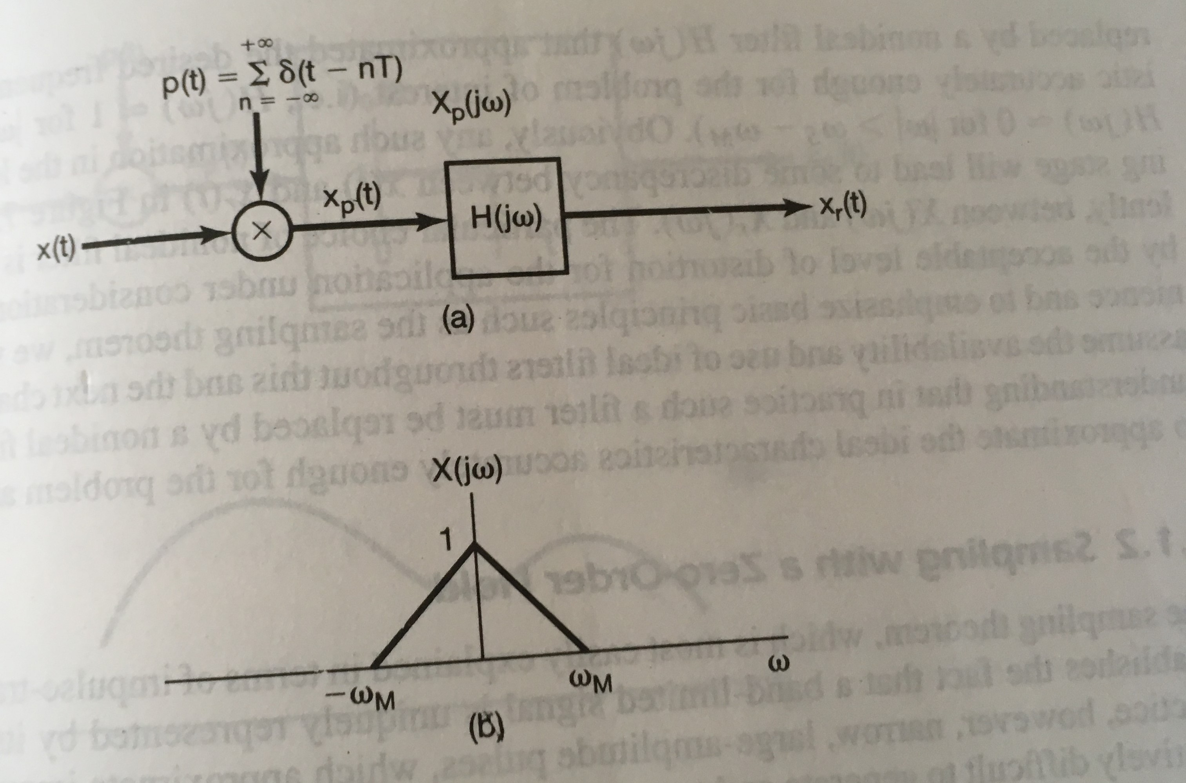
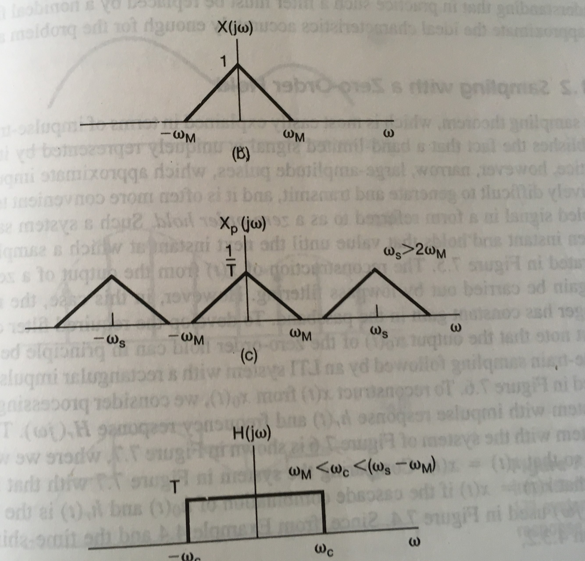
Fourier transform of $e^{at}$ $u(−t)$ (Contd.)
Fourier Transform Dr.Y.Mallikarjuna Rao SREC, Nandyal 01/34

Slide 54
Fourier transform of $e^{at}$ $u(−t)$ (Contd.)
Sampling :Problem -1
Find the sampling frequency and sampling period of the following signals.
(a). $x(t)$= 3 $\cos{4000πt}$ (b). $x(t)$= 3 $\cos{4000πt}$ + 6 $\sin{1000πt}$
(a).$x(t)=$3 $\cos{4000πt}$ + 6 $\sin{1000πt}$
Sol: (a) $x(t)$= 3 $\cos{4000πt}$, Here $f_{m}$= 2000$H_{Z}$
$∴ f_{s}$ $≥2f_{m}$ $∴$ $f_{s}$ $=2f_{m}=$2(2000)$=$4000 $H_{Z}$
$∴sampling frequency=$ 4 K$H_{Z}$
$∴Sampling Period= \frac{1}{\text{4}\text{K}\text{Hz}}$ = 0.00025 Sec
Fourier Transform Dr.Y.Mallikarjuna Rao SREC, Nandyal 01/34

Slide 55
Sampling :Problem -2
Fourier transform of $e^{at}$ $u(−t)$ (Contd.)
(b).$x(t)=$3 $\cos{4000πt}$ + 6 $\sin{1000πt}$
Here $x(t)$ contains two frequencies
$f_{m1}$ $=$2000 $Hz$ ; $f_{m2}=$ 5000 Hz
$∴$ Highest frequency of $x(t)=$5000 Hz
$∴$ $f_{s}=$ $2f_{m}$
$= 2(5000)$
$=$ $10000 Hz$
$∴ f_{s}$ $=$ $10 KHz$
$T_{S}$=$\frac{1}{{10}^{4}}$ Sec $=$ ${10}^{−4}$ Sec
Fourier Transform Dr.Y.Mallikarjuna Rao SREC, Nandyal 01/34

Slide 56
End of Presentation
Thank you all
Fourier Transform Dr.Y.Mallikarjuna Rao SREC, Nandyal 01/34

