Slide 1
Unit IV - Deadlocks
A process must request a resource before using it and must release the resource after using it. A process may request as many resources as it requires to carry out its designated task.
Under the normal mode of operation, a process may utilize a resource in only the following sequence:
Request, Use, Release

Slide 2
A deadlock happens in operating system when two or more processes need some resource to complete their execution that is held by the other process.
A deadlock situation can arise if the following four conditions hold simultaneously in a system:

Slide 3
Mutual Exclusion: At least one resource must be held in a non sharable mode; that is, only one process at a time can use the resource. If another process requests that resource, the requesting process must be delayed until the resource has been released.
Hold and Wait: A process must be holding at least one resource and waiting to acquire additional resources that are cmrently being held by other processes.

Slide 4
No preemption: Resources cannot be preempted; that is, a resource can be released only voluntarily by the process holding it, after that process has completed its task.
Circular wait. A set { P0, Pl, ... , P11 } of waiting processes must exist such that Po is waiting for a resource held by P1, P1 is waiting for a resource held by P2, ... , Pn-1 is waiting for a resource held by P,v and P11 is waiting for a resource held by Po.

Slide 5
Resource Allocation Graph
This graph consists of a set of vertices V and a set of edges E.
The set of vertices Vis partitioned into two different types of nodes: P == { P1, P2, ... , Pn}, the set consisting of all the active processes in the system, and R == {R1, R2, ... , Rm} the set consisting of all resource types in the system.

Slide 6
A directed edge from process pi to resource type Rj is denoted by Pi → Rj
it signifies that process P; has requested an instance of resource type Rj and is currently waiting for that resource.
A directed edge from resource type Rj to process P; is denoted by Rj → Pi;
it signifies that an instance of resource type R1 has been allocated to process P;.

Slide 7
A directed edge Pi → Rj is called a request edge
A directed edge Rj → Pi; is called an Assignment Edge
Pictorially we represent each process P; as a circle and each resource type Rj as a rectangle. Since resource type Rj may have more than one instance, we represent each such instance as a dot within the rectangle. Note that a request edge points to only the rectangle Rj, whereas an assignment edge must also designate one of the dots in the rectangle.

Slide 8
When process P; requests an instance of resource type Rj, a request edge is inserted in the resource-allocation graph.
When this request can be fulfilled, the request edge is instantaneously transformed to an assignment edge.
When the process no longer needs access to the resource, it releases the resource; as a result, the assignment edge is deleted.

Slide 10
If the graph contains no cycles, then no process in the system is deadlocked. If the graph does contain a cycle, then a deadlock may exist.
If each resource type has exactly one instance, then a cycle implies that a deadlock has occurred

Slide 11
If each resource type has several instances, then a cycle does not necessarily imply that a deadlock has occurred.
Suppose that process P3 requests an instance of resource type R2. Since no resource instance is currently available, a request edge P3 → R2 is added to the graph.
At this point, two minimal cycles exist in the system

Slide 13
Now consider the resource-allocation graph in this example we also have a cycle, however there is no deadlock.
P1→R1→p3→R2→p1
if a resource-allocation graph does not have a cycle, then the system is not in a deadlocked state. If there is a cycle, then the system may or may not be in a deadlocked state

Slide 15
Methods for Handling Deadlocks
We can use a protocol to prevent or avoid deadlocks, ensuring that the system will never enter a deadlocked state.(Deadlock Prevention or Deadlock Avoidance)
We can allow the system to enter a deadlocked state, detect it, and recover(Deadlock Detection and Recovery)
We can ignore the problem altogether and pretend that deadlocks never occur in the system.

Slide 16
Deadlock Prevention
We can prevent Deadlock by eliminating any of the above four conditions.
Eliminate Mutual Exclusion: It is not possible to dis-satisfy the mutual exclusion because some resources, such as the tape drive and printer, are inherently non-shareable.

Slide 17
Eliminate Hold and Wait:
Allocate all required resources to the process before the start of its execution, this way hold and wait condition is eliminated but it will lead to low device utilization.
for example, if a process requires printer at a later time and we have allocated printer before the start of its execution printer will remain blocked till it has completed its execution.
The process will make a new request for resources after releasing the current set of resources. This solution may lead to starvation.

Slide 18
Eliminate No Preemption: Preempt resources from the process when resources required by other high priority processes.
Eliminate Circular Wait:
To avoid circular wait, resources may be ordered and we can ensure that each process can request resources only in an increasing order of these numbers. The algorithm may itself increase complexity and may also lead to poor resource utilization.

Slide 19
Deadlock Avoidance
we can try to avoid deadlocks by making use prior knowledge about the usage of resources by processes including resources available, resources allocated, future requests and future releases by processes.
Most deadlock avoidance algorithms need every process to tell in advance the maximum number of resources of each type that it may need.
Based on all these info we may decide if a process should wait for a resource or not, and thus avoid chances for circular wait.

Slide 20
Two deadlock avoidance algorithms
Safe State:
If a system is already in a safe state, we can try to stay away from an unsafe state and avoid deadlock.
Deadlocks cannot be avoided in an unsafe state.
A system can be considered to be in safe state if it is not in a state of deadlock and can allocate resources upto the maximum available.
A safe sequence of processes and allocation of resources ensures a safe state.

Slide 21
Deadlock avoidance algorithms try not to allocate resources to a process if it will make the system in an unsafe state.
Since resource allocation is not done right away in some cases, deadlock avoidance algorithms also suffer from low resource utilization problem.

Slide 23
consider a system with twelve magnetic tape drives and three processes: P0, P1, and P2.
Process P0 requires ten tape drives, process P1 may need as many as four tape drives, and process P2 may need up to nine tape drives.
Suppose that, at time t0, process P0 is holding five tape drives, process P1 is holding two tape drives, and process P2 is holding two tape drives. (Thus, there are three free tape drives.)

Slide 24
At time t0, the system is in a safe state. The sequence satisfies the safety condition. Process P1 can immediately be allocated all its tape drives and then return them (the system will then have five available tape drives); then process P0 can get all its tape drives and return them (the system will then have ten available tape drives); and finally process P2 can get all its tape drives and return them (the system will then have all twelve tape drives available).

Slide 25
A system can go from a safe state to an unsafe state. Suppose that, at time t1, process P2 requests and is allocated one more tape drive. The system is no longer in a safe state.
At this point, only process P1 can be allocated all its tape drives. When it returns them, the system will have only four available tape drives. Since process P0 is allocated five tape drives but has a maximum of ten, it may request five more tape drives. If it does so, it will have to wait, because they are unavailable. Similarly, process P2 may request six additional tape drives and have to wait, resulting in a deadlock.

Slide 26
Resource Allocation Graph Algorithm
A resource allocation graph is generally used to avoid deadlocks. If there are no cycles in the resource allocation graph, then there are no deadlocks.
If there are cycles, there may be a deadlock
The resource allocation graph has request edges and assignment edges.
A claim edge denotes that a request may be made in future and is represented as a dashed line

Slide 27
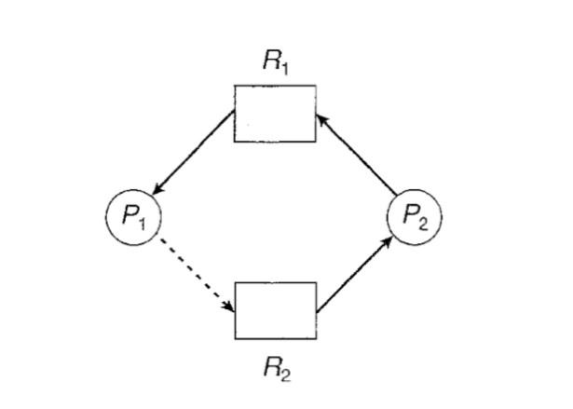
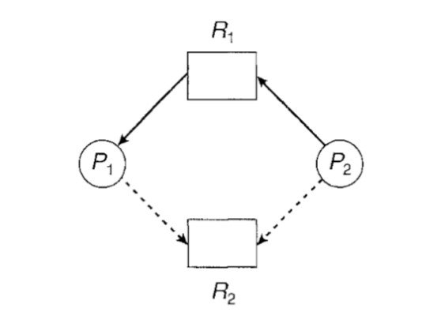
Based on claim edges we can see if there is a chance for a cycle and then grant requests if the system will again be in a safe state.

Slide 28
Suppose that P2 requests R2. Although R2 is currently free, we cannot allocate it to P2, since this action will create a cycle in the graph .
A cycle, as mentioned, indicates that the system is in an unsafe state. If P1 requests R2, and P2 requests R1, then a deadlock will occur.

Slide 29
Banker’s Algorithm
The resource-allocation-graph algorithm is not applicable to a resource allocation system with multiple instances of each resource type.
The deadlock avoidance algorithm is applicable to such a system but is less efficient than the resource-allocation graph scheme. This algorithm is commonly known as the banker's algorithm.

Slide 30
Working
When a new process enters the system, it must declare the maximum number of instances of each resource type that it may need.
When a user requests a set of resources, the system must determine whether the allocation of these resources will leave the system in a safe state.
If it will, the resources are allocated; otherwise, the process must wait until some other process releases enough resources.

Slide 31
Several data structures must be maintained to implement the banker's algorithm.
Following data structures with n is the number of processes in the system and m is the number of resource types
Available: A vector of length m indicates the number of available resources of each type. If Available[j] equals k, then k instances of resource type Rj are available

Slide 32
Max: An n x m matrix defines the maximum demand of each process. If Max[i] [j] equals k, then process Pi may request at most k instances of resource type Rj.
Allocation: An n x m matrix defines the number of resources of each type currently allocated to each process. If Allocation[i][j] equals k, then process Pi is currently allocated k instances of resource type Rj.

Slide 33
Need. An n x m matrix indicates the remaining resource need of each process. If Need[i][j] equals k, then process P; may need k more instances of resource type Rj to complete its task.
Need[i][j] = Max[i][j] - Allocation [i][j].

Slide 34
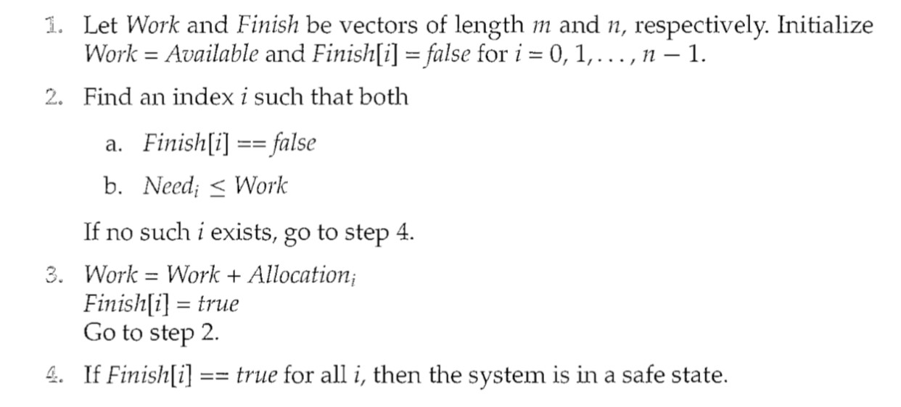
Safety Algorithm of Bankers
The algorithm for finding out whether or not a system is in a safe state.

Slide 35
Resource – Request Algorithm
The algorithm for determining whether requests can be safely granted.
Let Requesti be the request vector for process Pi. If Requesti [j] == k, then process Pi wants k instances of resource type Rj.
When a request for resources is made by process Pi, the following actions are taken:

Slide 37
Example- Banker’s Algorithm
consider a system with five processes Po through P4 and three resource types A, B, and C.
Resource type A has ten instances, resource type B has five instances, and resource type C has seven instances.
Suppose that, at time T0, The System has taken

Slide 39
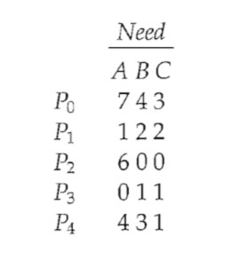
The content of the matrix Need is defined to be Max - Allocation and is as follows:

Slide 40
Check Need<= work (work is available)
We claim that the system is currently in a safe state. Indeed, the sequence < P1, P3, P4, P0, P2> satisfies the safety criteria. Suppose now that process P1 requests one additional instance of resource type A and two instances of resource type C, so Request1 = (1,0,2).
To decide whether this request can be immediately granted, we first check that Request with Available-that is, that (1,0,2) <= (3,3,2), which is true. We then pretend that this request has been fulfilled, and we arrive at the following new state:

Slide 42
We must determine whether this new system state is safe. To do so, we execute our safety algorithm and find that the sequence <P1, P3, P4, P0, P2> satisfies the safety requirement. Hence, we can immediately grant the request of process P1.
You should be able to see, however, that when the system is in this state, a request for (3,3,0) by P4 cannot be granted, since the resources are not available. Furthermore, a request for (0,2,0) by Po cannot be granted, even though the resources are available, since the resulting state is unsafe.

Slide 43
Detection-Algorithm Usage
Depending on the following factors the detection algorithm will be invoked:
How often is a deadlock likely to occur?
How many processes will be affected by deadlock when it happens?
If deadlocks occur frequently, then the detection algorithm should be invoked frequently

Slide 44
Resources allocated to deadlocked processes will be idle until the deadlock can be broken.
Deadlocks occur only when some process makes a request that cannot be granted immediately.
Of course, invoking the deadlock-detection algorithm for every resource request will incur considerable overhead in computation time.
A less expensive alternative is simply to invoke the algorithm at defined interval. for example, once per hour or whenever CPU utilization drops below 40 percent

Slide 45
Deadlock Detection
Single Instance of Each Resource Type :
If all resources have only a single instance, then we can define a deadlock detection algorithm that uses a variant of the resource-allocation graph, called a wait-for graph.
We obtain this graph from the resource-allocation graph by removing the resource nodes and collapsing the appropriate edges.

Slide 46
More precisely, an edge from Pi to Pj in a wait-for graph implies that process Pi is waiting for process Pj to release a resource that Pi needs. An edge Pi → Pj exists in a wait-for graph if and only if the corresponding resource allocation graph contains two edges Pi → Rq and Rq → Pi for some resource R.
As before, a deadlock exists in the system if and only if the wait-for graph contains a cycle.
An algorithm to detect a cycle in a graph requires an order of n2 operations, where n is the number of vertices in the graph.

Slide 48
Several Instances of a Resource Type
The wait-for graph scheme is not applicable to a resource-allocation system with multiple instances of each resource type.
The algorithm employs several time-varying data structures that are similar to those used in the banker's algorithm

Slide 49
Available. A vector of length m indicates the number of available resources of each type.
Allocation. An n x m matrix defines the number of resources of each type currently allocated to each process.
Request. An n x m matrix indicates the current request of each process. If Request[i][j] equals k, then process Pi is requesting k more instances of resource type Rj.

Slide 50
Detection Algorithm

Slide 51
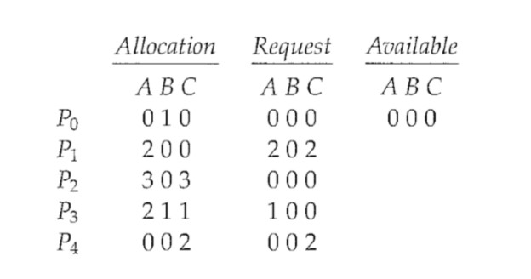
we consider a system with five processes Po through P4 and three resource types A, B, and C. Resource type A has seven instances, resource type B has two instances, and resource type C has six instances. Suppose that, at time T0, we have the following resource-allocation state:

Slide 52
We claim that the system is not in a deadlocked state. Indeed, if we execute our algorithm, we will find that the sequence <Po, P2, P3, P1, P4> results in Finish[i] == true for all i.
Suppose now that process P2 makes one additional request for an instance of type C. The Request matrix is modified as follows:

Slide 53
We claim that the system is now deadlocked. Although we can reclaim the resources held by process Po, the number of available resources is not sufficient to fulfill the requests of the other processes. Thus, a deadlock exists, consisting of processes P1, P2, P3, and P4.

Slide 54
Recovery from deadlock
When a Deadlock Detection Algorithm determines that a deadlock has occurred in the system, the system must recover from that deadlock. There are two approaches of breaking a deadlock:
Process Termination
Resource Preemption

Slide 55
Process Termination
Abort all the Deadlocked Processes:
Aborting all the processes will certainly break the deadlock, but with a great expenses. The deadlocked processes may have computed for a long time and the result of those partial computations must be discarded and there is a probability to recalculate them later.
2. Abort one process at a time untill deadlock is eliminated:
Abort one deadlocked process at a time, untill deadlock cycle is eliminated from the system. Due to this method, there may be considerable overhead, because after aborting each process, we have to run deadlock detection algorithm to check whether any processes are still deadlocked.

Slide 56
Resource Preemption
To eliminate deadlocks using resource preemption, we preempt some resources from processes and give those resources to other processes. This method will raise three issues.
Selecting a Victim
Rollback
Starvation

Slide 57
Selecting a Victim: We must determine which resources and which processes are to be preempted and also the order to minimize the cost.
Rollback: We must determine what should be done with the process from which resources are preempted. One simple idea is total rollback. That means abort the process and restart it.
Starvation: In a system, it may happen that same process is always picked as a victim. As a result, that process will never complete its designated task. This situation is called Starvation and must be avoided. One solution is that a process must be picked as a victim only a finite number of times.

Slide 58
Ostrich Algorithm
Briefly, Ostrich Algorithm is about ignoring deadlock if it occurs
This algorithm is a well-used method to ignore problems. It gets its name from The Ostrich and the way it sticks its head in the sand and ignores everything that’s happening around

Slide 60
No manpower is required to do any extra work. When the system crashes, just restart it. This is viable only when a deadlock occurs rarely.
If it happens quite often, then this is not an optimal solution. You’ll have to invest some time in properly dealing with deadlocks, that’s any of the next three methods mentioned above in prevention of deadlock.

Slide 61
File Systems
Files
Directories
File system implementation
management and optimization

Slide 62
File Naming
A file is an abstraction mechanism. It provides a way to store information on the disk and read it back later
When a process creates a file, it gives the file a name. When the process terminates, the file continues to exist and can be accessed by other processes using its name
The exact rules for file naming vary somewhat from system to system, but all current operating systems allow strings of one to eight letters as legal file names
Frequently digits and special characters are also permitted

Slide 63
Some file systems distinguish between upper- and lowercase letters, whereas others do not. UNIX falls in the first category, the old MS-DOS falls in the second.
Many operating systems support two-part file names, with the two parts separated by a period, as in prog.c. The part following the period is called the file extension and usually indicates something about the file

Slide 65
File Structure
Files can be structured in any of several ways. Three common possibilities are depicted as
Byte sequence
Record Sequence
Tree

Slide 67
Byte Sequence: The file in Fig.(a) is an unstructured sequence of bytes. In effect, the operating system does not know or care what is in the file. All it sees are bytes.
Record Sequence: file being a sequence of records is the idea that the read operation returns one record and the write operation overwrites or appends one record
Tree Structure: In this organization, a file consists of a tree of records, not necessarily all the same length, each containing a key field in a fixed position in the record. The tree is sorted on the key field, to allow rapid searching for a particular key. The basic operation here is not to get the ‘‘next’’ record, although that is also possible, but to get the record with a specific key.

Slide 68
File Types
Many operating systems support several types of files. UNIX (again, including OS X) and Windows, for example, have regular files and directories. UNIX also has character and block special files
Regular files are the ones that contain user information
Directories are system files for maintaining the structure of the file system

Slide 69
Character special files are related to input/output and used to model serial I/O devices, such as terminals, printers, and networks.
Block special files are used to model disks
Regular files are generally either ASCII files or binary files. ASCII files consist of lines of text. In some systems each line is terminated by a carriage return character. In others, the line feed character is used

Slide 70
A common technique for implementing file types is to include the type as part of the file name.
The name is split into two parts-a name and an extension, usually separated by a period character
The system uses the extension to indicate the type of the file and the type of operations that can be done on that file

Slide 71
File Access
Early operating systems provided only one kind of file access: sequential access. In these systems, a process could read all the bytes or records in a file in order, starting at the beginning, but could not skip around and read them out of order
Sequential files were convenient when the storage medium was magnetic tape rather than disk

Slide 72
When disks came into use for storing files, it became possible to read the bytes or records of a file out of order, or to access records by key rather than by position. Files whose bytes or records can be read in any order are called random-access files
Two methods can be used for specifying where to start reading. In the first one, every read operation gives the position in the file to start reading at. In the second one, a special operation, seek, is provided to set the current position

Slide 73
File Attributes
Every file has a name and its data. In addition, all operating systems associate other information with each file, for example, the date and time the file was last modified and the file’s size. We will call these extra items the file’s attributes. Some people call them metadata.
The list of attributes varies considerably from system to system.
The first four attributes relate to the file’s protection and tell who may access it and who may not

Slide 75
File Operations
Files exist to store information and allow it to be retrieved later. Different systems provide different operations to allow storage and retrieval
System calls related to files are
Create
Delete
Open
Close
Read
Write
Append
Seek
Get Attributes
Set Attributes
Rename

Slide 76
Directories
To keep track of files, file systems normally have directories or folders, which are themselves files
Single-Level Directory Systems: The simplest form of directory system is having one directory containing all the files. Sometimes it is called the root directory
the world’s first supercomputer, the CDC 6600, also had only a single directory for all files
The advantages of this scheme are its simplicity and the ability to locate files quickly—there is only one place to look

Slide 78
Hierarchical Directory Systems : The single level is adequate for very simple dedicated applications
but for modern users with thousands of files, it would be impossible to find anything if all files were in a single directory
Consequently, a way is needed to group related files together
With this approach, there can be as many directories as are needed to group the files in natural ways.

Slide 79
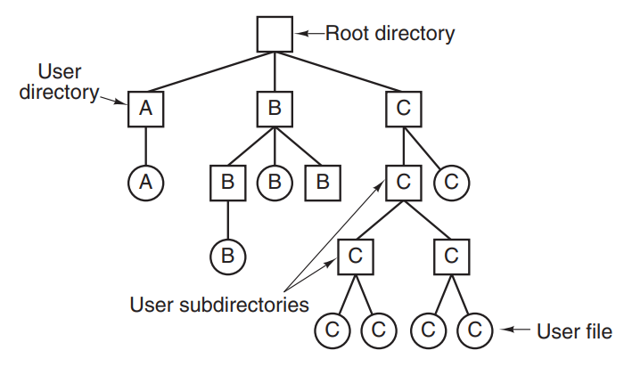
Furthermore, if multiple users share a common file server, as is the case on many company networks, each user can have a private root directory for his or her own hierarchy

Slide 80
Path Names:When the file system is organized as a directory tree, some way is needed for specifying file names. Two different methods are commonly used. In the first method, each file is given an absolute path name consisting of the path from the root directory to file name
Example: /usr/ast/mailbox
Absolute path names always start at the root directory and are unique

Slide 81
The other kind of name is the relative path name. This is used in conjunction with the concept of the working directory (also called the current directory)
A user can designate one directory as the current working directory, in which case all path names not beginning at the root directory are taken relative to the working directory

Slide 82
Directory Operations
Create. A directory is created
Delete. A directory is deleted.
Opendir. Directories can be read
Closedir. When a directory has been read, it should be closed to free up internal table space.
Readdir. This call returns the next entry in an open directory
Rename

Slide 83
Link. Linking is a technique that allows a file to appear in more than one directory. This system call specifies an existing file and a path name, and creates a link from the existing file to the name specified by the path.
A link of this kind, which increments the counter in the file’s i-node (to keep track of the number of directory entries containing the file), is sometimes called a hard link
Unlink. A directory entry is removed

Slide 84
File System Implementation
File System Layout: File systems are stored on disks. Most disks can be divided up into one or more partitions, with independent file systems on each partition. Sector 0 of the disk is called the MBR (Master Boot Record) and is used to boot the computer.
The end of the MBR contains the partition table. This table gives the starting and ending addresses of each partition

Slide 85
One of the partitions in the table is marked as active. When the computer is booted, the BIOS reads in and executes the MBR. The first thing the MBR program does is locate the active partition, read in its first block, which is called the boot block, and execute it.
The first one is the superblock. It contains all the key parameters about the file system and is read into memory when the computer is booted or the file system is first touched.

Slide 87
Implementing Files
Contiguous Allocation: The simplest allocation scheme is to store each file as a contiguous run of disk blocks. Thus on a disk with 1-KB blocks, a 50-KB file would be allocated 50 consecutive blocks. With 2-KB blocks, it would be allocated 25 consecutive blocks

Slide 89
Contiguous disk-space allocation has two significant advantages. First, it is simple to implement.
Second, the read performance is excellent because the entire file can be read from the disk in a single operation Only one seek is needed (to the first block)
Unfortunately, contiguous allocation also has a very serious drawback: over the course of time, the disk becomes fragmented

Slide 90
Linked List Allocation
The second method for storing files is to keep each one as a linked list of disk blocks.
as shown in Fig. The first word of each block is used as a pointer to the next one. The rest of the block is for data.
Unlike contiguous allocation, every disk block can be used in this method. No space is lost to disk fragmentation

Slide 92
On the other hand, although reading a file sequentially is straightforward, random access is extremely slow. To get to block n, the operating system has to start at the beginning and read the n − 1 blocks prior to it, one at a time. Clearly, doing so many reads will be painfully slow.

Slide 93
Linked List allocation using table in memory
Both disadvantages of the linked-list allocation can be eliminated by taking the pointer word from each disk block and putting it in a table in memory.
Figure shows what the table looks like for the example of Fig in linked list allocation
In both figures, we have two files. File A uses disk blocks 4, 7, 2, 10, and 12, in that order, and file B uses disk blocks 6, 3, 11, and 14, in that order

Slide 94
we can start with block 4 and follow the chain all the way to the end. The same can be done starting with block 6. Both chains are terminated with a special marker (e.g., −1) that is not a valid block number. Such a table in main memory is called a FAT (File Allocation Table).

Slide 95
Using this organization, the entire block is available for data. Furthermore, random access is much easier

Slide 96
Inodes
Our last method for keeping track of which blocks belong to which file is to associate with each file a data structure called an i-node (index-node), which lists the attributes and disk addresses of the file’s blocks
With I-node it is possible to find all the blocks of the file.

Slide 97
Implementing Directories
Before a file can be read, it must be opened. When a file is opened, the operating system uses the path name supplied by the user to locate the directory entry on the disk. The directory entry provides the information needed to find the disk blocks.
Depending on the system, this information may be the disk address of the entire file (with contiguous allocation), the number of the first block (both linked-list schemes), or the number of the i-node

Slide 98
Every file system maintains various file attributes, such as each file’s owner and creation time, and they must be stored somewhere. One obvious possibility is to store them directly in the directory entry.
In this simple design, a directory consists of a list of fixed-size entries, one per file, containing a (fixed-length) file name, a structure of the file attributes, and one or more disk addresses (up to some maximum) telling where the disk blocks are

Slide 100
For systems that use i-nodes, another possibility for storing the attributes is in the i-nodes, rather than in the directory entries
In that case, the directory entry can be shorter: just a file name and an i-node number.

Slide 101
Shared Files
When several users are working together on a project, they often need to share files. As a result, it is often convenient for a shared file to appear simultaneously in different directories belonging to different users
Figure shows the file system, only with one of C’s files now present in one of B’s directories as well. The connection between B’s directory and the shared file is called a link.

Slide 102
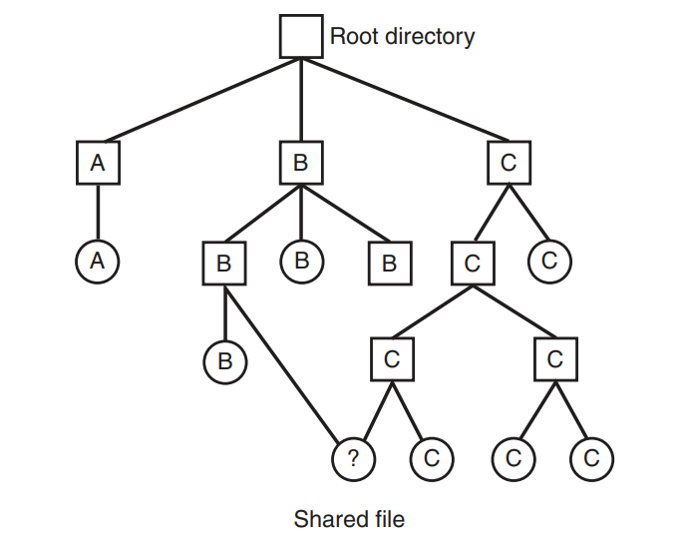
The file system itself is now a Directed Acyclic Graph, or DAG, rather than a tree

Slide 103
File System Management and Optimization
Click Here

