Slide 1
Software Project Management
Unit - II

Slide 2
Improving Software Economics
Five basic parameters of the software cost model are
Reducing the size or complexity of what needs to be developed.
Improving the development process.
Using more-skilled personnel and better teams (not necessarily the same thing).
Using better environments (tools to automate the process).
Trading off or backing off on quality thresholds.

Slide 3
These parameters are given in priority order for most software domains. Table 3-1 lists some of the technology developments, process improvement efforts, and management approaches targeted at improving the economics of software development and integration.

Slide 4
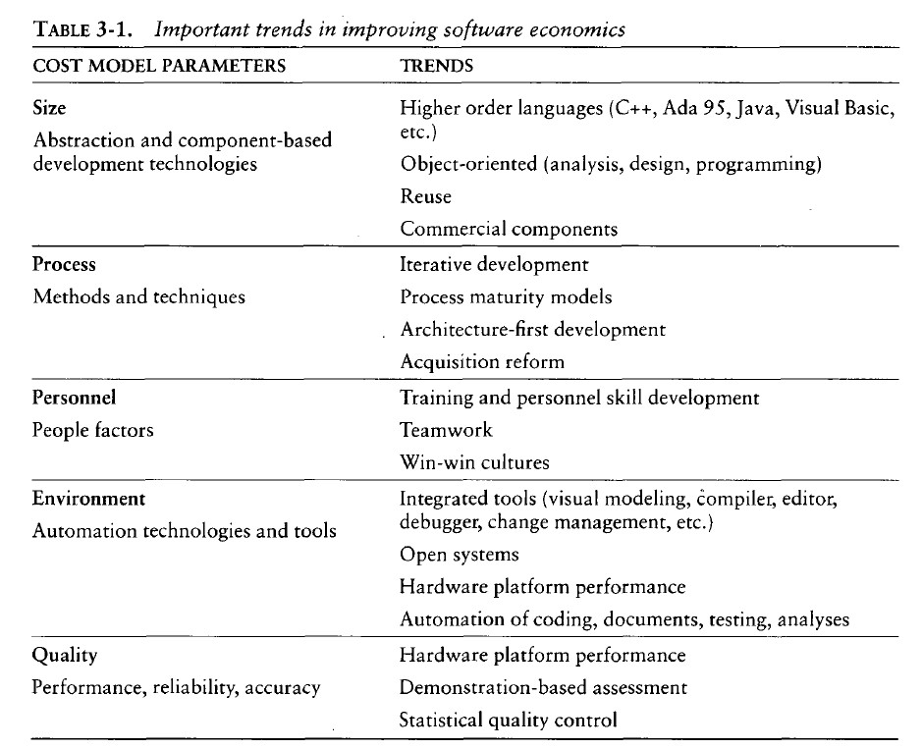

Slide 5
REDUCING SOFTWARE PRODUCT SIZE
The most significant way to improve affordability and return on investment (ROI) is usually to produce a product that achieves the design goals with the minimum amount of human-generated source material. Component-based development is introduced as the general term for reducing the "source" language size to achieve a software solution.
Reuse, object-oriented technology, automatic code production, and higher order programming languages are all focused on achieving a given system with fewer lines of human-specified source directives (statements).

Slide 6
size reduction is the primary motivation behind improvements in higher order languages (such as C++, Ada 95, Java, Visual Basic), automatic code generators (CASE tools, visual modeling tools, GUI builders), reuse of commercial components (operating systems, windowing environments, database management systems, middleware, networks), and object-oriented technologies (Unified Modeling Language, visual modeling tools, architecture frameworks).
The reduction is defined in terms of human-generated source material. In general, when size-reducing technologies are used, they reduce the number of human-generated source lines

Slide 7
LANGUAGES
Universal function points (UFPs1) are useful estimators for language-independent, early life-cycle estimates. The basic units of function points are external user inputs, external outputs, internal logical data groups, external data interfaces, and external inquiries.
SLOC metrics are useful estimators for software after a candidate solution is formulated and an implementation language is known. Substantial data have been documented relating SLOC to function points. Some of these results are shown in Table 3-2.

Slide 8
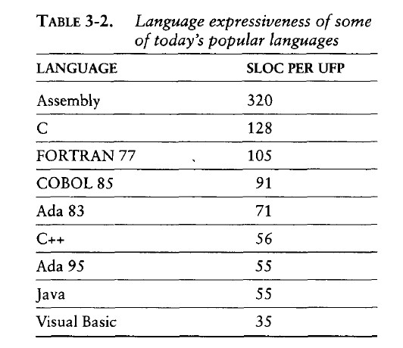

Slide 9
OBJECT-ORIENTED METHODS AND VISUAL MODELING
Object-oriented technology is not germane to most of the software management topics discussed here, and books on object-oriented technology abound. Object-oriented programming languages appear to benefit both software productivity and software quality. The fundamental impact of object-oriented technology is in reducing the overall size of what needs to be developed.

Slide 10
People like drawing pictures to explain something to others or to themselves. When they do it for software system design, they call these pictures diagrams or diagrammatic models and the very notation for them a modeling language.
These are interesting examples of the interrelationships among the dimensions of improving software eco- nomics.

Slide 11
An object-oriented model of the problem and its solution encourages a common vocabulary between the end users of a system and its developers, thus creating a shared understanding of the problem being solved.
The use of continuous integration creates opportunities to recognize risk early and make incremental corrections without destabilizing the entire development effort.
An object-oriented architecture provides a clear separation of concerns among disparate elements of a system, creating firewalls that prevent a change in one part of the system from rending the fabric of the entire architecture.

Slide 12
Booch also summarized five characteristics of a successful object-oriented project.
A ruthless focus on the development of a system that provides a well understood collection of essential minimal characteristics.
The existence of a culture that is centered on results, encourages communication, and yet is not afraid to fail.
The effective use of object-oriented modeling.
The existence of a strong architectural vision.
The application of a well-managed iterative and incremental development life cycle.

Slide 13
REUSE
Reusing existing components and building reusable components have been natural software engineering activities since the earliest improvements in programming languages.
With reuse in order to minimize development costs while achieving all the other required attributes of performance, feature set, and quality. Try to treat reuse as a mundane part of achieving a return on investment.

Slide 14
Most truly reusable components of value are transitioned to commercial products supported by organizations with the following characteristics:
They have an economic motivation for continued support.
They take ownership of improving product quality, adding new features, and transitioning to new technologies.
They have a sufficiently broad customer base to be profitable.

Slide 15
The cost of developing a reusable component is not trivial. Figure 3-1 examines the economic trade-offs. The steep initial curve illustrates the economic obstacle to developing reusable components.
Reuse is an important discipline that has an impact on the efficiency of all workflows and the quality of most artifacts.

Slide 16
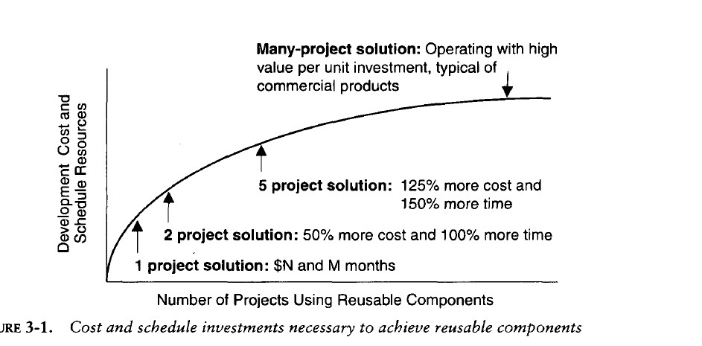

Slide 17
Commercial Components
A common approach being pursued today in many domains is to maximize integration of commercial components and off-the-shelf products.
While the use of commercial components is certainly desirable as a means of reducing custom development, it has not proven to be straightforward in practice.
Following table identifies some of the advantages and disadvantages of using commercial components

Slide 18
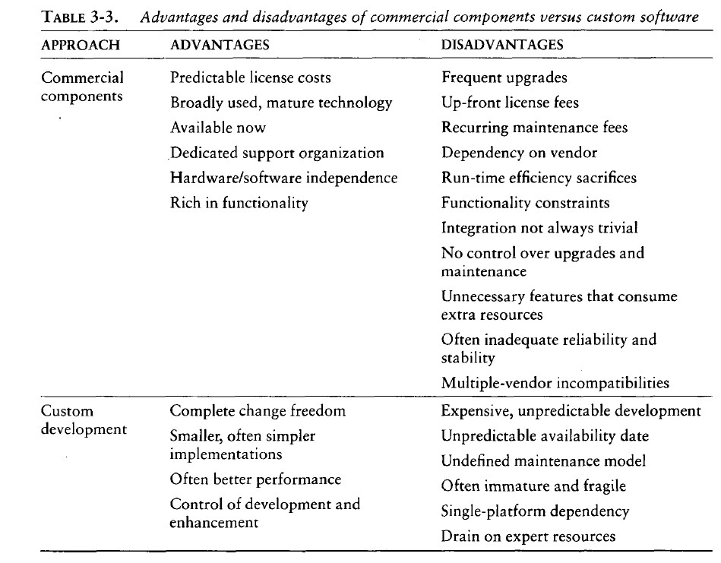

Slide 19
IMPROVING SOFTWARE PROCESSES
Process is an overloaded term. Three distinct process perspectives are.
Metaprocess: an organization's policies, procedures, and practices for pursuing a software-intensive line of business. The focus of this process is on organizational economics, long-term strategies, and software ROI.
Macroprocess: a project's policies, procedures, and practices for producing a complete software product within certain cost, schedule, and quality constraints. The focus of the macro process is on creating an adequate instance of the Meta process for a specific set of constraints.

Slide 20
Microprocess: a project team's policies, procedures, and practices for achieving an artifact of the software process. The focus of the micro process is on achieving an intermediate product baseline with adequate quality and adequate functionality as economically and rapidly as practical.
Although these three levels of process overlap somewhat, they have different objectives, audiences, metrics, concerns, and time scales as shown in Table

Slide 21
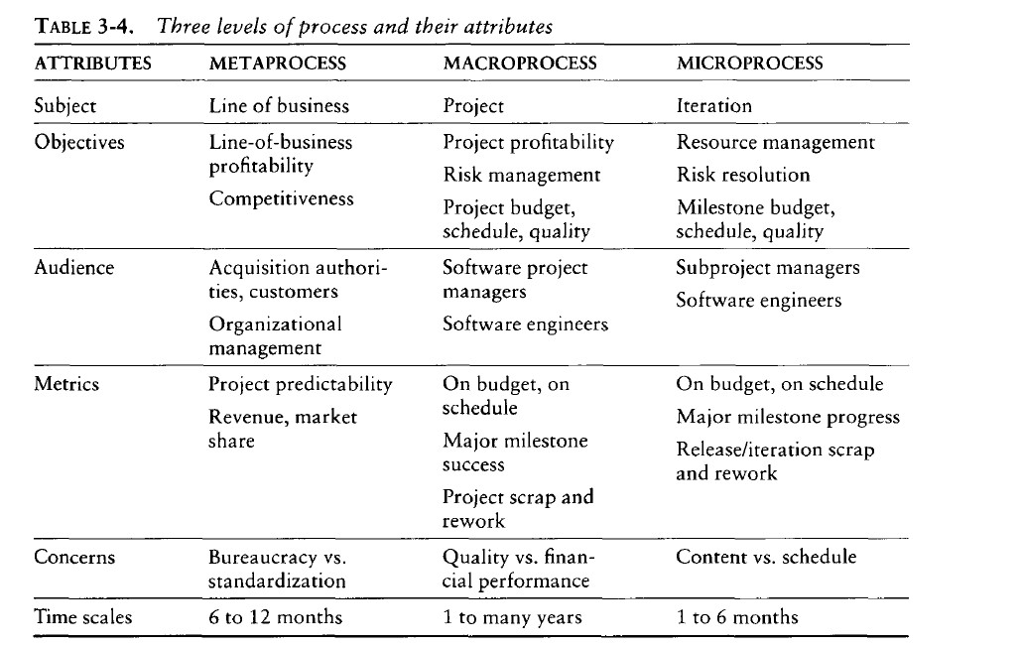

Slide 22
In a perfect software engineering world with an immaculate problem description, an obvious solution space, a development team of experienced geniuses, adequate resources, and stakeholders with common goals, we could execute a software development process in one iteration with almost no scrap and rework.
Because we work in an imperfect world, however, we need to manage engineering activities so that scrap and rework profiles do not have an impact on the win conditions of any stakeholder.
This should be the underlying premise for most process improvements.

