Slide 1
Software Project Management
Unit III

Slide 2
Life cycle phases
Characteristic of a successful software development process is the well-defined separation between "research and development" activities and "production" activities. Most unsuccessful projects exhibit one of the following characteristics:
An overemphasis on research and development
An overemphasis on production.

Slide 3
Successful modern projects-and even successful projects developed under the conventional process-tend to have a very well-defined project milestone when there is a noticeable transition from a research attitude to a production attitude. Earlier phases focus on achieving functionality. Later phases revolve around achieving a product that can be shipped to a customer, with explicit attention to robustness, performance, and finish.
A modern software development process must be defined to support the following:
Evolution of the plans, requirements, and architecture, together with well defined synchronization points
Risk management and objective measures of progress and quality
Evolution of system capabilities through demonstrations of increasing functionality

Slide 4
ENGINEERING AND PRODUCTION STAGES
To achieve economies of scale and higher returns on investment, we must move toward a software manufacturing process driven by technological improvements in process automation and component-based development. Two stages of the life cycle are:
The engineering stage, driven by less predictable but smaller teams doing design and synthesis activities
The production stage, driven by more predictable but larger teams doing construction, test, and deployment activities

Slide 5
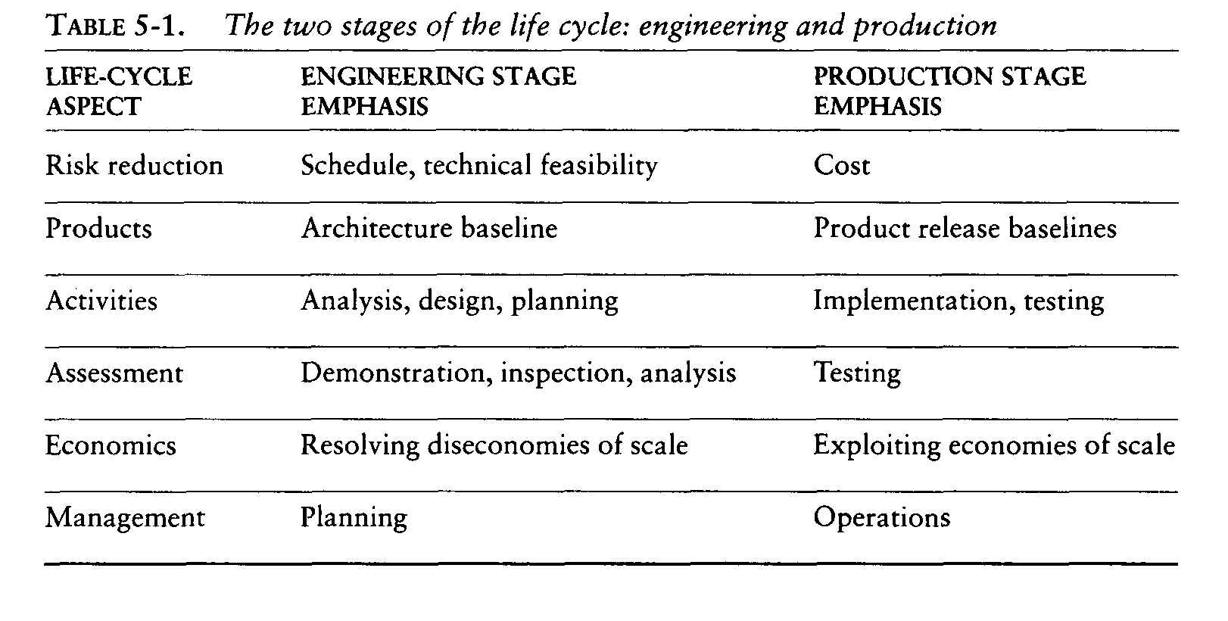

Slide 6
The transition between engineering and production is a crucial event for the various stakeholders. The production plan has been agreed upon, and there is a good enough understanding of the problem and the solution that all stakeholders can make a firm commitment to go ahead with production.
Engineering stage is decomposed into two distinct phases, inception and elaboration, and the production stage into construction and transition. These four phases of the life-cycle process are loosely mapped to the conceptual framework of the spiral model as shown in Figure 5-1

Slide 7
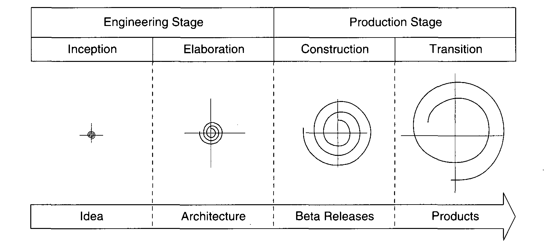
The process of Life Cycle

Slide 8
INCEPTION PHASE
The overriding goal of the inception phase is to achieve concurrence among stakeholders on the life-cycle objectives for the project.
PRIMARY OBJECTIVES
Establishing the project's software scope and boundary conditions, including an operational concept, acceptance criteria, and a clear understanding of what is and is not intended to be in the product
Discriminating the critical use cases of the system and the primary scenarios of operation that will drive the major design trade-offs

Slide 9
Demonstrating at least one candidate architecture against some of the primary scenarios.
Estimating the cost and schedule for the entire project (including detailed estimates for the elaboration phase)
Estimating potential risks (sources of unpredictability)

Slide 10
ESSENTIAL ACTIVITIES
Formulating the scope of the project. The information repository should be sufficient to define the problem space and derive the acceptance criteria for the end product.
Synthesizing the architecture. An information repository is created that is sufficient to demonstrate the feasibility of at least one candidate architecture and an, initial baseline of make/buy decisions so that the cost, schedule, and resource estimates can be derived.
Planning and preparing a business case. Alternatives for risk management, staffing, iteration plans, and cost/schedule/profitability trade-offs are evaluated.

Slide 11
PRIMARY EVALUATION CRITERIA
Do all stakeholders concur on the scope definition and cost and schedule estimates?
Are requirements understood, as evidenced by the fidelity of the critical use cases?
Are the cost and schedule estimates, priorities, risks, and development processes credible?
Do the depth and breadth of an architecture prototype demonstrate the preceding criteria? (The primary value of prototyping candidate architecture is to provide a vehicle for understanding the scope and assessing the credibility of the development group in solving the particular technical problem.)
Are actual resource expenditures versus planned expenditures acceptable

Slide 12
ELABORATION PHASE
At the end of this phase, the "engineering" is considered complete. The elaboration phase activities must ensure that the architecture, requirements, and plans are stable enough, and the risks sufficiently mitigated, that the cost and schedule for the completion of the development can be predicted within an acceptable range.
During the elaboration phase, an executable architecture prototype is built in one or more iterations, depending on the scope, size, & risk.

Slide 13
PRIMARY OBJECTIVES
Baselining the architecture as rapidly as practical (establishing a configuration-managed snapshot in which all changes are rationalized, tracked, and maintained)
Baselining the vision
Baselining a high-fidelity plan for the construction phase
Demonstrating that the baseline architecture will support the vision at a reasonable cost in a reasonable time
ESSENTIAL ACTIVITIES
Elaborating the vision.
Elaborating the process and infrastructure.
Elaborating the architecture and selecting components.

Slide 14
PRIMARY EVALUATION CRITERIA
Is the vision stable?
Is the architecture stable?
Does the executable demonstration show that the major risk elements have been addressed and credibly resolved?
Is the construction phase plan of sufficient fidelity, and is it backed up with a credible basis of estimate?
Do all stakeholders agree that the current vision can be met if the current plan is executed to develop the
Complete system in the context of the current architecture?
Are actual resource expenditures versus planned expenditures acceptable?

Slide 15
ELABORATION PHASE
At the end of this phase, the "engineering" is considered complete. The elaboration phase activities must ensure that the architecture, requirements, and plans are stable enough, and the risks sufficiently mitigated, that the cost and schedule for the completion of the development can be predicted within an acceptable range.
During the elaboration phase, an executable architecture prototype is built in one or more iterations, depending on the scope, size, & risk.

Slide 16
Primary Objectives
Baselining the architecture as rapidly as practical (establishing a configuration-managed snapshot in which all changes are rationalized, tracked, and maintained)
Baselining the vision
Baselining a high-fidelity plan for the construction phase
Demonstrating that the baseline architecture will support the vision at a reasonable cost in a reasonable time
Essential Activities
Elaborating the vision.
Elaborating the process and infrastructure.
Elaborating the architecture and selecting components

Slide 17
Primary Evaluation Criteria
Is the vision stable?
Is the architecture stable?
Does the executable demonstration show that the major risk elements have been addressed and credibly resolved?
Is the construction phase plan of sufficient fidelity, and is it backed up with a credible basis of estimate?
Do all stakeholders agree that the current vision can be met if the current plan is executed to develop the
Complete system in the context of the current architecture?
Are actual resource expenditures versus planned expenditures acceptable?

Slide 18
CONSTRUCTION PHASE
During the construction phase, all remaining components and application features are integrated into the application, and all features are thoroughly tested. Newly developed software is integrated where required.
The construction phase represents a production process, in which emphasis is placed on managing resources and controlling operations to optimize costs, schedules, and quality.

Slide 19
Primary Objectives:
Minimizing development costs by optimizing resources and avoiding unnecessary scrap and rework
Achieving adequate quality as rapidly as practical
Achieving useful versions (alpha, beta, and other test releases) as rapidly as practical
Essential Activities
Resource management, control, and process optimization
Complete component development and testing against evaluation criteria
Assessment of product releases against acceptance criteria of the vision

Slide 20
Primary Evaluation Criteria
Is this product baseline mature enough to be deployed in the user community? (Existing defects are not obstacles to achieving the purpose of the next release.)
Is this product baseline stable enough to be deployed in the user community? (Pending changes are not obstacles to achieving the purpose of the next release.)
Are the stakeholders ready for transition to the user community?
Are actual resource expenditures versus planned expenditures acceptable?

Slide 21
TRANSITION PHASE
The transition phase is entered when a baseline is mature enough to be deployed in the end-user domain. This typically requires that a usable subset of the system has been achieved with acceptable quality levels and user documentation so that transition to the user will provide positive results. This phase could include any of the following activities:
Beta testing to validate the new system against user expectations
Beta testing and parallel operation relative to a legacy system it is replacing
Conversion of operational databases
Training of users and maintainers
The transition phase concludes when the deployment baseline has achieved the complete vision.

Slide 22
Primary Objectives
Achieving user self-supportability
Achieving stakeholder concurrence that deployment baselines are complete and consistent with the evaluation criteria of the vision
Achieving final product baselines as rapidly and cost-effectively as practical
Essential Activities
Synchronization and integration of concurrent construction increments into consistent deployment baselines
Deployment-specific engineering (cutover, commercial packaging and production, sales rollout kit development, field personnel training)
Assessment of deployment baselines against the complete vision and acceptance criteria in the requirements set

Slide 23
Evaluation Criteria
Is the user satisfied?
Are actual resource expenditures versus planned expenditures acceptable?

Slide 24
ARTIFACTS OF THE PROCESS
The Artifact Sets
To make the development of a complete software system manageable, distinct collections of information are organized into artifact sets. Artifact represents cohesive information that typically is developed and reviewed as a single entity.
Life-cycle software artifacts are organized into five distinct sets that are roughly partitioned by the underlying language of the set: management (ad hoc textual formats), requirements (organized text and models of the problem space), design (models of the solution space), implementation (human-readable programming language and associated source files), and deployment (machine-process able languages and associated files).

Slide 25
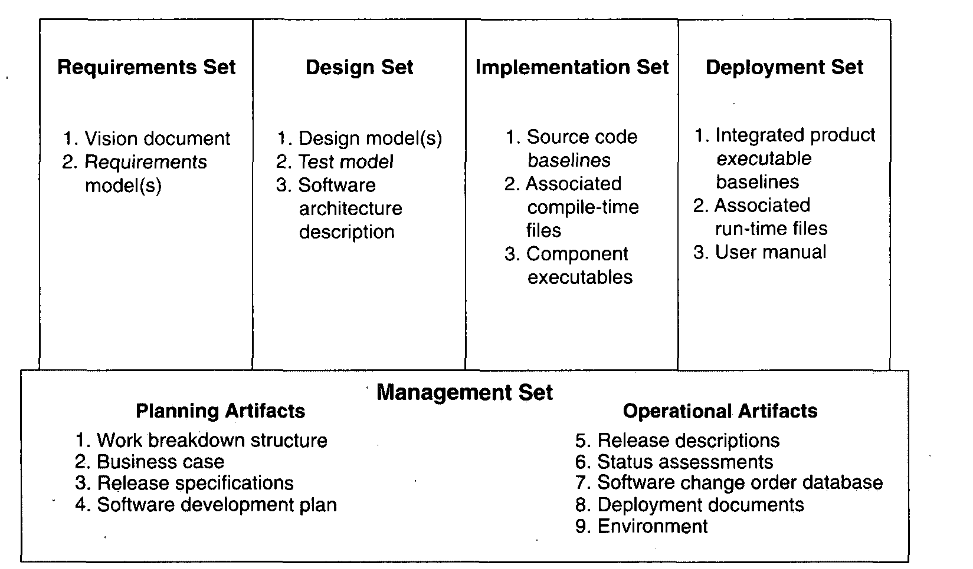

Slide 26
THE MANAGEMENT SET
The management set captures the artifacts associated with process planning and execution. These artifacts use ad hoc notations, including text, graphics, or whatever representation is required to capture the "contracts" among project personnel (project management, architects, developers, testers, marketers, administrators), among stakeholders (funding authority, user, software project manager, organization manager, regulatory agency), and between project personnel and stakeholders

Slide 27
. Specific artifacts included in this set are the work breakdown structure (activity breakdown and financial tracking mechanism), the business case (cost, schedule, profit expectations), the release specifications (scope, plan, objectives for release baselines), the software development plan (project process instance), the release descriptions (results of release baselines), the status assessments (periodic snapshots of project progress), the software change orders (descriptions of discrete baseline changes), the deployment documents (cutover plan, training course, sales rollout kit), and the environment (hardware and software tools, process automation, & documentation).

Slide 28
Management set artifacts are evaluated, assessed, and measured through a combination of the following:
Relevant stakeholder review
Analysis of changes between the current version of the artifact and previous versions
Major milestone demonstrations of the balance among all artifacts and, in particular, the accuracy of the business case and vision artifacts

Slide 29
THE ENGINEERING SETS
The engineering sets consist of the requirements set, the design set, the implementation set, and the deployment set.
Requirements Set
Analysis of consistency with the release specifications of the management set
Analysis of consistency between the vision and the requirements models
Mapping against the design, implementation, and deployment sets to evaluate the consistency and completeness and the semantic balance between information in the different sets

Slide 30
Analysis of changes between the current version of requirements artifacts and previous versions (scrap, rework, and defect elimination trends)
Subjective review of other dimensions of quality
Design Set
UML notation is used to engineer the design models for the solution. The design set contains varying levels of abstraction that represent the components of the solution space (their identities, attributes, static relationships, dynamic interactions). The design set is evaluated, assessed, and measured through a combination of the following:

Slide 31
Analysis of the internal consistency and quality of the design model
Analysis of consistency with the requirements models
Translation into implementation and deployment sets and notations (for example, traceability, source code generation, compilation, linking) to evaluate the consistency and completeness and the semantic balance between information in the sets
Analysis of changes between the current version of the design model and previous versions (scrap, rework, and defect elimination trends)
Subjective review of other dimensions of quality

Slide 32
Implementation Set
The implementation set includes source code (programming language notations) that represents the tangible implementations of components (their form, interface, and dependency relationships)
Implementation sets are human-readable formats that are evaluated, assessed, and measured through a
Combination of the following:
Analysis of consistency with the design models
Translation into deployment set notations (for example, compilation and linking) to evaluate the consistency and completeness among artifact sets

Slide 33
Assessment of component source or executable files against relevant evaluation criteria through inspection, analysis, demonstration, or testing
Execution of stand-alone component test cases that automatically compare expected results with actual results
Analysis of changes between the current version of the implementation set and previous versions (scrap, rework, and defect elimination trends)
Subjective review of other dimensions of quality

Slide 34
Deployment Set
The deployment set includes user deliverables and machine language notations, executable software, and the
build scripts, installation scripts, and executable target specific data necessary to use the product in its target environment. Deployment sets are evaluated, assessed, and measured through a combination of the following:

Slide 35
Testing against the usage scenarios and quality attributes defined in the requirements set to evaluate the consistency and completeness and the~ semantic balance between information in the two sets
Testing the partitioning, replication, and allocation strategies in mapping components of the implementation set to physical resources of the deployment system (platform type, number, network topology)

Slide 36
Testing against the defined usage scenarios in the user manual such as installation, user-oriented dynamic reconfiguration, mainstream usage, and anomaly management
Analysis of changes between the current version of the deployment set and previous versions (defect elimination trends, performance changes)
Subjective review of other dimensions of quality
Each artifact set is the predominant development focus of one phase of the life cycle; the other sets take on check and balance roles.

Slide 37
As illustrated in Figure 6-2, each phase has a predominant focus: Requirements are the focus of the inception phase; design, the elaboration phase; implementation, the construction phase; and deployment, the transition phase. The management artifacts also evolve, but at a fairly constant level across the life cycle.
Most of today's software development tools map closely to one of the five artifact sets.

Slide 38
Management: scheduling, workflow, defect tracking, change management, documentation, spreadsheet, resource management, and presentation tools
Requirements: requirements management tools
Design: visual modeling tools
Implementation: compiler/debugger tools, code analysis tools, test coverage analysis tools, and test management tools
Deployment: test coverage and test automation tools, network management tools, commercial components (operating systems, GUIs, RDBMS, networks, middleware), and installation tools.

Slide 39
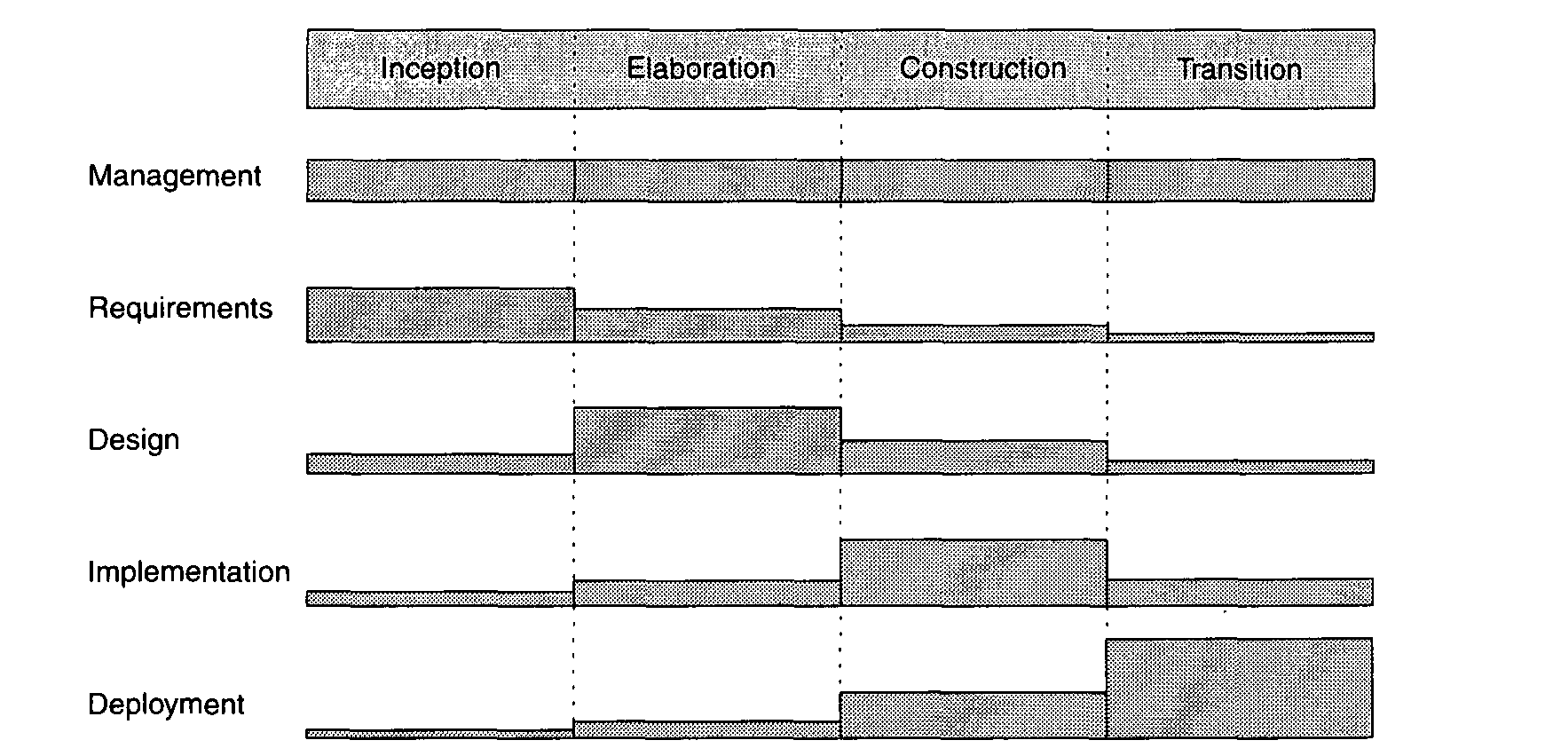

Slide 40
IMPLEMENTATION SET VERSUS DEPLOYMENT SET
The separation of the implementation set (source code) from the deployment set (executable code) is important because there are very different concerns with each set.
The structure of the information delivered to the user (and typically the test organization) is very different from the structure of the source code information. Engineering decisions that have an impact on the quality of the deployment set but are relatively incomprehensible in the design and implementation sets include the following

Slide 41
Dynamically reconfigurable parameters (buffer sizes, color palettes, number of servers, number of simultaneous clients, data files, run-time parameters)
Effects of compiler/link optimizations (such as space optimization versus speed optimization)
Performance under certain allocation strategies (centralized versus distributed, primary and shadow threads, dynamic load balancing, hot backup versus checkpoint/rollback)
Virtual machine constraints (file descriptors, garbage collection, heap size, maximum record size, disk file rotations)
Process-level concurrency issues (deadlock and race conditions)
Platform-specific differences in performance or behavior

