Slide 1
UNIT-5
LAPLACE TRANSFORM AND Z - TRANSFORM
SANTHIRAM ENGINEERING COLLEGE
Presented By
Dr.Y.Mallikarjuna Rao
Associate Professor & HoD
Department of E C E

Slide 2
LAPLACE TRANSFORM:-
Large part of broad class of signals can be expressed as a linear combination of periodic complex exponentials.
For few signals Fourier transform does not exist, but Laplace transform exist.
Eg:- $e^{at}u\left(t\right)$
Laplace transform can also be applied to unstable systems.
The Laplace transform of $x\left(t\right)$ is
$X\left(s\right)=\int_{−∞}^{∞}{x(t)}e^{−st} dt$
where $s=σ+jω$
Mallikarjuna Rao |ECE|SREC
Laplace Transform and Z-Transform/ 5 -
Slide No.1

Slide 3
If $σ=0$; i.e. $s=jω$ ;
then $X\left(jω\right)=$ $\int_{−∞}^{∞}{x(t)}e^{−jωt} dt$; it is the Fourier transform of $x\left(t\right)$.
Therefore; $X\left(s\right)=\int_{−∞}^{∞}{x(t)}e^{−st} dt$
$X\left(jω\right)=$ $\int_{−∞}^{∞}{x(t)}e^{−(σ+jω)t} dt$
$X\left(σ+jω\right)=$ $\int_{−∞}^{∞}{[x(t)}e^{−σt}]e^{−jωt} dt$
Therefore, Laplace transform can be interpreted as Fourier transform of $x(t )e^{−σt}$.
$$x\left(t\right)\underset{↔}{L.T}X(s)$$
Mallikarjuna Rao |ECE|SREC
Laplace Transform and Z-Transform/ 5 -
Slide No.2

Slide 4
Example:-1 Find the Laplace transform of $e^{−at}u\left(t\right)$?
Sol:-The Laplace transform of $x\left(t\right)$ is
$$=\int_{−∞}^{∞}{x(t)}e^{−st} dt$$
$=X\left(s\right)$
Then the Laplace transform of $e^{−at}u\left(t\right)$ is
= $\int_{−∞}^{∞}{e^{−at}u(t)}e^{−st} dt$
=$\int_{0}^{∞}{e^{−at}}e^{−st} dt$ [Since $u(t)=1$for $t>0$;
$u(t)= 0$for $t<0$]
$$∴x(t)\underset{↔}{L.T}X(s)$$
Mallikarjuna Rao |ECE|SREC
Laplace Transform and Z-Transform/ 5 -
Slide No.3

Slide 5
=$\int_{0}^{∞}{e^{−\left(s+a\right)t dt}}$
The integral converges only when $\left(s+a\right)>0$ or $s>−a$,
Therefore $Re\{s\}>a$
$=[{\frac{e^{−\left(s+a\right)t} }{\left(s+a\right)}}_{0}^{∞}]$
$=\frac{1}{s+a}$ for $Re\{s\}>−a$
The shaded region indicates ROC [Region of Convergence]
ROC :- The range of values of ‘$σ$’ for which Laplace transform converges (exists) is called Region of convergence.
j$ω$
$$s−plane$$
$$−a$$
$$σ$$
${∴e}^{−at}u\left(t\right)\underset{↔}{L.T}\frac{1}{s+a};$ $σ>−a$
Mallikarjuna Rao |ECE|SREC
Chapter Name/ Number - Slide No.4

Slide 6
Example-2: Laplace transform of ${−e}^{−at}u\left(−t\right)$?
Sol:-The Laplace transform of $x\left(t\right)$ is
$$=\int_{−∞}^{∞}{x(t)}e^{−st} dt$$
$=X\left(s\right)$
Then the Laplace transform of ${−e}^{−at}u\left(−t\right)$ is
= $\int_{−∞}^{0}{{−e}^{−at}u(−t)}e^{−st} dt$
=$\int_{−∞}^{0}{{−e}^{−at}}e^{−st} dt$
$$x\left(t\right)\underset{↔}{L.T}X(s)$$
Mallikarjuna Rao |ECE|SREC
Laplace Transform and Z-Transform/ 5 -
Slide No.5

Slide 7
=$\int_{−∞}^{0}{{−e}^{−at}e^{−(s+jω)} dt}$
The above integral converges only if $e^{−\left(σ+a\right)t}$ converges.
(or)
If $\left(σ+a\right)<$0 ; i.e. $\left(σ<−a\right)$
=$\int_{−∞}^{0}{{−e}^{−\left(s+a\right)t}dt}$
$=[\frac{e^{−\left(s+a\right)t}}{−\left(s+a\right)}]$ ; $σ<−a$
$=\frac{1}{s+a};$ $σ<−a$
j$ω$
$$s−plane$$
$$−a$$
$$σ$$
${∴−e}^{−at}u\left(−t\right)\underset{↔}{L.T}\frac{1}{s+a};$ $σ<−a$
Mallikarjuna Rao |ECE|SREC
Laplace Transform and Z-Transform/ 5 -
Slide No.6

Slide 8
Note :
From above two examples, the algebraic expression for the Laplace transform is identical for both the signals.
However, the set of values of ‘$σ$’ for which the expression is valid is different.(ROC is different)
Therefore, to represent the Laplace transform of a signal, both the algebraic expression and ROC are required.
${−e}^{−at}u\left(−t\right)\underset{↔}{L.T}\frac{1}{s+a};$ $σ<−a$
$e^{−at}u\left(t\right)\underset{↔}{L.T}\frac{1}{s+a};$ $σ>−a$
Mallikarjuna Rao |ECE|SREC
Laplace Transform and Z-Transform/ 5 -
Slide No.7

Slide 9
Example-3: Find the Laplace transform of $x\left(t\right)=3e^{−2t}u\left(t\right)−2$ $e^{−t}u\left(t\right)$?
Sol:-We know that
$e^{−at}u\left(t\right)\underset{↔}{L.T}\frac{1}{s+a}$; $σ >−a$
${−e}^{−at}u\left(−t\right)\underset{↔}{L.T}\frac{1}{s+a}$; $σ<−a$
From the above equations,
${3e}^{−2t}u\left(t\right)\underset{↔}{L.T}\frac{3}{s+2}$; $σ >−2$
${−2e}^{−t}u\left(−t\right)\underset{↔}{L.T}\frac{1}{s+1}$; $σ<−$1
The set values of $Re\{s\}$for which the Laplace transform of both terms
converge is $Re\{s\}>−1$; The ROC is $σ >−1$
$$jω$$
$$s−plane$$
-1
$$σ$$
Mallikarjuna Rao |ECE|SREC
Laplace Transform and Z-Transform/ 5 -
Slide No.8

Slide 10
Example-4: Find Laplace transform of $δ\left(t\right)$?
Sol:-The Laplace transform of $x\left(t\right)$ is
$$=\int_{−∞}^{∞}{x(t)}e^{−st} dt$$
$=X\left(s\right)$
Then the Laplace transform of $δ\left(t\right)$ is
=$\int_{−∞}^{∞}{δ(t)}e^{−st} dt$
$$x\left(t\right)\underset{↔}{L.T}X(s)$$
Mallikarjuna Rao |ECE|SREC
Laplace Transform and Z-Transform/ 5 -
Slide No.9

Slide 11
$δ\left(t\right)$ exists only at $t=0$
$=\int_{−∞}^{∞}{δ(t)}e^{0} dt$
$=1$ since, $\int_{−∞}^{∞}{δ(t)}dt=1$
$δ\left(t\right)\underset{↔}{L.T}1$
X$(s)$
$$δ\left(t\right)$$
1
t
0
s
Mallikarjuna Rao |ECE|SREC
Laplace Transform and Z-Transform/ 5 -
Slide No.10

Slide 12
Example-5 : Find Laplace transform of unit step signal?
Sol
Example :-6
Find Laplace transform of $e^{at}u\left(t\right)?$
Sol:-The Laplace transform of $x\left(t\right)$ is
=$\int_{−∞}^{∞}{x\left(t\right)e^{−st}dt}$
=X(s)
$e^{−at}u\left(t\right)\underset{↔}{L.T}$ $\frac{1}{s+a}$
L.T
Mallikarjuna Rao |ECE|SREC
Laplace Transform and Z-Transform/ 5 -
Slide No.11

Slide 13
Example:-5
Find Laplace transform of unit step signal?
Sol:- ;$σ$>-a
In the above expression Let a=0
Therefore, $u\left(t\right)$ $\frac{1}{s}$ ;$σ$>0
Example :-6
Find Laplace transform of $e^{at}u\left(t\right)?$
Sol:-The Laplace transform of $x\left(t\right)$ is
=$\int_{−∞}^{∞}{x\left(t\right)e^{−st}dt}$
=X(s)
$e^{−at}u\left(t\right)\underset{↔}{L.T}$ $\frac{1}{s+a}$
Mallikarjuna Rao |ECE|SREC
Laplace Transform and Z-Transform/ 5 -
Slide No.12

Slide 14
X(s)
Then the Laplace transform of $e^{at}u\left(t\right)$ is
= $\int_{−∞}^{∞}{e^{at}u\left(t\right)e^{−st}dt}$
= $\int_{0}^{∞}{e^{at}u\left(t\right)e^{−st}dt}$ [since $u\left(t\right)$ =1; for t≥0
= 0;for t<0
= $\int_{0}^{∞}{e^{−(s−a)t}dt}$
The above integral will converge only if $s−a$ > 0 (or) Re{s}>a
Therefore $\frac{e^{−(s−a)t}}{−(s−a)}$; $σ$>a
=$\frac{1}{s−a};$ $σ$>a
$$x\left(t\right)$$
L.T
Mallikarjuna Rao |ECE|SREC
Laplace Transform and Z-Transform/ 5 -
Slide No.13

Slide 15
X(s)
Then the Laplace transform of $e^{at}u\left(t\right)$ is
= $\int_{−∞}^{∞}{e^{at}u\left(t\right)e^{−st}dt}$
= $\int_{0}^{∞}{e^{at}u\left(t\right)e^{−st}dt}$ [since $u\left(t\right)$ =1; for t≥0
= 0;for t<0
= $\int_{0}^{∞}{e^{−(s−a)t}dt}$
The above integral will converge only if $s−a$ > 0 (or) Re{s}>a
Therefore $\frac{e^{−(s−a)t}}{−(s−a)}$; $σ$>a
= $\frac{1}{s−a};$ $σ$>a
$$x\left(t\right)$$
L.T
Mallikarjuna Rao |ECE|SREC
Laplace Transform and Z-Transform/ 5 -
Slide No.14

Slide 16
L.T
Therefore; $e^{at}u\left(t\right)$ $\frac{1}{s−a};$ $σ$>a
Example :-7
Find the Laplace transform of $\cos{wt}?$
Sol:- $\cos{wt}$ =$\frac{e^{jωt}+e^{−jωt}}{2}$
The Laplace transform of $\cos{wt}$ is
L[$\cos{wt}$]=L[$\frac{e^{jωt}u(t)+e^{−jωt}u(t)}{2}]$
Laplace transform of $e^{jωt}u\left(t\right)$ is
= $\int_{0}^{∞}{e^{−(s−jω)t}dt}$; $σ$>0
Mallikarjuna Rao |ECE|SREC
Laplace Transform and Z-Transform/ 5 -
Slide No.15

Slide 17
= $\frac{1}{s−jω}$ $σ$>0
The Laplace transform of $e^{−jωt}u\left(t\right)$
=$\int_{−∞}^{∞}{e^{−jωt}u\left(t\right)}e^{−st}dt$
=$\int_{0}^{∞}{e^{−jωt}e^{−st}dt}$
= $\frac{1}{s+jω}$ $σ$>0
Therefore L[$\cos{ωt]}$=$\frac{1}{2}\left(L[e^{+jωt}u\left(t\right)]+L[e^{−jωt}u\left(t\right)]\right)$
= $\frac{s}{s^{2}+ω^{2}}$
Therefore, $\cos{ωt u}\left(t\right)$ $\frac{s}{s^{2}+ω^{2}}$
L.T
Mallikarjuna Rao |ECE|SREC
Laplace Transform and Z-Transform/ 5 -
Slide No.16

Slide 18
Example :-7
Find the Laplace transform of $\cos{wt}?$
Sol:- $\sin{w_{0}t u(t)}$ =$\frac{e^{jω_{0}t}u(t)+e^{−jω_{0}t}u(t)}{2}$
L[$\sin{w_{0}t u(t)}$]=$\frac{1}{2j}\{L[e^{jω_{0}t}u(t)$]- $L[e^{jω_{0}t}u(t)$]}
We know
L[$e^{jω_{0}t}u(t)]$= $\frac{1}{s−jω_{0}}$ ;$σ$>0
L[$e^{−jω_{0}t}u(t)]$= $\frac{1}{s+jω_{0}}$; $σ$>0
Therefore, L[$\sin{w_{0}t u(t)}$]=$\frac{1}{2j}\{\frac{1}{s−jω_{0}}$ - $\frac{1}{s+jω_{0}}$}
Mallikarjuna Rao |ECE|SREC
Laplace Transform and Z-Transform/ 5 -
Slide No.17

Slide 19
= $\frac{ω_{0}}{s^{2}+ω_{0}^{2}}$;$σ$>0
$\sin{w_{0}t u(t)} \frac{ω_{0}}{s^{2}+ω_{0}^{2}}$;$σ$>0
Example :-8
Find the Laplace transform of -u$\left(−t\right)?$
Sol:-The Laplace transform of $x\left(t\right)$ is
$=\int_{−∞}^{∞}{x(t)}e^{−st} dt$
=$x\left(s\right)$
$x\left(t\right)$ $x\left(s\right)$
L.T
L.T
Mallikarjuna Rao |ECE|SREC
Laplace Transform and Z-Transform/ 5 -
Slide No.18

Slide 20
Then the Laplace transform of -u$\left(−t\right)$
=$\int_{−∞}^{∞}{x(t)}e^{−st} dt$
=$\int_{−∞}^{0}{−e^{−st}}$ $dt$
The above integral converges only if Re{s}<0
Therefore, $\int_{−∞}^{0}{−e^{−st}}$dt
=$\frac{−e^{−st}}{−s}$
= $\frac{1}{s}$
-u$\left(−t\right)$ $\frac{1}{s}$
; $σ<$0
; $σ<$0
; $σ<$0
L.T
; $σ<$0
Mallikarjuna Rao |ECE|SREC
Laplace Transform and Z-Transform/ 5 -
Slide No.20

Slide 21
Properties of Laplace Transform:-
Linear property :-
If ${ x}_{1}\left(t\right)$ $X_{1}\left(s\right)$ with ROC = $R_{1}$
and $x_{2}\left(t\right)$ $X_{2}\left(s\right)$ with ROC = $R_{2}$
Then a ${ x}_{1}\left(t\right)$+b $x_{2}\left(t\right)$ a$X_{1}\left(s\right)$+b$X_{2}\left(s\right)$ with RoC= $R_{1}∩$ $R_{2}$
Proof:-The Laplace transform of $x\left(t\right)$ is
$=\int_{−∞}^{∞}{x(t)}e^{−st} dt$
= $x\left(s\right)$
The Laplace transform of $x_{1}\left(t\right)$ is
= $\int_{−∞}^{∞}{x_{1}(t)}e^{−st} dt$
L.T
L.T
L.T
Mallikarjuna Rao |ECE|SREC
Laplace Transform and Z-Transform/ 5 -
Slide No.20

Slide 22
=$X_{1}\left(s\right)$ with RoC= $R_{1}$
Then the Laplace transform of $ax_{1} \left(t\right)$ is
= $\int_{−∞}^{∞}{ax_{1}(t)}e^{−st} dt$
= $a \int_{−∞}^{∞}{x_{1}(t)}e^{−st} dt$
= $a$ $X_{1}\left(s\right)$
Similarly, the Laplace transform of $x_{2} \left(t\right)$ is
= $\int_{−∞}^{∞}{x_{2}(t)}e^{−st} dt$
= $X_{2}\left(s\right)$ with ROC = $R_{2}$
Then the Laplace transform of $bx_{2} \left(t\right)$ is
= $\int_{−∞}^{∞}{{bx}_{2}(t)}e^{−st} dt$
Mallikarjuna Rao |ECE|SREC
Laplace Transform and Z-Transform/ 5 -
Slide No.21

Slide 23
= $b$ $X_{2}\left(s\right)$
Then the Laplace transform of $ax_{1} \left(t\right)$+ $bx_{2} \left(t\right)$ is
=$\int_{−∞}^{∞}{[}$ $ax_{1} \left(t\right)$+ $bx_{2} \left(t\right)$ ] $e^{−st} dt$
= $a$ $X_{1}\left(s\right)$ + $b$ $X_{2}\left(s\right)$ with RoC= $R_{1}∩$ $R_{2}$
$ax_{1} \left(t\right)$+ $bx_{2} \left(t\right)$ $a$ $X_{1}\left(s\right)$ + $b$ $X_{2}\left(s\right)$ with RoC= $R_{1}∩$ $R_{2}$
Time shifting property :-
If $x\left(t\right)$ $x\left(s\right)$ with RoC=R
Then, $x\left(t−t_{0}\right)$ $e^{−st_{0}}x\left(s\right)$ with RoC=R
Proof :-The Laplace transform of $x\left(t\right)$ is
L.T
L.T
Mallikarjuna Rao |ECE|SREC
Laplace Transform and Z-Transform/ 5 -
Slide No.22

Slide 24
$=\int_{−∞}^{∞}{x(t)}e^{−st} dt$
= $x\left(s\right)$
The Laplace transform of $x\left(t−t_{0}\right)$ is
= $\int_{−∞}^{∞}{x(t−t_{0})}e^{−st} dt$
Let $t−t_{0}$=$τ$ when $t$=-$∞$; $τ$=- $∞$
$dt$ =$dτ t$=$∞$; $τ$= $∞$
= $\int_{−∞}^{∞}{x(τ)}e^{−s(τ+t_{0})} dτ$
= $e^{−st_{0}}$ $x\left(s\right)$ with RoC =R
Therefore $x\left(t\right)$ $x\left(s\right)$ with RoC=R
Then, $x\left(t−t_{0}\right)$ $e^{−st_{0}}x\left(s\right)$ with RoC=R
L.T
L.T
Mallikarjuna Rao |ECE|SREC
Laplace Transform and Z-Transform/ 5 -
Slide No.23

Slide 25
Time Scaling property :-
If $x\left(t\right)$ $x\left(s\right)$ with RoC=R
If $x\left(at\right)$ $\frac{1}{a}x\left(\frac{s}{a}\right)$ with RoC=$\frac{R}{a}$
Proof :-
The Laplace transform of $x\left(t\right)$ is
=$\int_{−∞}^{∞}{x(t)}e^{−st}dt$
= $x\left(s\right)$ with RoC=R
Then the Laplace transform of $x\left(at\right)$ is
= $\int_{−∞}^{∞}{x(at)}e^{−st}dt$
Let $at$=$τ$;t=$\frac{1}{a}τ$
L.T
L.T
Mallikarjuna Rao |ECE|SREC
Laplace Transform and Z-Transform/ 5 -
Slide No.24

Slide 26
$dt$= $\frac{1}{a}dτ$
If $t$=-$∞;$then $τ$=-$∞$
$t$=$∞;$then $τ$=$∞$
=$\int_{−∞}^{∞}{x(τ)}e^{−s(\frac{τ}{a})}.\frac{1}{a}dτ$
= $\frac{1}{a}$ $\int_{−∞}^{∞}{x(τ)}e^{−s(\frac{τ}{a})}$ $dτ$
= $\frac{1}{a}$ $x\left(\frac{s}{a}\right)$
Thus if $x\left(t\right)$ $x\left(s\right)$ with Roc=R
Then $x\left(at\right)$ $\frac{1}{a}$ $x\left(\frac{s}{a}\right)$ with Roc =$\frac{R}{a}$
L.T
L.T
Mallikarjuna Rao |ECE|SREC
Laplace Transform and Z-Transform/ 5 -
Slide No.23

Slide 27
If $a$>1 corresponds compression of RoC ;0<a<1 corresponds to RoC expansion.
4. Shifting in S-Domain:-
If $x\left(t\right)$ $x\left(s\right)$ with RoC=R
If $e^{s_{0}t}x\left(t\right)$ $x\left(s−s_{0}\right)$ with RoC=R+Re{$s_{0}$}
Proof :-
The Laplace transform of $x\left(t\right)$ is
=$\int_{−∞}^{∞}{x(t)}e^{−st}dt$
= $x\left(s\right)$ with RoC=R
Then the Laplace transform of $e^{s_{0}t}x\left(t\right)$ is
L.T
L.T
$e^{s_{0}t}x\left(t\right)$
Mallikarjuna Rao |ECE|SREC
Laplace Transform and Z-Transform/ 5 -
Slide No.24

Slide 28
=$\int_{−∞}^{∞}{e^{s_{0}t}x(t)}e^{−st}dt$
= $\frac{1}{a}$ $\int_{−∞}^{∞}{x(τ)}e^{−(s−s_{0})}$ $dt$
= $x\left(s−s_{0}\right)$ with $R_{1}$= Roc=R+Re{s}
RoC of $x\left(s\right)$ is shifted by Re{$s_{0}$}
Any value of s that is in R,the value of S+ Re{s} will be RoC= $R_{1}$ .
i.e.; If $x\left(s\right)$ has a pole or zero at s=a, then X($s−s_{0})$ has a pole or zero at $s−s_{0}$=a or $s=s_{0}+a$
Mallikarjuna Rao |ECE|SREC
Laplace Transform and Z-Transform/ 5 -
Slide No.23

Slide 29
Z-Transform
Extension of Discrete time Fourier transform.
Many Discrete time aperiodic signal will have Z-transform
$X\left(z\right)=\sum_{n=−∞}^{∞}{x[n]z^{−n}}$
$x[n]$ $X\left(z\right)$
$x[n]$ has a Z-transform of $X\left(z\right)$ where Z=$re^{jω}$
‘z’ is a complex variable represented in polar form.
Relation Between Z-Transform and DTFT :-
We know
$x[n]$ $X\left(e^{jω}\right)$
Z.T
$$e^{jω}$$
D.T.F.T
Mallikarjuna Rao |ECE|SREC
Laplace Transform and Z-Transform/ 5 -
Slide No.28

Slide 30
$X\left(e^{jω}\right)$=$\sum_{n=−∞}^{∞}{x[n]e^{−jωn}}$
$x[n]$ $X\left(z\right)$
$X\left(z\right)$= $\sum_{n=−∞}^{∞}{x[n]z^{−n}}$= $\sum_{n=−∞}^{∞}{x[n]r^{−n}e^{−jωn}}$
If we Let $r$=1
Then ‘z’-transform of $x[n]r^{−n}$ is
= $\sum_{n=−∞}^{∞}{x[n]r^{−n}e^{−jωn}}$
= $\sum_{n=−∞}^{∞}{x\left[n\right]}{r{(e}^{jω})}^{−n}$
= $\sum_{n=−∞}^{∞}{x\left[n\right]}z^{−n}$
where z= $re^{jω}$
Therefore ,DTFT of $r^{−n}$ $x[n]$ is Z-transform of $x\left[n\right]$.
Z.T
Mallikarjuna Rao |ECE|SREC
Laplace Transform and Z-Transform/ 5 -
Slide No.29

Slide 31
Problem:-1
Find the Z-transform of $x[n]$=$a^{n}u\left[n\right]?$
Sol:
The z-transform of $x\left[n\right]$ is
=$\sum_{n=−∞}^{∞}{x\left[n\right]}z^{−n}$
= $X\left(z\right)$
Then the z-transform of $a^{n}u\left[n\right]$ is
= $\sum_{n=−∞}^{∞}{a^{n}u\left[n\right]}$ $z^{−n}$
= $\sum_{n=0}^{∞}{a^{n}}$ $z^{−n}$
=$\sum_{n=0}^{∞}{{{(az}^{−1})}^{n}}$
Mallikarjuna Rao |ECE|SREC
Laplace Transform and Z-Transform/ 5 -
Slide No.30

Slide 32
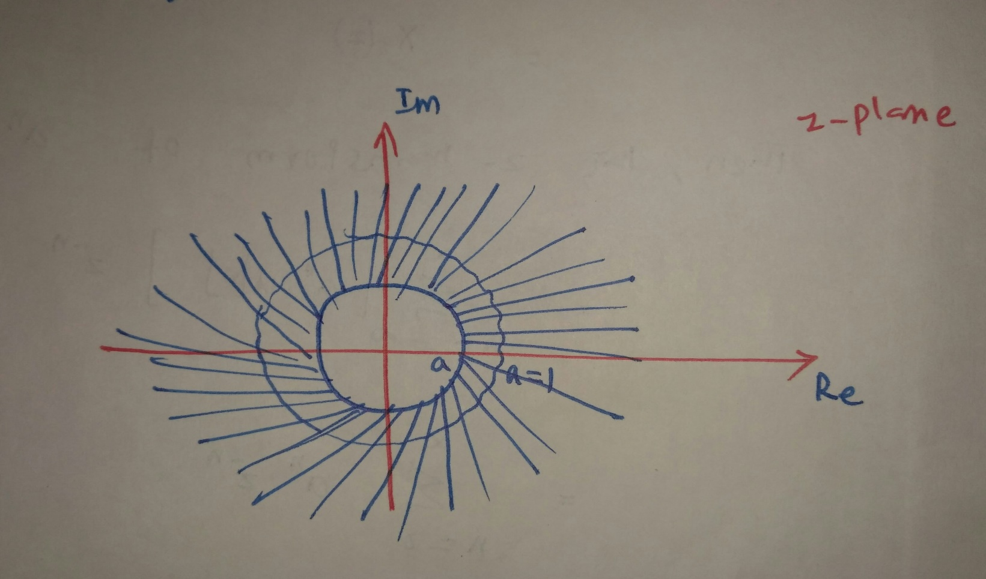
=$\frac{1}{1−{(az}^{−1})}$; ${(az}^{−1})$<1
=$\frac{z}{z−a}$;$\left|z\right|$>$\left|a\right|$
Therefore; $a^{n}u\left[n\right]$ $\frac{z}{z−a}$ ;$\left|z\right|$>$\left|a\right|$
For convergence of $X\left(z\right)$ we require that $\left|\sum_{n=0}^{∞}{{{(az}^{−1})}^{n}}\right|$ <$∞$
Therefore, The above summation converges only if $\left|{(az}^{−1})\right|$ <1,i.e;$\left|z\right|<1$,i,e; $\left|z\right|>$ $\left|a\right|$
The hashed Region ,represents ,
ROC .
The Z-transform exists only
$\left|z\right|$>$\left|a\right|$
Z.T
Mallikarjuna Rao |ECE|SREC
Laplace Transform and Z-Transform/ 5 -
Slide No.31

Slide 33
Problem:-2
Find the Z-transform of $x[n]$=${−a}^{n}u\left[−n−1\right]?$
Sol:
The z-transform of $x\left[n\right]$ is
=$\sum_{n=−∞}^{∞}{x\left[n\right]}z^{−n}$
= $X\left(z\right)$
Then the z-transform of -$a^{n}u\left[−n−1\right]$ is
= $\sum_{n=−∞}^{∞}{{[−a}^{n}u\left[−n−1\right]]}$ $z^{−n}$
= $\sum_{n=−1}^{∞}{{−a}^{n}}$ $z^{−n}$ [since; $u\left[−n−1\right]$=1; $n$ ≤-1
=$\sum_{n=−1}^{−∞}{{−a}^{n}}$ $z^{−n}$ =0; $n>$-1]
Mallikarjuna Rao |ECE|SREC
Laplace Transform and Z-Transform/ 5 -
Slide No.32

Slide 34
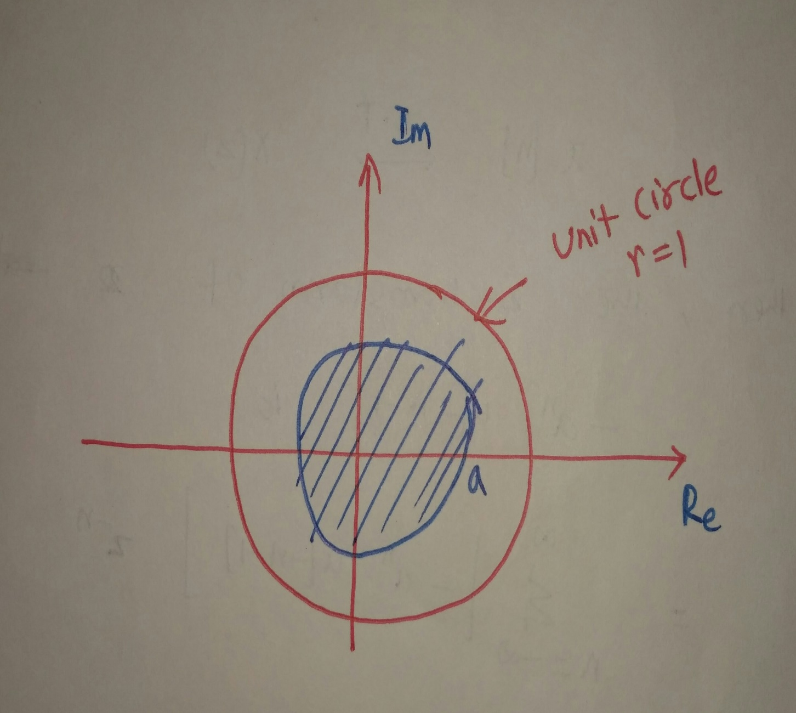
=$\sum_{n=−∞}^{−1}{{−a}^{n}}$ $z^{−n}$
=1-$\frac{1}{1−a^{−1}z}$; $a^{−1}z$<1
=$\frac{Z}{Z−a}$;|$Z$|<|a|
${−a}^{n}u\left[−n−1\right]$ $\frac{Z}{Z−a}$ ;|$Z$|<|a
The hashed region represents RoC
Since the summation
$\sum_{n=0}^{∞}{{(a}^{−1}}$ ${z)}^{n}$ is converges only
if |$a^{−1}$z|<1;$\frac{z}{a}<1$
z<a ;|z|<|a|
Z.T
Mallikarjuna Rao |ECE|SREC
Laplace Transform and Z-Transform/ 5 -
Slide No.33

Slide 35
From the Last two examples, two different sequences have the same algebraic expression $(\frac{Z}{Z−a}$);but their region of convergence is different.
i.e., one with RoC ;|z|>|a|
another with RoC ;|z|<|a|
Therefore it is very important to specify both algebraic expression and Region of Convergence.
Problem:-3
Find the Z-transform of $x[n]$=${7(\frac{1}{3})}^{n}u\left[n\right]$- ${6(\frac{1}{2})}^{n}u\left[n\right]$?
Sol: we know that
Mallikarjuna Rao |ECE|SREC
Laplace Transform and Z-Transform/ 5 -
Slide No.34

Slide 36
$a^{n}u\left[n\right]$ $\frac{z}{z−a}$ ;$\left|z\right|$>$\left|a\right|$
${\left(\frac{1}{3}\right)}^{n}u\left[n\right]$ $\frac{z}{z−\frac{1}{3}}$ ; $\left|z\right|$>$\left|\frac{1}{3}\right|$
${\left(\frac{1}{2}\right)}^{n}u\left[n\right]$ $\frac{z}{z−\frac{1}{2}}$ ; $\left|z\right|$>$\left|\frac{1}{2}\right|$
${7\left(\frac{1}{3}\right)}^{n}u\left[n\right]$- 6${\left(\frac{1}{2}\right)}^{n}u\left[n\right]$ $\frac{7z}{z−\frac{1}{3}}$ - $\frac{6z}{z−\frac{1}{2}}$ ; $\left|z\right|$>$\left|\frac{1}{3}\right|$ ; $\left|z\right|$>$\left|\frac{1}{2}\right|$
Z.T
Z.T
Z.T
Z.T
Mallikarjuna Rao |ECE|SREC
Laplace Transform and Z-Transform/ 5 -
Slide No.35

Slide 37
Properties of z-Transform:-
Linearity property:-
If $x_{1}\left(n\right) X_{1}\left(z\right)$ with RoC=$R_{1}$
$x_{2}\left(n\right) X_{2}\left(z\right)$ with RoC=$R_{2}$
Then ${ax}_{1}\left(n\right)$ + ${bx}_{1}\left(n\right) { aX}_{1}\left(z\right)$ + ${bX}_{1}\left(z\right) with$RoC=$R_{1}∩$ $R_{2}$
Proof:-
The z-transform of $x\left[n\right]$ is
=$\sum_{n=−∞}^{∞}{x\left[n\right]}z^{−n}$
= $X\left(z\right)$ $with$RoC=R
Similarly the z-transform of $x_{1 }\left(n\right)$ is
Z.T
Z.T
Z.T
Mallikarjuna Rao |ECE|SREC
Laplace Transform and Z-Transform/ 5 -
Slide No.36

Slide 38
=$\sum_{n=−∞}^{∞}{x_{1}\left[n\right]}z^{−n}$
= $X_{1}\left(z\right)$ with RoC=$R_{1}$
The z-transform of $x_{2 }\left(n\right)$
=$\sum_{n=−∞}^{∞}{x_{2}\left[n\right]}z^{−n}$
= $X_{2}\left(z\right)$ with RoC=$R_{2}$
The z-transform of ${ax}_{1}\left(n\right)$ + ${bx}_{1}\left(n\right)$is
=$\sum_{n=−∞}^{∞}{{[ax}_{1}\left[n\right]+bx_{2}\left[n\right]]}z^{−n}$
=$a$ $\sum_{n=−∞}^{∞}{x_{1}\left[n\right]}z^{−n}$+ $b$ $\sum_{n=−∞}^{∞}{x_{2}\left[n\right]}z^{−n}$
= $a$ $X_{1}\left(z\right)$ + ${bX}_{2}\left(z\right)$ with RoC= $R_{1}∩$ $R_{2}$
Mallikarjuna Rao |ECE|SREC
Laplace Transform and Z-Transform/ 5 -
Slide No.37

Slide 39
2.Time-shifting property:-
If $x\left[n\right]$ $X\left(z\right)$with RoC=R
Then $x\left[n−n_{0}\right]$ $z^{{−n}_{0}}$ $X\left(z\right)$with RoC=R, except for the possible addition of deletion of the origin or infinity.
The z-transform of $x\left[n\right]$ is
=$\sum_{n=−∞}^{∞}{x\left[n\right]}z^{−n}$
= $X\left(z\right)$ $with$RoC=R
The z-transform of $x\left[n−n_{0}\right]$ is
= $\sum_{n=−∞}^{∞}{x\left[n−n_{0}\right]}z^{−n}$
Let $n−n_{0}$=m$→$n= m+ $n_{0}$
If n=-$∞$then m=-$∞$
Z.T
Z.T
Mallikarjuna Rao |ECE|SREC
Laplace Transform and Z-Transform/ 5 -
Slide No.38

Slide 40
n=$∞$then m=$∞$
Therefore , =$\sum_{m=−∞}^{∞}{x\left[m\right]}z^{−(m+n_{0})}$
= $\sum_{m=−∞}^{∞}{x\left[m\right]}$ $z^{−m}.$ $z^{−n_{0}}$
= $z^{−n_{0}}$ $\sum_{m=−∞}^{∞}{x\left[m\right]}$ $z^{−m}$
= $z^{−n_{0}}$ $X\left(z\right)$
$x\left[n−n_{0}\right]$ $z^{{−n}_{0}}$ $X\left(z\right)$ with RoC=R
3.Scaling in z-domain:-
If $x\left[n\right]$ $X\left(z\right)$with RoC=R
Then $z_{0}^{n} X\left(z\right)$with RoC=|$z_{0}$|R
Proof:-
The z-transform of $x\left[n\right]$ is
Z.T
Z.T
Z.T
Mallikarjuna Rao |ECE|SREC
Laplace Transform and Z-Transform/ 5 -
Slide No.39

Slide 41
=$\sum_{n=−∞}^{∞}{x\left[n\right]}z^{−n}$
= $X\left(z\right)$ $with$RoC=R
The z-transform of${ z}_{0}^{n}x\left[n\right]$ is
= $\sum_{n=−∞}^{∞}{{ z}_{0}^{n}x\left[n\right]}z^{−n}$
= $\sum_{n=−∞}^{∞}{x\left[n\right]}$ ${z^{−n}z}_{0}^{n}$
=$\sum_{n=−∞}^{∞}{x\left[n\right]}{\left(\frac{z}{z_{0}}\right)}^{−n}$
= $X\left(\frac{z}{z_{0}}\right)$ with RoC =|$z_{0}$| R
RoC:-If ‘z’ is a point in the RoC of $X\left(z\right)$ then the point |$z_{0}$|z is in the Roc of $X\left(\frac{z}{z_{0}}\right)$
Mallikarjuna Rao |ECE|SREC
Laplace Transform and Z-Transform/ 5 -
Slide No.40

Slide 42
Note:-
When $z_{0}=e^{jω_{0}}$
$e^{jω_{0}n}$ $x\left[n\right]$ $X\left(e^{−jω_{0}}z\right)$
In this case all pole-zero locations rotate in the z-planeby an angle of $ω_{0}$.
4.Time reversal:-
If $x\left[n\right]$ $X\left(z\right)$with RoC=R
Then $x\left[−n\right]$ $X\left(\frac{1}{z}\right)$with RoC= $\frac{1}{R}$
Proof:-
The z-transform of $x\left[n\right]$ is
Z.T
Z.T
Z.T
Mallikarjuna Rao |ECE|SREC
Laplace Transform and Z-Transform/ 5 -
Slide No.41

Slide 43
=$\sum_{n=−∞}^{∞}{x\left[n\right]}z^{−n}$
= $X\left(z\right)$ $with$RoC=R
The z-transform of $x\left[−n\right]$ is
= $\sum_{n=−∞}^{∞}{x\left[−n\right]}z^{−n}$
Let $−n$=m if $n=−∞$;m=$∞$
$n=∞$;m=-$∞$
= $\sum_{m=−∞}^{∞}{x\left[m\right]}z^{m}$
=$\sum_{m=−∞}^{∞}{x\left[m\right]}{\left(z^{−1}\right)}^{−m}$
= $X\left(\frac{1}{z}\right)$ with RoC = R
$x\left[n\right]$ $X\left(z\right)$with RoC=R;then $x\left[−n\right]$ $X\left(\frac{1}{z}\right)$ with RoC= $\frac{1}{R}$
Z.T
Z.T
Mallikarjuna Rao |ECE|SREC
Laplace Transform and Z-Transform/ 5 -
Slide No.42

Slide 44
If $z_{0}$ is in the RoC of $X\left(z\right)$,then $\frac{1}{z_{0 }}$ is in the RoC of $x\left[−n\right]$.
5.Time expansion:-
Time expansion for discrete time signals is to insert number of zeroes between successive valves of discrete time sequence.
$x_{(k)}\left[n\right]=x\left(\frac{n}{k}\right)$; if n is a multiple of k
=0, if n is not a multiple of k
If $x_{(k)}\left[n\right]$,k-1 zeroes inserted between siccesive valves of the original signal.
Mallikarjuna Rao |ECE|SREC
Laplace Transform and Z-Transform/ 5 -
Slide No.43

Slide 45
Z.T
If $x\left[n\right]$ $X\left(z\right)$ with RoC=R,
then $x_{(k)}\left[n\right]$ with RoC=$R^{\frac{1}{k}}$
Z.T
Mallikarjuna Rao |ECE|SREC
Laplace Transform and Z-Transform/ 5 -
Slide No.44

Slide 46
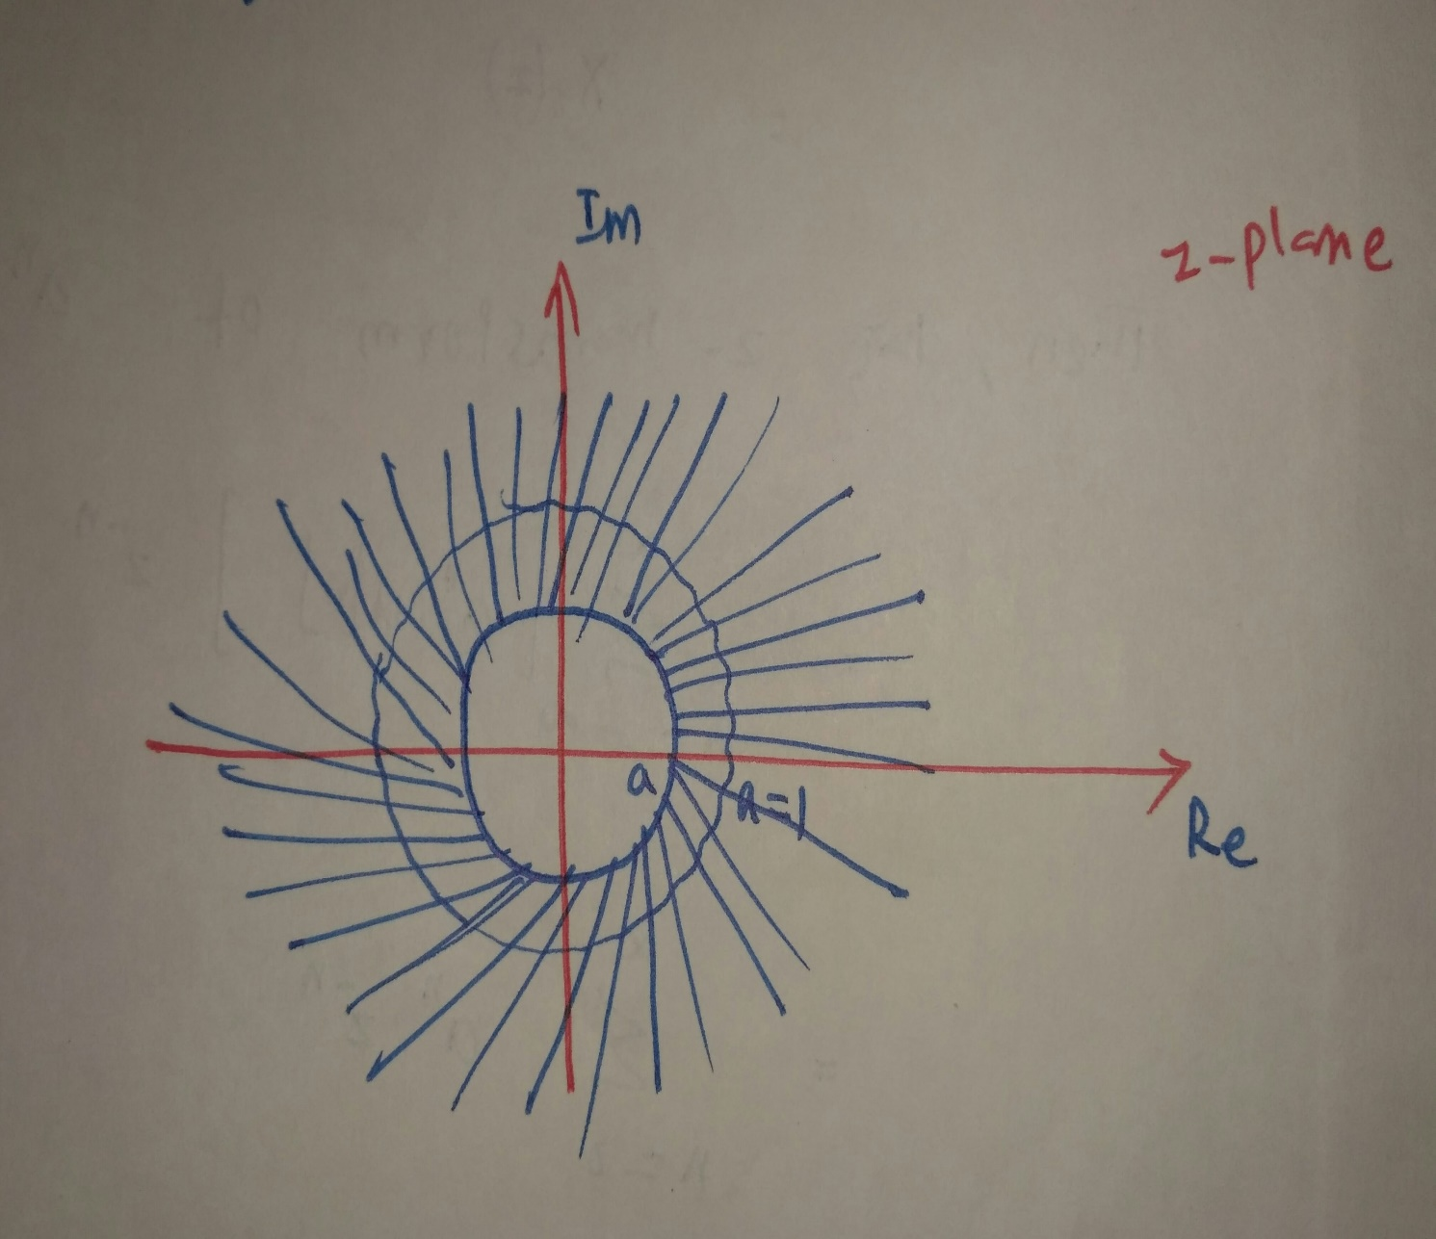
Z.T
If $x\left[n\right]$ $X\left(z\right)$ with RoC=R,
then $x_{(k)}\left[n\right]$ with RoC=$R^{\frac{1}{k}}$
Z.T
Mallikarjuna Rao |ECE|SREC
Laplace Transform and Z-Transform/ 5 -
Slide No.44

