Slide 1
STATES, STATE GRAPHS, AND TRANSITION TESTING
By: S.Md.Farooq

Slide 2
STATE GRAPHS
States
A state is a combination of circumstances or attributes belonging for the time being to a person or thing.
E.g., A program that detects the character sequence “ZCZC” can be in the following states:
1. Neither ZCZC nor any part of it has been detected.
2. Z has been detected.
3. ZC has been detected.
4. ZCZ has been detected.
5. ZCZC has been detected.

Slide 3
Examples
E.g., A moving automobile whose engine is running can have the following states with respect to its transmission:
1. Reverse gear 2. Neutral gear
3. First gear 4. Second gear
5. Third gear 6. Fourth gear
E.g., A person’s checkbook can have the following states with respect to the bank balance:
1. Equal
2. Less than
3. Greater than

Slide 4
Example
E.g., A word processing program menu can be in the following states with respect to file manipulation:
1. Copy document
2. Delete document
3. Rename document
4. Create document
5. Compress document
6. Copy disc
7. Format disc
8. Backup disc
9. Recover from backup

Slide 5
states
States are represented by nodes, states are numbered or may be identified by words or whatever else is convenient.
Fig. 1. shows a typical state graph. The automobile example is really more complicated because: (1) the engine might or might not be running, (2) the car itself might be moving forward or backward or be stopped, and (3) the clutch might or might not be depressed. These factors multiply the above six states by 2 × 3 × 2 = 12, for a total of 72 rather than 6 states.

Slide 6
Inputs and Transitions
Whatever is being modeled is subjected to inputs.
As a result of those inputs, the state changes, or is said to have made a transition.
Transitions are denoted by links that join the states. The input that causes the transition are marked on the link; that is, the inputs are link weights.
There is one outlink from every state for every input.
If several inputs in a state cause a transition to the same subsequent state, instead of drawing a bunch of parallel links we can abbreviate the notation by listing the several inputs as in: “input1, input2, input3. . .”.

Slide 7
A finite-state machine is an abstract device that can be represented by a state graph having a finite number of states and a finite number of transitions between states.
The ZCZC detection example can have the following kinds of inputs:
1. Z
2. C
3. Any character other than Z or C, which we’ll denote by A

Slide 8
One time zczc sequence detector state graph

Slide 9
Fig.1 intepreted as follows
1. If the system is in the “NONE” state, any input other than a Z will keep it in that state.
2. If a Z is received, the system transitions to the “Z” state.
3. If the system is in the “Z” state and a Z is received, it will remain in the “Z” state. If a C is received, it will go to the “ZC” state; if any other character is received, it will go back to the “NONE” state because the sequence has been broken.

Slide 10
4. A Z received in the “ZC” state progresses to the “ZCZ” state, but any other character breaks the sequence and causes a return to the “NONE” state.
5. A C received in the “ZCZ” state completes the sequence and the system enters the “ZCZC” state. A Z breaks the sequence and causes a transition back to the “Z” state; any other character causes a return to the “NONE” state.
6. The system stays in the “ZCZC” state no matter what is received.

Slide 11
Outputs
An output can be associated with any link.
Outputs are denoted by letters or words and are separated from inputs by a slash as follows: “input/ output.”
Output denotes anything of interest that’s observable and is not restricted to explicit outputs by devices.
Outputs are also link weights.
If every input associated with a transition causes the same output, then denote it as: “input 1, input 2, . . . input 3/ output.”
If there are many different combinations of inputs and outputs, it’s best to draw a separate parallel link for each output.

Slide 12
Example

Slide 13
explanation
“If no write errors are detected, (input = OK), no action is taken (output = NONE).
If a write error is detected (input = ERROR), backspace the tape one block and rewrite the block (output = REWRITE).
If the rewrite is successful (input = OK), ignore the fact that there has been a rewrite.
If the rewrite is not successful, try another backspace and rewrite.
Return to the original state if and only if there have been two successive successful writes.

Slide 14
explanation
If there have been two successive rewrites and a third error occurs, backspace ten centimeters and erase forward from that point (output = ERASE).
If the erasure works (input = OK), return to the initial state. If it does not work, backspace another ten centimeters, erase and treat the next write attempt as for the first erasure.
If the second erasure does not clear the problem, put the tape transport out of service.”
The state graph is shown in Fig. 2. As in the previous example, the inputs and actions have been simplified.
There are only two kinds of inputs (OK, ERROR) and four kinds of outputs (REWRITE, ERASE, NONE, OUT-OF-SERVICE).

Slide 15
State Tables
Big state graphs are cluttered (confuse) and hard to follow.
It’s more convenient to represent the state graph as a table (the state table or state-transition table) that specifies the states, the inputs, the transitions, and the outputs.
The following conventions are used:
1. Each row of the table corresponds to a state.
2. Each column corresponds to an input condition.
3. The box at the intersection of a row and column specifies the next state (the transition) and the output, if any.

Slide 16
State table

Slide 17
Time Versus Sequence
State graphs don’t represent time- they represent sequence.
A transition might take microseconds or centuries; a system could be in one state for milliseconds and another for eons (long time), or the state graph would be the same because it has no notion of time.
Although the finite-state machine model can be elaborated to include notions of time in addition to sequence, such as timed Petri nets.

Slide 18
Software Implementation
Implementation and Operation
There is rarely a direct correspondence between programs and the behavior of a process described as a state graph.
The state graph represents the total behavior consisting of the transport, the software, the executive, the status returns, interrupts, and so on.
There is no simple correspondence between lines of code and states. The state table, however, forms the basis for a widely used implementation shown in the PDL program below.

Slide 19
tables
There are four tables involved:
1. A table or process that encodes the input values into a compact list (INPUT_CODE_TABLE).
2. A table that specifies the next state for every combination of state and input code (TRANSITION_TABLE).
3. A table or case statement that specifies the output or output code, if any, associated with every state-input combination (OUTPUT_TABLE).
4. A table that stores the present state of every device or process that uses the same state table- e.g., one entry per tape transport (DEVICE_TABLE).

Slide 20
example
BEGIN
PRESENT_STATE := DEVICE_TABLE(DEVICE_NAME)
ACCEPT INPUT_VALUE
INPUT_CODE := INPUT_CODE_TABLE(INPUT_VALUE)
POINTER := INPUT_CODE#PRESENT STATE
NEW_STATE := TRANSITION_TABLE(POINTER)
OUTPUT_CODE := OUTPUT_TABLE(POINTER)
CALL OUTPUT_HANDLER(OUTPUT_CODE)
DEVICE_TABLE(DEVICE_NAME) := NEW_STATE
END

Slide 21
1. The present state is fetched from memory.
2. The present input value is fetched. If it is already numerical, it can be used directly; otherwise, it may have to be encoded into a numerical value, say by use of a case statement, a table, or some other process.
3. The present state and the input code are combined (e.g., concatenated) to yield a pointer (row and column) of the transition table and its logical image (the output table).
4. The output table, either directly or via a case statement, contains a pointer to the routine to be executed (the output) for that state-input combination. The routine is invoked (possibly a trivial routine if no output is required).
5. The same pointer is used to fetch the new state value, which is then stored.

Slide 22
GOOD STATE GRAPHS AND BAD
The good and bad state graphs are identified or judged based on what kind of graphs are used in the test design
Here are some principles for judging:
1. The total number of states is equal to the product of the possible number of factors that make up the state.
2. For every state and input there is exactly one transition specified to exactly one state.
3. For every transition there is one output action specified.
4. For every state there is a sequence of inputs that will move the system back to the same state.

Slide 23
Other Criteria:
The number of input codes for a state graph must be atleast two because only few kinds of state graphs can be constructed with one input code.
A good state graph has atleast two input symbols. With one symbol only a limited number of useful graphs are possible.
Bad State Graphs: the state graphs which cannot be good and which cannot follow any principles of good state graph are known as bad state graphs. The state graphs which are not reachable and which are buggy are bad state graphs

Slide 24
IMPROPER STATE GRAPHS

Slide 25
State Bugs
Number of States
The number of states in a state graph is the number of states that are required to identify the behavior of the system. In the context of the database, the state is the set of values of variables or attributes.
Every state of the state graph is very important to the state testing, so it is essential to find the number of states.
States can be identified by:
Finding all factors of the state
finding all possible values of each factor

Slide 26
FIND NUMBER OF STATES
Find the number of states as follows:
1. Identify all the component factors of the state.
2. Identify all the allowable values for each factor.
3. The number of states is the product of the number of allowable values of all the factors.
- Identify the factors and then the number of possible values for each factor and get an identification or recognition for each state, with one state corresponding to each combination of condition values.
- Make up a table, with a column for every factor, such that all combinations of factors are represented.

Slide 27
IMPOSSIBLE STATES
Some combinations of factors may appear to be impossible. The impossible states do not have any meaning in the systems as the impossible states are the one which are not possible to occur

Slide 28
EXPLANATION
But broken engines can’t run, so the combination of factors for engine condition and engine operation yields only 3 rather than 4 states. Therefore, the total number of states is at most 108.
A car with a broken transmission won’t move for long, thereby further decreasing the number of feasible states. The discrepancy between the programmer’s state count and the tester’s state count is often due to a difference of opinion concerning “impossible states.”

Slide 29
Equivalent States
Two states are equivalent if every sequence of inputs starting from one state produces exactly the same sequence of outputs when started from the other state. This notion can also be extended to sets of states.
Say that the system is in state S and that an input of a causes a transition to state A while an input of b causes a transition to state B.

Slide 30
EQUIVALENT STATES

Slide 31
PROCEDURE
The rows corresponding to the two states are identical with respect to input/output/next state but the name of the next state could differ.
The two states are differentiated only by the input that distinguishes between them. This situation is shown in Fig.7. Except for the a,b inputs, which distinguish between states A and B, the system’s behavior in the two states is identical for every input sequence; they can be merged.
There are two sets of rows which, except for the state names, have identical state graphs with respect to transitions and outputs. The two sets can be merged in Fig.8.

Slide 32
The rows are not identical, but except for the state names (A1 = B2, A2 = B2, A3 = B3), the system’s action, when judged by the relation between the output sequence produced by a given input sequence, is identical for either the A or the B set of states. Consequently, this state graph can be replaced by the simpler version shown in Fig.8.c.

Slide 33
EQUIVALENT STATES

Slide 34
MERGED EQUIVALENT STATES

Slide 35
UNMERGED STATES

Slide 36
Bugs are often the result of the unjustifiable merger of seemingly equivalent states. Two states or two sets of states appear to be equivalent because the programmer has failed to carry through to a proof of equivalence for every input sequence
The input sequence abbbb produces the output sequence uxuyy, while the input sequence bbbb produces the output sequence uxuyu. The two sets of states are not equivalent, although an incomplete analysis might lead you to believe that they are.

Slide 37
Transition Bugs
Unspecified and Contradictory Transitions
Unspecified Transactions: Transactions are nothing but the lines that are used to link the states.
For every state input combination, there should be a transition specified. If the transitions are not specified then the bugs can occur due to unspecified transitions between the states.
The system should adopt a mechanism such that when the transition is not possible in the state then there should be a method that prevents the occurrence of input in that state.
If such a method is not there, then the input becomes useless or inefficient.
there should be only one transition specified for each state and the input combinations so that the transition bugs due to unspecified transitions can be avoided

Slide 38
Contradictory transitions
Contradictions and ambiguities cannot occur in a program.
It is impossible for a program to be ambiguous because every input is processed to produce some or other output.
It does not matter whether the output is correct or incorrect.
In the same way, the program or software cannot be contradictory.

Slide 39
Conversion of specifications into state graph
Specifications are one of the most common source of ambiguities and contradictions.. The following example illustrates how to convert a specification into a state graph and how contradictions can come about.
The tape control routine will be used. Start with the first statement in the specification and add to the state graph one statement at a time. Here is the first statement of the specification:

Slide 40
Rule 1: The program will maintain an error counter, which will be incremented whenever there’s an error.
Rule 2: If there is an error, rewrite the block.
Rule 3: If there have been three successive errors, erase 10 centimeters of tape and then rewrite the block.
Rule 4: If there have been three successive erasures and another error occurs, put the unit out of service.
Rule 5: If the erasure was successful, return to the normal state and clear the error counter.
Rule 6: If the rewrite was unsuccessful, increment the error counter, advance the state, and try another rewrite.
Rule 7: If the rewrite was successful, decrement the error counter and return to the previous state.

Slide 41
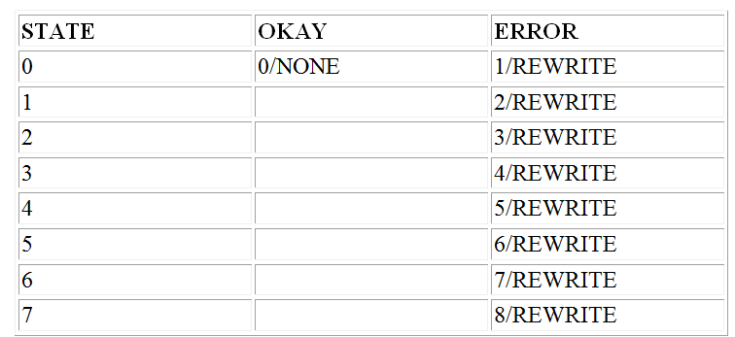
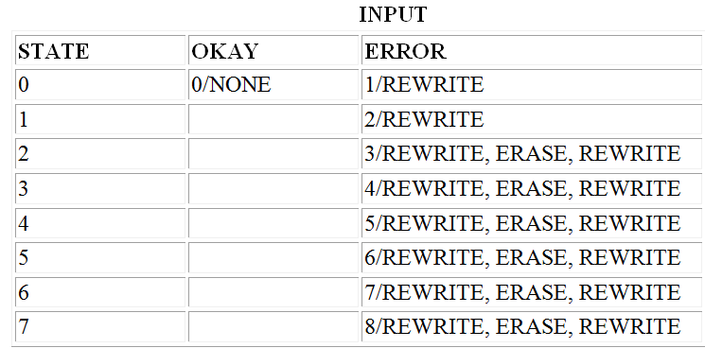
Adding Rule 2, we get
Rule 3:
If there have been three successive errors, erase 10 centimeters of tape and then rewrite the block.

Slide 42
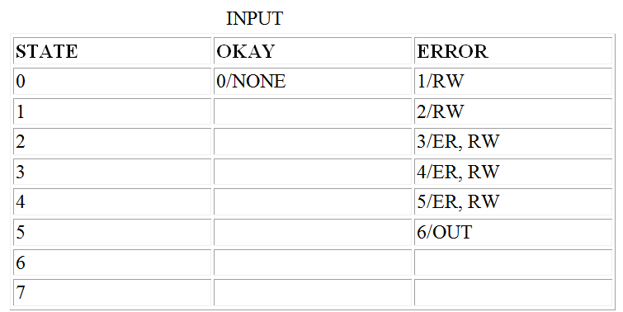
Rule 4: If there have been three successive erasures and another error occurs, put the unit out of service.

Slide 43
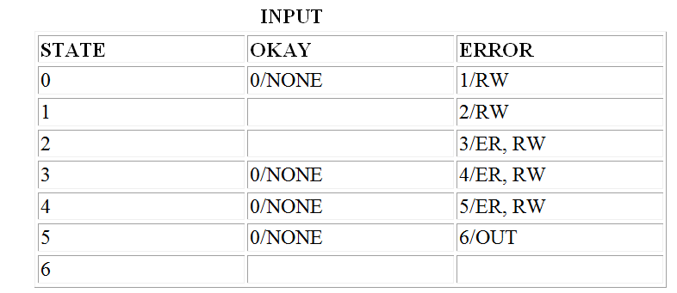
Rule 5: If the erasure was successful, return to the normal state and clear the counter.
Rule 6:
If the rewrite was unsuccessful, increment the error counter, advance the state, and try another rewrite.

Slide 44
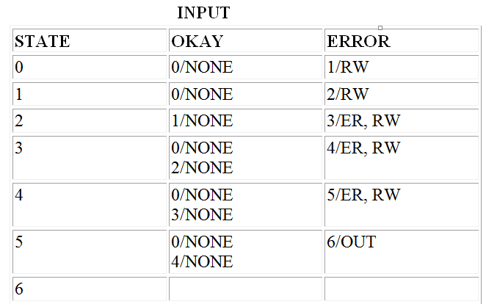
Rule 7: If the rewrite was successful, decrement the error counter and return to the previous state.

Slide 45
Unreachable states: If there are some state which no input sequence can reach then that state is known as “unreachable state”.
there may be transitions from the unreachable state to other states, because the state became unreachable as a result of incorrect transitions
The unreachable states can occur from impossible states. If groups of connected states are isolated, there can be two possibilities they are:
The missing of transition may result in a bug
There are some unknown transitions which the programmer does not know.

Slide 46
Dead States: A dead state or set of dead states is a state that once entered cannot be left. This is not necessarily a bug, but it is suspicious
Output errors: The output for the transition could be wrong if all the states, the transitions and inputs are correct and there are no dead or unreachable states.
Outputs are not dependent on transitions and inputs. They should also be tested and verified independently. The tester needs to distinguish the state graph that is correct and whose output is incorrect.
The reason for the wrong output would be incorrect call to the routine that should be executed for output. It is minor bug

Slide 47
Encoding bugs:
The process of converting or coding the inputs, transitions and outputs of the states in order to obtain the secure process of finite state machine is known as encoding.
Encoding is done both in explicit and implicit way. The probability of bugs is more in explicit finite state machine implementation. Bugs can even occur in implicit finite state machine because of different views made by programmer and tester.

Slide 48
STATE TESTING
State testing is defined as functional testing technique to test the functional bugs in the entire system
The principles of state testing are very similar to the principles of path testing.
For path testing it is not possible to test every possible path in a flow graph. Similarly, for state testing it is not possible to test every possible path is a state graph.
In a state graph a path is a sequence of transitions caused by a sequence of inputs
State testing examines each transition in a state graph to guarantee complete testing

Slide 49
To begin state testing do the following:
Define a set of input sequences such that when the system starts from the initial state, after going through all states It get backs to the initial state.
Define expected next state, expected transition and also expected output code for each step in each input sequence.
At last, a set of tests define three sets of sequences such as input sequences, transition sequences and output sequences to complete the test.

Slide 50
Advantages:
State testing is useful when the error corrections are less expensive.
Useful when the tester want to detect a specified input or when the order of inputs sequence is important.
It is especially designed for catching the deep bugs.
Disadvantages:
When state testing is completed, there might be some bugs remained in the system.
Testers requires large number of input sequences to catch transition errors, missing states, extra states and the link

Slide 51
Impact of bugs/implementation issues:
The bugs in the software can occur through many different cases. Due to these bugs it is impossible to pass through or cover all the paths in the state graph. The bugs may occur due to:
Incorrect number of states
Incorrect state transitions
Incorrect transition output
Dead states
Unreachable states

Slide 52
The occurrence of bugs will be more in strongly connected graphs.
State graphs are not time bounded- means some state graphs may consume less time and some may consume more time.
When the system has no state and when there are improper responses, the state diagrams are not applied.
The output errors in the state graphs can be caught easily but for transition errors long sequence covers should be used.
State testing is considered as bottom line method as it supports functional model rather than the structural details.

Slide 53
Testability tips
Switches, flags and unachievable paths:
The switches are flags are most essential tools for testing the state graph.
They are used to test the finite state machine in every possible state.
A flag is initialized and depending on this value a specific path is selected to find the easiest path for testing the finite state machine

Slide 54
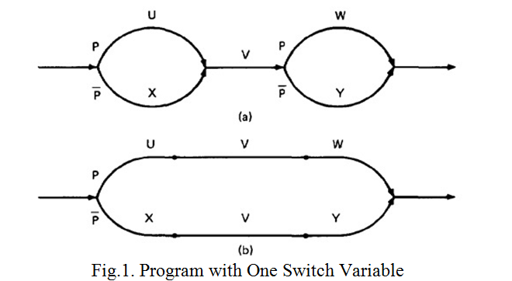
Consider the example of a program with one flag

Slide 55
In fig1 the flag value ‘P’ is assigned a value and it is to be evaluated. Depending on that value, the path is branched to continue the testing in both the ways.
The testing can also be done by removing the flag and dividing ‘V’ into two paths.
There are four paths named U,W,X,Y. Where two paths are not achievable.
The paths which cannot interact with each other are known as unachievable paths.
U is unachievable to Y
X is unachievable to w
Two paths are achievable.
U is achievable to W
X is achievable to Y

Slide 56
Essential and inessential finite state behavior
Finite state machine
Combinational machine
A combinational machine selects the path based on the values of predicates, the predicates depends only on prior processing and the predicate truth value will not change once they have been determined.
A path is equivalent to a Boolean algebra expression over the predicates. No matter in which order decisions are made.

Slide 57
The following are the conditions are inessential finite state machine behaviour. If these conditions are not satisfied then the behaviour of the state machine is known as essential.
If behaviour can be obtained by parallel program in data flow machine.
If behaviour is obtained from decision table or decision tree.
If expression of exit is equal to unity for a program including loops.
If the program’s exit expression is not equal to unity but we don't want to loop under the looping conditions.

Slide 58
Design guideliness
Following are some of the design guideliness for building finite state machine into user code.
Learn the procedure of finite state machine that are used in both hardware and software.
Design an abstract machine model that works properly and satisfy user requirements then use stateg raph or state table to analyse.
Design an explicit finite state machine which comprises of i/p encoding, o/p encoding, state code, tansition table, o/p table and state storage.

Slide 59
Prototype test must be conducted thoroughly to determine the processing time and space of finite state machine.
If time space is effecting the overall system, then use shortcuts to complete the design process.
If there are more than a few numbers of states then use hierarchical design
If large number of states then implement tools and programming languages that are used to implement the finite state machine as software.

