Slide 1
Sequential Logic Circuits
By :
Dr.M.V.SUBRAMANYAM
PRINCIPAL
SANTHIRAM ENGINEERING COLLGE, NANDYAL

Slide 2
Why do we study sequential logic
Why not only combinational logic?
We can build complex circuits: adder, multiplier etc.
But… real-world problems are sequential in time
We want to build systems that step through computations
These systems have memory and feedback
They use sequence of inputs to transition from state to state

Slide 3
Recall: Combinational vs. sequential systems
A simple model of a digital system is a unit with inputs and outputs:
Combinational systems are "memory-less"
The outputs depend only on the present inputs
Sequential systems have memory
The output values depend on the input values and previous input values
inputs
system
outputs
inputs
outputs

Slide 4
Recall: The steady-state abstraction
Combinational logic: Output depends on current inputs
After sufficient time has elapsed
Sequential logic: outputs retain their settled values
even after waiting for the transient activity to finish
Sequential logic relies on the steady-state abstraction:
the memory of a system is its state
changes in system state are only allowed to occur at specific times most often controlled by an external periodic clock
the clock period is the time that elapses between state changes. It must be sufficiently long so that the system reaches a steady-state before the next state change at the end of the period

Slide 5
Overview: Sequential logic
Assumes steady-state signals
Has memory
Usually employs feedback
Is clocked (or self-timed)
The basic devices and concepts
Latches, flip-flops, shift registers, state machines
Timing is critical
Asynchronous inputs must be synchronized
Metastability

Slide 6
Sequential circuits
Circuits with feedback
outputs = f(inputs, past inputs, past outputs)
basis for building "memory" into logic circuits
door combination lock is an example of a sequential circuit
If there is an error the lock doesn't open
Punch in 3 values in sequence and the door opens
new
equal
reset
value
C1
C2
C3
mux control
multiplexer
comb. logic
comparator
state
clock
equal
open/closed

Slide 7
Memory in sequential circuits
Memory: Stored combination, present digit, errors or successes in past inputs
new
equal
reset
value
C1
C2
C3
mux control
multiplexer
controller
clock
comparator
equal
open/closed

Slide 8
Feedback in sequential circuits
Inputs: Sequence of number values, reset
Outputs: Door open/close
Feedback: Comparator output ("equal" signal)
new
equal
reset
value
C1
C2
C3
mux control
multiplexer
controller
clock
comparator
equal
open/closed

Slide 9
Sequential circuits
SANTHIRAM ENGINEERING COLLEGE
Presented By
Dr. M. V. Subramanyam
Professor & Principal

Slide 10
Overview
Sequential circuits
Latch and Flip-Flops
SR latch
SR flip-flop
D flip-flop
JK flip-flop
T flip-flop
Design Procedure
Advantages
Dr. M.V. Subramanyam|ECE|SREC
Digital electronics

Slide 11
Sequential circuits
The sequential circuit is a special type of circuit and the outputs of the sequential circuits depend on both the combination of present inputs and previous outputs.
The previous output is treated as the present state. So, the sequential circuit contains the combinational circuit and memory storage elements.
Examples: counters, sequence generators etc
Dr. M.V. Subramanyam|ECE|SREC
Digital electronics

Slide 12
Sequential circuit block diagram
Dr. M.V. Subramanyam|ECE|SREC
Digital electronics

Slide 13
Sequential circuit -types
There are two main types of sequential circuits,
(1) A synchronous sequential circuit is a system whose behaviour can be defined from the knowledge of its input signals at discrete instants of time.
(2) An asynchronous sequential circuit is a system whose behaviour can be defined from the knowledge of its input signals at any instant of time and the order in which the inputs change.
Dr. M.V. Subramanyam|ECE|SREC
Digital electronics

Slide 14
SR latch
Dr. M.V. Subramanyam|ECE|SREC
Digital electronics

Slide 15
SR latch with Enable line
Dr. M.V. Subramanyam|ECE|SREC
Digital electronics

Slide 16
SR flip flop with clock
Dr. M.V. Subramanyam|ECE|SREC
Digital electronics

Slide 17
D flip flop with clock
Dr. M.V. Subramanyam|ECE|SREC
Digital electronics

Slide 18
JK flip flop with clock
Dr. M.V. Subramanyam|ECE|SREC
Digital electronics

Slide 19
T flip flop with clock
Dr. M.V. Subramanyam|ECE|SREC
Digital electronics

Slide 20
Sequential circuit - design
To design of Sequential circuits, the procedure involves the following steps:
Derive the state table and state equations.
Derive the state diagram using the state table.
Reduce states using state reduction technique.
Verify the number of Flip-Flops and type of Flip-Flop to be used.
Derive the excitation equations using the excitation table.
Derive the output function and the Flip-Flop input functions.
Derive the logic functions or equation for each output variable.
Draw the required logic diagram.
Dr. M.V. Subramanyam|ECE|SREC
Digital electronics

Slide 21
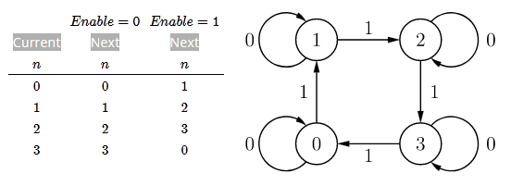
Example for design
Design a counter that has an input enable input. When enable = 1, it increments through the sequence 0,1,2,3,0,…. with each clock tick. Enable = 0 causes the counter to remain in its current state.
First we create a state table and state diagram
Dr. M.V. Subramanyam|ECE|SREC
Digital electronics

Slide 22
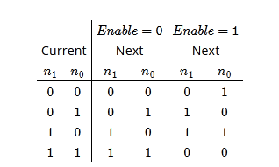
Example for design
A reasonable choice is to use the binary numbering system for each state. With four states we need two bits.
Dr. M.V. Subramanyam|ECE|SREC
Digital electronics

Slide 23
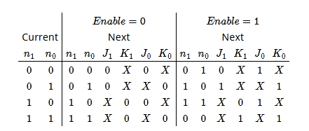
Example for design
We need two flip-flops, one for each bit.
Dr. M.V. Subramanyam|ECE|SREC
Digital electronics

Slide 24
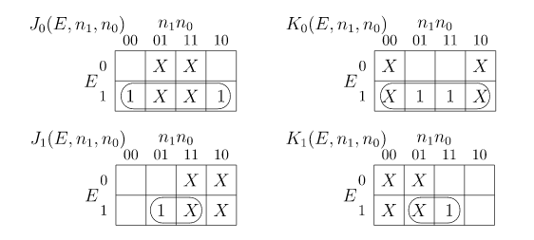
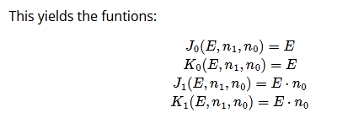
Example for design
We use Karnaugh maps, using E for enable
Dr. M.V. Subramanyam|ECE|SREC
Digital electronics

Slide 25
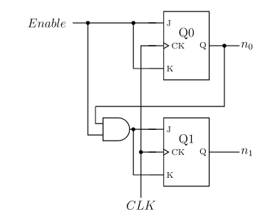
Example for design
The circuit to implement this counter is:
Dr. M.V. Subramanyam|ECE|SREC
Digital electronics

Slide 26
advantages
Memory: Sequential circuits have the ability to store binary values, which makes them ideal for applications that require memory elements, such as timers and counters.
Timing: Sequential circuits are commonly used to implement timing and synchronization in digital systems, making them essential for real-time control applications.
State machine implementation: Sequential circuits can be used to implement state machines, which are useful for controlling complex digital systems.
Error detection: Sequential circuits can be designed to detect errors in digital systems and respond accordingly, improving the reliability of digital systems.
Dr. M.V. Subramanyam|ECE|SREC
Digital electronics

Slide 27
Dr. M.V. Subramanyam|ECE|SREC
Digital electronics

