Slide 1
Memory Management
Unit - III

Slide 2
Introduction
Main memory and the registers built into the processor itself are the only storage that the CPU can access directly
any instructions in execution, and any data being used by the instructions, must be in one of these direct-access storage devices
If the data are not in memory, they must be moved there before the CPU can operate on them

Slide 3
Registers that are built into the CPU are generally accessible within one cycle of the CPU clock
Most CPUs can decode instructions and perform simple operations on register contents at the rate of one or more operations per clock tick
The same cannot be said of main memory, which is accessed via a transaction on the memory bus
Completing a memory access may take many cycles of the CPU clock.

Slide 4
In such cases, the processor normally needs to stall, since it does not have the data required to complete the instruction that it is executing
This situation is intolerable because of the frequency of memory accesses.
The remedy is to add fast memory between the CPU and main memory. A memory buffer used to accommodate a speed differential, called a cache

Slide 5
must ensure correct operation to protect the operating system from access by user processes and, in addition, to protect user processes from one another.
each process has a separate memory space. To do this, we need the ability to determine the range of legal addresses that the process may access and to ensure that the process can access only these legal addresses

Slide 6
We can provide this protection by using two registers, usually a base and a limit
The base register holds the smallest legal physical memory address
the Limit register specifies the size of the range
if the base register holds 300040 and the limit register is 120900, then the program can legally access all addresses from 300040 through 420939

Slide 7
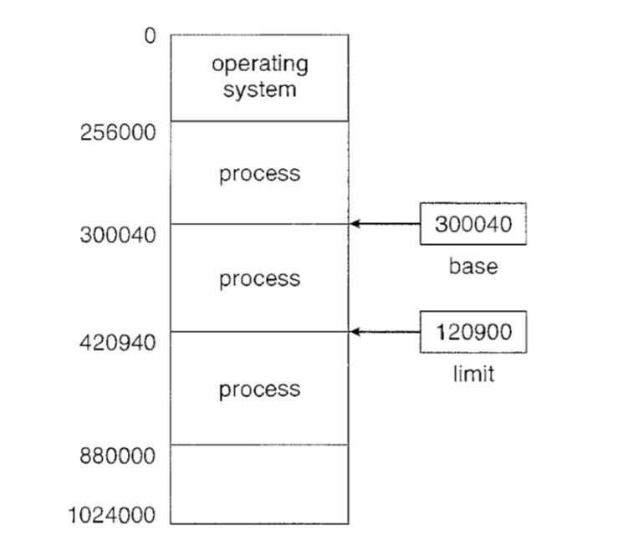
Base and limit register define a legal address space

Slide 8
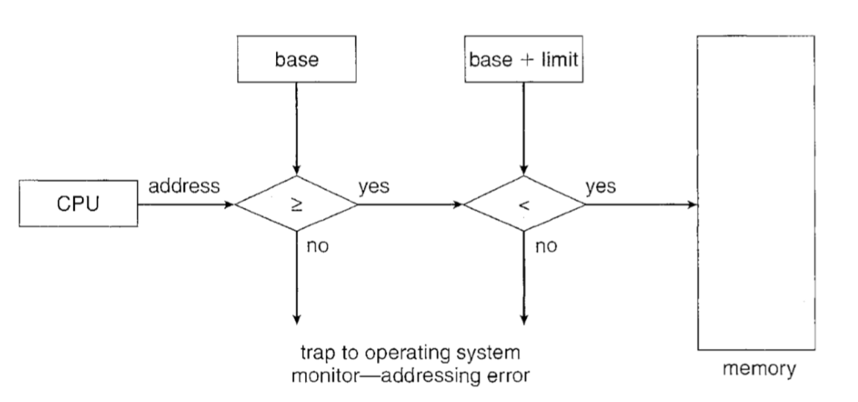
Hardware address protection

Slide 9
Address Binding
a program resides on a disk as a binary executable file. To be executed, the program must be brought into memory and placed within a process
the process may be moved between disk and memory during its execution.
The processes on the disk that are waiting to be brought into memory for execution form the input queue

Slide 10
The normal procedure is to select one of the processes in the input queue and to load that process into memory, executed and terminates then the memory space is declared as available
In most cases, a user program will go through several steps-some of which may be optional-before being executed. Addresses may be represented in different ways during these steps.

Slide 11
A compiler will typically bind these symbolic addresses to relocatable addresses
The linkage editor or loader will in turn bind the relocatable addresses to absolute addresses
Each binding is a mapping from one address space to another
the binding of instructions and data to memory addresses can be done at any step along the way

Slide 12
Compile time. If you know at compile time where the process will reside in memory, then absolute code can be generated
Load time. If it is not known at compile time where the process will reside in memory, then the compiler must generate relocatable code
Execution time. If the process can be moved during its execution from one memory segment to another, then binding must be delayed until run time.

Slide 13
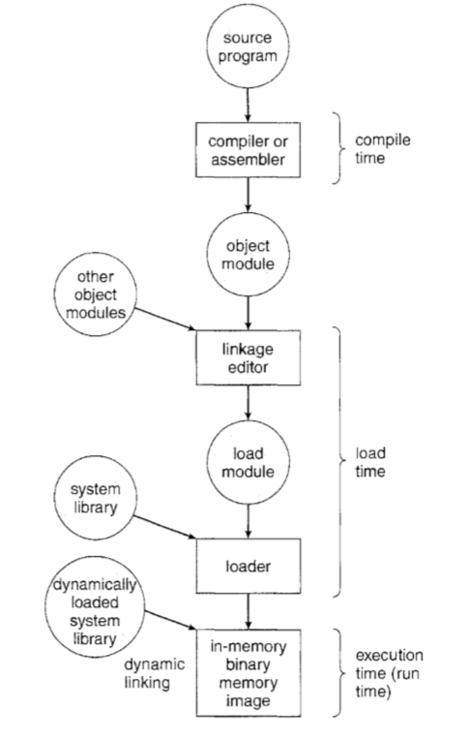
Multistep processing of a user program

Slide 14
Logical and Physical address space
An address generated by the CPU is commonly referred to as a Logical Address
An address seen by the memory unit-that is, the one loaded into the Memory address register of the memory-is commonly referred to as a Physical address
The compile-time and load-time address-binding methods generate identical logical and physical addresses. However, the execution-time address binding scheme results in differing logical and addresses

Slide 15
In this case, we usually refer to the logical address as a virtual address
We use logical address and virtual address interchangeably in this text
The set of all logical addresses generated by a program is a logical address space
the set of all physical addresses corresponding to these logical addresses is a Physical address space

Slide 16
The run-time mapping from virtual to physical addresses is done by a hardware device called the Memory Management Unit (MMU)
The base register is now called a relocation register
The value in the relocation register is added to every address generated by a user process at the time the address is sent to memory

Slide 17
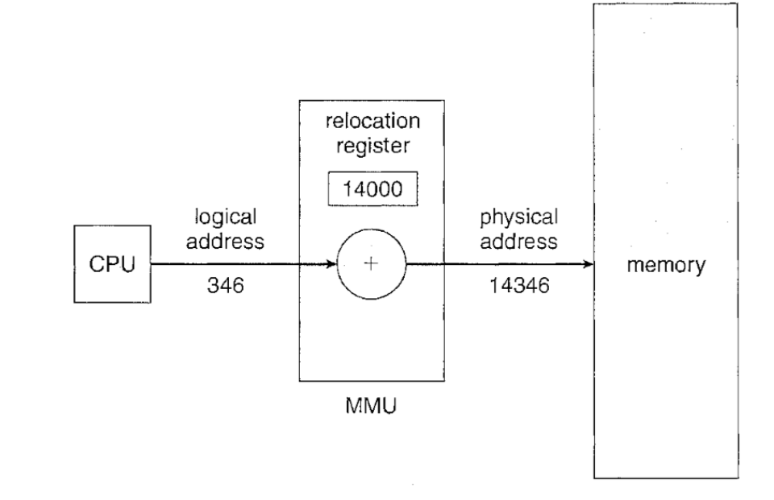
Dynamic relocation using relocation register

Slide 18
For example, if the base is at 14000, then an attempt by the user to address location 0 is dynamically relocated to location 14000; an access to location 346 is mapped to location 14346.

Slide 19
Dynamic Loading
To obtain better memory-space utilization, we can use Dynamic Loading
With dynamic loading a routine is not loaded until it is called. The main program is loaded into memory and is executed
When a routine needs to call another routine, the calling routine first checks to see whether the other routine has been loaded. If it has not, the relocatable linking loader is called to load the desired routine into memory
The advantage of dynamic loading is that an unused routine is never loaded.

Slide 20
Swapping
A process must be in memory to be executed. A process, however, can be swapped temporarily out of memory to a backing store and then brought back into memory for continued execution.
Swap-out and Swap-in, Roll-out and Roll-in
Examples: Round Robin Scheduling Algoriths
Priority Scheduling Algorithms

Slide 21
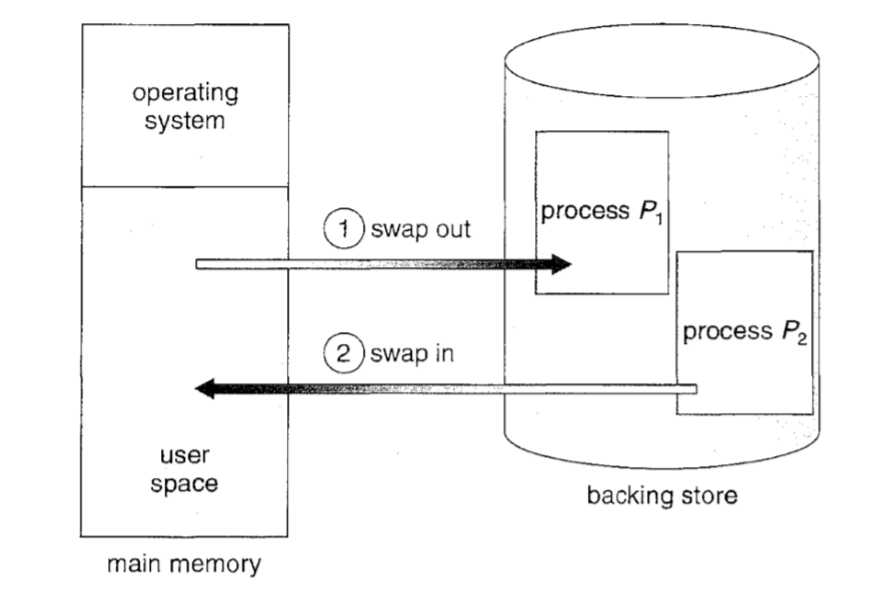
Swapping of two processes

Slide 22
Normally, a process that is swapped out will be swapped back into the same memory space it occupied previously.
This restriction is dictated by the method of address binding.( compile time or load time)
If execution-time binding is being used, however, then a process can be swapped into a different memory space

Slide 23
The total time taken by swapping process includes the time it takes to move the entire process to a secondary disk and then to copy the process back to memory, as well as the time the process takes to regain main memory.
let us assume that the user process is 100 MB in size and the backing store is a standard hard disk with a transfer rate of 50MB per second. The actual transfer of the 100-MB process to or from main memory takes
100MB/50MB per second= 2 seconds.

Slide 24
Contiguous Memory Allocation
The memory is usually divided into two partitions: one for the resident operating system and one for the user processes
In contiguous memory allocation, each process is contained in a single contiguous section of memory.

Slide 25
Memory Allocation
One of the simplest methods for allocating memory is to divide memory into several fixed-sized partitions.
Each partition may contain exactly one process.
The degree of multi programming is bound by number of partitions.
when a partition is free, a process is selected from the input queue and is loaded into the free partition.
When the process terminates, the partition becomes available for another process.

Slide 26
Variable Partition: the operating system keeps a table indicating which parts of memory are available and which are occupied.
Initially, all memory is available for user processes and is considered one large block of available memory, a Hole.
The memory blocks available comprise a set of holes of various sizes scattered throughout memory.

Slide 27
When a process arrives, The system searches for hole large enough for process, If the hole is too large, it is split into two parts. One part is allocated to the arriving process; the other is returned to the set of holes
When a process terminates, it releases its block of memory, which is then placed back in the set of holes.
If the new hole is adjacent to other holes, these adjacent holes are merged to form one larger hole.

Slide 28
Dynamic storage allocation problem
concerns how to satisfy a request of size n from a list of free holes
There are many solutions to this problem. The First-fit, best-fit and worst-fit stratergies are the ones most commonly used to select a free hole from the set of available holes.

Slide 29
First-fit: The first hole that is big enough is allocated to program.
Best Fit: The smallest hole that is big enough is allocated to program.
Worst Fit: The largest hole that is big enough is allocated to program.

Slide 30
Fragmentation
As processes are loaded and removed from memory, the free memory space is broken into little pieces. It happens after sometimes that processes cannot be allocated to memory blocks considering their small size and memory blocks remains unused. This problem is known as Fragmentation.

Slide 31
Types of Fragmentation
External Fragmentation: External fragmentation exists when there is enough total memory space to satisfy a request but the available spaces are not contiguous.
Both the first-fit and best-fit strategies for memory allocation suffer from External Fragmentation.
the memory allocated to a process may be slightly larger than the requested memory. The difference between these two numbers is Internal Fragmentation.

Slide 32
One solution to the problem of external fragmentation is “Compaction”. The goal is to shuffle the memory contents so as to place all free memory together in one large block.
compaction is possible only if relocation is dynamic and is done at execution time.
The internal fragmentation can be reduced by effectively assigning the smallest partition but large enough for the process.

Slide 33
Another possible solution to the external-fragmentation problem is to permit the logical address space of the processes to be noncontiguous, thus allowing a process to be allocated physical memory wherever such memory is available.
Two complementary techniques achieve this solution: paging and Segmentation

Slide 34
Paging
Paging is a memory-management scheme that permits the physical address space a process to be noncontiguous.
Paging avoids external fragmentation and the need for compaction.
It also solves the problem of fitting memory chunks of varying sizes onto the backing store

Slide 35
Basic Method
The basic method for implementing paging involves breaking physical memory into fixed-sized blocks called Frames and breaking logical memory into blocks of the same size called Pages.
When a process is to be executed, its pages are loaded into any available memory frames from their source.
The backing store is divided into fixed-sized blocks that are of the same size as the memory frames

Slide 36
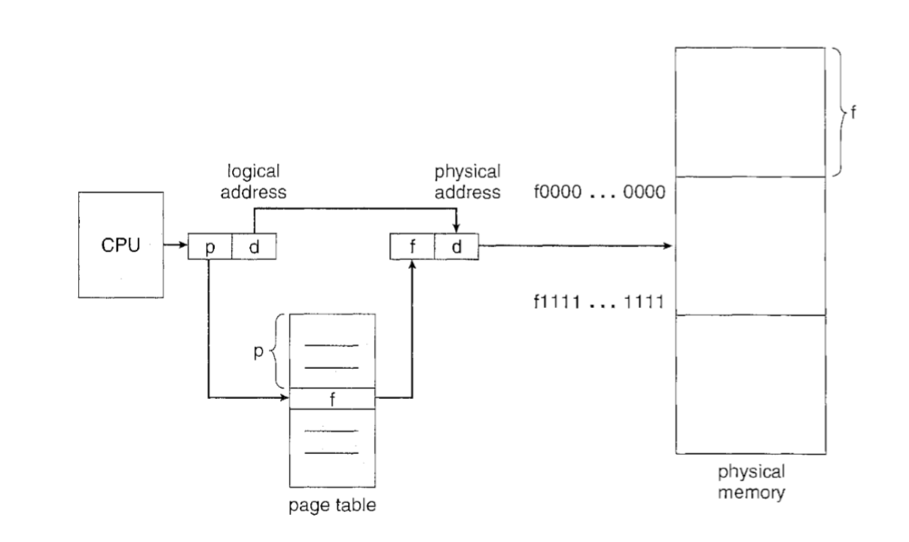

Slide 37
Every address generated the CPU is divided into two parts: a page number (p) and a page offset (d).
The page number is used as an index into a “page table”.
The page table contains the base address of each page in physical memory. This base address is combined with the page offset to define the physical memory address that is sent to the memory unit

Slide 38
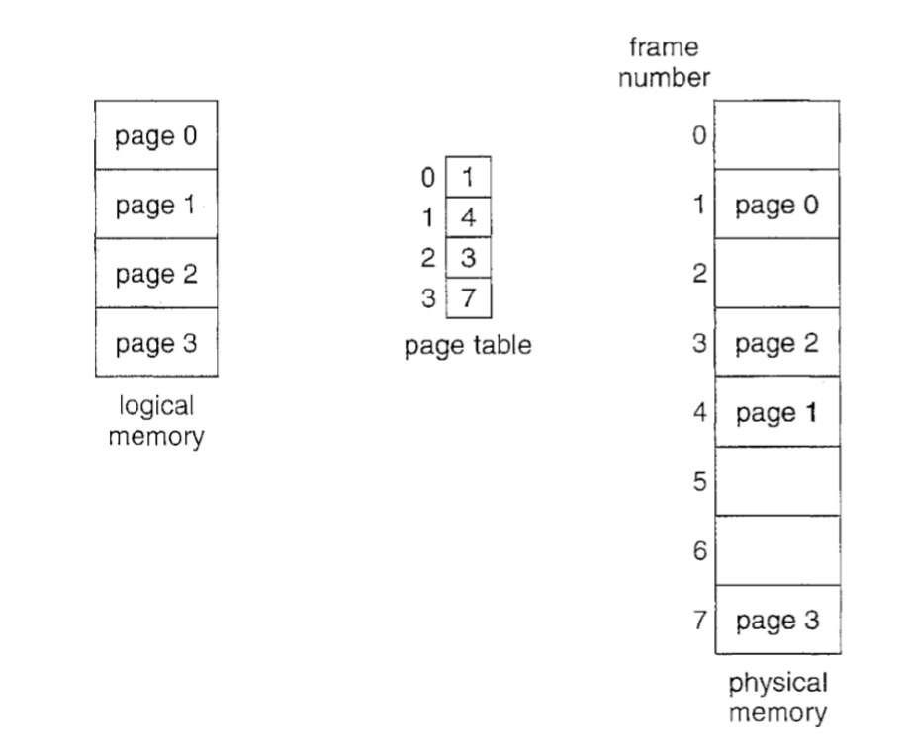

Slide 39
Every process has independent page table
The number of entries in the page table is equal to size of pages of a process
If the size of the logical address space is 2^{n} and a page size is 2^{n} addressing units (bytes or words)
then the high-order m- n bits of a logical address designate the page number, and the n low-order bits designate the page offset. Thus, the logical address is as follows:

Slide 40
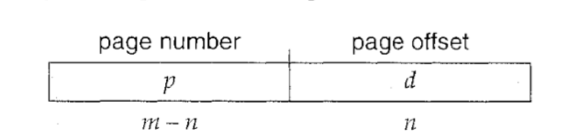
where p is an index into the page table and d is the displacement within the page.

Slide 41
The logical address, n= 2 and m = 4. Using a page size of 4 bytes and a physical memory of 32 bytes (8 pages)
Logical address 0 is page 0, offset 0. Indexing into the page table, we find that page 0 is in frame 5. Thus, logical address 0 maps to physical address
20 [= (5 x 4) + 0]
Logical address 3 (page 0, offset 3) maps to physical address 23 [ = (5 x 4) + 3]. Logical address 4 is page 1, offset 0; according to the page table, page 1 is mapped to frame 6. Thus, logical address 4 maps to physical address 24 [ = ( 6 x 4) + O]. Logical address 13 maps to physical address 9.

Slide 42
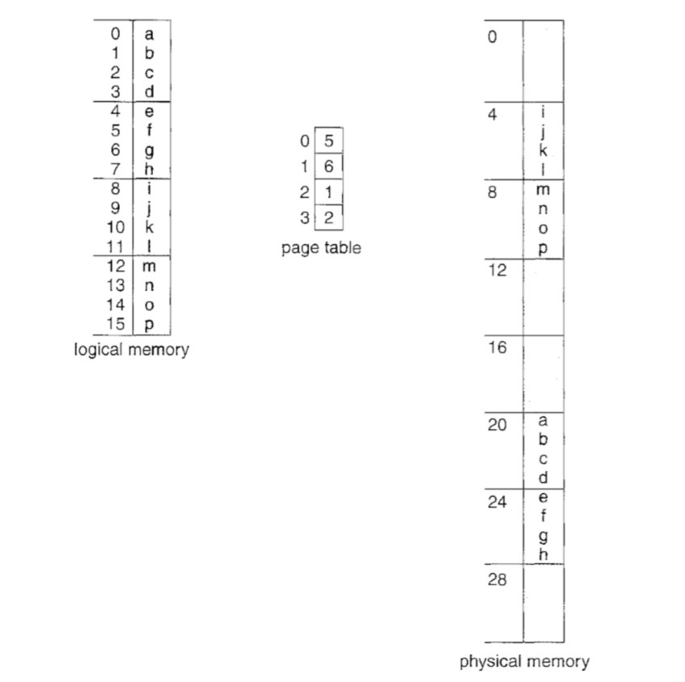

Slide 43
Each operating system has its own methods for storing page tables. Most allocate a page table for each process. A pointer to the page table is stored with the other register values in the process control block.
the page table is implemented as a set of dedicated registers.
These registers should be built with very high-speed logic to make the paging-address translation efficient

Slide 44
The use of registers for the page table is satisfactory if the page table is reasonably small (256 Entries)
For computers allow page table very large ( 1 million entries ) the use of fast registers to implement the page table is not feasible.
Rather, the page table is kept in main memory, and a “Page Table Base Register “ points to the page table

Slide 45
The problem with this approach is the time required to access a user memory location.
If we want to access location i, we must first index into the page table, using the value in the PTBR offset by the page number for i.
This task requires a memory access. It provides us with the frame number, which is combined with the page offset to produce the actual address. We can then access the desired place in memory

Slide 46
The standard solution to this problem is to use a special, small, fast lookup hardware cache “ Translation Look -aside Buffer (TLB)
Each entry in the TLB consists of two parts: a key (or tag) and a value.
The TLB contains only a few of the page-table entries. When a logical address is generated by the CPU, its page number is presented to the TLB. If the page number is found, its frame number is immediately available and is used to access memory.

Slide 47
If the page number is not in the TLB (TLB Miss). A memory reference to the page table must be made. When the frame number is obtained, we can use it to access memory.
In addition, we add the page number and frame number to the TLB, so that they will be found quickly on the next reference.
If the TLB is already full of entries, the operating system must select one for replacement. Replacement policies range from least recently used (LRU) to random

Slide 48
Some TLBs store “ Address Space Identifiers (ASID’s) in each TLB Entry.
An ASID uniquely identifies each process and is used to provide address-space protection for that process.

Slide 49
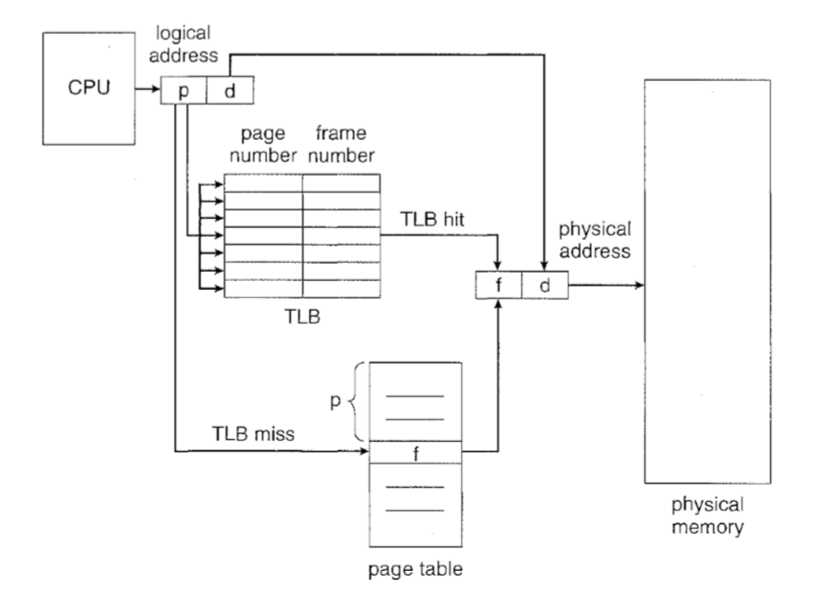

Slide 50
The percentage of times that a particular page number is found in the TLB is called the “ Hit Ratio”
Example: An 80-percent hit ratio, for example, means that we find the desired page number in the TLB 80 percent of the time.
If it takes 20 nanoseconds to search the TLB and 100 nanoseconds to access memory, then a mapped-memory access takes 120 nanoseconds when the page number is in the TLB.

Slide 51
If we fail to find the page number in the TLB (20 nanoseconds), then we must first access memory for the page table and frame number (100 nanoseconds) and then access the desired byte in memory (100 nanoseconds), for a total of 220 nanoseconds
To find the “ Effective – memory Access Time “

Slide 52
effective access time = 0.80 x 120 + 0.20 x 220 = 140 nanoseconds.
we suffer a 40-percent slowdown in memory-access time (from 100 to 140 nanoseconds).
For, 99 Percent Hit Ratio, effective access time = 0.98 x 120 + 0.02 x 220 = 122 nanoseconds.
This increased hit rate produces only a 22 percent slowdown in access time

Slide 53
Protection
Memory protection in a paged environment is accomplished by protection bits associated with each frame. Normally, these bits are kept in the page table
One bit can define a page to be read-write or read-only.
the protection bits can be checked to verify that no writes are being made to a read-only page. An attempt to write to a read-only page causes a hardware trap to the operating system

Slide 54
We can create hardware to provide read-only, read-write, or execute-only protection; or, by providing separate protection bits for each kind of access, we can allow any combination of these accesses. Illegal attempts will be trapped to the operating system.
One additional bit is generally attached to each entry in the page table: a Valid – Invalid Bit

Slide 55
When this bit is set to "valid," the associated page is in the process's logical address space and is thus a legal (or valid) page.
When the bit is set to"invalid," the page is not in the process's logical address space.
for example, that in a system with a 14-bit address space (0 to 16383), we have a program that should use only addresses 0 to 10468. Given a page size of 2 KB, we have the situation shown

Slide 56
Addresses in pages 0, 1, 2, 3, 4, and 5 are mapped normally through the page table. Any attempt to generate an address in pages 6 or 7, however, will find that the valid -invalid bit is set to invalid, and the computer will trap to flee operating system

Slide 57
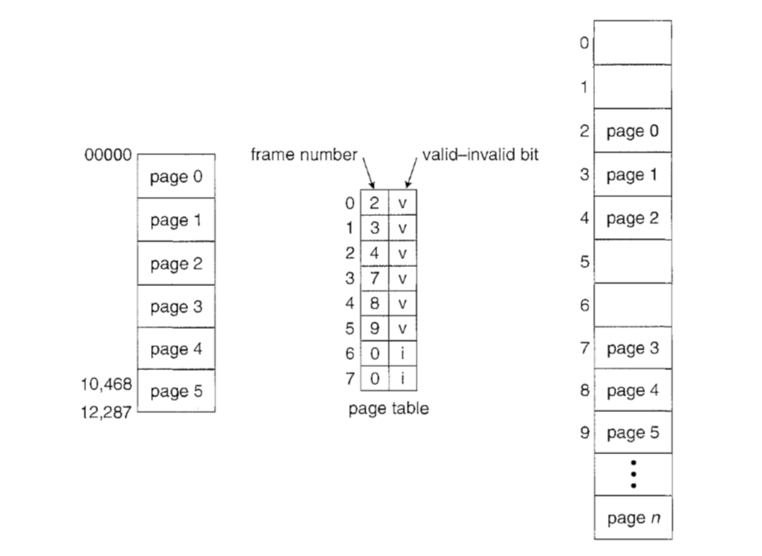

Slide 58
Shared Pages
An advantage of paging is the possibility of sharing common code. This consideration is particularly important in a time-sharing environment.
Consider a system that supports 40 users, each of whom executes a text editor. If the text editor consists of 150 KB of code and 50 KB of data space, we need 8,000 KB to support the 40 users

Slide 59
If the code is reentrant Code or Pure code however, it can be shared
Here we see a three-page editor-each page 50 KB in size being shared among three processes. Each process has its own data page.
Reentrant code is non-self-modifying code: it never changes during execution. Thus, two or more processes can execute the same code at the same time
Each process has its own copy of registers and data storage to hold the data for the process's execution

Slide 60
Only one copy of the editor need be kept in physical memory.
Each user's page table maps onto the same physical copy of the editor, but data pages are mapped onto different frames.
Thus, to support 40 users, we need only one copy of the editor (150 KB), plus 40 copies of the 50 KB of data space per user. The total space required is now 2150 KB instead of 8,000 KB-a significant savings.

Slide 61
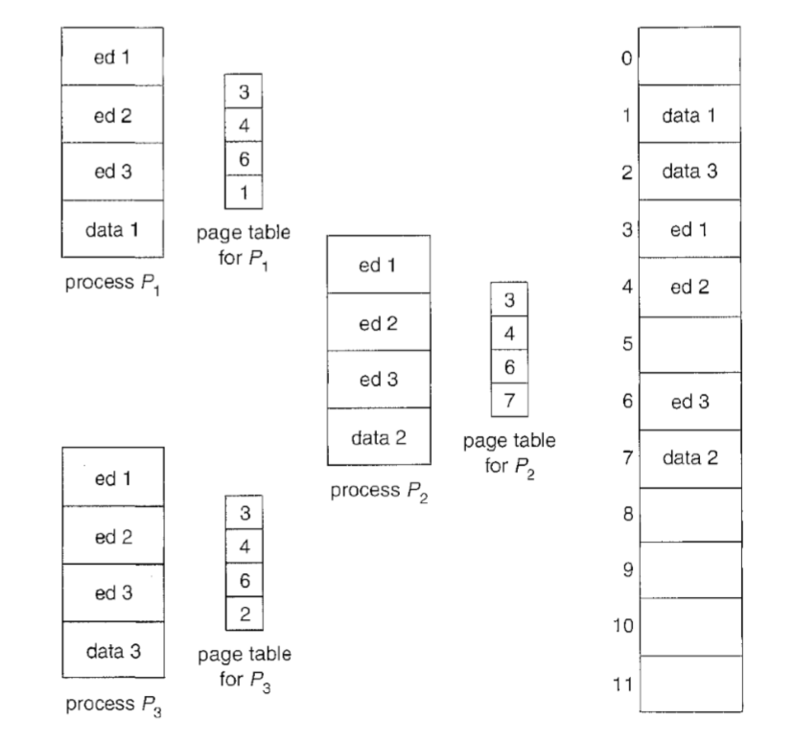

Slide 62
Structure of Page Table
Memory Structures for paging can get huge using straight forward methods.
Consider a 32-bit logical address space on modern computers
Total Size of logical address space = 2³²
Page size of 4 KB (2¹² )
  Page table would have 1 million entries
  If each entry is 4 bytes, then each process may need upto 4MB(1 MB=2²⁰ Bytes) of physical address space

Slide 63
Structure of the Page Table
Hierarchical Paging :
Most modern computer systems support a large logical address space (2³² to 2⁶⁴). In such an environment, the page table itself becomes excessively large.
One simple solution to this problem is to divide the page table into smaller pieces. We can accomplish this division in several ways

Slide 64
One way is to use a two-level paging algorithm, in which the page table itself is also paged .
For example, consider a system with a 32-bit logical address space and a page size of 4 KB. A logical address is divided into a page number consisting of 20 bits and a page offset consisting of 12 bits. Because we page the page table, the page number is further divided into a 10-bit page number and a 10-bit page offset. Thus, a logical address is as follows:

Slide 65
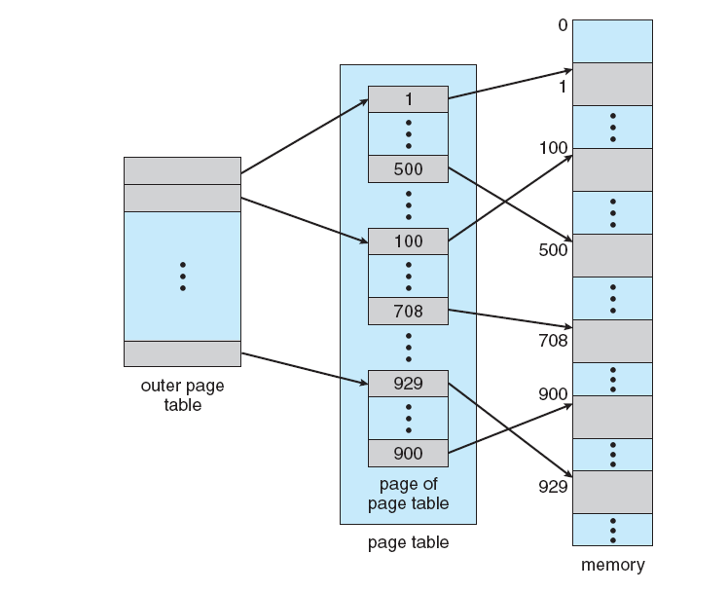

Slide 66
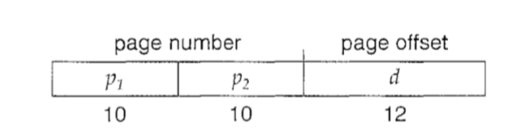
where p1 is an index into the outer page table and P2 is the displacement within the page of the outer page table. The address-translation method for this architecture is shown in Figure . Because address translation works from the outer page table inward, this scheme is also known as a Forward Mapped Page Table

Slide 67
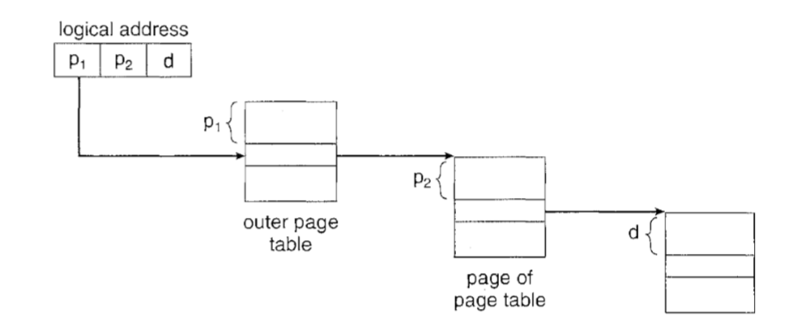

Slide 68
The VAX architecture supports a variation of two-level paging. The VAX is a 32-bit machine with a page size of 512 bytes.
The logical address space of a process is divided into four equal sections, each of which consists of 230 bytes.
Each section represents a different part of the logical address space of a process

Slide 69
The first 2 high-order bits of the logical address designate the appropriate section. The next 21 bits represent the logical page number of that section, and the final 9 bits represent an offset in the desired page.
By partitioning the page table in this manner, the operating system can leave partitions unused until a process needs them. An address on the VAX architecture is as follows:

Slide 70
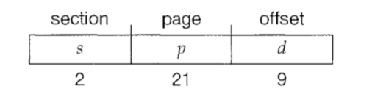
where s designates the section number, p is an index into the page table, and d is the displacement within the page

Slide 71
For a system with a 64-bit logical address space, a two-level paging scheme is no longer appropriate.
let us suppose that the page size in such a system is 4 KB (212). In this case, the page table consists of up to 252 entries. If we use a two-level paging scheme, then the similer page tables can conveniently be one page long, or contain 210 4-byte entries. The addresses look like this:

Slide 72
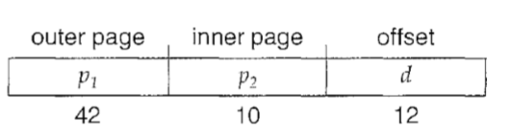
The outer page table consists of 242 entries, or 244 bytes. The obvious way to avoid such a large table is to divide the outer page table into smaller pieces.
We can divide the outer page table in various ways. We can page the outer page table, giving us a three-level paging scheme. Suppose that the outer page table is made up of standard-size pages

Slide 73
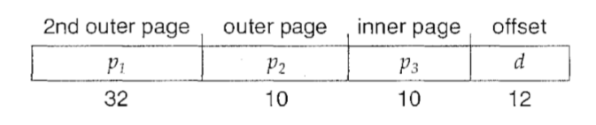

Slide 74
Hashed Page tables
A common approach for handling address spaces larger than 32 bits is to use a hashed page tables. with the hash value being the virtual page number.
Each entry in the hash table contains a linked list of elements that hash to the same location (to handle collisions).
Each element consists of three fields: (1) the virtual page number, (2) the value of the mapped page frame, and (3) a pointer to the next element in the linked list.

Slide 75
Working
The virtual page number in the virtual address is hashed into the hash table.
The virtual page number is compared with field 1 in the first element in the linked list. If there is a match, the corresponding page frame (field 2) is used to form the desired physical address.
If there is no match, subsequent entries in the linked list are searched for a matching virtual page number.

Slide 76
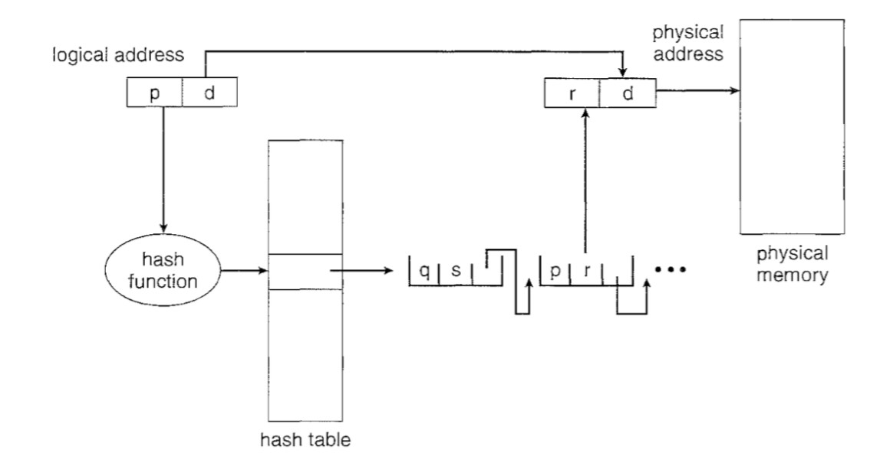

Slide 77
Inverted Page tables
Each process has an associated page table. The page table has one entry for each page that the process is using.
processes reference pages through the pages' virtual addresses. The operating system must then translate this reference into a physical memory address

Slide 78
Since the table is sorted by virtual address, the operating system is able to calculate where in the table the associated physical address entry is located and to use that value directly.
One of the drawbacks of this method is that each page table may consist of millions of entries. These tables may consume large amounts of physical memory just to keep track of how other physical memory is being used

Slide 79
An inverted page table has one entry for each real page (or frame) of memory. Each entry consists of the virtual address of the page stored in that real memory location, with information about the process that owns the page.
Thus, only one page table is in the system, and it has only one entry for each page of physical memory

Slide 80
Inverted page tables often require that an address-space identifier stored in each entry of the page table, since the table usually contains several different address spaces mapping physical memory.
Storing the address-space identifier ensures that a logical page for a particular process is mapped to the corresponding physical page frame.

Slide 81
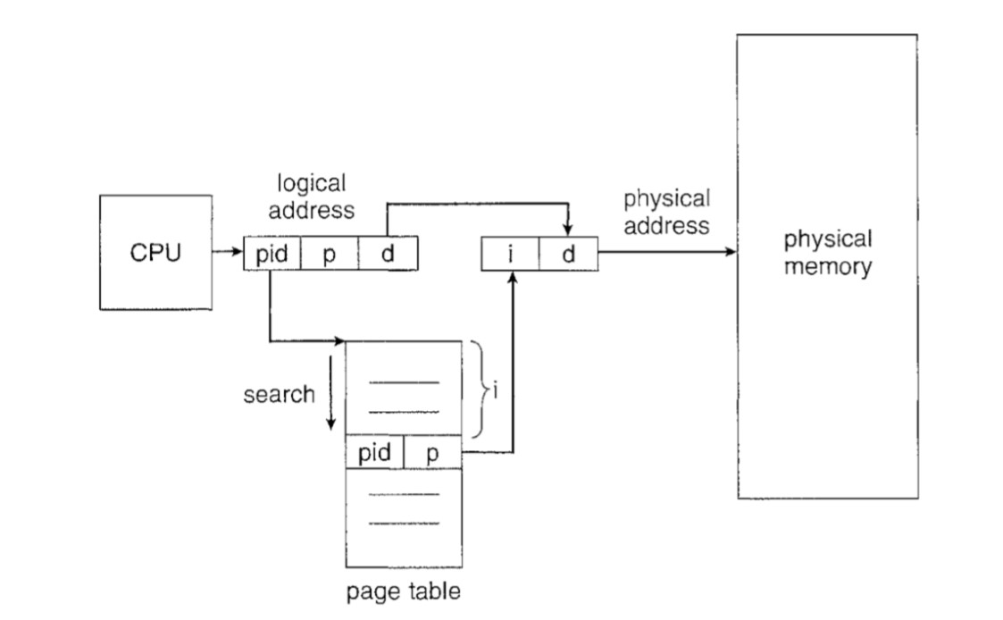

Slide 82
To illustrate this method, we describe a simplified version of the i11verted page table used in the IBM RT. Each virtual address in the system consists of a triple:
<process-id, page-number, offset>.
The inverted page table is then searched for a match. If a match is found-say, at entry i-then the physical address <i, offset> is generated. If no match is found, then an illegal address access has been attempted.

Slide 83
Segmentation
Segmentation is a memory-management scheme that supports this user view of memory.
A logical address space is a collection of segments.
Each segment has a name and a length. The addresses specify both the segment name and the offset within the segment. The user therefore specifies each address by two quantities: a segment name and an offset

Slide 84
For simplicity of implementation, segments are numbered and are referred to by a segment number, rather than by a segment name. Thus, a logical address consists of a two tuple.
<segment-number, offset>.

Slide 85
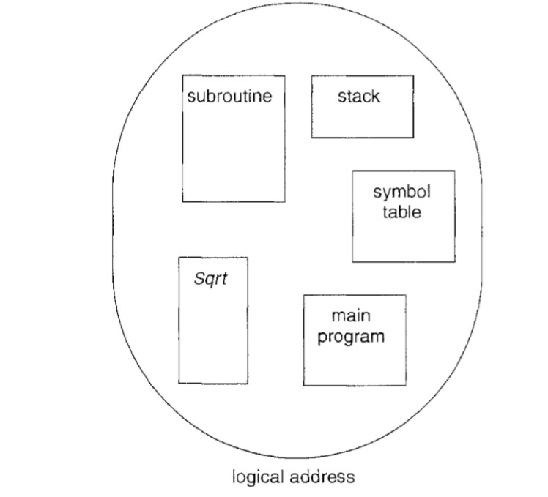

Slide 86
Although the user can now refer to objects in the program by a two-dimensional address, the actual physical memory is still, of course, a one-dimensional sequence of bytes.
Thus, we must define an implementation to map two dimensional user-defined addresses into one-dimensional physical addresses. This mapping is effected by a segment table.

Slide 87
Each entry in the segment table has a segment base and a segment limit.
The segment base contains the starting physical address where the segment resides in memory, and the segment limit specifies the length of the segment.

Slide 88
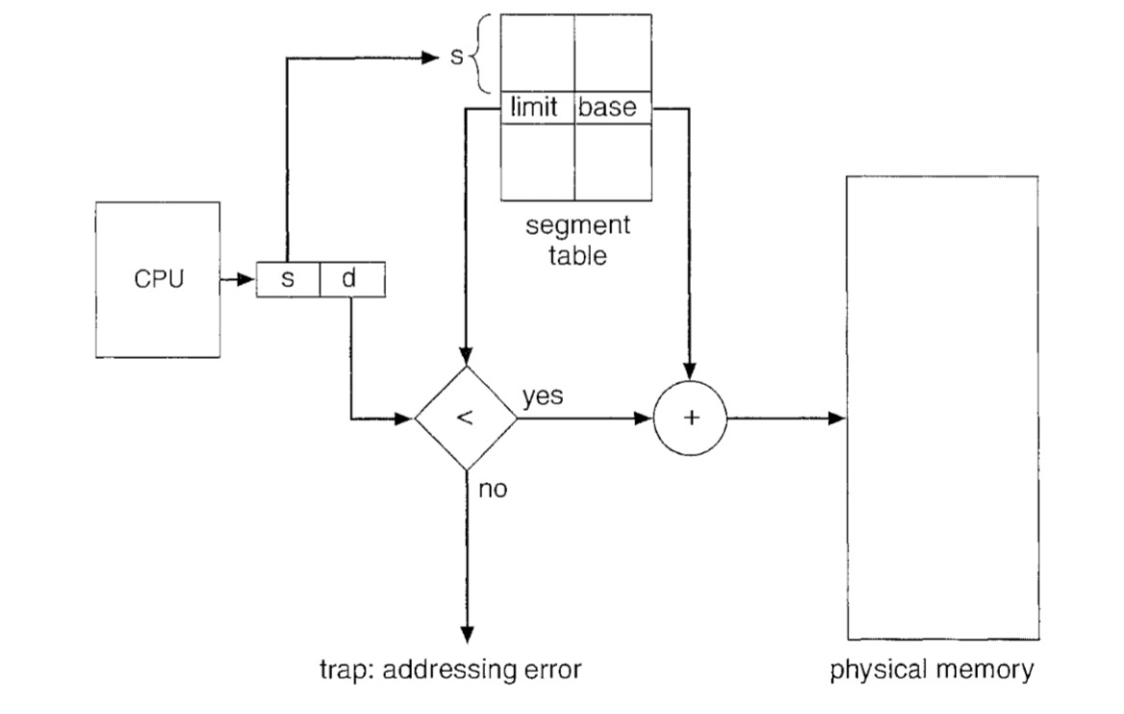

Slide 89
A logical address consists of two parts: a segment number, s, and an offset into that segment, d. The segment number is used as an index to the segment table. The offset d of the logical address must be between 0 and the segment limit. If it is not, we trap to the operating system .
When an offset is legal, it is added to the segment base to produce the address in physical memory of the desired byte

Slide 90
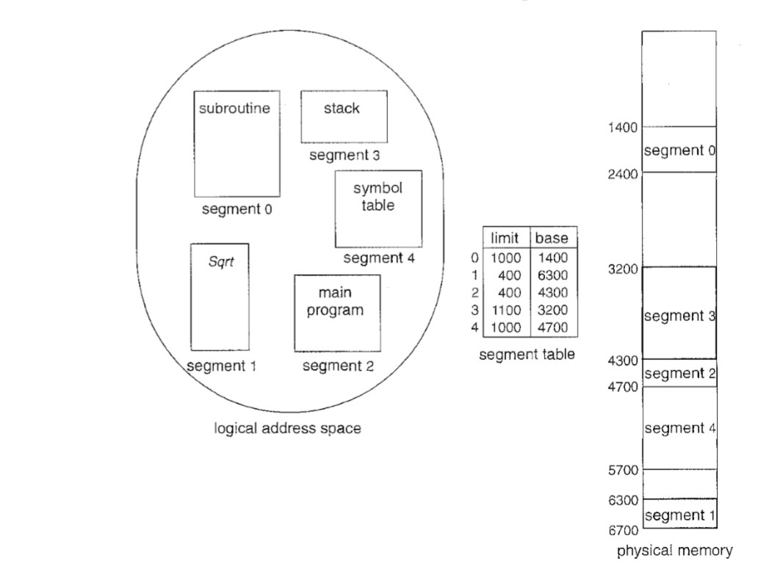

Slide 91
Part-II Virtual Memory Management
Virtual Memory:
Virtual Memory is a space where large programs can store themselves in form of pages while their execution and only the required pages or portions of processes are loaded into the main memory. This technique is useful as large virtual memory is provided for user programs when a very small physical memory is there.

Slide 92
Most processes never need all their pages at once, for following reasons :
Error handling code is not needed unless that specific error occurs, some of which are quite rare.
Arrays are often over-sized for worst-case scenarios, and only a small fraction of the arrays are actually used in practice.
Certain features of certain programs are rarely used.

Slide 93
Benefits of Virtual Memory
Large programs can be written, as virtual space available is huge compared to physical memory.
Less I/O required, leads to faster and easy swapping of processes.
More physical memory available, as programs are stored on virtual memory, so they occupy very less space on actual physical memory.

Slide 94
The Virtual address space of a process refers to the logical (or virtual) view of how a process is stored in memory.
Typically, this view is that a process begins at a certain logical address-say, address 0-and exists in contiguous memory.

Slide 95
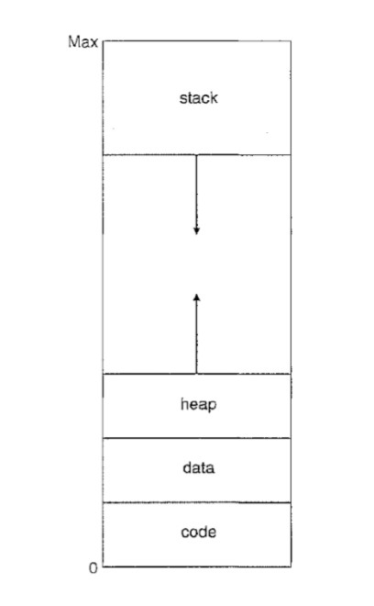

Slide 96
the heap to grow upward in memory as it is used for dynamic memory allocation. Similarly, we allow for the stack to grow downward in memory through successive function calls. The large blank space (or hole) between the heap and the stack is part of the virtual address space

Slide 97
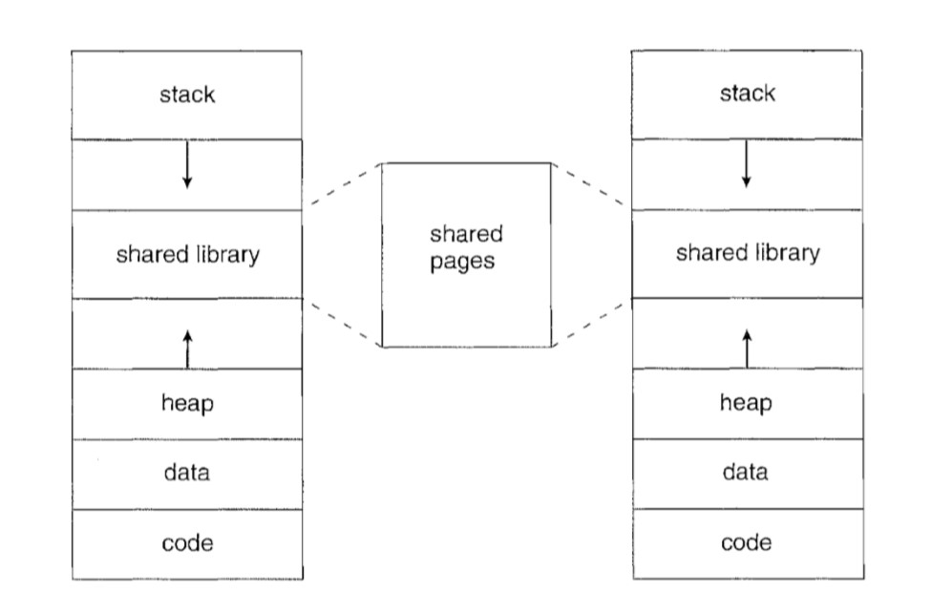
Virtual address spaces that include holes are known as Sparse address space
In addition to separating logical memory from physical memory, virtual memory allows files and memory to be shared by two or more processes through page sharing

Slide 98
Demand Paging
The basic idea behind demand paging is that when a process is swapped in, its pages are not swapped in all at once. Rather they are swapped in only when the process needs them(On demand). This is termed as lazy swapper or pager.
Initially only those pages are loaded which will be required the process immediately.

Slide 99
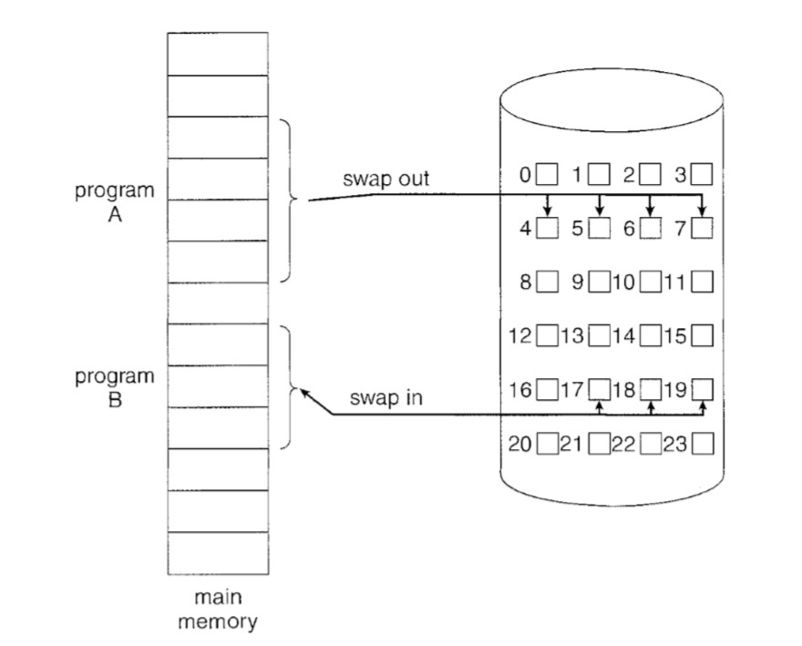

Slide 100
A demand-paging system is similar to a paging system with swapping .
where processes reside in secondary memory (usually a disk). When we want to execute a process, we swap it into memory. Rather than swapping the entire process into memory.
A lazy swapper never swaps a page into memory unless that page will be needed.
n the context of a demand-paging system, use of the term “swapper” is technically incorrect. A swapper manipulates entire processes, whereas a pager is concerned with the individual pages of a process. We thus use “pager,” rather than “swapper,” in connection with demand paging

Slide 101
Basic Concept
hardware support to distinguish between the pages that are in memory and the pages that are on the disk. The valid -invalid bit scheme is used.
when this bit is set to "valid' the associated page is both legal and in memory. If the bit is set to "invalid' the page either is not valid or is valid but is currently on the disk.

Slide 102
The page-table entry for a page that is brought into memory is set as usual, but the page-table entry for a page that is not currently in memory is either simply marked invalid or contains the address of the page on disk.
Notice that marking a page invalid will have no effect if the process never attempts to access that page

Slide 103
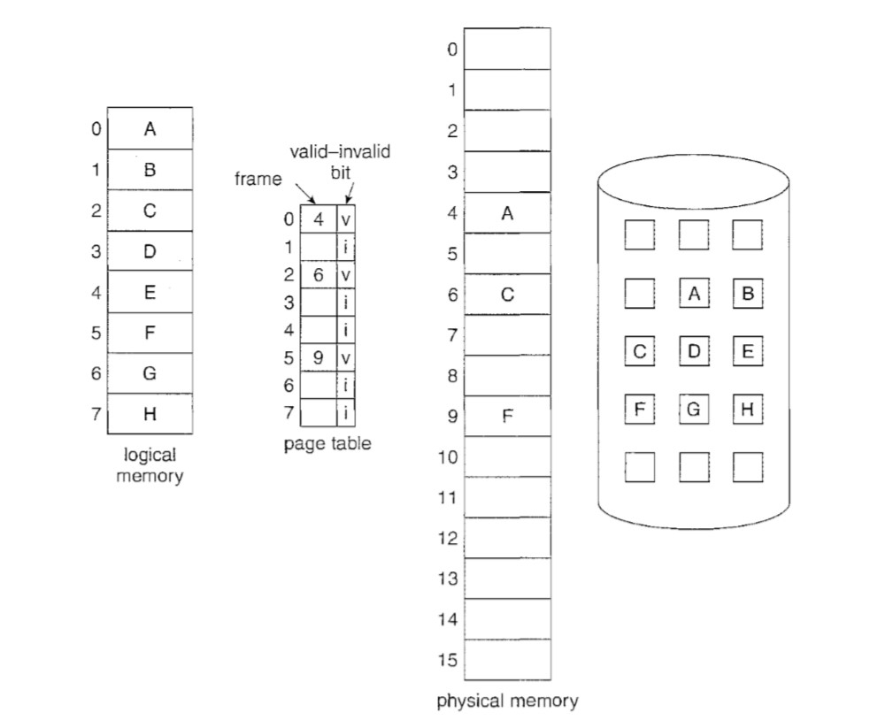

Slide 104
Page Fault
When the process requires any of the page that is not loaded into the memory, a page fault trap is triggered
This trap is the result of the operating system's failure to bring the desired page into memory
The procedure for handling this page fault is given

Slide 105
The memory address which is requested by the process is first checked, to verify the request made by the process
If its found to be invalid, the process is terminated.
In case the request by the process is valid, but we have not yet brought in that page, we now page it in.
We find a new frame
A new operation is scheduled to move the necessary page from disk to the newly allocated frame

Slide 106
When the I/O operation is complete, the process's page table is updated with the new frame number, and the invalid bit is changed to valid.
The instruction that caused the page fault must now be restarted from the beginning

Slide 107
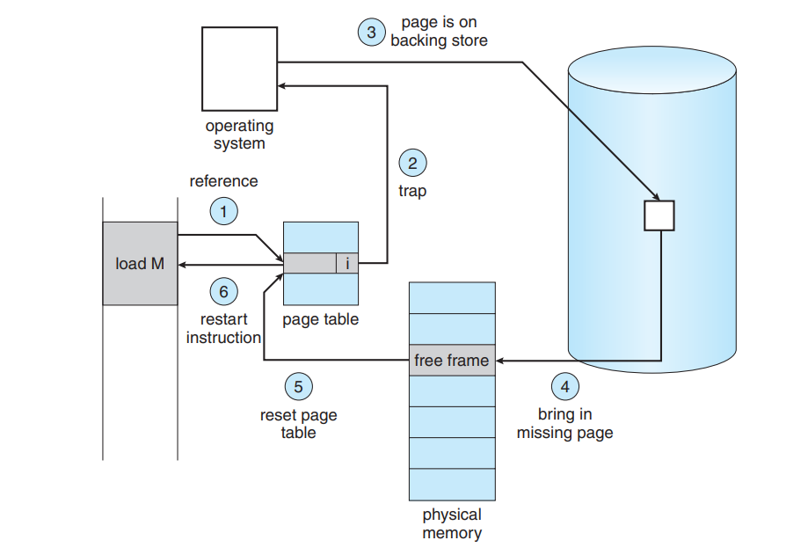
Fig. Steps in Handling a Page Fault

Slide 108
Pure Demand Paging
There are cases when no pages are loaded into the memory initially, pages are only loaded when demanded by the process by generating page faults. This is called Pure Demand Paging.
The only major issue with Demand Paging is, after a new page is loaded, the process starts execution from the beginning
It effects the performance in case of large programs

Slide 109
Page Replacement
In Demand Paging, only certain pages of a process are loaded initially into the memory. This allows us to get more number of processes into the memory at the same time.
but what happens when a process requests for more pages and no free memory is available to bring them in. Following steps can be taken to deal with this problem :

Slide 110
Put the process in the wait queue, until any other process finishes its execution thereby freeing frames.
Or, remove some other process completely from the memory to free frames.
Or, find some pages that are not being used right now, move them to the disk to get free frames. This technique is called Page replacement and is most commonly used.

Slide 111
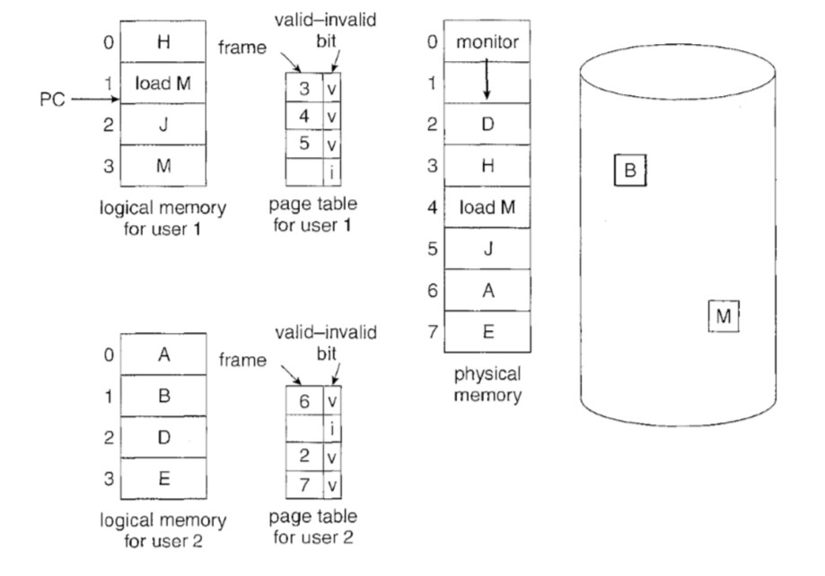

Slide 112
Basic Page replacement
Find the location of the desired page on the disk
Find a free frame: If there is a free frame, use it. If there is no free frame, use a page-replacement algorithm to select a Victim Frame. Write the victim frame to the disk; change the page and frame tables accordingly.
Read the desired page into the newly freed frame; change the page and frame tables.
Restart the user process

Slide 113
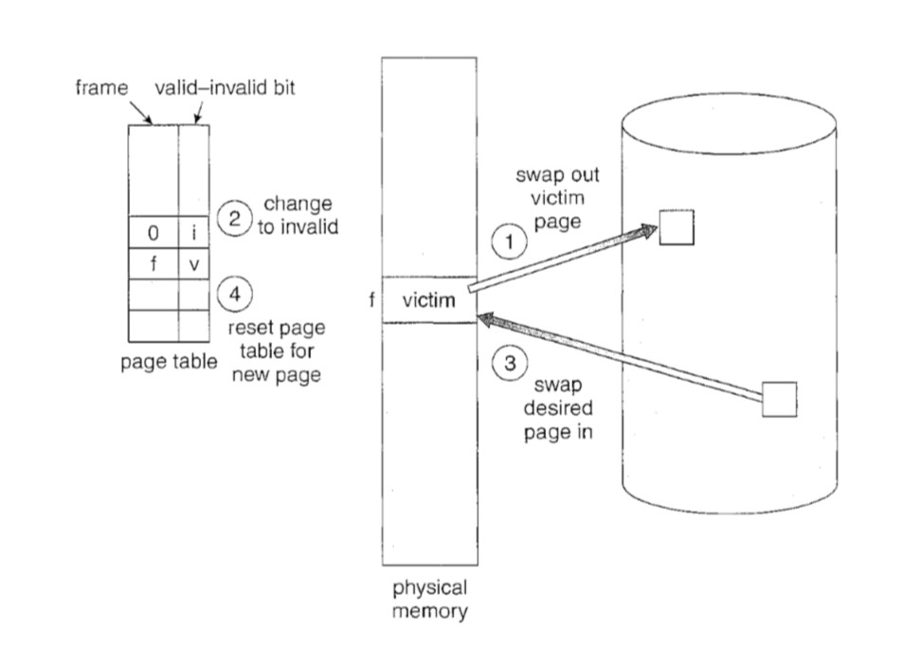

Slide 114
FIFO Page replacement Algo
The simplest page-replacement algorithm is a first-in, first-out (FIFO) algorithm.
A FIFO replacement algorithm associates with each page the time when that page was brought into memory.
When a page must be replaced, the oldest page is chosen.
We can create a FIFO queue to hold all pages in memory. We replace the page at the head of the queue. When a page is brought into memory, we insert it at the tail of the queue.

Slide 115
FIFO Example
our three frames are initially empty. The first three references (7, 0, 1) cause page faults and are brought into these empty frames.
The next reference (2) replaces page 7, because page 7 was brought in first. Since 0 is the next reference and 0 is already in memory, we have no fault for this reference
The first reference to 3 results in replacement of page 0, since it is now first in line. Because of this replacement, the next reference, to 0, will fault. Page 1 is then replaced by page 0. This process continues

Slide 116
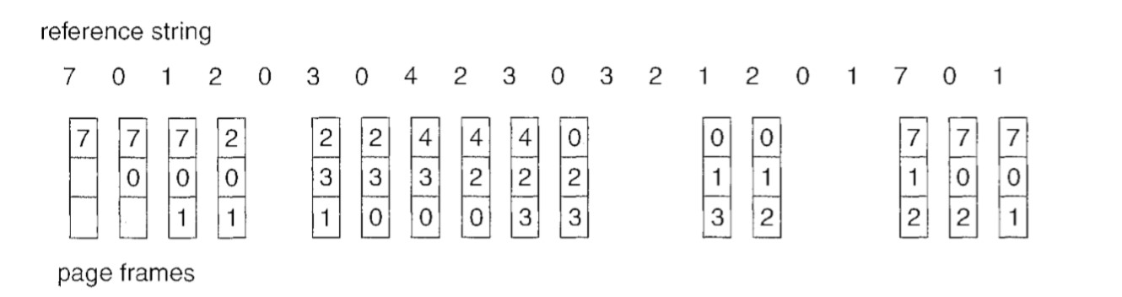

Slide 117
our three frames are initially empty. The first three references (7, 0, 1) cause page faults and are brought into these empty frames. The next reference (2) replaces page 7, because page 7 was brought in first.
Since 0 is the next reference and 0 is already in memory, we have no fault for this reference.
And the process will continue

Slide 118
for some page-replacement algorithms, the page-fault rate may increase as the number of allocated frames increases known as “Belady’s Anomaly”

Slide 119
Optimal Page Replacement
Replace the page that will not be used for the longest period of time.
This algorithm has lowest page-fault rate of all algorithms and will never suffer from Belady's anomaly.
Use of this page-replacement algorithm guarantees the lowest possible page fault rate for a fixed number of frames

Slide 120
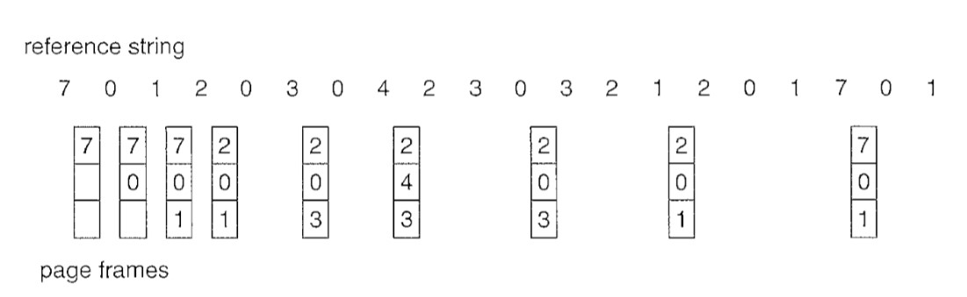

Slide 121
The first three references cause faults that fill the three empty frames. The reference to page 2 replaces page 7, because page 7 will not be used until reference 18, whereas page 0 will be used at 5, and page 1 at 14.
The reference to page 3 replaces page 1, as page 1 will be the last of the three pages in memory to be referenced again.
With only nine page faults, optimal replacement is much better than a FIFO algorithm, which results in fifteen faults

Slide 122
LRU Page Replacement
The key distinction between the FIFO and OPT algorithms is that the
FIFO algorithm uses the time when a page was brought into memory
whereas the OPT algorithm uses the time when a page is to be used.
If we use the recent past as an approximation of the near future, then we can replace the page that has not been used for the longest period of time. This approach is the LRU

Slide 123
LRU replacement associates with each page the time of that page's last use. When a page must be replaced, LRU chooses the page that has not been used for the longest period of time.
We can think of this strategy as the optimal page-replacement algorithm looking backward in time, rather than forward

Slide 124
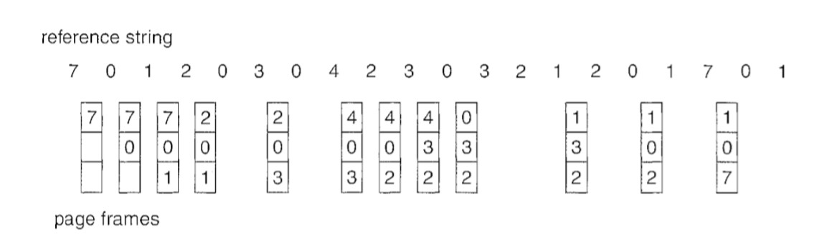

Slide 125
The LRU policy is often used as a page-replacement algorithm and is considered to be good.
An LRU page-replacement algorithm may require substantial hardware assistance. The problem is to determine an order for the frames defined by the time of last use. Two implementations are feasible: Counters and stacks

Slide 126
LRU Approximation Page replacement ( Second Chance Algorithm )
The basic algorithm of second-chance replacement is a FIFO replacement algorithm. When a page has been selected, however, we inspect its reference bit
If the value is 0, we proceed to replace this page; but if the reference bit is set to 1, we give the page a second chance and move on to select the next FIFO page

Slide 127
When a page gets a second chance, its reference bit is cleared, and its arrival time is reset to the current time.
Thus, a page that is given a second chance will not be replaced until all other pages have been replaced .
One way to implement the second-chance algorithm is a circular queue.

Slide 128
A pointer indicates which page is to be replaced next.
When a frame is needed, the pointer advances until it finds a page with a 0 reference bit. As it advances, it clears the reference bits
Once a victim page is found, the page is replaced, and the new page is inserted in the circular queue in that position

Slide 129
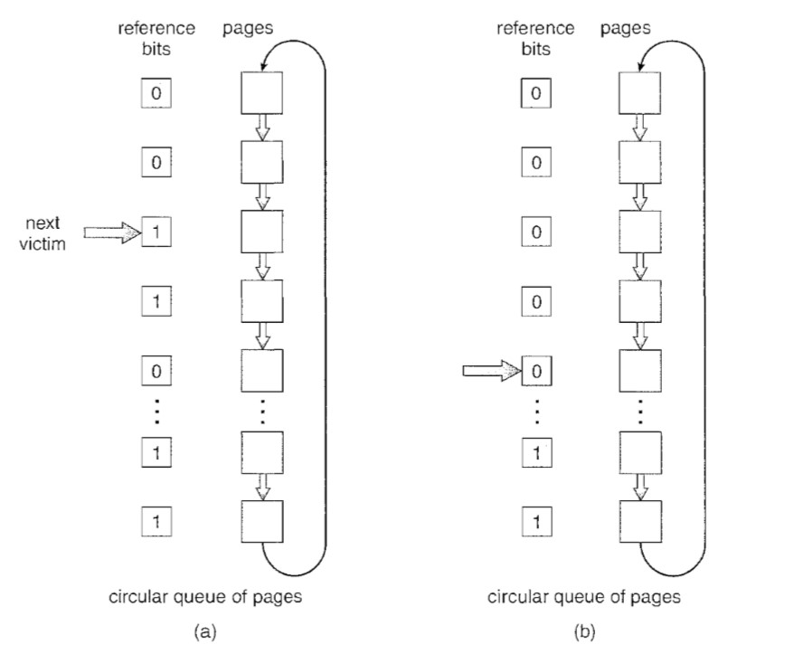

Slide 130
Enhanced second chance algorithm
We can enhance the second-chance algorithm by considering the reference bit and the modify bit as an order pair.
With these two bits, we have the following four possible classes:
(0, 0) neither recently used nor modified -best page to replace

Slide 131
(0, 1) not recently used hut modified-not quite as good
(1, 0) recently used but clean-probably will be used again soon
(1, 1) recently used and modified -probably will be used again soon, and the page will be need to be written out to disk before it can be replaced

Slide 132
Allocation of Frames
Frame allocation algorithms are used if you have multiple processes; it helps decide how many frames to allocate to each process.
Various constraints like: You cannot allocate more than the total number of available frames.
At least a minimum number of frames should be allocated to each process

Slide 133
Frame Allocation Algorithms
The two algorithms commonly used to allocate frames to a process are: Equal Allocation, Proportional Allocation.
Equal Allocation: In a system with x frames and y processes, each process gets equal number of frames, i.e. x/y. For instance, if the system has 48 frames and 9 processes, each process will get 5 frames. The three frames which are not allocated to any process can be used as a free-frame buffer pool.

Slide 134
Disadvantage: Allocation of a large number of frames to a small process will eventually lead to the wastage of a large number of allocated unused frames.
Proportional allocation:Frames are allocated to each process according to the process size.

Slide 135
For a process p_{i} of size s_{i}, the number of allocated frames is a_{i} = (s_{i}/S)*m.
Where S = sum of the sizes of all the processes
M=number of frames in the system.
Example: In a system with 62 frames, if there is a process of 10KB and another process of 127KB, then the first process will be allocated (10/137)*62 = 4 frames and the other process will get (127/137)*62 = 57 frames.

Slide 136
Global Vs Local Allocation
The number of frames allocated to a process can also dynamically change depending on whether you have used global replacement or local replacement for replacing pages in case of a page fault.
Local Replacement: When a process needs a page which is not in the memory, it can bring in the new page and allocate it a frame from its own set of allocated frames only.

Slide 137
Global Replacement: When a process needs a page which is not in the memory, it can bring in the new page and allocate it a frame from the set of all frames, even if that frame is currently allocated to some other process;
That is, one process can take a frame from another.

Slide 138
Thrashing
A process that is spending more time paging than executing is said to be thrashing.
In other words it means, that the process doesn't have enough frames to hold all the pages for its execution, so it is swapping pages in and out very frequently to keep executing.
Sometimes, the pages which will be required in the near future have to be swapped out.
To prevent thrashing we must provide processes with as many frames as they really need "right now".

Slide 139
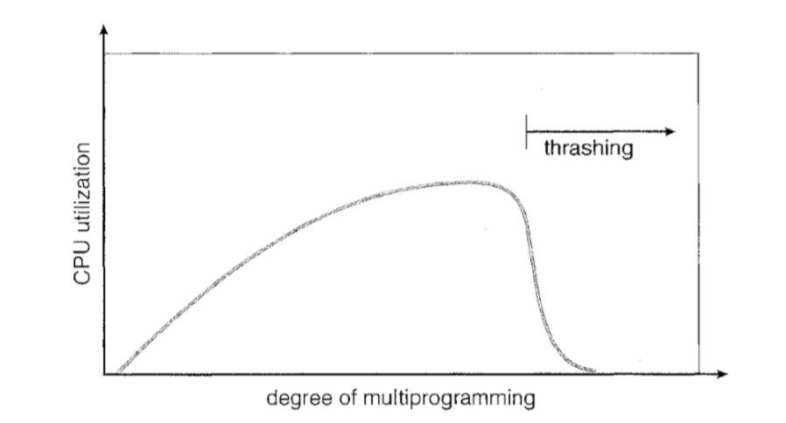

Slide 140
Memory Mapped Files
Consider a sequential read of a file on disk using the standard system calls open (),read (), and write ().
Each file access requires a system call and disk access. Alternatively, we can use the virtual memory techniques to treat file I/O as routine memory access, This approach is known as Memory Mapping a File

Slide 141
Memory mapping a file is accomplished by mapping a disk block to a page in memory.
Initial access to the file proceeds through ordinary demand paging, resulting in a page fault. However, a page-sized portion of the file is read from the file system into a physical page.
writes to the file mapped in memory are not necessarily immediate writes to the file on the disk.

Slide 142
Multiple processes may be allowed to map the same file concurrently, to allow sharing of data. Writes by any of the processes modify the data in virtual memory and can be seen by all others that map the same section of the file.
The virtual memory map of each sharing process points to the same page of physical memory-the page that holds a copy of the disk block

Slide 143
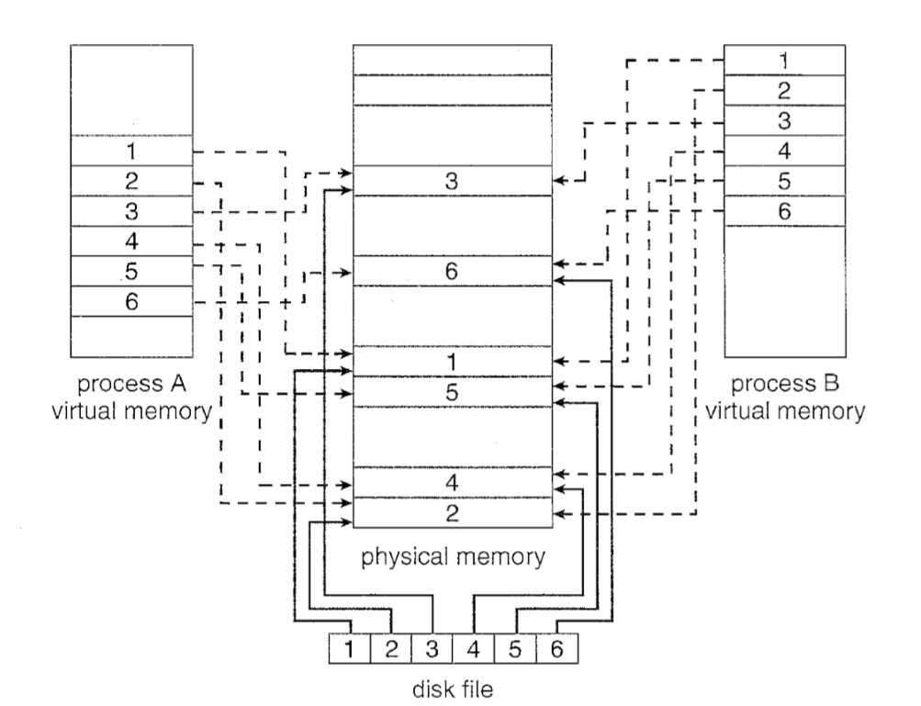

Slide 144
Allocating Kernel Memory
Two strategies for managing free memory that is assigned to kernel processes are Buddy System and Slab System.
Buddy allocation system is an algorithm in which a larger memory block is divided into small parts to satisfy the request. This algorithm is used to give best fit.
The two smaller parts of block are of equal size and called as buddies.

Slide 145
In the same manner one of the two buddies will further divide into smaller parts until the request is fulfilled.
Benefit of this technique is that the two buddies can combine to form the block of larger size according to the memory request known as coalescing

Slide 146
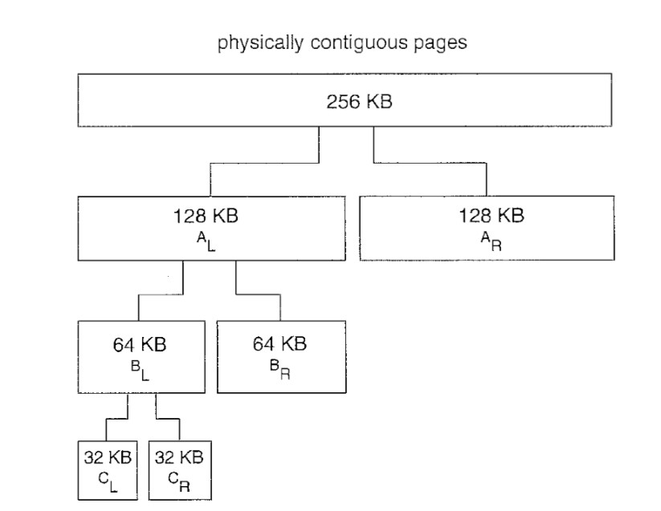

Slide 147
Drawback of Buddy System
The main drawback in buddy system is internal fragmentation as larger block of memory is acquired then required. For example if a 36 kb request is made then it can only be satisfied by 64 kb segment and remaining memory is wasted.

Slide 148
Slab System Allocation
A second strategy for allocating kernel memory is known as slab allocation. It eliminates fragmentation caused by allocations and de allocations.
A Slab is made up of one or more physically contiguous pages.
A Cache consists of one or more slabs.
There is a single cache for each unique kernel data structure

Slide 149
This method is used to retain allocated memory that contains a data object of a certain type for reuse upon subsequent allocations of objects of the same type.
In slab allocation memory chunks suitable to fit data objects of certain type or size are preallocated.
Cache does not free the space immediately after use although it keeps track of data which are required frequently so that whenever request is made the data will reach very fast.

Slide 150
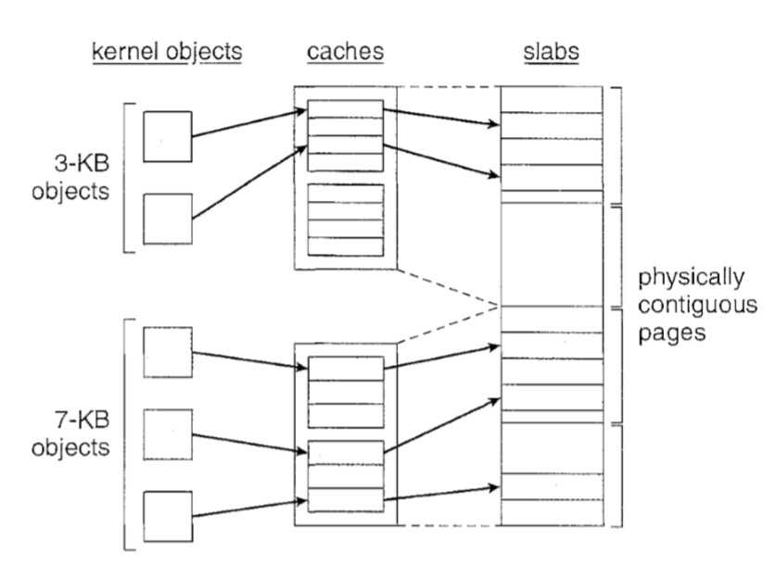

Slide 151
In Linux, a slab may be in one of three possible states:
Full. All objects in the slab are marked as used.
Empty. All objects in the slab are marked as free.
Partial. The slab consists of both used and free objects

