Slide 1
GOOD MORNING
Combinational Circuits
By :
Dr.M.V.SUBRAMANYAM
PRINCIPAL
SANTHIRAM ENGINEERING COLLGE, NANDYAL

Slide 2
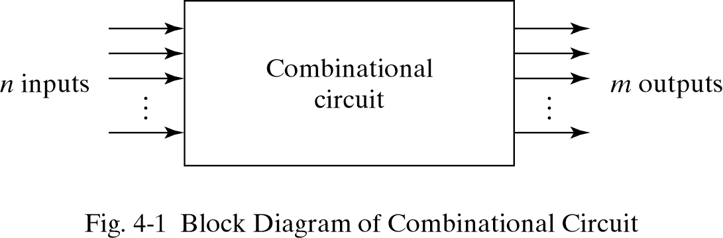
Combinational Logic
Logic circuits for digital systems may be combinational or sequential.
A combinational circuit consists of input variables, logic gates, and output variables.

Slide 3
4-2. Analysis procedure
To obtain the output Boolean functions from a logic diagram, proceed as follows:
Label all gate outputs that are a function of input variables with arbitrary symbols. Determine the Boolean functions for each gate output.
Label the gates that are a function of input variables and previously labeled gates with other arbitrary symbols. Find the Boolean functions for these gates.

Slide 4
4-2. Analysis procedure
Repeat the process outlined in step 2 until the outputs of the circuit are obtained.
By repeated substitution of previously defined functions, obtain the output Boolean functions in terms of input variables.

Slide 5
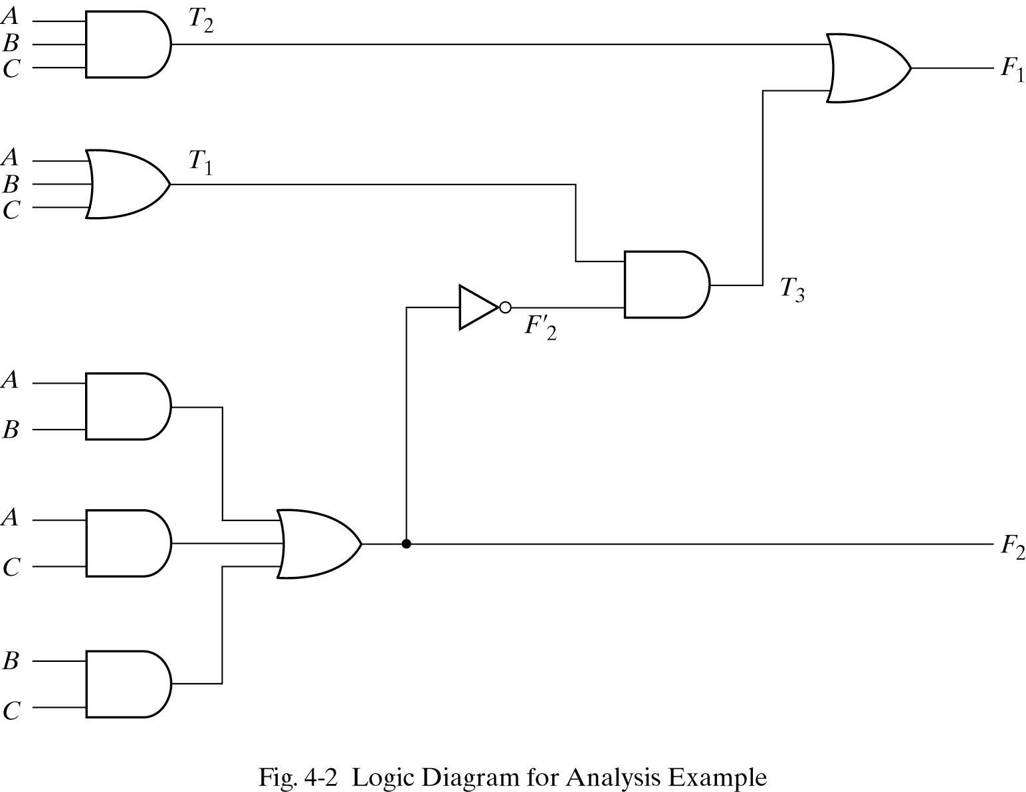
Example
F₂ = AB + AC + BC; T₁ = A + B + C; T₂ = ABC; T₃ = F₂’T₁;
F₁ = T₃ + T₂
F₁ = T₃ + T₂ = F₂’T₁ + ABC = A’BC’ + A’B’C + AB’C’ + ABC

Slide 6
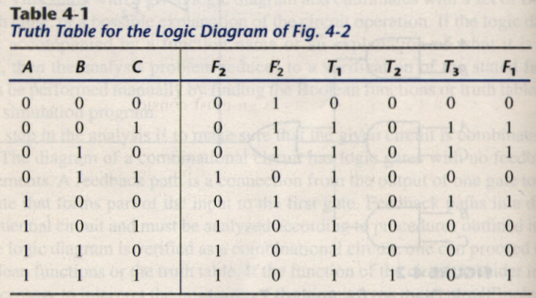
Derive truth table from logic diagram
We can derive the truth table in Table 4-1 by using the circuit of Fig.4-2.

Slide 7
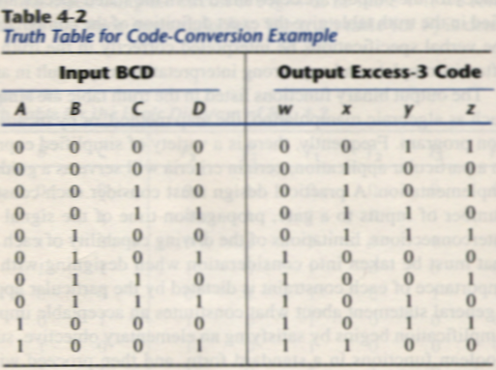
4-3. Design procedure
Table4-2 is a Code-Conversion example, first, we can list the relation of the BCD and Excess-3 codes in the truth table.

Slide 8
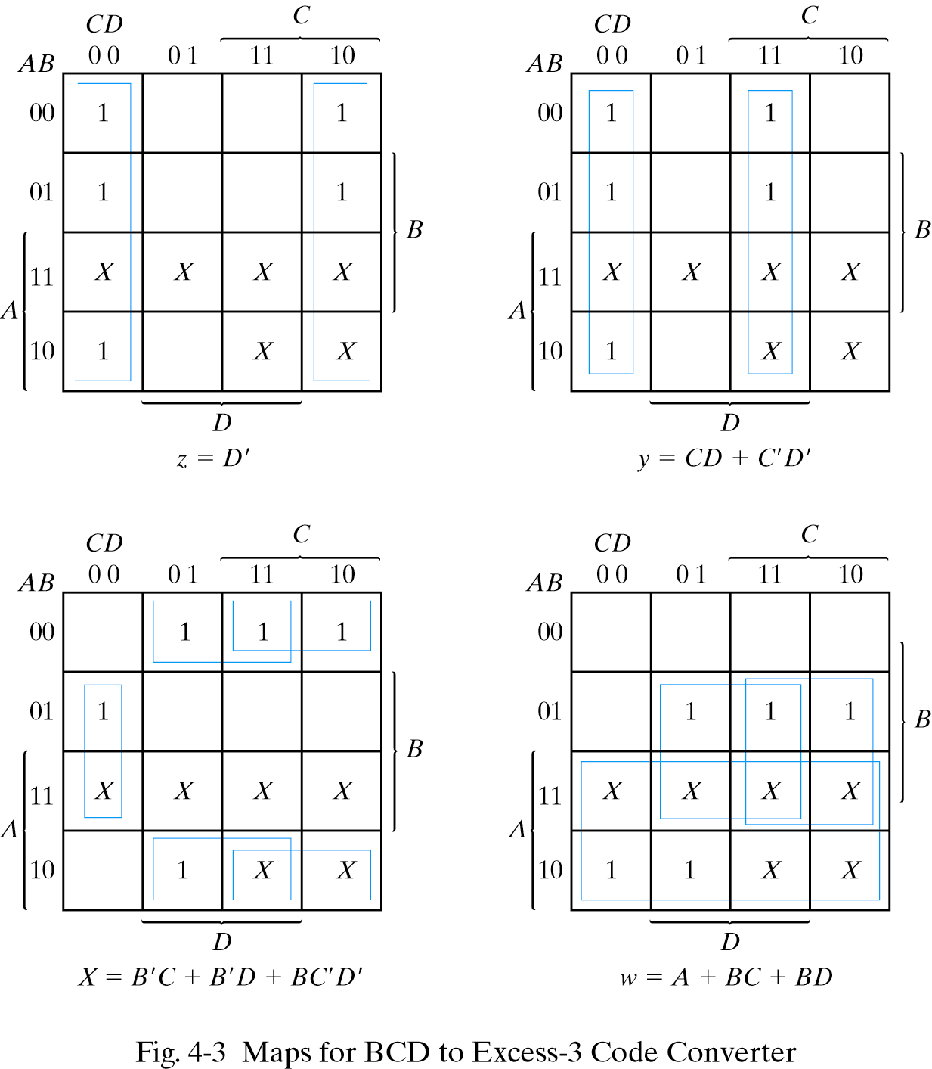
Karnaugh map
For each symbol of the Excess-3 code, we use 1’s to draw the map for simplifying Boolean function.

Slide 9

Combinational circuits
SANTHIRAM ENGINEERING COLLEGE
Presented By
Dr. M. V. Subramanyam
Professor & Principal

Slide 10

Overview
Classification of circuits
Combinational circuits
      Design procedure for full adder
Adders
      Parallel Adder
      Carry look ahead adder
      BCD Adder
Advantages
Comparison of combinational and sequential circuits
Dr. M.V. Subramanyam|ECE|SREC
Digital electronics

Slide 11
classification
Logic circuits for digital system is categorized into two
            Combinational circuits
            Sequential circuits
Dr. M.V. Subramanyam|ECE|SREC
Digital electronics

Slide 12
Combinational circuits
A combinational circuit is a circuit in which the output depends on the present combination of inputs.
Combinational circuits are made up of logic gates.
The output of each logic gate is determined by its logic function.
Example: Half adder, Full adder, Decoder, Encoder, multiplexer, Comparator etc.
Dr. M.V. Subramanyam|ECE|SREC
Digital electronics

Slide 13
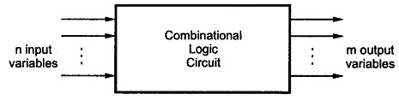
Block diagram
It contains ‘n’ number of inputs and ‘m’ number of outputs as shown below
Dr. M.V. Subramanyam|ECE|SREC
Digital electronics

Slide 14
Design procedure
Steps to be Followed:
Understand the problem statement (realize how the outputs of the circuit depend on the inputs to the circuit)
Draw the Truth Table (Truth Table establishes the relationship between the outputs and inputs for all the possible input combinations)
Derive the minimized Boolean Expressions for the outputs w.r.t. the inputs (You can use the K-Map method)
From the Boolean expressions draw the logic circuit
Dr. M.V. Subramanyam|ECE|SREC
Digital electronics

Slide 15
Design procedure - example
Design full adder
1. Understand the problem statement (realize how the outputs of the circuit depend on the inputs to the circuit)
ie full adder adds three inputs (A, B, Cin) and it has two outputs, sum and carry(Cout)
Dr. M.V. Subramanyam|ECE|SREC
Digital electronics

Slide 16
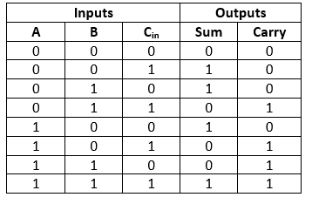
Design procedure - example
2. Draw the Truth Table
Dr. M.V. Subramanyam|ECE|SREC
Digital electronics

Slide 17
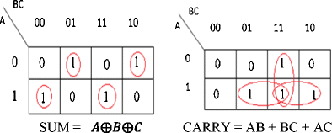
Design procedure - example
3. Derive the minimized Boolean Expressions for the outputs w.r.t. the inputs (You can use the K-Map method)
Dr. M.V. Subramanyam|ECE|SREC
Digital electronics

Slide 18
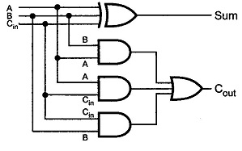
Design procedure - example
4. From the Boolean expressions draw the logic circuit
Dr. M.V. Subramanyam|ECE|SREC
Digital electronics

Slide 19
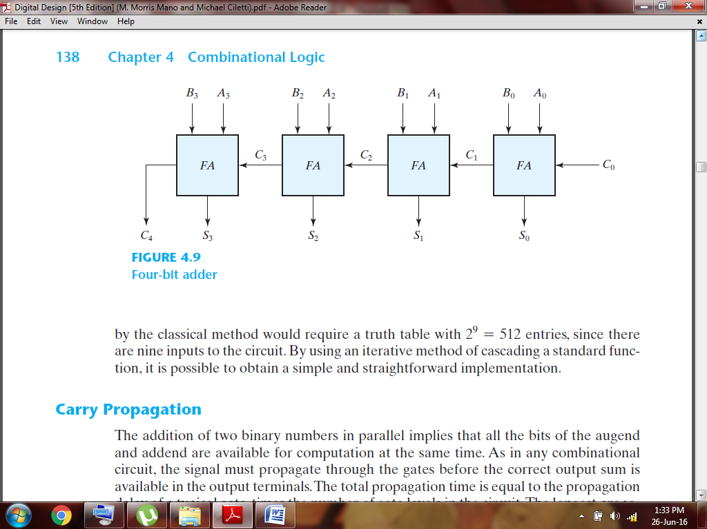
Parallel Adder
Dr. M.V. Subramanyam|ECE|SREC
Digital electronics

Slide 20
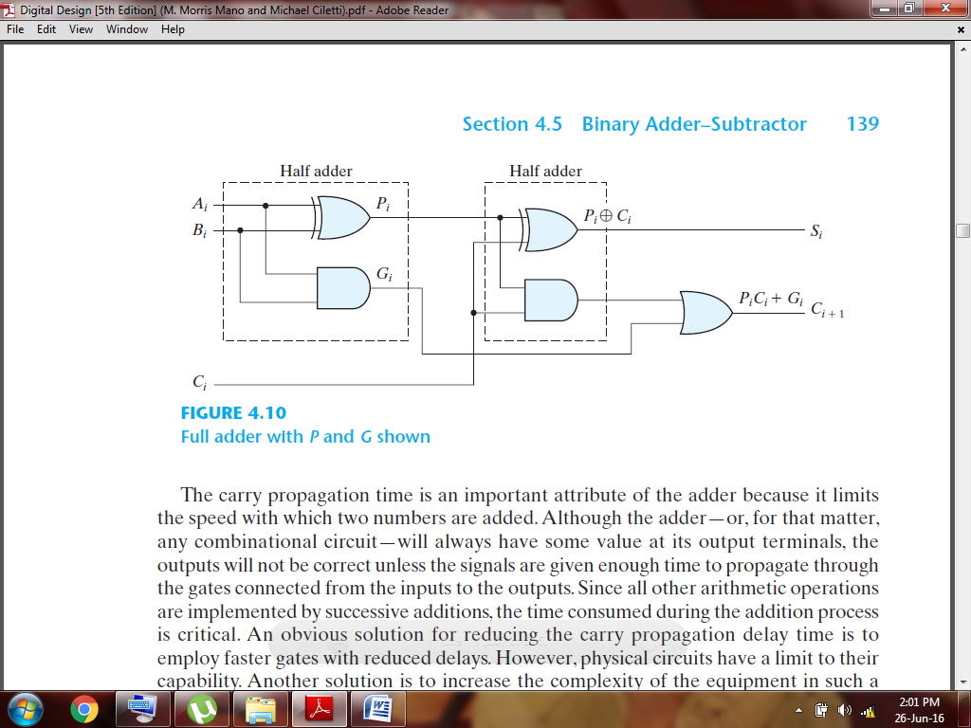
CARRY LOOK AHEAD ADDER
Dr. M.V. Subramanyam|ECE|SREC
Digital electronics

Slide 21
Continue…
Consider the circuit of the full adder shown in Fig. 4.10. We define two new binary variables
P_{i} = A_{i} ⊕ B_{i}
G_{i} = A_{i}B_{i}
The output sum and carry can respectively be expressed as
S_{i} = P_{i} ⊕ C_{i}
C_{i+1} = G_{i} + P_{i}C_{i}
G_{i} is called a carry generate , and it produces a carry of 1 when both A_{i} and B_{i} are 1.
P_{i} is called a carry propagate , because it determines whether a carry into stage i will propagate into stage i + 1
We now write the Boolean functions for the carry outputs of each stage:
C₀ = input carry
C₁ = G₀ + P₀C₀
C₂ = G₁ + P₁C₁ = G₁ + P₁ (G₀ + P₀C₀) = G₁ + P₁G₀ + P₁P₀C₀
C₃ = G₂ + P₂C₂ = G₂ + P₂G₁ + P₂P₁G₀ + P₂P₁P₀C₀
C₄=G₃+P₃C₃=G₃+P₃G₂+P₃P₂G₁+P₃P₂P₁G₀+P₃P₂P₁P₀G₀
Dr. M.V. Subramanyam|ECE|SREC
Digital electronics

Slide 22
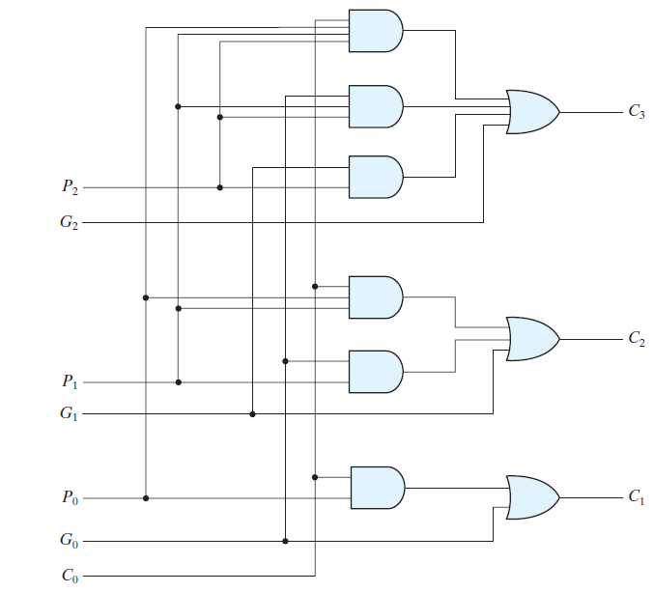
Continue…
Dr. M.V. Subramanyam|ECE|SREC
Digital electronics

Slide 23
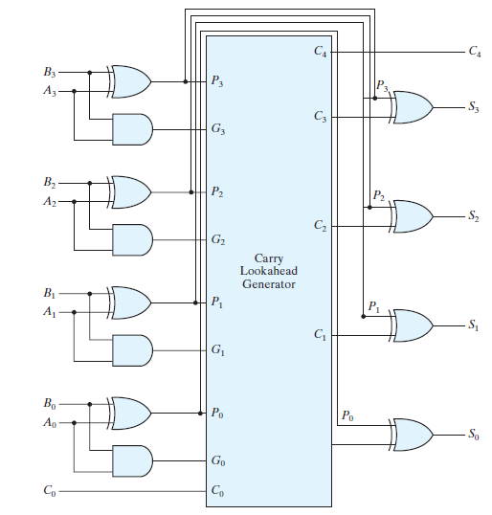
Continue…
Dr. M.V. Subramanyam|ECE|SREC
Digital electronics

Slide 24
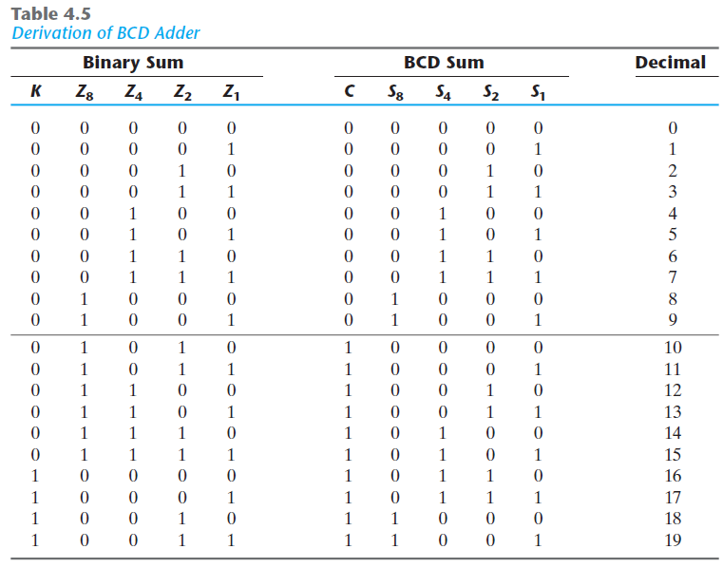
BCD Adder
Dr. M.V. Subramanyam|ECE|SREC
Digital electronics

Slide 25
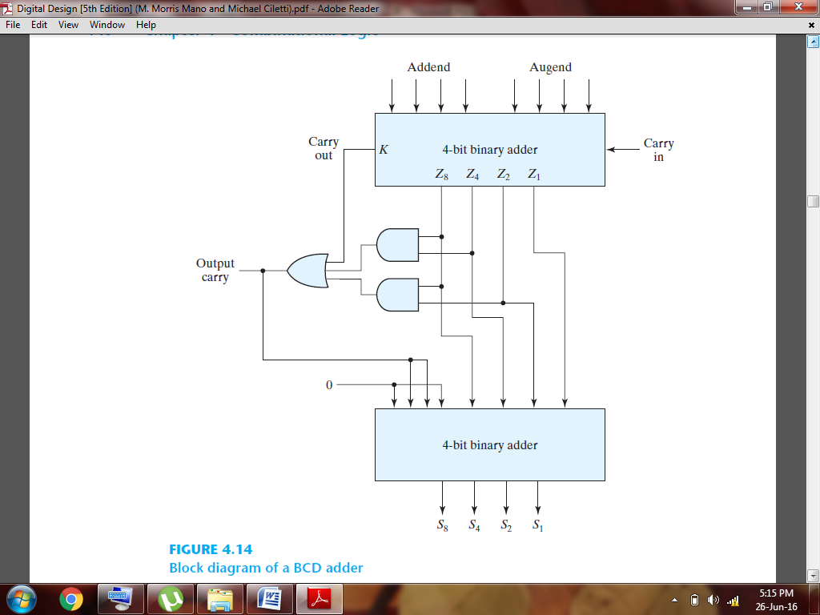
BCD Adder
Dr. M.V. Subramanyam|ECE|SREC
Digital electronics

Slide 26
advantages
Easy to design
The combinational circuits are faster
No feedback is required
No clock is required
Dr. M.V. Subramanyam|ECE|SREC
Digital electronics

Slide 27
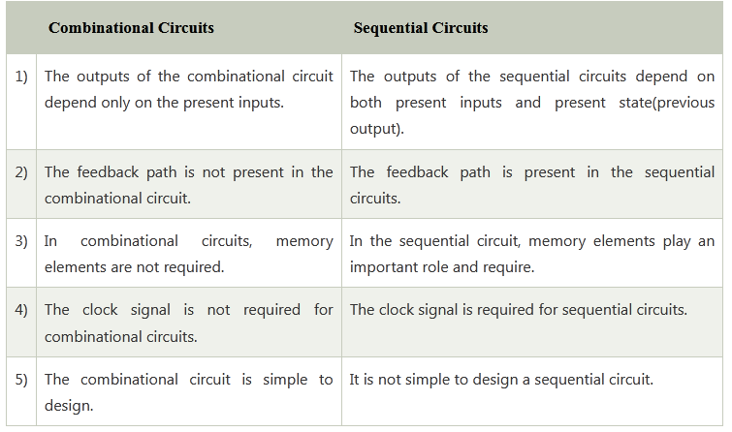
comparison
Dr. M.V. Subramanyam|ECE|SREC
Digital electronics

Slide 28

Dr. M.V. Subramanyam|ECE|SREC
Digital electronics

