Slide 1
DIGITAL COMMUNICATION Unit-II: Base band pulse transmission
Dr.Y. Mallikarjuna Rao _{M.Tech, Ph.D}
Assistant Professor & HOD
Electronics & Communication Engineering
Santhiram Engineering College, Nandyal, A.P
Email: hod.ece@srecnandyal.edu.in

Slide 2
UNIT-II: SYLLABUS
Matched filter
Inter Symbol Interference
Nyquist’s criterion
Raised cosine filter
Correlative coding
Partial response signalling
Baseband M-ary PAM transmission
Eye diagrams

Slide 3
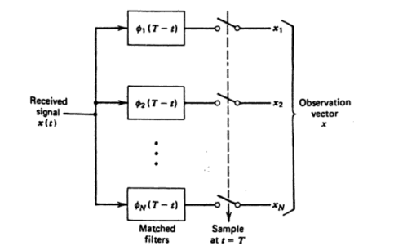
Matched filter
Figure: detector part of matched filter

Slide 5
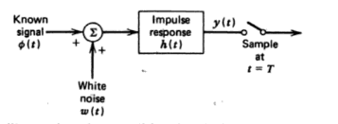
Maximization of output SNR
Figure: Illustrating the condition for derivative of the matched filter

Slide 7
Rayleigh energy theorem

Slide 8
Properities of matched filter property1: The spectrum of the output signal of a matched filter with the matched signal as input is except for time delay factor proportional to the energy spectal density of the input signal.

Slide 9
Property 2:
The output signal of a matched filter is proportional to a shifted version of the autocorrelation of the input signal to which the filter is matched
Property 3
The output signal to noise ratio of a matched filterdepends only on the ratio of the signal energy to the PSD of the white noise at the filter input

Slide 10
Property 4
The matched filter operation ca be seperated into two matching comditions.
Spectral matching that produces the desired output peak at time T
Spectral amplitude matching that gives this peak value iyts optimum signal to density ratio

Slide 11
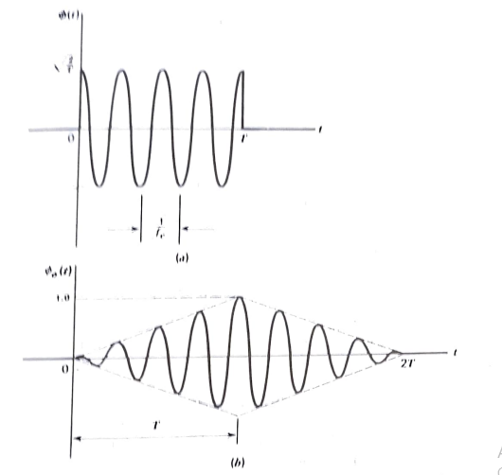
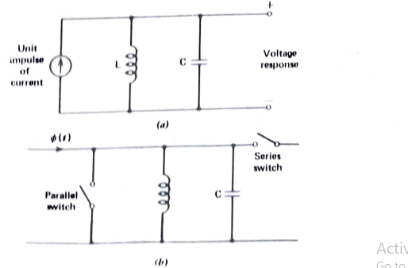
Matched filter for rectangular pulses
Figure a) RF pulse Input b) Matched filter output
Figure: a) parallel tuned LC circuit b) Integrate and dump circuit

Slide 13
Error rate due to channel noise
Figure: receiver for baseband transmission for binary encoded datastream using polar NRZ signalling
# $x(t)=\left\{\begin{aligned}+A+w\left(t\right), symbol 1 was sent \\ −A+w\left(t\right), symbol 0 was sent\end{aligned}\right.$
$\# w\left(t\right)$ is Additive White Gaussian Noise with zero mean & PSD $\frac{N_{0}}{2}$
$\#$The output of the matched filter is also Gaussian with
mean either –A or $+A$

Slide 14
Error rate due to channel noise
There are two types of errors
Symbol 0 is chosen when a 1 was actually transmitted
Symbol 1 is chosen when a 0 was actually transmitted
Case-1: Symbol 1 is chosen when a 0 was actually transmitted
# $x\left(t\right)=−A+w(t)$
# $y(t)$at $t=T_{b}$is a random variable with mean -$A$ and V$ariance σ_{Y}^{2}=\frac{N_{0}}{2T_{b}}$
# The Probability Density Function $f_{Y}\left(y | 0 was sent\right)$
$f_{Y}\left(y | 0 was sent\right)=\frac{1}{\sqrt{2πσ_{Y}^{2}}}e^{\frac{−{{(μ}_{x}−y)}^{2}}{2σ_{Y}^{2}}}$

Slide 15
Error rate due to channel noise
# $f_{Y}\left(y | 0 was sent\right)=\frac{1}{\sqrt{2πσ_{Y}^{2}}}e^{\frac{−{{(μ}_{x}−y)}^{2}}{2σ_{Y}^{2}}}$
# When 0 was sent $μ_{x}=−A$ and $σ_{Y}^{2}$= $\frac{N_{0}}{2T_{b}}$
# Upon Substitution of these values in the above equation, we get
# ${ f}_{Y}\left(y | 0\right)=\frac{1}{\sqrt{π\frac{N_{0}}{T_{b}}}}e^{\frac{−{(−A−y)}^{2}}{\frac{N_{0}}{T_{b}}}}$

Slide 16
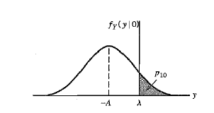
Error rate due to channel noise
# ${ f}_{Y}\left(y | 0\right)=\frac{1}{\sqrt{π\frac{N_{0}}{T_{b}}}}e^{\frac{−{(−A−y)}^{2}}{\frac{N_{0}}{T_{b}}}}$ $dy$
# the Threshold for the decision making is represented by $λ$
#$Here, λ=0;$U$sually,$The average value of two symbols $(−A+A)/2$

Slide 17
Error rate due to channel noise
# ${ P}_{e0} =\int_{y=0}^{y=∞}{\frac{1}{\sqrt{π\frac{N_{0}}{T_{b}}}}e^{\frac{−{(−A−y)}^{2}}{\frac{N_{0}}{T_{b}}}}}dy$
# ${ P}_{e0} =\sqrt{π/{N_{0}T_{b}}}\int_{y=0}^{y=∞}{ e^{\frac{−{(−A−y)}^{2}}{{N_{0}}/{T_{b}}}}}dy$
# Let $z=\frac{y+A}{\sqrt{{N_{0}}/{T_{b}}}}$ $; dz=$ $\frac{dy}{\sqrt{{N_{0}}/{T_{b}}}}$
# when $y=0; z=\frac{A}{\sqrt{{N_{0}}/{T_{b}}}}=\frac{A\sqrt{T_{b}}}{\sqrt{T_{b}}\sqrt{{N_{0}}/{T_{b}}}}=\sqrt{\frac{E_{b}}{N_{0}}}$
# when $y=∞; z=∞$

Slide 18
Error rate due to channel noise
# ${ P}_{e0} =1/\sqrt{π}\int_{z=\sqrt{\frac{E_{b}}{N_{0}}}}^{z=∞}{ e^{−z^{2}}}dz$
Consider the complementary error function $\operatorname{erfc}\left(u\right)=2/\sqrt{π}\int_{u}^{∞}{ e^{−u^{2}}}du$
# ${ P}_{e0} =\frac{1}{2}$ $erfc⁡(\sqrt{\frac{E_{b}}{N_{0}}})$

Slide 19
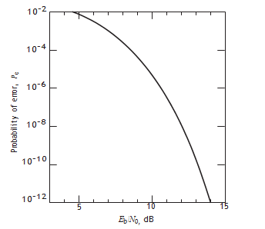
Figure: probability of error in the signalling scheme

Slide 20
Error rate due to channel noise
Case-2: Symbol 0 is chosen when a 1 was actually transmitted
# $x\left(t\right)=A+w(t)$
# $y(t)$at $t=T_{b}$is a random variable with mean $A$ and V$ariance σ_{Y}^{2}=\frac{N_{0}}{2T_{b}}$
# The Probability Density Function $f_{Y}\left(y | 1 was sent\right)$
$f_{Y}\left(y | 1 was sent\right)=\frac{1}{\sqrt{2πσ_{Y}^{2}}}e^{\frac{−{{(μ}_{x}−y)}^{2}}{2σ_{Y}^{2}}}$

Slide 21
Error rate due to channel noise
# $f_{Y}\left(y | 1 was sent\right)=\frac{1}{\sqrt{2πσ_{Y}^{2}}}e^{\frac{−{{(μ}_{x}−y)}^{2}}{2σ_{Y}^{2}}}$
# When 1 was sent $μ_{x}=A$ and $σ_{Y}^{2}$= $\frac{N_{0}}{2T_{b}}$
# Upon Substitution of these values in the above equation, we get
# ${ f}_{Y}\left(y | 1\right)=\frac{1}{\sqrt{π\frac{N_{0}}{T_{b}}}}e^{\frac{−{(A−y)}^{2}}{\frac{N_{0}}{T_{b}}}}$

Slide 22
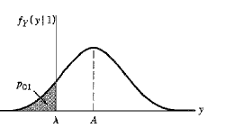
Error rate due to channel noise
# ${ f}_{Y}\left(y | 1\right)=\frac{1}{\sqrt{π\frac{N_{0}}{T_{b}}}}e^{\frac{−{(A−y)}^{2}}{\frac{N_{0}}{T_{b}}}}$ $dy$
# the Threshold for the decision making is represented by $λ$
#$Here, λ=0;$U$sually,$The average value of two symbols $(−A+A)/2$

Slide 23
Error rate due to channel noise
# ${ P}_{e1} =\int_{y=−∞}^{y=0}{\frac{1}{\sqrt{π\frac{N_{0}}{T_{b}}}}e^{\frac{−{(A−y)}^{2}}{\frac{N_{0}}{T_{b}}}}}dy$
# ${ P}_{e1} =\sqrt{π/{N_{0}T_{b}}}\int_{y=−∞}^{y=0}{ e^{\frac{−{(A−y)}^{2}}{{N_{0}}/{T_{b}}}}}dy$
# ${ P}_{e1} =\frac{1}{2}$ $erfc⁡(\sqrt{\frac{E_{b}}{N_{0}}})$
Consider the Priori probabilities${ P}_{0}=$ ${ P}_{1}=\frac{1}{2}$

Slide 24
Error rate due to channel noise
# Average Probability of error $P_{e}={{ P}_{0}{ P}_{e0}+ P}_{e1}{ P}_{1}$
# ${ P}_{e}=\frac{1}{2}\left(\frac{1}{2} erfc⁡(\sqrt{\frac{E_{b}}{N_{0}}}\right)+$ $\frac{1}{2}\left(\frac{1}{2} erfc⁡(\sqrt{\frac{E_{b}}{N_{0}}}\right)$
# ${ P}_{e}=\frac{1}{2} erfc⁡\left(\sqrt{\frac{E_{b}}{N_{0}}}\right)$

Slide 25
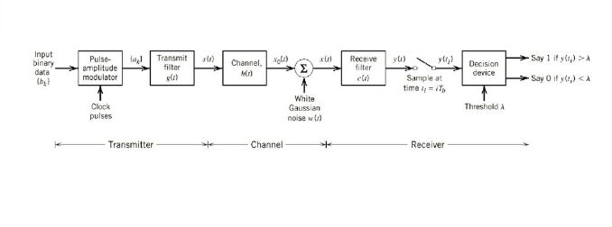
Intersymbol Interference(ISI)

Slide 26
Intersymbol Interference
Intersymbol interference (ISI) occurs when a pulse spreads out in such a way that it interferes with adjacent pulses at the sample instant.
Example: assume polar NRZ line code. The channel outputs are shown as spreaded (width T_{b} becomes 2T_{b}) pulses shown (Spreading due to bandlimited channel characteristics).
Channel Input
Pulse width T_{b}
Channel Output
Pulse width T_{b}
Data 1
Data 0

Slide 27
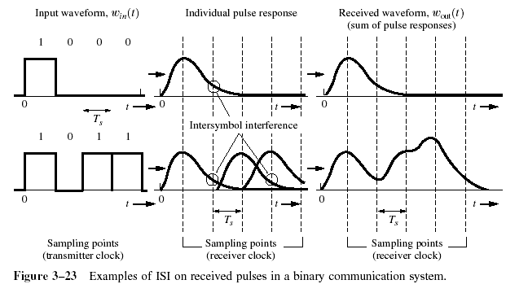
Intersymbol Interference
If the rectangular multilevel pulses are filtered improperly as they pass through a communications system, they will spread in time, and the pulse for each symbol may be smeared into adjacent time slots and cause Intersymbol Interference.

Slide 28
Inter Symbol Interference(ISI)

Slide 29
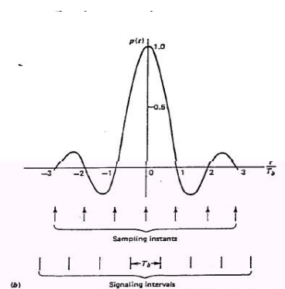
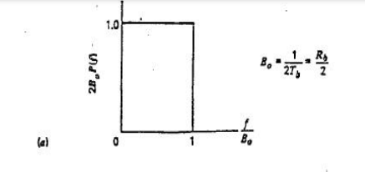
Ideal Nyquist channel
Figure: a) Ideal impulse response b) Ideal basic pulse shape

Slide 30
Nyquist criterion for ditortionless baseband binary transmission

Slide 32
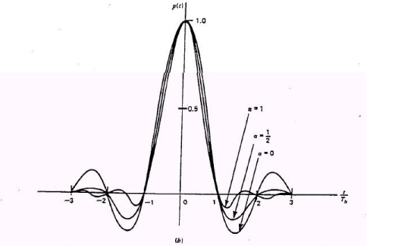
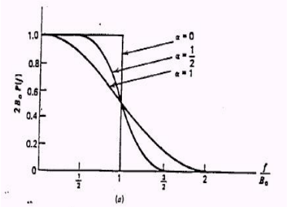
Raised Cosine Spectrum
Figure: Response for different rolloff factors a) frequency response b) time respose

Slide 34
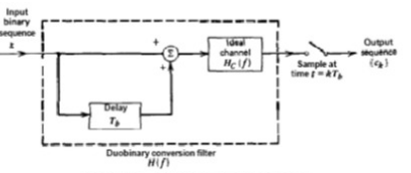
Correlative coding Duo binary signalling
figure: Duo binary signalling scheme

Slide 36
Figure: a) amplitude response b) frequency response
Figure: impulse response

Slide 37
Figure: A precoded duobinary scheme
Figure: detector for recovering original signal binary sequence from the precoder duobinary coder output

Slide 38
Modified Duo binary signalling
Figure: Modified Duo binary signalling scheme

Slide 40
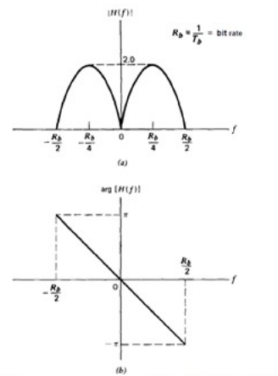
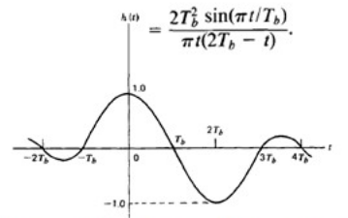
Figure: a) amplitude response b) phase response
Figure: impulse response

Slide 41
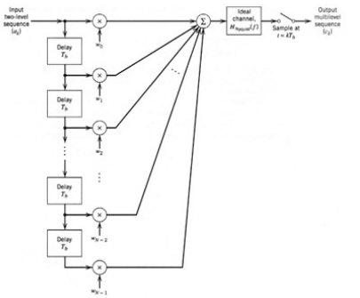
Partial response signalling
Figure: Generalized correlative coding scheme

Slide 42
Correlative sample c_{k} is obtained from N successive input sample values bk
In duobinary case
In modified duobinary case

Slide 43
Baseband M-ary PAM transmission
In baseband binary PAM systems, the output of pulse generation consists of binary pulses i.e pulses with one of the two possible amplitude levels.
In baseband M-ary PAM systems, the output of pulse generation takes on one of the M possible amplitude levels.
Figure: Baseband

Slide 44
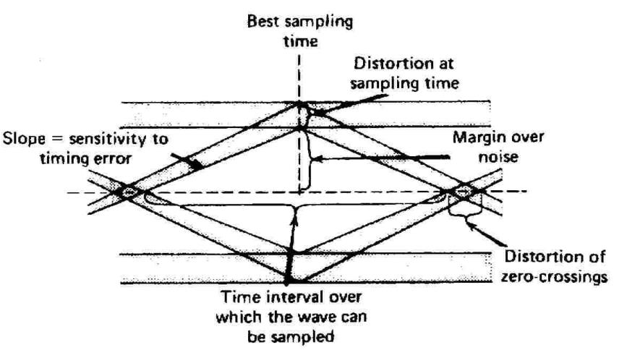
Eye Diagram
Figure: Inerpretation of eye pattern

Slide 45
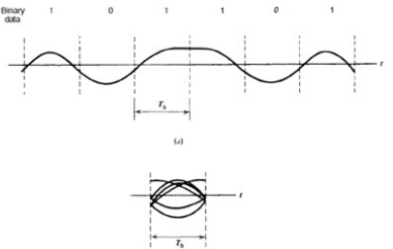
Figure: a) distorted wave b) eye pattern

