Slide 1
DIGITAL COMMUNICATION Unit-V: Channel coding
Dr.Y. Mallikarjuna Rao _{M.Tech, Ph.D}
Assistant Professor & HOD
Electronics & Communication Engineering
Santhiram Engineering College, Nandyal, A.P
Email: hod.ece@srecnandyal.edu.in

Slide 2
Syllabus
Discrete memory less channels
Linear Block Codes-Repetition codes
Syndrome decoding
minimum distance considerations
Cyclic codes- generator polynomial
parity check polynomial
encoder for cyclic code
calculation of syndrome
Convolutional Codes
generator polynomials
state diagrams
Viterbi algorithm

Slide 3
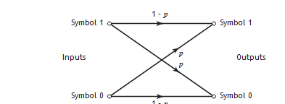
Discrete memory less channels
The simplest discrete memoryless channel results from the use of binary input and binary output symbols.
When binary coding is used, the modulator has only the binary symbols 0 and 1 as inputs.
Likewise, the decoder has only binary inputs if binary quantization of the demodulator output is used; that is, a hard decision is made on the demodulator output as to which binary symbol was actually transmitted. In this situation, we have a binary symmetric channel with a transition probability diagram as shown in Figure
Figure ;transition distribution diagram of binary symmetric channel

Slide 4
The use of hard decisions prior to decoding causes an irreversible loss of valuable information in the receiver. To reduce this loss, soft-decision coding can be used. This is achieved by including a multilevel quantizer at the demodulator output, as illustrated in Figure (a) for the case of binary PSK signals

Slide 5
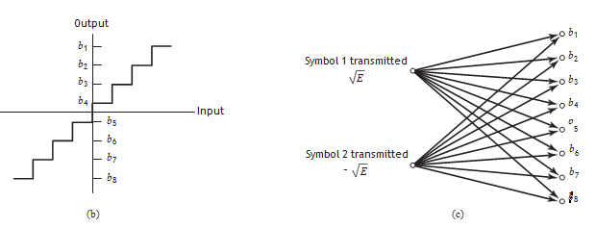
The input–output characteristic of the quantizer is shown in Figure b. The modulator has only binary symbols 0 and 1 as inputs, but the demodulator output now has an alphabet with Q symbols. Assuming the use of the three-level quantizer described in Figure b, we have Q = 8. Such a channel is called a binary input, Q-ary output discrete memoryless channel. The corresponding channel transition probability diagram is shown in Figure c

Slide 6
Linear Block Codes-Repetition codes
A code is said to be linear if any two codewords in the code can be added in modulo-2 arithmetic to produce a third codeword in the code.
Consider, then, an (n, k) linear block code, in which k bits of the n code bits are always identical to the message sequence to be transmitted. The (n – k) bits in the remaining portion are computed from the message bits in accordance with a prescribed encoding rule that determines the mathematical structure of the code.
Accordingly, these (n – k) bits are referred to as parity-check bits. Block codes in which the message bits are transmitted in unaltered form are called systematic codes.

Slide 7
Let m0, m1, ¼, mk – 1 constitute a block of k arbitrary message bits. Thus, we have 2k distinct message blocks. Let this sequence of message bits be applied to a linear blockn encoder, producing an n-bit codeword whose elements are denoted by c0, c1, ¼, cn – 1.
Let b0, b1, ¼, bn – k – 1 denote the (n – k) parity-check bits in the codeword
The (n – k) leftmost bits of a codeword are identical to the corresponding parity-check bits and the k rightmost bits of the codeword are identical to the corresponding message bits.

Slide 9
the parity check-bits in the compact matrix form b = mP k-by-(n – k) coefficient matrix P ,where m is the message vector, b parity vector, x is code vctor and I is the identity matrix

Slide 10
Define the k-by-n generator matrix G

Slide 11
Syndrome decoding
The 1 by n received vector is the sum of code vetor x and error vector e is
y=x+e
e_{i} = 1 if an error has occurred in the ith location
0 otherwise
The syndrome is

Slide 12
PROPERTY 1 :The syndrome depends only on the error pattern and not on the transmitted codeword.
PROPERTY 2 :All error patterns that differ by a codeword have the same syndrome.

Slide 13
PROPERTY 3 :The syndrome is the sum of those columns of the matrix H corresponding to the error locations.
PROPERTY 4:With syndrome decoding ,an (n,k) linear block code can correct upto t error per codeword,provided that n and k satisfy the hamming code

Slide 14
minimum distance considerations
The Hamming weight w(c) of a code vector c is defined as the number of nonzero elements in the code vector
The minimum distance d_{min} of a linear block code is the smallest Hamming distance between any pair of codewords.
The minimum distance of a linear block code is the smallest Hamming weight of the nonzero code vectors in the code.
a linear block code is defined by the set of all code vectors for which xH^{T}= 0
the smallest Hamming weight of the nonzero code vectors in a linear block code equals the minimum distance of the code.
The minimum distance of a linear block code is defined by the minimum number of rows of the matrix H^{T} whose sum is equal to the zero vector.

Slide 15
An (n, k) linear block code has the power to correct all error patterns of weight t or less if, and only if,
d(x_{i}, x_{j} ) > 2t + 1, for all x_{i} and x_{j}.
An (n,k) linear block code of minimum distance dmin can correct up to t errors if, and only if,

Slide 16
Cyclic codes- generator polynomial
Cyclic codes form a subclass of linear block codes.
A binary code is said to be a cyclic code if it exhibits two fundamental properties:
PROPERTY 1 :Linearity Property
The sum of any two codewords in the code is also a codeword.
PROPERTY 2: Cyclic Property
Any cyclic shift of a codeword in the code is also a codeword.

Slide 18
Generator polynomial
The generator polynomial g(D) has the following properities.
Property 1: The generator polynomial of an (n,k) cyclic codes is unique in that it is the only codeword polynomial if minimum degree (n-k).
Property 1: Any multiple of the generator polynomial g(d) is a codeword polynomial as

Slide 19
Suppose we are given the generator polynomial g(D) and the requirement is to encode the message sequence (m0, m1, …, mk – 1) into an (n, k) systematic cyclic code. That is, the message bits are transmitted in unaltered form, as shown by the following structure for a codeword

Slide 20
parity check polynomial
An (n,k) cyclic code is uniquely specified by its generator polynomial g(D) of order (n – k). Such a code is also uniquely specified by another polynomial of degree k, which is called the parity-check polynomial,we know

Slide 21
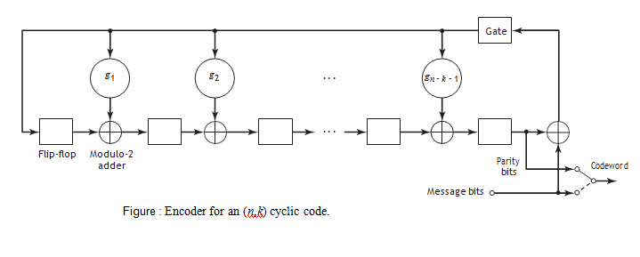
encoder for cyclic code
The operation of the encoder shown in Figure proceeds as follows:
The gate is switched on. Hence, the k message bits are shifted into the channel. As soon as the k message bits have entered the shift register, the resulting (n – k) bits in the register form the parity-check bits.
The gate is switched off, thereby breaking the feedback connections.
The contents of the shift register are read out into the channel.

Slide 22
calculation of syndrome
Figure: syndrome calculator

Slide 23
Convolutional Codes
In block coding, the encoder accepts a k-bit message block and generates an n-bit codeword, which contains n – k parity-check bits
A convolutional coder generates redundant bits by using modulo-2 convolutions; hence the name convolutional codes
The encoder of a binary convolutional code with rate 1/n, measured in bits per symbol, may be viewed as a finite-state machine that consists of an M-stage shift register with prescribed connections to n modulo-2 adders and a multiplexer that serializes the outputs of the adders.

Slide 24
A sequence of message bits produces a coded output sequence of length n(L + M) bits, where L is the length of the message sequence. The code rate is therefore given by
The constraint length of a convolutional code, expressed in terms of message bits, is the number of shifts over which a single incoming message bit can influence the encoder output.

Slide 25
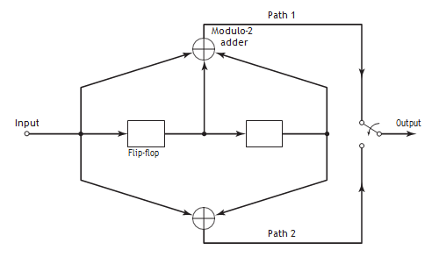
Figure 10.13 shows a convolutional encoder with the number of message bits n = 2 and constraint length K =(M+1)= 3. In this example, the code rate of the encoder is 1/2. The encoder operates on the incoming message sequence, one bit at a time, through a convolution process; it is therefore said to be a nonsystematic code.
Figure: Constraint length-3, rate -1/2 convolutional encoder.
In an encoder with an M-stage shift register, the memory of the encoder equals M message bits. Correspondingly, the constraint length, denoted by K equals M + 1 shifts that are required for a message bit to enter the shift register and finally come out.

Slide 26
Generator polynomial

Slide 27
Consider again the convolutional encoder of Figure which has two paths numbered 1 and 2 for convenience of reference. The impulse response of path 1 (i.e., upper path) is (1, 1, 1). Hence, the generator polynomial of this path is
g⁽¹⁾ D= 1 + D + D²
The impulse response of path 2 (i.e., lower path) is (1, 0, 1). The generator polynomial of this second path is
g⁽²⁾ = 1 + D²
For an incoming message sequence given by (10011), for example, we have the polynomial representation
m(D) = 1 + D³ + D⁴
x⁽¹⁾ D =g⁽¹⁾ (D)m(D) x⁽²⁾ D = g(2)(D)m(D) =(1 + D + D²)(1 + D³ + D⁴ ) =(1 + D²)(1 + D³ + D⁴ )
=1 + D + D ² + D³ + D⁶ = 1 + D² + D³ + D⁴ + D⁵ +D⁶

Slide 28
Code tree
A code branch produced by input bit 0 is drawn as a solid line, whereas a code branch produced by input bit 1 is a dashed line.
Each branch of the tree represents an input bit, with the corresponding pair of output bits indicated on the branch.
The convention used to distinguish the input bits 0 and 1 follows the graphical rule described above.
Thus, a specific path in the tree is traced from left to right in accordance with the message sequence.
The corresponding coded bits on the branches of that path constitute the message sequence (10011) applied to the input of the encoder of Figure

Slide 29
00 |  |  |  |  | a 11
00
 |  |  |  | a |  | 10
 |  |  |  | 11 | b 01
00
 |  |  | 11
 |  |  | 10 |  | c 00
 |  |  | 11
 |  |  |  | b |  | 01
 |  |  |  | 01 | d 10
00
 |  | 00
 |  | 11 |  |  | a 11
 |  | 10
 |  |  |  | c |  | 10
 |  |  |  | 00 | b 01
 |  | 11
 |  |  | 11
 |  |  | 01 |  | c 00
 |  |  | 01
 |  |  |  | d |  | 01
 |  |  |  | 10 | d 10
 | 00
 | 00 |  |  |  | a 11
 | 11
 |  |  |  | a |  | 10
 |  |  |  | 11 | b 01
 | 10
 |  |  | 11
 |  |  | 10 |  | c 00
 |  |  | 00
 |  |  |  | b |  | 01
 |  |  |  | 01 | d 10
 | 11
 |  | 00
 |  | 11 |  |  | a 11
 |  | 01
 |  |  |  | c |  | 10
 |  |  |  | 00 | b 01
 |  | 01
 |  |  | 11
 |  |  | 01 |  | c
 |  |  | 10
 |  |  |  |  |  | 00
 |  |  |  | d |  | 01
 |  |  |  | 10 | d 10
the corresponding encoded sequence is (11, 10, 11, 11, 01), which agrees with the first five pairs of bits in the encoded sequence {x_{(i)}}
Figure: code tree for the convolutional encoder

Slide 30
Code trellis
From Figure in code tree, we observe that the tree becomes repetitive after the first three branches. Indeed, beyond the third branch, the two nodes labeled a are identical and so are all the other node pairs that are identically labeled.
The encoder has memory M = K – 1 = 2 message bits. We therefore find that, when the third message bit enters the encoder, the first message bit is shifted out of the register.
Consequently, after the third branch, the message sequences (100 m3m4…) and (000 m3m4…) generate the same code symbols, and the pair of nodes labeled a may be joined together.
The same reasoning applies to the other nodes in the code tree. Accordingly, we may collapse the code tree of Figure into the new form shown in Figure below, which is called a trellis.

Slide 31
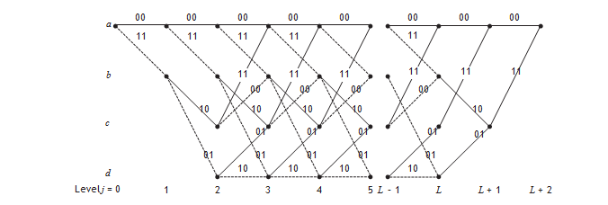
A code branch in a trellis produced by input binary symbol 0 is drawn as a solid line, whereas a code branch produced by an input 1 is drawn as a dashed line.
from Figure that the message sequence (10011) produces the encoded output sequence (11, 10, 11, 11, 01),
Figure: trellis for convolutional encoder

Slide 32
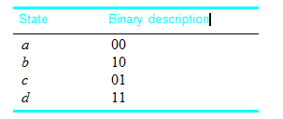
The state of a rate 1/n convolutional encoder is determined by the smallest number of message bits stored in memory (i.e., the shift register).
the convolutional encoder of Figure has a shift register made up of two memory cells. With the message bit stored in each memory cell being 0 or 1, it follows that this encoder can assume any one of 2² = 4 possible states
Given the current message bit and the state of the encoder, the codeword produced at the output of the encoder is completely determined.
Figure: state table for the convolutional encoder

Slide 33
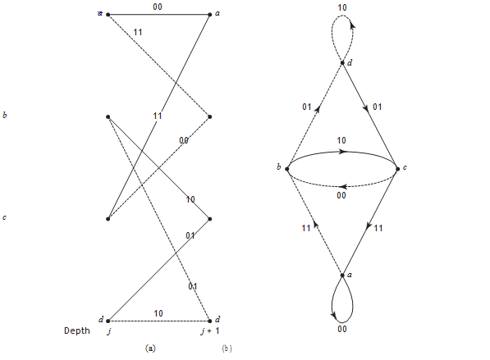
State diagram
The nodes of the figure represent the four possible states of the encoder a, b, c, and d, with each node having two incoming branches and two outgoing branches,
Figure: a) a portion of the central part of code trellis b) state diagram of the convolutional encoder

Slide 34
Viterbi algorithm
Consider, for example, the trellis diagram of Figure for a convolutional code with rate r = 1/2 and constraint length K = 3. We observe that, at time-unit j = 3, there are two paths entering any of the four nodes in the trellis.
Moreover, these two paths will be identical onward from that point. Clearly, a minimum distance decoder may make a decision at that point as to which of those two paths to retain, without any loss of performance.
A similar decision may be made at time-unit j = 4, and so on. This sequence of decisions is exactly what the Viterbi algorithm does as it walks through the trellis.
The algorithm operates by computing a metric (i.e., discrepancy) for every possible path in the trellis

Slide 35
The metric for a particular path is defined as the Hamming distance between the coded sequence represented by that path and the received sequence.
This computation is repeated for every time-unit j of the trellis in M < j < L, where M = K – 1 is the encoder’s memory and L is the length of the incoming message sequence.
The paths that are retained by the algorithm are called survivor or active paths. For a convolutional code of constraint length K = 3 no more than 2^{k} – 1 = 4 survivors and their metrics will ever be stored.
The Viterbi algorithm is a maximum-likelihood decoder, which is optimum for an AWGN channel as well as a binary symmetric channel.

Slide 36
Steps in Virtebi algorithm
Computation Step 1: time-unit j
Start the computation at some time-unit j and determine the metric for the path that enters each state of the trellis. Hence, identify the survivor and store the metric for each one of the states.
Computation Step 2: time-unit j + 1
For the next time-unit j + 1, determine the metrics for all 2^{k}-1 paths that enter a state where K is the constraint length of the convolutional encoder; hence do the following:
Add the metrics entering the state to the metric of the survivor at the preceding time-unit j;
Compare the metrics of all 2n paths entering the state; Select the survivor with the largest metric, store it along with its metric, and discard all other paths in the trellis
.
Computation Step 3: continuation of the search to convergence Repeat Step 2 for time-unit j < L + L¢ , where L is the length of the message sequence and L¢ is the length of the termination sequence. Stop the computation once the time-unit j = L + L¢ is reached.

Slide 37
