Slide 1
Software Testing Methodologies
UNIT-IV
Logic Based Testing

Slide 2
Overview of Logic Based Testing
Logic is the word which is used mostly by the programmers
Boolean algebra is to logic as arithmetic is to mathematics
The testing that is performed based on this boolean algebra is known as Logic Based Testing

Slide 3
Hardware Logic Testing
For several decades logic has been the primary tool for hardware logic designers.
Many test methods developed for hardware logic can be adapted to software logic system
The automation of hardware testing is done 10-15 years before than automation of software testing.

Slide 4
Specification Systems
The major problem with specifications is that they would be hard to express.
Boolean algebra (also known as sentinal calculus) is the most basic of all logic systems
To understand the specifications or the rejection of specifications, the boolean algebra should be known

Slide 5
Knowledge-based system
It is used to many applications which are very difficult.
These systems will gather knowledge from a knowledge repository or domain such as law, engineering etc.. Into a database.
Once the data is brought into database it can be modified retrieved and queried
Converting the expert’s knowledge into a collection or set of rules is known as knowledge based system.

Slide 6
Knowledge based system contd..
After setting up rules, the users can then ask the queries depending on data.
When query is asked, the data is processes based on the set of rules.
This step of processing the data in a system will be done by “Interface Engineerng”

Slide 7
Decision tables
The table which consist of set of conditions and corresponding actions is known as decision table.
It consist of four areas called :
The condition stub
The condition entry
The action stub
The action entry

Slide 8
Decision tables contd..
Each column of the table is a rule that specifies the conditions under which the actions named in the action stub will take place
The condition stub is a list of name of conditions

Slide 9
Condtion Stub:The list of names of conditions is known as Condition Stub. Every column in the table specifies some rules. For these rules to be matched, conditions are marked with YES/NO conditions. Apart from YES/NO there is “I” which is immaterial.
Condition Entry: All the rules are the columns of decision table. The condition for the rule i.e., the rule has to be satisfied by the condition or not.
Action Stub: As condition stub consists of list of conditions, action stub consist list of actions
Action Entry: The action entry contains YES/NO whether the actions are performed or not based on conditions and rules.

Slide 10
Decision table

Slide 11
Example of decision table

Slide 12
Rule
A rule specifies whether a condition should or should not be met for the rule to be satisfied.
“YES” means that the conditions must be met
“NO” menas that the conditions must not be met
“I” means that the conditions plays no part in the rule, or it is immaterial to the rule.

Slide 13
The action stub names the actions the routine will take take or initiate if the rule is satisfied.
If the action entry is “YES”, the action will take place.
If “NO” the action will not take place
Example Fig: Action 1 will take place if conditions 1 and 2 are met and if ocnditions 3 and 4 not met (rule 1) or if conditions 1,3, and 4 are met (rule 2)

Slide 14
Condition is another word for predicate.
Decision table uses conditions and satiesfied or met . Let us use predicate and TRUE/FALSE
Now the above translation become
Action 1 will take place if predicates 1 and 2 are true and if predicates 3 and 4 are false(rule 1) or if predicates 1,3, and 4 are true (rule 2)
Action 2 will take place if the predicates are all false (rule 2)
Action 3 will take place if predicate 1 is false and the predicate 4 is true ( rule 3)

Slide 15
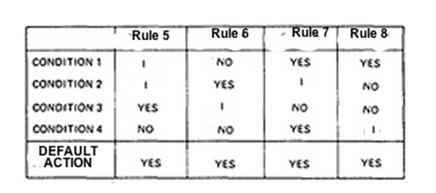
Default rule
In addition to the stated rules, we also need a default rule that specifies the default action to be taken when all other rules fail.

Slide 16
Decision table processors
Decision tables can be automatically translated into code and, as such are a higher-order language
If the rule is satisfied, the corresponding action takes place
Otherwise, rule 2 is tried. This process continues until either a satisfied rule results in an action or no rule is satisfied and the default action is taken
Decision tables have become a useful tool in the programmers kit, in business data processing

Slide 17
Decision tables as basis for test design
The decision tables should be used for test case design when decision table acts as specification.
Decision tables are used as basis for designing test cases when logic of the program is implemented as decision table.
The implementation of decision table can be guaranteed in some cases such as

Slide 18
1. the specifications is given as a decision table or can be easily converted into one.
2. the order in which the predicates are evaluated does not affect interpretation of the rules or the resulting action
3. the order in which rules are evaluated does not affect the resulting action
4. once a rule is satisfied and an action selected, no other rule need to be examined
5. if several actions can result from satisfying a rule, the order in which actions are executed doesn’t matter.

Slide 19
Expansion of Immaterial cases
These are the entries in the decision table in which the condition does not play any role.
It means the condition does not affect the action whether it is either “true” or “false”. It is denoted by “I” in decision table. It doesnt mean that the case is impossible

Slide 20
Example
Rule 1: if the person are male and over 30, then they receive a 15% raise
But if the persons are female, then they shall receive a 10% raise.
The above rules state that the age is a material for male’s raise but immaterial for determining female’s raise.
If there are ‘n’ cases there are 2^{n} cases to consider.

Slide 21
Example
You can find cases by expanding the immaterial cases.
This is done by converting each I entry into a pair of entries, one with a “YES” and the other with a “NO”.
Each I entry in a rule doubles the number of cases in the expansion of that rule

Slide 22
Expansion of immaterial cases for rule 2 &4

Slide 23
Test for consistency and completeness
The specifications are to be tested for consistency if default rules are specified
If default rules are not given then all the cases are explicitly covered and there is no need to check for consistency.
The specifications is said to be complete if ‘n’ conditions are expanded into exactly 2^{n} sub rules
It is consistent if and only if all rules expand into subrules whose condition combinations do not match those of any other rules.

Slide 24
Inconsistent specification

Slide 25
Rules 1 and 2 are contradictory because the expansion of rule 1 via condition 2 leads to the same set of predicate truth values as the expansion of rule 2 via condition 3.
Therefore action 1 or action 2 is taken depending on which rule is evaluated first.
Test Case Design:
Test case design by decision tables begins with examining the specifications consistency and completeness. This is done by expanding all immaterial cases and checking expanded tables.
Also makes the default case explicit and treat it as just another set of rules for the default action.

Slide 26
Once the specifications have been verified, the objective of the test cases is to show that the implementation provides the correct action for all combinations of predicate values.
if there are k rules over n binary predicates, there are at least k cases to consider and at most 2^{n} cases.
It is not usually possible to change the order in which the predicate are evaluated because that order is built into the programs, but if the implementation allows the order to be changed by input values, augment the test cases by using different predicate evaluation orders.
It is not usually possible to change the order in which the rules are evaluated because that order is built into the programs, but if the implementation allows the rule evaluation order to be modified, test different orders for the rules by pairwise interchanges

Slide 27
4. Identify the places in the routine where rules are invoked or where the processors that evaluate the rules are called. Identify the places where actions are initiated.
Decision Tables and Structures:
1. The main purpose of a decision table is to check the structure of a program. It can be represented in the form of a decision tree where, combinations of conditions can lead to executing different actions in order to give expected results.
2. Using this flow graph a decision table is constructed by following the path specified in the decision tree.
3. Every condition has two pairs of truth-values “yes” of “no”.

Slide 28
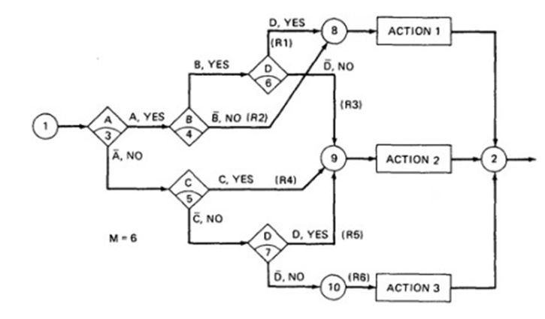
The value “yes” in action specifies that a condition is met and a path is drawn to the respective action. The value “no” specifies that condition is not satisfied and no action is executed.
The value I in condition entry specifies the immaterial test case that indicates the absence of a condition.

Slide 29
If the decision table appears on the path, put in a YES or NO as appropriate.
If the decision doesn't appear on a path, put in an I Rule.
Rule 1 doesn't contain decision C, therefore its entries are YES, YES, I, YES

Slide 30
The Expansion of table
16 cases are represented in table, and no case appears twice. Consequently the flow graph appears are complete and consistent.
Before you look for all 16 combinations, count he number of Y’s and N’s in each row. They should be equal

Slide 31
Another Example – A troublesome Program
consider the following specifications whose flow graph is shown below
IF condition A is met, do process A1 no matter what other actions are taken or what other conditions are met
If condition B is met, do process A2 no matter what other actions are taken or what other conditions are met.
If condition C is met, do process A3 no matter what other actions are taken or what other conditions are met
If none of the conditions is met, then do process A1, A2 and A3.
When more than one process is done, process A1 must be done first, then A2 and then A3. the only permissible cases are : (A1), (A2),(A3),(A1,A3),(A2,A3) and (A1,A2,A3)

Slide 32
A Troublesome Program-Example

Slide 33
Decision table-troublesome program
The following table shows the conversion of this flow graph into a decision table after expansion.
There are eight cases, and all paths lead to the evaluation of all three predicates even though some predicates on some paths may be evaluated more than once.
The programmer tried to force all three processes to be executed for the ABC (bar) cases but forgot that the B and C predicates would be done again, thereby passing processes A2 and A3.

Slide 35
Path Expression
General:
Logic based testing is structural testing when it is applied to structure
It is functional testing when it is applied to a specifications
Predicate: The process whose outcome is a truth value is known as predicate. The predicates are also based on relational operators. They are just not restricted to arithmetic relational operators which inlcude >,>=,=,<,<=,≠

Slide 36
Case statements and multivalued logic
Predicates are not restricted to binary truth values i.e., TRUE/FALSE, there are predicates such as Multiway logic and multivalued logic
Multiway Logic: the predicates which are not having only values at decision are known as multiway predicates.
Example: FORTRAN 3 WAY IF ( 3branches-negative,zero and positive)
Multivalued Logic: Multivalued logic is a propositional calculus in which there are more than two truth values.
For our purpose logic based testing is restricted to binary predicates.

Slide 37
Boolean Algebra
Boolean Algebra is the one which deals with the true and false values of the predicates. The true and false values of the predicates sometimes are indicated as “1” and “0”.
Notations:
Labelled each decision with an uppercase letter that represents the truth value of the predicate. The YES or TRUE branch is labelled with a letter (say A) and the NO or FALSE branch with the same letter overscored (say A¯ )
The truth value of a path is the product of the individual labels. Concatenation or product means “AND” for example, the straight through pair of fig which goes nodes 3,6,7,8,9,10,11,12, and 2 has a truth value of ABC.The path via nodes 3, 6, 7, 9 and 2 has a value of .
If two or more paths merge at a node, the fact is expressed by use of a plus sign (+) which means "OR".

Slide 38
Using this convention, the truth-functional values for several of the nodes can be expressed in terms of segments from previous nodes. Use the node name to identify the point.

Slide 39
There are only two numbers in boolean algebra: zero (0) and one (1). One means "always true" and zero means "always false".

Slide 40
The rules of Boolean Algebra
Boolean algebra mainly uses three operators:
x meaning AND
+ Meaning OR
A¯ meaning NOT
X(AND): the AND operator indicates the concatenation of two predicates . If A and B are two statements, the result A AND B is true when both A and B are TRUE. In all other cases, it is false.
+(OR): either A OR B is true or both
A¯(NOT): also negation or complementation.. This is read as either not A or A bar. If A is true A¯ is false and vice versa

Slide 42
In all of the above, a letter can represent a single sentence or an entire boolean algebra expression.
Terminology:
Individual letters in a boolean algebra expression are called Literals (e.g. A,B)
The product of several literals is called a product term (e.g., ABC, DE).
An arbitrary boolean expression that has been multiplied out so that it consists of the sum of products (e.g., ABC + DEF + GH) is said to be in sum-of-products form.
The result of simplifications (using the rules above) is again in the sum of product form and each product term in such a simplified version is called a prime implicant . The result of simplifications (using the rules above) is again in the sum of product form and each product term in such a simplified version is called a prime implicant

Slide 43
Examples:

Slide 44
Example

Slide 45
KV CHARTS
Introduction:
If you had to deal with expressions in four, five, or six variables, you could get bogged down in the algebra and make as many errors in designing test cases as there are bugs in the routine you're testing.
Karnaugh-Veitch chart reduces boolean algebraic manipulations to graphical trivia.
Beyond six variables these diagrams get cumbersome and may not be effective.

Slide 46
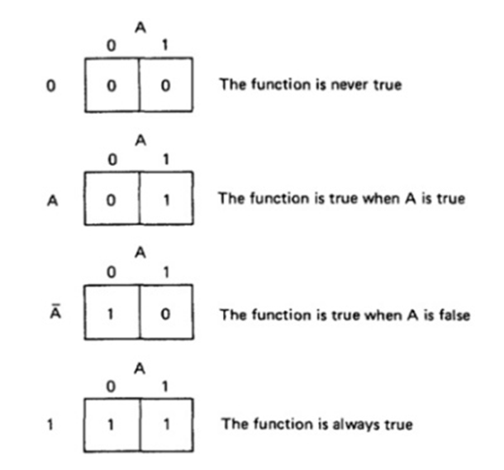
Single Variable
shows all the boolean functions of a single variable and their equivalent representation as a KV chart.

Slide 47
Single Variable
The charts show all possible truth values that the variable A can have.
A "1" means the variable’s value is "1" or TRUE. A "0" means that the variable's value is 0 or FALSE.
The entry in the box (0 or 1) specifies whether the function that the chart represents is true or false for that value of the variable.
We usually do not explicitly put in 0 entries but specify only the conditions under which the function is true.

Slide 48
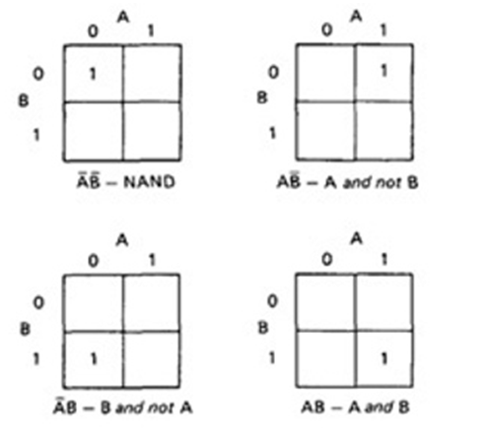
Two variables
The following shows eight of the sixteen possible functions of two variables.

Slide 49
KV Charts for Functions of Two Variables.

Slide 50
Each box corresponds to the combination of values of the variables for the row and column of that box.
A pair may be adjacent either horizontally or vertically but not diagonally.
Any variable that changes in either the horizontal or vertical direction does not appear in the expression.
In the fifth chart, the B variable changes from 0 to 1 going down the column, and because the A variable's value for the column is 1, the chart is equivalent to a simple A.

Slide 51
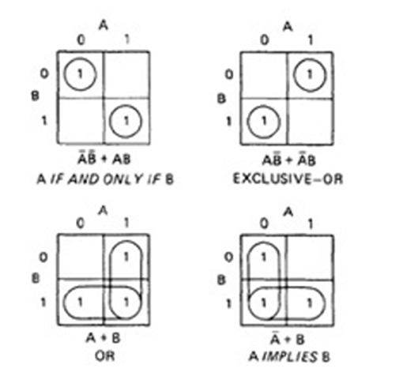
The following figure shows the remaining eight functions of two variables.

Slide 53
Two variables
The first chart has two 1's in it, but because they are not adjacent, each must be taken separately.
They are written using a plus sign.
It is clear now why there are sixteen functions of two variables.
Each box in the KV chart corresponds to a combination of the variables' values.
That combination might or might not be in the function (i.e., the box corresponding to that combination might have a 1 or 0 entry).
Since n variables lead to 2^{n} combinations of 0 and 1 for the variables, and each such combination (box) can be filled or not filled, leading to 2^{2n} ways of doing this.

Slide 54
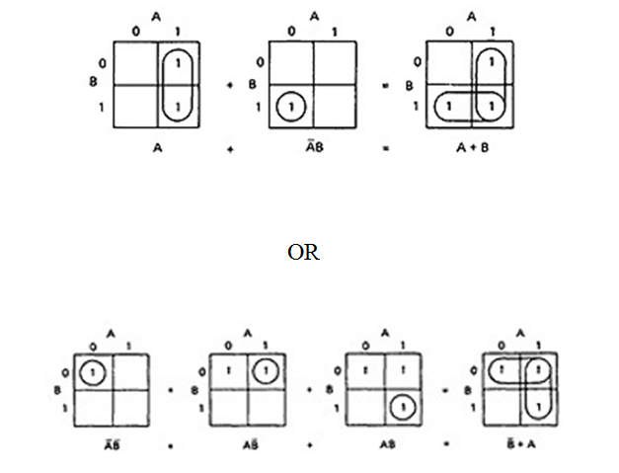
Consequently for one variable there are 2²¹ = 4 functions, 16 functions of 2 variables, 256 functions of 3 variables, 16,384 functions of 4 variables, and so on.
Given two charts over the same variables, arranged the same way, their product is the term by term product, their sum is the term by term sum, and the negation of a chart is gotten by reversing all the 0 and 1 entries in the chart.

Slide 55
Three Variables
KV charts for three variables are shown below.
As before, each box represents an elementary term of three variables with a bar appearing or not appearing according to whether the row-column heading for that box is 0 or 1.
A three-variable chart can have groupings of 1, 2, 4, and 8 boxes.
A few examples will illustrate the principles:

Slide 56
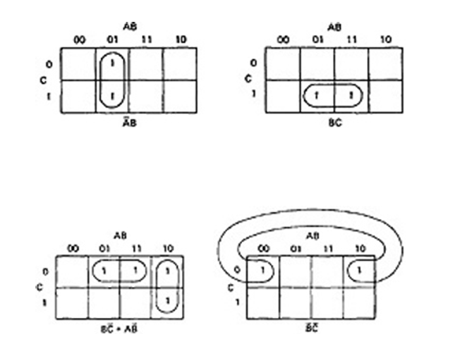

Slide 58
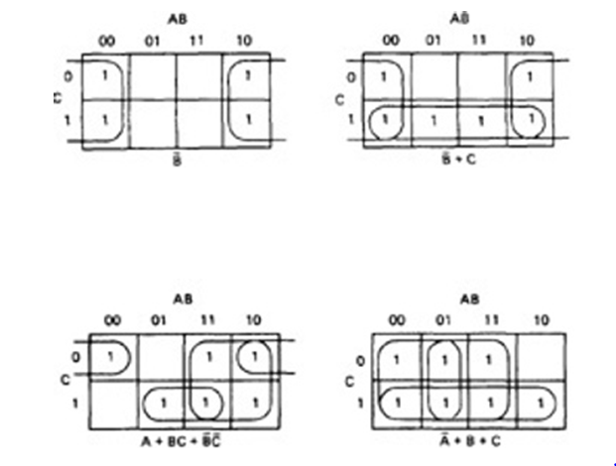

Slide 59
Four variables and more
A four variable chart and several possible adjacencies are shown below. Adjacencies can now consist of 1,2,4,8 and 16 boxes, and the terms resulting will have 4,3,2,1 and 0 literals in them respectively

Slide 61
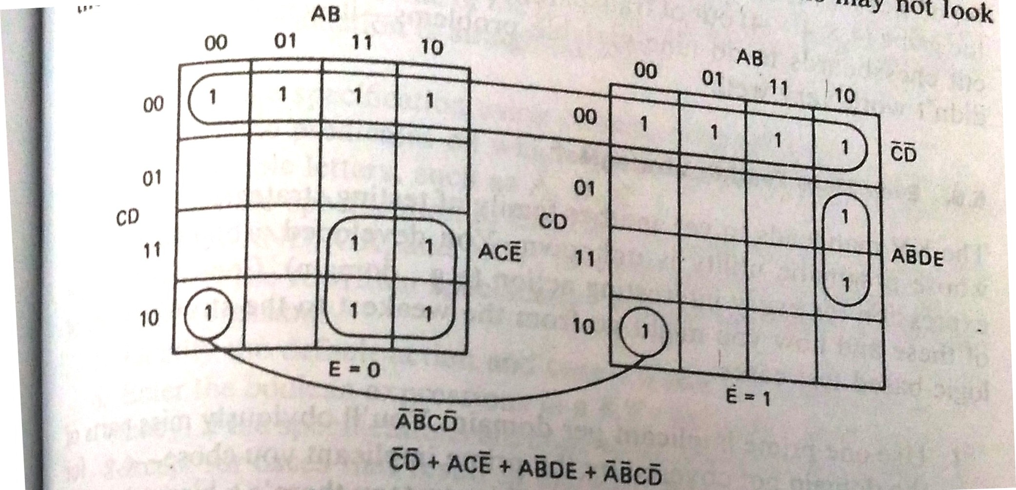
As with three variable charts, the way you can group adjacent entries to cover all the 1s in the chart is not unique, but all such ways are equivalent, even though the resulting boolean expressions may not look the same

Slide 63
Specifications
There is no point in getting into design and coding until you are sure that the specifications is logically consistent and complete. Specification analysis can be done using KV charts
The procedure for specification validation is:
Rewrite the specifications using consistent terminology
Identify the predicates on which the cases are based. Name them with suitable letters such as A,B,C.
Rewrite the specifications in english that uses only the logical connectives AND,OR and NOT.
Convert the rewritten specification into an equivalent set of boolean expressions.

Slide 64
Specifications contd..
Identify the default action and cases, if they are specified.
Enter the boolean expression in a KV chart and check for consistency.
Enter the default cases and check for consistency
If all boxes are covered, the specification is complete.
If the specification is incomplete or inconsistent, translate the corresponding boxes of the KV chart into english and get a clarification, explanation, or revision.
If the default cases were not specified explicitly, translate the default cases back into english and get a confirmation.

Slide 65
Finding and Translating the Logic
The specifications are coasted into sentences by using the following IF-THEN format
“If a predicate THEN action”
The predicates are written using the boolean connectivities such as AND,OR and NOT. Therefore the problems should be one of finding the keywords IF, THEN, AND, OR and NOT.
Sometimes we have to deal with the real world of specifications and specification writers, where clarity varies. Here is a sample of phrases that can be used for the words we need

Slide 66
IF – based on, based upon, because, but, if, if and when, only if, only, when, provided that, when, when or if, whenever.
THEN – applies to, assign, consequently, do , implies that, infers that, initiate, means that, shall, should, then , will, would
AND – all, and, as well as, both, but, in conjunction with, coincidental with, consisting of, comprising, either..or, furthere more, in addition to,, including, jointly, moreover, mutually, plus, together with, total, with
OR – and, and if..then, alternatively, any of, anyone of, as well as, but, case, contrast, depending upon, each, either, either..or, except if, conversely,, failing that, furthermore, in addition to, nor, not only.. But, although, other than, otherwise, or , or else, on the other hand, plus

Slide 67
NOT – but, but not, by, contrast, besides, contrary, conversely, contrast, except if, excluding, excepting, fail, failing, less, neither, never, no, not, other than
EXCLUSIVE OR – but, by contrast, conversely,not, on the ther hand, other than, or
IMMATERIAL – independent of, irregardless, irrespective, irrelevant, regardless, but not if, whether or not

