Slide 1

DIGITAL COMMUNICATION
Unit-III: Signal Space Analysis
Dr.Y. Mallikarjuna Rao _{M.Tech, Ph.D}
Assistant Professor & HOD
Electronics & Communication Engineering
Santhiram Engineering College, Nandyal, A.P
Email: hod.ece@srecnandyal.edu.in

Slide 2
Syllabus
Geometric representation of signals
Gram-Schmidt orthogonalization procedure
Response of bank of correlators to noisy input
Coherent detection of signals in noise - maximum likelihood decoder
Probability of error
Correlation receiver
detection of signals with unknown phase

Slide 3
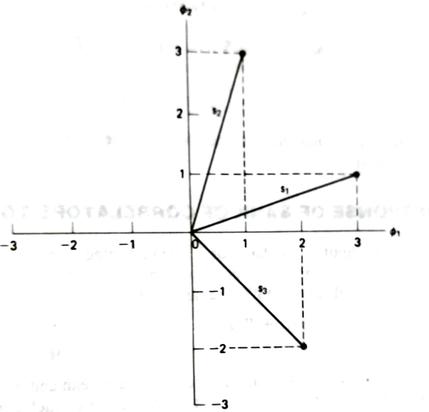
Geometric representation of signals
Figure : Geometric representation of signals for the case when N=2 and M=3

Slide 6
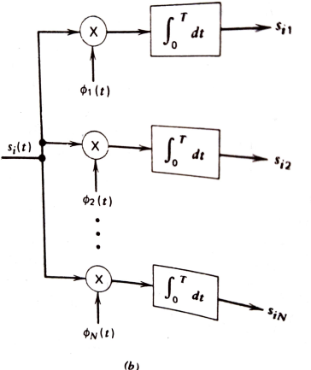
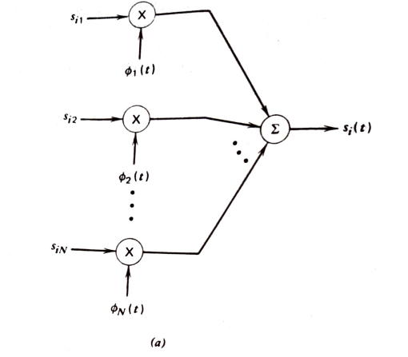
Gram-Schmidt orthogonalization procedure
Figure: a) scheme for generating the signal s(t) b) scheme for generating the set of coefficients{s_{i}}

Slide 10
Response of bank of correlators to noisy input
Suppose that the input to the bank of N product integrators or correlators is not transmitted signal si(t) but rather the recevied process X(t) of the idealized AWGN channel is

Slide 15
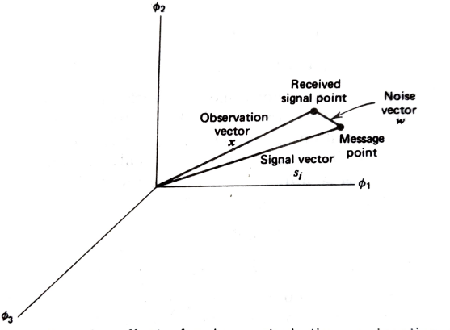
Coherent detection of signals in noise - maximum likelihood decoder
Figure: illustrating the effect of noise perturbation on location of the received signal point

Slide 19
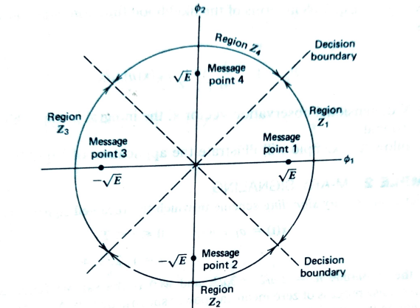
Figure: illustrating partitioning of the observation space into decision regions for the case when N=2 and M=4

Slide 20
Probability of error

Slide 21
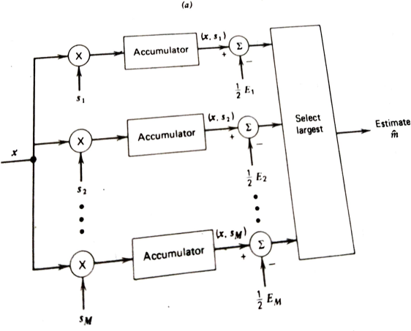
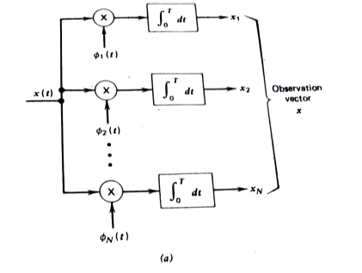
Correlation receiver
Figure a)Detector b) vector receiver

Slide 22
Detection of signals with unknown phase

Slide 24
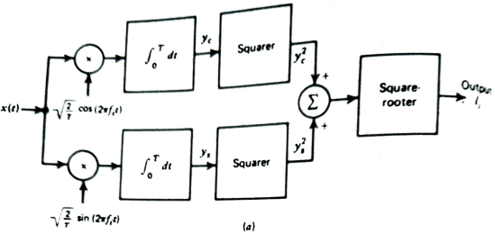
Figure a : Quadrature receiver using correlators

Slide 25
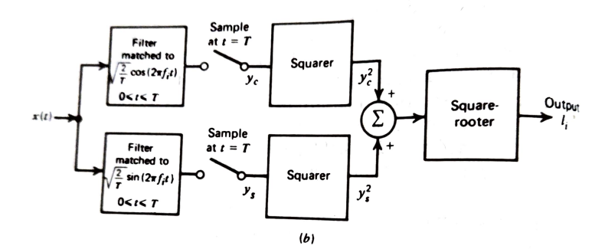
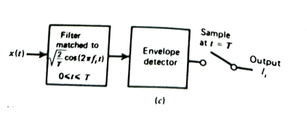
Figure c: non coherent matched filters
Figure b : Quadrature receiver using Matched filters

Slide 26
Thank You

