Slide 1
MIMO-OFDM (PART-1)
Dr.Y.Mallikarjuna Rao M.Tech., Ph.D
Professor & Head of ECE
Santhiram Engineering College
hod.ece@srecnandyal.edu.in

Slide 2
Outline of the Presentation(PART -A)
Introduction to MIMO-OFDM
Impact of carrier frequency offset in OFDM
PAPR in OFDM SYSTEMS
Introduction to SC-FDMA
A Presentation to NAAC Peer Team Dr.Y.Mallikarjuna Rao 08-04-2022

Slide 3
MIMO-OFDM
INTRODUCTION TO MIMO-OFDM :
MIMO-OFDM is a combination of the Multiple-Input Multiple-Output (MIMO) wireless technology with that of OFDM, to further increase the rate in broadband multi-antenna wireless systems. Similar to OFDM, MIMO-OFDM converts a frequency-selective MIMO channel into multiple parallel flat fading MIMO channels. The frequency-selective SISO channel is modeled as an FIR channel filter, with the output $y\left(n\right)$at time instant n given as
$$y\left(n\right)=\sum_{l=0}^{L−1}{h\left(l\right)x\left(n−l\right)+w(n)}$$
$$=h\left(0\right)x\left(n\right)+\underset{ISI from prvious symbols}{\underbrace{h\left(l\right)x\left(n−l\right)+…+h\left(L−1\right)x\left(n−L+1\right)+}}w\left(n\right)$$
Hence, a MIMO frequency-selective channel can be modeled as a MIMO FIR filter, which can be described as
$$y\left(n\right)=\sum_{l=0}^{L−1}{H\left(l\right)x\left(n−l\right)+w(n)}$$
$$H\left(0\right)x\left(n\right)+\underset{ISI from prvious symbol vector}{\underbrace{H\left(l\right)x\left(n−l\right)+…+H\left(L−1\right)x\left(n−L+1\right)+}}w\left(n\right)$$
MIMO-OFDM Dr.Y.Mallikarjuna Rao 01-04-2023 01/33

Slide 4
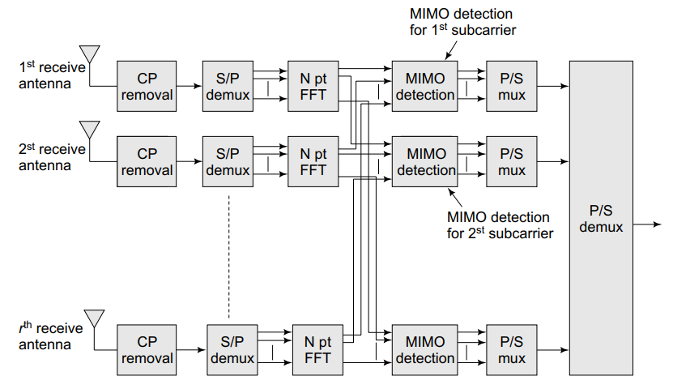
MIMO-OFDM
FIGURE 1: MIMO OFDM TRANSMITTER SCHEMATIC
FIGURE 2: MIMO-OFDM RECEIVER SCHEMATIC
MIMO-OFDM Dr.Y.Mallikarjuna Rao 01-04-2023 02/33

Slide 5
MIMO-OFDM
Therefore, the symbol vector y (n) at the time instant n is affected by inter-symbol vector interference from$x\left(n−1\right),x\left(n−2\right),…x\left(n−L+1\right)$. This is an L-tap frequency-selective MIMO channel.
The schematic figures showing clearly the processing at the transmitter and receiver of the MIMO-OFDM system are shown in figures 1 and 2respectively. Hence, employing MIMO-OFDM, the MIMO frequency-selective channel can be converted into a set of parallel flat-fading MIMO channels. These can be described as,
$$\begin{matrix}\tilde{y}\left(0\right)=\tilde{H}\left(0\right)\tilde{x}\left(0\right) \\ \begin{matrix}\tilde{y}\left(1\right)=\tilde{H}\left(1\right)\tilde{x}\left(1\right) \\ ⋮ \\ \tilde{y}\left(N−1\right)=\tilde{H}\left(N−1\right)\tilde{x}\left(N−1\right)\end{matrix}\end{matrix}$$
The model across the $k^{th}$subcarrier is$\tilde{ y}\left(k\right)=\tilde{H}\left(k\right)\tilde{x}\left(k\right)$where $\tilde{y}\left(k\right)$and $\tilde{x}\left(k\right)$are the received and transmitted symbol vectors corresponding to the $k^{th}$subcarrier, and $\tilde{H}\left(k\right)$is the flat-fading channel matrix corresponding to the subcarrier k.
The zero-forcing MIMO receiver is given as
$$\tilde{\hat{x_{ZF}}}\left(k\right)={\left(\tilde{H}\left(k\right)\right)}^{−1}\tilde{y}\left(k\right)={\left({\tilde{H}}^{H}(k)\tilde{H}\left(k\right)\right)}^{−1}{\tilde{H}}^{H}\left(k\right)\tilde{y}\left(k\right)$$
MIMO-OFDM Dr.Y.Mallikarjuna Rao 01-04-2023 03/33

Slide 6
MIMO-OFDM
Also, the MMSE receiver for the subcarrier k of the MIMO-OFDM system is given as
$$\tilde{\hat{x_{MMSE}}}\left(k\right)={\left(\tilde{H}\left(k\right)\right)}^{−1}\tilde{y}\left(k\right)$$
$${data power (P}_{d})={\left(P_{d}{\tilde{H}}^{H}\left(k\right)\tilde{H}\left(k\right)+{σ_{w}}_{}^{2}I\right)}^{−1}{\tilde{H}}^{H}\left(k\right)\tilde{y}\left(k\right)$$
The channel matrices $\tilde{H}\left(0\right),\tilde{H}\left(1\right),…\tilde{H}\left(N−1\right)$corresponding to the OFDM subcarriers are given as follows. Let $h_{u,v}\left(k\right),\tilde{h_{u,v}}\left(k\right)$ denote the ${\left(u,v\right)}^{th}$entries of the matrices $H\left(k\right),\tilde{H}\left(k\right)$respectively. Then, $\tilde{h_{u,v}}\left(k\right)$is given as the N-point DFT of the zero-padded coefficients
$$h_{u,v}\left(0\right),h_{u,v}\left(1\right),…h_{u,v}\left(L−1\right),\underset{\left(N−L\right)}{\underbrace{0,…0}}$$
In effect, the channel matrix $\tilde{H}\left(k\right)$is the $k^{th}$frequency point corresponding to the FFT of the zero padded channel matrices$\left[\tilde{H}\left(0\right),\tilde{H}\left(1\right),…\tilde{H}\left(N−1\right),0_{r×t},…,0_{r×t}\right]$.
MIMO-OFDM Dr.Y.Mallikarjuna Rao 01-04-2023 04/33

Slide 7
MIMO-OFDM
IMPACT OF FREQUENCY OFFSET IN OFDM:
In this section, we characterize the effect of frequency offset on the performance of the OFDM system. Consider a frequency offset $∆f$such that
$$∈=\frac{∆f}{B/N}$$
Where $∈$denotes the normalized frequency offset, normalized with respect to the subcarrier bandwidth B/N. Corresponding to the frequency offset , the baseband received samples $y\left(n\right)$are given as
$$y\left(n\right)=\frac{1}{N}\sum_{k=−\frac{N}{2}}^{\frac{N}{2}}{X\left(k\right)H\left(k\right)e^{j2πn\frac{k+∈}{N}}}+w\left(n\right)−−−1$$
To verify the above equation, set $∈$= 0. The above equation then reduces to
$$y\left(n\right)=\frac{1}{N}\sum_{k=−\frac{N}{2}}^{\frac{N}{2}}{X\left(k\right)H\left(k\right)e^{j2πn\frac{k}{N}}}+w\left(n\right)$$
MIMO-OFDM Dr.Y.Mallikarjuna Rao 01-04-2023 05/33

Slide 8
MIMO-OFDM
Performing now the FFT of $y\left(0\right),y\left(1\right)…y\left(N−1\right)$at the receiver,$Y\left(l\right)$, which corresponds to the symbol received on the $l^{th}$subcarrier, is given as
$$Y\left(l\right)=\frac{1}{N}\sum_{n}{y\left(n\right)e^{−j2π\frac{nl}{N}}}$$
$$=\frac{1}{N}\sum_{N}{\sum_{k=−\frac{N}{2}}^{\frac{N}{2}}{X\left(k\right)H\left(k\right)e^{j2π\frac{k}{N}}}}e^{−j2π\frac{nl}{N}}+\underset{W\left(l\right)}{\underbrace{\frac{1}{N}\sum_{n}{w\left(n\right)}}}e^{−j2π\frac{nl}{N}}$$
$$=\frac{1}{N}\sum_{N}{\sum_{k=−\frac{N}{2}}^{\frac{N}{2}}{X\left(k\right)H\left(k\right)}}e^{j2πn\frac{k−l}{N}}+W\left(l\right)$$
$$=X\left(k\right)H\left(k\right)+\frac{1}{N}\sum_{k=−\frac{N}{2},k≠l}^{\frac{N}{2}}{X\left(k\right)H\left(k\right)}\underset{0}{\underbrace{\left(\sum_{n}{e^{j2πn\frac{k−l}{n}}}\right)}}+W\left(l\right)=X\left(l\right)H\left(l\right)+W\left(l\right)$$
MIMO-OFDM Dr.Y.Mallikarjuna Rao 01-04-2023 06/33

Slide 9
MIMO-OFDM
where we have used the fact that $\sum_{n}{e^{j2πn\frac{k−l}{N}}}$ if$k≠l$. Thus, in the absence of a carrier-frequency offset, i.e., = 0, the system in Eq. (1) reduces to the earlier flat-fading OFDM system across each subcarrier, i.e.,
$$Y\left(l\right)=X\left(l\right)H\left(l\right)+W\left(l\right)$$
Now consider the received symbols $y\left(n\right)$in the presence of a carrier-frequency offset
$$\left(n\right)=\frac{1}{N}\sum_{k=−\frac{N}{2}}^{\frac{N}{2}}{X\left(k\right)H\left(k\right)e^{j2πn\frac{k}{N}}}+w\left(n\right)$$
Therefore, the demodulated symbol $Y\left(l\right)$in the presence of a carrier-frequency offset is given as
$$Y\left(l\right)=\frac{1}{N}\sum_{n}{y\left(n\right)e^{−j2π\frac{nl}{N}}}=\frac{1}{N}\sum_{N}{\sum_{k=−\frac{N}{2}}^{\frac{N}{2}}{X\left(k\right)H\left(k\right)}}e^{j2πn\frac{k−l+∈}{N}}+\underset{W\left(l\right)}{\underbrace{\frac{1}{N}\sum_{n}{w\left(n\right)}}}e^{−j2π\frac{nl}{N}}$$
$$=\frac{1}{N}\sum_{n}{X\left(l\right)H\left(l\right)}e^{−j2π\frac{∈}{N}}+\frac{1}{N}\sum_{k=−\frac{N}{2},k≠l}^{\frac{N}{2}}{X\left(k\right)H\left(k\right)}e^{j2πn\frac{k−l+∈}{N}}+W\left(l\right)=X\left(l\right)H\left(l\right)+W\left(l\right)$$
MIMO-OFDM Dr.Y.Mallikarjuna Rao 01-04-2023 07/33

Slide 10
MIMO-OFDM
To simplify the above expression, we will use the result below
$$\sum_{n=0}^{N−1}{e^{jθn}=\frac{\sin\left(\frac{Nθ}{2}\right)}{\sin\left(\frac{θ}{2}\right)}e^{j\overline{Φ}}}$$
where$e^{j\overline{Φ}}$is a phase factor, which does not affect the power at the output. Using the relation above, the expression for $Y\left(l\right)$ can be simplified as
$$Y\left(l\right)=\underset{desired signal }{\underbrace{H\left(l\right)X\left(l\right)\frac{\sin\left(π∈\right)}{\sin\left(\frac{π∈}{N}\right)}}}+\underset{inter carrier interference I_{l}}{\underbrace{\sum_{k=−\frac{N}{2},k≠l}^{\frac{N}{2}}{\left(\frac{\sin\left(π∈\right)}{N\sin\left(\left(π\frac{l−k+∈}{N}\right)\right)}\right)}}e^{j\overline{Φ}kl}}+W\left(l\right)$$
The SINR is given as
$$SINR=\frac{Signal powwer }{Interference+Noise Power}=\frac{Signal power}{E\left\{{\left|I_{l}\right|}^{2}\right\}+{σ_{n}}_{}^{2}}$$
MIMO-OFDM Dr.Y.Mallikarjuna Rao 01-04-2023 08/33

Slide 11
MIMO-OFDM
The desired signal power can be calculated as
$$signal power=E\left\{{\left|H\left(l\right)\right|}^{2}\right\}E\left\{{\left|X\left(l\right)\right|}^{2}\right\}{\left(\frac{\sin\left(π∈\right)}{N sin{\frac{π∈}{N}}}\right)}^{2}$$
For a large value of N, i.e., number of subcarriers, we have
$$\lim_{N→∞}{\sin\left(\frac{π∈}{N}\right)≈\frac{π∈}{N}}$$
$$⇒N\sin{\frac{π∈}{N}→N\frac{π∈}{N}=π∈}$$
Hence, the signal power for a large number of subcarriers N is given as
$$Signal power=E\left\{{\left|H\left(l\right)\right|}^{2}\right\}P{\left(\frac{\sin\left(π∈\right)}{π∈}\right)}^{2}$$
where $P=E\left\{{\left|X\left(l\right)\right|}^{2}\right\}$is the power of the transmitted data symbols and ${\left|H\right|}^{2}=E\left\{{\left|H\left(l\right)\right|}^{2}\right\}$ denotes the average channel-power gain across each subcarrier. The interference power is given as,
$$E\left\{{\left|I_{l}\right|}^{2}\right\}=E\left\{{\left|H\left(l\right)\right|}^{2}\right\}E\left\{{\left|X\left(l\right)\right|}^{2}\right\}\sum_{k=−\frac{N}{2},k≠l}^{\frac{N}{2}}{{\left(\frac{\sin\left(π∈\right)}{N\sin\left(π\frac{l−k+∈}{N}\right)}\right)}^{2}}$$
MIMO-OFDM Dr.Y.Mallikarjuna Rao 01-04-2023 09/33

Slide 12
MIMO-OFDM
Setting k − l = u and letting N → ∞, we have
$$E\left\{{\left|I_{l}\right|}^{2}\right\}=P{\left|H\right|}^{2}\sum_{u=−∞,u≠0}^{∞}{{\left(\frac{\sin{π∈}}{ N\sin{π\frac{u}{N}}}\right)}^{2}}=P{\left|H\right|}^{2}{\left(\sin{π∈}\right)}^{2}\sum_{u=−∞,u≠0}^{∞}{{\left(\frac{1}{ N\sin{π\frac{u}{N}}}\right)}^{2}}$$
Employing the inequality$\sin{θ≥\frac{2θ}{π}}$, we have
$$\sin{\frac{πu}{N}≥\frac{{2πu}/N}{π}=\frac{2u}{N}}$$
$$⇒N\sin{\frac{πu}{N}≥2u−−−2}$$
The interference power $E\left\{{\left|I_{l}\right|}^{2}\right\}$can, therefore, be approximated as
$$E\left\{{\left|I_{l}\right|}^{2}\right\}≤P{\left|H\right|}^{2}{\left(\sin{π∈}\right)}^{2}\sum_{u=−∞,u≠0}^{∞}{{\left(\frac{1}{2u}\right)}^{2}}$$
$$P{\left|H\right|}^{2}2{\left(sinπ∈\right)}^{2}\sum_{u=1}^{∞}{{\left(\frac{1}{2u}\right)}^{2}}$$
MIMO-OFDM Dr.Y.Mallikarjuna Rao 01-04-2023 10/33

Slide 13
MIMO-OFDM
$$E\left\{{\left|I_{l}\right|}^{2}\right\}=\frac{π^{2}}{12}P{\left|H\right|}^{2}\sin^{2}π∈=0.822P{\left|H\right|}^{2}\sin^{2}π∈$$
Hence, the SINR in the presence of carrier-frequency offset of is given as
$$SINR=\frac{p{\left|H\right|}^{2}{\left(\frac{\sin{π∈}}{π∈}\right)}^{2}}{0.822P{\left|H\right|}^{2}\sin^{2}π∈+{σ_{n}}_{}^{2} }−−−−3$$
OFDM–PEAK-TO-AVERAGE POWER RATIO (PAPR) :
The Peak-to-Average Power Ratio (PAPR) is a critical problem in OFDM systems, which needs to be handled effectively in order to limit the distortion at the receiver
Consider a non-OFDM or single-carrier system with BPSK modulated symbols. For example, let the symbol stream $x\left(0\right),x\left(1\right),x\left(2\right),…$be given as +a, −a, +a, . . . and so on.
The power in each symbol equals${ a}^{2}$. Further, also observe that this is the peak power at any given instant of time. Therefore, we have
$$Peak power=Average power=E\left\{{\left|x\left(k\right)\right|}^{2}\right\}=a^{2}$$
MIMO-OFDM Dr.Y.Mallikarjuna Rao 01-04-2023 11/33

Slide 14
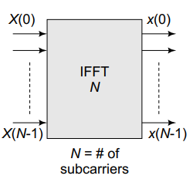
MIMO-OFDM
Thus, since the peak and average power are equal, the peak-to-average power ratio, or PAPR, is given as
$$PAPR=\frac{peak power}{Average powwer}=\frac{a^{2}}{a^{2}}=1=0dB$$
Now, consider an OFDM system in which the different information symbols$X\left(0\right),X\left(1\right),X\left(2\right),…$given by +a, −a, +a, . . .for instance, are loaded onto the subcarriers, which is illustrated from figure 3
The actual samples transmitted over the wireless channel are$x\left(0\right),x\left(1\right)x\left(2\right)…x\left(N−1\right)$, which are the IFFT samples of the information symbols $X\left(0\right),X\left(1\right)x\left(2\right)…X\left(N−1\right)$
Consider the $k^{th }$IFFT sample $x\left(k\right)$given as
$$x\left(k\right)=\frac{1}{N}\sum_{i=o}^{N−1}{{\underset{information symbols}{\underbrace{X\left(i\right)}}e}^{j2π\frac{ki}{N}}}$$
The average power in the symbols is given as
$$Average power=E\left\{{\left|x\left(k\right)\right|}^{2}\right\}=\frac{1}{N}\sum_{i=0}^{N−1}{E\left\{{\left|X\left(i\right)\right|}^{2}\right\}}E\left\{{\left|e^{j2π\frac{ki}{N}}\right|}^{2}\right\}=\frac{a^{2}}{N}$$
FIGURE 3: OFDM SUBCARRIER LOADING
MIMO-OFDM Dr.Y.Mallikarjuna Rao 01-04-2023 12/33

Slide 15
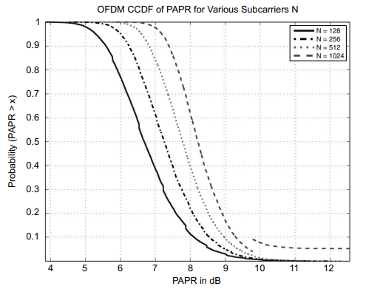
MIMO-OFDM
Observe that the peak of the OFDM sample arises for all symbols $X\left(i\right)=+a$or$X\left(i\right)=−a$. This can be verified as follows.
$$\left|x\left(k\right)\right|=\left|\frac{1}{N}\sum_{i=0}^{N−1}{X\left(i\right)e^{j2π\frac{ki}{N}}}\right|=\frac{1}{N}\sum_{i=0}^{N−1}{\underset{a}{\underbrace{\left|X\left(i\right)\right|}}}\underset{1}{\underbrace{\left|e^{j2π\frac{ki}{N}}\right|}}=\frac{1}{N}\sum_{i=0}^{N−1}{a}=a$$
Therefore, the peak power is given as${ a}^{2}$. Hence, the peak-to-average power ratio in an OFDM system is given as
$$OFDM PAPR=\frac{a^{2}}{{a^{2}}/N}$$
From the above expression, it can be seen that the peak-to-average power ratio in an OFDM system is N, which is significantly higher compared to that of the single-carrier system, which is 1. Further, interestingly, this PAPR rises with N, i.e., the number of subcarriers.
The data symbols across the subcarriers can add up to produce a high peak valued signal as seen above. For instance, in an OFDM system with 512 subcarriers and BPSK modulation, the PAPR at the output can be as high as 10 dB.
FIGURE 4: OFDM PAPR FOR VARIOUS NUMBER OF SUBCARRIERS N
MIMO-OFDM Dr.Y.Mallikarjuna Rao 01-04-2023 13/33

Slide 16
MIMO-OFDM
The PAPR of an OFDM system is characterized using the CCDF, i.e., the complementary cumulative distribution function. The CCDF $\overline{F_{X}}\left(x\right)$of a random variable X is given as the probability that X > x, expressed as
$$\overline{F_{X}}\left(x\right)=Pr\left(X>x\right)$$
Naturally, the CCDF is related to the CDF, i.e., cumulative distribution function $F_{X}\left(x\right)of X$as
$$F_{X}\left(x\right)=Pr\left(X≤x\right)=1−Pr\left(X>x\right)=1−F_{X}\left(x\right)$$
The impact of PAPR on the OFDM system hardware can be understood as follows. Every communication system has a receiver amplifier, which serves to amplify the amplitude of the receive signal, in order to boost its strength
Typically, the amplifier operates around a bias point, as shown in Figure 5, which is roughly around the average power of the signal. As long as the signal amplitude is restricted to the dynamic range of the amplifier around this bias point, for which the amplifier characteristic is linear, there is no non-linear distortion at the output.
MIMO-OFDM Dr.Y.Mallikarjuna Rao 01-04-2023 14/33

Slide 17
MIMO-OFDM
However, in the case of OFDM, since the peak power deviates significantly from the average power, there is a high chance that the signal crosses into the voltage region outside the dynamic range of the amplifier, thus resulting in a non-linear distortion of the received signal.
The net result is a poor decoding performance and a rise in the bit-error rate. A slightly modified OFDM technique, which can significantly reduce the PAPR, is SC-FDMA, which is described next.
FIGURE 5: NONLINEAR AMPLIFIER CHARACTERISTIC
MIMO-OFDM Dr.Y.Mallikarjuna Rao 01-04-2023 15/33

Slide 18
MIMO-OFDM
INTRODUCTION TO SC-FDMA:
SC-FDMA, which stands for Single-Carrier Frequency Division for Multiple Access, can be employed to reduce the peak-to-average power ratio in an OFDM system. Consider the following hypothetical modification of the OFDM transmitter, shown in Figure 6 by the insertion of an N-point FFT block before the N-point IFFT block.
It can then be seen that the FFT and the IFFT cancel the effect of each other and the net output is the exact input symbol stream, i.e., corresponding to a single-carrier system which drastically reduces the PAPR, since, as seen previously, the PAPR of a single-carrier system is 0 dB.
FIGURE 6: HYPOTHETICAL MODIFICATION OF OFDM TRANSMITTER
MIMO-OFDM Dr.Y.Mallikarjuna Rao 01-04-2023 16/33

Slide 19
MIMO-OFDM
FIGURE 7: SC-FDMA TRANSMITTER SCHEMATIC
However, instead of using an N-point FFT, one can use an M-point FFT, where M < N, to reduce the PAPR, while still retaining the properties of the OFDM system.
This proposed SC-FDMA schematic is shown in Figure 7. Hence, introduction of the M-point FFT in SC-FDMA significantly reduces the PAPR of the system. This is the central principle of SC-FDMA
MIMO-OFDM Dr.Y.Mallikarjuna Rao 01-04-2023 17/33

Slide 20
MIMO-OFDM
SC-FDMA RECEIVER :
The SC-FDMA receiver incorporates two new blocks compared to the OFDM receiver. The purpose of these additional blocks can be described as follows:
After the n-point FFT operation at the receiver, the signals are equalized across all the sub-carries, to remove the effect of the fading-channel coefficient across the subcarriers.
They are de-mapped from the subcarriers, which are n in number, to the original FFT block size of m. Finally, the m-point FFT is performed on these samples to generate the symbol stream from the above operation.
FIGURE 8: SC-FDMA RECEIVER SCHEMATIC
MIMO-OFDM Dr.Y.Mallikarjuna Rao 01-04-2023 18/33

Slide 21
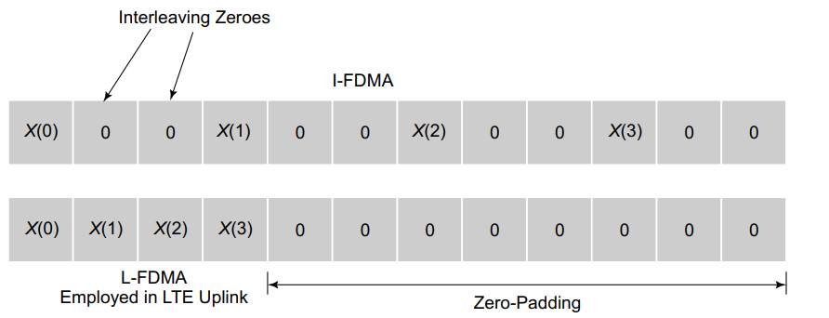
MIMO-OFDM
SUBCARRIER MAPPING IN SC-FDMA:
FIGURE 9: SC-FDMA VARIOUS SUBCARRIER MAPPING SCHEMES
Subcarrier mapping, in which the M samples at the output of the m-point FFT are mapped to the N subcarriers, is a key operation in SC-FDMA, a block representation of which can be seen in the SC-FDMA transmitter schematic in figure 7.
The various possible SC-FDMA subcarrier mappings are illustrated through the following example.
MIMO-OFDM Dr.Y.Mallikarjuna Rao 01-04-2023 19/33

Slide 22
MIMO-OFDM
Consider $M=4$SC-FDMA symbols and $N=12$subcarriers. Let $x\left(0\right),x\left(1\right),x\left(2\right),x\left(3\right)$denote the symbols and $X\left(0\right),X\left(1\right),X\left(2\right),X\left(3\right)$denote the corresponding M = 4-point FFT samples which are to be loaded onto the subcarriers
Let the number of subcarriers be N = 12. In Interleaved FDMA (IFDMA) shown in Figure, the samples $X\left(i\right)$are interleaved with zeros.
In LFDMA, which is also employed in the uplink of the 4G mobile standard LTE, the samples are loaded as a block onto the subcarriers, with appropriate zero padding. This is shown in Figure 9. Post this subcarrier mapping, the rest of the procedure prior to transmission proceeds as shown in the SC-FDMA transmitter block
MIMO-OFDM Dr.Y.Mallikarjuna Rao 01-04-2023 20/33

Slide 23
Outline of the Presentation(PART -B)
WCDMA
LTE/LTE Advanced
WiMAX
A Presentation to NAAC Peer Team Dr.Y.Mallikarjuna Rao 08-04-2022

Slide 24
WCDMA
WCDMA Uplink Frame Structure :
data channel
DPDCH
sync & control
Pilot:
TFCI
FBI
TCP
DPCCH
Slot 0
Slot 1
I
Slot i
Slot14
I
radio frame = 10 ms
TFCI = transmit format combination indicator
FBI = feedback information
TPC = transmit power control
DPDCH = dedicated physical data channel
DPCCH = dedicated physical control channel
MIMO-OFDM Dr.Y.Mallikarjuna Rao 01-04-2023 21/33

Slide 25
WCDMA
TRANSMIT DIVERSITY STRATEGY FOR DOWNLINK
MIMO-OFDM Dr.Y.Mallikarjuna Rao 01-04-2023 22/33

Slide 26
WCDMA
WCDMA DOWNLINK MODULATOR STRUCTURE:
dedicated
traffic channels
primary &
secondary
common pilot
channels
primary &
secondary
common
control
channels
other channels
s/p
s/p
pulse shape
filter (SRC)
sum
Primary
Sync Code
Secondary
Sync Code
MIMO-OFDM Dr.Y.Mallikarjuna Rao 01-04-2023 23/33

Slide 27
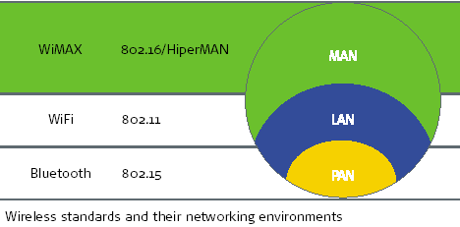
Wi-MAX
Goal: Provide high-speed Internet access to home and business subscribers, without wires.
Base stations (BS) and subscriber stations (SS)
Centralized access control to prevents collisions
Supports applications with different QoS requirements
WiMAX is a subset of IEEE 802.16 standard
MIMO-OFDM Dr.Y.Mallikarjuna Rao 01-04-2023 24/33

Slide 28
WiMAX
MIMO-OFDM Dr.Y.Mallikarjuna Rao 01-04-2023 25/33

Slide 29
WiMAX
MIMO-OFDM Dr.Y.Mallikarjuna Rao 01-04-2023 26/33

Slide 30
LTE/LTE Advanced
LONG TIME EVOLUTION (LTE) STRUCTURE
MIMO-OFDM Dr.Y.Mallikarjuna Rao 01-04-2023 27/33

Slide 31
LTE/LTE Advanced
LONG TIME EVOLUTION (LTE) OVERVIEW:
MIMO-OFDM Dr.Y.Mallikarjuna Rao 01-04-2023 28/33

Slide 32
LTE/LTE Advanced
LTE ARCHITECTURE
evolved NodeB (eNodeB)
Most devices connect into the network through the
eNodeB
Evolution of the previous 3GPP NodeB
Now based on OFDMA instead of CDMA
Has its own control functionality, rather than using
THE RADIO NETWORK CONTROLLER (RNC)
eNodeB supports radio resource control, admission
control, and mobility management
Originally the responsibility of the RNC
MIMO-OFDM Dr.Y.Mallikarjuna Rao 01-04-2023 29/33

Slide 33
LTE/LTE Advanced
EVOLVED PACKET CORE
Traditionally circuit switched but now entirely
packet switched
Based on IP
Voice supported using voice over IP (VoIP)
Core network was first called the System Architecture Evolution (SAE)
EPC COMPONENTS
Home Subscriber Server (HSS)
Database of user-related and subscriber-related information
– Similar to HLR in GSM architecture
INTERFACES
– S1 interface between the E-UTRAN and the EPC
• For both control purposes (connect MME to eNodeB) and for user
plane data traffic(connect SGW to eNodeB)
– S5/S8 connects MME with PGW
– S11 connects SGW with MME
MIMO-OFDM Dr.Y.Mallikarjuna Rao 01-04-2023 30/33

Slide 34
End of Presentation
Thank you all
Digital modualtion schemes & information theory Dr.Y.Mallikarjuna rao 07-04-2022

