Slide 1

DIGITAL COMMUNICATION
Unit-I : Source Coding Systems
Dr.Y. Mallikarjuna Rao _{M.Tech, Ph.D}
Assistant Professor & HOD
Electronics & Communication Engineering
Santhiram Engineering College, Nandyal, A.P
Email: hod.ece@srecnandyal.edu.in

Slide 2
UNIT-1: SYLLABUS
Sampling
Quantization
Encoding
Pulse Code Modulation - PCM
Line Codes
Time Division Multiplexing - TDM
Delta Modulation - DM
Differential Pulse Code Modulation - DPCM
Adaptive Differential Pulse Code Modulation - ADPCM
Comparison

Slide 3
ADVANTAGES OF DIGITAL COMMUNICATION
Immunity to Transmission Noise & Interference
Digital Circuits are less subjected to distortion & Interference
Error Detection & Correction are possible
Multiplexing is easy
Regeneration of coded signals is possible
Provides Security & Privacy
Transmission rate can be adoptable
Digital Storage is cheaper & flexible
A common format can be to encode the different signals
Signal Jamming can be avoided using Spread Spectrum

Slide 4
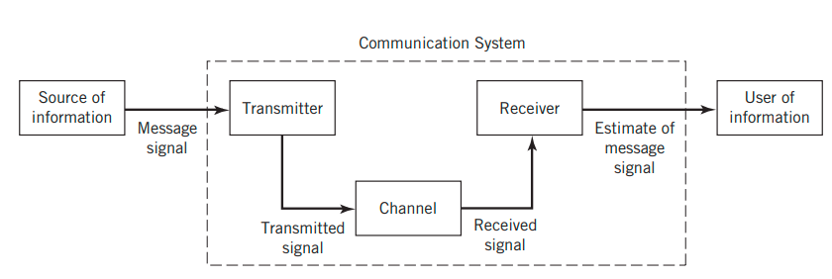
Communication System

Slide 5
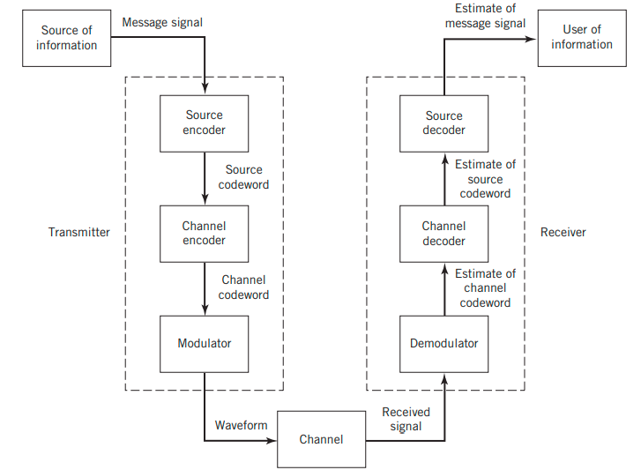
Digital Communication System
Block diagram of a digital communication system.

Slide 6
Digital Communication System
Information Source:
  Originator of Information.
  Text, Audio, Video etc.
  Analog or Digital.
Source Encoder:
  Removes the redundancy.
Channel Encoder:
  Add controlled amount of redundancy.
  Error control
Modulator:
  Convert the bitstream into suitable waveform to transmit on channel.

Slide 7
Sampling Theorem
A band-limited signal of finite energy that has no frequency components higher than W hertz is completely described by specifying the values of the signal instants of time separated by 1/2W seconds.
A band-limited signal of finite energy that has no frequency components higher than W hertz is completely recovered from a knowledge of its samples taken at the rate of 2W samples per second.

Slide 8
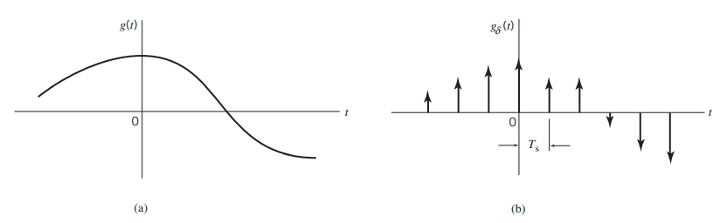
Sampling
The sampling process. (a) Analog signal. (b) Instantaneously sampled version of the analog signal.

Slide 9
Sampling (Contd.)
g(t)

Slide 10
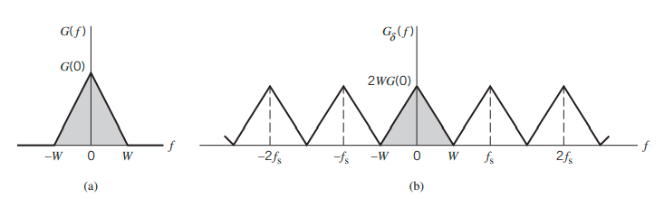
Sampling
(a) Spectrum of a strictly band-limited signal g(t). (b) Spectrum of the sampled version of g(t) for a sampling period Ts = 1/2W.

Slide 11
Aliasing
Aliasing refers to the phenomenon of a high-frequency component in the spectrum of the signal seemingly taking on the identity of a lower frequency in the spectrum of its sampled version.
To combat the effects of aliasing in practice, we may use two corrective measures:
Prior to sampling, a low-pass anti-aliasing filter is used to attenuate those high frequency components of the signal that are not essential to the information being conveyed by the message signal g(t).
The filtered signal is sampled at a rate slightly higher than the Nyquist rate.

Slide 12
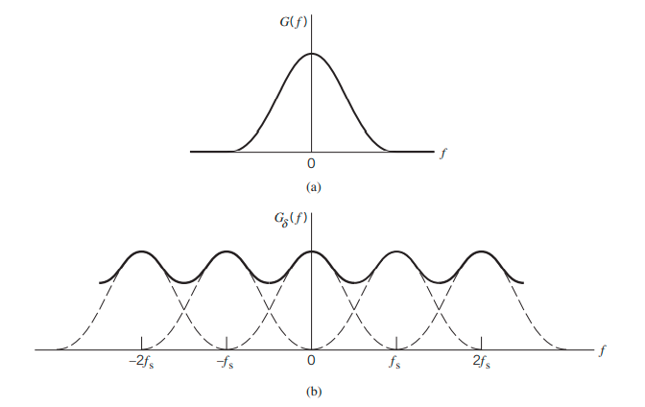
Sampling
(a) Spectrum of a signal. (b) Spectrum of an under-sampled version of the signal exhibiting the aliasing phenomenon.

Slide 13
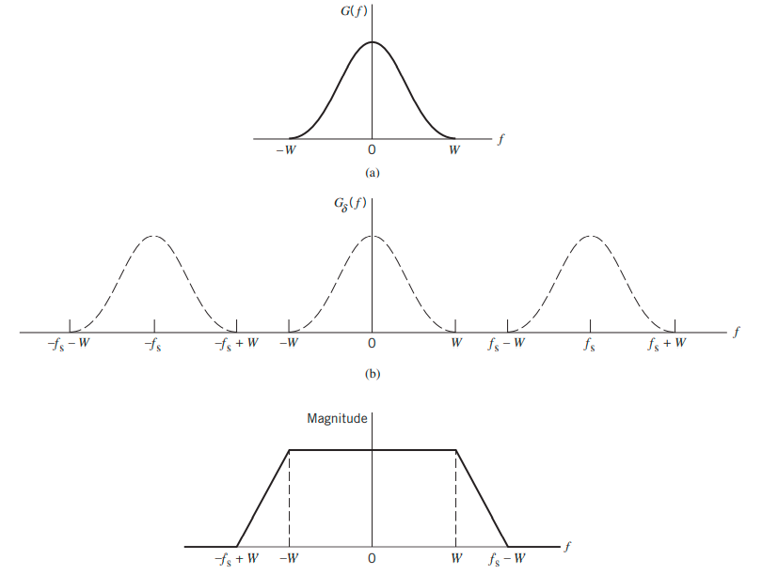
Sampling
(a) Anti-alias filtered spectrum of an information-bearing signal. (b) Spectrum of instantaneously sampled version of the signal, assuming the use of a sampling rate greater than the Nyquist rate. (c) Magnitude response of reconstruction filter.

Slide 14
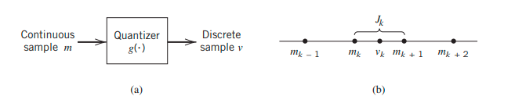
Quantizers
Description of a memoryless quantizer.

Slide 15
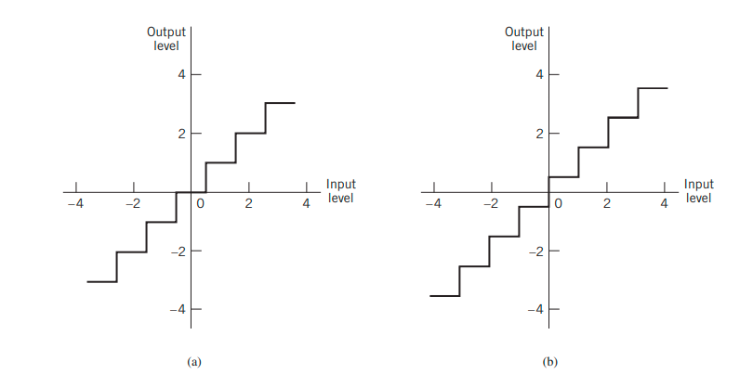
Quantizers
Two types of quantization: (a) midtread and (b) midrise.

Slide 16
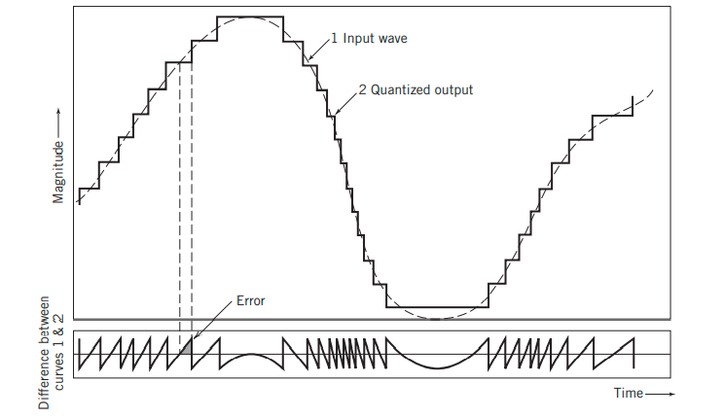
Quantizers
Illustration of the quantization process.

Slide 17
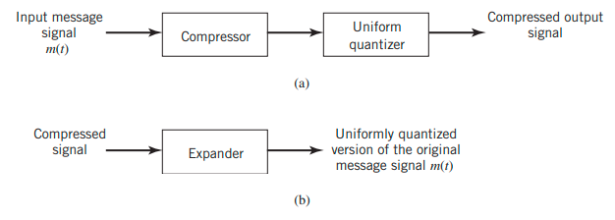
Quantizers
(a) Nonuniform quantization of the message signal in the transmitter. (b) Uniform quantization of the original message signal in the receiver.

Slide 18
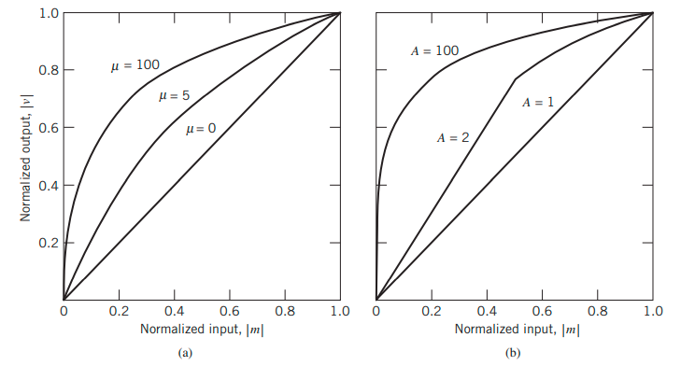
Compression Laws
Compression laws: (a) µ-law; (b) A-law.

Slide 19
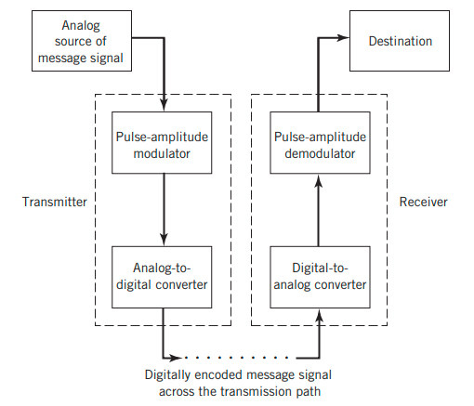
Pulse Coded Modulation - PCM
Block diagram of a PCM system.

Slide 20
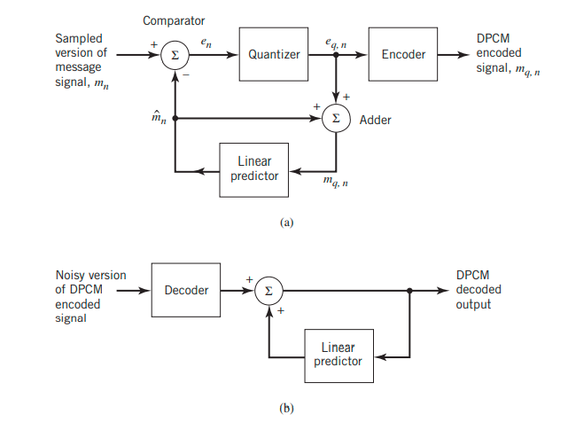
Differential Pulse Code Modulation - DPCM
DPCM system: (a) transmitter; (b) receiver.

Slide 21
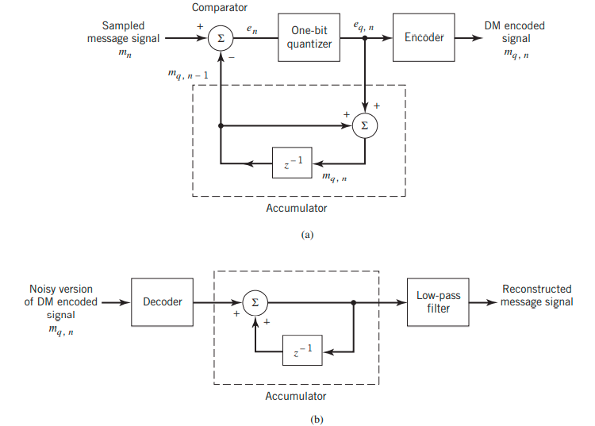
Delta Modulation - DM
DM system: (a) transmitter; (b) receiver.

Slide 22
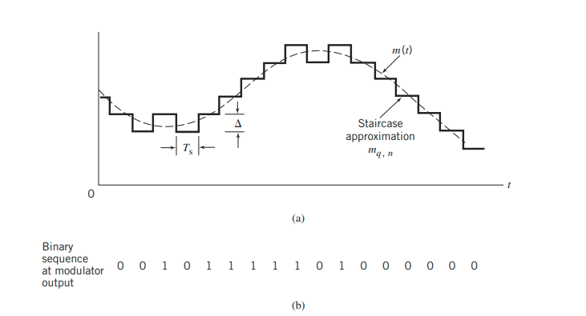
Delta Modulation - DM
Illustration of DM.

Slide 23
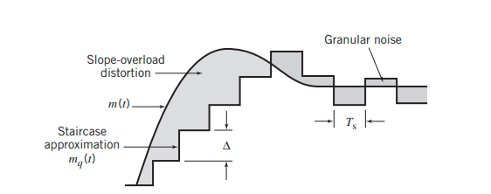
Delta Modulation - DM
Illustration of the two different forms of quantization error in DM.

Slide 24
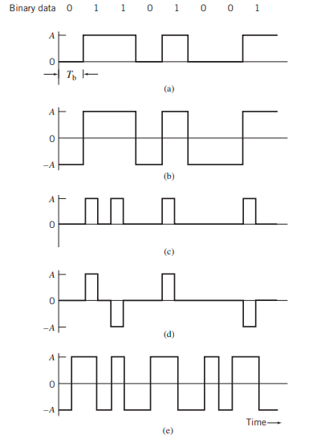
Line Codes
Line codes for the electrical representations of binary data: (a) unipolar nonreturn-to-zero (NRZ) signaling; (b) polar NRZ signaling; (c) unipolar return-to-zero (RZ) signaling; (d) bipolar RZ signaling; (e) split-phase or Manchester code.

Slide 25
Thank You !!

