Slide 1
Unit IV
Mass Storage Structure
File System Interface
File System Implementation

Slide 2
Overview of Mass Storage Structure
Magnetic Disks: provide the bulk of secondary storage for modern computer systems.
disks are relatively simple
Each disk platter has a flat circular shape.
Common platter diameters range from 1.8 to 5.25 inches
The two surfaces of a platter are covered with a magnetic material. Stores the information by recording it magnetically

Slide 3
A read -write head "flies" just above each surface of every platter. The heads are attached to a Disk Arm that moves all the heads as a unit
The surface of a platter is logically divided into circular tracks, which are subdivided into Sectors
The set of tracks that are at one arm position makes up a Cylinder
There may be thousands of concentric cylinders in a disk drive, and each track may contain hundreds of sectors

Slide 4
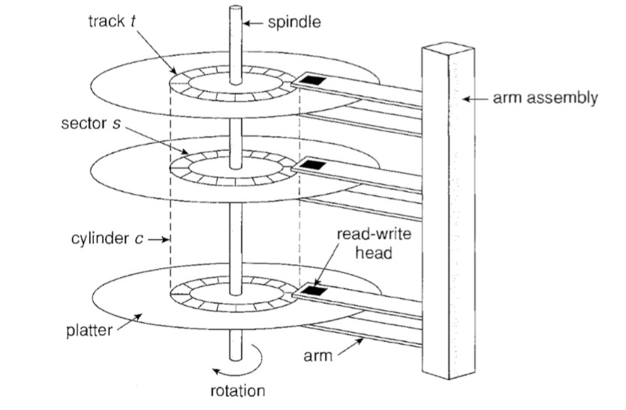

Slide 5
Disk speed has two parts:
Drives rotate at 60 to 250 times per second
Transfer Rate The is the rate at which data flow between the drive and the computer.
Positioning time (random-access time) is time to move disk arm to desired cylinder (seek time) and time for desired sector to rotate under the disk head (rotational latency)
Head crash results from disk head making contact with the disk surface -- That’s bad

Slide 6
Disks can be removable
Drive attached to computer via I/O bus
Busses vary, including EIDE, ATA, SATA, USB, Fibre Channel, SCSI, SAS, Firewire
EIDA-Enhanced Integrated Drive Electronics
ATA- Advanced Technology Attachment
SATA- Serial ATA
SCSI- Small computer System Interface
USB-Universal Serial Bus
SAS – Serial Attached SCSI
Host controller in computer uses bus to talk to disk controller built into drive or storage array

Slide 7
Magnetic Tapes
Was early secondary-storage medium
Evolved from open spools to cartridges
Relatively permanent and holds large quantities of data
Access time slow
Random access ~1000 times slower than disk
Mainly used for backup, storage of infrequently-used data, transfer medium between systems
Kept in spool and wound or rewound past read-write head
Once data under head, transfer rates comparable to disk
140MB/sec and greater
200GB to 1.5TB typical storage
Common technologies are LTO-{3,4,5} and T10000

Slide 8
Firewire
Fireware refers to an interface designed for connecting peripheral devices such as hard drives, DVD drives, and digital video cameras to a computer system.
Fire Wire was first developed by Apple Computer and became the IEEE 1394 standard in 1995.
The original FireWire standard provided bandwidth up to 400 megabits per second.
FireWire 2-has emerged and is identified by the IEEE 1394b standard-800 MB per second

Slide 9
Disk Structure
Disk drives are addressed as large 1-dimensional arrays of logical blocks, where the logical block is the smallest unit of transfer
Low-level formatting creates logical blocks on physical media
The 1-dimensional array of logical blocks is mapped into the sectors of the disk sequentially
Sector 0 is the first sector of the first track on the outermost cylinder
Mapping proceeds in order through that track, then the rest of the tracks in that cylinder, and then through the rest of the cylinders from outermost to innermost

Slide 10
Logical to physical address should be easy
Except for bad sectors
Non-constant # of sectors per track via constant angular velocity
the density of bits per track is uniform known as Constant Linear Velocity
As we move from outer zones to inner zones, the number of sectors per track decreases
Tracks in the outermost zone typically hold 40 percent more sectors than do tracks in the innermost zone

Slide 11
The drive increases its rotation speed as the head moves from the outer to the inner tracks to keep the same rate of data moving under the head (CD-ROM, DVD-ROM)
the disk rotation speed can stay constant; in this case, the density of bits decreases from inner tracks to outer tracks to keep the data rate constant. This method is used in hard disks and is known as Constant Angular Velocity

Slide 12
Disk Attachment
Computers access disk storage in two ways. One way is via I/O ports or Disk attached Storage
The other way is via a remote host in a distributed file system; this is referred to as Network Attached Storage

Slide 13
Host attached Storage
The typical desktop PC uses an I/0 bus architecture called IDE or ATA, This architecture supports a maximum of two drives per I/0 bus
similar protocol that has simplified cabling is SATA.
High-end workstations and servers generally use more sophisticated I/0 architectures, such as SCSI and fiber channel (FC).

Slide 14
SCSI is a bus architecture. Its physical medium is usually a ribbon cable with a large number of conductor ( 50 or 68)
The SCSI protocol supports a maximum of 16 devices per bus.
Generally, the devices include one controller card in the host SCSI Initiator and up to 15 storage devices SCSI Targets
SCSI initiator requests operation and SCSI targets perform tasks. Each target can have up to 8 logical units (disks attached to device controller)

Slide 15
FC is a high-speed serial architecture that can operate over optical fiber or over a four-conductor copper cable. It has two variants.
One is a large switched fabric having a 24-bit address space is the basis of Storage Area Networks.
The other FC variant is an Arbitrated Loop (FC-AL) that can address 126 devices
Examples: hard disk drives, RAID arrays, and CD, DVD, and tape drives.

Slide 16
Network Attached Storage
A network-attached storage (NAS) device is a special-purpose storage system that is accessed remotely over a data network
Client Access via a remote-procedure-call interface such as NFS for UNIX systems or CIFS for Windows machines
The remote procedure calls (RPCs) are carried via TCP or UDP over an IP network

Slide 17
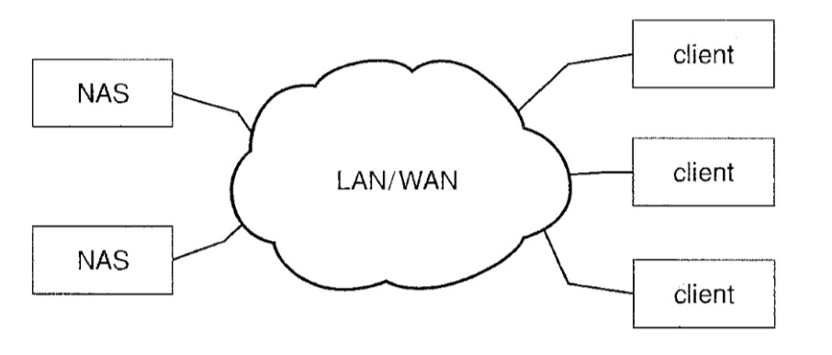

Slide 18
The network attached storage unit is usually implemented as a RAID array with software that implements the RPC interface.
rather than using a SCSI device driver and SCSI protocols to access storage, a system using NAS would use RPC over TCP /IP.
Network-attached storage provides a convenient way for all the computers on a LAN to share a pool of storage with the same ease of naming and access enjoyed with local host-attached storage

Slide 19
It is less efficient and have lower performance
ISCSI is the latest network-attached storage protocol.
it uses the IP network protocol to carry the SCSI protocol

Slide 20
Storage Area Network
One drawback of network-attached storage systems is that the storage I/O operations consume bandwidth on the data network, thereby increasing the latency of network communication.
A storage-area network (SAN) is a private network connecting servers and storage units.
The power of a SAN lies in its flexibility

Slide 21
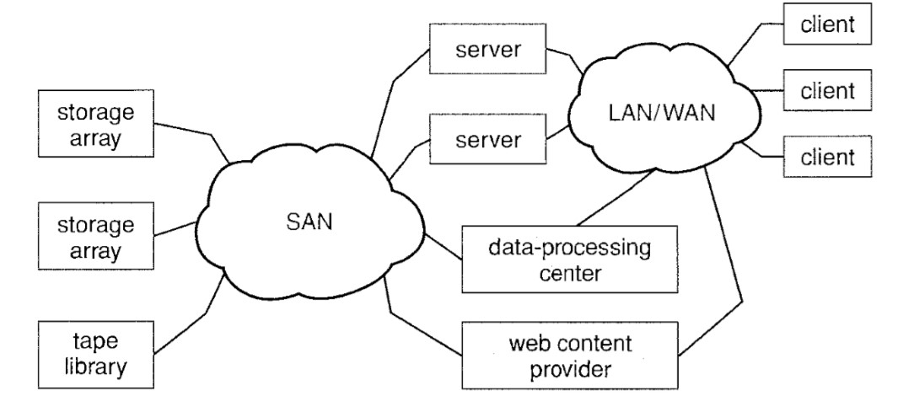

Slide 22
Multiple hosts and multiple storage arrays can attach to the same SAN, and storage can be dynamically allocated to hosts.
A SAN switch allows or prohibits access between the hosts and the storage.
For Example if a host is running low on disk space, the SAN can be configured to allocate more storage to that host.
SANs typically have more ports, and less expensive ports, than storage arrays.

Slide 23
Disk Scheduling
One of the responsibilities of the operating system is to use the hardware efficiently.
Should have fast access time and large disk bandwidth.
The access time has two major components- Seek time and Rotational Latency.
Disk Bandwidth is the total number of bytes transferred, divided by the total time between the first request for service and the completion of the last transfer.

Slide 24
On a typical multiprogramming system, there will usually be multiple disk access requests at any point of time. So those requests must be scheduled to achieve good efficiency. Disk scheduling is similar to process scheduling. Some of the disk scheduling algorithms are described below.

Slide 25
FCFS Scheduling
This algorithm performs requests in the same order asked by the system. Let's take an example where the queue has the following requests with cylinder numbers as follows:
98, 183, 37, 122, 14, 124, 65, 67
If the disk head is initially at cylinder 53, it will first move from 53 to 98, then to 183, 37, 122, 14, 124, 65, and finally to 67, for a total head movement of 640 cylinders

Slide 26
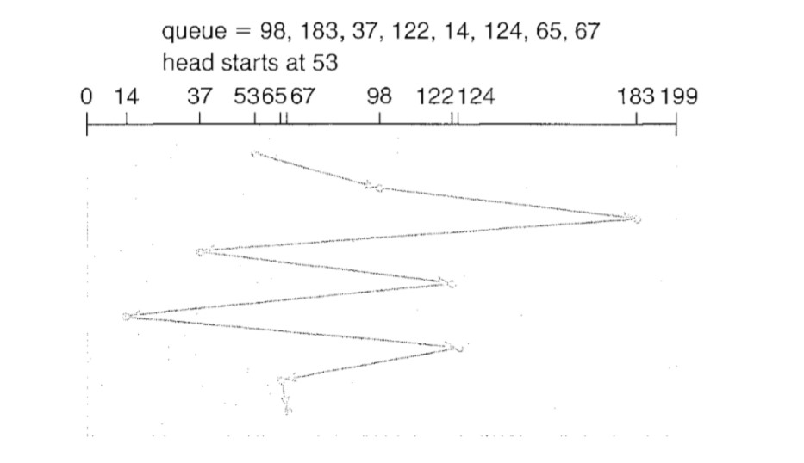

Slide 27
Shortest Seek Time First (SSTF)
Here the position which is closest to the current head position is chosen first. Consider the previous example where disk queue looks like,
98, 183, 37, 122, 14, 124, 65, 67
Assume the head is initially at cylinder 56. The next closest cylinder to 56 is 65, and then the next nearest one is 67, then 37, 14, so on.

Slide 28
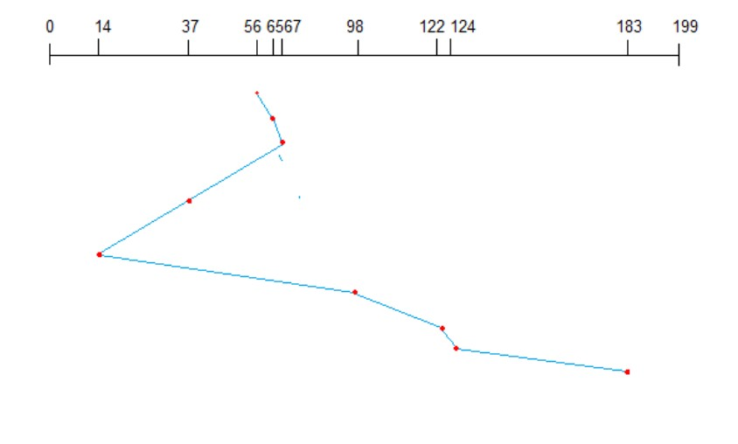
This scheduling method results in a total head movement of only 236 cylinders

Slide 29
SCAN Scheduling
This algorithm is also called the elevator algorithm because of it's behavior. Here, first the head moves in a direction (say backward) and covers all the requests in the path. Then it moves in the opposite direction and covers the remaining requests in the path
98, 183, 37, 122, 14, 124, 65, 67

Slide 30
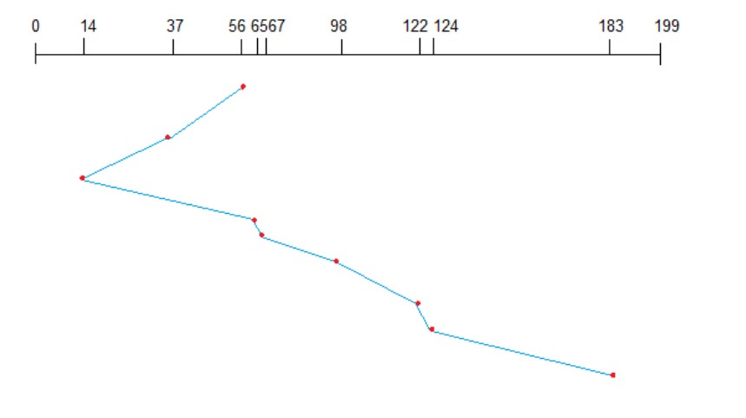
Assume the head is initially at cylinder 56. The head moves in backward direction and accesses 37 and 14. Then it goes in the opposite direction and accesses the cylinders as they come in the path.

Slide 31
C-SCAN Scheduling
C-SCAN is a variant of SCAN designed to provide a more uniform wait time.
Like SCAN, C-SCAN moves the head from one end of the disk to the other, servicing requests along the way.
When the head reaches the other end, however, it immediately returns to the beginning of the disk without servicing any requests on the return trip

Slide 32
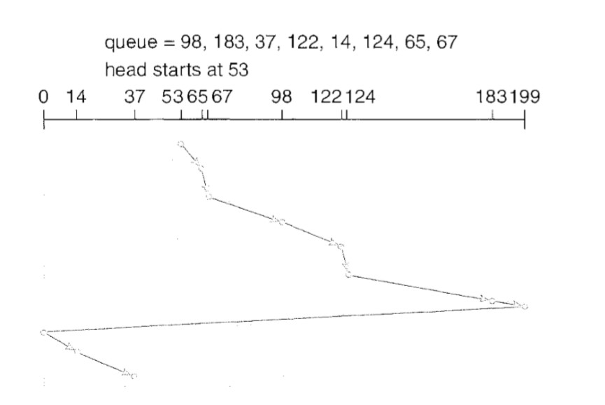
The C-SCAN scheduling algorithm essentially treats the cylinders as a circular list that wraps around from the final cylinder to the first one.

Slide 33
LOOK and C-LOOK Scheduling
both SCAN and C-SCAN move the disk arm across the full width of the disk.
the arm goes only as far as the final request in each direction. Then, it reverses direction immediately without going all the way to the end of the disk
Versions of SCAN and C-SCAN that follow this pattern are called LOOK and C-LOOK Scheduling, because they look for a request before continuing to move in a given direction

Slide 34
Disk Management
Disk Formatting:
A new magnetic disk is a blank slate: it is just a platter of a magnetic recording material.
Before a disk can store data, it must be divided into sectors that the disk controller can read and write.
This process is called “ Low-Level Formatting” or Physical Formatting

Slide 35
Low-level formatting fills the disk with a special data structure for each sector.
The data structure for a sector typically consists of a header, a data area and a trailer.
The header and trailer contain information used by the disk controller, such as a sector number and an ECC “ Error Correcting Code”

Slide 36
When the controller writes a sector of data, the ECC is updated with a value calculated from all the bytes in the data area
When the sector is read, the ECC is recalculated and compared with the stored value
If the stored and calculated numbers are different, this mismatch indicates that the data area of the sector has become corrupted and that the disk sector may be bad

Slide 37
Before it can use a disk to hold files, the operating system still needs to record its own data structures on the disk.
The first step is to Partition the disk into one or more groups of cylinders. OS treats each partition as a separate disk.
The second step is Logical Formatting or creation of a file system. In this step, the operating system stores the initial file-system data structures onto the disk.
These data structures may include maps of free and allocated space and an initial empty directory.

Slide 38
To increase efficiency, most file systems group blocks together into larger chunks, frequently called Clusters.
Boot Block:
when it is powered up or rebooted -it must have an initial program to run. The bootstrap program loads all aspects of the system, and then start the Operating System.
To do its job, the bootstrap program finds the operating-system kernel on disk, loads that kernel into memory, and jumps to an initial address to begin the operating-system execution

Slide 39
Bootstrap Program is stored in ROM. since ROM is read only, it cannot be infected by a computer virus.
The problem is that changing this bootstrap code requires changing the ROM hardware chips
For this reason, most systems store a tiny bootstrap loader program in the boot ROM whose only job is to bring in a full bootstrap program from disk
The full bootstrap program is stored in the "boot blocks" at a fixed location on the disk.
A disk that has a boot partition is called a Boot Disk or System Disk

Slide 40
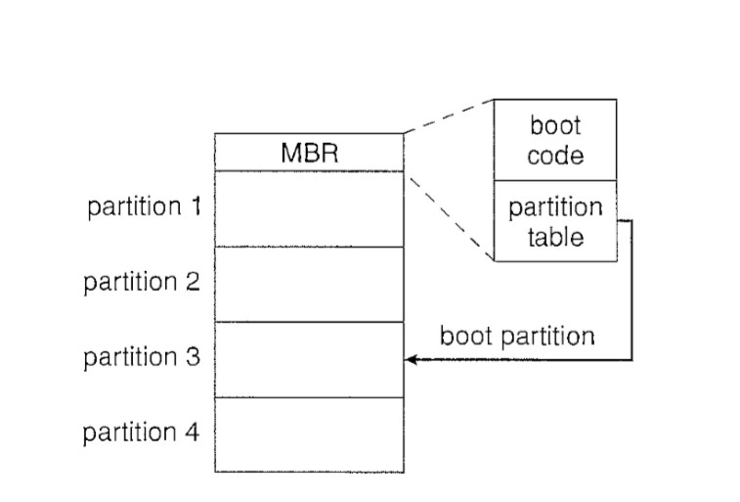

Slide 41
Windows 2000 system places its boot code in the first sector on the hard disk called MBR or Master Boot Record.
Windows 2000 allows a hard disk to be divided into one or more partitions; one partition, identified as the Boot Partition contains the operating system and device drivers.
In addition to containing boot code, the MBR contains a table listing the partitions for the hard disk and a flag indicating which partition the system is to be booted from

Slide 42
Bad Blocks
Because disks have moving parts and small tolerances they are prone to failures.
Sometimes the failure is complete, in this case, the disk needs to be replaced and its contents restored from backup media to the new disk.
More frequently, one or more sectors become defective
Most disks even come from the factory with bad blocks

Slide 43
The controller maintains a list of bad blocks on the disk
The controller can be told to replace each bad sector logically with one of the spare sectors. This scheme is known as “Sector Sparing or Forwarding”

Slide 44
Example:
A typical bad-sector transaction might be as follows
The operating system tries to read logical block 87
The controller calculates the ECC and finds that the sector is bad. It reports this finding to the operating system
The next time the system is rebooted, a special command is run to tell the SCSI controller to replace the bad sector with a spare
After that, whenever the system requests logical block 87, the request is translated into the replacement sector's address by the controller

Slide 45
As an alternative to sector some controllers can be instructed to replace a bad block by Sector Slipping.
Slipping moves all down one spot.
17 is defective and spare is 202, then it slips 201 to 202, 200 to 201 until 18 is copied into sector 19… Finally at the place of sector 18, sector 17 will be placed.

Slide 46
Swap space management
wap space is a space on hard disk which is a substitute of physical memory. It is used as virtual memory which contains process memory image.
Swap space helps the computer’s operating system in pretending that it have more RAM than it actually has. It is also called as swap file
This interchange of data between virtual memory and real memory is called as swapping and space on disk as “swap space”

Slide 47
Virtual memory is a combination of RAM and disk space that running processes can use. Swap space is the portion of virtual memory that is on the hard disk, used when RAM is full.

Slide 48
RAID- Redundant Array of Independent Disks
RAID, or “Redundant Arrays of Independent Disks” is a technique which makes use of a combination of multiple disks instead of using a single disk for increased performance, data redundancy or both
Data Redundancy: Data redundancy, although taking up extra space, adds to disk reliability. This means, in case of disk failure, if the same data is also backed up onto another disk, we can retrieve the data and go on with the operation. On the other hand, if the data is spread across just multiple disks without the RAID technique, the loss of a single disk can affect the entire data.

Slide 49
Improvement of reliability via redundancy
The simplest approach to introducing redundancy is to duplicate every disk. This technique is called “ Mirroring”
With mirroring, a logical disk consists of two physical disks, and every write is carried out on both disks. The result is called a “ Mirrored Volume”
where failure is the loss of data- depends on two factors. One is the mean time to failure of the individual disks. The other is the mean time to repair

Slide 50
Improvement of Performance Via parallelism
With multiple disks, we can improve the transfer rate as well (or instead) by striping data across the disks.
Data Stripping consist of the bits of each byte across multiple disks; such striping is called “ Bit-Level Stripping”.
For Ex: if we have an array of eight disks, we write bit i of each byte to disk i.

Slide 51
In Block – Level Stripping blocks of a file are striped across multiple disks; with n disks, block i of a file goes to disk (i mod n) + 1.
Parallelism in a disk system, as achieved through striping, has two main goals:
Increase the throughput of multiple small accesses (that is, page accesses) by load balancing.
Reduce the response time of large accesses

Slide 52
RAID Levels
RAID System is used to increase performance and improve reliability of the storage system.
Data striping increases the performance and data redundancy improves the reliability. Disks are organized in several ways and referred as RAID levels.

Slide 53
Level 0 : Non Redundant
In this level, a striped array of disks is implemented. The data is broken down into blocks and the blocks are distributed among disks. Each disk receives a block of data to write/read in parallel. It enhances the speed and performance of the storage device. There is no parity and backup in Level 0.

Slide 54
Level 1 : Mirrored
In this level same data is copied on two different disks. This type of redundancy is called as mirroring. It is the most expensive system. Because two copies of same data are available in two different disks, it allows parallel read
Level 1+0 : Stripping and Mirroring
This level is combination of level 0 and level 1, sometimes called as level 10.

Slide 55
Level 2: Error Correcting Codes
RAID Level 2 is also known as “ Memory Style Error Correcting Code Organization
Each byte in a memory system may have a parity bit associated with it that records whether the number of bits in the byte set to 1 is even (parity= 0) or odd (parity= 1).
If one of the bits in the byte is damaged (either a 1 becomes a 0, or a 0 becomes a 1) the parity of the byte changes and thus does not match the stored parity.
Error-correcting schemes store two or more extra bits and can reconstruct the data if a single bit is damaged

Slide 56
RAID Level 3: Bit – Interleaved Parity
RAID 3 stripes the data onto multiple disks. The parity bit generated for data word is stored on a different disk. This technique makes it to overcome single disk failures.
RAID Level 4: Block – Interleaved Parity
In this level, an entire block of data is written onto data disks and then the parity is generated and stored on a different disk. Note that level 3 uses byte-level striping, whereas level 4 uses block-level striping. Both level 3 and level 4 require at least three disks to implement RAID.

Slide 58
RAID Level 5:Block Interleaved Distributed Parity
RAID 5 writes whole data blocks onto different disks, but the parity bits generated for data block stripe are distributed among all the data disks rather than storing them on a different dedicated disk.
RAID 6: (P+Q Redundancy Scheme )
is an extension of level 5. In this level, two independent parities are generated and stored in distributed fashion among multiple disks. Two parities provide additional fault tolerance. This level requires at least four disk drives to implement RAID.

Slide 59
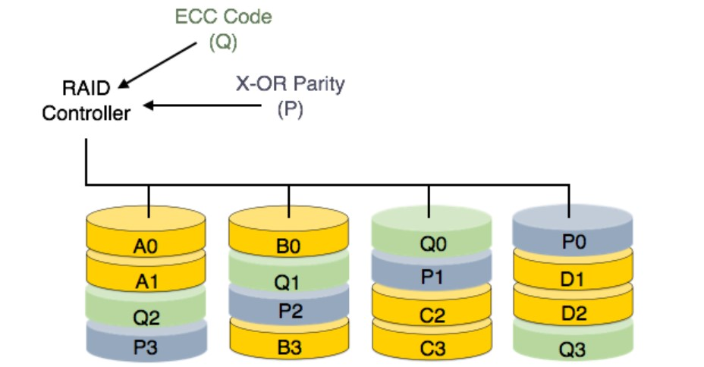

Slide 60
RAID Level 0+1 and 1+0
RAID level 0 + 1 refers to a combination of RAID levels 0 and 1. RAID 0 provides the performance, while RAID 1 provides the reliability. Generally, this level provides better performance than RAID 5.
In RAID 0 + 1, a set of disks are striped, and then the stripe is mirrored to another, equivalent stripe.

Slide 61
disks are mirrored in pairs and then the resulting mirrored pairs are striped. This scheme has some advantages over RAID 0 + 1
if a single disk fails in RAID 0 + 1, an entire stripe is inaccessible, leaving only the other stripe available
in RAID 1 + 0, a single disk is unavailable, but the disk that mirrors it is still available, as are all the rest of the disks

Slide 62
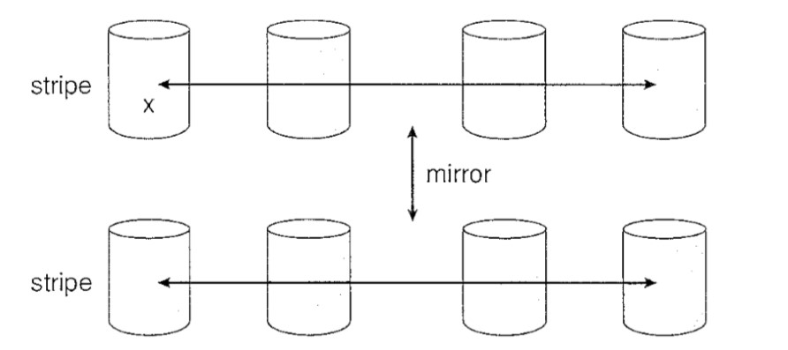
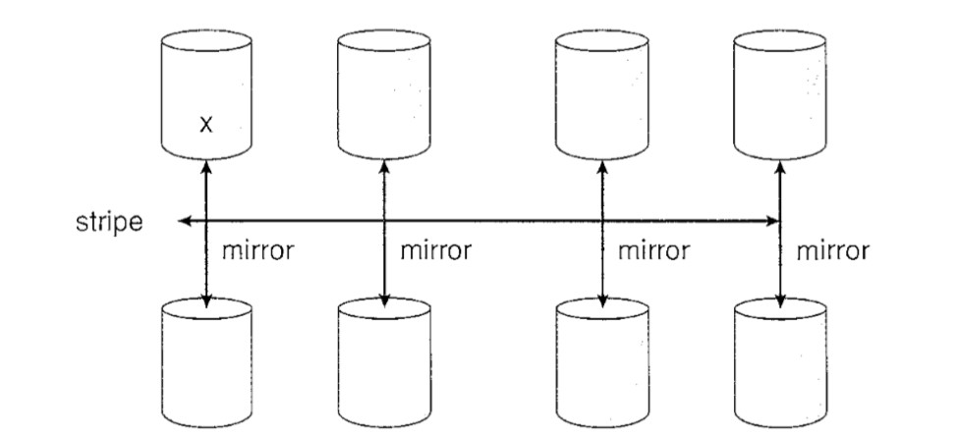

Slide 63
Stable Storage Implementation
Information residing in stable storage is never lost.
To implement such storage, we need to replicate the required information on multiple storage devices with independent failure modes

Slide 64
A disk write results in one of three outcomes
Successful completion: The data were written correctly on disk.
Partial failure. A failure occurred in the midst of transfer, so only some of the sectors were written with the new data, and the sector being written during the failure may have been corrupted.
Total failure. The failure occurred before the disk write started, so the previous data values on the disk remain intact

Slide 65
Whenever a failure occurs during writing of a block, the system needs to detect it and invoke a recovery procedure to restore the block to a consistent state. To do that, the system must maintain two physical blocks for each logical block.
Write the information onto the first physical block.
When the first write completes successfully, write the same information onto the second physical block.
Declare the operation complete only after the second write completes successfully.

