Slide 1

SMALL SCALE FADING AND MULTI PATH;
DIVERSITY TECHNIQUES
Dr.Y.Mallikarjuna Rao M.Tech., Ph.D
Professor & Head of ECE
Santhiram Engineering College
hod.ece@srecnandyal.edu.in

Slide 2

Outline of the Presentation
2. SMALL SCALE FADING AND MULTIPATH
2.1 FADING IN WIELESS CHANNEL
2.2 RAYLEIGH FADING
2.3 BER IN WIRED AND WIRELESS CHANNEL
2.4 WIRELESS CHANNEL AND DELAY SPREAD
2.5 COHERENCE BAND WIDTH OF WIRELESS CHNNEL
2.6 ISI AND DOPPLER IN WIRELESS CHANNEL
2.7 DOPPLER SPECTRUM AND JAKE’S MODEL
2.1 DIVERSITY TECHNIQUES
2.1.1 INTRODUCTION TO DIVERSITY TECHNIQUES
2.1.2 MRC FOR MULTI-ANTENNA SYSTEM
2.1.3 BER WITH DIVERSITY
2.1.4 SPATIAL DIVERSITY AND DIVERSITY ORDER
Noise and pulse modulation Dr.Y.Mallikarjuna Rao 21-02-2023

Slide 3
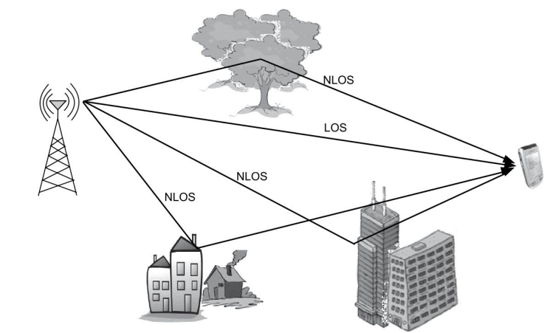
SMALL SCALE FADING AND MULTI PATH
FADING IN WIRELESS CHANNEL:
In conventional wire line communication systems, there is a single signal-propagation path between the transmitter and the receiver, which is constrained by the propagation medium such as a coaxial cable or a twisted pair.
From fig 1 in wireless systems, the signal can reach the receiver via direct, reflected, and scattered paths as shown which result, at the receiver, there is a superposition of multiple copies of the transmitted signal.
The interference of signals received from these multiple propagation paths, which is termed MULTIPATH INTERFERENCE at the receiver
The variation in the received signal strength arising from the multipath propagation phenomenon is termed MULTIPATH FADING OR SIMPLY FADING.
FIGURE 1: SCHEMATIC OF THE WIRELESS-PROPAGATION ENVIRONMENT
Small Scale Fading and Multipath Dr.Y.Mallikarjuna Rao 21-02-2023 01/5

Slide 4
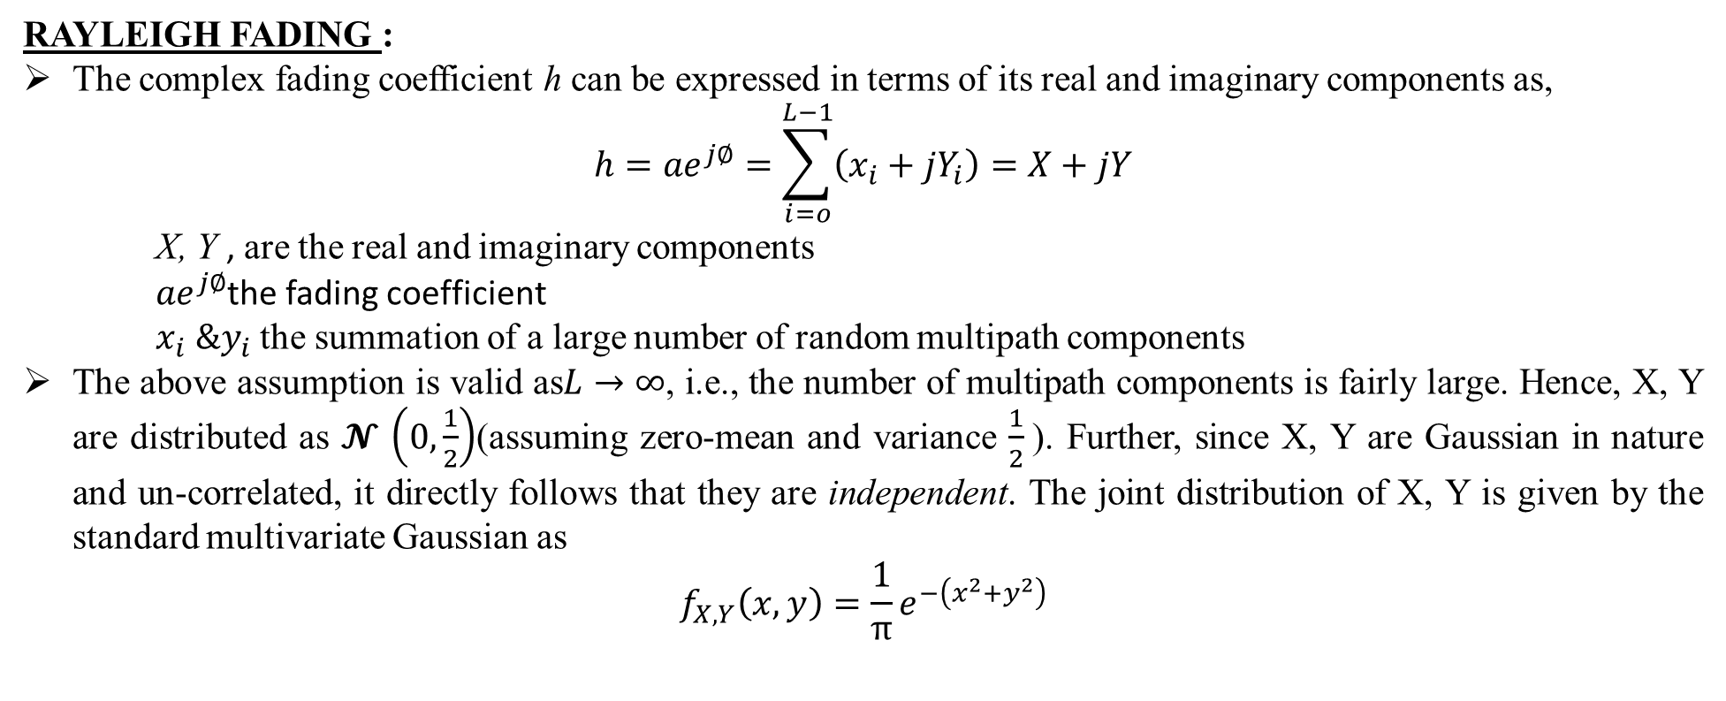
SMALL SCALE FADING AND MULTI PATH
RAYLEIGH FADING :
The complex fading coefficient h can be expressed in terms of its real and imaginary components as,
$$h={ae}^{j∅}=\sum_{i=o}^{L−1}{\left(x_{i}+{jY}_{i}\right)=X+jY}$$
X, Y , are the real and imaginary components
${ae}^{j∅}$the fading coefficient
$x_{i} \&y_{i}$ the summation of a large number of random multipath components
The above assumption is valid as$L→∞$, i.e., the number of multipath components is fairly large. Hence, X, Y are distributed as 𝓝 $\left(0,\frac{1}{2}\right)$(assuming zero-mean and variance $\frac{1}{2}$). Further, since X, Y are Gaussian in nature and un-correlated, it directly follows that they are independent. The joint distribution of X, Y is given by the standard multivariate Gaussian as
$$f_{X,Y}\left(x,y\right)=\frac{1}{π}e^{−\left(x^{2}+y^{2}\right)}$$
Small Scale Fading and Multipath Dr.Y.Mallikarjuna Rao 21-02-2023 02/50

Slide 5
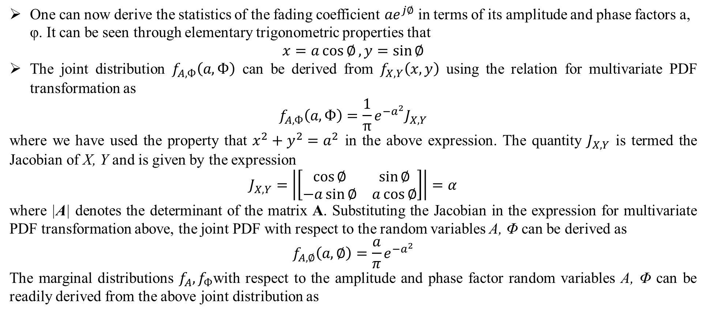
SMALL SCALE FADING AND MULTI PATH
One can now derive the statistics of the fading coefficient ${ae}^{j∅}$ in terms of its amplitude and phase factors a, φ. It can be seen through elementary trigonometric properties that
$$x=a\cos{∅},y=\sin{∅}$$
The joint distribution $f_{A,Ф}\left(a,Ф\right)$ can be derived from $f_{X,Y}\left(x,y\right)$ using the relation for multivariate PDF transformation as
$$f_{A,Ф}\left(a,Ф\right)=\frac{1}{π}e^{{−a}^{2}}J_{X,Y}$$
where we have used the property that $x^{2}+y^{2}=a^{2}$ in the above expression. The quantity $J_{X,Y}$ is termed the Jacobian of X, Y and is given by the expression
$$J_{X,Y}=\left|\left[\begin{matrix}\cos{∅} & \sin{∅} \\ −a\sin{∅} & a\cos{∅}\end{matrix}\right]\right|=α$$
where |A| denotes the determinant of the matrix A. Substituting the Jacobian in the expression for multivariate PDF transformation above, the joint PDF with respect to the random variables A, Φ can be derived as
$$f_{A,∅}\left(a,∅\right)=\frac{a}{π}e^{{−a}^{2}}$$
The marginal distributions $f_{A},f_{Ф}$with respect to the amplitude and phase factor random variables A, Φ can be readily derived from the above joint distribution as
Small Scale Fading and Multipath Dr.Y.Mallikarjuna Rao 21-02-2023 03/50

Slide 6
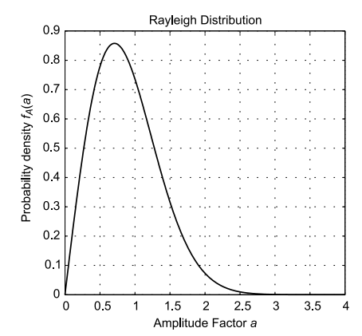
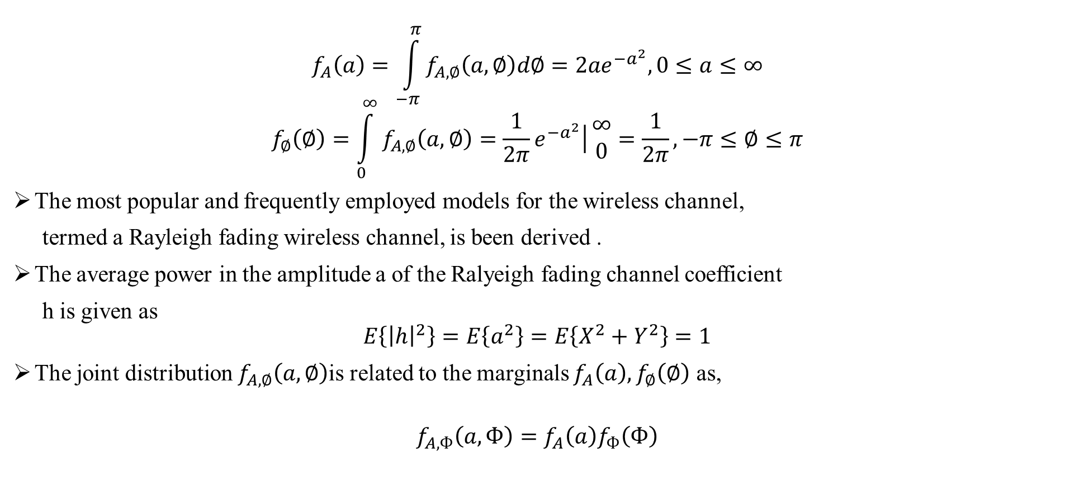
SMALL SCALE FADING AND MULTI PATH
$$f_{A}\left(a\right)=\int_{−π}^{π}{f_{A,∅}\left(a,∅\right)d∅={2ae}^{{−a}^{2}},0≤a≤∞}$$
$$f_{∅}\left(∅\right)=\int_{0}^{∞}{f_{A,∅}\left(a,∅\right)=\frac{1}{2π}\left.e^{{−a}^{2}}\right|}\begin{matrix}∞ \\ 0\end{matrix}=\frac{1}{2π},−π≤∅≤π$$
The most popular and frequently employed models for the wireless channel,
termed a Rayleigh fading wireless channel, is been derived .
The average power in the amplitude a of the Ralyeigh fading channel coefficient
h is given as
$$E\left\{{\left|h\right|}^{2}\right\}=E\left\{a^{2}\right\}=E\left\{X^{2}+Y^{2}\right\}=1$$
The joint distribution $f_{A,∅}\left(a,∅\right)$is related to the marginals $f_{A}\left(a\right),f_{∅}\left(∅\right)$ as,
$$f_{A,Ф}\left(a,Ф\right)=f_{A}\left(a\right)f_{Ф}\left(Ф\right)$$
FIGURE 2: RAYLEIGH DENSITY FOR AMPLITUDE FACTOR A
Small Scale Fading and Multipath Dr.Y.Mallikarjuna Rao 21-02-2023 04/50

Slide 7
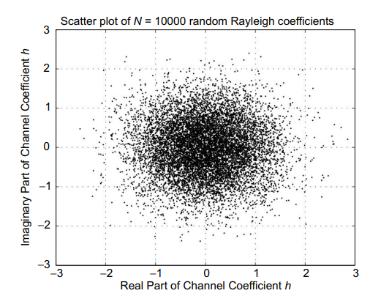
SMALL SCALE FADING AND MULTI PATH
The random variables A, Φ are independent. This is a fairly important result since it suggests that the random varying nature of the phase factor of the arriving signal is independent of that of the amplitude, i.e., for a given amplitude a, all phase factors in (−π, π) are equiprobable.
The below figure represents the scatter plot of the real and imaginary components of 10000 randomly generated samples of the Rayleigh fading coefficient. From the circular symmetry of the plot, it can be readily seen that the phase of the Rayleigh coefficient is distributed uniformly in (−π, π).
FIGURE 3: SCATTER PLOT OF THE RAYLEIGH FADING CHANNELCOEFFICIENT H
Small Scale Fading and Multipath Dr.Y.Mallikarjuna Rao 21-02-2023 05/50

Slide 8
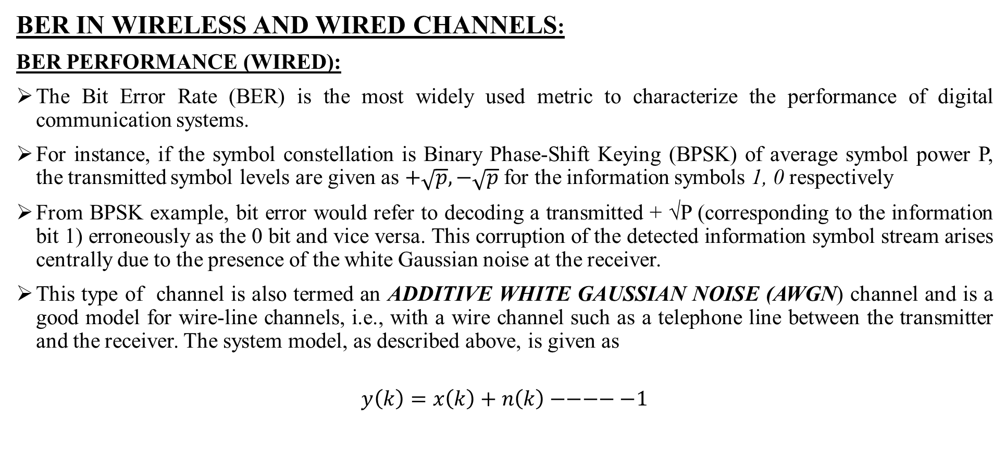
SMALL SCALE FADING AND MULTI PATH
BER IN WIRELESS AND WIRED CHANNELS:
BER PERFORMANCE (WIRED):
The Bit Error Rate (BER) is the most widely used metric to characterize the performance of digital communication systems.
For instance, if the symbol constellation is Binary Phase-Shift Keying (BPSK) of average symbol power P, the transmitted symbol levels are given as $+\sqrt{p},−\sqrt{p}$ for the information symbols 1, 0 respectively
From BPSK example, bit error would refer to decoding a transmitted + √P (corresponding to the information bit 1) erroneously as the 0 bit and vice versa. This corruption of the detected information symbol stream arises centrally due to the presence of the white Gaussian noise at the receiver.
This type of channel is also termed an ADDITIVE WHITE GAUSSIAN NOISE (AWGN) channel and is a good model for wire-line channels, i.e., with a wire channel such as a telephone line between the transmitter and the receiver. The system model, as described above, is given as
$$y\left(k\right)=x\left(k\right)+n\left(k\right)−−−−−1$$
Small Scale Fading and Multipath Dr.Y.Mallikarjuna Rao 21-02-2023 06/50

Slide 9
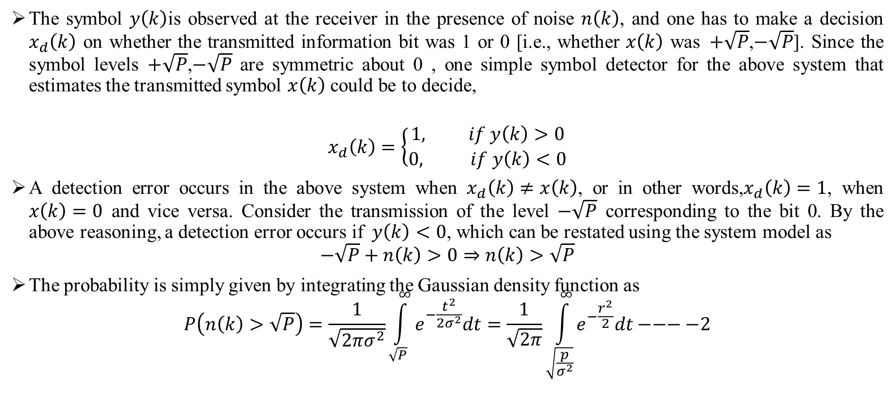
SMALL SCALE FADING AND MULTI PATH
The symbol $y\left(k\right)$is observed at the receiver in the presence of noise $n\left(k\right)$, and one has to make a decision $x_{d}\left(k\right)$ on whether the transmitted information bit was 1 or 0 [i.e., whether $x\left(k\right)$ was$+\sqrt{P}$,$−\sqrt{P}$]. Since the symbol levels$+\sqrt{P}$,$−\sqrt{P}$ are symmetric about 0 , one simple symbol detector for the above system that estimates the transmitted symbol $x\left(k\right)$ could be to decide,
$$x_{d}\left(k\right)=\left\{\begin{aligned}1, if y\left(k\right)>0 \\ 0, if y\left(k\right)<0\end{aligned}\right.$$
A detection error occurs in the above system when $x_{d}\left(k\right)≠x\left(k\right)$, or in other words,$x_{d}\left(k\right)=1$, when $x\left(k\right)=0$ and vice versa. Consider the transmission of the level $−\sqrt{P}$corresponding to the bit 0. By the above reasoning, a detection error occurs if$y\left(k\right)<0$, which can be restated using the system model as
$$−\sqrt{P}+n\left(k\right)>0⇒n\left(k\right)>\sqrt{P}$$
The probability is simply given by integrating the Gaussian density function as
$$P\left(n\left(k\right)>\sqrt{P}\right)=\frac{1}{\sqrt{2πσ^{2}}}\int_{\sqrt{P}}^{∞}{e^{−\frac{t^{2}}{2σ^{2}}}dt}=\frac{1}{\sqrt{2π}}\int_{\sqrt{\frac{p}{σ^{2}}}}^{∞}{e^{−\frac{r^{2}}{2}}dt}−−−−2$$
Small Scale Fading and Multipath Dr.Y.Mallikarjuna Rao 21-02-2023 07/50
Small Scale Fading and Multipath Dr.Y.Mallikarjuna Rao 08-04-2022 09/52

Slide 10
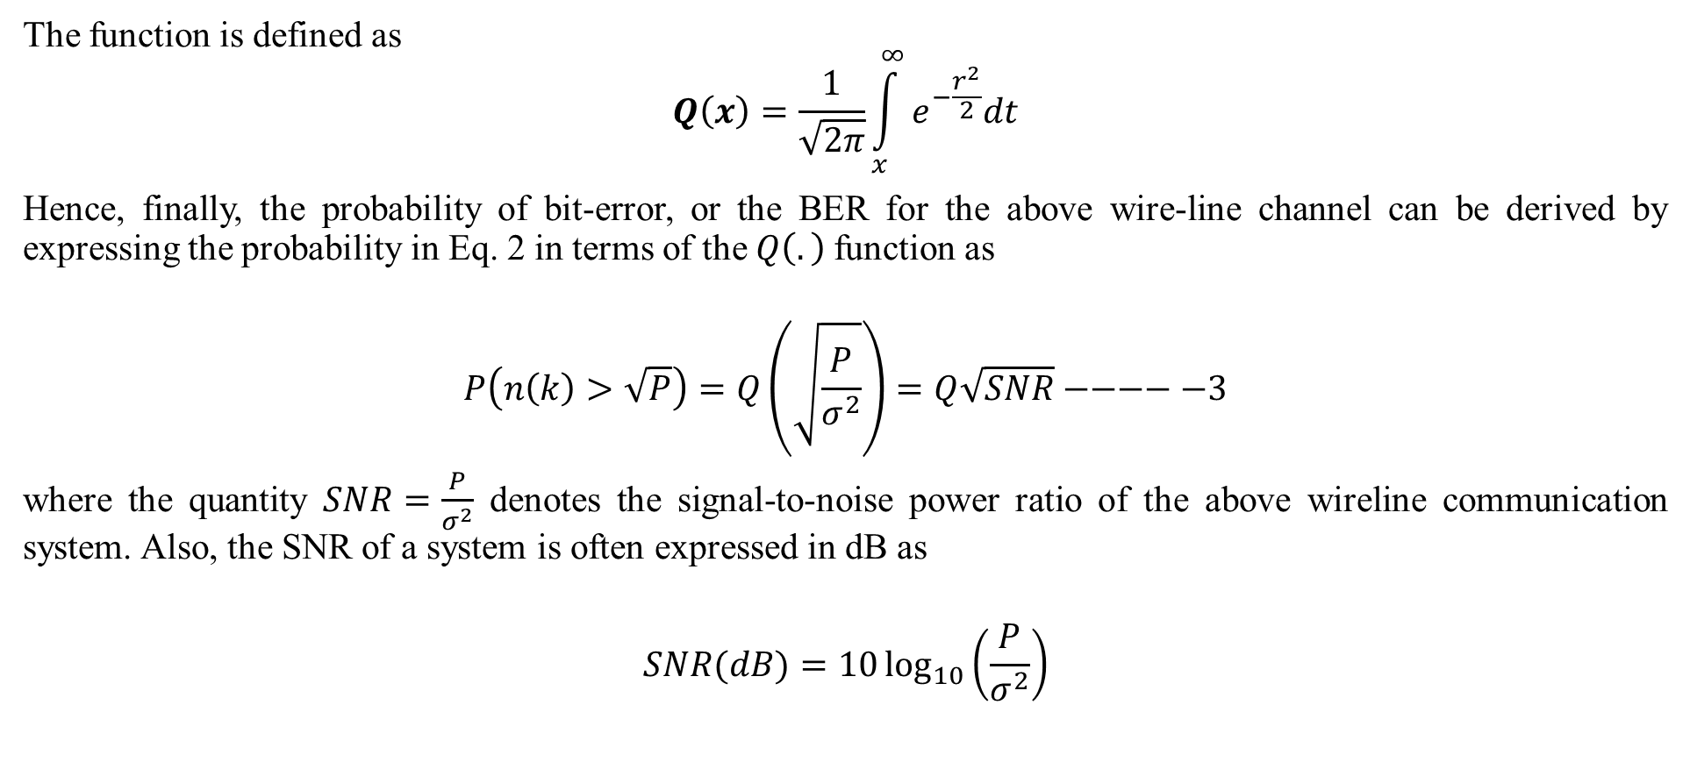
SMALL SCALE FADING AND MULTI PATH
The function is defined as
$$Q\left(x\right)=\frac{1}{\sqrt{2π}}\int_{x}^{∞}{e^{−\frac{r^{2}}{2}}dt}$$
Hence, finally, the probability of bit-error, or the BER for the above wire-line channel can be derived by expressing the probability in Eq. 2 in terms of the $Q\left(.\right)$function as
$$P\left(n\left(k\right)>\sqrt{P}\right)=Q\left(\sqrt{\frac{P}{σ^{2}}}\right)=Q\sqrt{SNR}−−−−−3$$
where the quantity $SNR=\frac{P}{σ^{2}}$ denotes the signal-to-noise power ratio of the above wireline communication system. Also, the SNR of a system is often expressed in dB as
$$SNR(dB)=10\log_{10}\left(\frac{P}{σ^{2}}\right)$$
Small Scale Fading and Multipath Dr.Y.Mallikarjuna Rao 21-02-2023 08/50

Slide 11
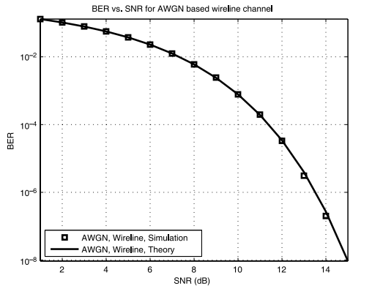
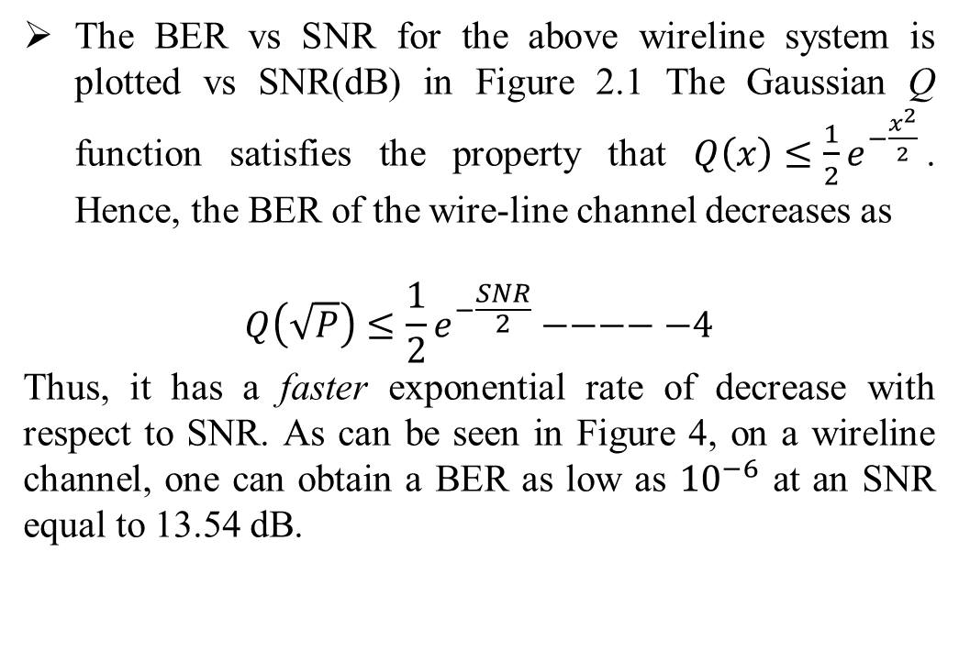
SMALL SCALE FADING AND MULTI PATH
The BER vs SNR for the above wireline system is plotted vs SNR(dB) in Figure 2.1 The Gaussian Q function satisfies the property that $Q\left(x\right)≤\frac{1}{2}e^{−\frac{x^{2}}{2}}$. Hence, the BER of the wire-line channel decreases as
$$Q\left(\sqrt{P}\right)≤\frac{1}{2}e^{−\frac{SNR}{2}}−−−−−4$$
Thus, it has a faster exponential rate of decrease with respect to SNR. As can be seen in Figure 4, on a wireline channel, one can obtain a BER as low as ${10}^{−6}$ at an SNR equal to 13.54 dB.
Figure 4 BER of a wireline or AWGN channel based communication system. The plot corresponding to ’theory’ is obtained from the analytical expression in Eq.3 . Observe that the curves obtained from the theory and simulation coincide accurately.
Small Scale Fading and Multipath Dr.Y.Mallikarjuna Rao 21-02-2023 09/50

Slide 12
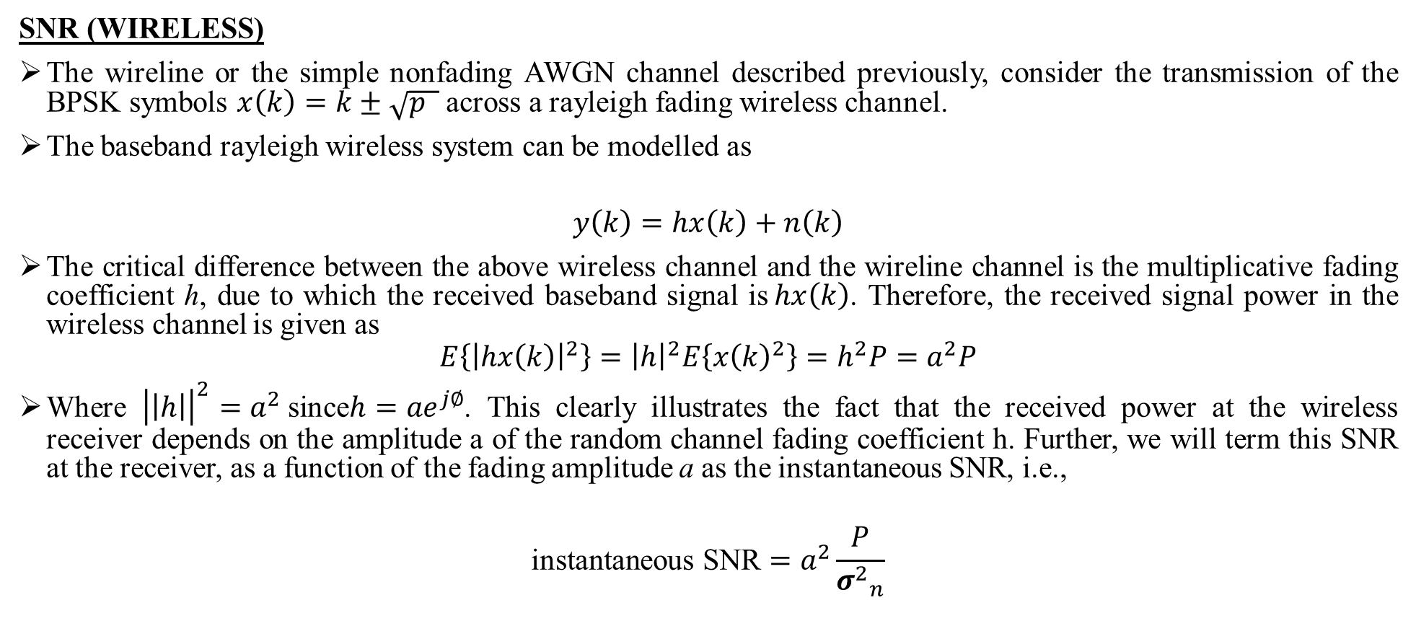
SMALL SCALE FADING AND MULTI PATH
SNR (WIRELESS)
The wireline or the simple nonfading AWGN channel described previously, consider the transmission of the BPSK symbols $x\left(k\right)=k±\sqrt{p }$ across a rayleigh fading wireless channel.
The baseband rayleigh wireless system can be modelled as
$$y\left(k\right)=hx\left(k\right)+n\left(k\right)$$
The critical difference between the above wireless channel and the wireline channel is the multiplicative fading coefficient h, due to which the received baseband signal is$hx\left(k\right)$. Therefore, the received signal power in the wireless channel is given as
$$E\left\{{\left|hx\left(k\right)\right|}^{2}\right\}={\left|h\right|}^{2}E\left\{{x\left(k\right)}^{2}\right\}=h^{2}P=a^{2}P$$
Where ${\left|\left|h\right|\right|}^{2}=a^{2}$since$h={ae}^{j∅}$. This clearly illustrates the fact that the received power at the wireless receiver depends on the amplitude a of the random channel fading coefficient h. Further, we will term this SNR at the receiver, as a function of the fading amplitude a as the instantaneous SNR, i.e.,
$$\text{instantaneous} \text{SNR}=a^{2}\frac{P}{{σ^{2}}_{n}}$$
Small Scale Fading and Multipath Dr.Y.Mallikarjuna Rao 21-02-2023 10/50

Slide 13
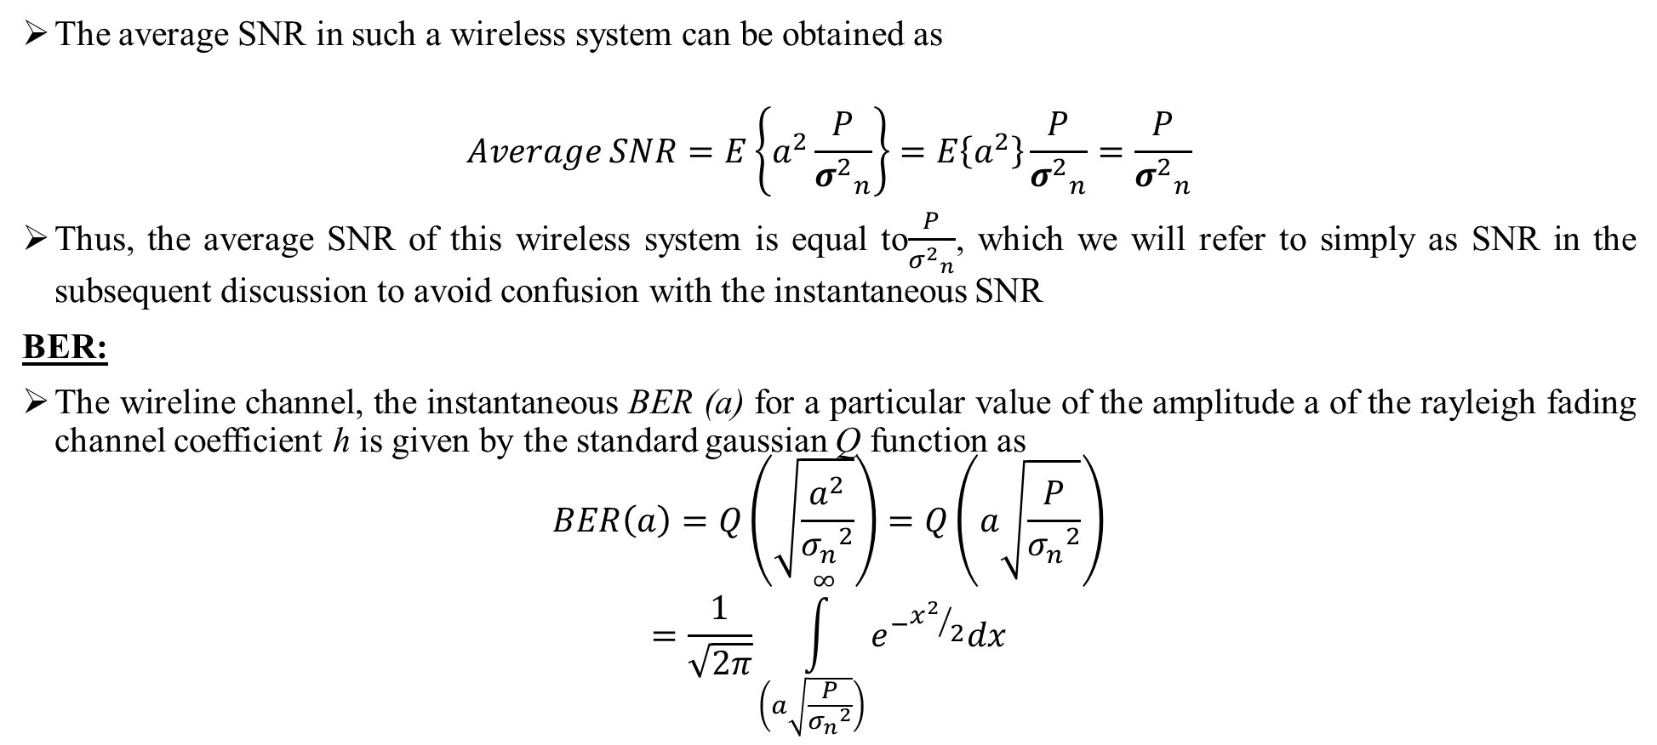
SMALL SCALE FADING AND MULTI PATH
The average SNR in such a wireless system can be obtained as
$$Average SNR=E\left\{a^{2}\frac{P}{{σ^{2}}_{n}}\right\}=E\left\{a^{2}\right\}\frac{P}{{σ^{2}}_{n}}=\frac{P}{{σ^{2}}_{n}}$$
Thus, the average SNR of this wireless system is equal to$\frac{P}{{σ^{2}}_{n}}$, which we will refer to simply as SNR in the subsequent discussion to avoid confusion with the instantaneous SNR
BER:
The wireline channel, the instantaneous BER (a) for a particular value of the amplitude a of the rayleigh fading channel coefficient h is given by the standard gaussian Q function as
$$BER\left(a\right)=Q\left(\sqrt{\frac{a^{2}}{{σ_{n}}^{2}}}\right)=Q\left(a\sqrt{\frac{P}{{σ_{n}}^{2}}}\right)$$
$$=\frac{1}{\sqrt{2π}}\int_{\left(a\sqrt{\frac{P}{{σ_{n}}^{2}}}\right)}^{∞}{e^{−{x^{2}}/2}dx}$$
Small Scale Fading and Multipath Dr.Y.Mallikarjuna Rao 21-02-2023 11/50

Slide 14
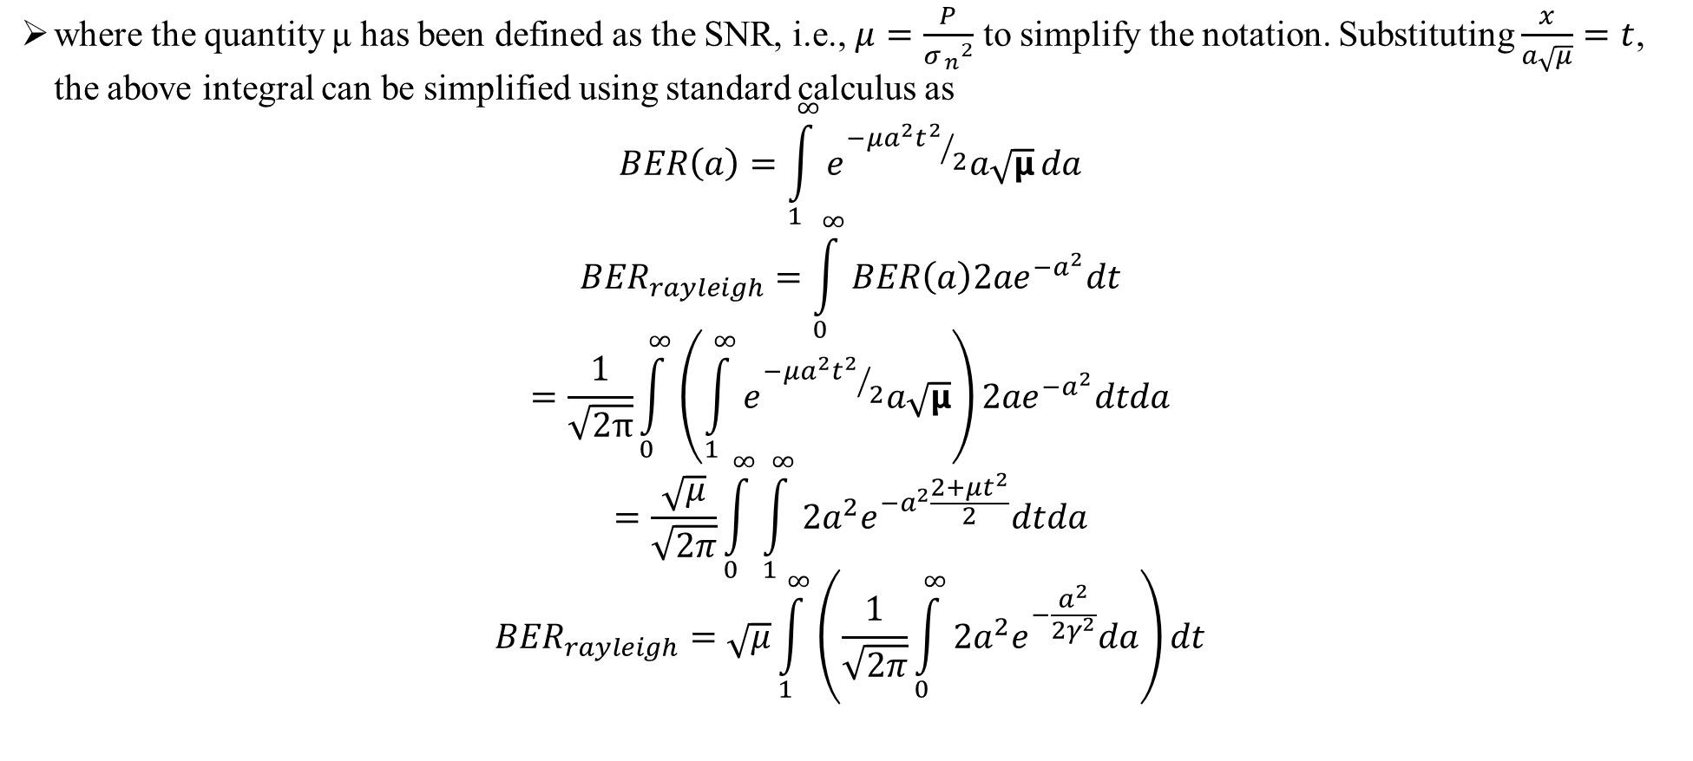
SMALL SCALE FADING AND MULTI PATH
where the quantity μ has been defined as the SNR, i.e., $μ=\frac{P}{{σ_{ n}}^{2}}$ to simplify the notation. Substituting $\frac{x}{a\sqrt{μ}}=t$, the above integral can be simplified using standard calculus as
$$BER\left(a\right)=\int_{1}^{∞}{e^{{−μa^{2}t^{2}}/2}a\sqrt{μ}}da$$
$${BER}_{rayleigh}=\int_{0}^{∞}{BER\left(a\right){2ae}^{{−a}^{2}}dt}$$
$$=\frac{1}{\sqrt{2π}}\int_{0}^{∞}{\left(\int_{1}^{∞}{e^{{−μa^{2}t^{2}}/2}a\sqrt{μ}}\right)}{2ae}^{{−a}^{2}}dtda$$
$$=\frac{\sqrt{μ}}{\sqrt{2π}}\int_{0}^{∞}{\int_{1}^{∞}{2a^{2}e^{−a^{2}\frac{2+{μt}^{2}}{2}}dtda}}$$
$${BER}_{rayleigh}=\sqrt{μ}\int_{1}^{∞}{\left(\frac{1}{\sqrt{2π}}\int_{0}^{∞}{2a^{2}e^{−\frac{a^{2}}{2γ^{2}}}da}\right)dt}$$
Small Scale Fading and Multipath Dr.Y.Mallikarjuna Rao 21-02-2023 12/50

Slide 15
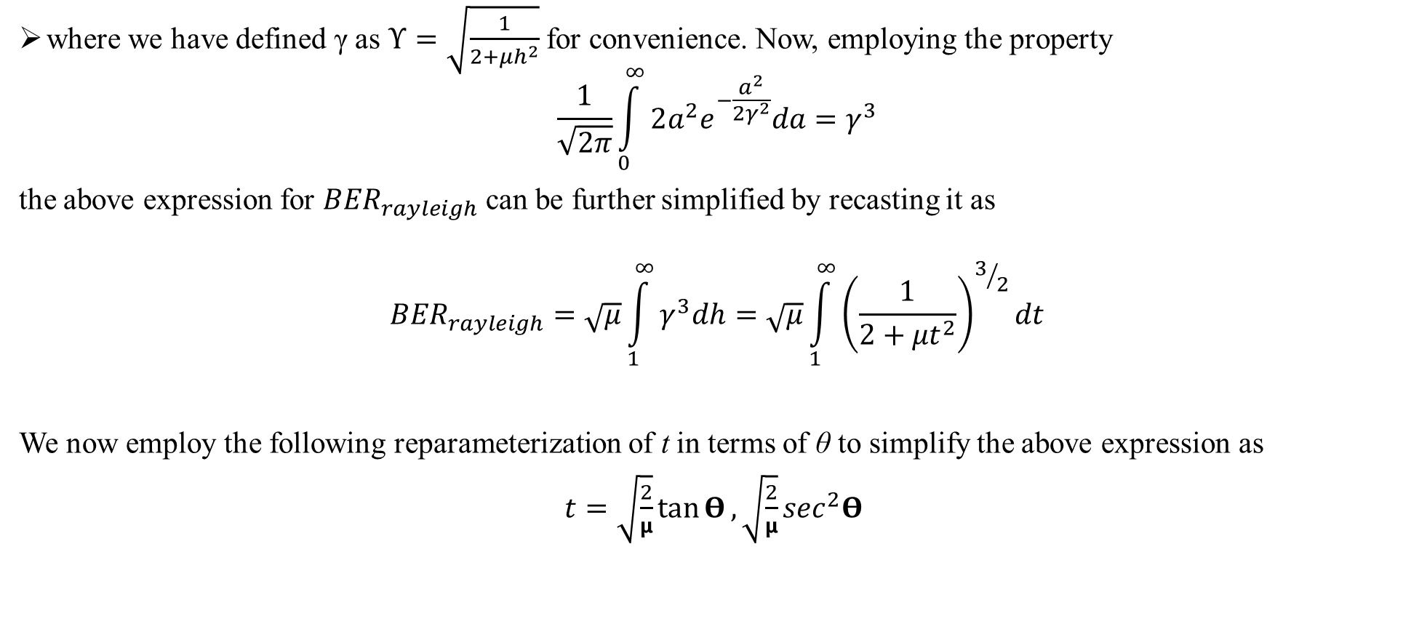
SMALL SCALE FADING AND MULTI PATH
where we have defined γ as $ϒ=\sqrt{\frac{1}{2+μh^{2}}}$ for convenience. Now, employing the property
$$\frac{1}{\sqrt{2π}}\int_{0}^{∞}{2a^{2}e^{−\frac{a^{2}}{2γ^{2}}}da}=γ^{3}$$
the above expression for ${BER}_{rayleigh}$ can be further simplified by recasting it as
$${BER}_{rayleigh}=\sqrt{μ}\int_{1}^{∞}{γ^{3}dh=\sqrt{μ}\int_{1}^{∞}{{\left(\frac{1}{2+{μt}^{2}}\right)}^{3/2}}dt}$$
We now employ the following reparameterization of t in terms of θ to simplify the above expression as
$t=\sqrt{\frac{2}{μ}}\tan{Θ},\sqrt{\frac{2}{μ}}\sec^{2}$𝚹
Small Scale Fading and Multipath Dr.Y.Mallikarjuna Rao 21-02-2023 13/52

Slide 16

SMALL SCALE FADING AND MULTI PATH
$${BER}_{rayleigh}=\sqrt{μ}\int_{\tan^{−1}{\sqrt{\frac{μ}{2}}}}^{π/2}{\frac{1}{2^{3/2}}}\frac{1}{\sec^{3}θ}\sec^{2}θ\sqrt{\frac{2}{μ}}dθ$$
$$=\int_{\tan^{−1}{\sqrt{\frac{μ}{2}}}}^{π/2}{\cos{θdθ}} =\frac{1}{2}\left.\sin{θ}\right|{π/2 \atop \tan^{−1}{\sqrt{\frac{μ}{2}}}}$$
$$=\frac{1}{2}\left(\sin{\frac{π}{2}−\sin\left(\tan^{−1}{\sqrt{\frac{μ}{2}}}\right)}\right) =\frac{1}{2}\left(1−\frac{\sqrt{\frac{μ}{2}}}{1+\sqrt{\frac{μ}{2}}}\right)$$
$$\boxed{{BER}_{rayleigh}=\frac{1}{2}\left(1−\sqrt{\frac{SNR}{2+SNR}}\right)}$$
Small Scale Fading and Multipath Dr.Y.Mallikarjuna Rao 21-02-2023 14/50

Slide 17
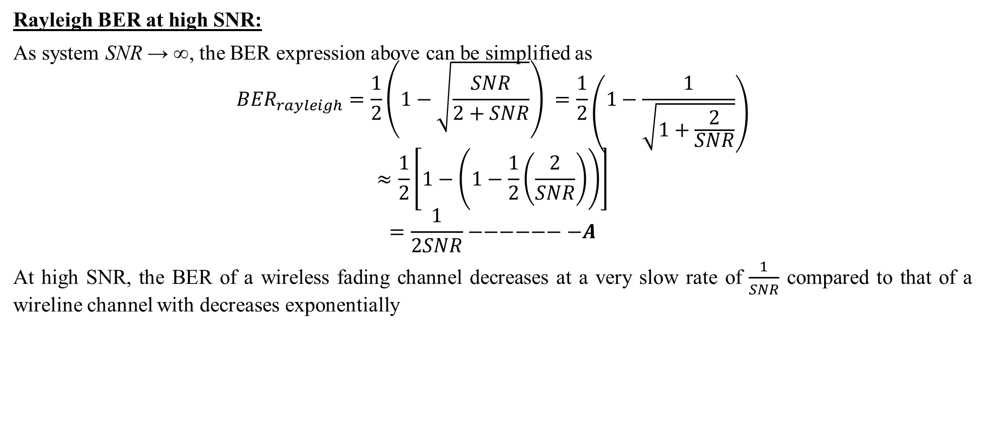
SMALL SCALE FADING AND MULTI PATH
Rayleigh BER at high SNR:
As system SNR → ∞, the BER expression above can be simplified as
$${BER}_{rayleigh}=\frac{1}{2}\left(1−\sqrt{\frac{SNR}{2+SNR}}\right) =\frac{1}{2}\left(1−\frac{1}{\sqrt{1+\frac{2}{SNR}}}\right)$$
$$≈\frac{1}{2}\left[1−\left(1−\frac{1}{2}\left(\frac{2}{SNR}\right)\right)\right]$$
$$=\frac{1}{2SNR}−−−−−−−A$$
At high SNR, the BER of a wireless fading channel decreases at a very slow rate of $\frac{1}{SNR}$ compared to that of a wireline channel with decreases exponentially
Small Scale Fading and Multipath Dr.Y.Mallikarjuna Rao 21-02-2023 15/50

Slide 18
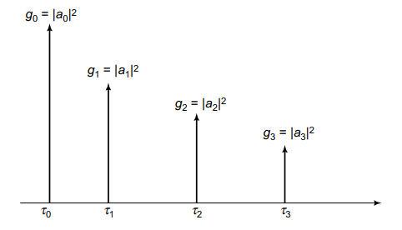
SMALL SCALE FADING AND MULTI PATH
WIRELESS CHANNEL AND DELAY SPEED:
The fading wireless channel comprises several multipath components arising from the presence of multiple non-line-of-sight (NLOS) signal-propagation paths. These NLOS components arise from the scattering effects of objects in the wireless environment such as buildings, trees, vehicles, water bodies, etc.
In Wireless Channel Modellingwe aim to develop a systemic framework to study the nature of the wireless channel, especially with respect to key properties such as inter-symbol interference and, time-varying characteristics amongst others.
FIGURE 5: SCHEMATIC OF AN L = 4 TAP WIRELESS CHANNEL PROFILE
Small Scale Fading and Multipath Dr.Y.Mallikarjuna Rao 21-02-2023 16/50

Slide 19
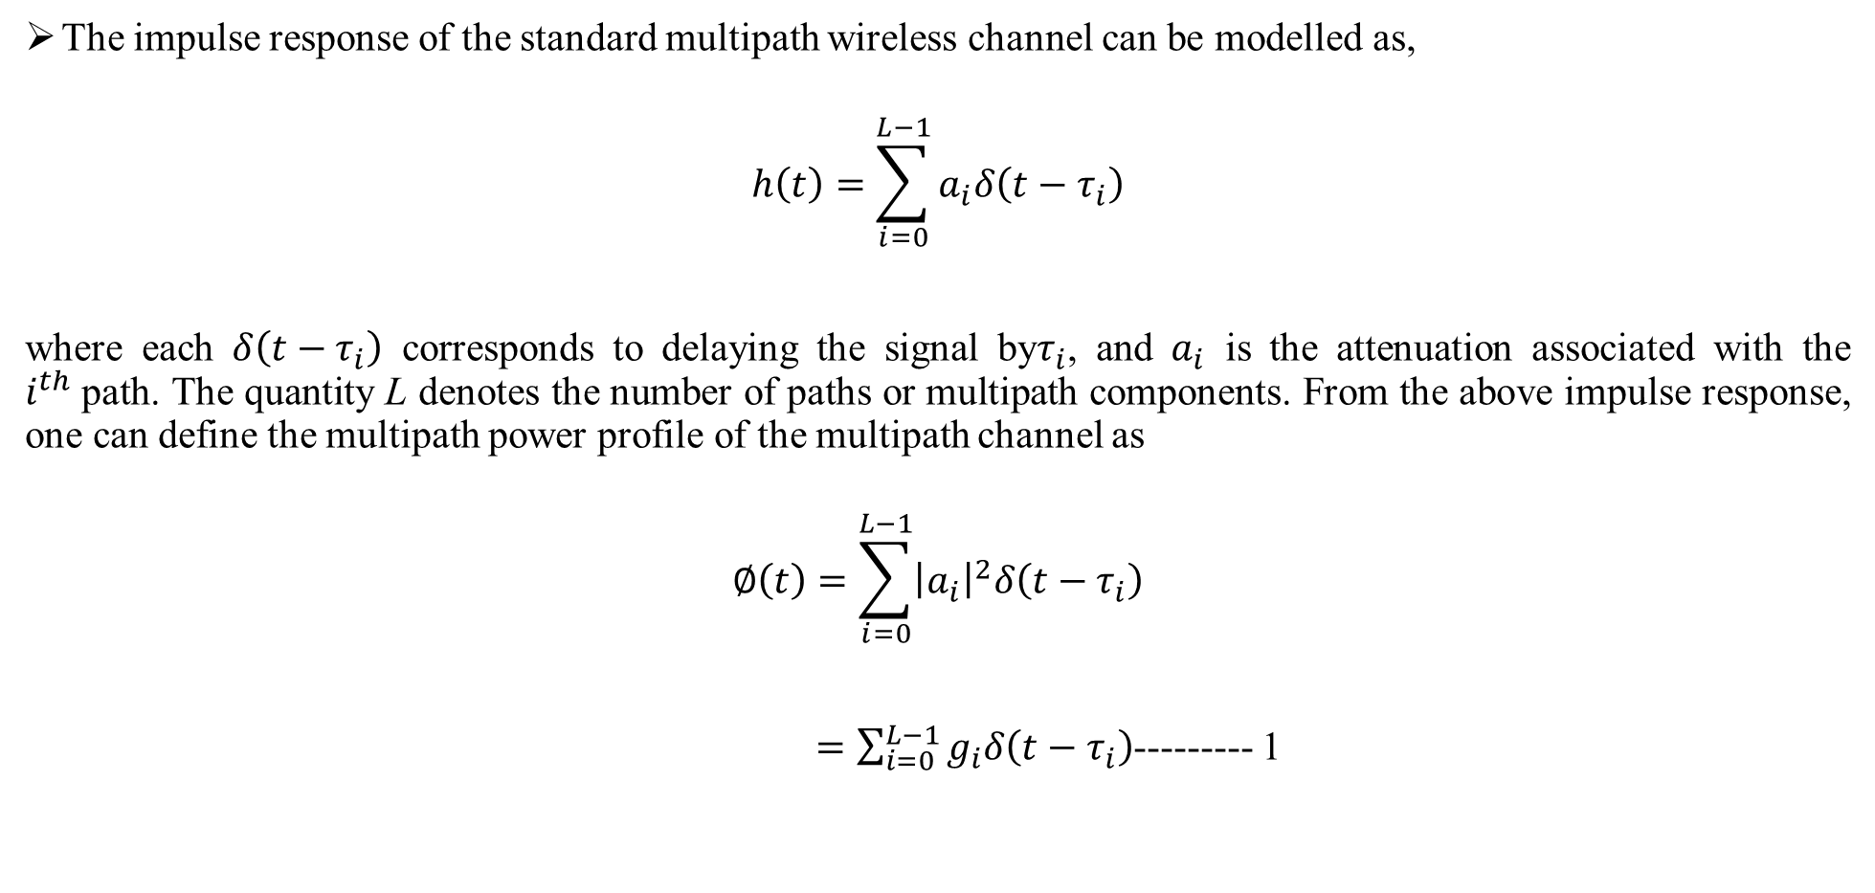
SMALL SCALE FADING AND MULTI PATH
The impulse response of the standard multipath wireless channel can be modelled as,
$$h\left(t\right)=\sum_{i=0}^{L−1}{a_{i}δ\left(t−τ_{i}\right)}$$
where each $δ\left(t−τ_{i}\right)$ corresponds to delaying the signal by$τ_{i}$, and $a_{i}$ is the attenuation associated with the $i^{th}$path. The quantity L denotes the number of paths or multipath components. From the above impulse response, one can define the multipath power profile of the multipath channel as
$$∅\left(t\right)=\sum_{i=0}^{L−1}{{\left|a_{i}\right|}^{2}δ\left(t−τ_{i}\right)}$$
$=\sum_{i=0}^{L−1}{g_{i}δ\left(t−τ_{i}\right)}$--------- 1
Small Scale Fading and Multipath Dr.Y.Mallikarjuna Rao 21-02-2023 17/50

Slide 20
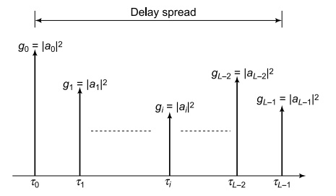
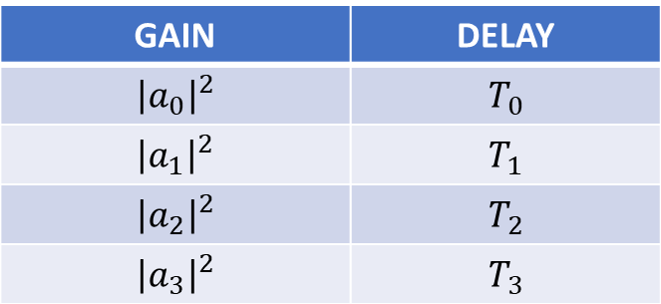
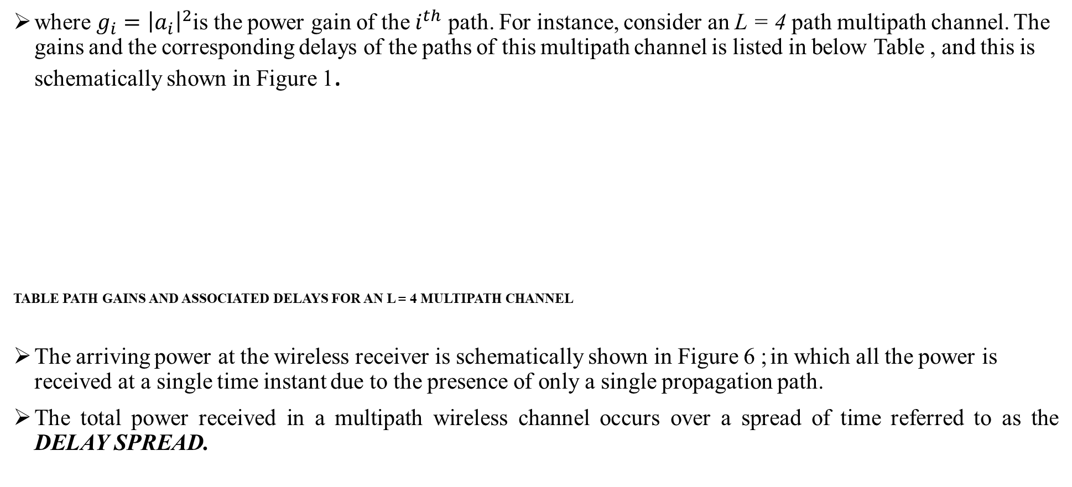
SMALL SCALE FADING AND MULTI PATH
where $g_{i}={\left|a_{i}\right|}^{2}$is the power gain of the $i^{th}$ path. For instance, consider an L = 4 path multipath channel. The gains and the corresponding delays of the paths of this multipath channel is listed in below Table , and this is schematically shown in Figure 1.
TABLE PATH GAINS AND ASSOCIATED DELAYS FOR AN L = 4 MULTIPATH CHANNEL
The arriving power at the wireless receiver is schematically shown in Figure 6 ; in which all the power is received at a single time instant due to the presence of only a single propagation path.
The total power received in a multipath wireless channel occurs over a spread of time referred to as the DELAY SPREAD.
GAIN | DELAY
$${\left|a_{0}\right|}^{2}$$ | $$T_{0}$$
$${\left|a_{1}\right|}^{2}$$ | $$T_{1}$$
$${\left|a_{2}\right|}^{2}$$ | $$T_{2}$$
$${\left|a_{3}\right|}^{2}$$ | $$T_{3}$$
FIGURE 6: SCHEMATIC OF A TYPICAL WIRELESS CHANNEL POWER PROFILE AND DELAY SPREAD
Small Scale Fading and Multipath Dr.Y.Mallikarjuna Rao 21-02-2023 18/50

Slide 21
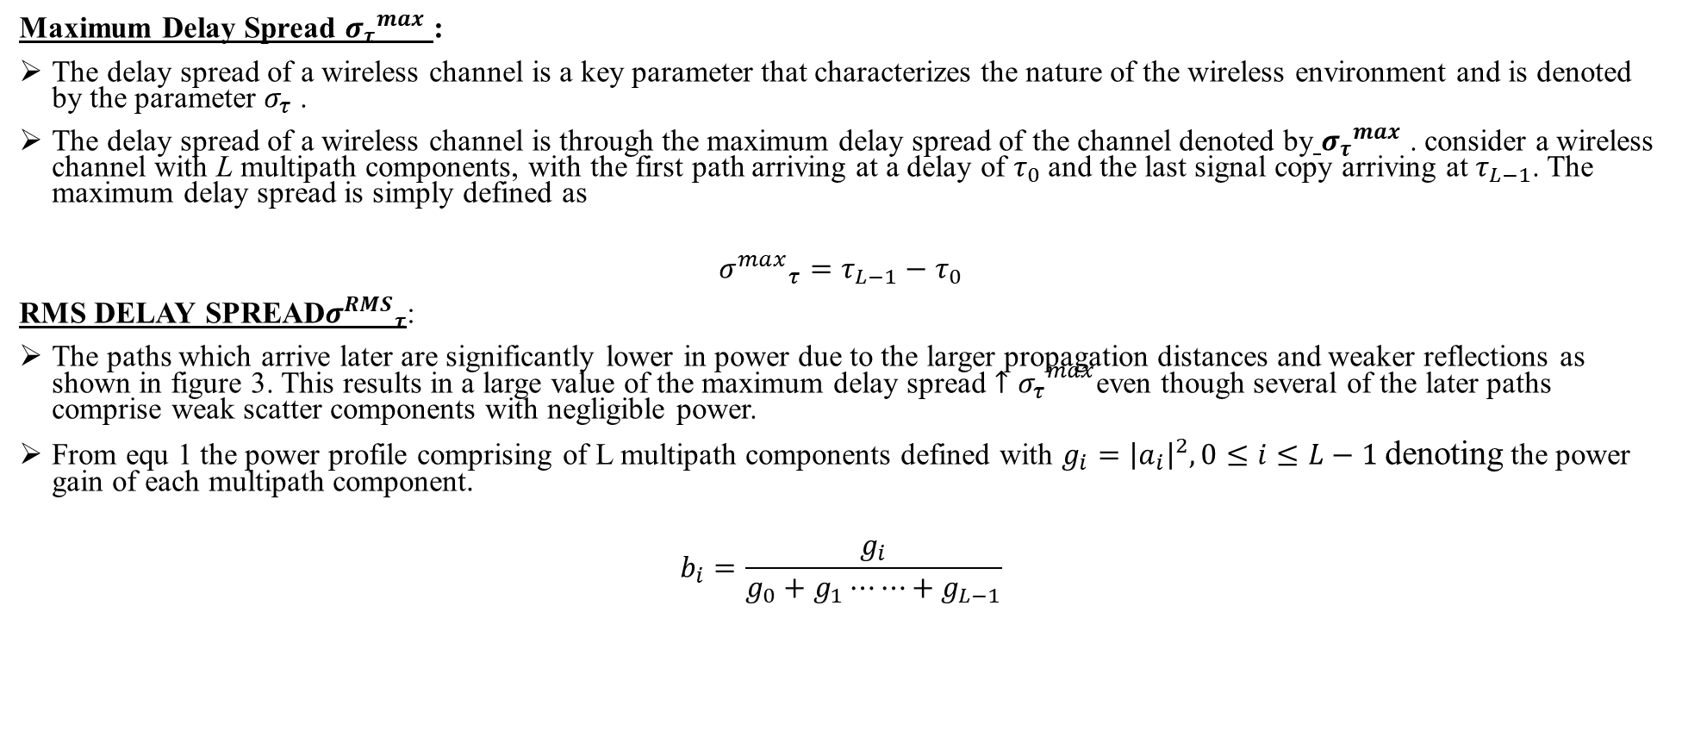
SMALL SCALE FADING AND MULTI PATH
Maximum Delay Spread ${σ_{τ}}^{max}$ :
The delay spread of a wireless channel is a key parameter that characterizes the nature of the wireless environment and is denoted by the parameter $σ_{τ}$ .
The delay spread of a wireless channel is through the maximum delay spread of the channel denoted by ${σ_{τ}}^{max}$ . consider a wireless channel with L multipath components, with the first path arriving at a delay of $τ_{0}$and the last signal copy arriving at $τ_{L−1}$. The maximum delay spread is simply defined as
$${σ^{max}}_{τ}=τ_{L−1}−τ_{0}$$
RMS DELAY SPREAD${σ^{RMS}}_{τ}$:
The paths which arrive later are significantly lower in power due to the larger propagation distances and weaker reflections as shown in figure 3. This results in a large value of the maximum delay spread ${{↑σ}_{τ}}^{max}$even though several of the later paths comprise weak scatter components with negligible power.
From equ 1 the power profile comprising of L multipath components defined with $g_{i}={\left|a_{i}\right|}^{2},0≤i≤L−1$ denoting the power gain of each multipath component.
$$b_{i}=\frac{g_{i}}{g_{0}+g_{1}⋯⋯+g_{L−1}}$$
Small Scale Fading and Multipath Dr.Y.Mallikarjuna Rao 21-02-2023 19/50

Slide 22
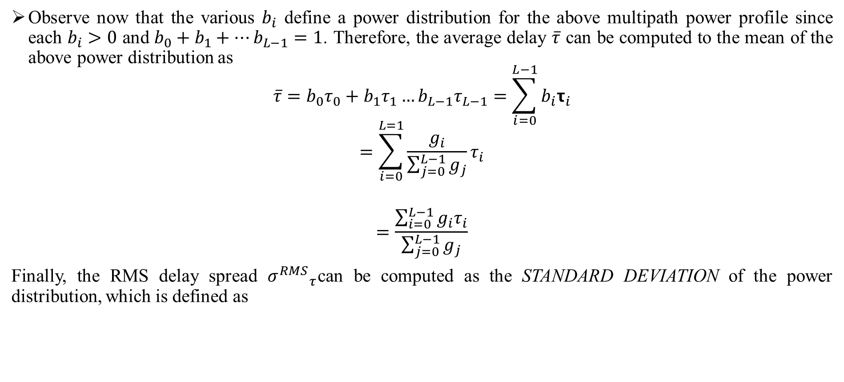
SMALL SCALE FADING AND MULTI PATH
Observe now that the various $b_{i}$ define a power distribution for the above multipath power profile since each $b_{i}>0$ and $b_{0}+b_{1}+…b_{L−1}=1$. Therefore, the average delay $\overline{τ}$ can be computed to the mean of the above power distribution as
$$\overline{τ}=b_{0}τ_{0}+b_{1}τ_{1}…b_{L−1}τ_{L−1}=\sum_{i=0}^{L−1}{b_{i}τ_{i}}$$
$$=\sum_{i=0}^{L=1}{\frac{g_{i}}{\sum_{j=0}^{L−1}{g_{j}}}τ_{i}}$$
$$=\frac{\sum_{i=0}^{L−1}{g_{i}τ_{i}}}{\sum_{j=0}^{L−1}{g_{j}}}$$
Finally, the RMS delay spread ${σ^{RMS}}_{τ}$can be computed as the STANDARD DEVIATION of the power distribution, which is defined as
Small Scale Fading and Multipath Dr.Y.Mallikarjuna Rao 21-02-2023 20/50

Slide 23
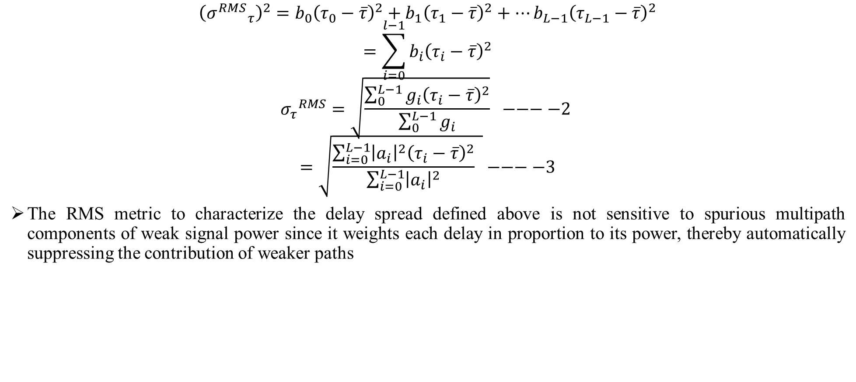
SMALL SCALE FADING AND MULTI PATH
$${\left({σ^{RMS}}_{τ}\right)}^{2}=b_{0}{\left(τ_{0}−\overline{τ}\right)}^{2}+b_{1}{\left(τ_{1}−\overline{τ}\right)}^{2}+…b_{L−1}{\left(τ_{L−1}−\overline{τ}\right)}^{2}$$
$$=\sum_{i=0}^{l−1}{b_{i}{\left(τ_{i}−\overline{τ}\right)}^{2}}$$
$${σ_{τ}}^{RMS}=\sqrt{\frac{\sum_{0}^{L−1}{g_{i}{\left(τ_{i}−\overline{τ}\right)}^{2}}}{\sum_{0}^{L−1}{g_{i}}}} −−−−2$$
$$=\sqrt{\frac{\sum_{i=0}^{L−1}{{\left|a_{i}\right|}^{2}{\left(τ_{i}−\overline{τ}\right)}^{2}}}{\sum_{i=0}^{L−1}{{\left|a_{i}\right|}^{2}}} }−−−−3$$
The RMS metric to characterize the delay spread defined above is not sensitive to spurious multipath components of weak signal power since it weights each delay in proportion to its power, thereby automatically suppressing the contribution of weaker paths
Small Scale Fading and Multipath Dr.Y.Mallikarjuna Rao 21-02-2023 21/50

Slide 24
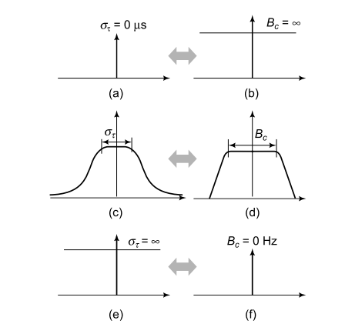
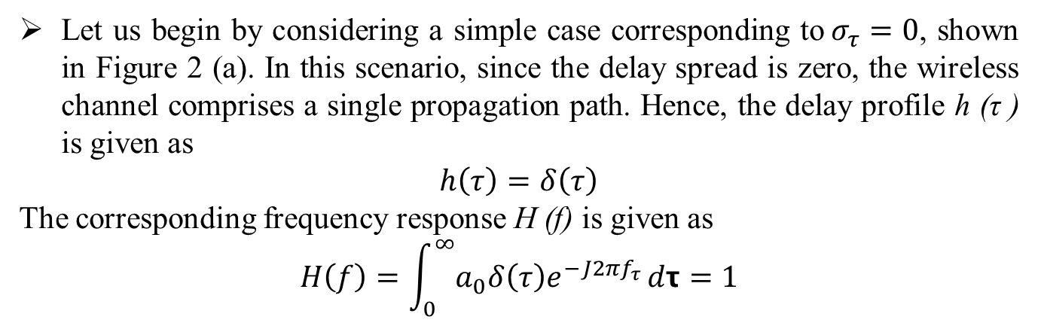
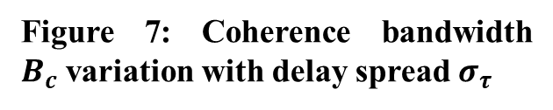

SMALL SCALE FADING AND MULTI PATH
COHERENCE BANDWIDTH IN WIRELESS COMMUNICATIONS:
In this section, we introduce another important parameter of a wireless communication channel, namely, the coherence bandwidth${ B}_{c}$. Towards this end, let us define the frequency response H (f) of the wireless channel as
$$H\left(f\right)=\int_{0}^{∞}{h\left(τ\right)e^{−j2πfτ}dτ}$$
Let us begin by considering a simple case corresponding to$σ_{τ}=0$, shown in Figure 2 (a). In this scenario, since the delay spread is zero, the wireless channel comprises a single propagation path. Hence, the delay profile h (τ ) is given as
$$h\left(τ\right)=δ\left(τ\right)$$
The corresponding frequency response H (f) is given as
$$H\left(f\right)=\int_{0}^{∞}{a_{0}δ\left(τ\right)e^{−J2πf_{τ}}}dτ=1$$
Figure 7: Coherence bandwidth $B_{c}$variation with delay spread $σ_{τ}$
Small Scale Fading and Multipath Dr.Y.Mallikarjuna Rao 21-02-2023 22/50

Slide 25
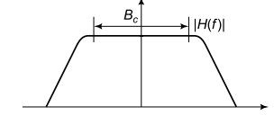

SMALL SCALE FADING AND MULTI PATH
The frequency response is the constant 1 and |H (f)| = 1. This is basically a flat frequency response over the entire frequency band as shown in figure 2 (b), i.e., Of infinite bandwidth
As the delay spread $σ_{τ}$ increases in Figure 2 (c), the time spread of this response increases, leading to a decrease in the bandwidth of the response $H\left(f\right)$ as shown in Figure 2 (d). Finally, as the time spread of the response becomes ∞ as shown in Figure 2(e), the channel filter becomes an impulse $δ\left(f\right)$ as shown in Figure 2 (f) and the bandwidth of the channel filter reduces to 0. The coherence bandwidth $B_{c}$ is then defined as the bandwidth of the response, i.e., the frequency band over which the response $H\left(f\right)$ is flat as shown in Figure 2.
Figure 8: coherence bandwidth of wireless-channel response
Small Scale Fading and Multipath Dr.Y.Mallikarjuna Rao 21-02-2023 23/50

Slide 26
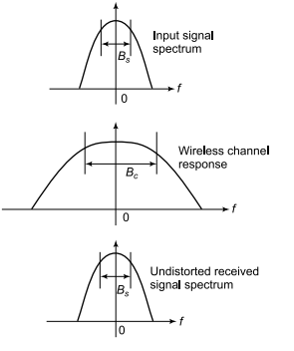
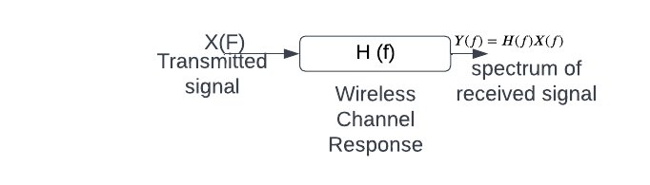
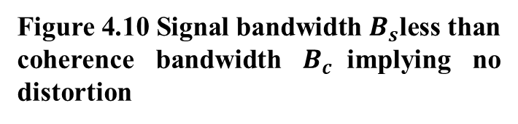

SMALL SCALE FADING AND MULTI PATH
from the theory of linear signals and systems that the output response $y\left(f\right)$ of the output signal $y\left(t\right)$ is given as
$$Y\left(f\right)=H\left(f\right) X\left(f\right)−−−4$$
Figure 9: Linear input-output system model for the wireless channel
Figure 4.10 Signal bandwidth $B_{s}$less than coherence bandwidth $B_{c}$implying no distortion
Small Scale Fading and Multipath Dr.Y.Mallikarjuna Rao 21-02-2023 24/50

Slide 27
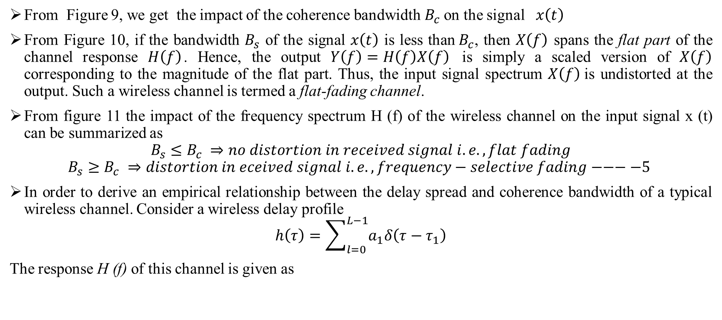
SMALL SCALE FADING AND MULTI PATH
From Figure 9, we get the impact of the coherence bandwidth $B_{c}$on the signal$x\left(t\right)$
From Figure 10, if the bandwidth $B_{s}$ of the signal $x\left(t\right)$ is less than$B_{c}$, then $X\left(f\right)$ spans the flat part of the channel response $H\left(f\right)$. Hence, the output $Y\left(f\right)=H\left(f\right)X\left(f\right)$ is simply a scaled version of $X\left(f\right)$ corresponding to the magnitude of the flat part. Thus, the input signal spectrum $X\left(f\right)$is undistorted at the output. Such a wireless channel is termed a flat-fading channel.
From figure 11 the impact of the frequency spectrum H (f) of the wireless channel on the input signal x (t) can be summarized as
$$B_{s}≤B_{c} ⇒no distortion in received signal i.e.,flat fading$$
$$B_{s}≥B_{c} ⇒distortion in eceived signal i.e., frequency−selective fading−−−−5$$
In order to derive an empirical relationship between the delay spread and coherence bandwidth of a typical wireless channel. Consider a wireless delay profile
$$h\left(τ\right)=\sum_{l=0}^{L−1}{a_{1}δ\left(τ−τ_{1}\right)}$$
The response H (f) of this channel is given as
Small Scale Fading and Multipath Dr.Y.Mallikarjuna Rao 21-02-2023 25/50

Slide 28

SMALL SCALE FADING AND MULTI PATH
$$H\left(f\right)=\int_{0}^{∞}{h\left(τ\right)e^{−j2πf_{τ}}}dτ$$
$$=\int_{0}^{∞}{\left(\sum_{l=0}^{L−1}{a_{1}δ\left(τ−τ_{1}\right)}\right)dτ }e^{−j2πf_{t}}$$
$$=\sum_{l=0}^{L−1}{a_{1}e^{−j2πf_{t_{1}}}}$$
Consider now the highest frequency harmonic corresponding to${ a}_{L−1}e^{−j2πfτ_{L−1}}$, i.e., with phase varying at the rate$τ_{L−1}$. Its values at frequencies 0 and $\frac{1}{4τ_{L−1}}$are given as
$$f=0⇒a_{L−1}e^{−j2πfτ_{L−1}}=a_{L−1}e^{0}=1$$
$$f=\frac{1}{4τ_{L−1}}⇒a_{L−1}e^{−j2π\frac{1}{τ_{L−1}}τ_{L−1}}=a_{L−1}e^{−jπ\frac{1}{2}}=−ja_{L−1}$$
Small Scale Fading and Multipath Dr.Y.Mallikarjuna Rao 21-02-2023 26/50

Slide 29
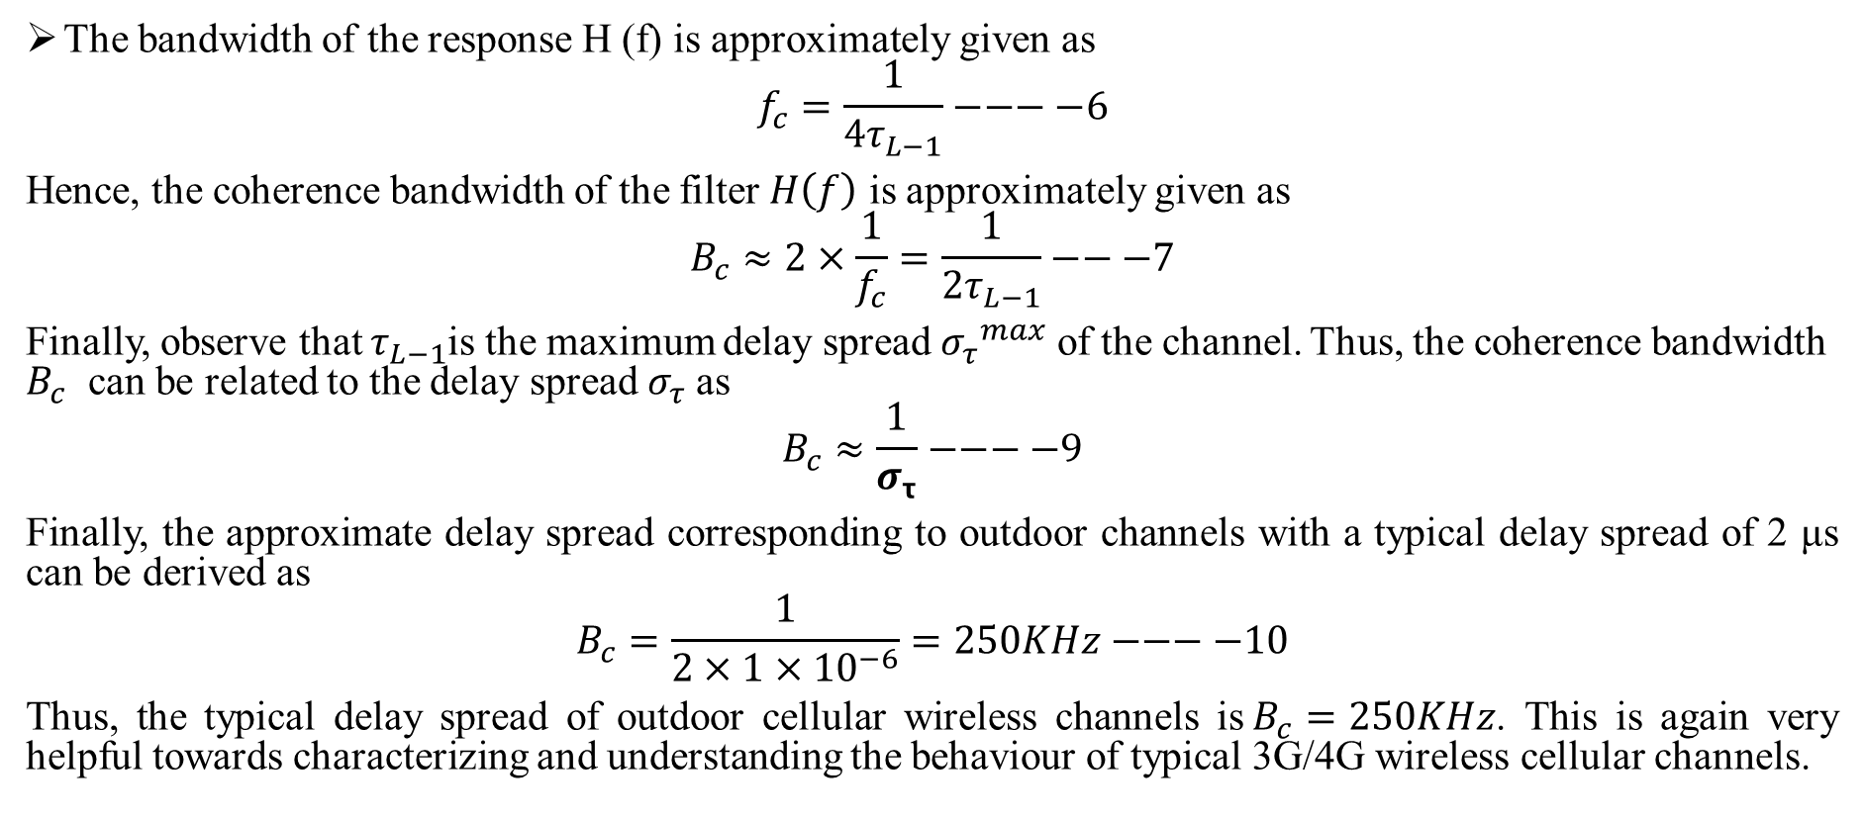
SMALL SCALE FADING AND MULTI PATH
The bandwidth of the response H (f) is approximately given as
$$f_{c}=\frac{1}{4τ_{L−1}}−−−−6$$
Hence, the coherence bandwidth of the filter $H\left(f\right)$ is approximately given as
$$B_{c}≈2×\frac{1}{f_{c}}=\frac{1}{2τ_{L−1}}−−−7$$
Finally, observe that $τ_{L−1}$is the maximum delay spread ${σ_{τ}}^{max}$ of the channel. Thus, the coherence bandwidth $B_{c}$ can be related to the delay spread $σ_{τ}$as
$$B_{c}≈\frac{1}{σ_{τ}}−−−−9$$
Finally, the approximate delay spread corresponding to outdoor channels with a typical delay spread of 2 μs can be derived as
$$B_{c}=\frac{1}{2×1×{10}^{−6}}=250KHz−−−−10$$
Thus, the typical delay spread of outdoor cellular wireless channels is$B_{c}=250KHz$. This is again very helpful towards characterizing and understanding the behaviour of typical 3G/4G wireless cellular channels.
Small Scale Fading and Multipath Dr.Y.Mallikarjuna Rao 21-02-2023 27/50

Slide 30
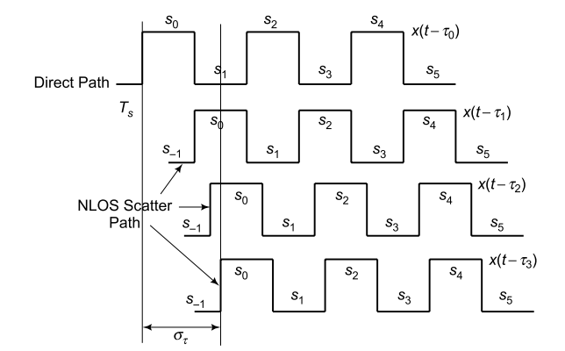
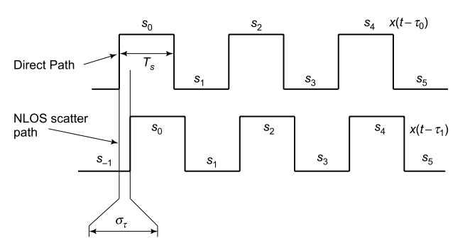

SMALL SCALE FADING AND MULTI PATH
ISI AND DOPPLER IN WIRELESS CHANNEL:
ISI IN WIRELESS CHANNEL:
Figure 4.13: Negligible ISI when $σ_{τ}≪τ_{S}$
Figure 4.12 severe ISI caused by multiple scatter components
Small Scale Fading and Multipath Dr.Y.Mallikarjuna Rao 21-02-2023 28/50

Slide 31
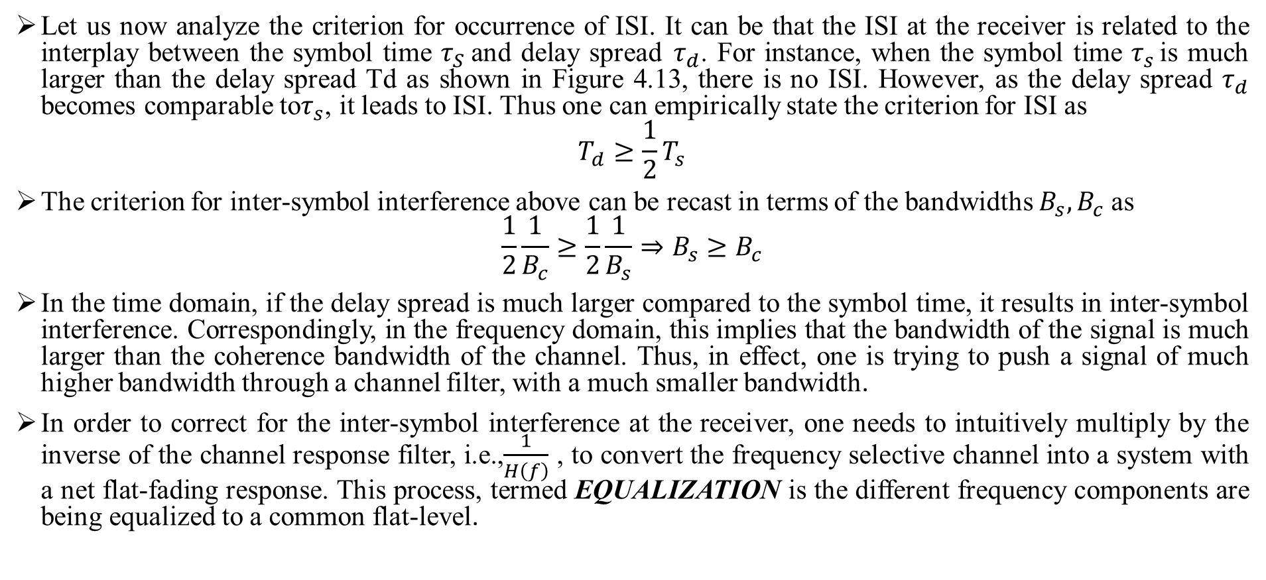
SMALL SCALE FADING AND MULTI PATH
Let us now analyze the criterion for occurrence of ISI. It can be that the ISI at the receiver is related to the interplay between the symbol time $τ_{S}$and delay spread${ τ}_{d}$. For instance, when the symbol time $τ_{s }$is much larger than the delay spread Td as shown in Figure 4.13, there is no ISI. However, as the delay spread $τ_{d}$ becomes comparable to$τ_{s}$, it leads to ISI. Thus one can empirically state the criterion for ISI as
$$T_{d}≥\frac{1}{2}T_{s}$$
The criterion for inter-symbol interference above can be recast in terms of the bandwidths $B_{s},B_{c}$ as
$$\frac{1}{2}\frac{1}{B_{c}}≥\frac{1}{2}\frac{1}{B_{s}}⇒B_{s}≥B_{c}$$
In the time domain, if the delay spread is much larger compared to the symbol time, it results in inter-symbol interference. Correspondingly, in the frequency domain, this implies that the bandwidth of the signal is much larger than the coherence bandwidth of the channel. Thus, in effect, one is trying to push a signal of much higher bandwidth through a channel filter, with a much smaller bandwidth.
In order to correct for the inter-symbol interference at the receiver, one needs to intuitively multiply by the inverse of the channel response filter, i.e.,$\frac{1}{H\left(f\right)}$ , to convert the frequency selective channel into a system with a net flat-fading response. This process, termed EQUALIZATION is the different frequency components are being equalized to a common flat-level.
Small Scale Fading and Multipath Dr.Y.Mallikarjuna Rao 21-02-2023 29/50

Slide 32
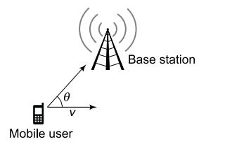
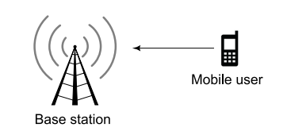
SMALL SCALE FADING AND MULTI PATH
DOPPLER SPECTRUM AND JAKES MODEL:
DOPPLER IN WIRELESS CHANNEL:
The Doppler shift is a fundamental principle related to the electromagnetic radio-wave propagation. In this context, the Doppler shift associated with an electromagnetic wave is defined as the perceived change in the frequency of the wave due to relative motion between the transmitter and receiver, which is schematically shown below. The perceived frequency is higher than the true frequency if the transmitter is moving towards the receiver and lower otherwise.
Figure 4.14 Doppler fading due to user mobility
Figure 4.15 Doppler scenario
Small Scale Fading and Multipath Dr.Y.Mallikarjuna Rao 21-02-2023 30/50

Slide 33
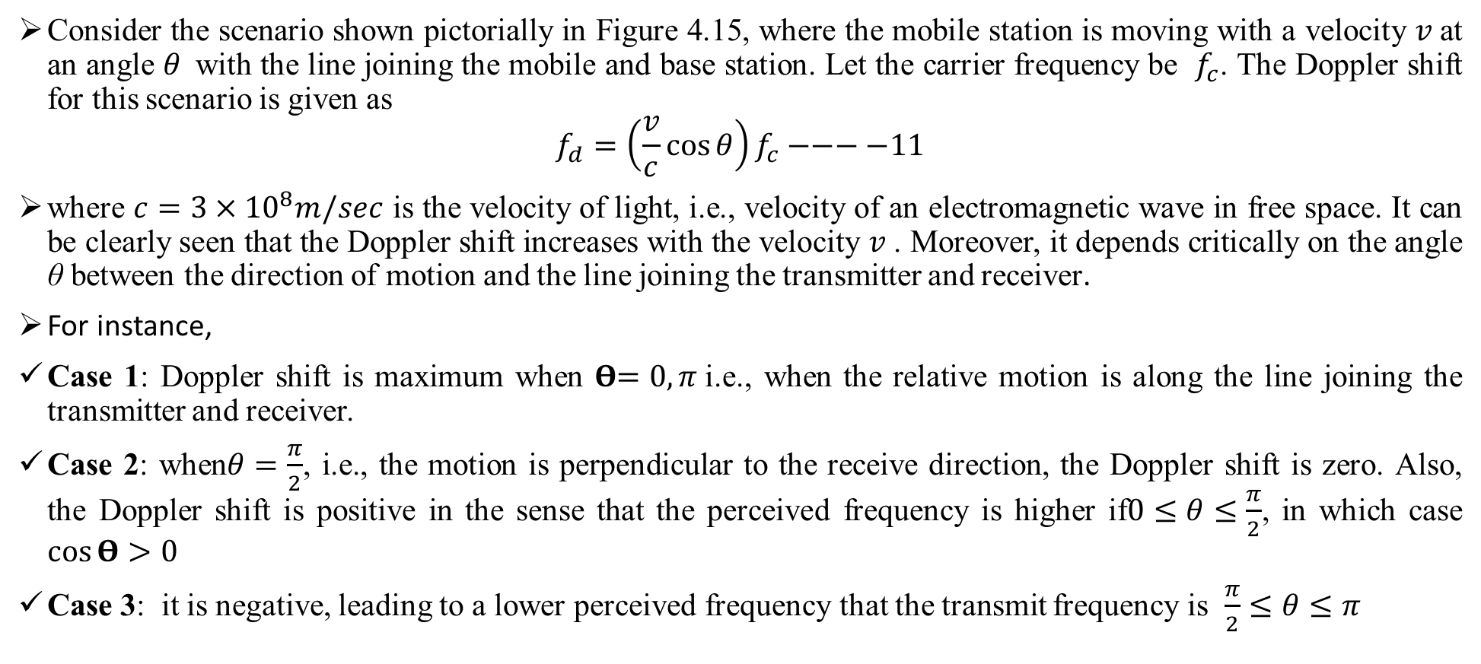
SMALL SCALE FADING AND MULTI PATH
Consider the scenario shown pictorially in Figure 4.15, where the mobile station is moving with a velocity $v$at an angle $θ$with the line joining the mobile and base station. Let the carrier frequency be $f_{c}$. The Doppler shift for this scenario is given as
$$f_{d}=\left(\frac{v}{c}\cos{θ}\right)f_{c}−−−−11$$
where $c=3×{10}^{8}m/sec$ is the velocity of light, i.e., velocity of an electromagnetic wave in free space. It can be clearly seen that the Doppler shift increases with the velocity $v$. Moreover, it depends critically on the angle θ between the direction of motion and the line joining the transmitter and receiver.
For instance,
Case 1: Doppler shift is maximum when 𝚹$=0,π$i.e., when the relative motion is along the line joining the transmitter and receiver.
Case 2: when$θ=\frac{π}{2}$, i.e., the motion is perpendicular to the receive direction, the Doppler shift is zero. Also, the Doppler shift is positive in the sense that the perceived frequency is higher if$0≤θ≤\frac{π}{2}$, in which case $\cos{Θ}>0$
Case 3: it is negative, leading to a lower perceived frequency that the transmit frequency is $\frac{π}{2}≤θ≤π$
Small Scale Fading and Multipath Dr.Y.Mallikarjuna Rao 21-02-2023 31/50

Slide 34
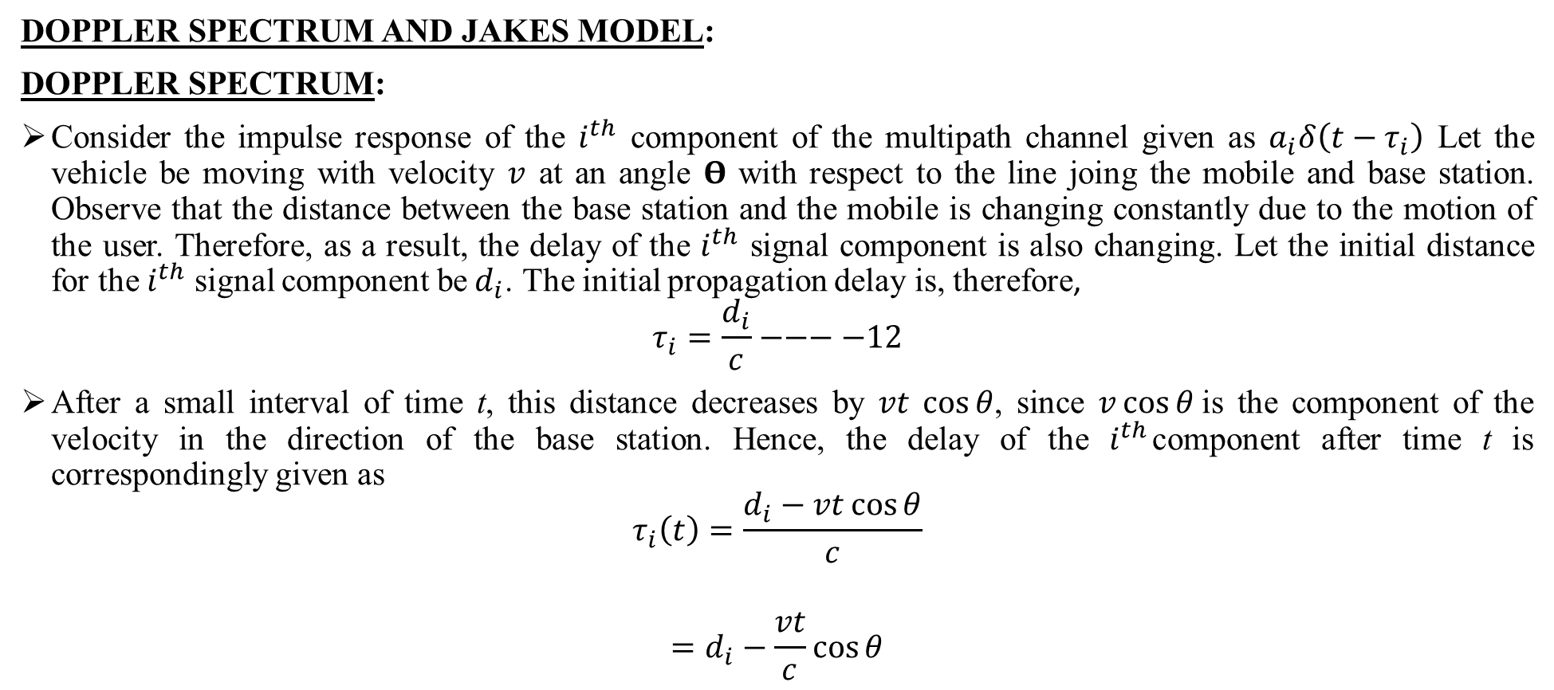
SMALL SCALE FADING AND MULTI PATH
DOPPLER SPECTRUM AND JAKES MODEL:
DOPPLER SPECTRUM:
Consider the impulse response of the $i^{th}$ component of the multipath channel given as $a_{i}δ\left(t−τ_{i}\right)$ Let the vehicle be moving with velocity $v$ at an angle 𝚹 with respect to the line joing the mobile and base station. Observe that the distance between the base station and the mobile is changing constantly due to the motion of the user. Therefore, as a result, the delay of the $i^{th}$ signal component is also changing. Let the initial distance for the $i^{th}$ signal component be${ d}_{i}$. The initial propagation delay is, therefore,
$$τ_{i}=\frac{d_{i}}{c}−−−−12$$
After a small interval of time t, this distance decreases by $vt \cos{θ}$, since $v\cos{θ}$is the component of the velocity in the direction of the base station. Hence, the delay of the $i^{th}$component after time t is correspondingly given as
$$τ_{i}\left(t\right)=\frac{d_{i}−vt\cos{θ}}{c}$$
$$=d_{i}−\frac{vt}{c}\cos{θ}$$
Small Scale Fading and Multipath Dr.Y.Mallikarjuna Rao 21-02-2023 32/50

Slide 35
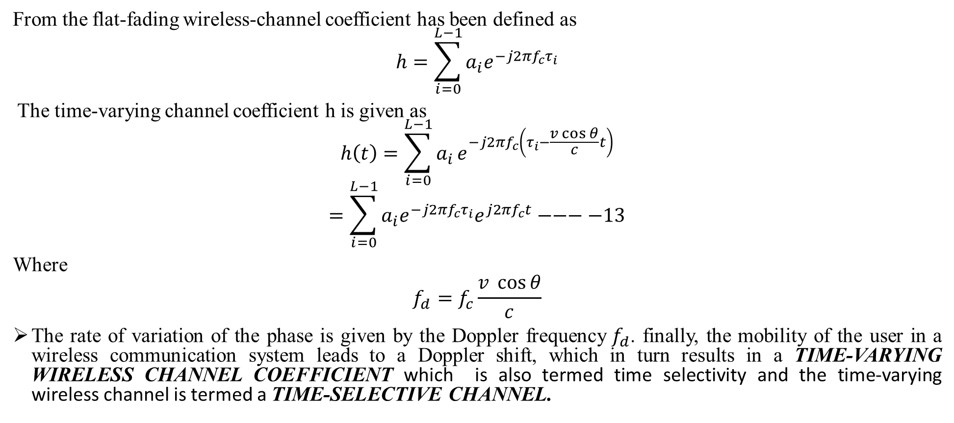
SMALL SCALE FADING AND MULTI PATH
From the flat-fading wireless-channel coefficient has been defined as
$$h=\sum_{i=0}^{L−1}{a_{i}e^{−j2πf_{c}τ_{i}}}$$
The time-varying channel coefficient h is given as
$$h\left(t\right)=\sum_{i=0}^{L−1}{a_{i}}e^{−j2πf_{c}\left(τ_{i}−\frac{v\cos{θ}}{c}t\right)}$$
$$=\sum_{i=0}^{L−1}{a_{i}e^{−j2πf_{c}τ_{i}}e^{j2πf_{c}t}}−−−−13$$
Where
$$f_{d}=f_{c}\frac{v \cos{θ}}{c}$$
The rate of variation of the phase is given by the Doppler frequency$f_{d}$. finally, the mobility of the user in a wireless communication system leads to a Doppler shift, which in turn results in a TIME-VARYING WIRELESS CHANNEL COEFFICIENT which is also termed time selectivity and the time-varying wireless channel is termed a TIME-SELECTIVE CHANNEL.
Small Scale Fading and Multipath Dr.Y.Mallikarjuna Rao 21-02-2023 33/50

Slide 36
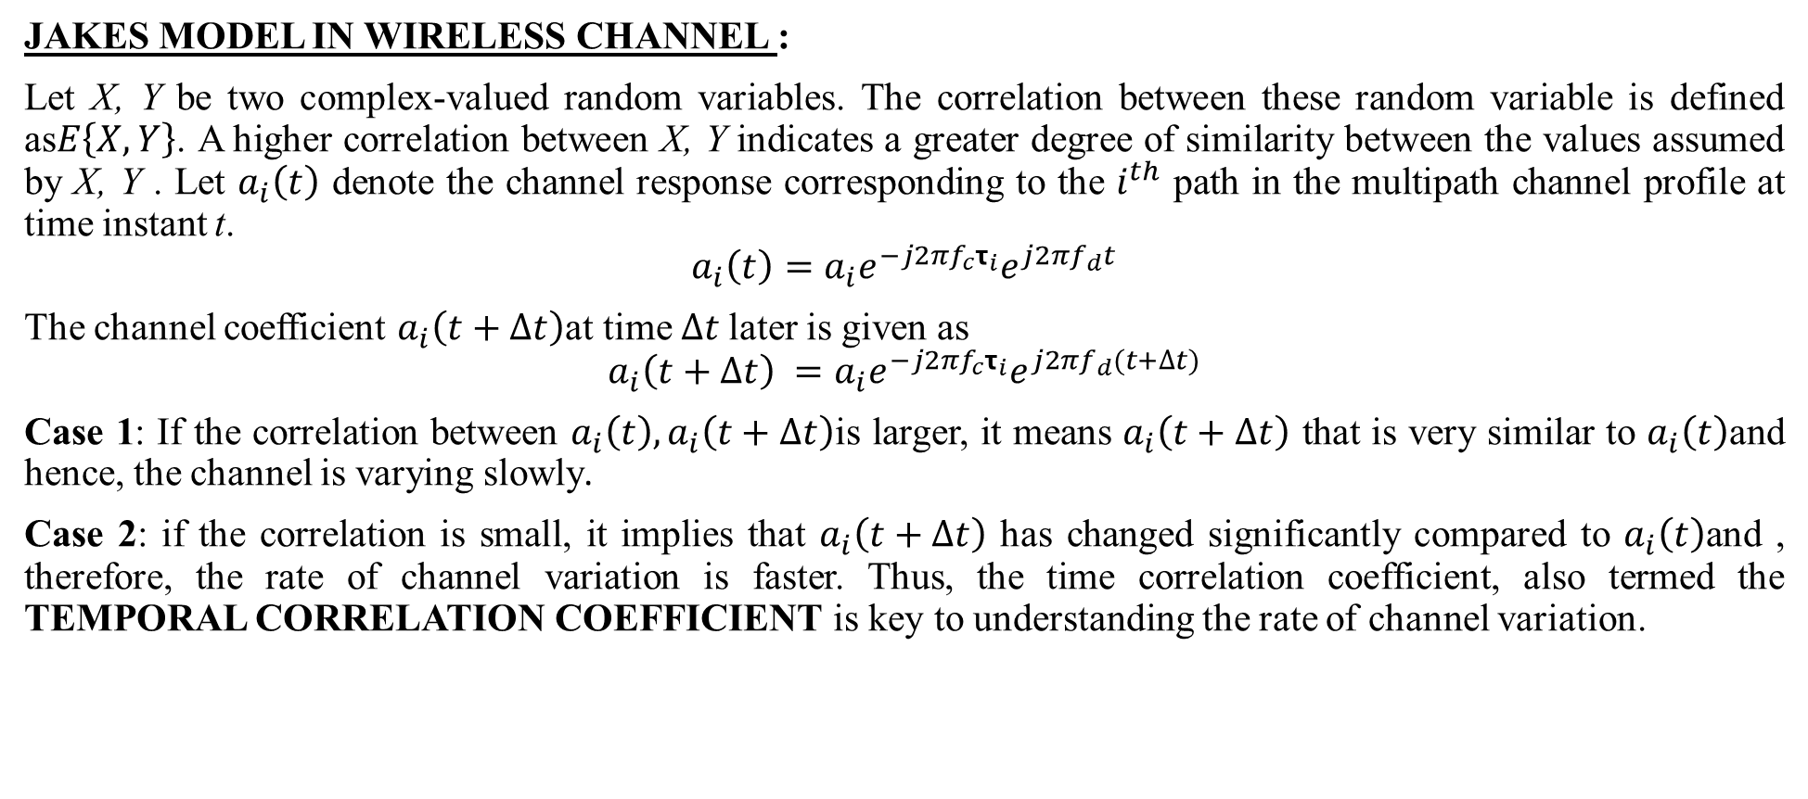
SMALL SCALE FADING AND MULTI PATH
JAKES MODEL IN WIRELESS CHANNEL :
Let X, Y be two complex-valued random variables. The correlation between these random variable is defined as$E\left\{X,Y\right\}$. A higher correlation between X, Y indicates a greater degree of similarity between the values assumed by X, Y . Let $a_{i}\left(t\right)$ denote the channel response corresponding to the $i^{th}$ path in the multipath channel profile at time instant t.
$$a_{i}\left(t\right)=a_{i}e^{−j2πf_{c}τ_{i}}e^{j2πf_{d}t}$$
The channel coefficient $a_{i}\left(t+Δt\right)$at time $∆t$later is given as
$$a_{i}\left(t+Δt\right) =a_{i}e^{−j2πf_{c}τ_{i}}e^{j2πf_{d}(t+∆t)}$$
Case 1: If the correlation between $a_{i}\left(t\right),a_{i}\left(t+∆t\right)$is larger, it means $a_{i}\left(t+∆t\right)$ that is very similar to $a_{i}\left(t\right)$and hence, the channel is varying slowly.
Case 2: if the correlation is small, it implies that $a_{i}\left(t+∆t\right)$ has changed significantly compared to $a_{i}\left(t\right)$and , therefore, the rate of channel variation is faster. Thus, the time correlation coefficient, also termed the TEMPORAL CORRELATION COEFFICIENT is key to understanding the rate of channel variation.
Small Scale Fading and Multipath Dr.Y.Mallikarjuna Rao 21-02-2023 34/50

Slide 37
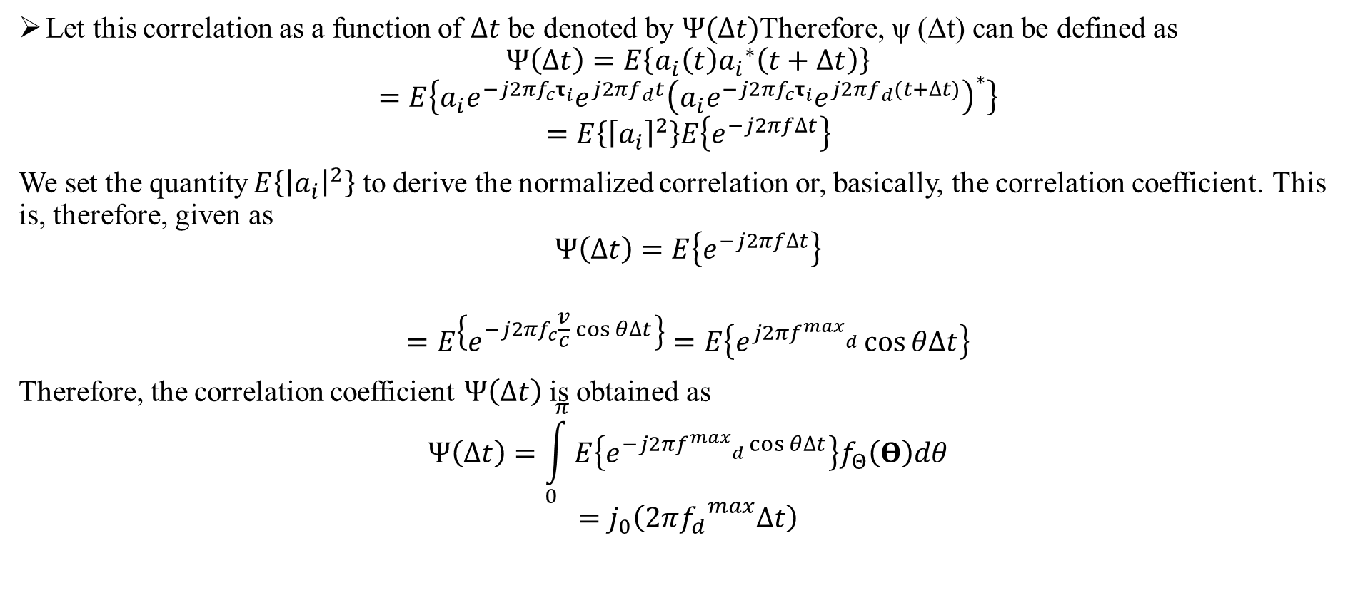
SMALL SCALE FADING AND MULTI PATH
Let this correlation as a function of $∆t$ be denoted by $Ψ(Δt)$Therefore, ψ (Δt) can be defined as
$$Ψ\left(∆t\right)=E\left\{a_{i}\left(t\right){a_{i}}^{∗}\left(t+∆t\right)\right\}$$
$$=E\left\{a_{i}e^{−j2πf_{c}τ_{i}}e^{j2πf_{d}t}{\left(a_{i}e^{−j2πf_{c}τ_{i}}e^{j2πf_{d}(t+∆t)}\right)}^{∗}\right\}$$
$$=E\left\{{\left\lceil a_{i}\right\rceil }^{2}\right\}E\left\{e^{−j2πf∆t}\right\}$$
We set the quantity $E\left\{{\left|a_{i}\right|}^{2}\right\}$ to derive the normalized correlation or, basically, the correlation coefficient. This is, therefore, given as
$$Ψ\left(∆t\right)=E\left\{e^{−j2πf∆t}\right\}$$
$$=E\left\{e^{−j2πf_{c}\frac{v}{c}\cos{θ∆t}}\right\}=E\left\{e^{j2π{f^{max}}_{d}}\cos{θ∆t}\right\}$$
Therefore, the correlation coefficient $Ψ\left(∆t\right)$ is obtained as
$$Ψ\left(∆t\right)=\int_{0}^{π}{E\left\{e^{−j2π{f^{max}}_{d}\cos{θ∆t}}\right\}f_{Θ}\left(Θ\right)dθ}$$
$$=j_{0}\left(2π{f_{d}}^{max}∆t\right)$$
Small Scale Fading and Multipath Dr.Y.Mallikarjuna Rao 21-02-2023 35/50

Slide 38

SMALL SCALE FADING AND MULTI PATH
$$S_{H}\left(f\right)=\int_{−∞}^{∞}{j_{0}\left(2π{f_{d}}^{max}∆t\right) }e^{−j2πf∆t},d\left(∆t\right)$$
$$=\frac{1}{{{πf}_{d}}^{max}}\frac{rect\left(\frac{f}{{fmax}_{d}^{}}\right)}{\sqrt{1−{\left(\frac{f}{{fmax}_{d}^{}}\right)}^{2}}}−−−−14$$
where the function $rect\left(.\right)$is defined as
$$rect\left(.\right)=\left\{\begin{aligned}1\left|x\right|≤\frac{1}{2} \\ 0\left|x\right|>\frac{1}{2}\end{aligned}\right.−−−−−−15$$
i.e., $rect\left(x\right)$is basically a pulse of height 1 between $x=\frac{1}{2}$ and x = 1
Diversity Techniques Dr.Y.Mallikarjuna Rao 21-02-2023 36/50

Slide 39




SMALL SCALE FADING AND MULTI PATH
where $J_{0}$is the Bessel function of the $0^{th}$order. Therefore, substituting${{ f}^{max}}_{d}=\frac{1}{4T_{c}}$, we have
$$Ψ\left(∆t\right)=J_{0}\left(2π\frac{1}{4πT_{c}}∆t\right)=J_{0}\left(\frac{π}{2}\frac{∆t}{T_{c}}\right)$$
The above temporal correlation model for $Ψ\left(∆t\right)$is a popular model for wireless communication systems and is termed Jakes’ model. The Jakes correlation as a function of the normalized time lag $\frac{∆t}{T_{c}}$is shown in Figure 16
The Doppler spectrum corresponding to the temporal correlation function $Ψ\left(∆t\right)$ is given by its Fourier transform as
$$S_{H}\left(f\right)=\int_{−∞}^{∞}{Ψ\left(∆t\right)e^{−j2πf∆t},d\left(∆t\right)}$$
Figure 4.16 Jakes’ correlation as a function of $\frac{∆t}{T_{c}}$
Diversity Techniques Dr.Y.Mallikarjuna Rao 21-02-2023 37/50

Slide 40




SMALL SCALE FADING AND MULTI PATH
The Doppler spectrum $S_{H}\left(f\right)$of Eq. (4.14), which is associated with the Jakes’ temporal correlation model, is termed the Jakes’ spectrum and is very popular in the context of wireless communications to model the correlation function of time-varying wireless channels.
A figure of the Jakes spectrum is shown in Figure 4.17. It can be seen that the spectrum is ’U’ shaped and restricted between ${{−f}_{d}}^{max}$ and ${f_{d}}^{max}$. Hence, this is colloquially also termed a U-shaped Doppler spectrum
The spectrum of Doppler spread is given as
$${{2f}^{max}}_{d}=2\frac{v}{c}f_{c}$$
Figure 4.17 Jakes’ spectrum as a function of normalized frequency$\frac{f}{f_{d}}$
Diversity Techniques Dr.Y.Mallikarjuna Rao 21-02-2023 38/50

Slide 41

DIVERSITY TECHNIQUES
INTRODUCCTION TO DIVERSITY TECHNIQUES :
The diversity theory underpins all modern wireless communication theory and technologies. It is by far the most effective strategy for combating the effects of multipath fading in a wireless channel and ensuring reliable communication.
The simple fact that independent wireless channels incur randomly independent levels of fading underpins diversity. As a result, the likelihood of numerous independent wireless channels experiencing a deep fade at the same time is far smaller than that of a single fading channel.
Figure 3.18 Schematic of diversity-based wireless system
Diversity Techniques Dr.Y.Mallikarjuna Rao 21-02-2023 39/50

Slide 42


DIVERSITY TECHNIQUES
The diversity-based system, which operates on four parallel links from the above figure, is able to operate even with two links in a deep fade. Hence, the philosophy of diversity can, therefore, be stated concisely as “transmission of multiple copies of the information signal over independent channels, thereby substantially reducing the chance of information loss due to the erratic nature of the wireless channels which causes any one or a subset of these channels to be in a deep fade”.
A typical example of such a diversity-based system is the multiple receive antenna wireless system, also termed the Single-Input Multiple-Output (SIMO) wireless system, schematically shown in Figure 3.19.
The single transmit antenna in this system is denoted by$T_{x}≠1$, while the L receive antennas are denoted by $R_{x}≠i,0 ≤ i ≤ L$. In this system, there is a wireless link between the transmit antenna and each of the receive antennas, thus accounting for a total of L links between the transmitter and receiver. Hence, naturally, such a system is a diversity-based wireless system
Figure 3.19 Schematic of multiple receive antenna wireless system
Diversity Techniques Dr.Y.Mallikarjuna Rao 21-02-2023 40/50

Slide 43

DIVERSITY TECHNIQUES
MRC FOR MULTI-ANTENNA SYSTEMS :
Consider the signal $y_{1}\left(k\right),y_{2}\left(k\right)…y_{n}\left(k\right)$received over the L receive antennas at the time instant k. These can now be employed at the receiver for detection of the transmitted symbol x (k). For this purpose, we combine the received signals with complex weights $w_{1},w_{2}…w_{L}$as follows:
$$r\left(k\right)={w_{1}}^{∗}y_{1}+{w_{2}}^{∗}y_{2}…{w_{L}}^{∗}y_{L}$$
where ${w_{i}}^{∗}$ denotes the complex conjugate of $w_{i}$and $r\left(k\right)$ is termed the decision statistic that is formed from the received signals. Defining the vector $w∈𝕔^{L−1}$ as
$$w=\left[\begin{matrix}w_{1} \\ w_{2} \\ \begin{matrix}⋮ \\ w_{L}\end{matrix}\end{matrix}\right]$$
it can be easily seen that the receiver statistic r (k) can be compactly expressed in vector form as
$$r\left(k\right)=\left[\begin{matrix}{w_{1}}^{∗} & {w_{2}}^{∗} & \begin{matrix}… & {w^{∗}}_{L}\end{matrix}\end{matrix}\right]\left[\begin{matrix}y_{1}\left(k\right) \\ y_{2}\left(k\right) \\ \begin{matrix}⋮ \\ y_{L}\left(k\right)\end{matrix}\end{matrix}\right]$$
Diversity Techniques Dr.Y.Mallikarjuna Rao 21-02-2023 41/50

Slide 44


DIVERSITY TECHNIQUES
$$r\left(k\right)=w^{H}y\left(k\right)$$
$$=w^{H}\left(hx\left(k\right)+n\left(k\right)\right)$$
$$=w^{H}hx\left(k\right)+w^{H}n\left(k\right)$$
where $w^{H}$represents the Hermitian transpose of the vector w. The weight vector w is also termed the receive beamformer at the wireless receiver. As given above, the signal and noise components of the received statistic are given as $w^{H}hx\left(K\right)$and $w^{H}n\left(K\right),$respectively. Hence, the signal power is given as
$$Signal power=E\left\{{\left|w^{H}hx\left(k\right)\right|}^{2}\right\}={\left|w^{H}h\right|}^{2}E\left\{{\left(x\left(k\right)\right)}^{2}\right\}={\left|w^{H}h\right|}^{2}P$$
we need to compute the noise power to characterize the signal-to-noise power ratio of the receiver statistic. This is computed as follows
$$noise power=E\left\{{\left|w^{H}n\left(k\right)\right|}^{2}\right\}=E\left\{{\left|\sum_{i=1}^{L}{{ω_{i}}^{∗}n_{i}}\right|}^{2}\right\}=\sum_{i=1}^{L}{\sum_{j=1}^{L}{w_{i}{w^{∗}}_{j}E\left\{n_{i}{n^{∗}}_{j}\right\}}}$$
Diversity Techniques Dr.Y.Mallikarjuna Rao 21-02-2023 42/50

Slide 45

DIVERSITY TECHNIQUES
The noise samples $n_{1}\left(k\right),n_{2}\left(k\right)…n_{L}\left(k\right)$are independent with noise power ${σ^{2}}_{n}$. Hence, we $E\left\{n_{i}\left(k\right){n^{∗}}_{j}\left(k\right)\right\}=δ\left(i−j\right){σ_{n}}^{2}$ i.e., $E\left\{n_{i}\left(k\right){n^{∗}}_{j}\left(k\right)\right\}={σ_{n}}^{2}$ only if i = j and 0 if i = j. The noise power can, therefore, be simplified as
$$noise power =\sum_{i=1}^{L}{\sum_{j=1}^{L}{δ\left(i−j\right)w_{i}{w^{∗}}_{j}}}{σ_{n}}^{2}=\sum_{i=1}^{L}{w_{i}{w_{i}}^{∗}}{σ^{2}}_{n}$$
$$={σ_{n}}^{2}{\left|w_{i}\right|}^{2}={σ^{2}}_{n}{\left|\left|w\right|\right|}^{2}$$
$$={σ^{2}}_{n}w^{H}w$$
The above can also be derived conveniently using the noise-covariance matrix $R_{n}$defined above as
$$noise power=E\left\{{\left|w^{H}n\left(k\right)\right|}^{2}\right\}=E\left\{w^{H}n\left(k\right)){(w^{H}n\left(k\right))}^{H}\right\}$$
$$=w^{H}E\left\{\left(n\left(k\right)\right){n(k)}^{H}\right\}w=w^{H}R_{n}w=w^{H}{σ^{2}}_{n}Iw$$
$$={σ^{2}}_{n}w^{H}w={σ^{2}}_{n}{\left|\left|w\right|\right|}^{2}$$
Hence, the noise power at the output corresponding to the receive beam former w is equal to ${σ^{2}}_{n}{\left|\left|w\right|\right|}^{2}$Therefore, the signal-to-noise power ratio at the output of the beam former is given as
Diversity Techniques Dr.Y.Mallikarjuna Rao 21-02-2023 43/50

Slide 46

DIVERSITY TECHNIQUES
$$SNR\left(w\right)=\frac{{\left|w^{h}h\right|}^{2}p}{w^{h}{{wσ}_{n}}^{2}}=\left(\frac{P}{{σ^{2}}_{n}}\right)\frac{{\left|w^{H}h\right|}^{2}}{w^{H}w}$$
We wish to now find the optimum beam former w such that the output SNR is maximized. Firstly, observe that scaling the beam former w by a constant C leaves the SNR unchanged. This can be observed by substituting $\tilde{w}=Cw$ in the above expression. One can see,
$$SNR\left(\tilde{w}\right)=\left(\frac{p}{{σ^{2}}_{n}}\right)\frac{{\left|{\tilde{w}}^{H}h\right|}^{2}}{{\tilde{w}}^{H}\tilde{w}}=\left(\frac{P}{{σ^{2}}_{n}}\right)\frac{{\left|w^{H}h\right|}^{2}}{w^{H}w}$$
Hence, to fix the scale of the beam former w, one can restrict the choice of beam formers such that ${\left|\left|w\right|\right|}^{2}$. The optimal SNR maximizing beam former computation, therefore, reduces to,
$$max.\left(\frac{P}{{σ^{2}}_{n}}\right){\left|w^{H}h\right|}^{2} s.t{\left|\left|w\right|\right|}^{2}=1$$
where "s.t." is the acronym for subject to and denotes the constraint for the optimization problem. Observe that from the standard Cauchy–Schwarz inequality,
Diversity Techniques Dr.Y.Mallikarjuna Rao 21-02-2023 44/50

Slide 47

DIVERSITY TECHNIQUES
$${SNR}_{max}=SNR\left(\frac{1}{\left|\left|h\right|\right|}h\right)=\left(\frac{P}{{σ_{n}}^{2}}\right){\left|\left|h\right|\right|}^{2}$$
The optimal beam former $w_{opt}=\frac{1}{\left|\left|h\right|\right|}h$is termed the Maximal Ratio Combiner (MRC) and this beam forming technique is termed maximal ratio combining. The beam forming step is a key step to achieving high SNR over a multi-antenna wireless link.
Observe that the MRC beam former $w_{opt}=Ch$, where the constant of proportionality $C=\frac{1}{\left|\left|h\right|\right|}$. Hence, this is a vector matched to the direction of h, similar to the concept of a matched filter in the receiver of a digital communication system. In fact, one can term the MRC beam former as a spatially matched filter.
Diversity Techniques Dr.Y.Mallikarjuna Rao 21-02-2023 45/50

Slide 48

DIVERSITY TECHNIQUES
Continuing the above discussion, let the quantity g denote the channel power gain, i.e.,
$$g={\left|\left|h\right|\right|}^{2}={\left|h_{1}\right|}^{2}+{\left|h_{2}\right|}^{2}+…+{\left|h_{L}\right|}^{2}−−−−−16$$
The SNR after MRC is given as${SNR}_{MRC}={\left|\left|h\right|\right|}^{2}\frac{p}{{σ_{n}}^{2}}$.$=g\frac{P}{{σ_{n}}^{2}}$ it can be demonstrated that the quantity g is a chi-squared random variable with 2L degrees of freedom and probability density given as
$$f_{G}\left(g\right)=\frac{1}{\left(L−1\right)!}g^{L−1}e^{−g}$$
The average bit-error rate can then be obtained by averaging over the distribution of the channel coefficient $f_{G}\left(g\right)$ as
$${BER}_{Multi−antenna}=\int_{0}^{∞}{Q\left(\sqrt{g\frac{P}{{σ_{n}}^{2}}}\right)f_{G}\left(g\right)dg}$$
The final expression for the BER of this multi-antenna wireless system with MRC combining is given as
$${BER}_{Multi−anteena}={\left(\frac{1−λ}{2}\right)}^{L}\sum_{i=0}^{L−1}{{{L+l−1}_{C}}_{1}{\left(\frac{1+λ}{2}\right)}^{l}}−−−−17$$
Diversity Techniques Dr.Y.Mallikarjuna Rao 21-02-2023 46/50

Slide 49

DIVERSITY TECHNIQUES
Notice that for L = 1, i.e., the case with a single receive antenna, the above expression reduces to
$$BER={\left(\frac{1−λ}{2}\right)}^{1}\sum_{L=0}^{0}{{0_{C}}_{1}{\left(\frac{1+λ}{2}\right)}^{L}=\frac{1}{2}\left(1−λ\right)}$$
$$=\frac{1}{2}\left(1−\sqrt{\frac{SNR}{2+SNR}}\right)$$
From equ A
$=\frac{1}{2}\left(1+λ\right)=\frac{1}{2}\left(1+\sqrt{\frac{SNR}{2+SNR}}\right)≈\frac{1}{2}\left(1+\left(1−\frac{1}{2}\frac{2}{SNR}\right)\right)=1$
The above simplifications imply that at high SNR, the BER in a multi-antenna wireless system can be simplified as
$${BER}_{Multi antenna}={\left(\frac{1−λ}{2}\right)}^{L}\sum_{l=0}^{L}{{L+l−1}_{C_{1}}{\left(\frac{1+λ}{2}\right)}^{l}}={{2L−1}_{C}}_{1}{\left(\frac{1}{2}\right)}^{L}{\left(\frac{1}{SNR}\right)}^{L}−−−18$$
Diversity Techniques Dr.Y.Mallikarjuna Rao 21-02-2023 47/50

Slide 50

DIVERSITY TECHNIQUES
Let $P_{e}\left(SNR\right)$ give the probability of error as a function of SNR in the system. The diversity order d of the system is defined as
$$d=−{lim \atop SNR→∞}\frac{\log\left(P_{e}\left(SNR\right)\right)}{\log\left(SNR\right)}$$
The diversity order d is essentially the number of independently fading channels comprising the given system or scheme. For instance, consider the single-antenna Rayleigh fading wireless channel. It has been demonstrated in Eq. (A) that the probability of bit-error at high SNR in this system is given as $P_{e}\left(SNR\right)$. Hence, the diversity order is given as
$$d=−{lim \atop SNR→∞}\left\{−\frac{\log\left(2\right)}{\log\left(SNR\right)}−\frac{\log\left(SNR\right)}{\log\left(SNR\right)}\right\}=1$$
Consider now an L receive antenna wireless system. It has been shown earlier that the BER of such a system at high SNR is given from Eq. (18) as${2L−1}_{C_{2}}{\left(\frac{1}{2}\right)}^{L}{\left(\frac{1}{SNR}\right)}^{L}$. The diversity, therefore, given as
$$d=−\begin{matrix}lim \\ SNR→∞\end{matrix}\left\{\frac{\log\left({2L−1}_{c_{1}}{\left(\frac{1}{2}\right)}^{}\right)}{\log\left(SNR\right)}−\frac{L\log\left(SNR\right)}{\log\left(SNR\right)}\right\}=L$$
Diversity Techniques Dr.Y.Mallikarjuna Rao 21-02-2023 48/50

Slide 51

DIVERSITY TECHNIQUES
The diversity order of the L antenna system is L indicating the presence of L independently fading signal copies. How about the diversity order of a wire line communication system? Recall that the BER for communication over the wire line channel is given as$Q\left(SNR\right)$, which can be approximated as $\frac{1}{2}e^{−\frac{1}{2}SNR}$at high SNR. The diversity order of this system is, therefore, given as
$$d=−\begin{matrix}lim \\ SNR→∞\end{matrix}\left\{\frac{\log\left(\frac{1}{2}e^{−\frac{1}{2}SNR}\right)}{\log{(SNR})}\right\}$$
$$=−\begin{matrix}lim \\ SNR→∞\end{matrix}\left\{\frac{SNR}{\log\left(SNR\right)}\right\}=∞$$
Hence, the probability that all of them are simultaneously in a deep fade is zero, thus resulting in a perfect system not susceptible to fading. In fact, the standard wire line AWGN channel can be though of as having a constant fading coefficient$h_{AWGN}=1$, which can never result in a deep fade.
Diversity Techniques Dr.Y.Mallikarjuna Rao 21-02-2023 49/50

Slide 52
End of Presentation
Thank you all
Dr.Y.Mallikarjuna Rao 21-02-2023 50/50

