Slide 1

CONTINUOUS WAVE MODULATION
Dr.Y.Mallikarjuna Rao M.Tech., Ph.D
Professor & Head of ECE
Santhiram Engineering College
hod.ece@srecnandyal.edu.in

Slide 2

Syllabus
1.INTRODUCTION
  1.1 THE COMMUNICATION PROCESS
  1.2 COMMUNICATION CHANNELS
  1.3 BASE BAND AND PASS BAND SIGNALS
  1.4 ANALOG VS DIGITAL COMMUNICATIONS
  1.5 NEED FOR THE MODULATION
2. AMPLITUDE MODULATION
  2.1 AM AND ITS MODIFICATIONS-DSB;SSB;VSB
  2.2 FREQUENCY TRANSALTION
  2.3 FREQUENCY DIVISION MULTIPLEXING
3. ANGLE MODULATION
  3.1. FREQUENCY MODULATION
  3.2. PHASE MODULATION
  3.3.PHASE LOCKED LOOP
  3.4 NON LINEAR EFFECTS IN FM
  3.5 SUPERHETRO DYNE RECEIVERS
Continuous Wave Modulation Dr.Y.Mallikarjuna Rao 08-04-2022 01/34

Slide 3
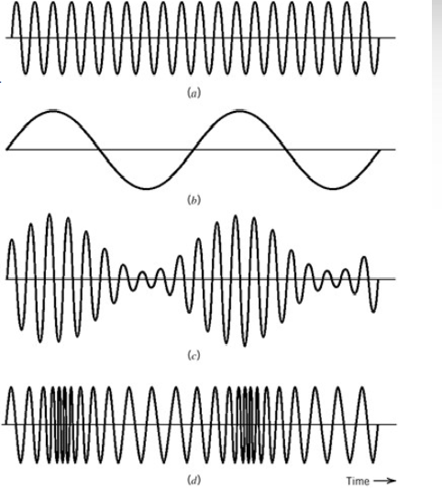
What is Modulation?
MODULATION :A process by which some characteristic of a carrier is varied in accordance with a modulating signal
SINUSOIDAL CONTINUOUS –WAVE (CW)MODULATION
Amplitude modulation
Angle modulation
From fig
(a) sinusoidal carrier
(b)base band signal or message signal
(c) Amplitude modulation
(d) Frequency modulation
Continuous Wave Modulation Dr.Y.Mallikarjuna Rao 08-04-2022 02/34

Slide 4
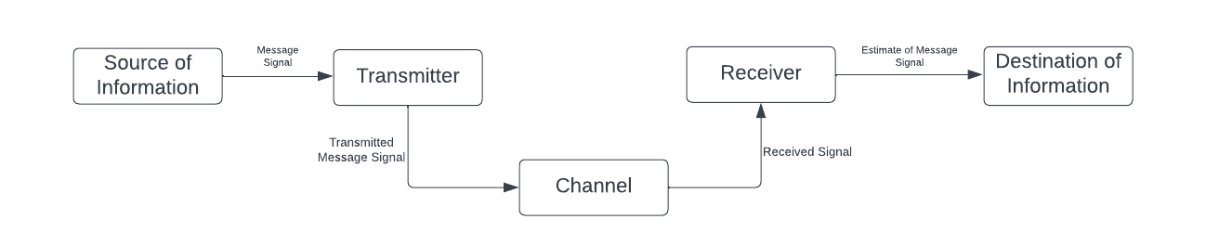
1.1THE COMMUNICATION PROCESS
FIG: BLOCK DIAGRAM OF COMMUNICATION PROCESS
Continuous Wave Modulation Dr.Y.Mallikarjuna Rao 08-04-2022 03/44

Slide 5
THE COMMUNICATION PROCESS:
Communication: The process of exchanging information from one point to another through succession processes
Communication system: Broadcasting (radio ; television); mobile communication; RADAR communication; computer communication are some examples of communication system
Source of information: The source of information are carried out in three forms(PPP) which are I) Production II) Propagation and III) Perception
Transmitter: The transmitter modifies the baseband(message) signal for efficient transmission. The transmitter may consist of one or more subsystems: an A/D converter, an encoder and modulator
Receiver : the information is reproduced at the receiver which is decoded in electrical form
User of Information: This is the final stage at which original signal is received in original form
7. Channel: It is a medium between the transmitter and receiver while transmitting the base band signal
      Physical channel Eg: coaxial cable
      Wireless channel Eg: Mobile communication
Continuous wave modulation Dr.Y.Mallikarjuna Rao 08-04-2022 04/44

Slide 6
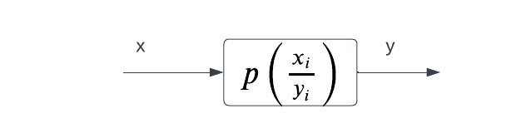

1.2 THE COMMUNICATION CHANNELS
The communication channel between modulated and demodulated is located in communication system is discrete in nature and is referred as coding channel
The probability of an error can be evaluated as
$$Pe=p(x≠y)=(x=0,y=1)+p(x=1,y=0)$$
$=p((y=1)⁄(x=0)) p(x=0)+p({y=0}/{x=1}$)$p(x=1)$
CHANNEL REPRESENTATION:
LOSSLESS CHANNEL:
$$P(xi,yj)= \left[\begin{matrix}\frac{2}{3} & \frac{3}{4} & 0 \\ 0 & 0 & \frac{1}{3} \\ 0 & 0 & \frac{2}{5}\end{matrix}\right]$$
Continuous Wave Modulation Dr.Y.Mallikarjuna Rao 08-04-2022 05/44

Slide 7
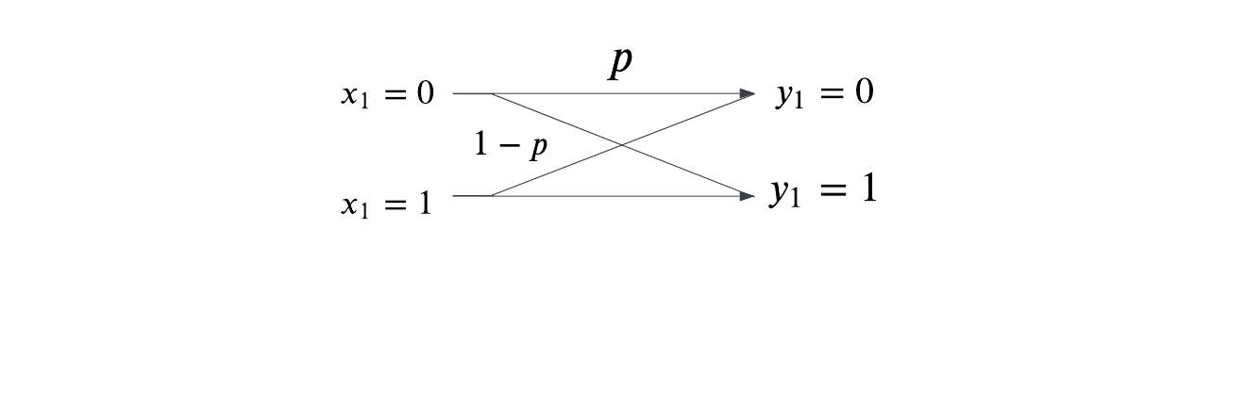

1.2 COMMUNICATION CHANNELS
DETERMINISTIC CHANNEL:$p(xi,yj)= \left[\begin{matrix}\frac{3}{2} & 0 & 0 \\ 0 & 0 & \frac{4}{3} \\ 0 & \frac{3}{2} & 0\end{matrix}\right]$
NOISELESS CHANNEL: $p(xi,yj)= \left[\begin{matrix}1 & 0 & 0 \\ 0 & 1 & 0 \\ 0 & 0 & 1\end{matrix}\right]$
BINARY REPRESENTATION CHANNEL:
Continuous wave modulation Dr.Y.Mallikarjuna Rao 08-04-2022 06/34

Slide 8
1.3 BASE BAND AND BANDPASS SIGNALS
BASE BAND SIGNAL : The information or the input to the communication system can be analog. The electrical equivalent of this original information is known as base band signal. Examples : the computer data
BAND PASS SIGNAL : The modulated signal is called band pass signal which is obtained from the shifting of frequency spectrum. Examples : visible light; ultrasound waves.
FIG: spectrum for base band signal FIG: spectrum for band pass signal
where f1 is an lowest frequency f2 is an highest frequency
Continuous wave modulation Dr.Y.Mallikarjuna Rao 08-04-2022 07/34

Slide 9
1.4 ANALOG VS DIGITAL COMUNICATION SYSTEM
S.NO | ANALOG COMMUNICATION | DIGITAL COMMUNICATION
1 | Signals are transmitted in every time intervals | Signals are transmitted at discrete time intervals
2 | Amplitude , frequency and phase modulation in the transmitted signal represent in the form of message | Amplitude, frequency and phase in the transmitted signal represent in the form of codes
3 | Coding is not possible | Coding techniques can be used to detect and correct the errors
4 | Bandwidth requirement is lower than digital communication | Band width is required due to high bit rates in the system
5 | Not suitable for transmitting signals in military applications | Suitable for transmitting signals in military applications due to coding techniques
6 | FDM is used for multiplexing | TDM is used for multiplexing
7 | Analog modulation systems are PM,AM,FM,PWM,PAM | Digital modulation systems are PCM,DM,DPCM,ADM
8 | Noise immunity is less in AM but improved in FM and PM | Noise immunity is excellent
Continuous wave modulation Dr.Y.Mallikarjuna Rao 08-04-2022 08/34

Slide 10
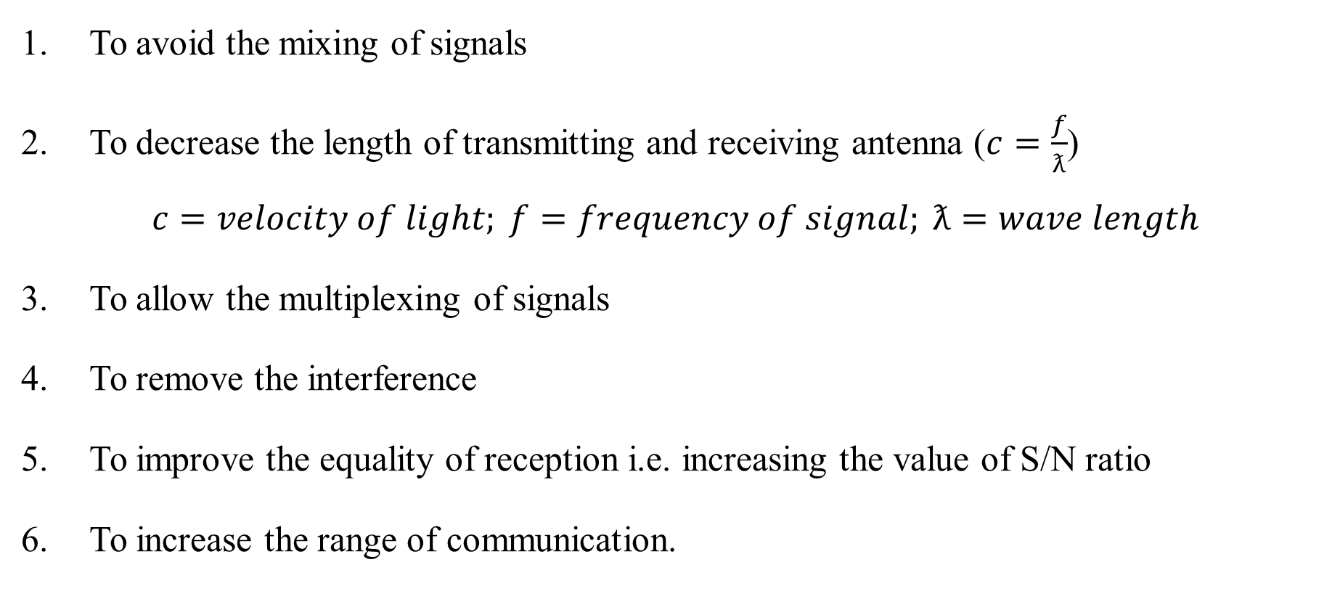
1.5 NEED FOR MODULATION
To avoid the mixing of signals
To decrease the length of transmitting and receiving antenna ($c=\frac{f}{ƛ}$)
$$c=velocity of light; f=frequency of signal; ƛ=wave length$$
To allow the multiplexing of signals
To remove the interference
To improve the equality of reception i.e. increasing the value of S/N ratio
To increase the range of communication.
Continuous Wave Modulation Dr.Y.Mallikarjuna Rao 08-04-2022 09/44

Slide 11
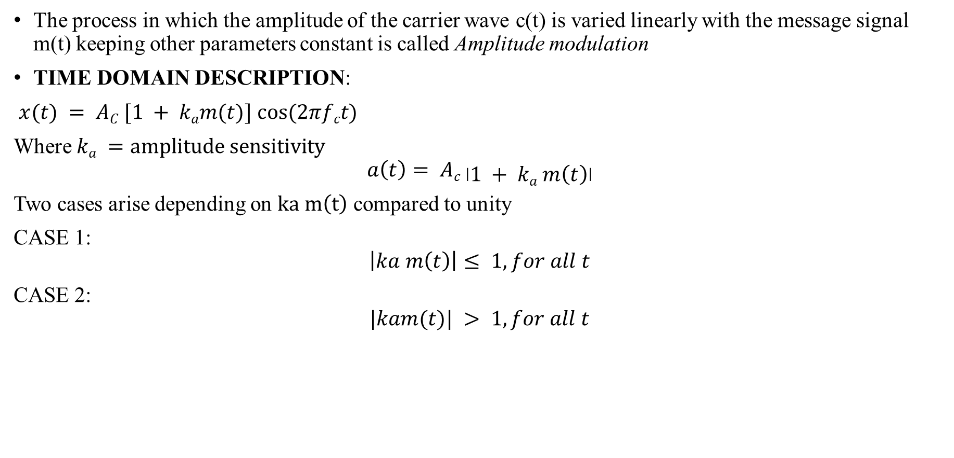
2. AMPLITUDE MODULATION
The process in which the amplitude of the carrier wave c(t) is varied linearly with the message signal m(t) keeping other parameters constant is called Amplitude modulation
TIME DOMAIN DESCRIPTION:
$x(t) = AC [1 + kam(t)] cos⁡(2πfct)$
Where $ka =amplitude sensitivity$
$$a\left(t\right)= Ac \left|1 + ka m\left(t\right)\right|$$
Two cases arise depending on $ka m\left(t\right)$ compared to unity
CASE 1:
$$\left|ka m\left(t\right)\right|≤ 1, for all t$$
CASE 2:
$$|kam(t)| > 1, for all t$$
Continuous wave modulation Dr.Y.Mallikarjuna Rao 08-04-2022 10/34

Slide 12

2.AMPLITUDE MODULATION
FREQUENCY DOMAIN DESCRIPTION:
$s(t)=\frac{Ac}{2}$[$δ (f−fc)+δ(f+fc$)]+$\frac{kaAc}{2}[(M(f−fc)+M(f+fc)]$
$B=2w$
$B.W = (fc + fm) – (fc – fm$)
$B.W = 2fm Hz or kHz$
𝛚 $B.W = 2ωm rad/se$
Continuous wave modulation Dr.Y.Mallikarjuna Rao 08-04-2022 11/34

Slide 13
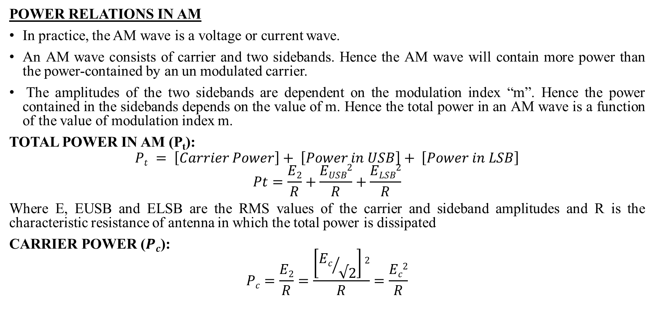
Amplitude modulation
POWER RELATIONS IN AM
In practice, the AM wave is a voltage or current wave.
An AM wave consists of carrier and two sidebands. Hence the AM wave will contain more power than the power-contained by an un modulated carrier.
The amplitudes of the two sidebands are dependent on the modulation index “m”. Hence the power contained in the sidebands depends on the value of m. Hence the total power in an AM wave is a function of the value of modulation index m.
TOTAL POWER IN AM (P_{t}):
$$Pt = \left[Carrier Power\right]+ \left[Power in USB\right]+ \left[Power in LSB\right]$$
$$Pt=\frac{E2}{R}+\frac{EUSB2}{R}+\frac{ELSB2}{R}$$
Where E, EUSB and ELSB are the RMS values of the carrier and sideband amplitudes and R is the characteristic resistance of antenna in which the total power is dissipated
CARRIER POWER ($Pc$):
$$Pc=\frac{E2}{R}=\frac{\left[{Ec}/{√2}\right]2}{R}=\frac{Ec2}{R}$$
Continuous wave modulation Dr.Y.Mallikarjuna Rao 08-04-2022 12/34

Slide 14

Amplitude Modulation
POWER IN SIDE BANDS:
The power in the two sidebands is given as
$$PUSB=PLSB=\frac{ESB2}{R}$$
As we know the peak amplitude of each sideband is $\frac{MaEC}{2}$
$$PUSB=PLSB=\frac{\left[{maEC}/{2√2}\right]2}{R}=\frac{ma2Ec2}{8R}$$
$$PUSB=PLSB=\frac{ma2}{4}×\frac{Ec2}{2R}$$
$$PUSB=PLSB=\frac{ma2}{4} Pc$$
Continuous wave modulation Dr.Y.Mallikarjuna Rao 08-04-2022 13/34

Slide 15

Amplitude modulation
TOTAL POWER
The total power is given by
$$Pt = Pc + PUSB + PLSB$$
$$=Pc+\frac{ma2}{4}Pc+\frac{ma2}{4} Pc$$
$$Pt=\left[1+\frac{ma2}{2}\right]Pc$$
$\frac{Pt}{Pc}=\left[1+\frac{ma2}{2}\right]$---------a
MODULATION INDEX IN TERMS OF P_{t} AND P_{c}
From above equ a we can write $ma2=2\left[\frac{Pt}{Pc}−1\right]$
$$ma=\left[2\left(\frac{Pt}{Pc}−1\right)\right]1/2$$
Continuous wave modulation Dr.Y.Mallikarjuna Rao 08-04-2022 14/44

Slide 16
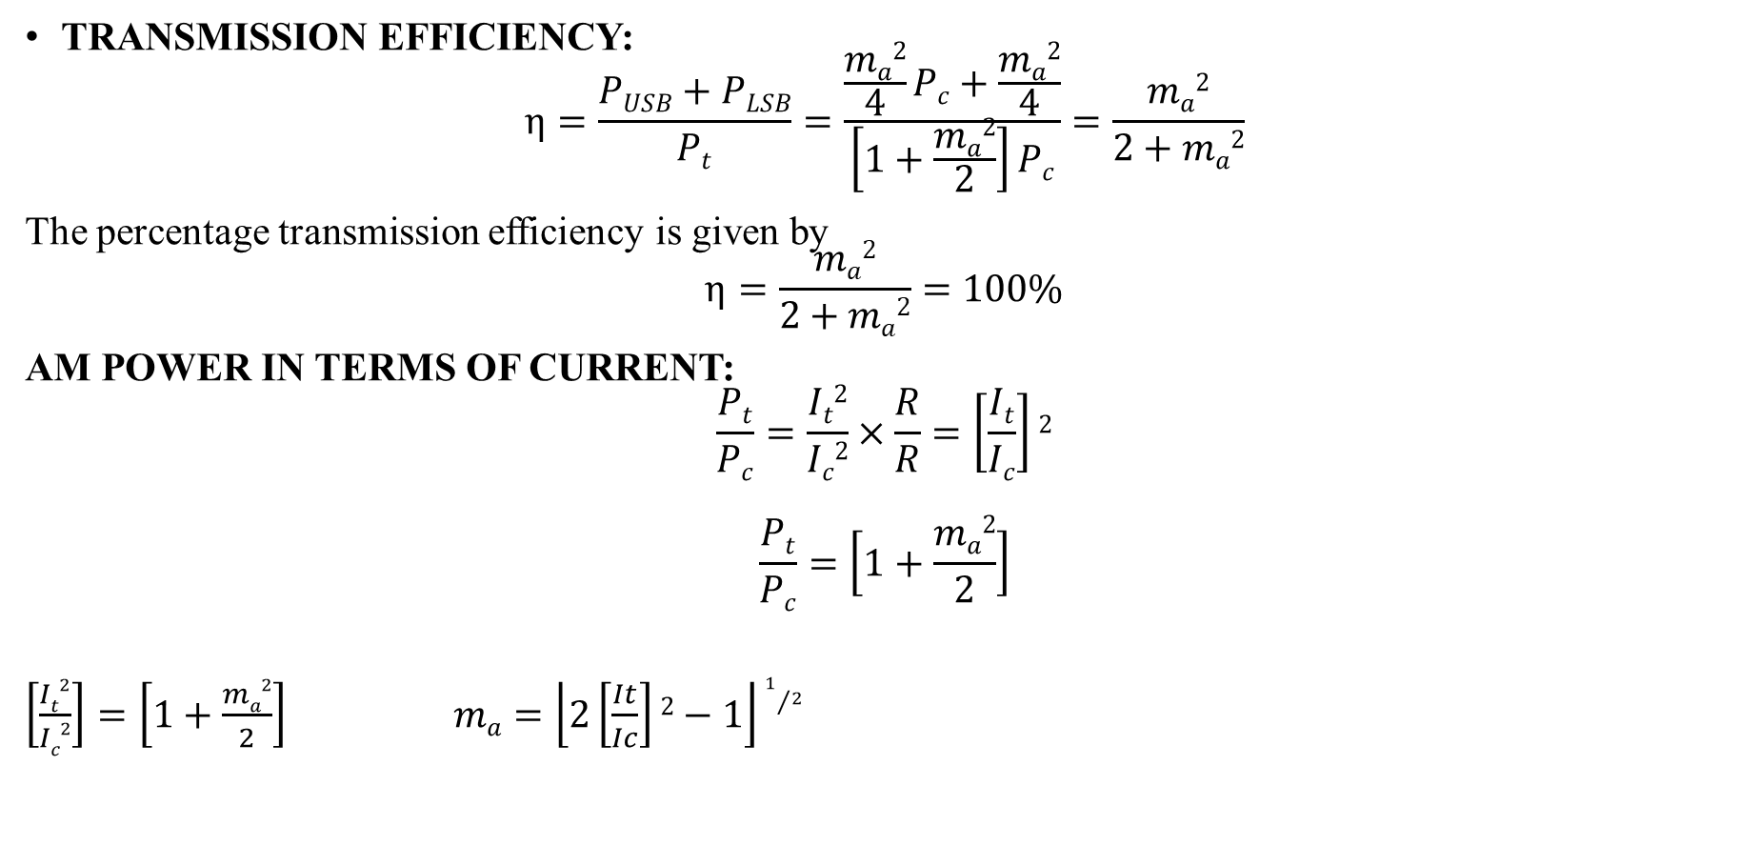
Amplitude modulation
TRANSMISSION EFFICIENCY:
$$η=\frac{PUSB+PLSB}{Pt}=\frac{\frac{ma2}{4}Pc+\frac{ma2}{4}}{\left[1+\frac{ma2}{2}\right]Pc}=\frac{ma2}{2+ma2}$$
The percentage transmission efficiency is given by
$$η=\frac{ma2}{2+ma2}=100\%$$
AM POWER IN TERMS OF CURRENT:
$$\frac{Pt}{Pc}=\frac{It2}{Ic2}×\frac{R}{R}=\left[\frac{It}{Ic}\right]2$$
$$\frac{Pt}{Pc}=\left[1+\frac{ma2}{2}\right]$$
$\left[\frac{It2}{Ic2}\right]=\left[1+\frac{ma2}{2}\right]$ $ma=\left\lfloor 2\left[\frac{It}{Ic}\right]2−1\right\rfloor 1/2$
Continuous wave modulation Dr.Y.Mallikarjuna Rao 08-04-2022 15/34

Slide 17
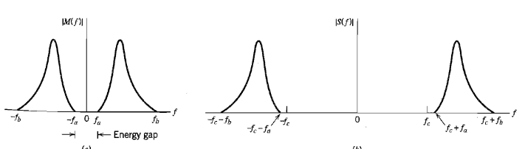
2.1.1Amplitude modulation-SSB
FIG: spectrum for SSB modulation
For the generation of SSB modulated signal to be possible the message spectrum must have an energy gap centred at the origin
Continuous wave modulation Dr.Y.Mallikarjuna Rao 08-04-2022 16/34

Slide 18

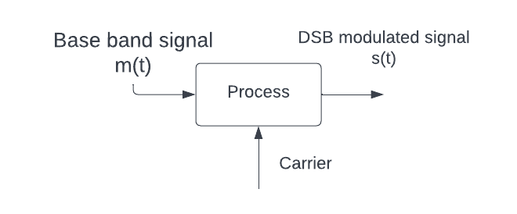
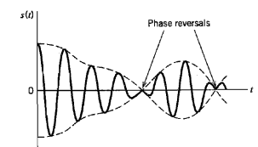

2.1.2 AMPLITUDE MODULATION -DSB
$$S\left(t\right)=Acm\left(t\right)+\cos\left(2πfct\right)$$
$$Carrier:Accos(2πfct)$$
Continuous wave modulation Dr.Y.Mallikarjuna Rao 08-04-2022 17/34

Slide 19
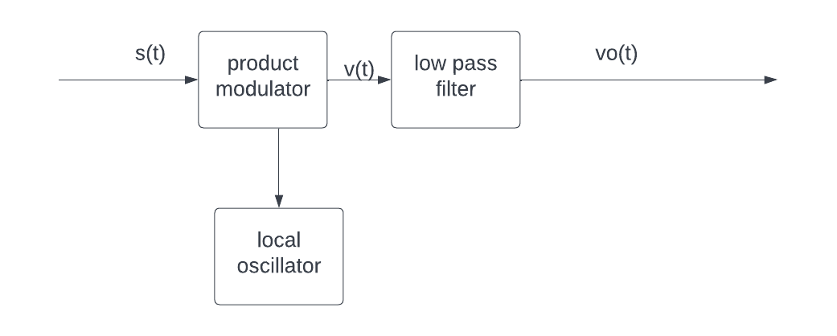
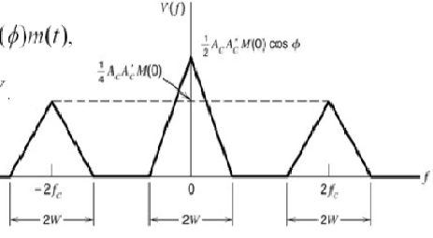
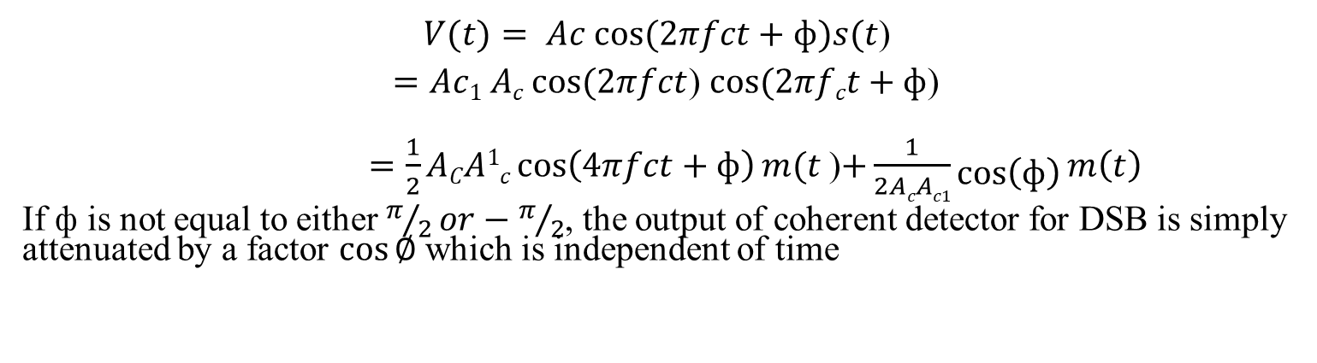
2.1.2 coherent detection for DSB
$V(t)= Ac cos⁡(2πfct+ф)s(t$)
$=Ac1 Ac cos⁡(2πfct$) $cos⁡(2πfct+ф$)
$=\frac{1}{2}ACA1c\cos\left(4πfct+ф\right)m(t$)$+\frac{1}{2AcAc1}\cos\left(ф\right)m\left(t\right)$
If ф is not equal to either $π/2or−π/2$, the output of coherent detector for DSB is simply attenuated by a factor $\cos{∅ }$which is independent of time
Continuous wave modulation Dr.Y.Mallikarjuna Rao 08-04-2022 18/34

Slide 20
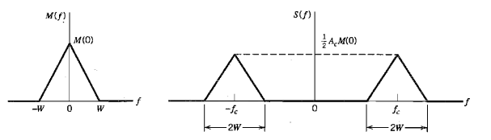

DSB
From below fig
$S(f)=\frac{1}{2}Ac[M(f−fc$)$+M(f+fc)$]
FIG: Spectrum for DSB modulation
Continuous wave modulation Dr.Y.Mallikarjuna Rao 08-04-2022 19/34

Slide 21
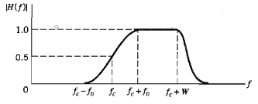
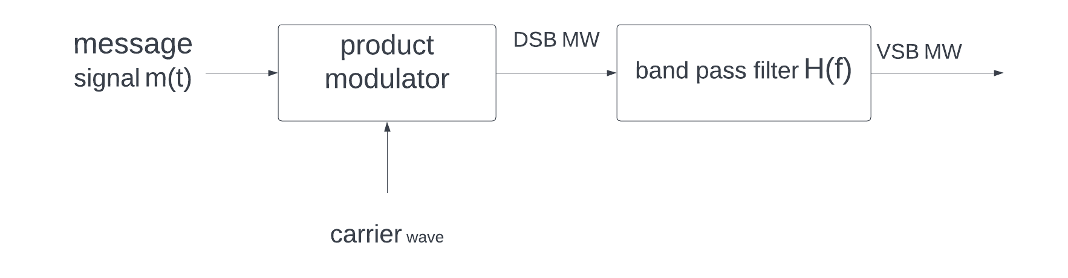
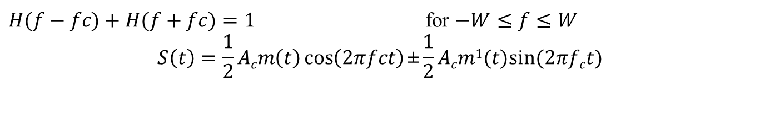
Amplitude modulation-VSB
$H(f−fc)+H(f+fc)=1$ for $−W≤f≤W$
$$S\left(t\right)=\frac{1}{2}Acm\left(t\right)\cos\left(2πfct\right)\text{±}\frac{1}{2}Acm1(t)sin⁡(2πfct)$$
Continuous wave modulation Dr.Y.Mallikarjuna Rao 08-04-2022 20/34

Slide 22
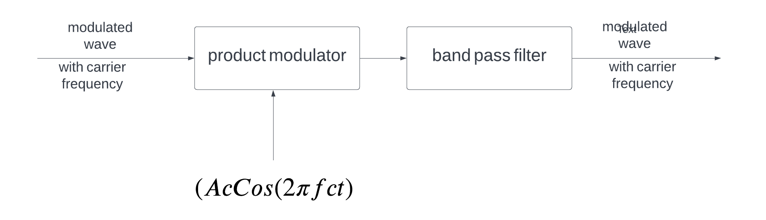
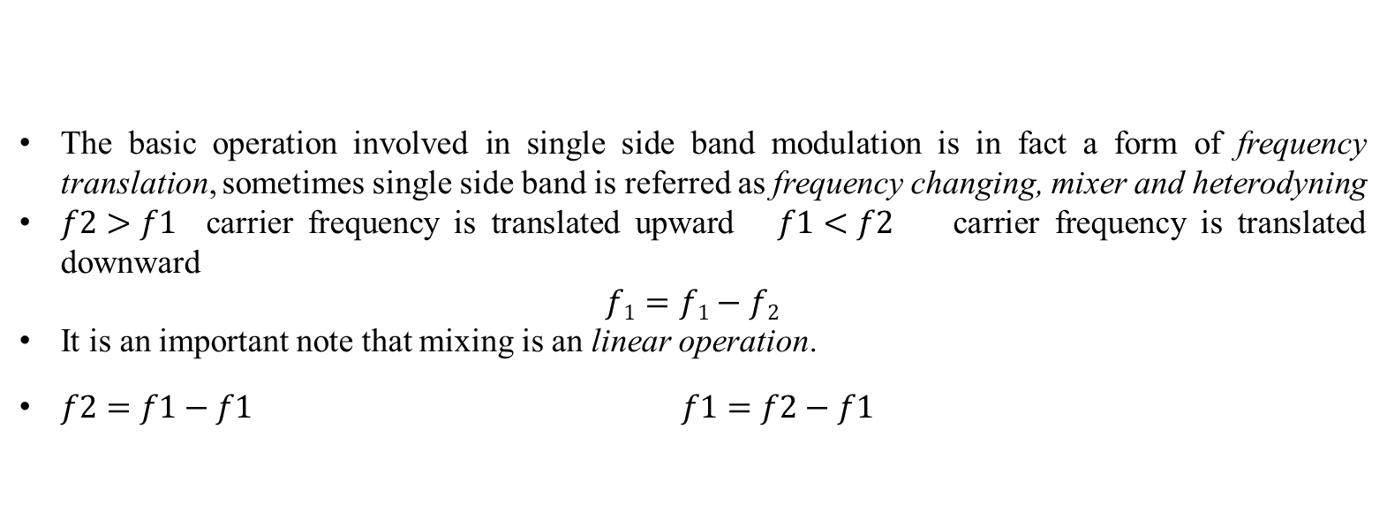
2.2 FRQUENCY TRANSLATION
The basic operation involved in single side band modulation is in fact a form of frequency translation, sometimes single side band is referred as frequency changing, mixer and heterodyning
$f2>f1$carrier frequency is translated upward $f1<f2$ carrier frequency is translated downward
$$f1=f1−f2$$
It is an important note that mixing is an linear operation.
$f2=f1−f1$ $f1=f2−f1$
FIG: BLOCK DIAGRAM OF MIXER
Continuous Wave Modulation Dr.Y.Mallikarjuna Rao 08-04-2022 21/34

Slide 23
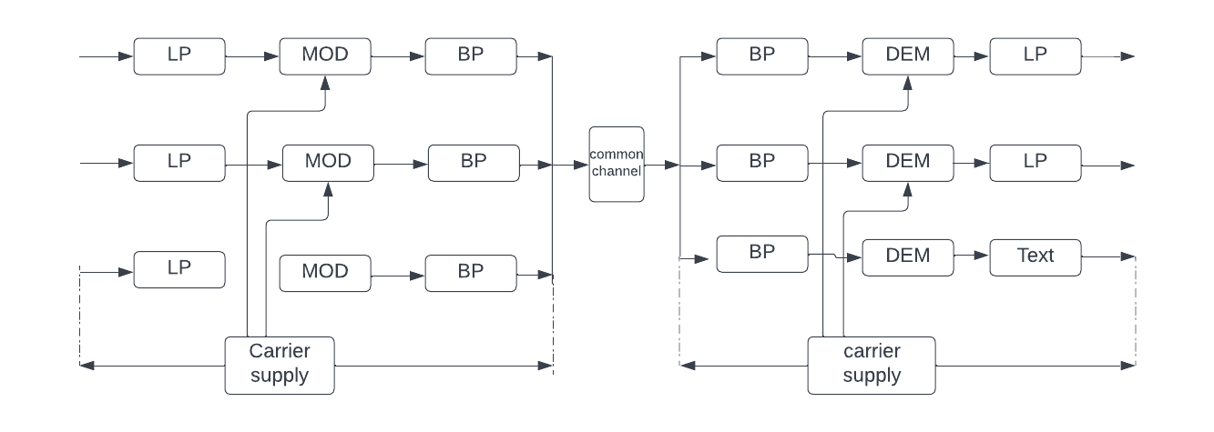
2.3 FREQUENCY DIVISION MULTIPLEXING (FDM)
MULTIPLEXING: combining independent signals into composite signal suitable for transmission.
FDM: The technique of separating the signals in frequency is referred as FDM
Continuous wave modulation Dr.Y.Mallikarjuna Rao 08-04-2022 22/34

Slide 24
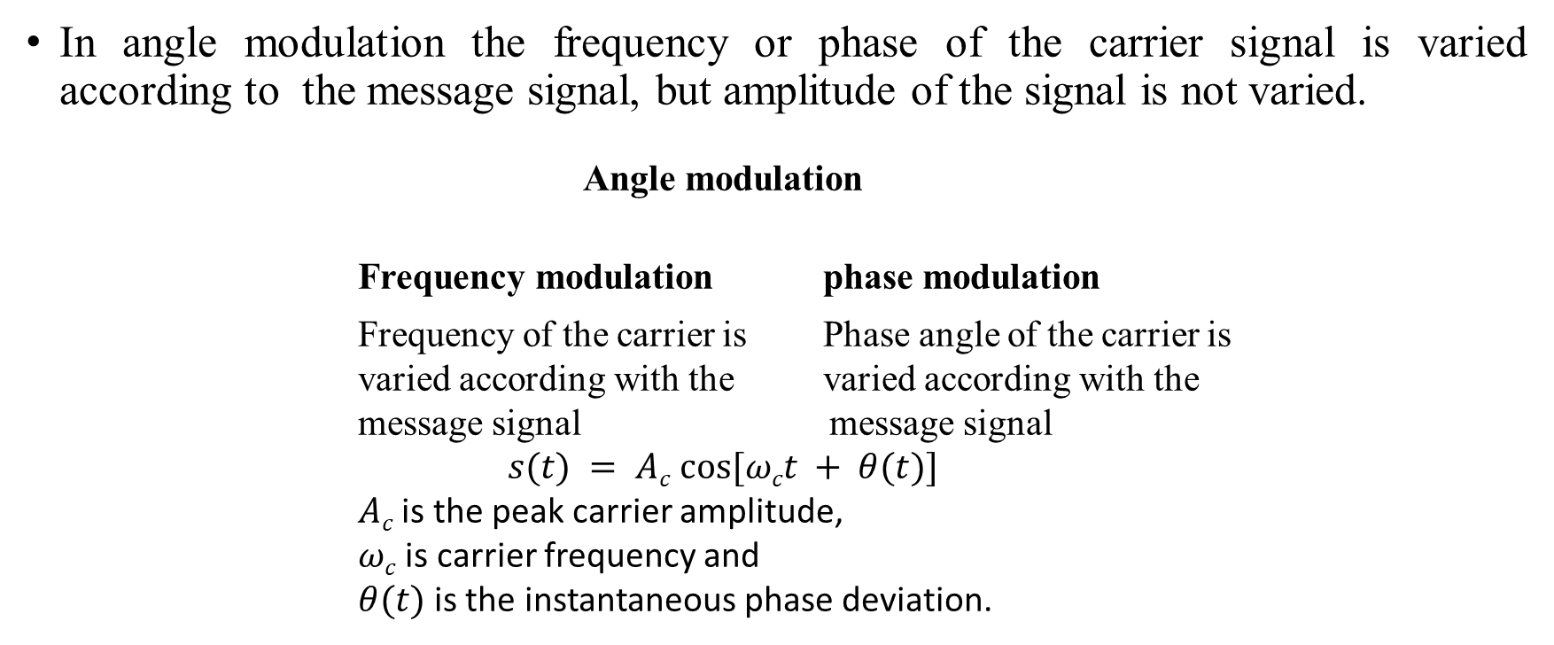
3.ANGLE MODULATION
In angle modulation the frequency or phase of the carrier signal is varied according to the message signal, but amplitude of the signal is not varied.
          Angle modulation
          Frequency modulation phase modulation
          Frequency of the carrier is Phase angle of the carrier is
          varied according with the varied according with the
          message signal message signal
          $s(t) = Ac cos⁡[ωct + θ(t)]$
          $Ac$ is the peak carrier amplitude,
          $ωc$ is carrier frequency and
          $θ(t)$is the instantaneous phase deviation.
Continuous wave modulation Dr.Y.Mallikarjuna Rao 08-04-2022 23/34

Slide 25
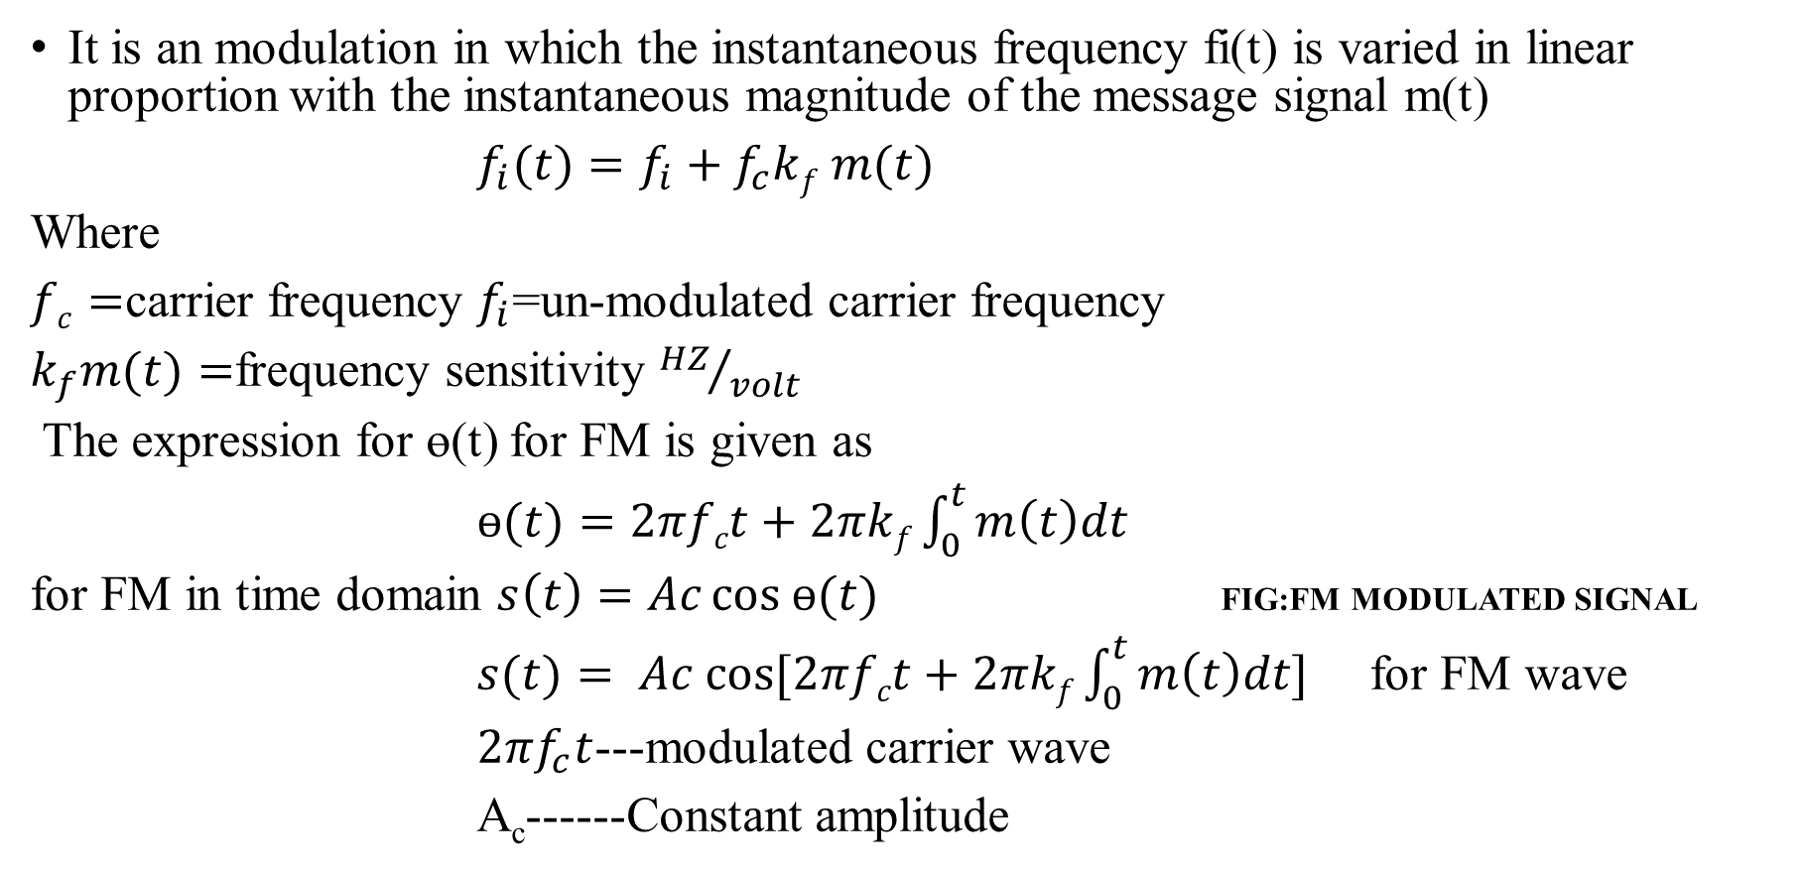
3.1 FREQUENCY MODULATION
It is an modulation in which the instantaneous frequency fi(t) is varied in linear proportion with the instantaneous magnitude of the message signal m(t)
$f_{i}(t)=f_{i}+f_{c}kf m(t)$
Where
$fc=$carrier frequency $f_{i}$=un-modulated carrier frequency
$k_{f}m(t)=$frequency sensitivity${ HZ}/{volt}$
The expression for ɵ(t) for FM is given as
$ɵ(t)=2πfct+2πkf\int_{0}^{t}{m\left(t\right)dt}$
for FM in time domain $s\left(t\right)=Ac cos ɵ(t)$ FIG:FM MODULATED SIGNAL
$s(t)= Ac cos⁡[2πfct+2πkf\int_{0}^{t}{m\left(t\right)dt]}$ for FM wave
$2πf_{c}t$---modulated carrier wave
A_{c}------Constant amplitude
Continuous wave modulation Dr.Y.Mallikarjuna Rao 08-04-2022 24/34

Slide 26
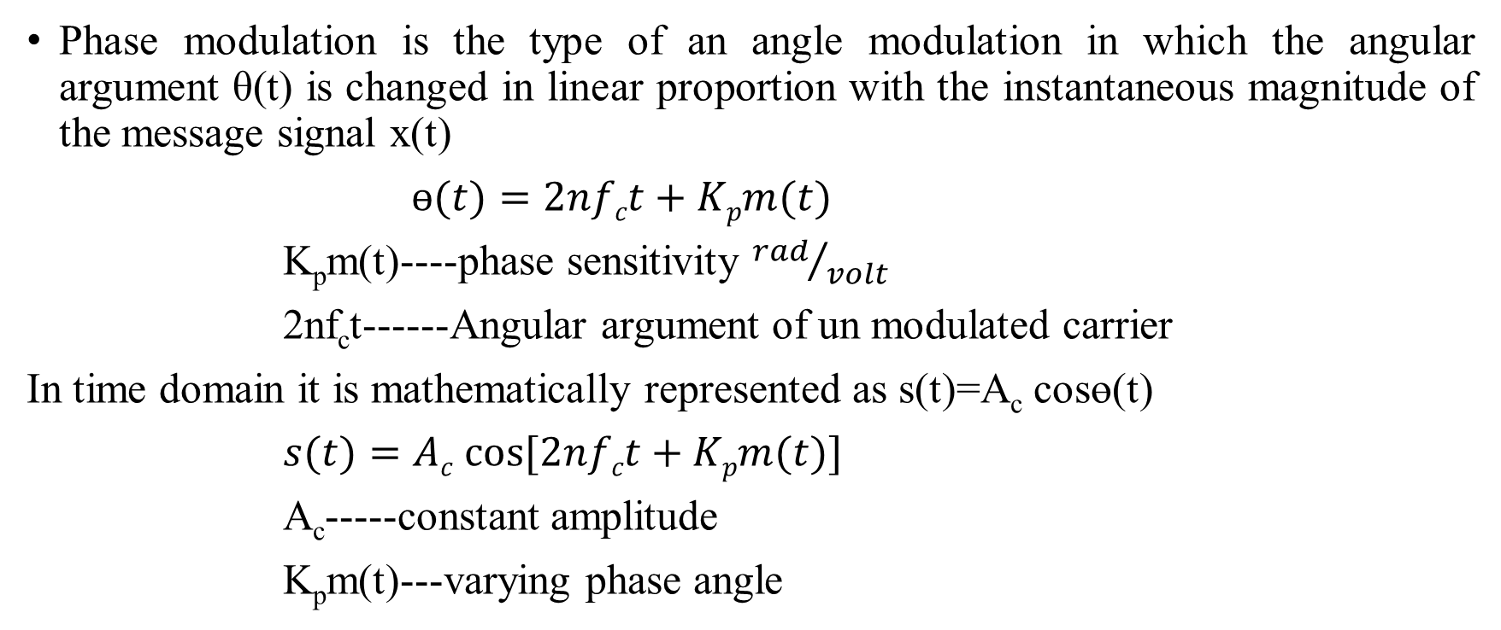
3.1.1 PHASE MODULATION
Phase modulation is the type of an angle modulation in which the angular argument θ(t) is changed in linear proportion with the instantaneous magnitude of the message signal x(t)
$ɵ(t)=2nfct+Kpm(t)$
K_{p}m(t)----phase sensitivity ${rad}/{volt}$
2nf_{c}t------Angular argument of un modulated carrier
In time domain it is mathematically represented as s(t)=A_{c} cosɵ(t)
$s(t)=Ac cos⁡[2nfct+Kpm(t)]$
A_{c}-----constant amplitude
K_{p}m(t)---varying phase angle
Continuous wave modulation Dr.Y.Mallikarjuna Rao 08-04-2022 25/34

Slide 27
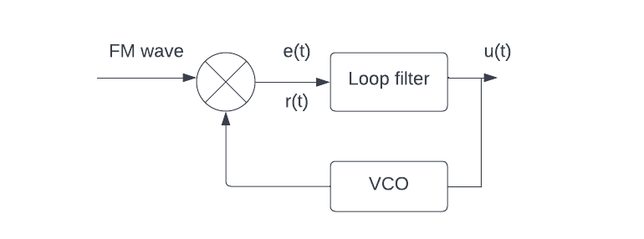
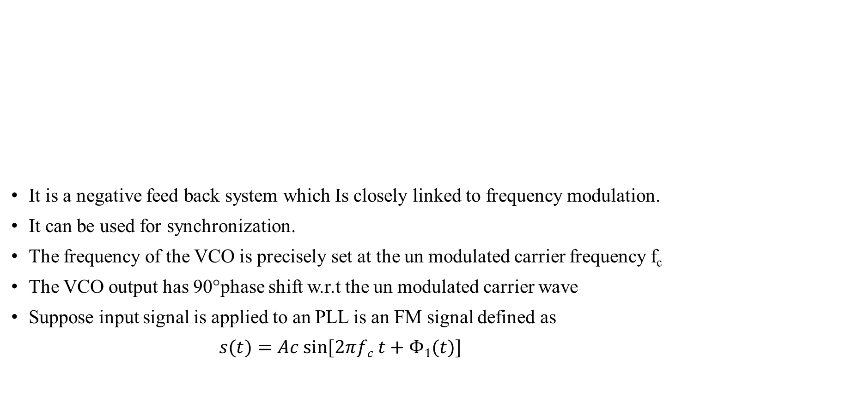
3.2 PHASE LOCKED LOOP (PLL)
It is a negative feed back system which Is closely linked to frequency modulation.
It can be used for synchronization.
The frequency of the VCO is precisely set at the un modulated carrier frequency f_{c}
The VCO output has 90°phase shift w.r.t the un modulated carrier wave
Suppose input signal is applied to an PLL is an FM signal defined as
$s(t)=Ac sin⁡[2πfc t+Φ1(t)]$
FIG: PHASE LOCKED LOOP
Continuous wave modulation Dr.Y.Mallikarjuna Rao 08-04-2022 26/34

Slide 28
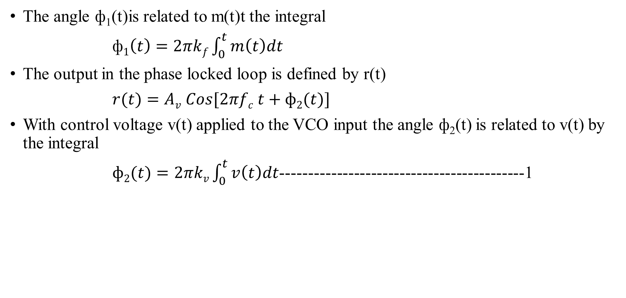
3.2 PHASE LOCKED LOOP
The angle ф₁(t)is related to m(t)t the integral
ф$1\left(t\right)=2πkf\int_{0}^{t}{m\left(t\right)dt}$
The output in the phase locked loop is defined by r(t)
$r(t)=Av Cos[2πfc t+ф2(t)]$
With control voltage v(t) applied to the VCO input the angle ф₂(t) is related to v(t) by the integral
$ф2(t)=2πkv\int_{0}^{t}{v\left(t\right)dt}$-------------------------------------------1
Continuous wave modulation Dr.Y.Mallikarjuna Rao 08-04-2022 27/34

Slide 29
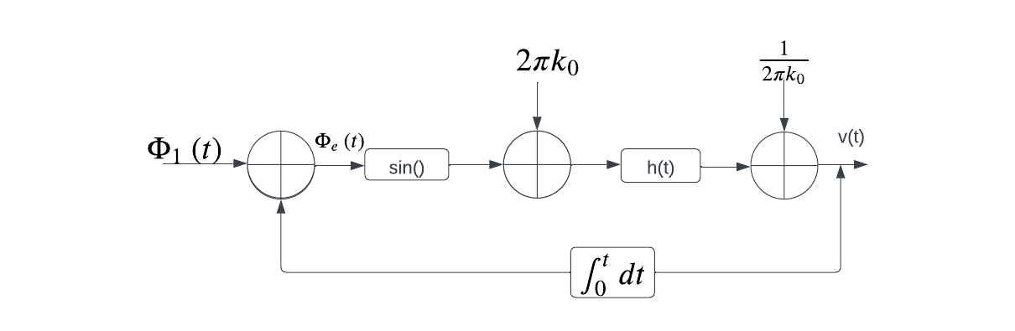

3.2.1 NON LINEAR MODEL OF PLL
FIG: NON LINEARISED MODEL
Phase error is given as $фe\left(t\right)=ф1\left(t\right)−ф2\left(t\right)$ v(t)=$\int_{−∾}^{∾}{e\left(τ\right)h\left(t−τ\right)dτ}$
$=ф1(t)−2πkv\int_{0}^{t}{v\left(t\right)dt −−−−−−2}$
From equ’s 1 & 2 we get
$\frac{dфe(t)}{dt}$ =$\frac{dф1(t)}{dt}$ -$2πk0\int_{−∞}^{∞}{sinф\left(τ\right)h\left(t−τ\right)d(t−τ)}$----------------3
Continuous wave modulation Dr.Y.Mallikarjuna Rao 08-04-2022 28/34

Slide 30
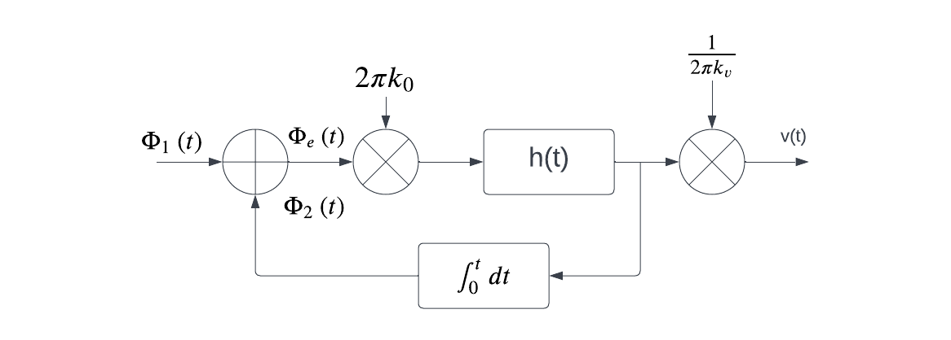

3.2.2 LINEAR MODEL OF PLL
Equ 3 can be written in frequency form
$фe\left(f\right)=\frac{1}{1+L\left(f\right)} ф1\left(f\right) −−−−−−4$ $L\left(f\right)= k0\frac{H\left(f\right)}{jf}$
It isrelated by the fourier transform of PLL as $V(f)= \frac{k0}{kv} H\left(f\right)Φe\left(f\right)$
From above equ $v(f)=\frac{jf}{kv} L\left(f\right)фe\left(f\right)−−−−−−−−−5$
FIG: LINEARISED MODEL
Continuous wave modulation Dr.Y.Mallikarjuna Rao 08-04-2022 29/34

Slide 31
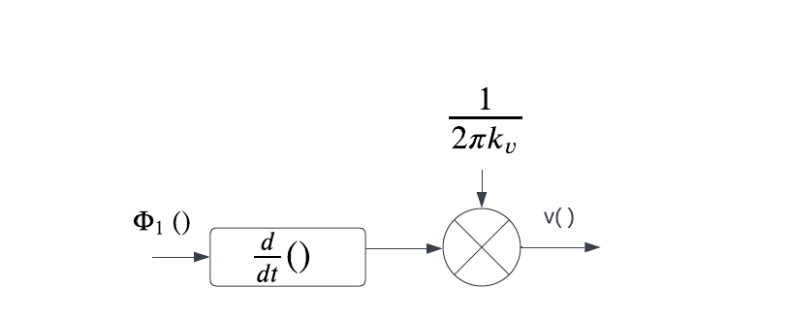

3.2.1 linear model of pll
            From equ 4& 5 we get
            $$V\left(f\right)=\frac{\left({jf}/{kv}\right)L\left(f\right)}{1+L\left(f\right)} ф1\left(f\right)$$
            When we make mod L(f )>>1 then
            $$V\left(f\right)= {jf}/{kv}$$
            In time domain we get
            $$V(t)=\frac{1}{2πkv} \frac{dф1(t)}{dt}$$
Continuous wave modulation Dr.Y.Mallikarjuna Rao 08-04-2022 30/34

Slide 32
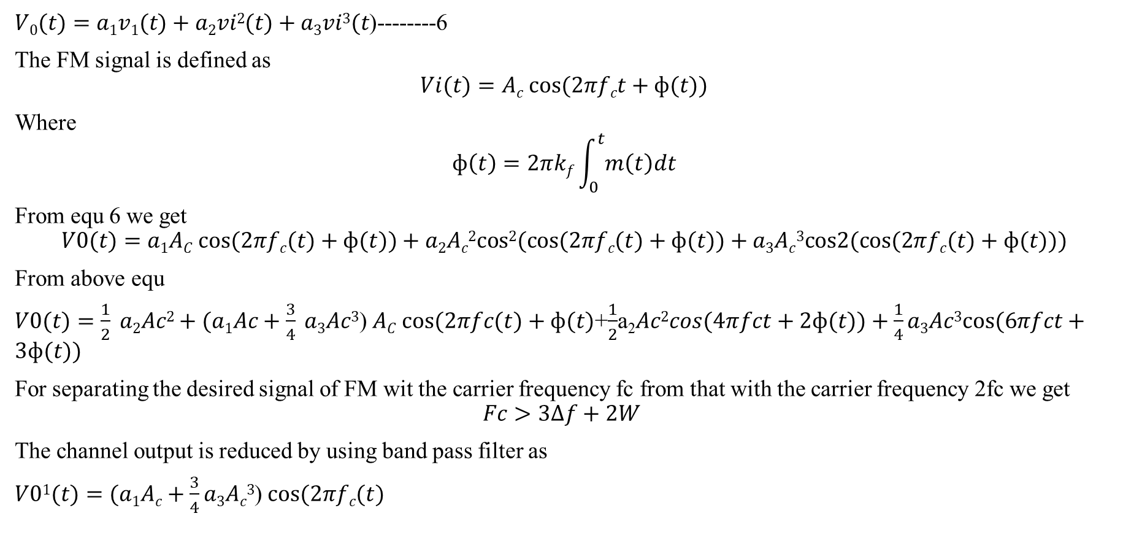
3.3 NON LINEAR EFFECTS IN FM
$V0(t)=a1v1(t)+a2vi2(t)+a3vi3(t$)--------6
The FM signal is defined as
$$Vi(t)=Ac cos⁡(2πfct+ф(t))$$
Where
$$ф\left(t\right)=2πkf\int_{0}^{t}{m\left(t\right)dt}$$
From equ 6 we get
$$V0(t)=a1AC cos⁡(2πfc(t)+ф(t))+a2Ac2cos2(cos⁡(2πfc(t)+ф(t))+a3Ac3cos2(cos⁡(2πfc(t)+ф(t)))$$
From above equ
$V0(t)=\frac{1}{2} a2Ac2+(a1Ac+\frac{3}{4} a3Ac3$) $AC cos⁡(2πfc(t)+ф(t)$+$\frac{1}{2}$a₂$Ac2cos(4πfct+2ф(t))+\frac{1}{4}a3Ac3cos⁡(6πfct+3ф(t))$
For separating the desired signal of FM wit the carrier frequency fc from that with the carrier frequency 2fc we get
$$Fc>3Δf+2W$$
The channel output is reduced by using band pass filter as
$V01(t)=(a1Ac+\frac{3}{4}a3Ac3$) $cos⁡(2πfc(t)$
Continuous wave modulation Dr.Y.Mallikarjuna Rao 08-04-2022 31/34

Slide 33
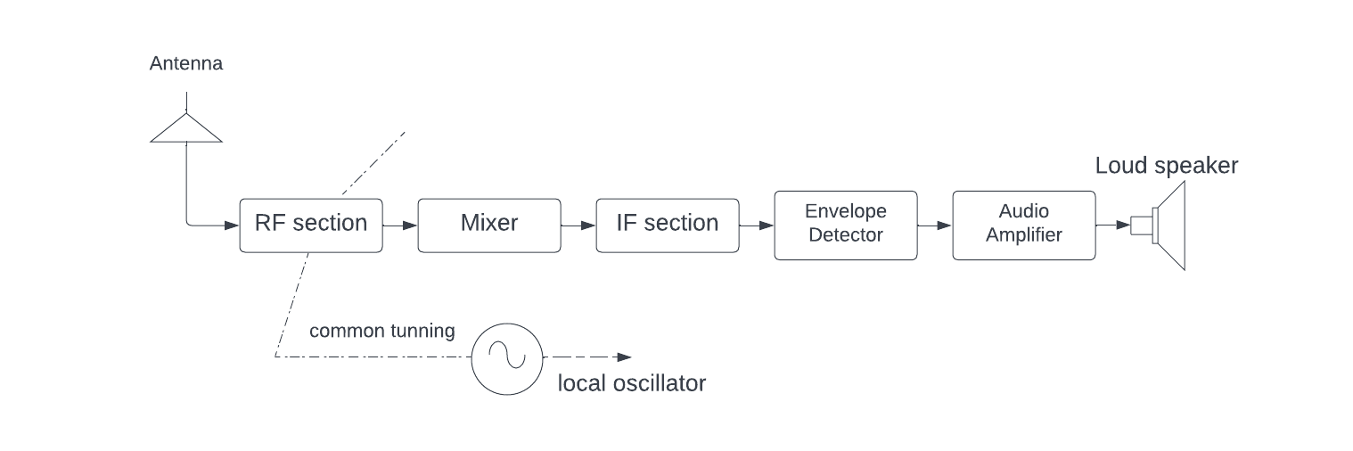
3.4 SUPER HETERO DYNE RECEIVER
      FIG:BASIC ELEMENTS OF SUPER HETERO DYNE RECIVER
The super heterodyne receiver as it is often referred to , is a special type of receiver that fulfils all three functions which are
Carrier frequency
filtering
Amplification
Continuous wave modulation Dr.Y.Mallikarjuna Rao 08-04-2022 32/34

Slide 34
End of Presentation
Thank you all
Continuous wave modulation Dr.Y.Mallikarjuna Rao 07-04-2022 34/34

